Slide 1
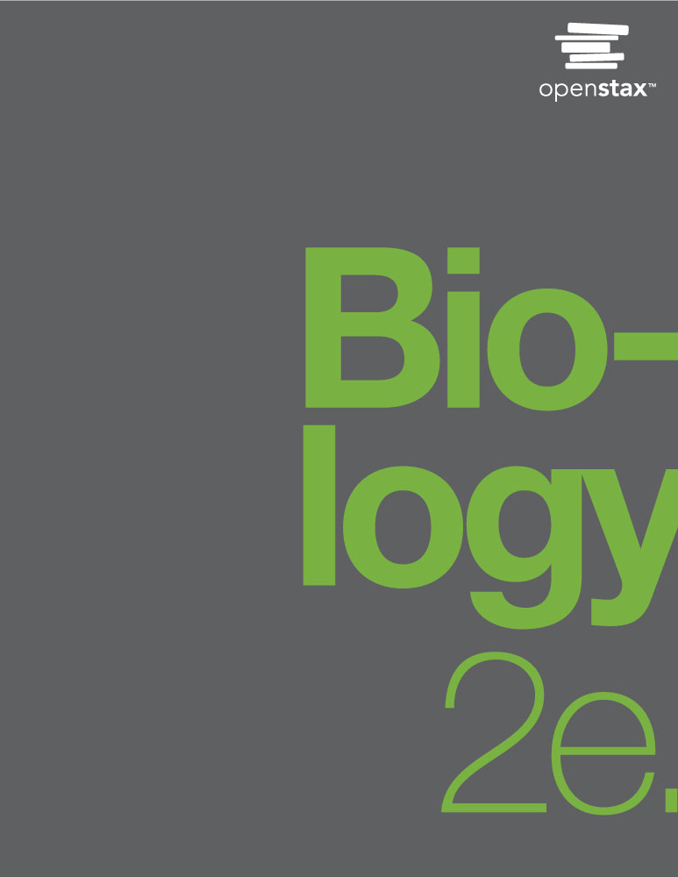
BIOLOGY 2e
Chapter 34 ANIMAL NUTRITION AND DIGESTIVE SYSTEM
PowerPoint Image Slideshow

Slide 2
Figure 34.1
For humans, fruits and vegetables are important in maintaining a balanced diet. (credit: modification of work by Julie Rybarczyk)

Slide 3
Figure 34.2
Herbivores, like this (a) mule deer and (b) monarch caterpillar, eat primarily plant material. (credit a: modification of work by Bill Ebbesen; credit b: modification of work by Doug Bowman)

Slide 4
Figure 34.3
Carnivores like the (a) lion eat primarily meat. The (b) ladybug is also a carnivore that consumes small insects called aphids. (credit a: modification of work by Kevin Pluck; credit b: modification of work by Jon Sullivan)

Slide 5
Figure 34.4
Omnivores like the (a) bear and (b) crayfish eat both plant and animal based food. (credit a: modification of work by Dave Menke; credit b: modification of work by Jon Sullivan)

Slide 6
Figure 34.5
A gastrovascular cavity has a single opening through which food is ingested and waste is excreted, as shown in this hydra and in this jellyfish medusa.
An alimentary canal has two openings: a mouth for ingesting food, and an anus for eliminating waste, as shown in this nematode.

Slide 7
Figure 34.6
(a) Humans and herbivores, such as the (b) rabbit, have a monogastric digestive system. However, in the rabbit the small intestine and cecum are enlarged to allow more time to digest plant material. The enlarged organ provides more surface area for absorption of nutrients. Rabbits digest their food twice: the first time food passes through the digestive system, it collects in the cecum, and then it passes as soft feces called cecotrophes. The rabbit re-ingests these cecotrophes to further digest them.

Slide 8
Figure 34.7
The avian esophagus has a pouch, called a crop, which stores food. Food passes from the crop to the first of two stomachs, called the proventriculus, which contains digestive juices that break down food. From the proventriculus, the food enters the second stomach, called the gizzard, which grinds food. Some birds swallow stones or grit, which are stored in the gizzard, to aid the grinding process. Birds do not have separate openings to excrete urine and feces. Instead, uric acid from the kidneys is secreted into the large intestine and combined with waste from the digestive process. This waste is excreted through an opening called the cloaca.

Slide 9
Figure 34.8
Ruminant animals, such as goats and cows, have four stomachs. The first two stomachs, the rumen and the reticulum, contain prokaryotes and protists that are able to digest cellulose fiber. The ruminant regurgitates cud from the reticulum, chews it, and swallows it into a third stomach, the omasum, which removes water. The cud then passes onto the fourth stomach, the abomasum, where it is digested by enzymes produced by the ruminant.

Slide 10
Figure 34.9
Digestion of food begins in the (a) oral cavity. Food is masticated by teeth and moistened by saliva secreted from the (b) salivary glands. Enzymes in the saliva begin to digest starches and fats. With the help of the tongue, the resulting bolus is moved into the esophagus by swallowing. (credit: modification of work by the National Cancer Institute)

Slide 11
Figure 34.10
The esophagus transfers food from the mouth to the stomach through peristaltic movements.

Slide 12
Figure 34.11
The human stomach has an extremely acidic environment where most of the protein gets digested. (credit: modification of work by Mariana Ruiz Villareal)

Slide 13
Figure 34.12
Villi are folds on the small intestine lining that increase the surface area to facilitate the absorption of nutrients.

Slide 14
Figure 34.13
The large intestine reabsorbs water from undigested food and stores waste material until it is eliminated.

Slide 15
Figure 34.14
For humans, a balanced diet includes fruits, vegetables, grains, and protein. (credit: USDA)

Slide 16
Figure 34.15
A healthy diet should include a variety of foods to ensure that needs for essential nutrients are met. (credit: Keith Weller, USDA ARS)

Slide 17
Figure 34.16
Digestion of carbohydrates is performed by several enzymes. Starch and glycogen are broken down into glucose by amylase and maltase. Sucrose (table sugar) and lactose (milk sugar) are broken down by sucrase and lactase, respectively.

Slide 18
Figure 34.17
Protein digestion is a multistep process that begins in the stomach and continues through the intestines.

Slide 19
Figure 34.18
Lipids are digested and absorbed in the small intestine.

Slide 20
Figure 34.19
Mechanical and chemical digestion of food takes place in many steps, beginning in the mouth and ending in the rectum.

Slide 21
Figure 34.20
Seeing a plate of food triggers the secretion of saliva in the mouth and the production of HCL in the stomach. (credit: Kelly Bailey)

