Slide 1
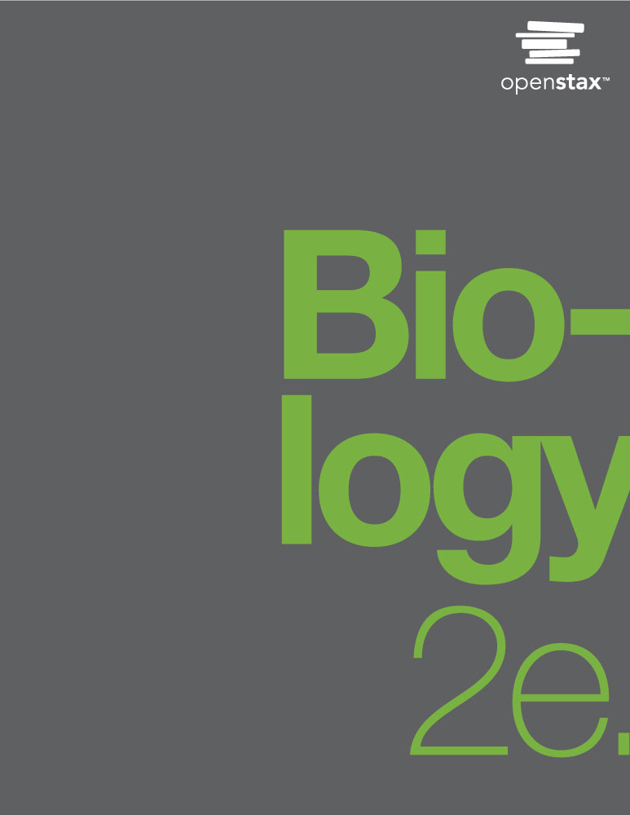
Biology 2e
Chapter 43 ANIMAL REPRODUCTION AND DEVELOPMENT
PowerPoint Image Slideshow

Slide 2
Figure 43.1
Female seahorses produce eggs for reproduction that are then fertilized by the male. Unlike almost all other animals, the male seahorse then gestates the young until birth. (credit: modification of work by “cliff1066”/Flickr)

Slide 3
Figure 43.2
Coral polyps reproduce asexually by fission. (credit: G. P. Schmahl, NOAA FGBNMS Manager)

Slide 4
Figure 43.3
Hydra reproduce asexually through budding.

Slide 5
Figure 43.4
Sea stars can reproduce through fragmentation. The large arm, a fragment from another sea star, is developing into a new individual.

Slide 6
Figure 43.5
Many snails are hermaphrodites. When two individuals mate, they can produce up to one hundred eggs each. (credit: Assaf Shtilman)

Slide 7
Figure 43.6
Salmon reproduce through spawning. (credit: Dan Bennett)

Slide 8
Figure 43.7
During sexual reproduction in toads, the male grasps the female from behind and externally fertilizes the eggs as they are deposited. (credit: “OakleyOriginals”/Flickr)

Slide 9
Figure 43.8
The reproductive structures of the human male are shown.

Slide 10
Figure 43.9
Human sperm, visualized using scanning electron microscopy, have a flagellum, neck, and head. (credit b: modification of work by Mariana Ruiz Villareal; scale-bar data from Matt Russell)

Slide 11
Figure 43.10
The reproductive structures of the human female are shown. (credit a: modification of work by Gray's Anatomy; credit b: modification of work by CDC)

Slide 12
Figure 43.11
Oocytes develop in (a) follicles, located in the ovary. At the beginning of the menstrual cycle, the follicle matures. At ovulation, the follicle ruptures, releasing the egg. The follicle becomes a corpus luteum, which eventually degenerates. The (b) follicle in this light micrograph has an oocyte at its center. (credit a: modification of work by NIH; scale-bar data from Matt Russell)

Slide 13
Figure 43.12
During spermatogenesis, four sperm result from each primary spermatocyte.

Slide 14
Figure 43.13
The process of oogenesis occurs in the ovary’s outermost layer.

Slide 15
Figure 43.14
Hormones control sperm production in a negative feedback system.

Slide 16
Figure 43.15
The ovarian and menstrual cycles of female reproduction are regulated by hormones produced by the hypothalamus, pituitary, and ovaries.

Slide 17
Figure 43.16
This mature egg follicle may rupture and release an egg. (credit: scale-bar data from Matt Russell)

Slide 18
Figure 43.17
Rising and falling hormone levels result in progression of the ovarian and menstrual cycles. (credit: modification of work by Mikael Häggström)

Slide 19
Figure 43.18
In humans, fertilization occurs soon after the oocyte leaves the ovary. Implantation occurs eight or nine days later.(credit: Ed Uthman)

Slide 20
Figure 43.19
Fetal development is shown at nine weeks gestation. (credit: Ed Uthman)

Slide 21
Figure 43.20
This fetus is just entering the second trimester, when the placenta takes over more of the functions performed as the baby develops. (credit: National Museum of Health and Medicine)

Slide 22
Figure 43.21
There is rapid fetal growth during the third trimester. (credit: modification of work by Gray’s Anatomy)

Slide 23
Figure 43.22
A sperm is inserted into an egg for fertilization during intracytoplasmic sperm injection (ICSI). (credit: scale-bar data from Matt Russell)

Slide 24
Figure 43.23
Fertilization is the process in which sperm and egg fuse to form a zygote.
Acrosomal reactions help the sperm degrade the glycoprotein matrix protecting the egg and allow the sperm to transfer its nucleus. (credit: (b) modification of work by Mariana Ruiz Villareal; scale-bar data from Matt Russell)

Slide 25
Figure 43.24
During cleavage, the zygote rapidly divides into multiple cells without increasing in size.
The cells rearrange themselves to form a hollow ball with a fluid-filled or yolk-filled cavity called the blastula. (credit a: modification of work by Gray’s Anatomy; credit b: modification of work by Pearson Scott Foresman, donated to the Wikimedia Foundation)

Slide 26
Figure 43.25
The rearrangement of the cells in the mammalian blastula to two layers—the inner cell mass and the trophoblast—results in the formation of the blastocyst.

Slide 27
Figure 43.26
The three germ layers give rise to different cell types in the animal body. (credit: modification of work by NIH, NCBI)

Slide 28
Figure 43.27
This logo from the Second International Eugenics Conference in New York City in September of 1921 shows how eugenics attempted to merge several fields of study with the goal of producing a genetically superior human race.

Slide 29
Figure 43.28
The central region of the ectoderm forms the neural tube, which gives rise to the brain and the spinal cord.

Slide 30
Figure 43.29
In this five-week old human embryo, somites are segments along the length of the body. (credit: modification of work by Ed Uthman)

Slide 31
Figure 43.30
Animal bodies have three axes for symmetry. (credit: modification of work by NOAA)

