Slide 1
Chapter 45
Hormones and the Endocrine System
Lecture Presentations by Nicole Tunbridge and Kathleen Fitzpatrick
© 2017 Pearson Education, Inc.

Slide 2
The Body’s Long-Distance Regulators
Animal hormones are chemical signals that are secreted into the circulatory system and communicate regulatory messages within the body
Hormones reach all parts of the body, but only target cells have receptors for that hormone

Slide 3
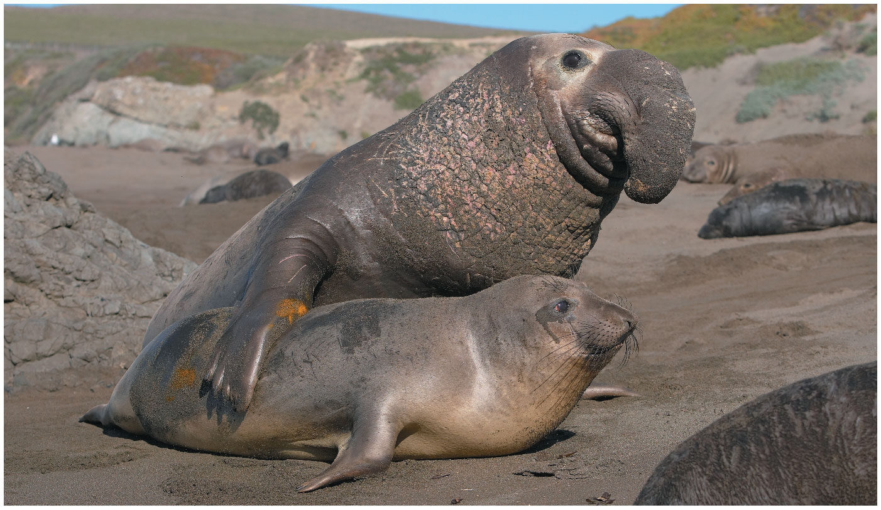
Figure 45.1 What Makes Male and Female Elephant Seals Look so Different?
Notes:
Figure 45.1 What makes male and female elephant seals look so different?

Slide 4
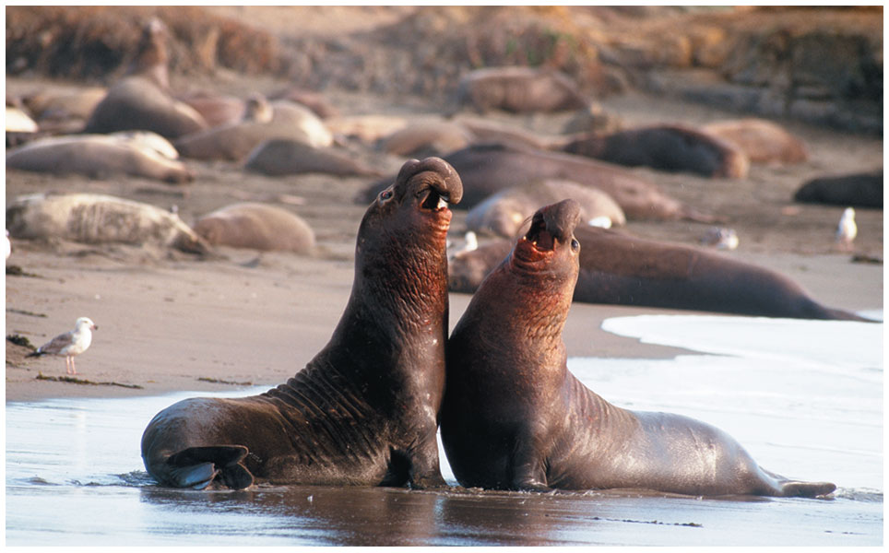
Figure 45.1a Male Elephant Seals Sparring
Notes:
Figure 45.1a Male elephant seals sparring

Slide 5
The Body’s Long-Distance Regulators, Continued
Chemical signaling by hormones is the function of the endocrine system
The nervous system is a network of specialized cells—neurons—that transmit signals along dedicated pathways
The nervous and endocrine systems often overlap in function

Slide 6
Concept 45.1: Hormones and other signaling molecules bind to target receptors, triggering specific response pathways
Animals use chemical signals to communicate in diverse ways

Slide 7
Intercellular Communication
Communication between animal cells through secreted signals can be classified by two criteria:
The type of secreting cell
The route taken by the signal in reaching its target

Slide 8
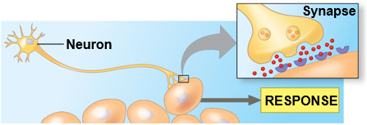
Figure 45.2 Intercellular Communication by Secreted Molecules
Endocrine signaling
Synaptic signaling
Paracrine signaling
Neuroendocrine signaling
Autocrine signaling
Notes:
Figure 45.2 Intercellular communication by secreted molecules

Slide 9
Figure 45.2a Intercellular Communication by Secreted Molecules (Part 1: Endocrine, Paracrine, and Autocrine)
Endocrine signaling
Paracrine signaling
Autocrine signaling
Notes:
Figure 45.2a Intercellular communication by secreted molecules (part 1: endocrine, paracrine, and autocrine)

Slide 10
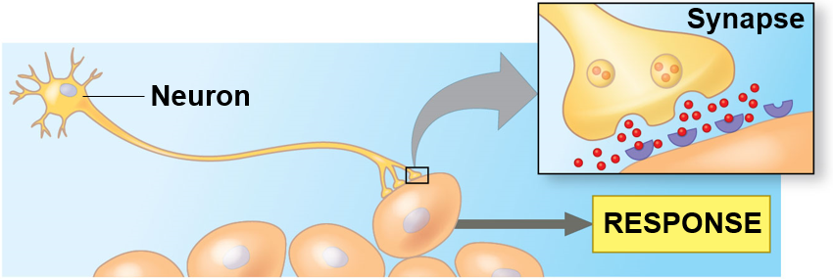
Figure 45.2b Intercellular Communication by Secreted Molecules (Part 2: Synaptic and Neuroendocrine)
Synaptic signaling
Neuroendocrine signaling
Notes:
Figure 45.2b Intercellular communication by secreted molecules (part 2: synaptic and neuroendocrine)

Slide 11
Endocrine Signaling
Hormones secreted into extracellular fluids by endocrine cells reach their targets via the bloodstream
Endocrine signaling maintains homeostasis, mediates responses to stimuli, and regulates growth and development

Slide 12
Paracrine and Autocrine Signaling
Local regulators are molecules that act over short distances, reaching target cells solely by diffusion
In paracrine signaling, the target cells lie near the secreting cells
In autocrine signaling, the target cell is also the secreting cell

Slide 13
Paracrine and Autocrine Signaling, Continued
Paracrine and autocrine signaling play roles in processes such as blood pressure regulation, nervous system function, and reproduction
Local regulators that mediate such signaling include the prostaglandins
Prostaglandins function in the immune system and blood clotting

Slide 14
Synaptic and Neuroendocrine Signaling
In synaptic signaling, neurons form specialized junctions with target cells, called synapses
At synapses, secreted molecules called neurotransmitters diffuse short distances and bind to receptors on target cells
In neuroendocrine signaling, specialized neurosecretory cells secrete neurohormones that diffuse from nerve endings into the bloodstream

Slide 15
Signaling by Pheromones
Members of some animal species may communicate with pheromones, chemicals that are released into the environment
Pheromones serve many functions, including marking trails leading to food, defining territories, warning of predators, and attracting potential mates

Slide 16
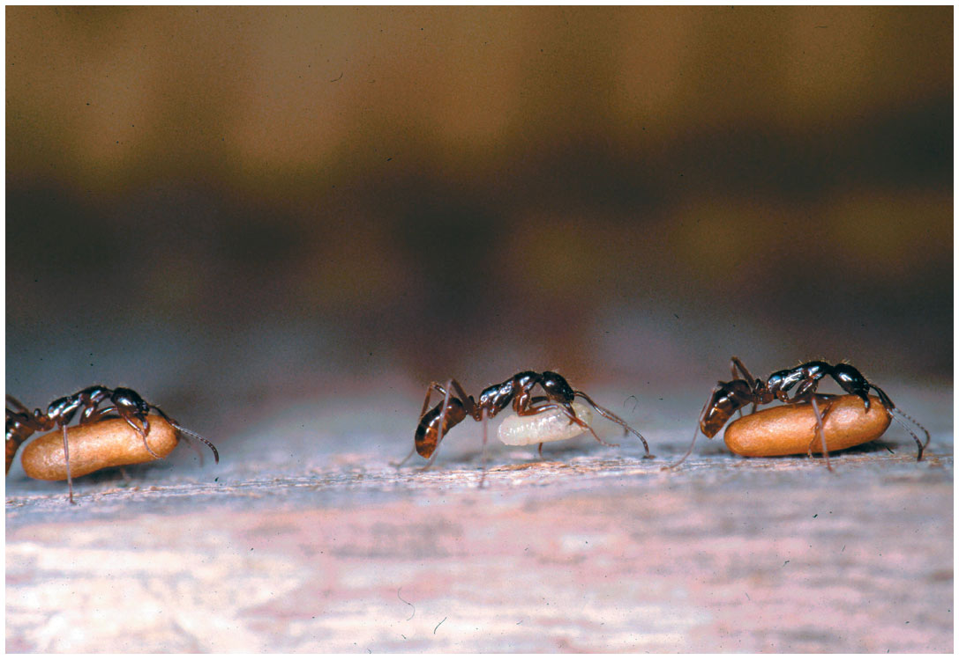
Figure 45.3 Signaling by Pheromones
Notes:
Figure 45.3 Signaling by pheromones

Slide 17
Chemical Classes of Local Regulators and Hormones
A variety of types of molecules convey signals in animal bodies

Slide 18
Classes of Local Regulators
Local regulators such as the prostaglandins are modified fatty acids
Others are polypeptides, and some are gases
Nitric oxide (NO) is a gas that functions in the body as both a local regulator and a neurotransmitter
When the level of oxygen in blood falls, NO activates an enzyme that results in vasodilation, increasing blood flow to tissues

Slide 19
Classes of Hormones
Hormones fall into three major classes: polypeptides, steroids, and amines
Polypeptides and most amines are water-soluble
Steroid hormones and other largely nonpolar hormones are lipid-soluble

Slide 20
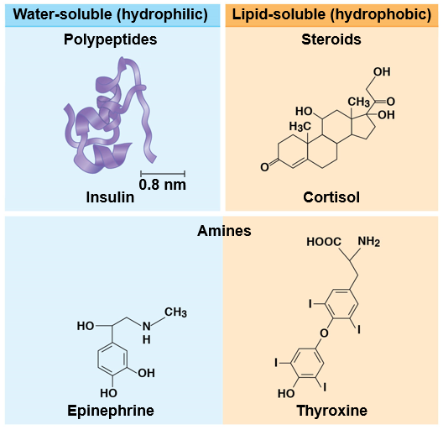
Figure 45.4 Differences in Hormone Solubility and Structure
Notes:
Figure 45.4 Differences in hormone solubility and structure

Slide 21
Cellular Hormone Response Pathways
Water-soluble hormones are secreted by exocytosis, travel freely in the bloodstream, and bind to cell-surface receptors
Lipid-soluble hormones diffuse across cell membranes, travel in the bloodstream bound to transport proteins, and diffuse through the membrane of target cells
They bind to receptors in the cytoplasm or nucleus of the target cells

Slide 22
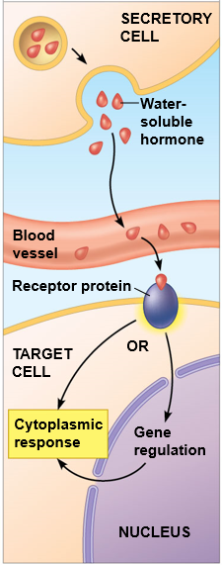
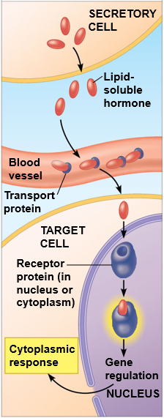
Figure 45.5 Variation in Hormone Receptor Location
Water-soluble hormone; receptor in plasma membrane
Lipid-soluble hormone; receptor in nucleus or cytoplasm
Notes:
Figure 45.5 Variation in hormone receptor location

Slide 23
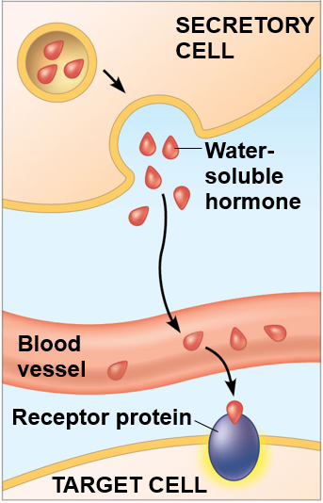
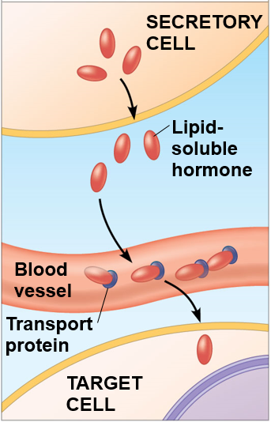
Figure 45.5a Variation in Hormone Receptor Location (Part 1: Secretory Cell)
Water-soluble hormone; receptor in plasma membrane
Lipid-soluble hormone; receptor in nucleus or cytoplasm
Notes:
Figure 45.5a Variation in hormone receptor location (part 1: secretory cell)

Slide 24
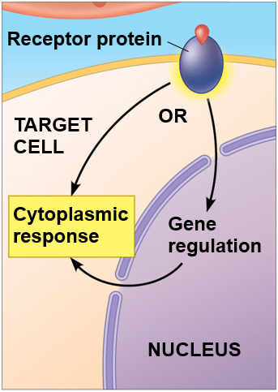
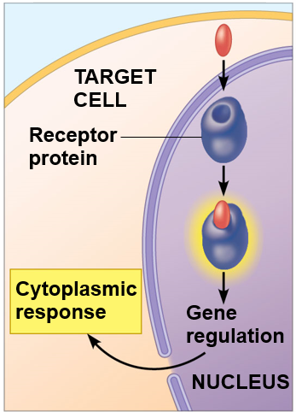
Figure 45.5b Variation in Hormone Receptor Location (Part 2: Target Cell)
Water-soluble hormone; receptor in plasma membrane
Lipid-soluble hormone; receptor in nucleus or cytoplasm
Notes:
Figure 45.5b Variation in hormone receptor location (part 2: target cell)

Slide 25
Response Pathway for Water-Soluble Hormones
Binding of a hormone to its receptor initiates a signal transduction pathway leading to responses in the cytoskeleton, enzyme activation, or a change in gene expression

Slide 26
Response Pathway for Water-Soluble Hormones, Continued
The hormone epinephrine (or adrenaline) regulates many organs in response to stressful situations
Epinephrine binds to receptors on the plasma membrane of liver cells
This triggers the release of messenger molecules that activate enzymes and result in the release of glucose into the bloodstream

Slide 27
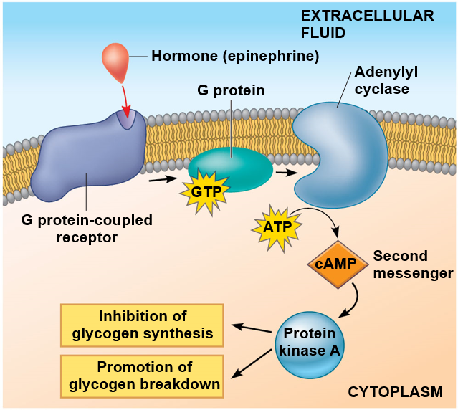
Figure 45.6 Signal Transduction Triggered by a Cell-surface Hormone Receptor
Notes:
Figure 45.6 Signal transduction triggered by a cell-surface hormone receptor

Slide 28
Animation: Water-Soluble Hormone

Slide 29
Response Pathway for Lipid-Soluble Hormones
The response to a lipid-soluble hormone is usually a change in gene expression
When a steroid hormone binds to its cytosolic receptor, a hormone-receptor complex forms that moves into the nucleus
There, the receptor part of the complex acts as a transcriptional regulator of specific target genes

Slide 30
Response Pathway for Lipid-Soluble Hormones, Continued
The steroid hormone receptors that bind to estrogens are well-characterized
In female birds and frogs, estradiol, a form of estrogen, binds to a cytoplasmic receptor in liver cells
The estradiol-bound receptor activates transcription of genes needed to produce egg yolk

Slide 31
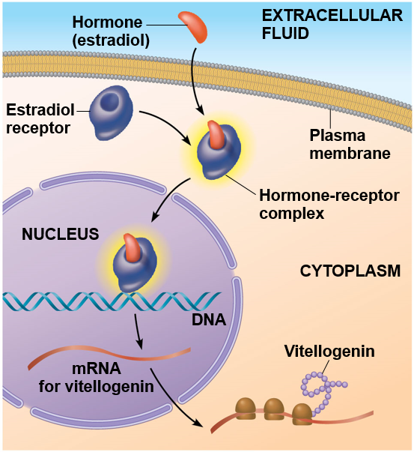
Figure 45.7 Direct Regulation of Gene Expression by a Steroid Hormone Receptor
Notes:
Figure 45.7 Direct regulation of gene expression by a steroid hormone receptor

Slide 32
Animation: Lipid-Soluble Hormone

Slide 33
Multiple Responses to a Single Hormone
The same hormone may have different effects on target cells that have
Different receptors for the hormone
Different signal transduction pathways
For example, the hormone epinephrine has multiple effects that form the basis of the “fight-or-flight” response

Slide 34
Endocrine Tissues and Organs
Endocrine cells are often grouped in ductless organs called endocrine glands, such as the thyroid and parathyroid glands and testes or ovaries
In contrast, exocrine glands, such as salivary glands, have ducts to carry secreted substances onto body surfaces or into body cavities

Slide 35
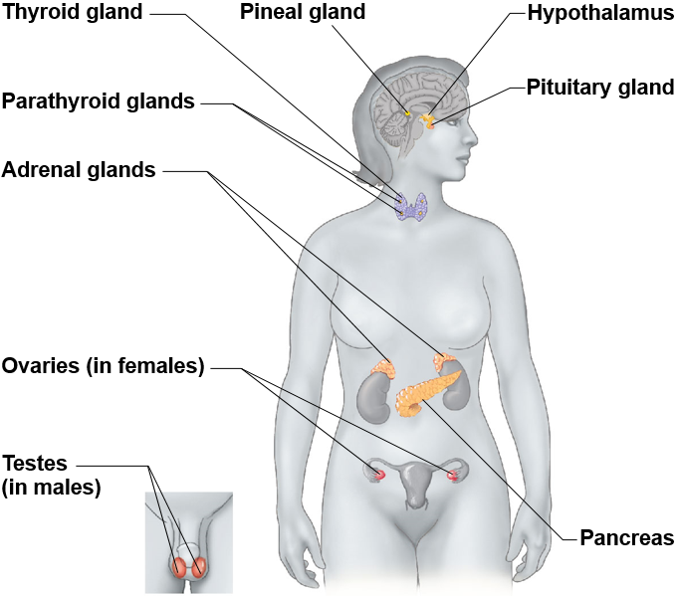
Figure 45.8 Human Endocrine Glands and their Hormones
Notes:
Figure 45.8 Human endocrine glands and their hormones

Slide 36
Concept 45.2: Feedback regulation and coordination with the nervous system are common in hormone pathways
Hormones are assembled into regulatory pathways

Slide 37
Simple Endocrine Pathways
Hormones are released from an endocrine cell, travel through the bloodstream, and interact with specific receptors within a target cell to cause a physiological response

Slide 38
Simple Endocrine Pathways, Continued
For example, the release of acidic contents of the stomach into the duodenum stimulates endocrine cells there to secrete secretin
This causes target cells in the pancreas, a gland behind the stomach, to raise the pH in the duodenum

Slide 39
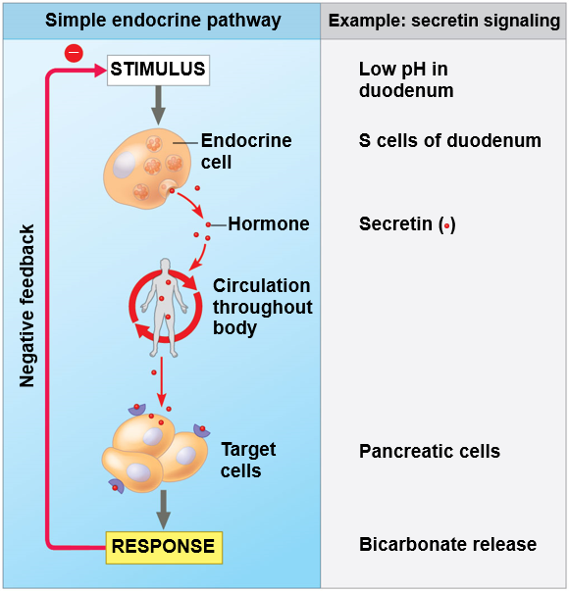
Figure 45.9 A Simple Endocrine Pathway
Notes:
Figure 45.9 A simple endocrine pathway

Slide 40
BioFlix: Homeostasis: Regulating Blood Sugar

Slide 41
Simple Neuroendocrine Pathways
In a simple neuroendocrine pathway, the stimulus is received by a sensory neuron, which stimulates a neurosecretory cell
The neurosecretory cell secretes a neurohormone, which enters the bloodstream and travels to target cells

Slide 42
Simple Neuroendocrine Pathways, Continued
For example, the suckling of an infant stimulates signals in the nervous systems that reach the hypothalamus
Nerve impulses from the hypothalamus trigger the release of oxytocin from the posterior pituitary
This causes the mammary glands to secrete milk

Slide 43
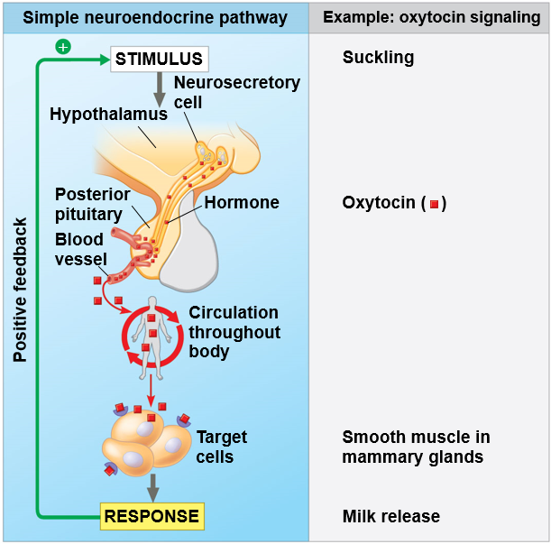
Figure 45.10 A Simple Neuroendocrine Pathway
Notes:
Figure 45.10 A simple neuroendocrine pathway

Slide 44
Feedback Regulation
A negative feedback loop inhibits a response by reducing the initial stimulus, thus preventing excessive pathway activity
Positive feedback reinforces a stimulus to produce an even greater response
For example, in mammals oxytocin causes the release of milk, causing greater suckling by offspring, which stimulates the release of more oxytocin

Slide 45
Coordination of Endocrine and Nervous Systems
In a wide range of animals, endocrine organs in the brain integrate function of the endocrine system with that of the nervous system

Slide 46
Invertebrates
The endocrine pathway that controls the molting of larva originates in the larval brain, where neurosecretory cells produce PTTH
In the prothoracic gland, PTTH directs the release of ecdysteroid
Bursts of ecdysteroid trigger each successive molt as well as metamorphosis
Metamorphosis is not triggered until the level of another hormone, JH (juvenile hormone), drops

Slide 47
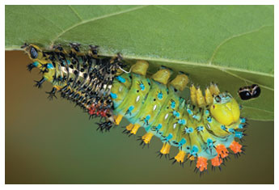
Figure 45.11 Larva of the Giant Silk Moth
Notes:
Figure 45.11 Larva of the giant silk moth

Slide 48
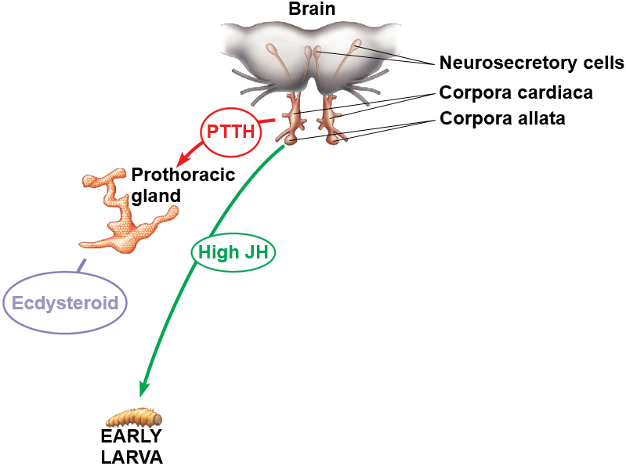
Figure 45.12_1 Regulation of Insect Development and Metamorphosis (Step 1)
Notes:
Figure 45.12_1 Regulation of insect development and metamorphosis (step 1)

Slide 49
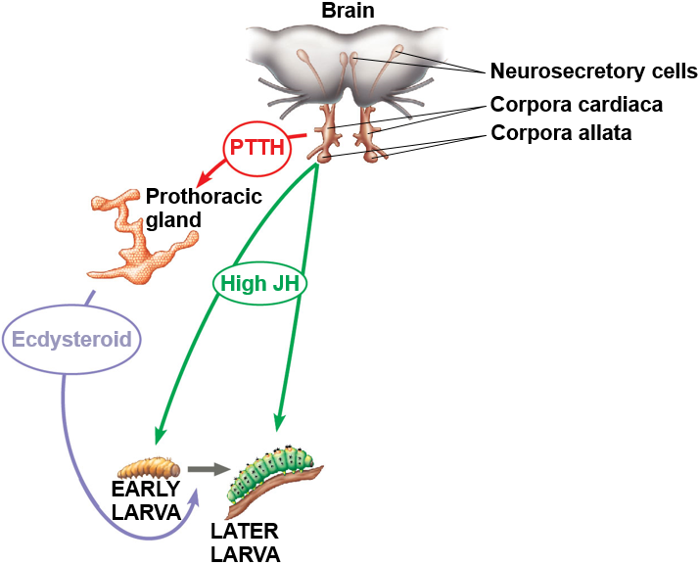
Figure 45.12_2 Regulation of Insect Development and Metamorphosis (Step 2)
Notes:
Figure 45.12_2 Regulation of insect development and metamorphosis (step 2)

Slide 50
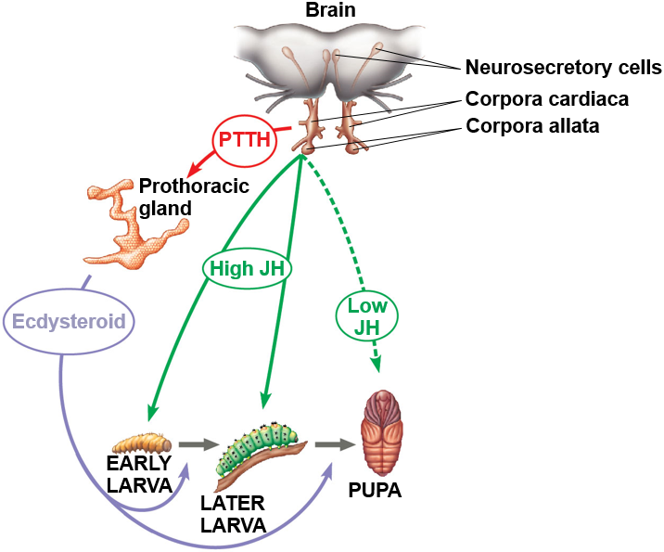
Figure 45.12_3 Regulation of Insect Development and Metamorphosis (Step 3)
Notes:
Figure 45.12_3 Regulation of insect development and metamorphosis (step 3)

Slide 51
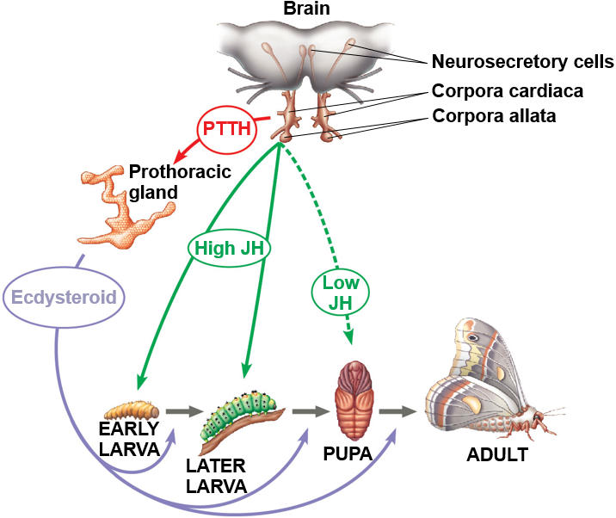
Figure 45.12_4 Regulation of Insect Development and Metamorphosis (Step 4)
Notes:
Figure 45.12_4 Regulation of insect development and metamorphosis (step 4)

Slide 52
Vertebrates
The hypothalamus coordinates endocrine signaling
It receives information from nerves throughout the body and initiates appropriate neuroendocrine signals
At the base of the hypothalamus is the pituitary gland, composed of the posterior pituitary and anterior pituitary

Slide 53
Vertebrates, Continued
The posterior pituitary stores and secretes hormones that are made in the hypothalamus
The anterior pituitary makes and releases hormones under regulation of the hypothalamus

Slide 54
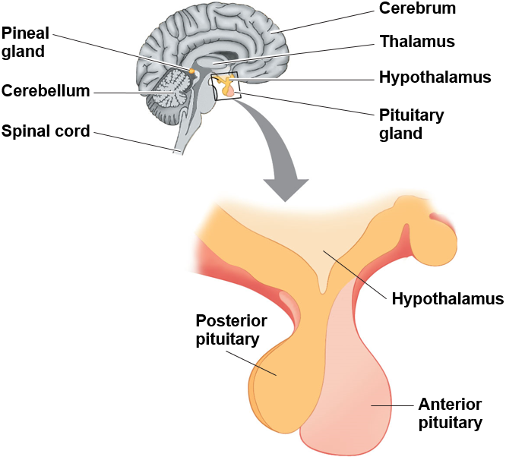
Figure 45.13 Endocrine Glands in the Human Brain
Notes:
Figure 45.13 Endocrine glands in the human brain

Slide 55
Vertebrates, Continued-1
Posterior Pituitary Hormones
Neurosecretory cells of the hypothalamus synthesize the two posterior pituitary hormones
Antidiuretic hormone (ADH) regulates physiology and behavior
Oxytocin regulates milk secretion by the mammary glands

Slide 56
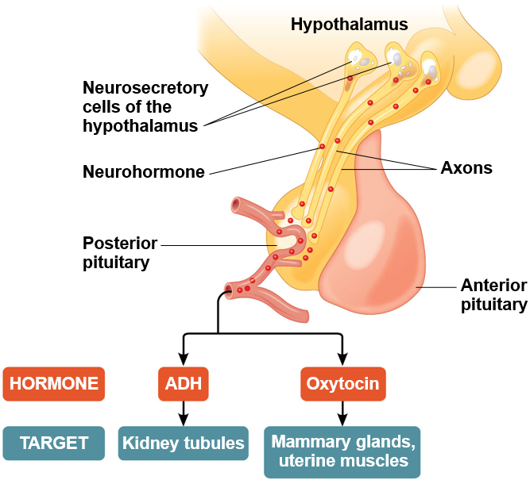
Figure 45.14 Production and Release of Posterior Pituitary Hormones
Notes:
Figure 45.14 Production and release of posterior pituitary hormones

Slide 57
Vertebrates, Continued-2
Anterior Pituitary Hormones
The anterior pituitary controls diverse processes, such as metabolism, osmoregulation, and reproduction
Hormones secreted by the hypothalamus control release of all anterior pituitary hormones
For example, prolactin-releasing hormone from the hypothalamus stimulates the anterior pituitary to secrete prolactin (PRL), which has a role in milk production

Slide 58
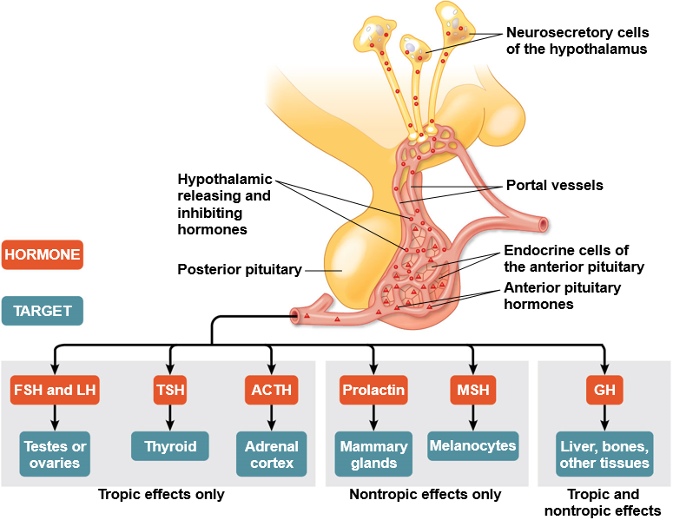
Figure 45.15 Production and Release of Anterior Pituitary Hormones
Notes:
Figure 45.15 Production and release of anterior pituitary hormones

Slide 59
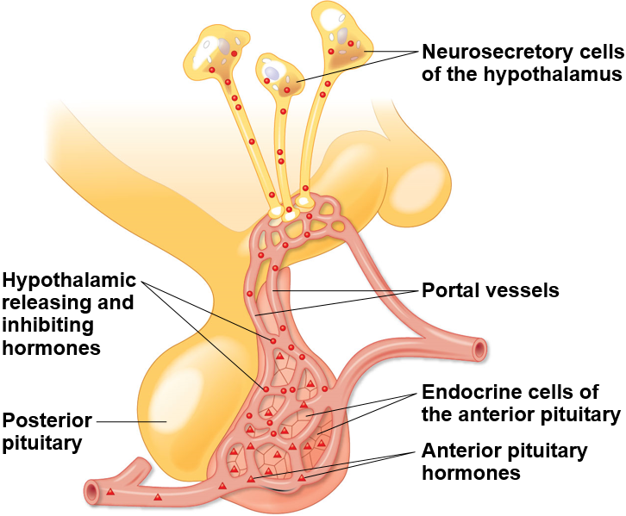
Figure 45.15a Production and Release of Anterior Pituitary Hormones (Part 1)
Notes:
Figure 45.15a Production and release of anterior pituitary hormones (part 1)

Slide 60
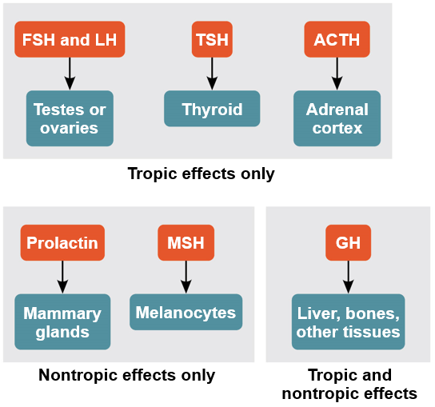
Figure 45.15b Production and Release of Anterior Pituitary Hormones (Part 2)
Notes:
Figure 45.15b Production and release of anterior pituitary hormones (part 2)

Slide 61
Vertebrates, Continued-3
Sets of hormones from the hypothalamus, anterior pituitary, and a target endocrine gland are often organized into a hormone cascade
The anterior pituitary hormones in these pathways are called tropic hormones

Slide 62
Thyroid Regulation: A Hormone Cascade Pathway
In humans and other mammals, thyroid hormone regulates many functions
If thyroid hormone level drops in the blood, the hypothalamus secretes thyrotropin-releasing hormone (TRH), causing the anterior pituitary to secrete thyroid-stimulating hormone (TSH)
TSH stimulates release of thyroid hormone by the thyroid gland

Slide 63
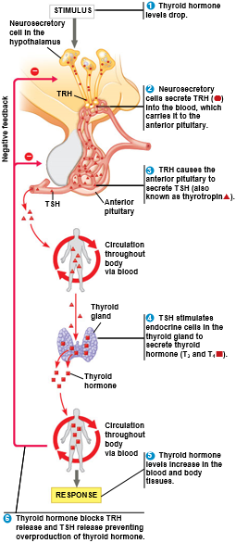
Figure 45.16 Regulation of Thyroid Hormone Secretion: A Hormone Cascade Pathway
Notes:
Figure 45.16 Regulation of thyroid hormone secretion: a hormone cascade pathway

Slide 64
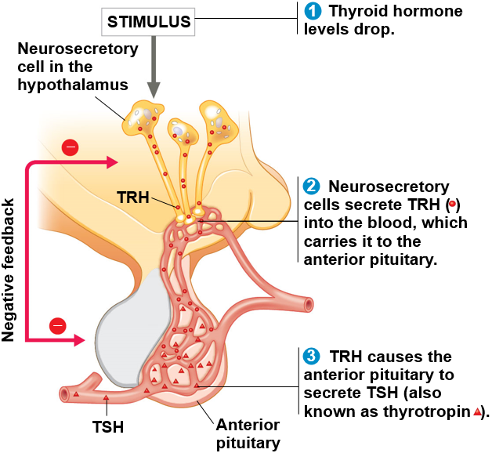
Figure 45.16a Regulation of Thyroid Hormone Secretion: A Hormone Cascade Pathway (Part 1)
Notes:
Figure 45.16a Regulation of thyroid hormone secretion: a hormone cascade pathway (part 1)

Slide 65
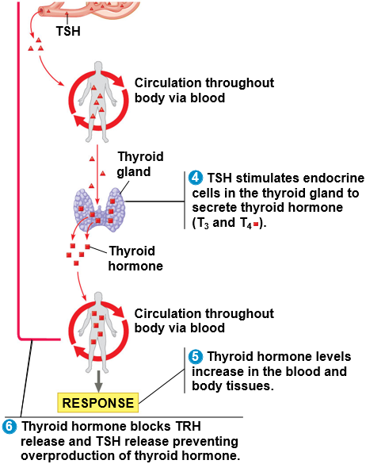
Figure 45.16b Regulation of Thyroid Hormone Secretion: A Hormone Cascade Pathway (Part 2)
Notes:
Figure 45.16b Regulation of thyroid hormone secretion: a hormone cascade pathway (part 2)

Slide 66
Disorders of Thyroid Function and Regulation
Disruption of thyroid hormone production and regulation can result in serious disorders
Thyroid hormone is the only iodine-containing molecule synthesized in the body
With low levels of thyroid hormone, due to insufficient iodine, the pituitary continues to secrete TSH
This causes the thyroid to enlarge, resulting in a goiter

Slide 67
Hormonal Regulation of Growth
Growth hormone (GH) is secreted by the anterior pituitary gland, and has tropic and nontropic effects
The liver is a major target and responds to GH by releasing insulin-like growth factors (IGFs)
These stimulate bone and cartilage growth
An excess of GH can cause gigantism, while a lack of GH can cause dwarfism

Slide 68
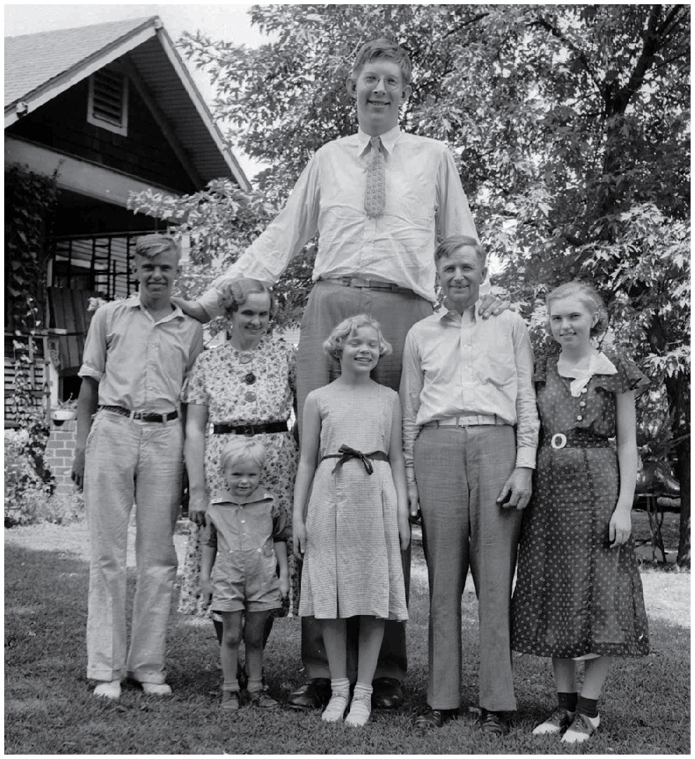
Figure 45.17 Effect of Growth Hormone Overproduction
Notes:
Figure 45.17 Effect of growth hormone overproduction

Slide 69
Concept 45.3: Endocrine glands respond to diverse stimuli in regulating homeostasis, development, and behavior
Endocrine signaling regulates homeostasis, development, and behavior

Slide 70
Parathyroid Hormone and Vitamin D: Control of Blood Calcium
Homeostatic regulation of calcium
in the blood
is vital
In mammals, parathyroid hormone (PTH) is released by the parathyroid glands when
levels fall below a set point

Slide 71
Parathyroid Hormone and Vitamin D: Control of Blood Calcium, Continued
PTH increases the level of blood
It releases
from bone and stimulates
reabsorption of
in the kidneys
It indirectly affects
by promoting production of
vitamin D
Calcitonin decreases the level of blood
It stimulates
deposition in bones and secretion
by kidneys

Slide 72
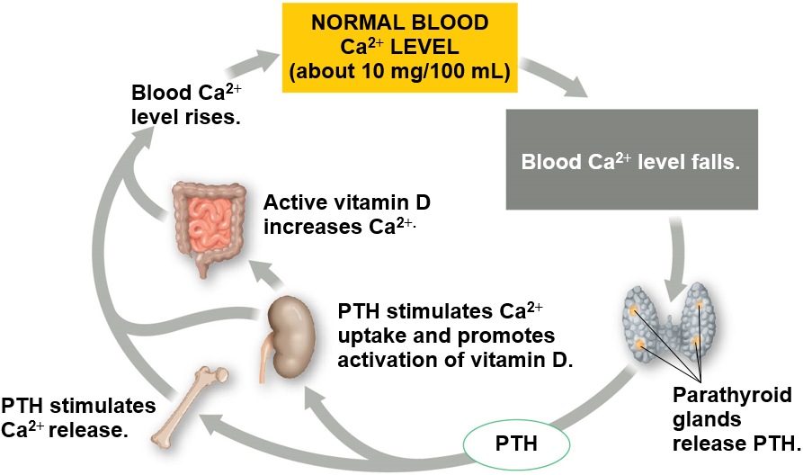
Figure 45.18 The Roles of Parathyroid Hormone (PTH) in Regulating Blood Calcium Levels in Mammals
Notes:
Figure 45.18 The roles of parathyroid hormone (PTH) in regulating blood calcium levels in mammals

Slide 73
Adrenal Hormones: Response to Stress
The adrenal glands are located atop the kidneys
Each adrenal gland consists of two glands: the adrenal medulla (inner portion) and adrenal cortex (outer portion)

Slide 74
The Role of the Adrenal Medulla
The adrenal medulla secretes epinephrine (adrenaline) and norepinephrine (noradrenaline)
These hormones are members of a class of compounds called catecholamines
They coordinate a set of physiological responses that comprise the “fight-or-flight” response

Slide 75
The Role of the Adrenal Medulla, Continued
Epinephrine and norepinephrine
Trigger the release of glucose and fatty acids into the blood
Increase oxygen delivery to body cells
Direct blood toward heart, brain, and skeletal muscles and away from skin, digestive system, and kidneys

Slide 76
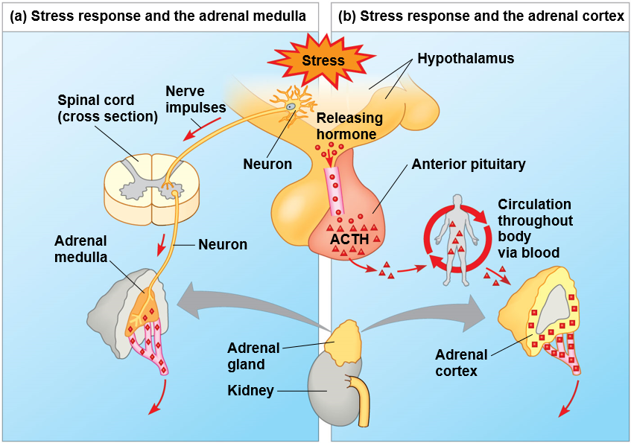
Figure 45.19a Stress and the Adrenal Gland (Part 1: Art)
Notes:
Figure 45.19a Stress and the adrenal gland (part 1: art)

Slide 77
The Role of the Adrenal Medulla, Continued-1
Epinephrine’s Multiple Effects: A Closer Look
Epinephrine coordinates a response in a range of target cells
In liver cells, it binds to a receptor that activates protein kinase A, which regulates glycogen metabolism
In smooth muscle cells lining blood vessels that supply skeletal muscle, it leads to vasodilation to increase blood supply
In smooth muscle of blood vessels of the intestines, it leads to vasoconstriction and reduced blood flow

Slide 78
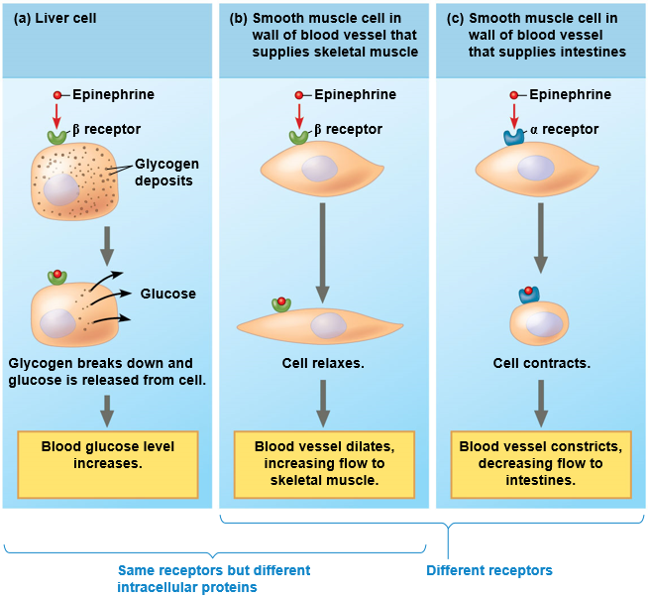
Figure 45.20 One Hormone, Different Effects
Notes:
Figure 45.20 One hormone, different effects

Slide 79
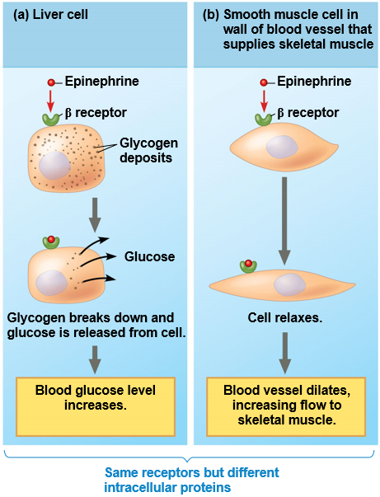
Figure 45.20a One Hormone, Different Effect (Part 1: Same Receptors)
Notes:
Figure 45.20a One hormone, different effect (part 1: same receptors)

Slide 80
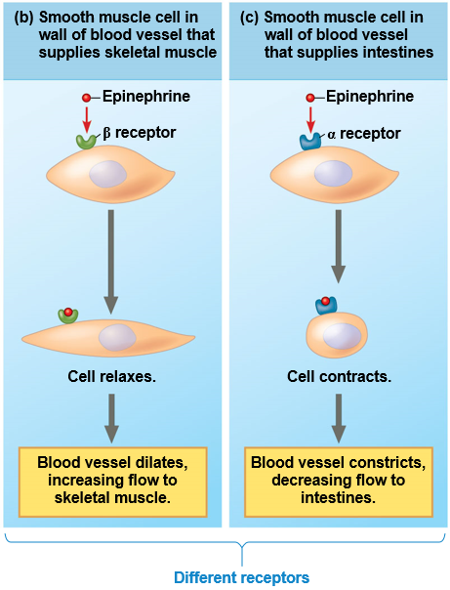
Figure 45.20b One Hormone, Different Effects (Part 2: Different Receptors)
Notes:
Figure 45.20b One hormone, different effects (part 2: different receptors)

Slide 81
The Role of the Adrenal Cortex
The adrenal cortex becomes active under stressful conditions including low blood sugar, decreased blood volume and pressure, and shock
A series of hormonal signals lead to production and secretion of a family of steroids called corticosteroids
Humans produce two types of corticosteroids: glucocorticoids and mineralocorticoids

Slide 82
The Role of the Adrenal Cortex, Continued
Glucocorticoids, such as cortisol, influence glucose metabolism and the immune system
Mineralocorticoids, such as aldosterone, affect salt and water balance

Slide 83
Stress and the Adrenal Gland (Part 2: Epinephrine and Norepinephrine Effects)
Effects of epinephrine and norepinephrine:
Glycogen broken down to glucose; increased blood glucose
Increased blood pressure
Increased breathing rate
Increased metabolic rate
Change in blood flow patterns, leading to increased alertness and decreased digestive, excretory, and reproductive system activity
Notes:
Figure 45.19b Stress and the adrenal gland (part 2: epinephrine and norepinephrine effects)

Slide 84
Sex Hormones
The gonads, testes and ovaries, produce most of the sex hormones: androgens, estrogens, and progesterone
All three sex hormones are found in both males and females, but in different proportions

Slide 85
Sex Hormones, Continued
The testes primarily synthesize androgens, mainly testosterone, which promote development of male reproductive structures
Testosterone is responsible for male secondary sex characteristics

Slide 86
Sex Hormones, Continued-1
Estrogens, most importantly estradiol, are responsible for maintenance of the female reproductive system
They are also responsible for development of female secondary sex characteristics
In mammals, progesterone is primarily involved in preparing and maintaining the uterus

Slide 87
Sex Hormones, Continued-2
Synthesis of the sex hormones is controlled by the gonadotropins, follicle-stimulating hormone and luteinizing hormone from the anterior pituitary
Gonadotropin secretion is controlled by gonadotropin-releasing hormone from the hypothalamus

Slide 88
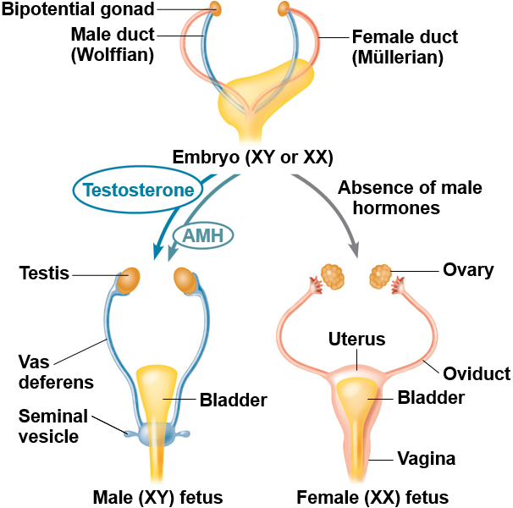
Figure 45.21 Sex Hormones Regulate Formation of Internal Reproductive Structures in Human Development
Notes:
Figure 45.21 Sex hormones regulate formation of internal reproductive structures in human development

Slide 89
Endocrine Disruptors
Between 1938 and 1971, some pregnant women at risk for complications were prescribed a synthetic estrogen called diethylstilbestrol (DES)
Daughters of women treated with DES are at higher risk for reproductive abnormalities, including miscarriage, structural changes, and cervical and vaginal cancers

Slide 90
Endocrine Disruptors, Continued
DES is an endocrine disruptor, a molecule that interrupts the normal function of a hormone pathway, in this case, that of estrogen

Slide 91
Hormones and Biological Rhythms
The pineal gland, located in the brain, secretes melatonin
Primary functions of melatonin appear to relate to biological rhythms associated with reproduction and with daily activity levels
The release of melatonin by the pineal gland is controlled by a group of neurons in the hypothalamus called the suprachiasmatic nucleus (SCN)

Slide 92
Evolution of Hormone Function
Over the course of evolution, the functions of particular hormones have diverged
For example, thyroid hormone plays a role in metabolism across many lineages, but in frogs has taken on a unique function: stimulating the resorption of the tadpole tail during metamorphosis
Prolactin also has a broad range of activities in vertebrates

Slide 93
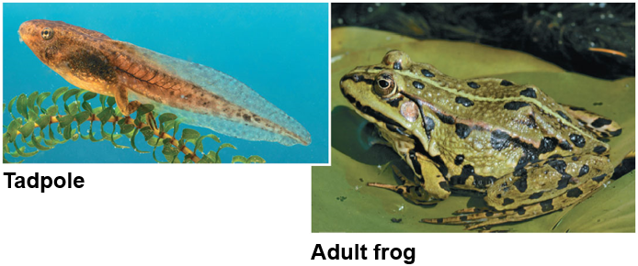
Figure 45.22 Specialized Role of a Hormone in Frog Metamorphosis
Notes:
Figure 45.22 Specialized role of a hormone in frog metamorphosis

Slide 94
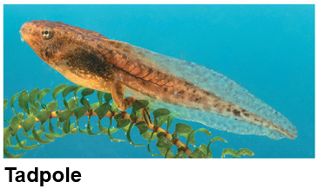
Figure 45.22a Specialized Role of a Hormone in Frog Metamorphosis (Part 1: Tadpole)
Notes:
Figure 45.22a Specialized role of a hormone in frog metamorphosis (part 1: tadpole)

Slide 95
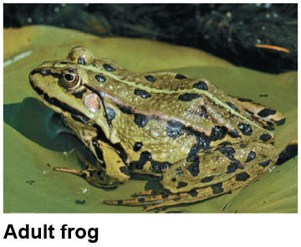
Figure 45.22b Specialized Role of a Hormone in Frog Metamorphosis (Part 2: Adult Frog)
Notes:
Figure 45.22b Specialized role of a hormone in frog metamorphosis (part 2: adult frog)

Slide 96
Evolution of Hormone Function, Continued
Melanocyte-stimulating hormone (MSH) regulates skin color in amphibians, fish, and reptiles by controlling pigment distribution in melanocytes
In mammals, MSH plays roles in hunger and metabolism in addition to coloration

Slide 97
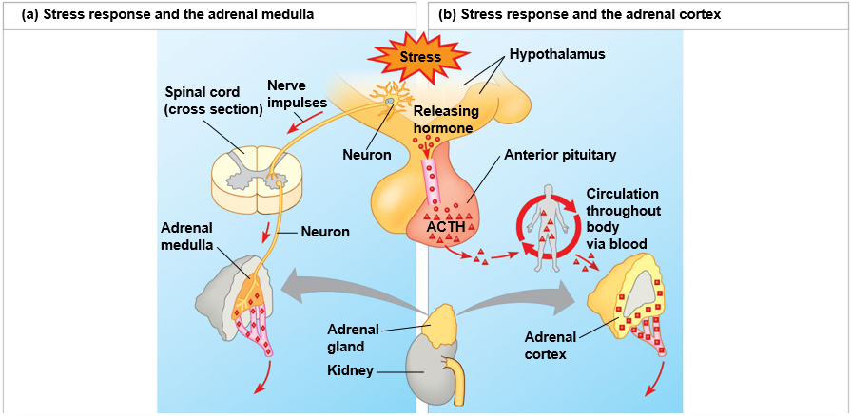
Figure 45.19 Stress and the Adrenal Gland
Effects of epinephrine and norepinephrine:
Glycogen broken down to glucose; increased blood glucose
Increased blood pressure
Increased breathing rate
Increased metabolic rate
Change in blood flow patterns, leading to increased alertness and decreased digestive, excretory, and reproductive system activity
Effects of
mineralocorticoids:
Retention of sodium ions and water by kidneys
Increased blood volume and blood pressure
Effects of
glucocorticoids:
Proteins and fats broken down and converted to glucose, leading to increased blood glucose
Partial suppression of immune system
Notes:
Figure 45.19 Stress and the adrenal gland

Slide 98
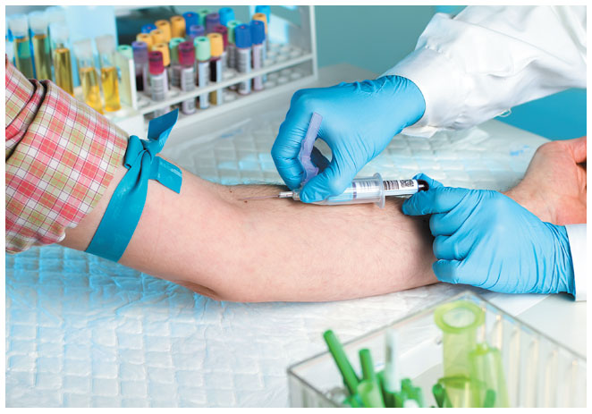
Figure 45.UN01 Problem Solving Exercise: Blood Draw
Notes:
Figure 45.UN01 Problem Solving Exercise: blood draw

Slide 99
Problem Solving Exercise: Thyroid Test
#
Test
Patient
Normal Range
Comments
Serum total
2.93 nmol/L
0.89-2.44 nmol/L
Free thyroxine
27.4 pmol/L
9.0-21.0 pmol/L
TSH levels
5.55 mU/L
0.35-4.94 mU/L
TSH receptor autoantibody
0.2 U/mL
0-1.5 U/mL
Notes:
Figure 45.UN02 Problem Solving Exercise: thyroid test

Slide 100
Scientific Skills Exercise: Designing a Controlled Experiment
Sleep Protocol | Expected Wake Time | Actual Wake Time | Mean Plasma ACTH Level (pg/mL) 1:00 AM | Mean Plasma ACTH Level (pg/mL) 6:00 AM | Mean Plasma ACTH Level (pg/mL) ∆ in the 30 Minutes Post-waking
Short | 6:00 AM | 6:00 AM | 9.9 | 37.3 | 10.6
Long | 9:00 AM | 9:00 AM | 8.1 | 26.5 | 12.2
Surprise | 9:00 AM | 6:00 AM | 8.0 | 25.5 | 22.1
Data from J. Born et al., Timing the end of nocturnal sleep, Nature 397:29-30 (1999).
Notes:
Figure 45.UN03 Scientific Skills Exercise: designing a controlled experiment

Slide 101
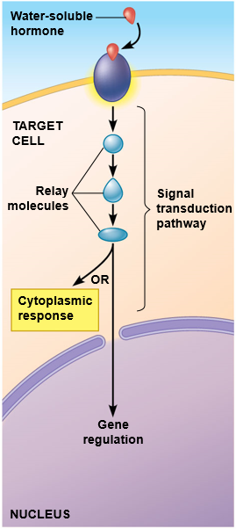
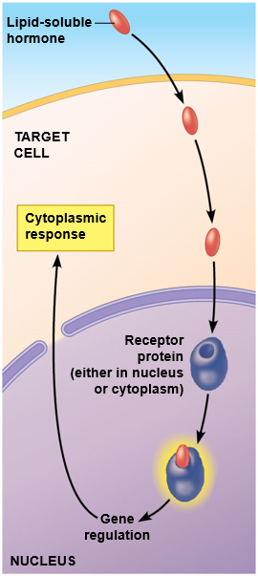
Figure 45.UN04 Summary of Key Concepts: Water- vs. Lipid-soluble Hormones
Notes:
Figure 45.UN04 Summary of key concepts: water- vs. lipid-soluble hormones

Slide 102
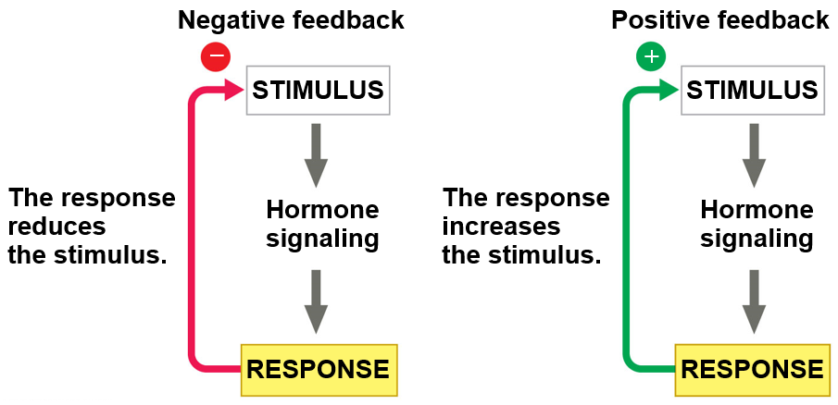
Figure 45.UN05 Negative and Positive Feedback
Notes:
Figure 45.UN05 Negative and positive feedback

Slide 103
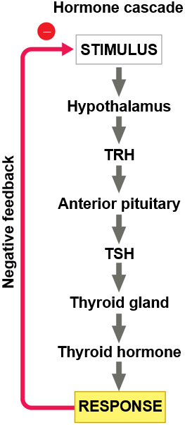
Figure 45.UN06 Hormone Cascade
Notes:
Figure 45.UN06 Hormone cascade

Slide 104
Figure 45.UN07 Test Your Understanding, Question 10 (Cushing’s Syndrome)
Notes:
Figure 45.UN07 Test your understanding, question 10 (Cushing’s syndrome)

Slide 105
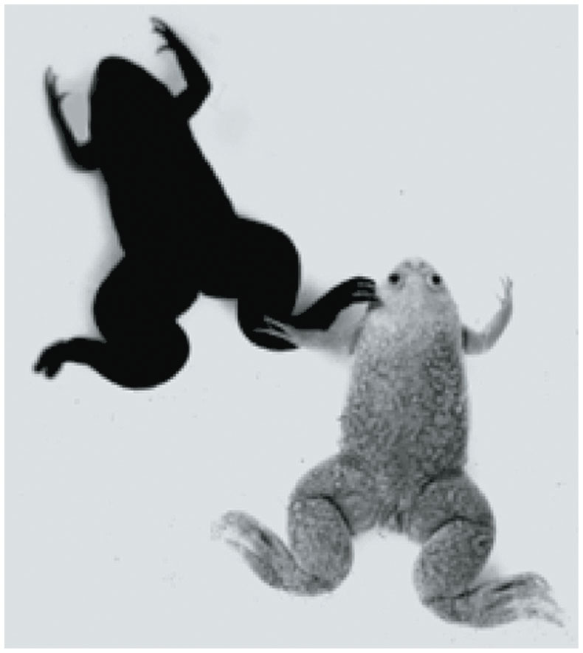
Figure 45.UN08 Test your Understanding, Question 12 (MSH)
Notes:
Figure 45.UN08 Test your understanding, question 12 (MSH)

