Slide 2
The Muscular System
Muscles are responsible for all types of body movement
Three basic muscle types are found in the body
Skeletal muscle
Cardiac muscle
Smooth muscle

Slide 3
Muscle Types
Skeletal and smooth muscle cells are elongated (muscle cell = muscle fiber)
Contraction and shortening of muscles are due to the movement of microfilaments
All muscles share some terminology
Prefixes myo- and mys- refer to “muscle”
Prefix sarco- refers to “flesh”

Slide 4
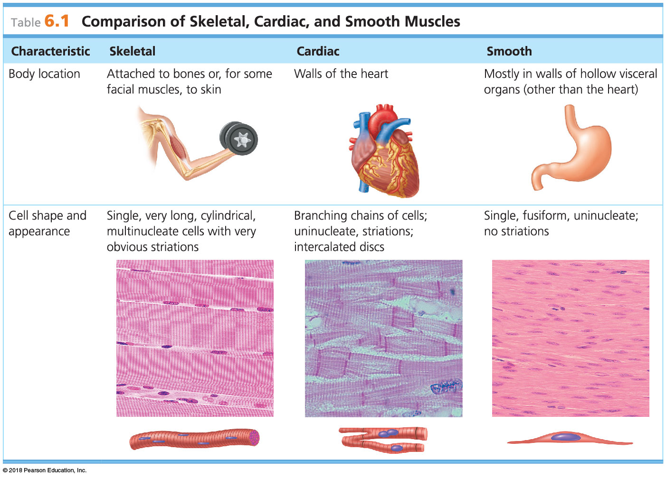
Table 6.1 Comparison of Skeletal, Cardiac, and Smooth Muscles
© 2018 Pearson Education, Inc.

Slide 5
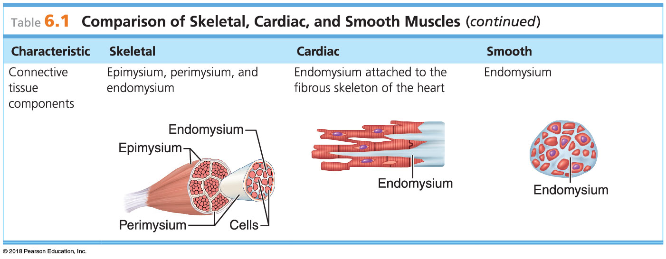
Table 6.1 Comparison of Skeletal, Cardiac, and Smooth Muscles (1 of 2)
© 2018 Pearson Education, Inc.

Slide 6
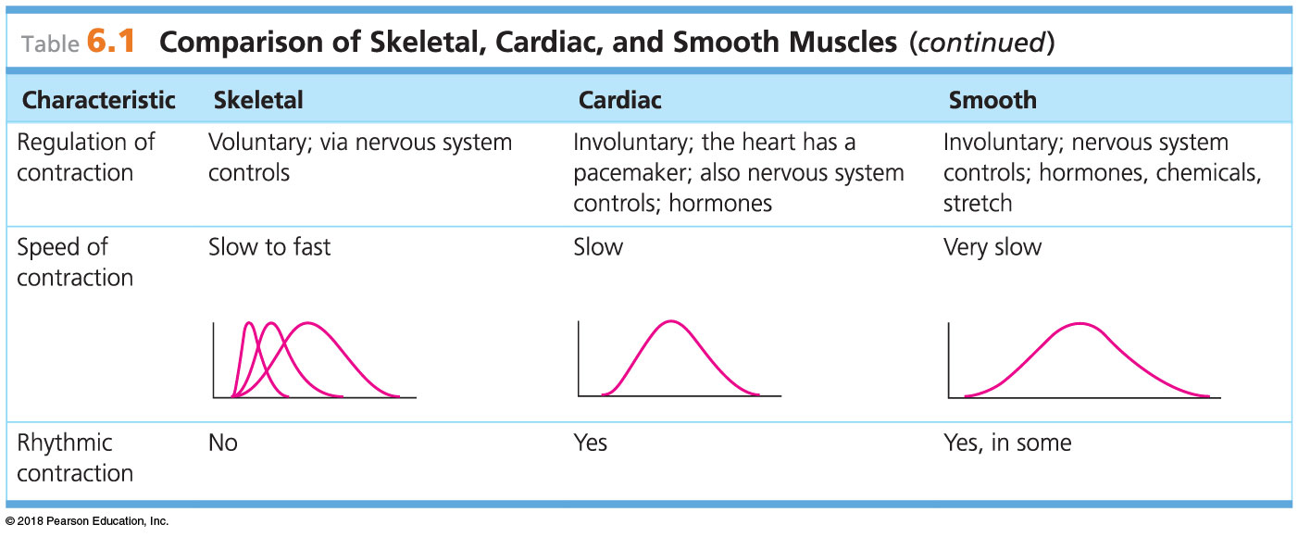
Table 6.1 Comparison of Skeletal, Cardiac, and Smooth Muscles (2 of 2)
© 2018 Pearson Education, Inc.

Slide 7
Muscle Types
Skeletal muscle
Most skeletal muscle fibers are attached by tendons to bones
Skeletal muscle cells are large, cigar-shaped, and multinucleate
Also known as striated muscle because of its obvious stripes
Also known as voluntary muscle because it is the only muscle tissue subject to conscious control

Slide 8
Muscle Types
Skeletal muscle cells are surrounded and bundled by connective tissue
Endomysium—encloses a single muscle fiber
Perimysium—wraps around a fascicle (bundle) of muscle fibers
Epimysium—covers the entire skeletal muscle
Fascia—on the outside of the epimysium

Slide 9
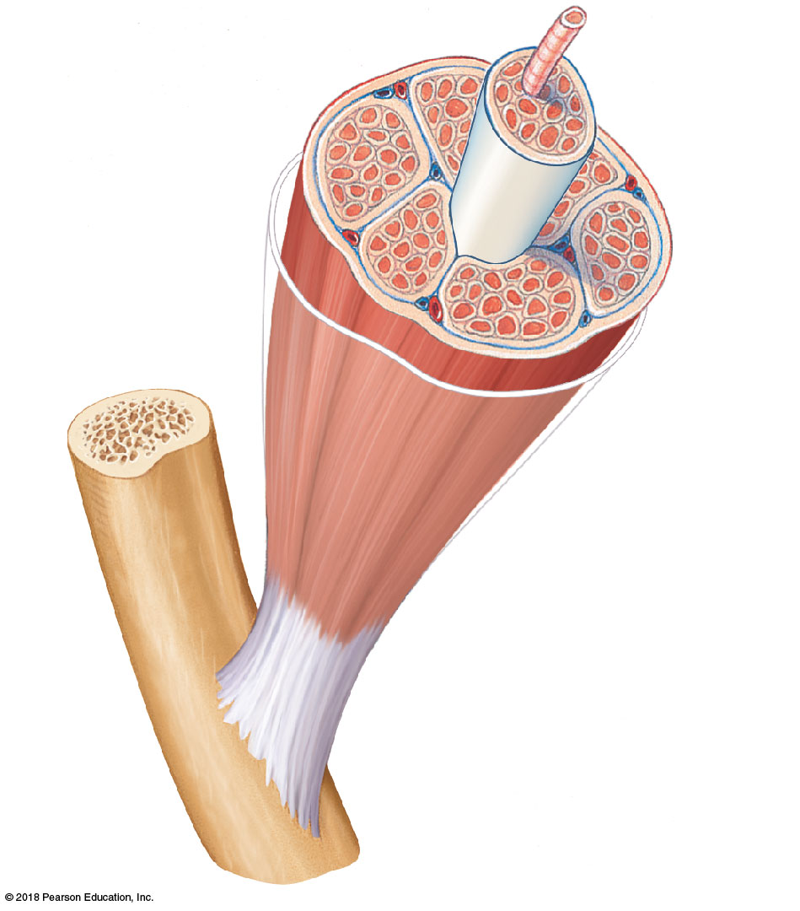
Figure 6.1 Connective tissue wrappings of skeletal muscle.
Muscle ﬁber (cell)
Blood vessel
Perimysium
Epimysium
(wraps entire muscle)
Fascicle (wrapped by perimysium)
Endomysium (between ﬁbers)
Tendon
Bone
© 2018 Pearson Education, Inc.

Slide 10
Muscle Types
The epimysium of skeletal muscle blends into a connective tissue attachment
Tendons—cordlike structures
Mostly collagen fibers
Often cross a joint because of their toughness and small size
Aponeuroses—sheetlike structures
Attach muscles indirectly to bones, cartilages, or connective tissue coverings

Slide 11
Muscle Types
Smooth muscle
No striations
Involuntary—no conscious control
Found mainly in the walls of hollow visceral organs (such as stomach, urinary bladder, respiratory passages)
Spindle-shaped fibers that are uninucleate
Contractions are slow and sustained

Slide 12
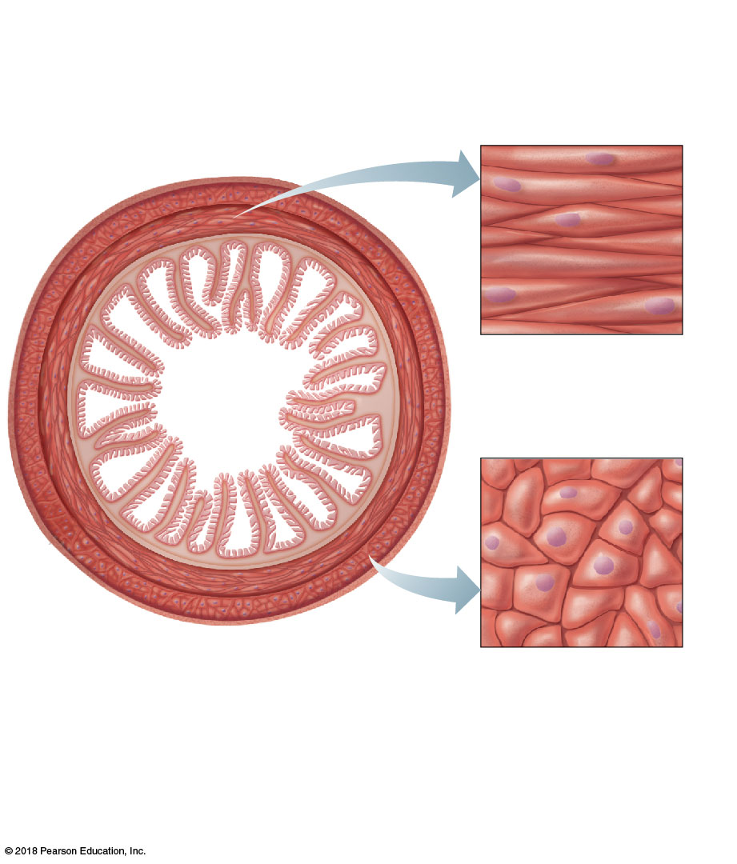
Figure 6.2a Arrangement of smooth and cardiac muscle cells.
Circular layer
of smooth muscle (longitudinal view of cells)
Mucosa
Submucosa
Longitudinal layer of smooth muscle (cross-sectional view of cells)
(a)
© 2018 Pearson Education, Inc.

Slide 13
Muscle Types
Cardiac muscle
Striations
Involuntary
Found only in the walls of the heart
Uninucleate
Branching cells joined by gap junctions called intercalated discs
Contracts at a steady rate set by pacemaker

Slide 14
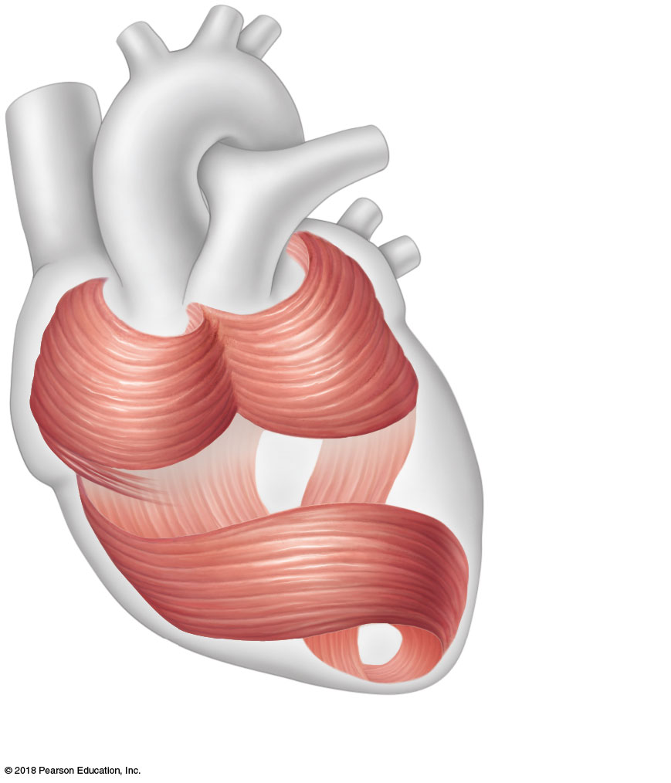
Figure 6.2b Arrangement of smooth and cardiac muscle cells.
Cardiac muscle bundles
(b)
© 2018 Pearson Education, Inc.

Slide 15
Muscle Functions
Whereas all muscle types produce movement, skeletal muscle has three other important roles:
Maintain posture and body position
Stabilize joints
Generate heat

Slide 16
Microscopic Anatomy of Skeletal Muscle
Sarcolemma—specialized plasma membrane
Myofibrils—long organelles inside muscle cell
Light (I) bands and dark (A) bands give the muscle its striated (banded) appearance

Slide 17
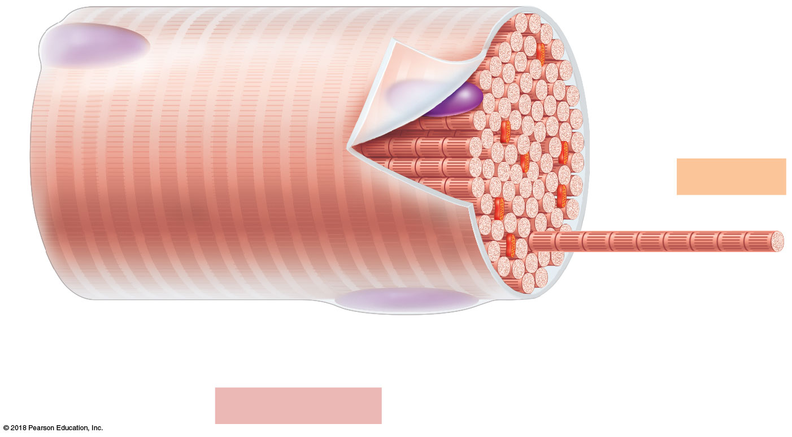
Figure 6.3a Anatomy of a skeletal muscle fiber (cell).
Sarcolemma
Myofibril
Dark
(A) band
Light
(I) band
Nucleus
(a) Segment of a muscle fiber (cell)
© 2018 Pearson Education, Inc.

Slide 18
Microscopic Anatomy of Skeletal Muscle
Banding pattern of myofibrils
I band = light band
Contains only thin filaments
Z disc is a midline interruption
A band = dark band
Contains the entire length of the thick filaments
H zone is a lighter central area
M line is in center of H zone

Slide 19
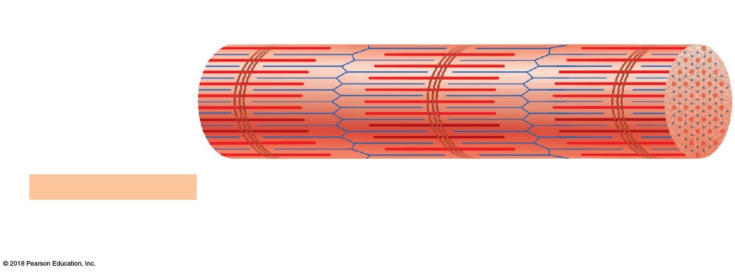
Figure 6.3b Anatomy of a skeletal muscle fiber (cell).
Z disc
H zone
Z disc
Thin (actin) myofilament
Thick (myosin)
myofilament
(b) Myofibril or fibril (complex organelle composed of bundles of myofilaments)
I band
A band
I band
M line
© 2018 Pearson Education, Inc.

Slide 20
Microscopic Anatomy of Skeletal Muscle
Sarcomere—contractile unit of a muscle fiber
Structural and functional unit of skeletal muscle
Organization of the sarcomere
Myofilaments produce banding (striped) pattern
Thick filaments = myosin filaments
Thin filaments = actin filaments

Slide 21
Microscopic Anatomy of Skeletal Muscle
Thick filaments = myosin filaments
Composed of the protein myosin
Contain ATPase enzymes to split ATP to release energy for muscle contractions
Possess projections known as myosin heads
Myosin heads are known as cross bridges when they link thick and thin filaments during contraction

Slide 22
Microscopic Anatomy of Skeletal Muscle
Thin filaments = actin filaments
Composed of the contractile protein actin
Actin is anchored to the Z disc
At rest, within the A band there is a zone that lacks actin filaments called the H zone
During contraction, H zones disappear as actin and myosin filaments overlap

Slide 23
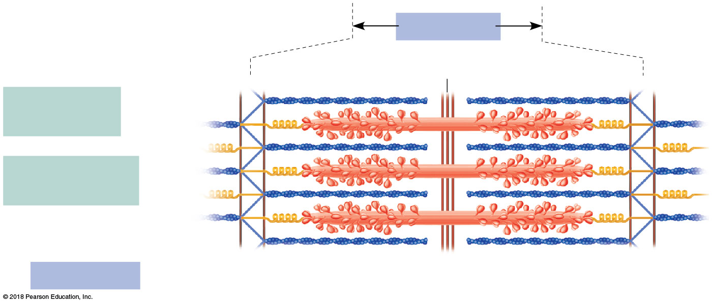
Figure 6.3c Anatomy of a skeletal muscle fiber (cell).
Sarcomere
M line
Z disc
Z disc
Thin (actin) myofilament
Thick (myosin) myofilament
(c) Sarcomere (segment of a myofibril)
© 2018 Pearson Education, Inc.

Slide 24
Microscopic Anatomy of Skeletal Muscle
Sarcoplasmic reticulum (SR)
Specialized smooth endoplasmic reticulum
Surrounds the myofibril
Stores and releases calcium

Slide 25
Stimulation and Contraction of Single Skeletal Muscle Cells
Special functional properties of skeletal muscles
Irritability (also called responsiveness)—ability to receive and respond to a stimulus
Contractility—ability to forcibly shorten when an adequate stimulus is received
Extensibility—ability of muscle cells to be stretched
Elasticity—ability to recoil and resume resting length after stretching

Slide 26
The Nerve Stimulus and Action Potential
Skeletal muscles must be stimulated by a motor neuron (nerve cell) to contract
Motor unit—one motor neuron and all the skeletal muscle cells stimulated by that neuron

Slide 27
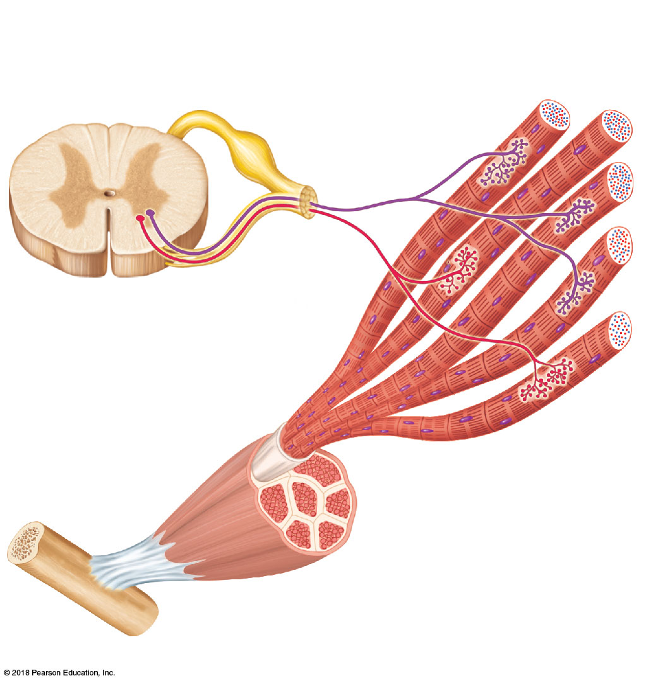
Figure 6.4a Motor units.
Axon terminals at neuromuscular junctions
Spinal cord
Motor unit 1
Motor
unit 2
Nerve
Axon of motor neuron
Motor neuron cell bodies
Muscle
Muscle fibers
(a)
© 2018 Pearson Education, Inc.

Slide 28
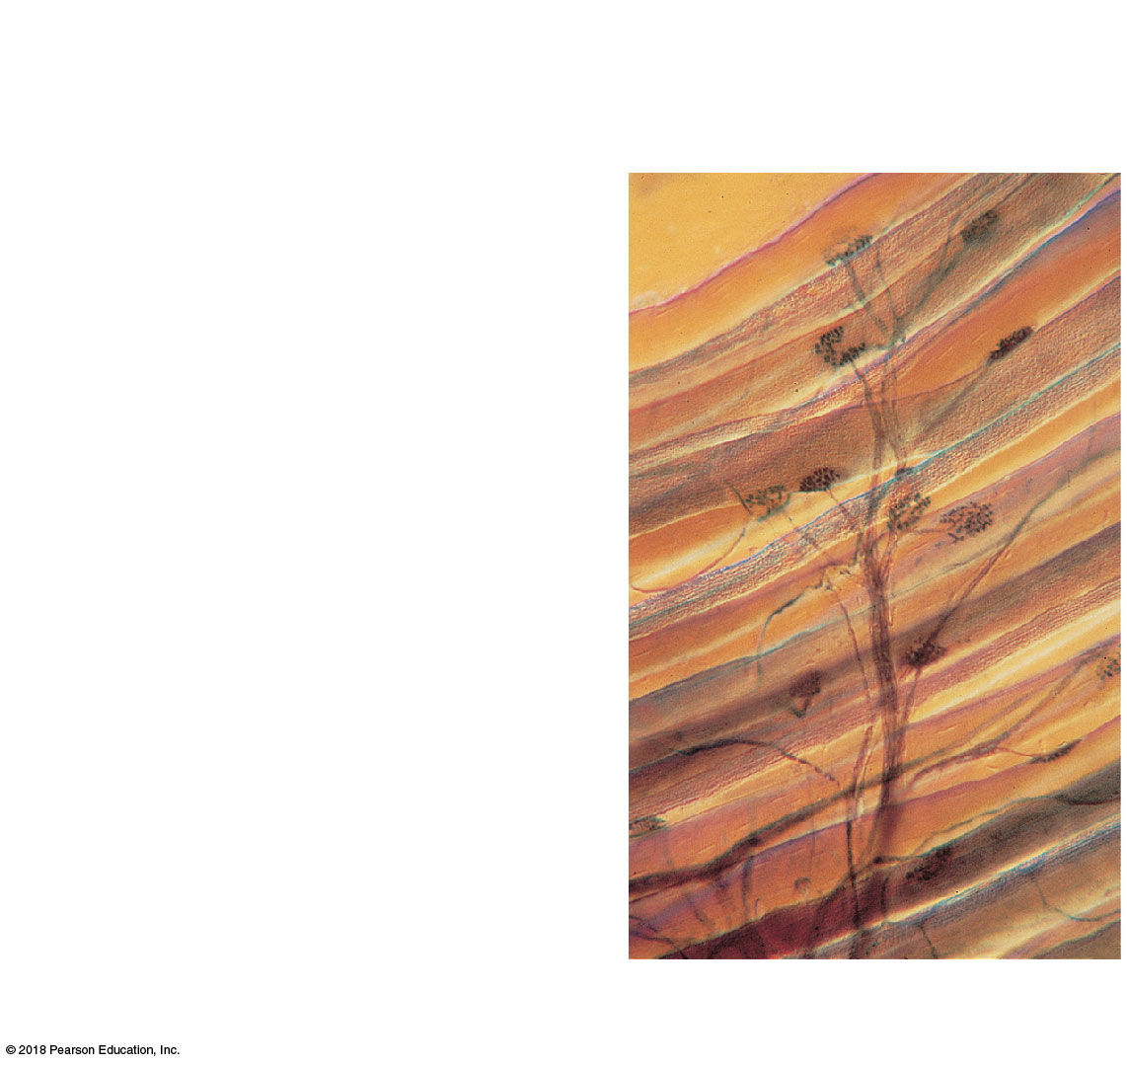
Figure 6.4b Motor units.
Axon terminals at neuromuscular junctions
Muscle fibers
Branching axon to motor unit
(b)
© 2018 Pearson Education, Inc.

Slide 29
The Nerve Stimulus and Action Potential
Neuromuscular junction
Association site of axon terminal of the motor neuron and sarcolemma of a muscle
Neurotransmitter
Chemical released by nerve upon arrival of nerve impulse in the axon terminal
Acetylcholine (ACh) is the neurotransmitter that stimulates skeletal muscle

Slide 30
The Nerve Stimulus and Action Potential
Synaptic cleft
Gap between nerve and muscle filled with interstitial fluid
Although very close, the nerve and muscle do not make contact

Slide 31
The Nerve Stimulus and Action Potential
When a nerve impulse reaches the axon terminal of the motor neuron,
Step 1: Calcium channels open, and calcium ions enter the axon terminal
Step 2: Calcium ion entry causes some synaptic vesicles to release acetylcholine (ACh)
Step 3: ACh diffuses across the synaptic cleft and attaches to receptors on the sarcolemma of the muscle cell

Slide 32
The Nerve Stimulus and Action Potential
Step 4: If enough ACh is released, the sarcolemma becomes temporarily more permeable to sodium ions (Na⁺)
Potassium ions (K⁺) diffuse out of the cell
More sodium ions enter than potassium ions leave
Establishes an imbalance in which interior has more positive ions (depolarization), thereby opening more Na⁺ channels

Slide 33
The Nerve Stimulus and Action Potential
Step 5: Depolarization opens more sodium channels that allow sodium ions to enter the cell
An action potential is created
Once begun, the action potential is unstoppable
Conducts the electrical impulse from one end of the cell to the other
Step 6: Acetylcholinesterase (AChE) breaks down acetylcholine into acetic acid and choline
AChE ends muscle contraction
A single nerve impulse produces only one contraction

Slide 34
The Nerve Stimulus and Action Potential
Cell returns to its resting state when:
Potassium ions (K⁺) diffuse out of the cell
Sodium-potassium pump moves sodium and potassium ions back to their original positions

Slide 35
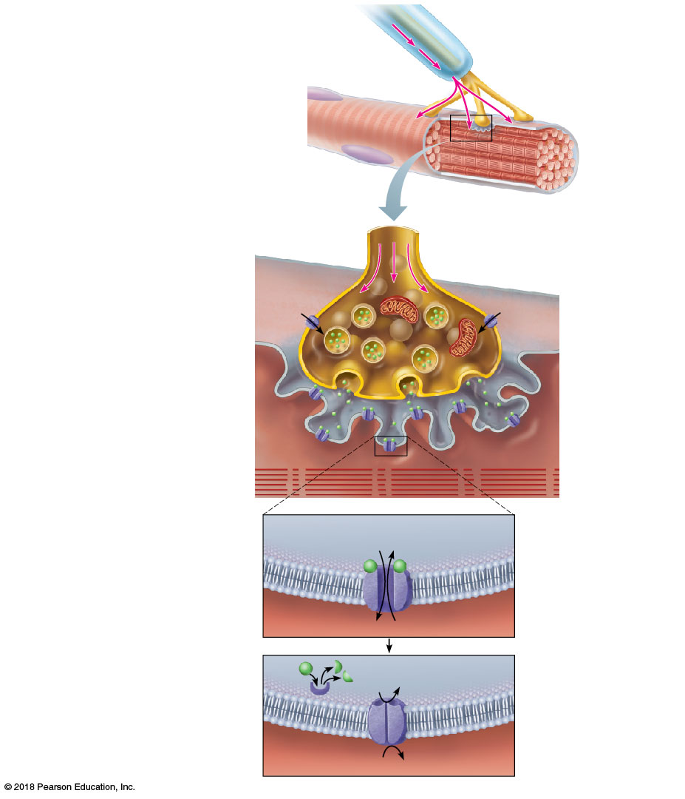
Figure 6.5 Events at the neuromuscular junction.
Slide 1
Nerve impulse Nucleus
Myelinated axon of motor neuron
Axon terminal of neuromuscular junction
Sarcolemma of the muscle fiber
1
Synaptic vesicle containing ACh
Nerve impulse reaches axon terminal of motor neuron.
Axon terminal of motor neuron
Mitochondrion
Calcium (Ca²⁺) channels open, and Ca²⁺ enters the axon terminal.
Ca²⁺
2
Ca²⁺
Synaptic
cleft
Sarcolemma
Fusing synaptic
vesicle
Sarcoplasm
of muscle fiber
3
Ca²⁺ entry causes some synaptic vesicles to release their contents (the neurotransmitter acetylcholine) by exocytosis.
ACh
ACh receptor
Folds of
sarcolemma
Acetylcholine diffuses across the synaptic cleft and binds to receptors in the sarcolemma.
4
5
Na⁺
K⁺
Ion channel in sarcolemma opens; ions pass.
ACh binds and opens channels that allow simultaneous passage of Na⁺ into the muscle fiber and K⁺ out of the muscle fiber. More Na⁺ ions enter than K⁺ ions leave, producing a local change in the electrical conditions of the membrane (depolarization). This eventually leads to an action potential.
ACh
Degraded ACh Na⁺
Ion channel closes; ions cannot pass.
The enzyme acetylcholinesterase breaks down ACh in the synaptic cleft, ending the process.
6
Acetylcholinesterase
K⁺

Slide 36
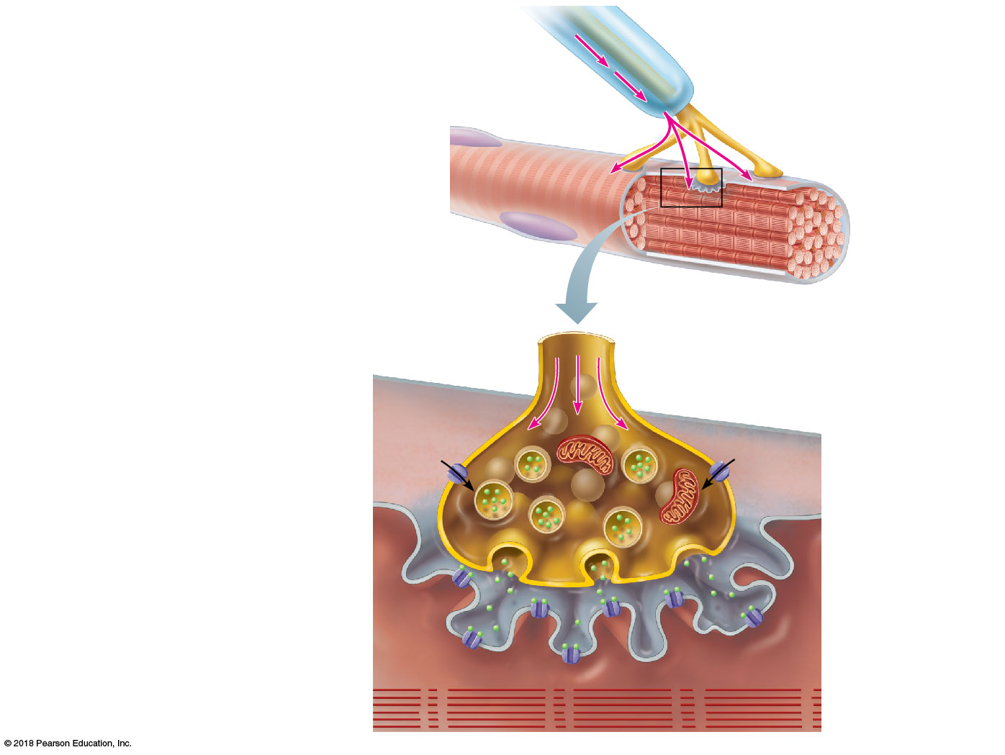
Figure 6.5 Events at the neuromuscular junction.
Slide 2
Myelinated axon
of motor neuron
Nerve
impulse
Nucleus
Axon terminal of
neuromuscular
junction
Sarcolemma of
the muscle fiber
Synaptic vesicle containing ACh
Nerve impulse reaches axon
terminal of motor neuron.
1
Axon terminal of motor neuron
Mitochondrion
Ca²⁺
Ca²⁺
Synaptic
cleft
Sarcolemma
Fusing synaptic
vesicle
Sarcoplasm
of muscle fiber
ACh
ACh
receptor
Folds of
sarcolemma

Slide 37
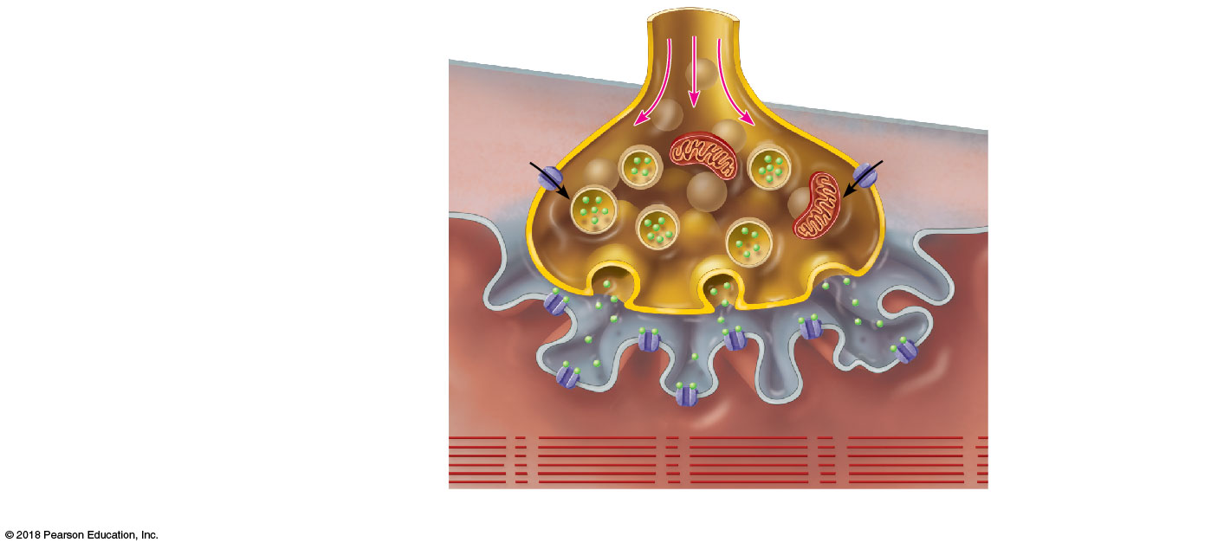
Figure 6.5 Events at the neuromuscular junction.
Slide 3
Synaptic vesicle containing ACh
Nerve impulse reaches axon
terminal of motor neuron.
1
Axon terminal of motor neuron
Mitochondrion
Calcium (Ca²⁺) channels
open, and Ca²⁺ enters the
axon terminal.
Ca²⁺
Ca²⁺
2
Synaptic
cleft
Sarcolemma
Fusing synaptic
vesicle
Sarcoplasm
ACh
of muscle fiber
ACh
receptor
Folds of
sarcolemma

Slide 38
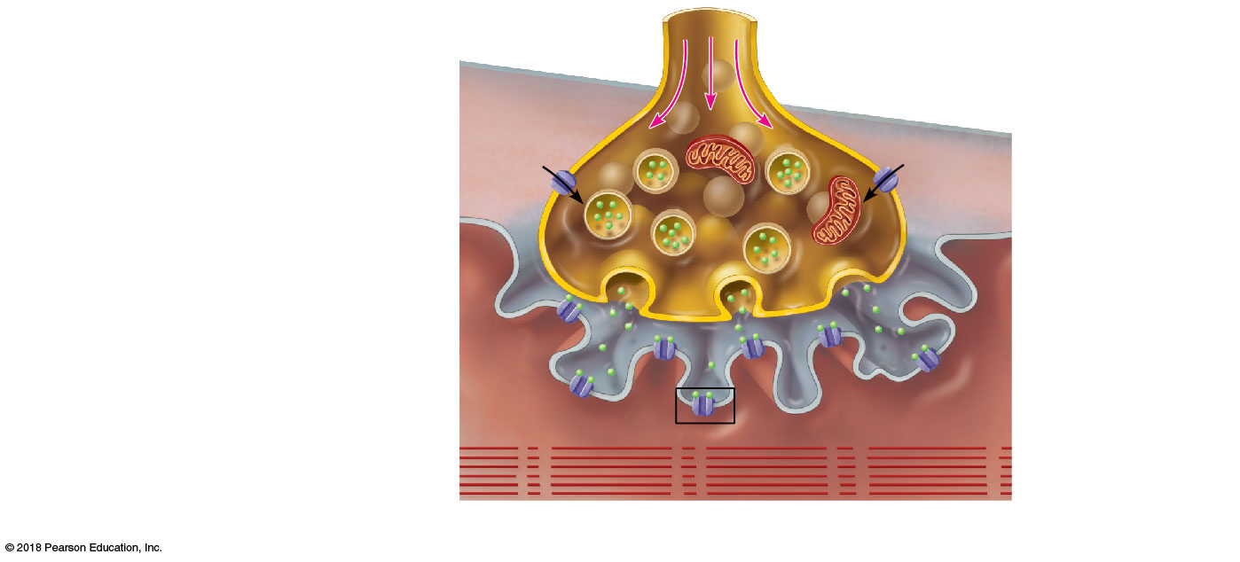
Figure 6.5 Events at the neuromuscular junction.
Slide 4
Synaptic vesicle containing ACh
Nerve impulse reaches axon
terminal of motor neuron.
1
Axon terminal of motor neuron
Mitochondrion
Calcium (Ca²⁺) channels
open, and Ca²⁺ enters the
axon terminal.
Ca²⁺
Ca²⁺
2
Synaptic
cleft
Sarcolemma
Fusing synaptic
vesicle
Sarcoplasm
Ca²⁺ entry causes some
synaptic vesicles to release their
contents (the neurotransmitter
acetylcholine) by exocytosis.
of muscle fiber
3
ACh
ACh
receptor
Folds of
sarcolemma

Slide 39
Figure 6.5 Events at the neuromuscular junction.
Slide 5
Synaptic vesicle containing ACh
Nerve impulse reaches axon
terminal of motor neuron.
1
Axon terminal of motor neuron
Mitochondrion
Calcium (Ca²⁺) channels
open, and Ca²⁺ enters the
axon terminal.
Ca²⁺
Ca²⁺
2
Synaptic
cleft
Sarcolemma
Fusing synaptic
vesicle
Sarcoplasm
Ca²⁺ entry causes some
synaptic vesicles to release their
contents (the neurotransmitter
acetylcholine) by exocytosis.
of muscle fiber
3
ACh
ACh
receptor
Folds of
sarcolemma
4
Acetylcholine diffuses across
the synaptic cleft and binds to
receptors in the sarcolemma.

Slide 40
Figure 6.5 Events at the neuromuscular junction.
Slide 6
Na⁺ K⁺
Ion channel in
sarcolemma opens;
ions pass.
5
ACh binds and opens channels
that allow simultaneous passage
of Na⁺ into the muscle fiber and
K⁺ out of the muscle fiber. More
Na⁺ ions enter than K⁺ ions leave,
producing a local change in the
electrical conditions of the
membrane (depolarization). This
eventually leads to an action
potential.

Slide 41
Figure 6.5 Events at the neuromuscular junction.
Slide 7
ACh
Degraded ACh
Ion channel closes; ions cannot pass.
Na⁺
The enzyme acetylcholinesterase breaks down ACh in the synaptic cleft, ending the process.
6
Acetylcholinesterase
K⁺

Slide 42
Figure 6.5 Events at the neuromuscular junction.
Slide 8
Nerve impulse Nucleus
Myelinated axon of motor neuron
Axon terminal of neuromuscular junction
Sarcolemma of the muscle fiber
1
Synaptic vesicle containing ACh
Nerve impulse reaches axon terminal of motor neuron.
Axon terminal of motor neuron
Mitochondrion
Calcium (Ca²⁺) channels open, and Ca²⁺ enters the axon terminal.
Ca²⁺
2
Ca²⁺
Synaptic
cleft
Sarcolemma
Fusing synaptic
vesicle
Sarcoplasm
of muscle fiber
3
Ca²⁺ entry causes some synaptic vesicles to release their contents (the neurotransmitter acetylcholine) by exocytosis.
ACh
ACh receptor
Folds of
sarcolemma
Acetylcholine diffuses across the synaptic cleft and binds to receptors in the sarcolemma.
4
5
Na⁺
K⁺
Ion channel in sarcolemma opens; ions pass.
ACh binds and opens channels that allow simultaneous passage of Na⁺ into the muscle fiber and K⁺ out of the muscle fiber. More Na⁺ ions enter than K⁺ ions leave, producing a local change in the electrical conditions of the membrane (depolarization). This eventually leads to an action potential.
ACh
Degraded ACh Na⁺
Ion channel closes; ions cannot pass.
The enzyme acetylcholinesterase breaks down ACh in the synaptic cleft, ending the process.
6
Acetylcholinesterase
K⁺

Slide 43
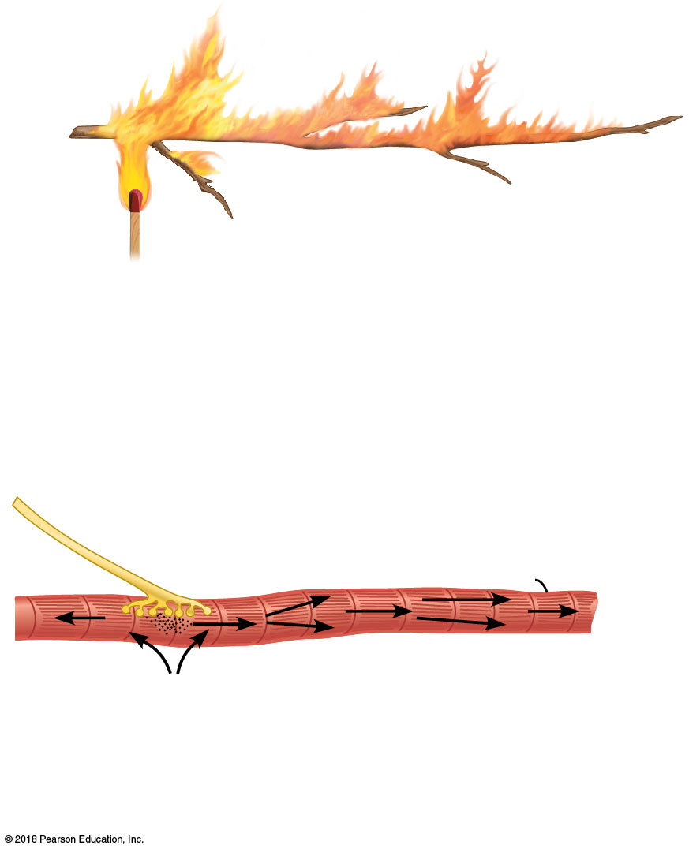
Figure 6.6 Comparing the action potential to a flame consuming a dry twig.
Small twig
Match flame
Flame ignites the twig.
Flame spreads rapidly along the twig.
1
2
(a)
Neuromuscular junction
Muscle fiber (cell)
Nerve fiber
Striations
Na⁺ diffuses into the cell.
1
Action potential spreads rapidly along the sarcolemma.
2
(b)
© 2018 Pearson Education, Inc.

Slide 44
A&P Flix™: Events at the Neuromuscular Junction
© 2018 Pearson Education, Inc.

Slide 45
Mechanism of Muscle Contraction: The Sliding Filament Theory
What causes filaments to slide?
Calcium ions (Ca²⁺) bind regulatory proteins on thin filaments and expose myosin-binding sites, allowing the myosin heads on the thick filaments to attach
Each cross bridge pivots, causing the thin filaments to slide toward the center of the sarcomere
Contraction occurs, and the cell shortens
During a contraction, a cross bridge attaches and detaches several times
ATP provides the energy for the sliding process, which continues as long as calcium ions are present

Slide 46
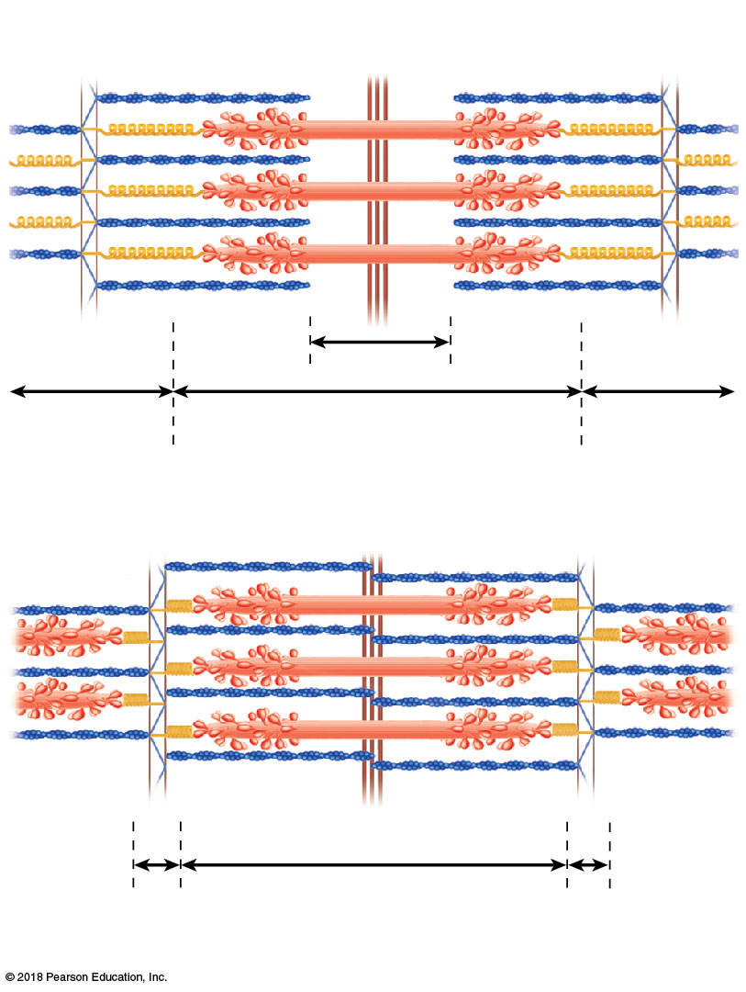
Figure 6.7 Diagrammatic views of a sarcomere.
Myosin
Actin
Z
H
Z
I
A
I
(a) Relaxed sarcomere
Z
Z
I
A
I
(b) Fully contracted sarcomere
© 2018 Pearson Education, Inc.

Slide 47
Figure 6.8a Schematic representation of contraction mechanism: the sliding filament theory.
Regulatory proteins
In a relaxed muscle fiber, the regulatory proteins forming part of the actin myofilaments prevent myosin binding (see a). When an action potential (AP) sweeps along its sarcolemma and a muscle fiber is excited, calcium ions (Ca²⁺) are released from intracellular storage areas (the sacs of the sarcoplasmic reticulum).
Myosin myofilament
Actin myofilament
(a)
© 2018 Pearson Education, Inc.

Slide 48
Figure 6.8b Schematic representation of contraction mechanism: the sliding filament theory.
Myosin-binding site
Ca²⁺
The flood of calcium acts as the final trigger for contraction, because as calcium binds to the regulatory proteins on the actin filaments, the proteins undergo a change in both their shape and their position on the thin filaments. This action exposes myosin-binding sites on the actin, to which the myosin heads can attach (see b), and the myosin heads immediately begin seeking out binding sites.
Upper part of thick filament only
(b)
© 2018 Pearson Education, Inc.

Slide 49
Figure 6.8c Schematic representation of contraction mechanism: the sliding filament theory.
The free myosin heads are “cocked,” much like an
oar ready to be pulled on for rowing. Myosin attachment to actin causes the myosin heads to snap (pivot) toward the center of the sarcomere in a rowing motion. When this happens, the thin filaments are slightly pulled toward the center of the sarcomere
(see c). ATP provides the energy needed to release and recock each myosin head so that it is ready to attach to a binding site farther along the thin filament.
(c)
© 2018 Pearson Education, Inc.

Slide 50
A&P Flix™: The Cross Bridge Cycle

Slide 51
Contraction of a Skeletal Muscle as a Whole
Graded responses
Muscle fiber contraction is “all-or-none,” meaning it will contract to its fullest when stimulated adequately
Within a whole skeletal muscle, not all fibers may be stimulated during the same interval
Different combinations of muscle fiber contractions may give differing responses
Graded responses—different degrees of skeletal muscle shortening

Slide 52
Contraction of a Skeletal Muscle as a Whole
Graded responses can be produced in two ways
By changing the frequency of muscle stimulation
By changing the number of muscle cells being stimulated at one time

Slide 53
Contraction of a Skeletal Muscle as a Whole
Muscle response to increasingly rapid stimulation
Muscle twitch
Single, brief, jerky contraction
Not a normal muscle function

Slide 54
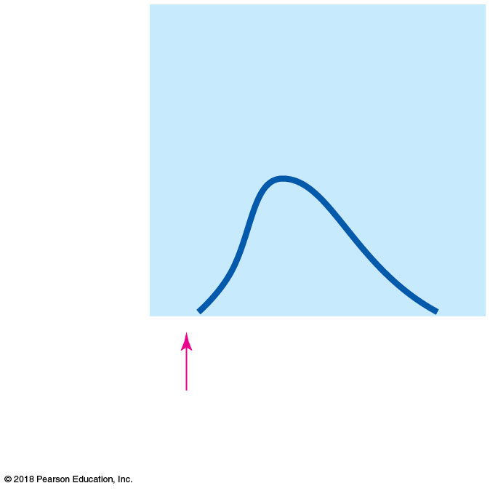
Figure 6.9a A whole muscle’s response to different stimulation rates.
Tension (g)
(Stimuli)
(a) Twitch
© 2018 Pearson Education, Inc.

Slide 55
Contraction of a Skeletal Muscle as a Whole
Muscle response to increasingly rapid stimulation (continued)
In most types of muscle activity, nerve impulses are delivered at a rapid rate
As a result, contractions are “summed” (added) together, and one contraction is immediately followed by another

Slide 56
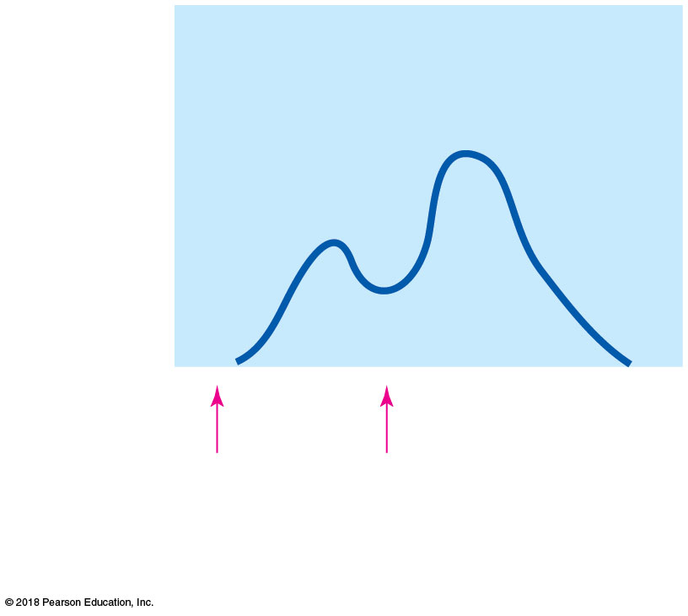
Figure 6.9b A whole muscle’s response to different stimulation rates.
Tension (g)
(Stimuli)
(b) Summing of contractions
© 2018 Pearson Education, Inc.

Slide 57
Contraction of a Skeletal Muscle as a Whole
Muscle response to increasingly rapid stimulation (continued)
When stimulations become more frequent, muscle contractions get stronger and smoother
The muscle now exhibits unfused (incomplete) tetanus

Slide 58
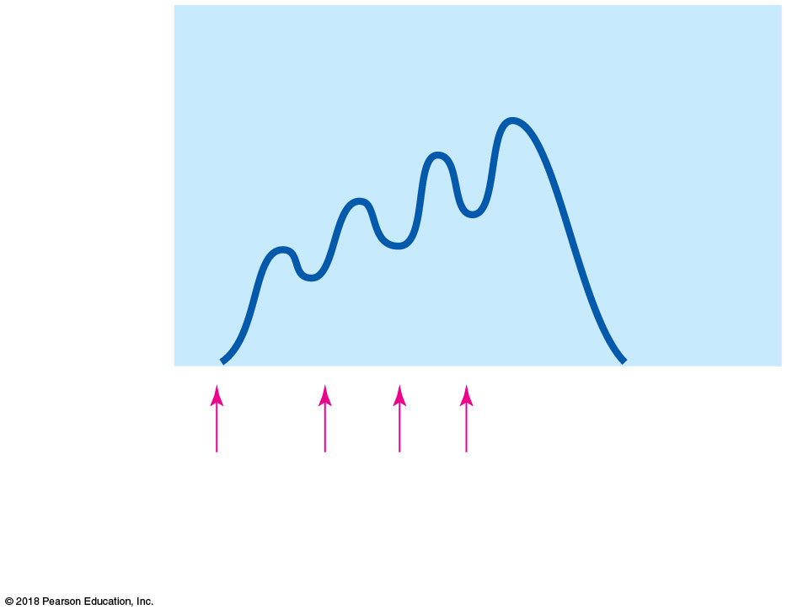
Figure 6.9c A whole muscle’s response to different stimulation rates.
Tension (g)
(Stimuli)
(c) Unfused (incomplete) tetanus
© 2018 Pearson Education, Inc.

Slide 59
Contraction of a Skeletal Muscle as a Whole
Muscle response to increasingly rapid stimulation (continued)
Fused (complete) tetanus is achieved when the muscle is stimulated so rapidly that no evidence of relaxation is seen
Contractions are smooth and sustained

Slide 60
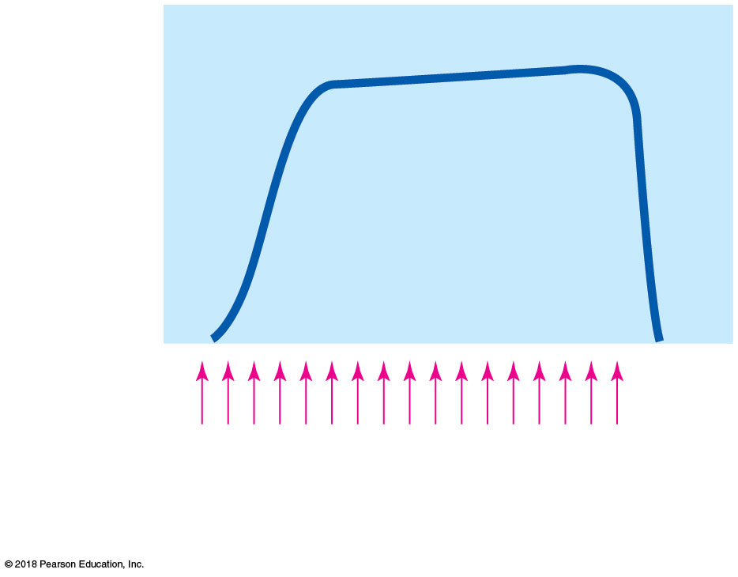
Figure 6.9d A whole muscle’s response to different stimulation rates.
Tension (g)
(Stimuli)
(d) Fused (complete) tetanus
© 2018 Pearson Education, Inc.

Slide 61
Contraction of a Skeletal Muscle as a Whole
Muscle response to stronger stimuli
Muscle force depends upon the number of fibers stimulated
Contraction of more fibers results in greater muscle tension
When all motor units are active and stimulated, the muscle contraction is as strong as it can get

Slide 62
Providing Energy for Muscle Contraction
ATP
Only energy source that can be used to directly power muscle contraction
Stored in muscle fibers in small amounts that are quickly used up
After this initial time, other pathways must be utilized to produce ATP

Slide 63
© 2018 Pearson Education, Inc.

Slide 64
Providing Energy for Muscle Contraction
Three pathways to regenerate ATP
Direct phosphorylation of ADP by creatine phosphate
Aerobic pathway
Anaerobic glycolysis and lactic acid formation

Slide 65
Providing Energy for Muscle Contraction
Direct phosphorylation of ADP by creatine phosphate (CP)—fastest
Muscle cells store CP, a high-energy molecule
After ATP is depleted, ADP remains
CP transfers a phosphate group to ADP to regenerate ATP
CP supplies are exhausted in less than 15 seconds
1 ATP is produced per CP molecule

Slide 66
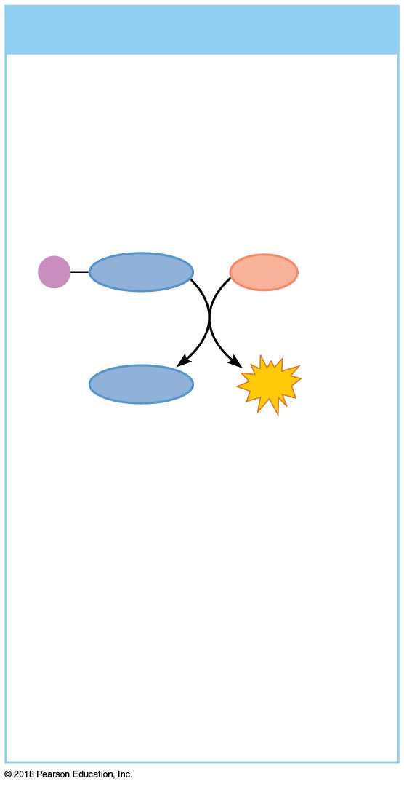
Figure 6.10a Methods of regenerating ATP during muscle activity.
(a) Direct phosphorylation
Coupled reaction of creatine phosphate (CP) and ADP
Energy source: CP
P
Creatine
ADP
Creatine
ATP
Oxygen use: None
Products: 1 ATP per CP, creatine
Duration of energy provision: 15 seconds
© 2018 Pearson Education, Inc.

Slide 67
Providing Energy for Muscle Contraction
Aerobic respiration
Supplies ATP at rest and during light/moderate exercise
A series of metabolic pathways, called oxidative phosphorylation, use oxygen and occur in the mitochondria
Glucose is broken down to carbon dioxide and water, releasing energy (about 32 ATP)
This is a slower reaction that requires continuous delivery of oxygen and nutrients

Slide 68
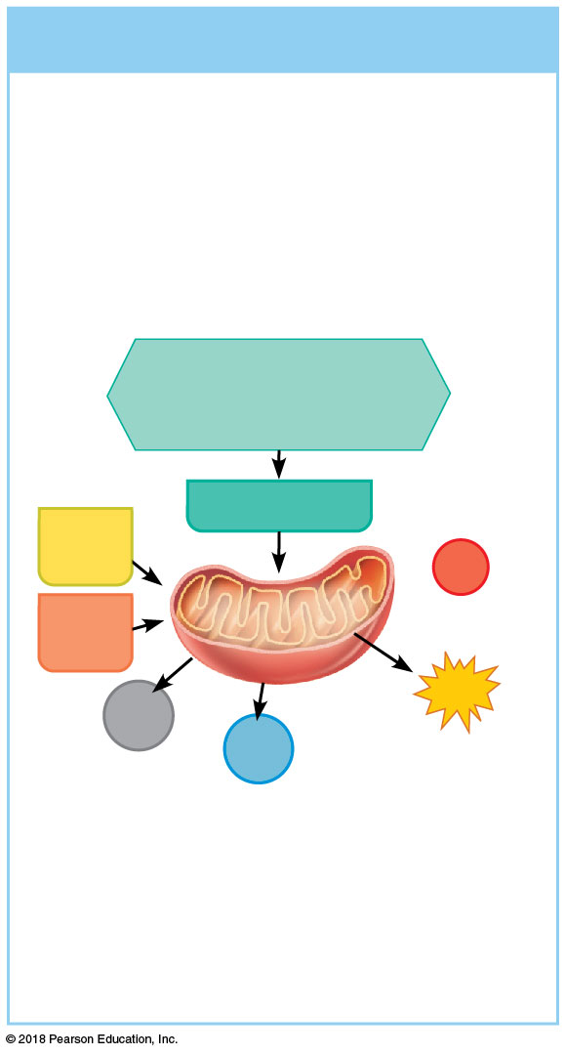
Figure 6.10b Methods of regenerating ATP during muscle activity.
(b) Aerobic pathway
Aerobic cellular respiration
Energy source: glucose; pyruvic acid; free fatty acids from adipose tissue; amino acids from protein catabolism
Glucose (from glycogen breakdown or delivered from blood)
Pyruvic acid
Fatty acids
O₂
Aerobic respiration
in mitochondria
Amino
acids
Aerobic respiration
in mitochondria
32
ATP
CO₂
H₂O
net gain per glucose
Oxygen use: Required
Products: 32 ATP per glucose,
CO₂, H₂O
Duration of energy provision: Hours
© 2018 Pearson Education, Inc.

Slide 69
Providing Energy for Muscle Contraction
Anaerobic glycolysis and lactic acid formation
Reaction that breaks down glucose without oxygen
Glucose is broken down to pyruvic acid to produce about 2 ATP
Pyruvic acid is converted to lactic acid, which causes muscle soreness
This reaction is not as efficient, but it is fast
Huge amounts of glucose are needed

Slide 70
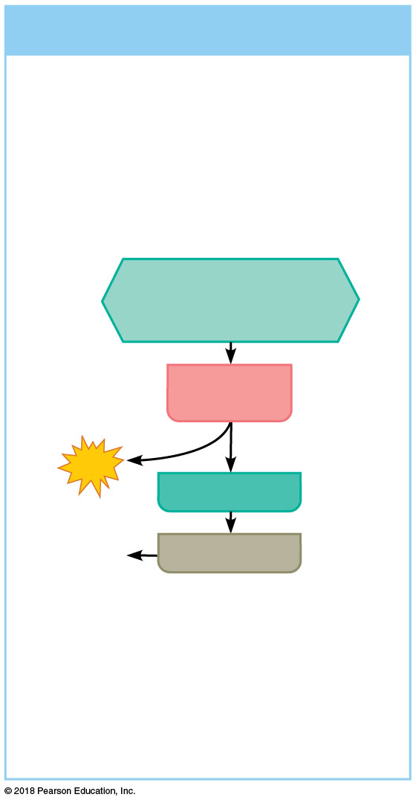
Figure 6.10c Methods of regenerating ATP during muscle activity.
(c) Anaerobic pathway
Glycolysis and lactic acid
formation
Energy source: glucose
Glucose (from glycogen breakdown or delivered from blood)
Glycolysis
in cytosol
2
ATP
Pyruvic acid
net gain
Released
to blood
Lactic acid
Oxygen use: None
Products: 2 ATP per glucose,
lactic acid
Duration of energy provision: 40 seconds, or slightly more
© 2018 Pearson Education, Inc.

Slide 71
Muscle Fatigue and Oxygen Deficit
If muscle activity is strenuous and prolonged, muscle fatigue occurs
Suspected factors that contribute to muscle fatigue include:
Ion imbalances (Ca²⁺, K⁺)
Oxygen deficit and lactic acid accumulation
Decrease in energy (ATP) supply
After exercise, the oxygen deficit is repaid by rapid, deep breathing

Slide 72
Types of Muscle Contractions
Isotonic contractions
Myofilaments are able to slide past each other during contractions
The muscle shortens, and movement occurs
Example: bending the knee; lifting weights, smiling
Isometric contractions
Muscle filaments are trying to slide, but the muscle is pitted against an immovable object
Tension increases, but muscles do not shorten
Example: pushing your palms together in front of you

Slide 73
Muscle Tone
Muscle tone
State of continuous partial contractions
Result of different motor units being stimulated in a systematic way
Muscle remains firm, healthy, and constantly ready for action

Slide 74
Effect of Exercise on Muscles
Exercise increases muscle size, strength, and endurance
Aerobic (endurance) exercise (biking, jogging) results in stronger, more flexible muscles with greater resistance to fatigue
Makes body metabolism more efficient
Improves digestion, coordination
Resistance (isometric) exercise (weight lifting) increases muscle size and strength
Individual muscle fibers enlarge

Slide 75
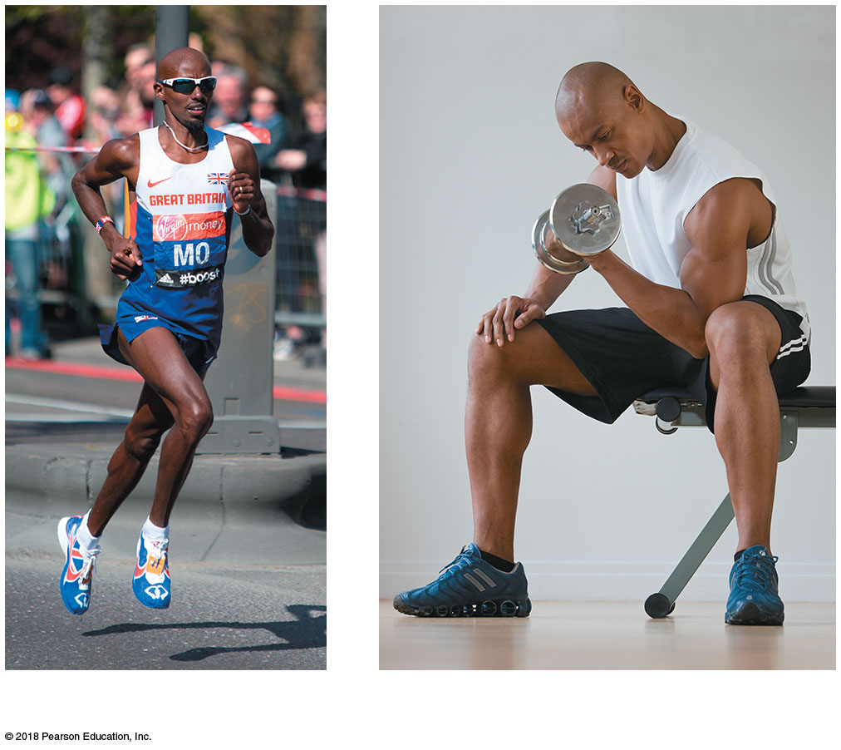
Figure 6.11 The effects of aerobic training versus strength training.
(a)
(b)
© 2018 Pearson Education, Inc.

