Slide 1
Chapter 50
Sensory and Motor Mechanisms
Lecture Presentations by Nicole Tunbridge and Kathleen Fitzpatrick
© 2017 Pearson Education, Inc.
Notes:
1

Slide 2
Sense and Sensibility
The star-nosed mole can detect and eat its prey in near total darkness in as little as 120 milliseconds
It uses the 11 pairs of appendages protruding from its nose to locate and capture prey through touch
Sensory processes convey information about an animal’s environment to its brain, and muscles and skeletons carry out movements as instructed by the brain

Slide 3
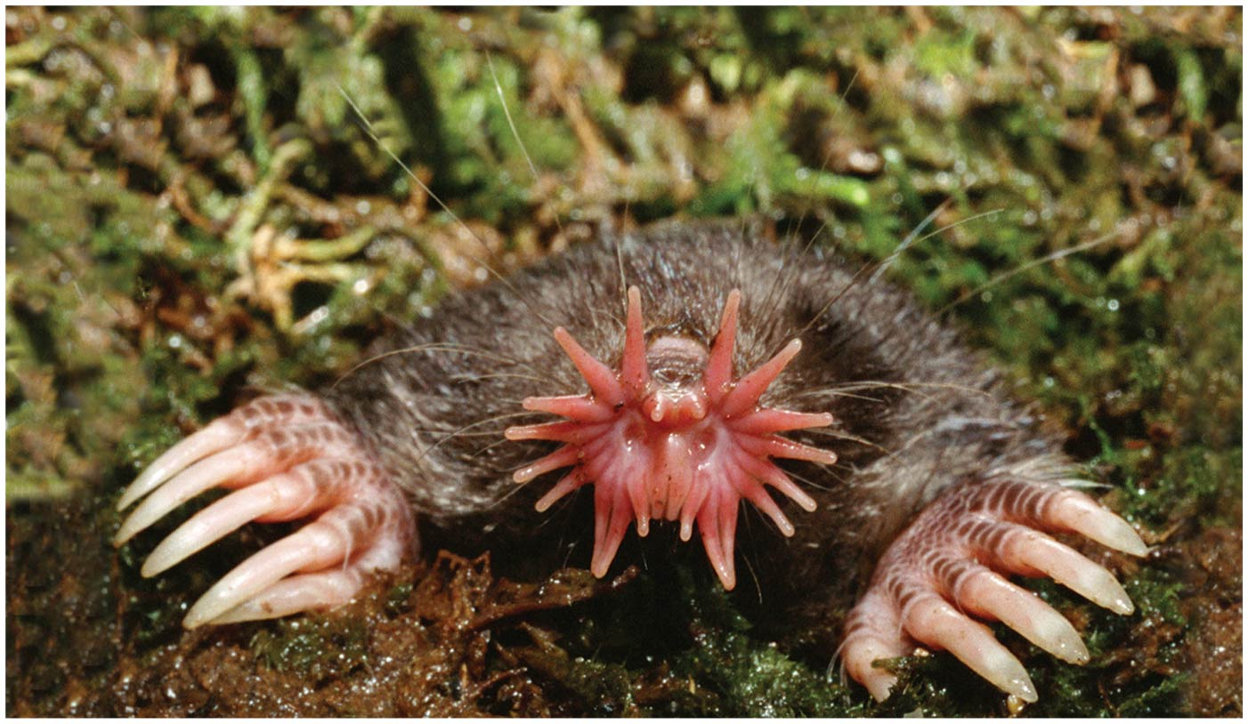
Figure 50.1 Of What Use is a Star-shaped Nose?
Notes:
Figure 50.1 Of what use is a star-shaped nose?

Slide 4
Concept 50.1: Sensory receptors transduce stimulus energy and transmit signals to the central nervous system
All stimuli represent forms of energy
A sensory receptor converts stimulus energy into a change in the membrane potential
When a stimulus is received and processed by the nervous system, a motor response may be generated
This may involve a simple reflex or more elaborate processing

Slide 5
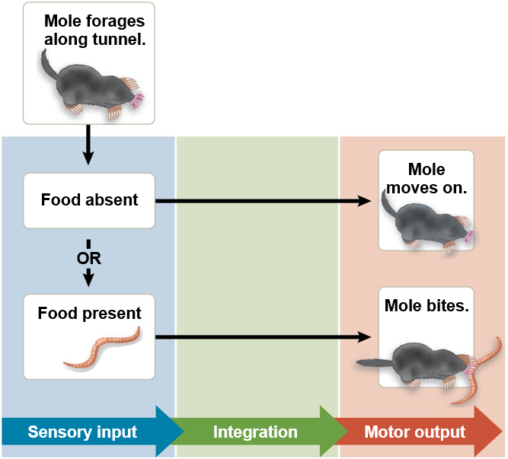
Figure 50.2 A Simple Response Pathway: Foraging by a Star-nosed Mole
Notes:
Figure 50.2 A simple response pathway: foraging by a star-nosed mole

Slide 6
Concept 50.1: Sensory receptors transduce stimulus energy and transmit signals to the central nervous system, Continued
Sensory pathways have four basic functions in common
Sensory reception
Transduction
Transmission
Perception

Slide 7
Sensory Reception and Transduction
A sensory pathway begins with sensory reception, detection of stimuli by sensory receptors
Sensory receptors are sensory cells or organs
They interact with stimuli, both inside and outside the body

Slide 8
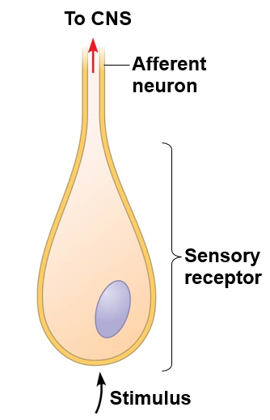
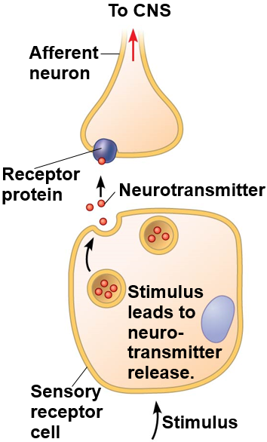
Figure 50.3 Categories of Sensory Receptors
Neuronal receptors: Receptor is afferent neuron.
Non-neuronal receptors: Receptor regulates afferent neuron.
Notes:
Figure 50.3 Categories of sensory receptors

Slide 9
Sensory Reception and Transduction, Continued
Sensory transduction is the conversion of stimulus energy into a change in the membrane potential of a sensory receptor
This change in membrane potential is called a receptor potential
Receptor potentials are graded potentials; their magnitude varies with the strength of the stimulus

Slide 10
Transmission
Sensory information travels through the nervous system as action potentials
Sensory receptors may be neurons or non-neuronal receptors
The size of a receptor potential increases with the intensity of the stimulus
In sensory neurons that spontaneously generate action potentials at a low rate, a stimulus changes how often an action potential is produced

Slide 11
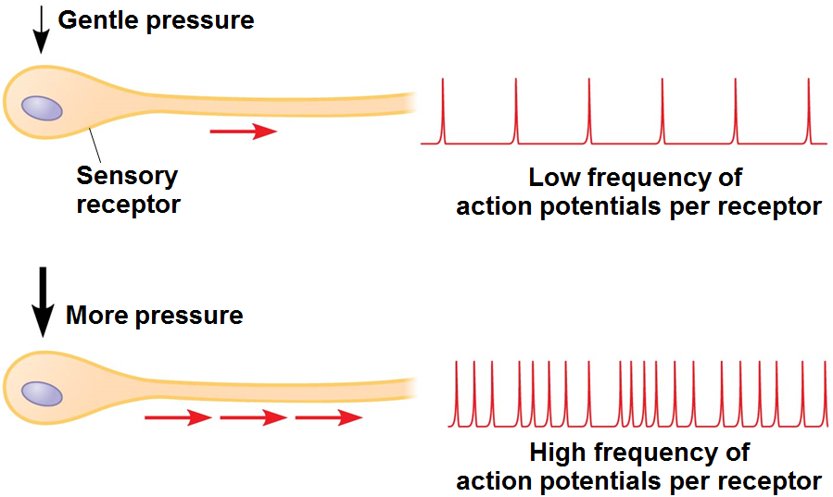
Figure 50.4 Coding of Stimulus Intensity by a Single Sensory Receptor
Notes:
Figure 50.4 Coding of stimulus intensity by a single sensory receptor

Slide 12
Transmission, Continued
Processing of sensory information can occur before, during, and after transmission of action potentials to the central nervous system (CNS)
Integration often begins as soon as the information is received

Slide 13
Perception
Perceptions are the brain’s construction of stimuli
Stimuli from different sensory receptors travel as action potentials along dedicated neural pathways
The brain distinguishes stimuli from different receptors based on the path by which the action potentials arrive

Slide 14
Amplification and Adaptation
Amplification is the strengthening of a sensory signal during transduction
Sensory adaptation is a decrease in responsiveness to continued stimulation

Slide 15
Types of Sensory Receptors
Based on energy transduced, sensory receptors fall into five categories
Mechanoreceptors
Chemoreceptors
Electromagnetic receptors
Thermoreceptors
Pain receptors

Slide 16
Mechanoreceptors
Mechanoreceptors sense physical deformation caused by forms of mechanical energy
They typically consist of ion channels linked to structures that end outside the cell, such as “hairs” (cilia)
The mammalian sense of touch relies on mechanoreceptors that are dendrites of sensory neurons

Slide 17
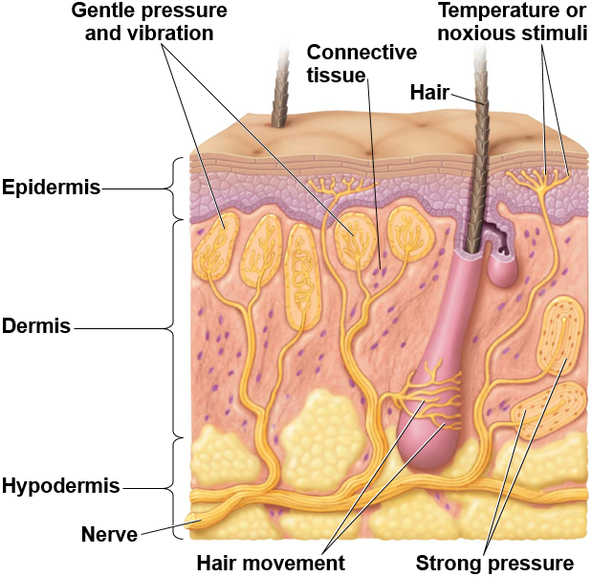
Figure 50.5 Sensory Receptors in Human Skin
Notes:
Figure 50.5 Sensory receptors in human skin

Slide 18
Chemoreceptors
Some chemoreceptors transmit information about the total solute concentration of a solution
Other chemoreceptors respond to individual kinds of molecules
When a stimulus molecule binds to a chemoreceptor, the chemoreceptor becomes more or less permeable to ions
The antennae of the male silkworm moth have very sensitive specific chemoreceptors

Slide 19
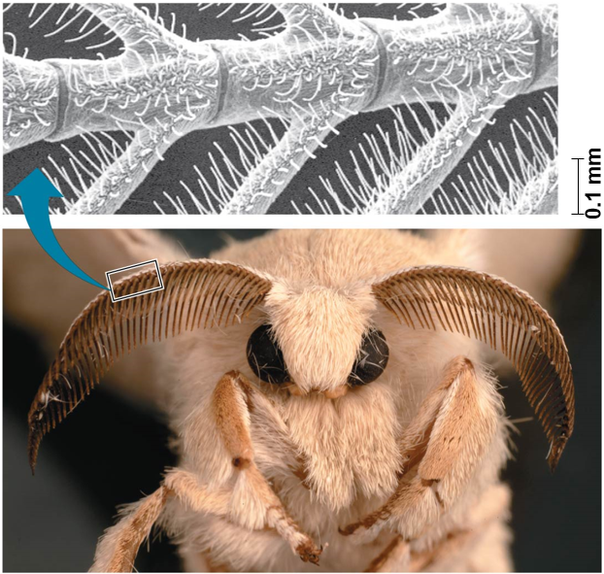
Figure 50.6 Chemoreceptors in an Insect
Notes:
Figure 50.6 Chemoreceptors in an insect

Slide 20
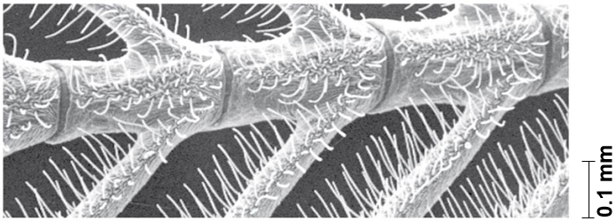
Figure 50.6a Chemoreceptors in an Insect (Part 1: Male Silkworm Moth Antennae, SEM)
Notes:
Figure 50.6a Chemoreceptors in an insect (part 1: male silkworm moth antennae, SEM)

Slide 21
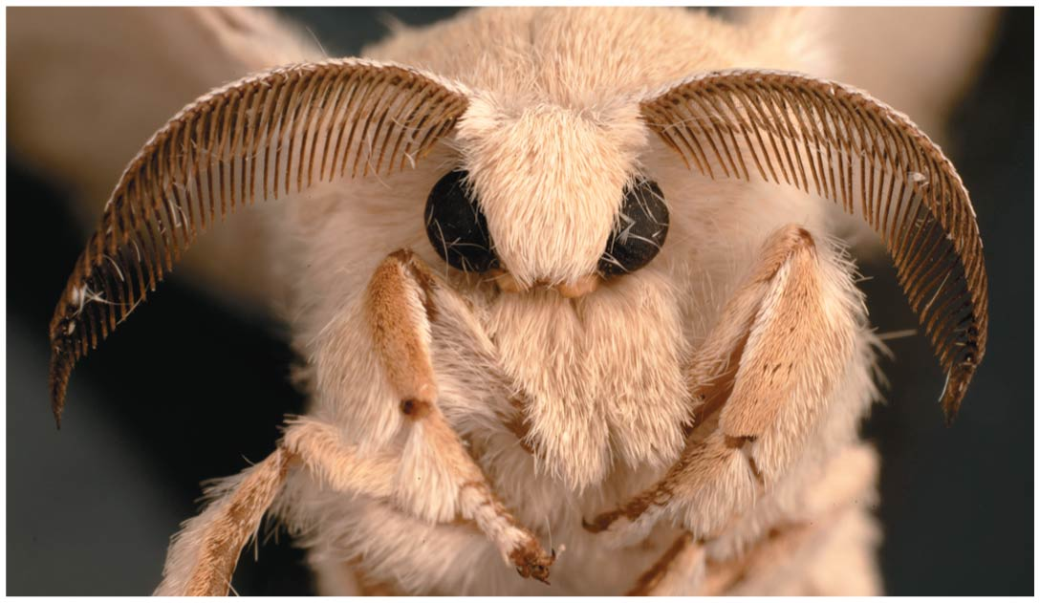
Figure 50.6b Chemoreceptors in an Insect (Part 2: Male Silkworm Moth)
Notes:
Figure 50.6b Chemoreceptors in an insect (part 2: male silkworm moth)

Slide 22
Electromagnetic Receptors
Electromagnetic receptors detect electromagnetic energy such as light, electricity, and magnetism
The platypus has electroreceptors on its bill that can detect the electric field generated by prey
Many animals apparently migrate using Earth’s magnetic field to orient themselves

Slide 23
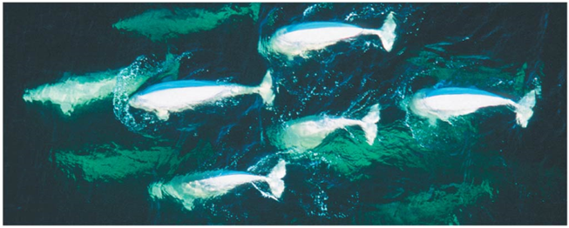
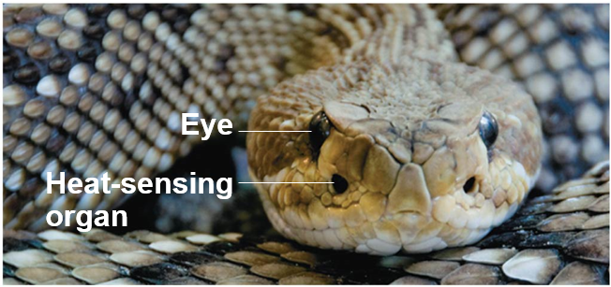
Figure 50.7 Examples of Electromagnetic Reception and Thermoreception
Beluga whales
Rattlesnake
Notes:
Figure 50.7 Examples of electromagnetic reception and thermoreception

Slide 24
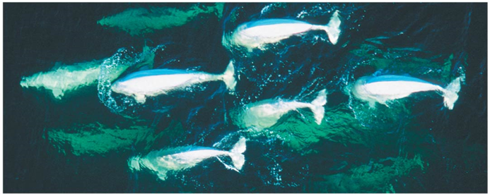
Figure 50.7a Examples of Electromagnetic Reception and Thermoreception (Part 1: Beluga Whales)
Beluga whales
Notes:
Figure 50.7a Examples of electromagnetic reception and thermoreception (part 1: beluga whales)

Slide 25
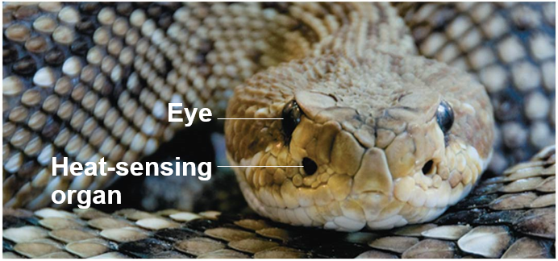
Figure 50.7b Examples of Electromagnetic Reception and Thermoreception (Part 2: Rattlesnake)
Rattlesnake
Notes:
Figure 50.7b Examples of electromagnetic reception and thermoreception (part 2: rattlesnake)

Slide 26
Thermoreceptors
Thermoreceptors detect heat and cold
Certain snakes rely on thermoreceptors to detect infrared radiation emitted by warm prey
Jalapeno and cayenne peppers contain a substance called capsaicin
Receptors that respond to capsaicin respond to high temperatures also, by opening a calcium channel
Mammals have a variety of thermoreceptors, each specific for a particular temperature range

Slide 27
Pain Receptors
In humans, pain receptors, or nociceptors, detect stimuli that reflect harmful conditions
They respond to excess heat, pressure, or chemicals released from damaged or inflamed tissues
Chemicals produced in an animal’s body sometimes enhance the perception of pain

Slide 28
Concept 50.2: In hearing and equilibrium, mechanoreceptors detect moving fluid or settling particles
Hearing and perception of body equilibrium are related in most animals
For both senses, settling particles or moving fluid is detected by mechanoreceptors

Slide 29
Sensing of Gravity and Sound in Invertebrates
Most invertebrates maintain equilibrium using mechanoreceptors located in organs called statocysts
Statocysts contain mechanoreceptors that detect the movement of granules called statoliths
Statoliths provide information about the body position with respect to gravity

Slide 30
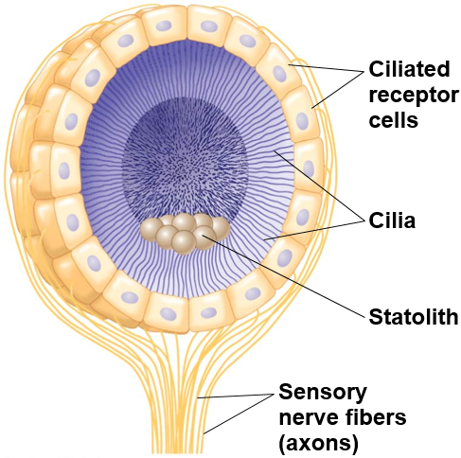
Figure 50.8 The Statocyst of an Invertebrate
Notes:
Figure 50.8 The statocyst of an invertebrate

Slide 31
Sensing of Gravity and Sound in Invertebrates, Continued
Many insects have body hairs that vibrate in response to sound waves
Many also detect sound with localized organs consisting of a tympanic membrane stretched over an internal air chamber

Slide 32
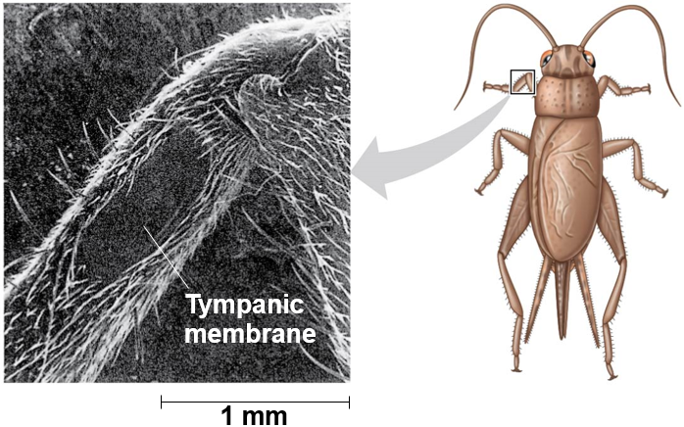
Figure 50.9 An Insect’s “Ear”—on its Leg
Notes:
Figure 50.9 An insect’s “ear”—on its leg

Slide 33
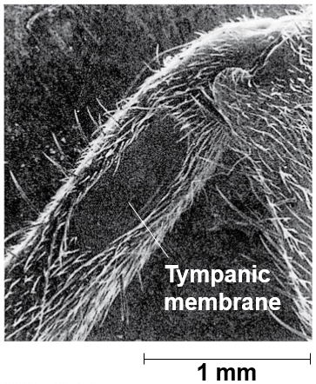
Figure 50.9a An Insect’s “Ear”—on its Leg (Part 1: SEM)
Notes:
Figure 50.9a An insect’s “ear”—on its leg (part 1: SEM)

Slide 34
Hearing and Equilibrium in Mammals
In most terrestrial vertebrates, sensory organs for hearing and equilibrium are closely associated in the ear

Slide 35
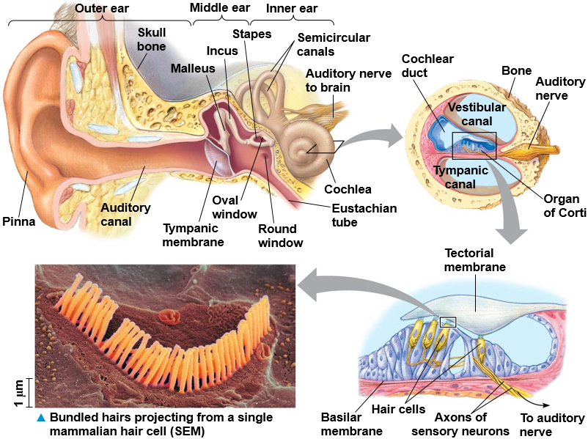
Figure 50.10 Exploring the Structure of the Human Ear
Notes:
Figure 50.10 Exploring the structure of the human ear

Slide 36
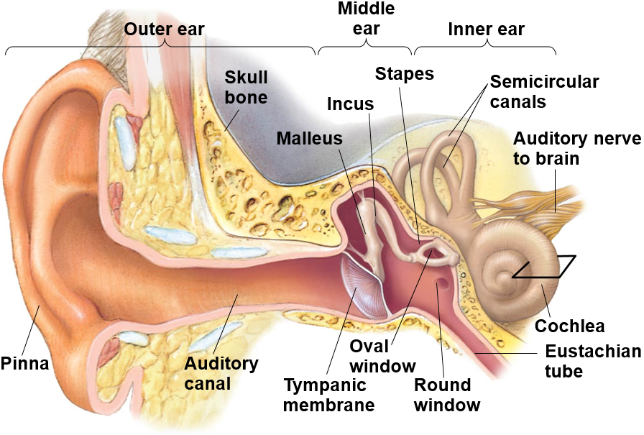
Figure 50.10a Exploring the Structure of the Human Ear (Part 1: Overview)
Notes:
Figure 50.10a Exploring the structure of the human ear (part 1: overview)

Slide 37
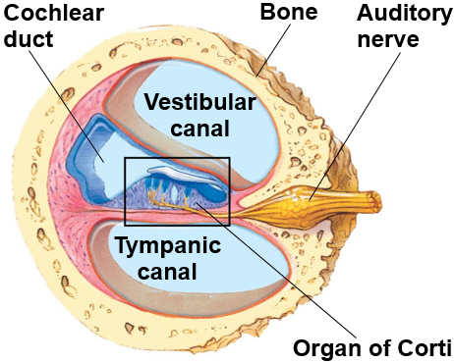
Figure 50.10b Exploring the Structure of the Human Ear (Part 2: Cochlea)
Notes:
Figure 50.10b Exploring the structure of the human ear (part 2: cochlea)

Slide 38
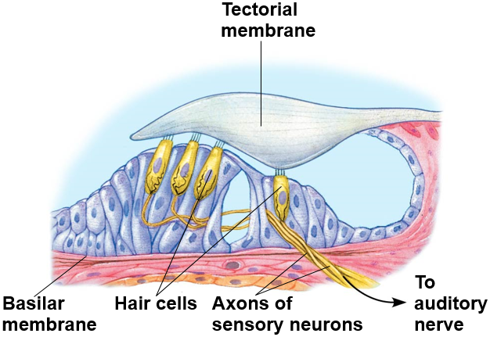
Figure 50.10c Exploring the Structure of the Human Ear (Part 3: Organ of Corti)
Notes:
Figure 50.10c Exploring the structure of the human ear (part 3: organ of Corti)

Slide 39
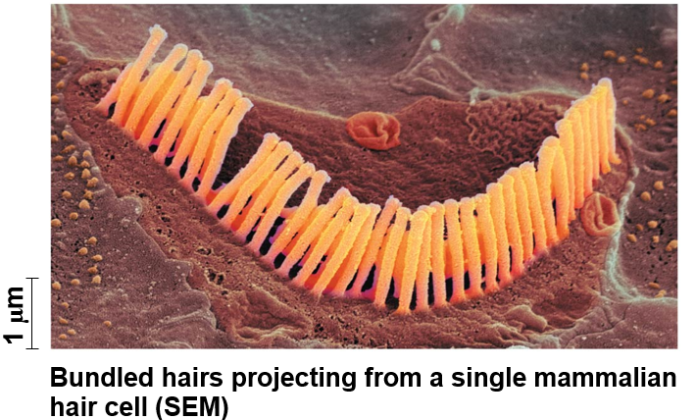
Figure 50.10d Exploring the Structure of the Human Ear (Part 4: Hair Cell, SEM)
Notes:
Figure 50.10d Exploring the structure of the human ear (part 4: hair cell, SEM)

Slide 40
Hearing
Vibrating objects create pressure waves in the air
The ear transduces this stimulus into nerve impulses
To hear sounds, we rely on hair cells, sensory cells with hairlike projections that detect motion
Moving air reaches the outer ear and causes vibration of the tympanic membrane
The three bones of the middle ear transmit the vibrations to the oval window

Slide 41
Hearing, Continued
When one of the three bones, the stapes, vibrates again the oval window, it creates pressure waves in the fluid inside the cochlea
Fluid pressure waves push down on the cochlear duct and basilar membrane
The basilar membrane and the attached hair cells vibrate up and down

Slide 42
Hearing, Continued-1
The bending of hair cells depolarizes the membranes of mechanoreceptors and sends action potentials to the brain via the auditory nerve

Slide 43
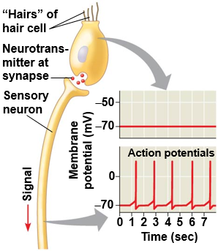
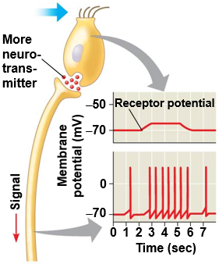
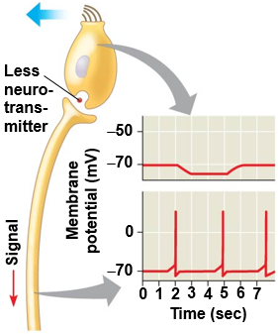
Figure 50.11 Sensory Reception by Hair Cells
No bending of hairs
Bending of hairs in one direction
Bending of hairs in other direction
Notes:
Figure 50.11 Sensory reception by hair cells

Slide 44
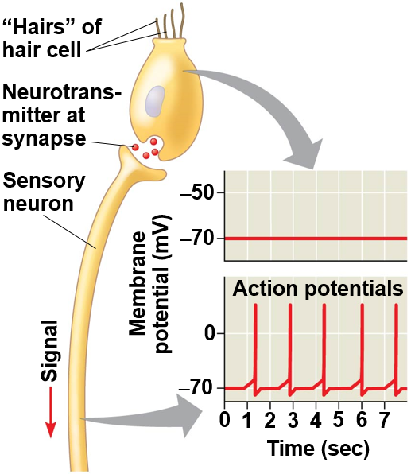
Figure 50.11a Sensory Reception by Hair Cells (Part 1: No Bending)
No bending of hairs
Notes:
Figure 50.11a Sensory reception by hair cells (part 1: no bending)

Slide 45
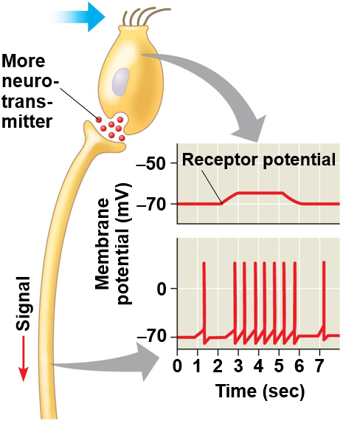
Figure 50.11b Sensory Reception by Hair Cells (Part 2: Bending in One Direction)
Bending of hairs in one direction
Notes:
Figure 50.11b Sensory reception by hair cells (part 2: bending in one direction)

Slide 46
Figure 50.11c Sensory Reception by Hair Cells (Part 3: Bending in other Direction)
Bending of hairs in other direction
Notes:
Figure 50.11c Sensory reception by hair cells (part 3: bending in other direction)

Slide 47
Hearing, Continued-2
The fluid waves dissipate when they strike the round window at the end of the tympanic canal
This damping of sound resets the apparatus for the next vibrations that arrive

Slide 48
Hearing, Continued-3
The ear captures information about
Volume, the amplitude of the sound wave
Pitch, the frequency of the sound wave
The cochlea can distinguish pitch because the basilar membrane is not uniform along its length
Each region of the basilar membrane is tuned to a particular vibration frequency

Slide 49
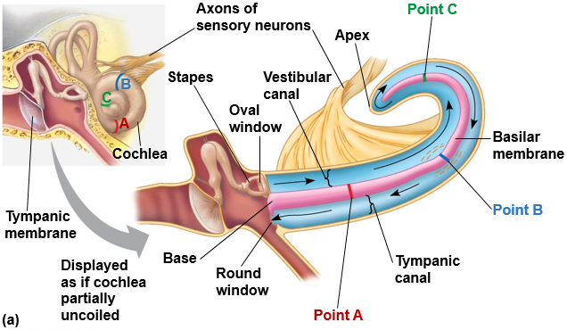
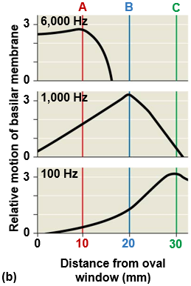
Figure 50.12 Sensory Transduction in the Cochlea
Notes:
Figure 50.12 Sensory transduction in the cochlea

Slide 50
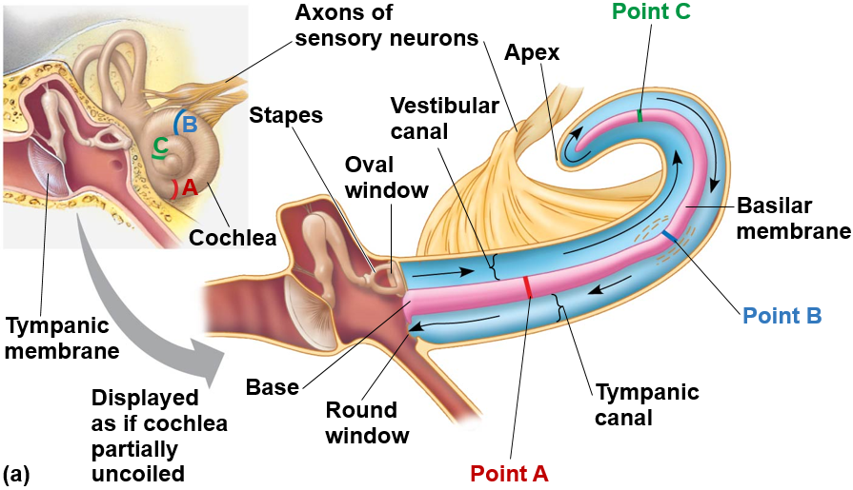
Figure 50.12a Sensory Transduction in the Cochlea (Part 1: Art)
Notes:
Figure 50.12a Sensory transduction in the cochlea (part 1: art)

Slide 51
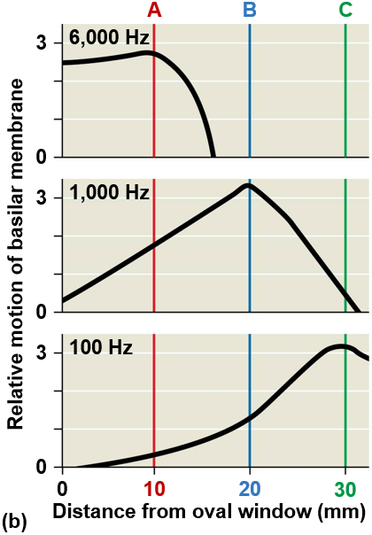
Figure 50.12b Sensory Transduction in the Cochlea (Part 2: Graph)
Notes:
Figure 50.12b Sensory transduction in the cochlea (part 2: graph)

Slide 52
Equilibrium
Several organs in the inner ear detect body movement, position, and balance
The utricle and saccule contain hair cells projecting into a gelatinous material
Embedded in the gel are granules called otoliths that allow us to perceive position relative to gravity or linear movement
Three semicircular canals contain fluid and can detect angular movement in any direction

Slide 53
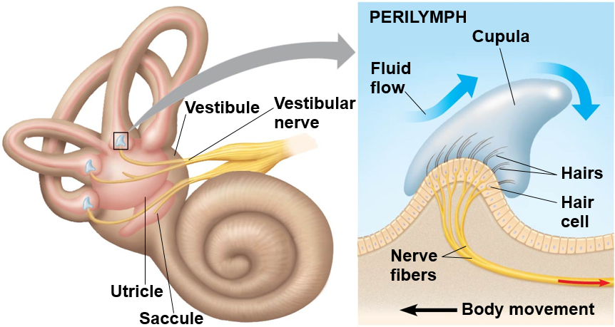
Figure 50.13 Organs of Equilibrium in the Inner Ear
Notes:
Figure 50.13 Organs of equilibrium in the inner ear

Slide 54
Hearing and Equilibrium in Other Vertebrates
Unlike mammals, fishes have only a pair of inner ears near the brain
Most fishes and aquatic amphibians also have a lateral line system along both sides of their body
The lateral line system contains mechanoreceptors with hair cells that detect and respond to water movement

Slide 55
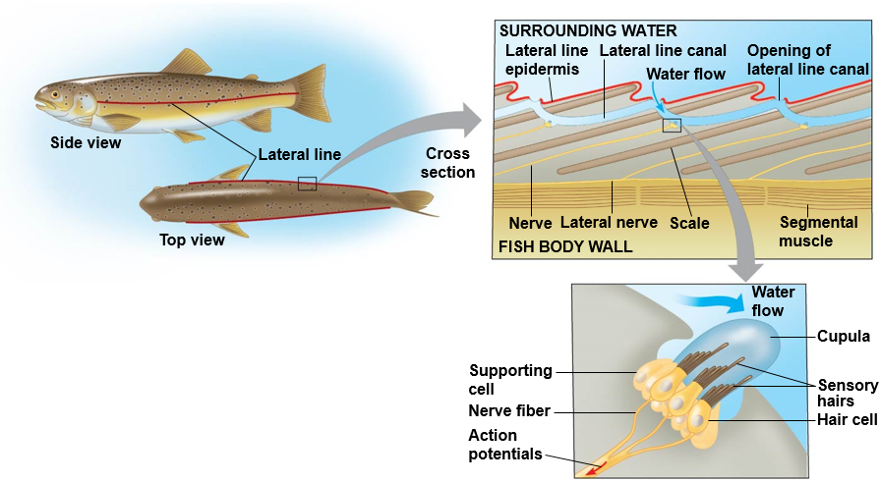
Figure 50.14 The Lateral Line System in a Fish
Notes:
Figure 50.14 The lateral line system in a fish

Slide 56
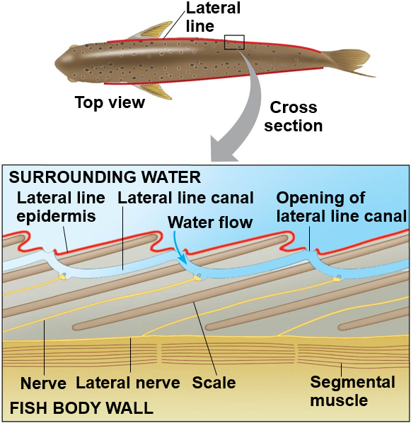
Figure 50.14a The Lateral Line System in a Fish (Part 1: Fish Body Wall)
Notes:
Figure 50.14a The lateral line system in a fish (part 1: fish body wall)

Slide 57
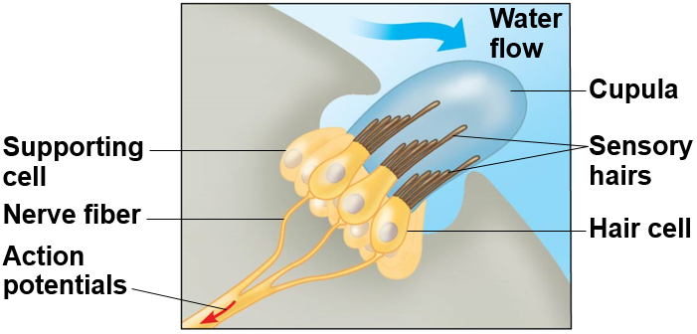
Figure 50.14b The Lateral Line System in a Fish (Part 2: Cupula)
Notes:
Figure 50.14b The lateral line system in a fish (part 2: cupula)

Slide 58
Concept 50.3: The diverse visual receptors of animals depend on light-absorbing pigments
Animals use a diverse set of organs for vision, but the underlying mechanism for capturing light is the same, suggesting a common evolutionary origin

Slide 59
Evolution of Visual Perception
Light detectors in the animal kingdom range from simple clusters of cells that detect direction and intensity of light to complex organs that form images
Light detectors all contain photoreceptors, cells that contain light-absorbing pigment molecules

Slide 60
Light-Detecting Organs
Most invertebrates have a light-detecting organ
One of the simplest light-detecting organs is that of planarians
A pair of ocelli called eyespots are located near the head
These allow planarians to move away from light and seek shaded locations

Slide 61
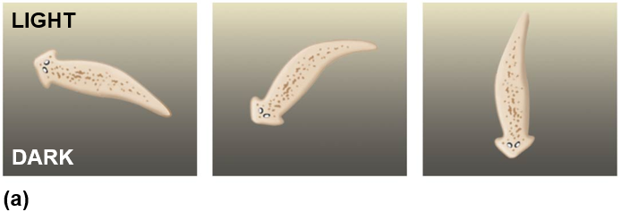
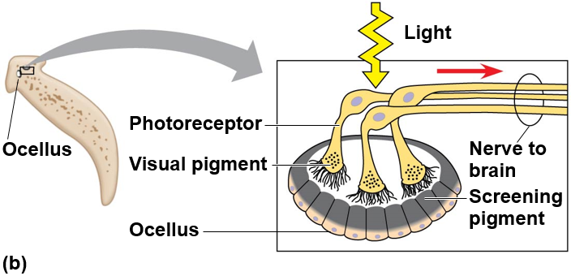
Figure 50.15 Ocelli and Orientation Behavior of a Planarian
Notes:
Figure 50.15 Ocelli and orientation behavior of a planarian

Slide 62
Compound Eyes
Insects, crustaceans, and some polychaete worms have compound eyes, which consist of up to several thousand light detectors called ommatidia
Compound eyes are very effective at detecting movement
Insects have excellent color vision, and some can see into the ultraviolet range

Slide 63
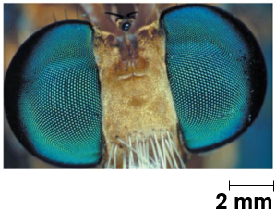
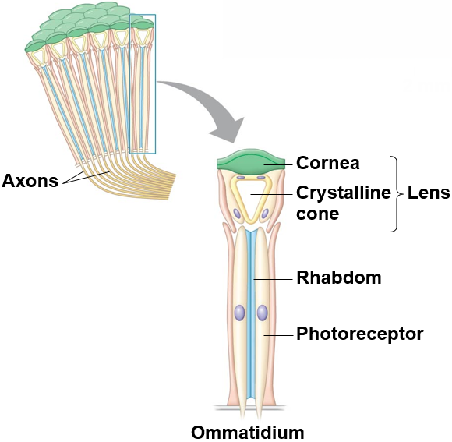
Figure 50.16 Compound Eyes
The faceted eyes on the head of a fly
Ommatidia
Notes:
Figure 50.16 Compound eyes

Slide 64
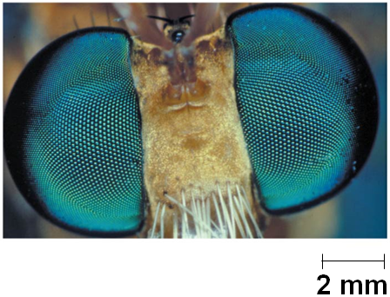
Figure 50.16a Compound Eyes (Part 1: Micrograph)
The faceted eyes on the head of a fly
Notes:
Figure 50.16a Compound eyes (part 1: micrograph)

Slide 65
Single-Lens Eyes
Among invertebrates, single-lens eyes are found in some jellies and polychaete worms, as well as spiders and many molluscs
They work on a camera-like principle: The iris changes the diameter of the pupil to control how much light enters
The eyes of all vertebrates have a single lens

Slide 66
The Vertebrate Visual System
In vertebrates, the eye detects color and light, but the brain assembles the information and perceives the image

Slide 67
The Vertebrate Visual System, Continued
The human eye is surrounded by several layers
Just inside the choroid (a thin, pigmented layer) are the neurons and photoreceptors of the retina
The lens is a transparent disk of protein
In front of the lens is the clear and watery aqueous humor and behind it is the jellylike vitreous humor

Slide 68
The Vertebrate Visual System, Continued-1
Light entering the eye strikes the retina, reaching the rods and cones, two types of photoreceptors
The neurons of the retina then relay visual information to the optic nerve and brain
The optic disk, in the retina, lacks photoreceptors and thus forms a blind spot, where light is not detected

Slide 69
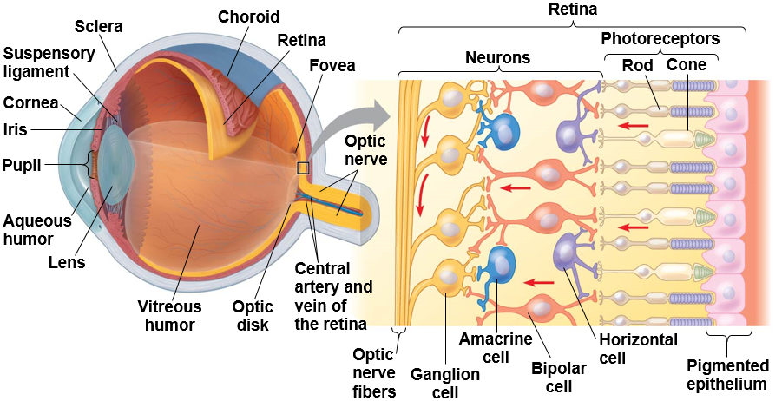
Figure 50.17a Exploring the Structure of the Human Eye (Part 1)
Notes:
Figure 50.17a Exploring the structure of the human eye (part 1)

Slide 70
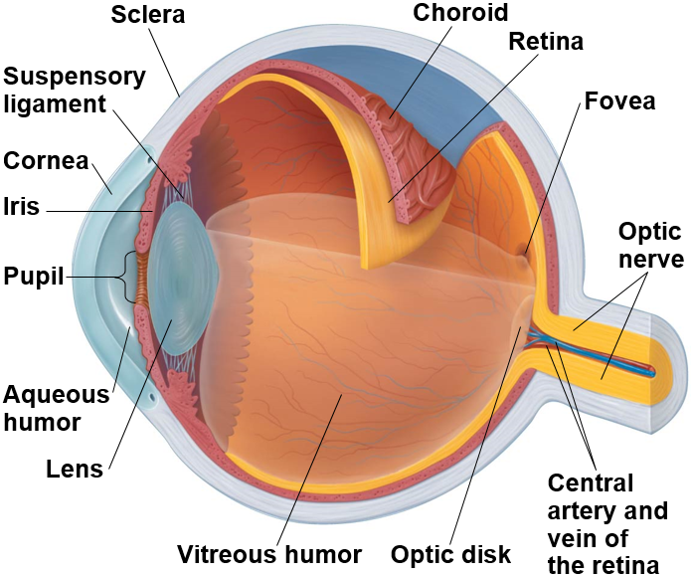
Figure 50.17aa Exploring the Structure of the Human Eye (Part 1a: Overview)
Notes:
Figure 50.17aa Exploring the structure of the human eye (part 1a: overview)

Slide 71
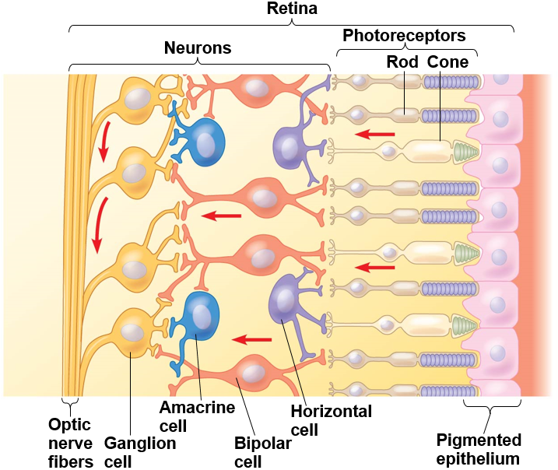
Figure 50.17ab Exploring the Structure of the Human Eye (Part 1b: Retina)
Notes:
Figure 50.17ab Exploring the structure of the human eye (part 1b: retina)

Slide 72
The Vertebrate Visual System, Continued-2
Humans have two main types of photoreceptor cells
Rods are more sensitive to light but do not distinguish colors
Cones provide color vision

Slide 73
The Vertebrate Visual System, Continued-3
Vertebrate visual pigments consist of retinal, a light-absorbing pigment bound to a membrane protein called an opsin
One such pigment is called rhodopsin
Absorption of light causes a shape change in retinal

Slide 74
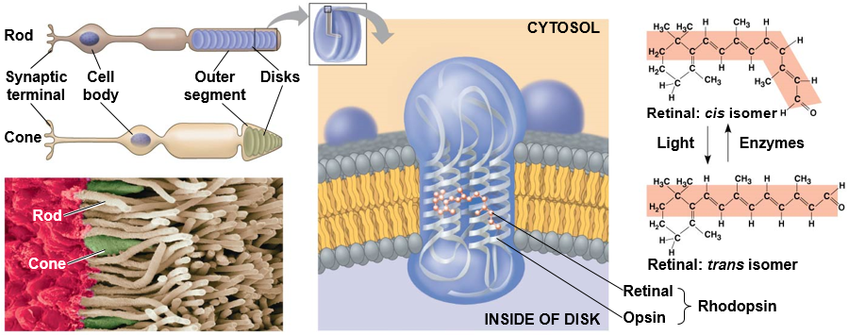
Figure 50.17b Exploring the Structure of the Human Eye (Part 2)
Notes:
Figure 50.17b Exploring the structure of the human eye (part 2)

Slide 75
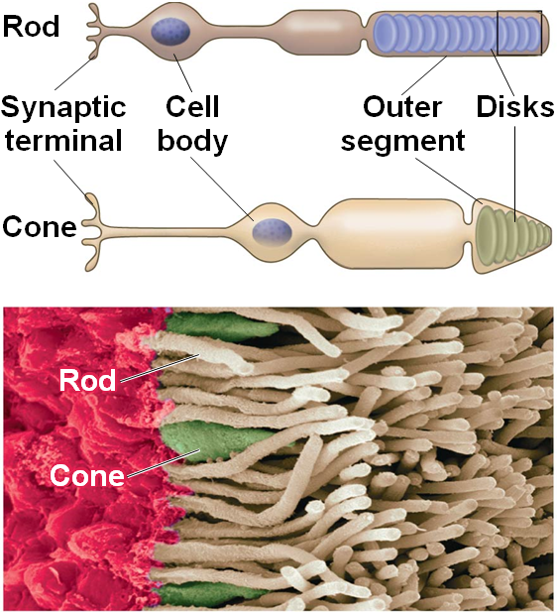
Figure 50.17ba Exploring the Structure of the Human Eye (Part 2a: Photoreceptor Cells)
Notes:
Figure 50.17ba Exploring the structure of the human eye (part 2a: photoreceptor cells)

Slide 76
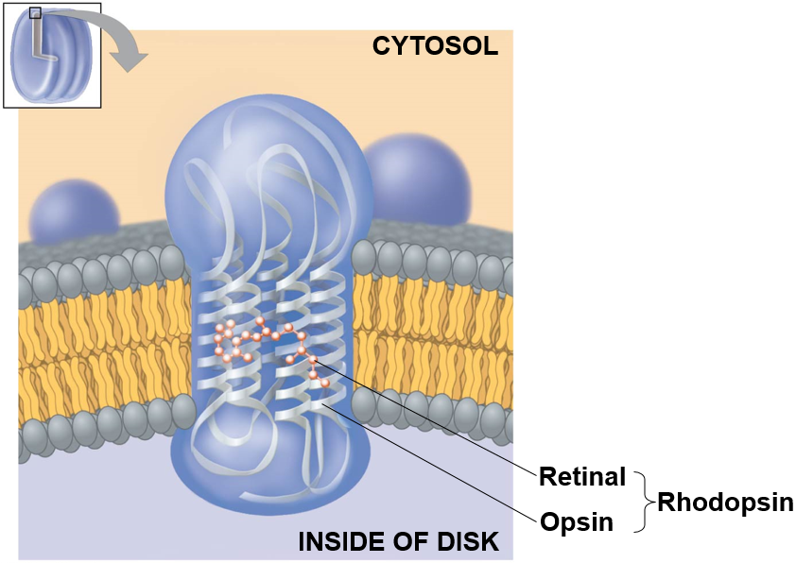
Figure 50.17bb Exploring the Structure of the Human Eye (Part 2b: Rhodopsin)
Notes:
Figure 50.17bb Exploring the structure of the human eye (part 2b: rhodopsin)

Slide 77
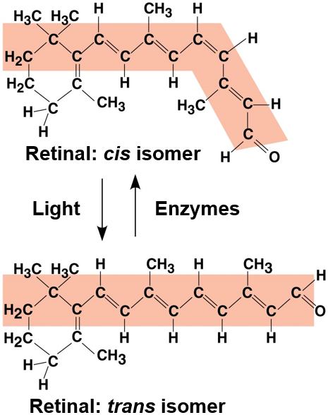
Figure 50.17bc Exploring the Structure of the Human Eye (Part 2c: Retinal Isomers)
Notes:
Figure 50.17bc Exploring the structure of the human eye (part 2c: retinal isomers)

Slide 78
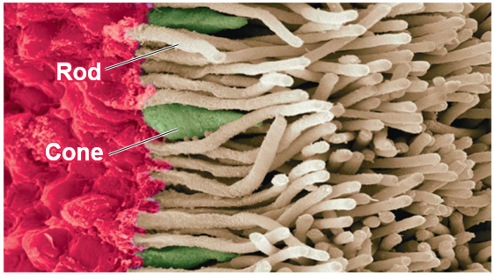
Figure 50.17bd Exploring the Structure of the Human Eye (Part 2d: Photoreceptor Cells, SEM)
Notes:
Figure 50.17bd Exploring the structure of the human eye (part 2d: photoreceptor cells, SEM)

Slide 79
Sensory Transduction in the Eye
Transduction of visual information to the nervous system begins when light induces the conversion of cis-retinal to trans-retinal
Trans-retinal activates rhodopsin, which activates a G protein, eventually leading to hydrolysis of cyclic GMP
Cyclic GMP in the dark binds sodium ion channels and keeps them open

Slide 80
Sensory Transduction in the Eye, Continued
When cyclic GMP breaks down,
channels close
This hyperpolarizes the cell
The signal transduction pathway usually shuts off again as enzymes convert retinal back to the cis form

Slide 81
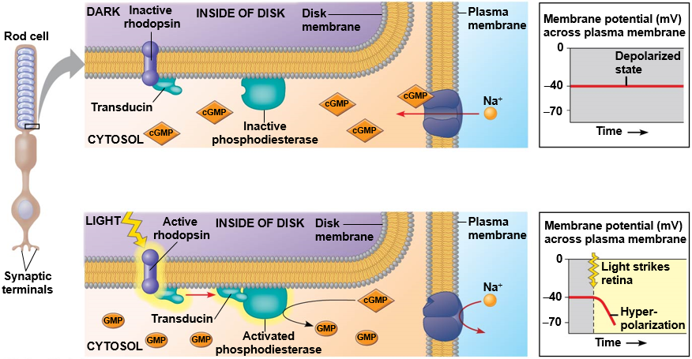
Figure 50.18 Response of a Photoreceptor Cell to Light
Notes:
Figure 50.18 Response of a photoreceptor cell to light

Slide 82
Figure 50.18a Response of a Photoreceptor Cell to Light (Part 1: Dark)
Notes:
Figure 50.18a Response of a photoreceptor cell to light (part 1: dark)

Slide 83
Figure 50.18b Response of a Photoreceptor Cell to Light (Part 2: Light)
Notes:
Figure 50.18b Response of a photoreceptor cell to light (part 2: light)

Slide 84
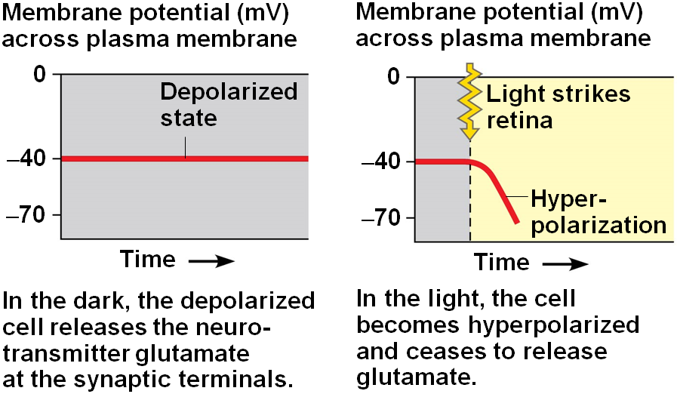
Figure 50.18c Response of a Photoreceptor Cell to Light (Part 3: Membrane Potential)
Notes:
Figure 50.18c Response of a photoreceptor cell to light (part 3: membrane potential)

Slide 85
Processing of Visual Information in the Retina
Processing of visual information begins in the retina
In the dark, rods and cones continually release the neurotransmitter glutamate into synapses with neurons called bipolar cells
When light strikes the rods and cones, they hyperpolarize, shutting off their release of glutamate

Slide 86
Processing of Visual Information in the Retina, Continued
The decrease in glutamate changes the membrane potential of bipolar cells
Lateral inhibition is when a rod or cone stimulates a horizontal cell and the horizontal cell then inhibits more distant photoreceptors and bipolar cells
In this way, regions receiving light appear lighter and dark surroundings even darker
This enhances contrast in an image

Slide 87
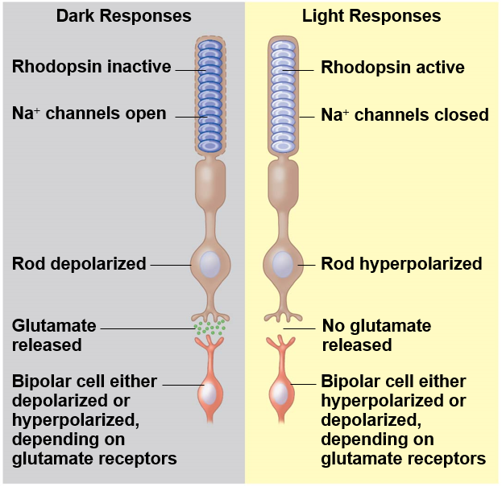
Figure 50.19 Synaptic Activity of Rod Cells in Light and Dark
Notes:
Figure 50.19 Synaptic activity of rod cells in light and dark

Slide 88
Processing of Visual Information in the Retina, Continued-1
A single ganglion receives information from an array of rods and cones
Together, the rods and cones that are feeding information to one ganglion cell define a receptive field
A smaller receptive field typical results in a sharper image

Slide 89
Processing of Visual Information in the Brain
The optic nerves meet at the optic chiasm near the center of the base of the cerebral cortex
Sensations from the left visual field of both eyes are transmitted to the right side of the brain
Sensations from the right visual field of both eyes are transmitted to the left side of the brain

Slide 90
Processing of Visual Information in the Brain, Continued
Most ganglion cell axons lead to the lateral geniculate nuclei
The lateral geniculate nuclei relay information to the primary visual cortex in the cerebrum
At least 30% of the cerebral cortex, in dozens of integrating centers, is active in creating visual perceptions

Slide 91
Figure 50.20 Neural Pathways for Vision
Notes:
Figure 50.20 Neural pathways for vision

Slide 92
Color Vision
Among vertebrates, most fishes, amphibians, and reptiles, including birds, have very good color vision
Humans and other primates are among the minority of mammals with the ability to see color well
Mammals that are nocturnal usually have a high proportion of rods in the retina and probably see a pastel world during the day

Slide 93
Color Vision, Continued
In humans, perception of color is based on three types of cones, each with a different visual pigment: red, green, or blue
These pigments are called photopsins and are formed when retinal binds to three distinct opsin proteins

Slide 94
Color Vision, Continued-1
Abnormal color vision results from mutations in the genes for one or more photopsin proteins
Researchers studying color vision in squirrel monkeys made a breakthrough in gene therapy
Male squirrel monkeys are red-green color-blind
When researchers introduced the missing gene using a virus, full color vision was apparent

Slide 95
Figure 50.21 Gene Therapy for Vision
Notes:
Figure 50.21 Gene therapy for vision

Slide 96
The Visual Field
The brain processes visual information and controls what information is captured
Focusing occurs by changing the shape of the lens
The fovea is the center of the visual field and contains no rods, but a high density of cones

Slide 97
Figure 50.22 Focusing in the Mammalian Eye
Near vision (accommodation)
Distance vision
Notes:
Figure 50.22 Focusing in the mammalian eye

Slide 98
Figure 50.22a Focusing in the Mammalian Eye (Part 1: Near Vision)
Near vision (accommodation)
Notes:
Figure 50.22a Focusing in the mammalian eye (part 1: near vision)

Slide 99
Figure 50.22b Focusing in the Mammalian Eye (Part 2: Distance Vision)
Distance vision
Notes:
Figure 50.22b Focusing in the mammalian eye (part 2: distance vision)

Slide 100
Animation: Near and Distance Vision

Slide 101
Concept 50.4: The senses of taste and smell rely on similar sets of sensory receptors
In terrestrial animals
Gustation (taste) is dependent on the detection of chemicals called tastants
Olfaction (smell) is dependent on the detection of odorant molecules
In aquatic animals there is no distinction between taste and smell
Taste receptors of insects are in sensory hairs located on feet and in mouthparts

Slide 102
Taste in Mammals
In humans and other mammals, there are five taste perceptions: sweet, sour, salty, bitter, and umami (elicited by glutamate)
Researchers have identified receptors for all five tastes
Experiments show that an individual taste cell expresses one receptor type and detects one of the five tastes

Slide 103
Figure 50.23 Inquiry: How do Mammals Detect Different Tastes?
Results
Data from K. L. Mueller et al., The receptors and coding logic for bitter taste, Nature 434:225–229 (2005).
Notes:
Figure 50.23 Inquiry: How do mammals detect different tastes?

Slide 104
Taste in Mammals, Continued
Receptor cells for taste in mammals are modified epithelial cells organized into taste buds, located in several areas of the tongue and mouth
Most taste buds are associated with projections called papillae
Any region with taste buds can detect any of the five types of taste

Slide 105
Figure 50.24 Human Taste Receptors
Notes:
Figure 50.24 Human taste receptors

Slide 106
Figure 50.24a Human Taste Receptors (Part 1: Tongue and Papilla)
The tongue
Notes:
Figure 50.24a Human taste receptors (part 1: tongue and papilla)

Slide 107
Figure 50.24b Human Taste Receptors (Part 2: Taste Bud)
A taste bud
Notes:
Figure 50.24b Human taste receptors (part 2: taste bud)

Slide 108
Taste in Mammals, Continued-1
Taste receptors are of three types
The sensations of sweet, umami, and bitter require specific G protein-coupled receptors (GPCRs)
The receptor for sour belongs to the TRP family and is similar to the capsaicin and other thermoreceptor proteins
The taste receptor for salt is a sodium channel

Slide 109
Smell in Humans
Olfactory receptor cells are neurons that line the upper portion of the nasal cavity
Binding of odorant molecules to receptors triggers a signal transduction pathway, generating action potentials
Mammals can distinguish thousands of different odors
Although receptors and brain pathways for taste and smell are independent, the two senses do interact

Slide 110
Figure 50.25 Smell in Humans
Notes:
Figure 50.25 Smell in humans

Slide 111
Figure 50.25a Smell in Humans (Part 1: Nasal Cavity)
Notes:
Figure 50.25a Smell in humans (part 1: nasal cavity)

Slide 112
Figure 50.25b Smell in Humans (Part 2: Olfactory Receptor Cells)
Notes:
Figure 50.25b Smell in humans (part 2: olfactory receptor cells)

Slide 113
Figure 50.25c Smell in Humans (Part 3: Chemoreceptors)
Notes:
Figure 50.25c Smell in humans (part 3: chemoreceptors)

Slide 114
Concept 50.5: The physical interaction of protein filaments is required for muscle function
Muscle activity is a response to input from the nervous system
Muscle cell contraction relies on the interaction between thin filaments, composed mainly of actin, and thick filaments, staggered arrays of myosin

Slide 115
Vertebrate Skeletal Muscle
Vertebrate skeletal muscle moves bones and the body and is characterized by a hierarchy of smaller and smaller units
A skeletal muscle consists of a bundle of long fibers, each a single cell, running along the length of the muscle
Each muscle fiber is itself a bundle of smaller myofibrils arranged longitudinally

Slide 116
Vertebrate Skeletal Muscle, Continued
Skeletal muscle is also called striated muscle because the regular arrangement of myofilaments creates a pattern of light and dark bands
The functional unit of a muscle is called a sarcomere and is bordered by Z lines, where thin filaments attach

Slide 117
Figure 50.26 The Structure of Skeletal Muscle
Notes:
Figure 50.26 The structure of skeletal muscle

Slide 118
Figure 50.26a The Structure of Skeletal Muscle (Part 1: Muscle Fibers)
Notes:
Figure 50.26a The structure of skeletal muscle (part 1: muscle fibers)

Slide 119
Figure 50.26b The Structure of Skeletal Muscle (Part 2: Sarcomere)
Notes:
Figure 50.26b The structure of skeletal muscle (part 2: sarcomere)

Slide 120
Figure 50.26c The Structure of Skeletal Muscle (Part 3: Sarcomere, TEM)
Notes:
Figure 50.26c The structure of skeletal muscle (part 3: sarcomere, TEM)

Slide 121
The Sliding-Filament Model of Muscle Contraction
According to the sliding-filament model, thin and thick filaments ratchet past each other longitudinally, powered by the myosin molecules

Slide 122
Figure 50.27 The Sliding-filament Model of Muscle Contraction
Notes:
Figure 50.27 The sliding-filament model of muscle contraction

Slide 123
Figure 50.27a The Sliding-filament Model of Muscle Contraction (Part 1: Relaxed Muscle, TEM)
Notes:
Figure 50.27a The sliding-filament model of muscle contraction (part 1: relaxed muscle, TEM)

Slide 124
Figure 50.27b The Sliding-filament Model of Muscle Contraction (Part 2: Contracting Muscle, TEM)
Notes:
Figure 50.27b The sliding-filament model of muscle contraction (part 2: contracting muscle, TEM)

Slide 125
Figure 50.27c The Sliding-filament Model of Muscle Contraction (Part 3: Fully Contracted Muscle, TEM)
Notes:
Figure 50.27c The sliding-filament model of muscle contraction (part 3: fully contracted muscle, TEM)

Slide 126
The Sliding-Filament Model of Muscle Contraction, Continued
Each myosin has a long “tail” region and a globular “head” region
The head of a myosin molecule binds to an actin filament, forming a cross-bridge and pulling the thin filament toward the center of the sarcomere
Muscle contraction requires repeated cycles of this binding and release

Slide 127
The Sliding-Filament Model of Muscle Contraction, Continued-1
Glycolysis and aerobic respiration generate the ATP needed to sustain muscle contraction
During intense muscle activity, oxygen becomes limiting and ATP is generated instead by lactic acid fermentation
This activity generates less activity per glucose than glycolysis and can sustain contraction for only about 1 minute

Slide 128
Figure 50.28_1 Myosin-actin Interactions Underlying Muscle Fiber Contraction (Step 1)
Notes:
Figure 50.28_1 Myosin-actin interactions underlying muscle fiber contraction (step 1)

Slide 129
Figure 50.28_2 Myosin-actin Interactions Underlying Muscle Fiber Contraction (Step 2)
Notes:
Figure 50.28_2 Myosin-actin interactions underlying muscle fiber contraction (step 2)

Slide 130
Figure 50.28_3 Myosin-actin Interactions Underlying Muscle Fiber Contraction (Step 3)
Notes:
Figure 50.28_3 Myosin-actin interactions underlying muscle fiber contraction (step 3)

Slide 131
Figure 50.28_4 Myosin-actin Interactions Underlying Muscle Fiber Contraction (Step 4)
Notes:
Figure 50.28_4 Myosin-actin interactions underlying muscle fiber contraction (step 4)

Slide 132
Figure 50.28_5 Myosin-actin Interactions Underlying Muscle Fiber Contraction (Step 5)
Notes:
Figure 50.28_5 Myosin-actin interactions underlying muscle fiber contraction (step 5)

Slide 133
BioFlix Animation: Muscle Contraction

Slide 134
Video: Myosin-actin Interaction

Slide 135
The Role of Calcium and Regulatory Proteins
The regulatory protein tropomyosin and the troponin complex, a set of additional proteins, bind to actin strands on thin filaments when a muscle fiber is at rest
This prevents actin and myosin from interacting

Slide 136
The Role of Calcium and Regulatory Proteins, Continued
For a muscle fiber to contract, myosin-binding sites must be exposed
This occurs when calcium ions
bind to the
troponin complex and expose the myosin-binding sites
Contraction occurs when the concentration of
is
high; muscle fiber contraction stops when the
concentration of
is low

Slide 137
Figure 50.29 The Role of Regulatory Proteins and Calcium in Muscle Fiber Contraction
Myosin-binding sites blocked by tropomyosin
Myosin-binding sites exposed
Notes:
Figure 50.29 The role of regulatory proteins and calcium in muscle fiber contraction

Slide 138
The Role of Calcium and Regulatory Proteins, Continued-1
The stimulus leading to contraction of a muscle fiber is an action potential in a motor neuron that makes a synapse with the muscle fiber
The synaptic terminal of the motor neuron releases the neurotransmitter acetylcholine
Acetylcholine depolarizes the muscle, causing it to produce an action potential

Slide 139
The Role of Calcium and Regulatory Proteins, Continued-2
Action potentials travel to the interior of the muscle fiber along transverse (T) tubules
The action potential along T tubules causes the sarcoplasmic reticulum (SR) to release
The
binds to the troponin complex, initiating the
muscle fiber contraction

Slide 140
The Role of Calcium and Regulatory Proteins, Continued-3
When motor neuron input stops, the muscle cell relaxes
Transport proteins in the SR pump
out of the
cytosol
Regulatory proteins bound to thin filaments shift back to their starting positions

Slide 141
Figure 50.30 The Roles of the Sarcoplasmic Reticulum and T Tubules in Muscle Fiber Contraction
Notes:
Figure 50.30 The roles of the sarcoplasmic reticulum and T tubules in muscle fiber contraction

Slide 142
The Role of Calcium and Regulatory Proteins, Continued-4
Amyotrophic lateral sclerosis (ALS), formerly called Lou Gehrig’s disease, interferes with the excitation of skeletal muscle fibers; this disease is usually fatal
Myasthenia gravis is an autoimmune disease that attacks acetylcholine receptors on muscle fibers; treatments exist for this disease

Slide 143
Figure 50.31 Summary of Contraction in a Skeletal Muscle Fiber
Notes:
Figure 50.31 Summary of contraction in a skeletal muscle fiber

Slide 144
Nervous Control of Muscle Tension
Contraction of a whole muscle is graded; the extent and strength of its contraction can be voluntarily altered
There are two basic mechanisms by which the nervous system produces graded contractions
Varying the number of fibers that contract
Varying the rate at which fibers are stimulated

Slide 145
Nervous Control of Muscle Tension, Continued
In vertebrates, each motor neuron may synapse with multiple muscle fibers, although each fiber is controlled by only one motor neuron
A motor unit consists of a single motor neuron and all the muscle fibers it controls

Slide 146
Figure 50.32 Motor Units in a Vertebrate Skeletal Muscle
Notes:
Figure 50.32 Motor units in a vertebrate skeletal muscle

Slide 147
Nervous Control of Muscle Tension, Continued-1
Recruitment is the process by which more and more motor neurons are activated
As recruitment proceeds, the force developed by a muscle increases
A twitch results from a single action potential in a motor neuron
More rapidly delivered action potentials produce a graded contraction through summation

Slide 148
Figure 50.33 Summation of Twitches
Notes:
Figure 50.33 Summation of twitches

Slide 149
Nervous Control of Muscle Tension, Continued-2
Tetanus is a state of smooth and sustained contraction produced when the rate of stimulation is so high that muscle fibers cannot relax between stimuli

Slide 150
Types of Skeletal Muscle Fibers
There are several distinct types of skeletal muscles, each of which is adapted to a particular function
They are classified by the source of ATP powering the muscle activity or by the speed of muscle contraction

Slide 151
Types of Skeletal Muscle Fibers, Continued
Table 50.1 Types of Skeletal Muscle Fibers
 | Slow Oxidative | Fast Oxidative | Fast Glycolytic
Contraction speed | Slow | Fast | Fast
Major ATP source | Aerobic respiration | Aerobic respiration | Glycolysis
Rate of fatigue | Slow | Intermediate | Fast
Mitochondria | Many | Many | Few
Myoglobin content | High (red muscle) | High (red muscle) | Low (white muscle)
Notes:
Table 50.1 Types of skeletal muscle fibers

Slide 152
Types of Skeletal Muscle Fibers, Continued-1
Oxidative and Glycolytic Fibers
Oxidative fibers rely mostly on aerobic respiration to generate ATP
These fibers have many mitochondria, a rich blood supply, and a large amount of myoglobin
Myoglobin is a protein that binds oxygen more tightly than hemoglobin does

Slide 153
Types of Skeletal Muscle Fibers, Continued-2
Glycolytic fibers use glycolysis as their primary source of ATP
Glycolytic fibers have less myoglobin and a larger diameter than oxidative fibers
They also tire more easily
In poultry and fish, light meat is composed of glycolytic fibers, while dark meat is composed of oxidative fibers

Slide 154
Types of Skeletal Muscle Fibers, Continued-3
Fast-Twitch and Slow-Twitch Fibers
Fast-twitch fibers enable brief, rapid, powerful contractions
Fast-twitch fibers can be either glycolytic or oxidative

Slide 155
Types of Skeletal Muscle Fibers, Continued-4
Slow-twitch fibers contract more slowly but sustain longer contractions
Slow fibers have less sarcoplasmic reticulum than
fast fibers and pump
more slowly
All slow-twitch fibers are oxidative

Slide 156
Types of Skeletal Muscle Fibers, Continued-5
Most skeletal muscles contain both slow-twitch and fast-twitch fibers in varying ratios
Some vertebrates have muscles that twitch at rates much faster than human muscles
In producing its characteristic mating call, the male toadfish can contract and relax certain muscles more than 200 times per second

Slide 157
Figure 50.34 Specialization of Skeletal Muscles
Notes:
Figure 50.34 Specialization of skeletal muscles

Slide 158
Other Types of Muscle
In addition to skeletal muscle, vertebrates have cardiac muscle and smooth muscle
Cardiac muscle, found only in the heart, consists of striated cells electrically connected by intercalated disks
Cardiac muscle can generate action potentials without neural input

Slide 159
Other Types of Muscle, Continued
Smooth muscle is found mainly in walls of hollow organs such as those of the circulatory, digestive, and reproductive systems
Contractions are relatively slow and may be initiated by the muscles themselves
Contractions may also be caused by stimulation from neurons in the autonomic nervous system

Slide 160
Other Types of Muscle, Continued-1
Smooth muscle lacks striations because the actin and myosin are not regularly arrayed
Calcium ions enter the cytosol through the plasma membrane; smooth muscle contraction is regulated
by
but the mechanism is different

Slide 161
Concept 50.6: Skeletal systems transform muscle contraction into locomotion
The skeleton provides a rigid structure to which muscles attach
Skeletal muscles are attached in antagonistic pairs, the actions of which are coordinated by the nervous system
The paired muscles work cooperatively
Skeletons function in support, protection, and movement

Slide 162
Figure 50.35 The Interaction of Muscles and Skeletons in Movement
Notes:
Figure 50.35 The interaction of muscles and skeletons in movement

Slide 163
Types of Skeletal Systems
The three main types of skeletons are
Exoskeletons (external hard parts)
Endoskeletons (internal hard parts)
Hydrostatic skeletons (fluid-based support)

Slide 164
Hydrostatic Skeletons
A hydrostatic skeleton consists of fluid held under pressure in a closed body compartment
This is the main type of skeleton in most cnidarians, flatworms, nematodes, and annelids
Annelids use their hydrostatic skeleton for peristalsis, a type of movement produced by rhythmic waves of muscle contractions from front to back

Slide 165
Figure 50.36 Crawling by Peristalsis
Notes:
Figure 50.36 Crawling by peristalsis

Slide 166
Video: Earthworm Locomotion

Slide 167
Video: Echinoderm Tube Feet

Slide 168
Video: Jelly Swimming

Slide 169
Video: Thimble Jellies

Slide 170
Exoskeletons
An exoskeleton is a hard covering deposited on the surface of an animal
Exoskeletons are found in most molluscs and arthropods
Arthropods have a jointed exoskeleton called a cuticle, which can be both strong and flexible
The polysaccharide chitin is often found in the arthropod cuticle

Slide 171
Endoskeletons
An endoskeleton consists of a hard internal skeleton buried in soft tissue
Endoskeletons are found in organisms ranging from sponges to mammals
Vertebrate endoskeletons consist of cartilage, bone, or a combination of these
A mammalian skeleton has more than 200 bones, some fused together, others connected at joints by ligaments

Slide 172
Figure 50.37 Bones and Joints of the Human Skeleton
Notes:
Figure 50.37 Bones and joints of the human skeleton

Slide 173
Figure 50.38 Types of Joints
Ball-and-socket joint
Hinge joint
Pivot joint
Notes:
Figure 50.38 Types of joints

Slide 174
Endoskeletons, Continued
The skeletons of small and large animals have different proportions
In mammals and birds, the position of legs relative to the body is very important in determining how much weight the legs can bear

Slide 175
Types of Locomotion
Most animals are capable of locomotion, active travel from place to place
In locomotion, energy is expended to overcome friction and gravity

Slide 176
Locomotion on Land
Walking, running, hopping, or crawling on land requires an animal to support itself and move against gravity
Diverse adaptations for locomotion on land have evolved in vertebrates

Slide 177
Figure 50.39 Energy-efficient Locomotion on Land
Notes:
Figure 50.39 Energy-efficient locomotion on land

Slide 178
Locomotion on Land, Continued
Air poses relatively little resistance for land locomotion
Maintaining balance is a prerequisite to walking, running, or hopping
Crawling poses a different challenge; a crawling animal must exert energy to overcome friction

Slide 179
Swimming
In water, friction is a bigger problem than gravity
Fast swimmers usually have a sleek, torpedo-like shape to minimize friction
Animals swim in diverse ways
Paddling with their legs as oars
Jet propulsion
Undulating their body and tail from side to side or up and down

Slide 180
Flying
Active flight requires that wings develop enough lift to overcome the downward force of gravity
Many flying animals have adaptations that reduce body mass
For example, birds have no urinary bladder or teeth and have relatively large bones with air-filled regions

Slide 181
Figure 50.UN01a Skills Exercise: Interpreting a Graph with Log Scales (Part 1)
Data from the Experiments
Data from K. Schmidt-Nielsen, Locomotion: Energy cost of swimming, flying, and running, Science 177:222–228 (1972). Reprinted with permission from AAAS.
Notes:
Figure 50.UN01a Skills exercise: interpreting a graph with log scales (part 1)

Slide 182
Figure 50.UN01b Skills Exercise: Interpreting a Graph with Log Scales (Part 2)
Notes:
Figure 50.UN01b Skills exercise: interpreting a graph with log scales (part 2)

Slide 183
Figure 50.UN02 Summary of Key Concepts: Muscle Function
Notes:
Figure 50.UN02 Summary of key concepts: muscle function

Slide 184
Figure 50.UN03 Test Your Understanding, Question 7 (Rods and Cones)
Notes:
Figure 50.UN03 Test your understanding, question 7 (rods and cones)

Slide 185
Test Your Understanding, Question 9 (Energy Storage in Tendons)
Frequency (hops/sec) | Energy used (joules/sec)
1.85 | 735
0.92 | 716
Notes:
Figure 50.UN04 Test your understanding, question 9 (energy storage in tendons)

Slide 186
Figure 50.UN05 Test Your Understanding, Question 11 (Bloodhound)
Notes:
Figure 50.UN05 Test your understanding, question 11 (bloodhound)

