Slide 1
Notes:
1

Slide 2
Trading Places
Every organism must exchange substances with its environment
Exchanges ultimately occur at the cellular level by crossing the plasma membrane
In unicellular organisms, these exchanges occur directly with the environment

Slide 3
For most cells of multicellular organisms, direct exchange with the environment is not possible
Gills are an example of a specialized exchange system in animals
O₂ diffuses from the water into blood vessels
CO₂ diffuses from blood into the water
Internal transport and gas exchange are functionally related in most animals

Slide 4
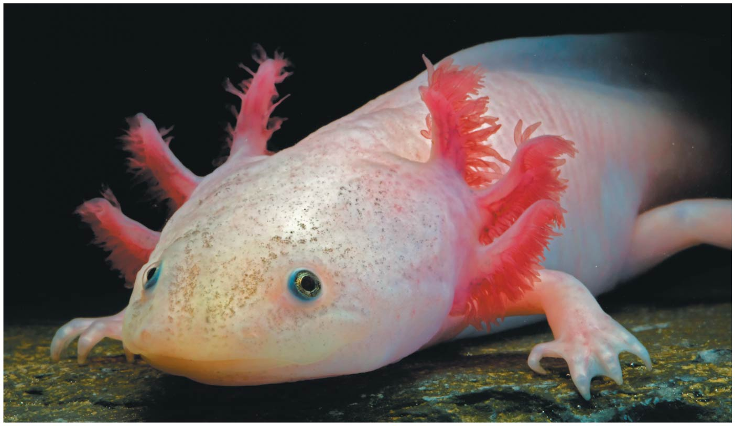
Figure 42.1
© 2017 Pearson Education, Inc.
Notes:
Figure 42.1 How does a feathery fringe help this animal survive?

Slide 5
Concept 42.1: Circulatory systems link exchange surfaces with cells throughout the body
Small molecules can move between cells and their surroundings by diffusion
Diffusion is only efficient over small distances because the time it takes to diffuse is proportional to the square of the distance

Slide 6
In some animals, many or all cells are in direct contact with the environment
In most animals, cells exchange materials with the environment via a fluid-filled circulatory system

Slide 7
Gastrovascular Cavities
Some animals lack a circulatory system
Some cnidarians have elaborate gastrovascular cavities that function in both digestion and distribution of substances throughout the body
The body wall that encloses the gastrovascular cavity is only two cells thick
Flatworms have a gastrovascular cavity and a flat body that minimizes diffusion distances

Slide 8
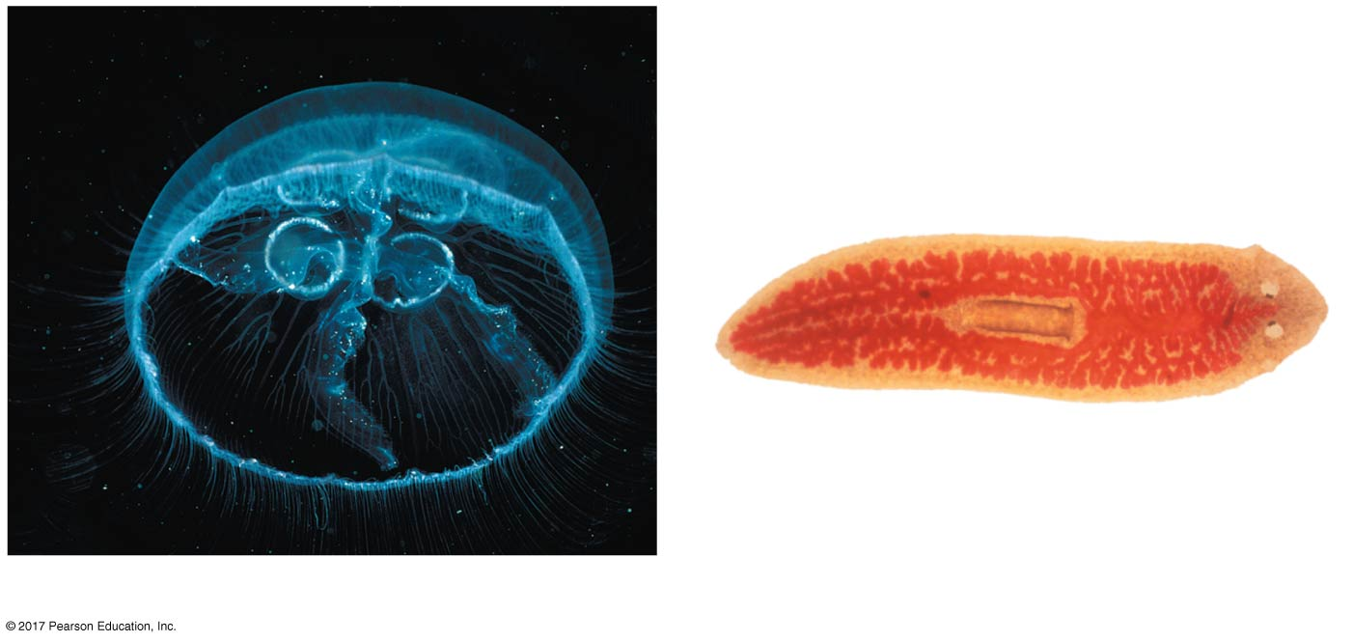
Figure 42.2
Mouth
Radial canals
Mouth
Gastrovascular
cavity
Pharynx
Circular canal
2.5 cm
1 mm
(a) The moon jelly Aurelia, a cnidarian
(b) The planarian Dugesia, a flatworm
© 2017 Pearson Education, Inc.
Notes:
Figure 42.2 Internal transport in gastrovascular cavities

Slide 9
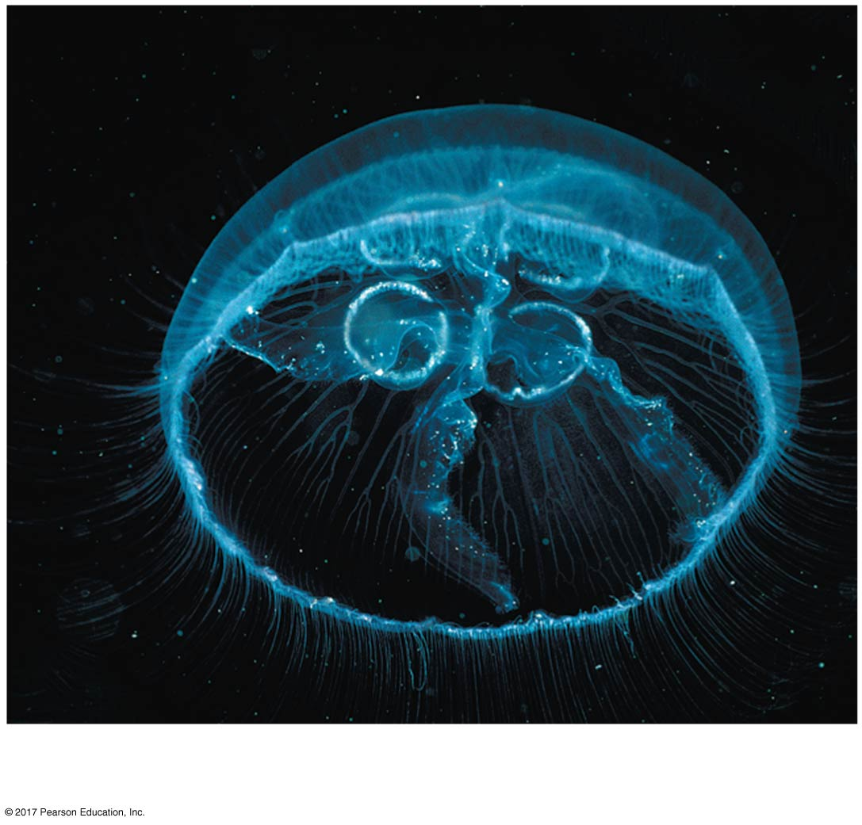
Figure 42.2a
Mouth
Radial canals
Circular canal
2.5 cm
(a) The moon jelly Aurelia, a cnidarian
© 2017 Pearson Education, Inc.
Notes:
Figure 42.2a Internal transport in gastrovascular cavities (part 1: cnidarian)

Slide 10
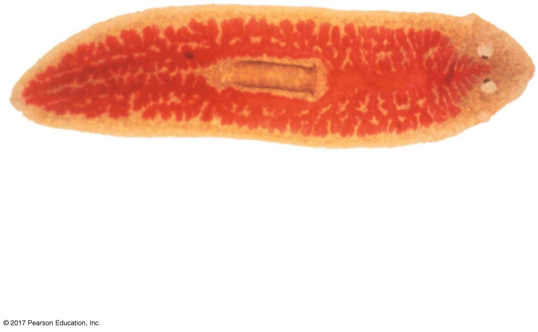
Figure 42.2b
Mouth
Gastrovascular
cavity
Pharynx
1 mm
(b) The planarian Dugesia, a flatworm
© 2017 Pearson Education, Inc.
Notes:
Figure 42.2b Internal transport in gastrovascular cavities (part 2: flatworm)

Slide 11
Open and Closed Circulatory Systems
A circulatory system has
A circulatory fluid
A set of interconnecting vessels
A muscular pump, the heart
The circulatory system connects the fluid that surrounds cells with the organs that exchange gases, absorb nutrients, and dispose of wastes
Circulatory systems can be open or closed

Slide 12
In insects, other arthropods, and some molluscs, circulatory fluid called hemolymph bathes the organs directly in an open circulatory system
In a closed circulatory system, blood is confined to vessels and is distinct from the interstitial fluid
Annelids, cephalopods, and vertebrates have closed circulatory systems

Slide 13
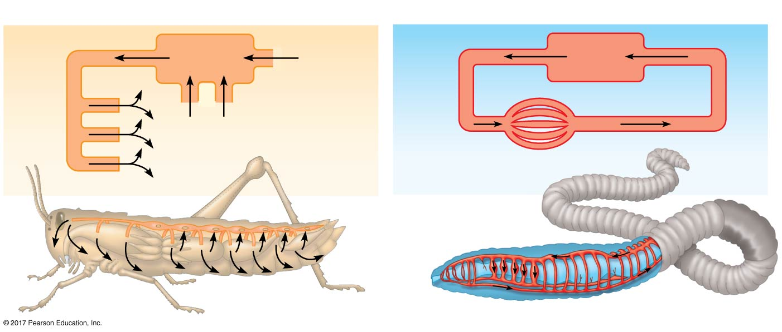
Figure 42.3
(a) An open circulatory system
(b) A closed circulatory system
Heart
Heart
Interstitial fluid
Hemolymph in sinuses
Blood
Small branch
vessels in
each organ
Pores
Dorsal vessel
(main heart)
Auxiliary
hearts
Tubular heart
Ventral vessels
© 2017 Pearson Education, Inc.
Notes:
Figure 42.3 Open and closed circulatory systems

Slide 14
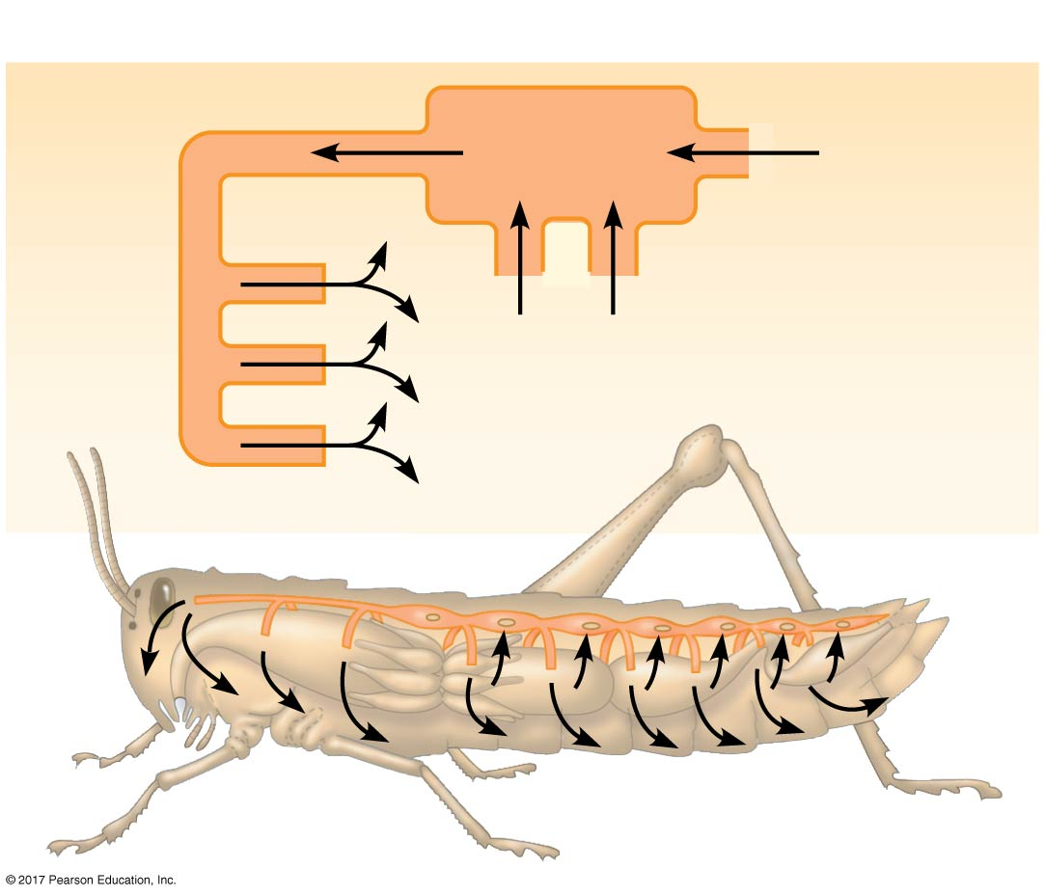
Figure 42.3a
(a) An open circulatory system
Heart
Hemolymph in sinuses
Pores
Tubular heart
© 2017 Pearson Education, Inc.
Notes:
Figure 42.3a Open and closed circulatory systems (part 1: open)

Slide 15
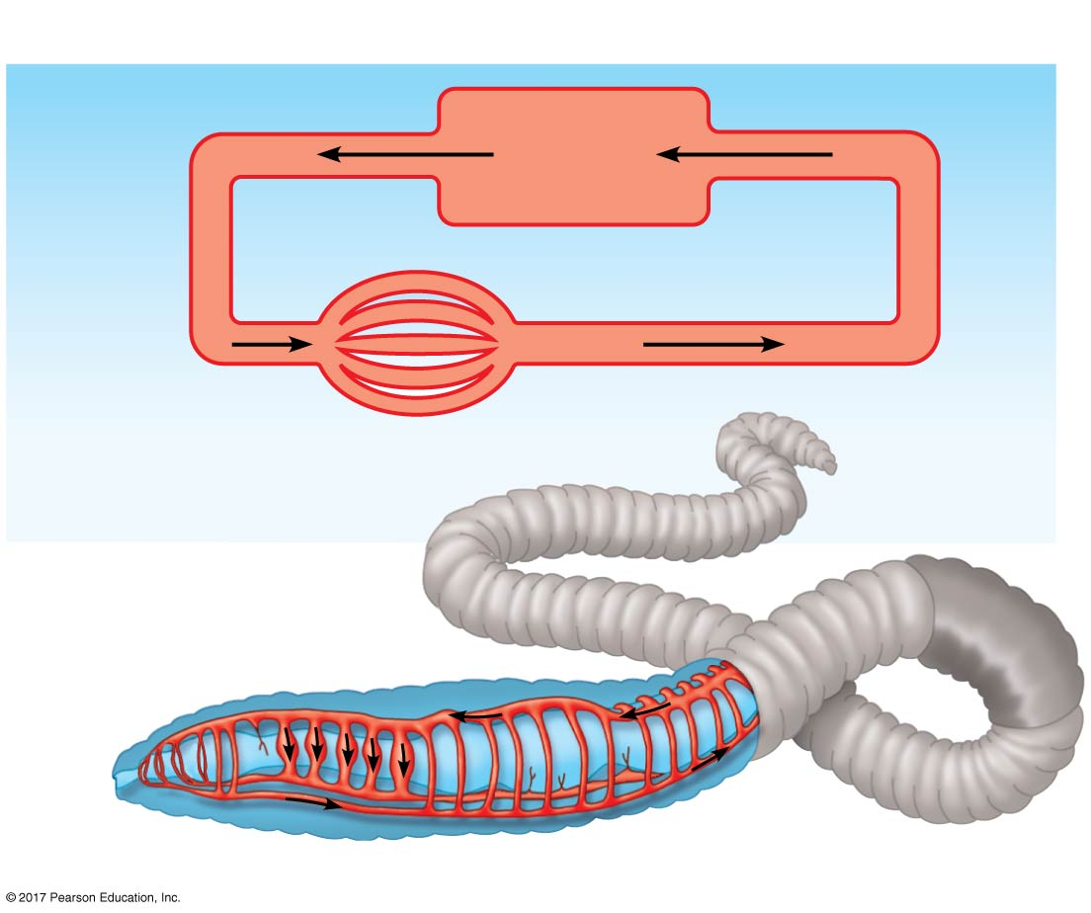
Figure 42.3b
(b) A closed circulatory system
Heart
Interstitial fluid
Blood
Small branch
vessels in
each organ
Dorsal vessel
(main heart)
Auxiliary
hearts
Ventral vessels
© 2017 Pearson Education, Inc.
Notes:
Figure 42.3b Open and closed circulatory systems (part 2: closed)

Slide 16
Organization of Vertebrate Circulatory Systems
Humans and other vertebrates have a closed circulatory system called the cardiovascular system
The three main types of blood vessels are arteries, veins, and capillaries
Blood flow is one way in these vessels

Slide 17
Arteries branch into arterioles and carry blood away from the heart to capillaries
Networks of capillaries called capillary beds are the sites of chemical exchange between the blood and interstitial fluid
Venules converge into veins and return blood from capillaries to the heart

Slide 18
Arteries and veins are distinguished by the direction of blood flow, not by O₂ content
Vertebrate hearts contain two or more chambers
Blood enters through an atria and is pumped out through ventricles

Slide 19
Single Circulation
Bony fishes, rays, and sharks have single circulation with a two-chambered heart
In single circulation, blood leaving the heart passes through two capillary beds before returning

Slide 20
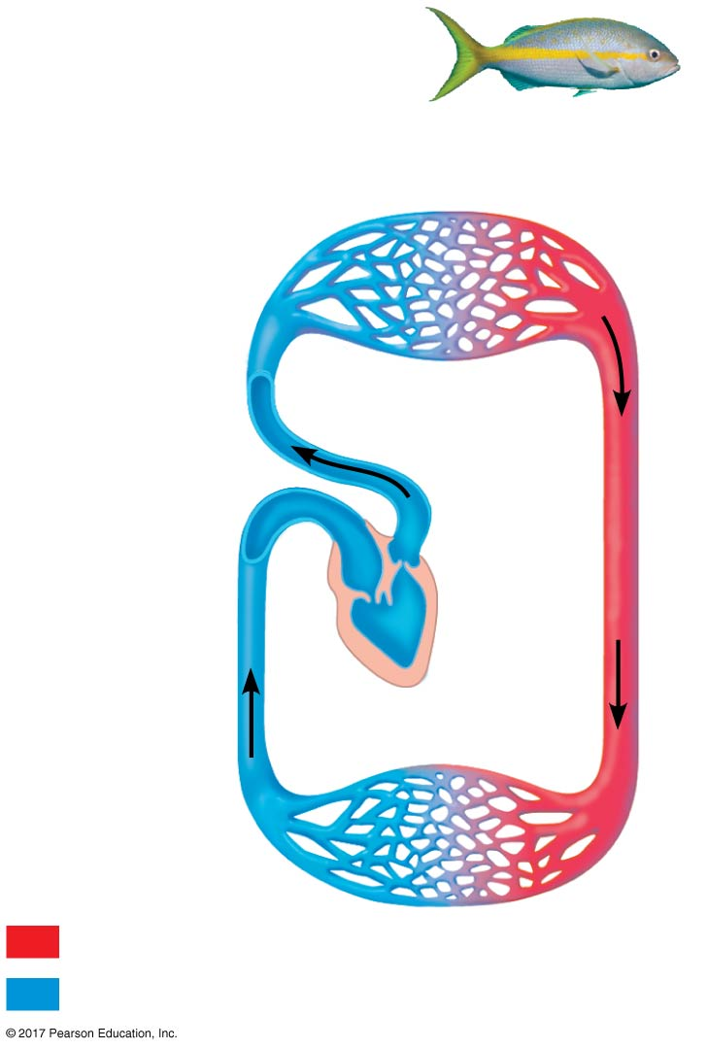
Figure 42.4a
(a) Single circulation: fish
Gill
capillaries
Artery
Heart:
Atrium (A)
Ventricle (V)
Vein
Oxygen-rich blood
Body
capillaries
Oxygen-poor blood
© 2017 Pearson Education, Inc.
Notes:
Figure 42.4a Examples of vertebrate circulatory schemes (part 1: fish)

Slide 21
Double Circulation
Amphibians, reptiles, and mammals have double circulation
Oxygen-poor and oxygen-rich blood are pumped separately from the right and left sides of the heart

Slide 22
In reptiles and mammals, oxygen-poor blood flows through the pulmonary circuit to pick up oxygen through the lungs
In amphibians, oxygen-poor blood flows through a pulmocutaneous circuit to pick up oxygen through the lungs and skin
Oxygen-rich blood delivers oxygen through the systemic circuit
Double circulation maintains higher blood pressure in the organs than does single circulation

Slide 23
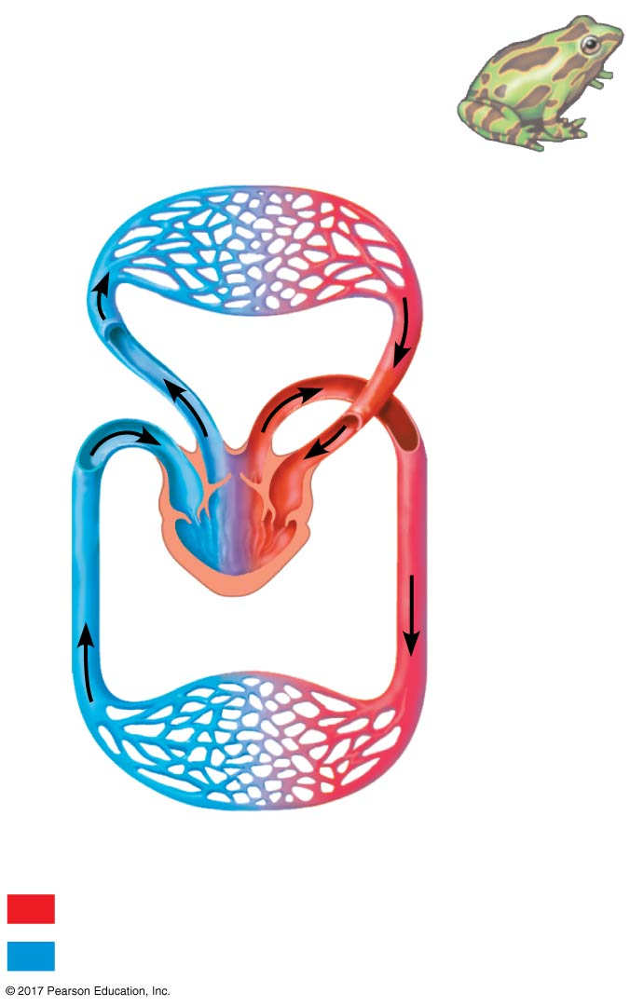
Figure 42.4b
(b) Double circulation: amphibian
Pulmocutaneous circuit
Lung
and skin
capillaries
Atrium
(A)
Atrium
(A)
Right
Left
Ventricle (V)
Systemic
capillaries
Systemic circuit
Oxygen-rich blood
Oxygen-poor blood
© 2017 Pearson Education, Inc.
Notes:
Figure 42.4b Examples of vertebrate circulatory schemes (part 2: amphibian)

Slide 24
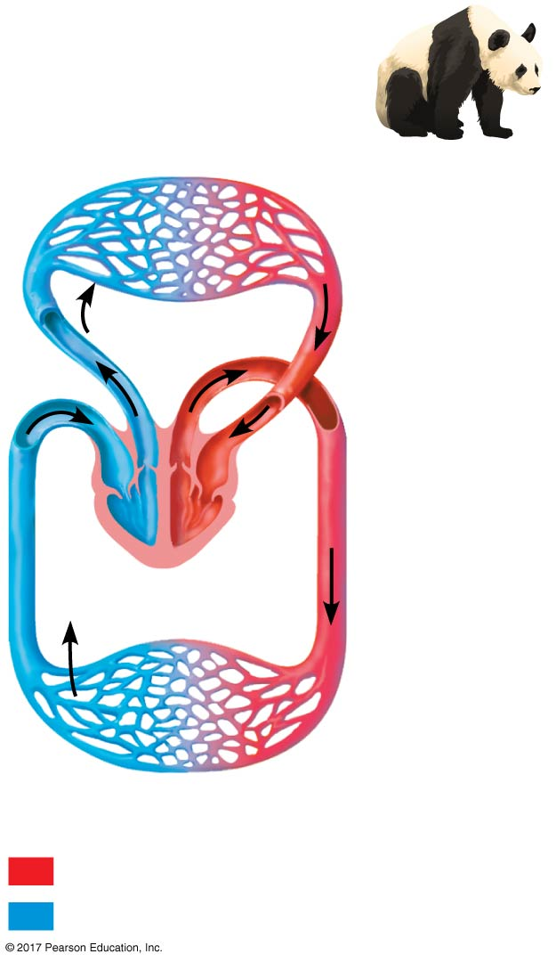
Figure 42.4c
(c) Double circulation: mammal
Pulmonary circuit
Lung
capillaries
A
A
V
V
Right
Left
Systemic
capillaries
Systemic circuit
Oxygen-rich blood
Oxygen-poor blood
© 2017 Pearson Education, Inc.
Notes:
Figure 42.4c Examples of vertebrate circulatory schemes (part 3: mammal)

Slide 25
Evolutionary Variation in Double Circulation
Some vertebrates with double circulation are intermittent breathers
Amphibians and many reptiles may pass long periods without gas exchange or relying on gas exchange from another tissue, usually the skin

Slide 26
Frogs and other amphibians have a three-chambered heart: two atria and one ventricle
A ridge in the ventricle diverts most of the oxygen-rich blood into the systemic circuit and most oxygen-poor blood into the pulmocutaneous circuit
When underwater, blood flow to the lungs is nearly shut off

Slide 27
Turtles, snakes, and lizards have a three-chambered heart: two atria and one ventricle, partially divided by an incomplete septum
In alligators, caimans, and other crocodilians, a septum divides the ventricles, but pulmonary and systemic circuits connect where arteries exit the heart

Slide 28
Mammals and birds have a four-chambered heart with two atria and two ventricles
The left side of the heart pumps and receives only oxygen-rich blood, while the right side receives and pumps only oxygen-poor blood
Mammals and birds are endotherms and require more O₂ than ectotherms

Slide 29
Concept 42.2: Coordinated cycles of heart contraction drive double circulation in mammals
The mammalian cardiovascular system meets the body’s continuous demand for O₂

Slide 30
Mammalian Circulation
Contraction of the right ventricle pumps blood to the lungs via the pulmonary arteries
The blood flows through capillary beds in the left and right lungs and loads O₂ and unloads CO₂
Oxygen-rich blood returns from the lungs via the pulmonary veins to the left atrium of the heart

Slide 31
Oxygen-rich blood flows into the left ventricle and is pumped out to body tissues via the systemic circuit
Blood leaves the left ventricle via the aorta, which conveys blood to arteries leading throughout the body
The first branches are the coronary arteries, supplying the heart muscle

Slide 32
Further branches lead to capillary beds in the abdominal organs and hind limbs
O₂ diffuses from blood to tissues, and CO₂ diffuses from tissues to blood
Capillaries rejoin, forming venules, conveying blood to veins
Oxygen-poor blood from the head, neck, and forelimbs is channeled into the superior vena cava

Slide 33
The inferior vena cava drains blood from the trunk and hind limbs
The two venae cavae empty their blood into the right atrium from which the oxygen-poor blood flows into the right ventricle

Slide 34
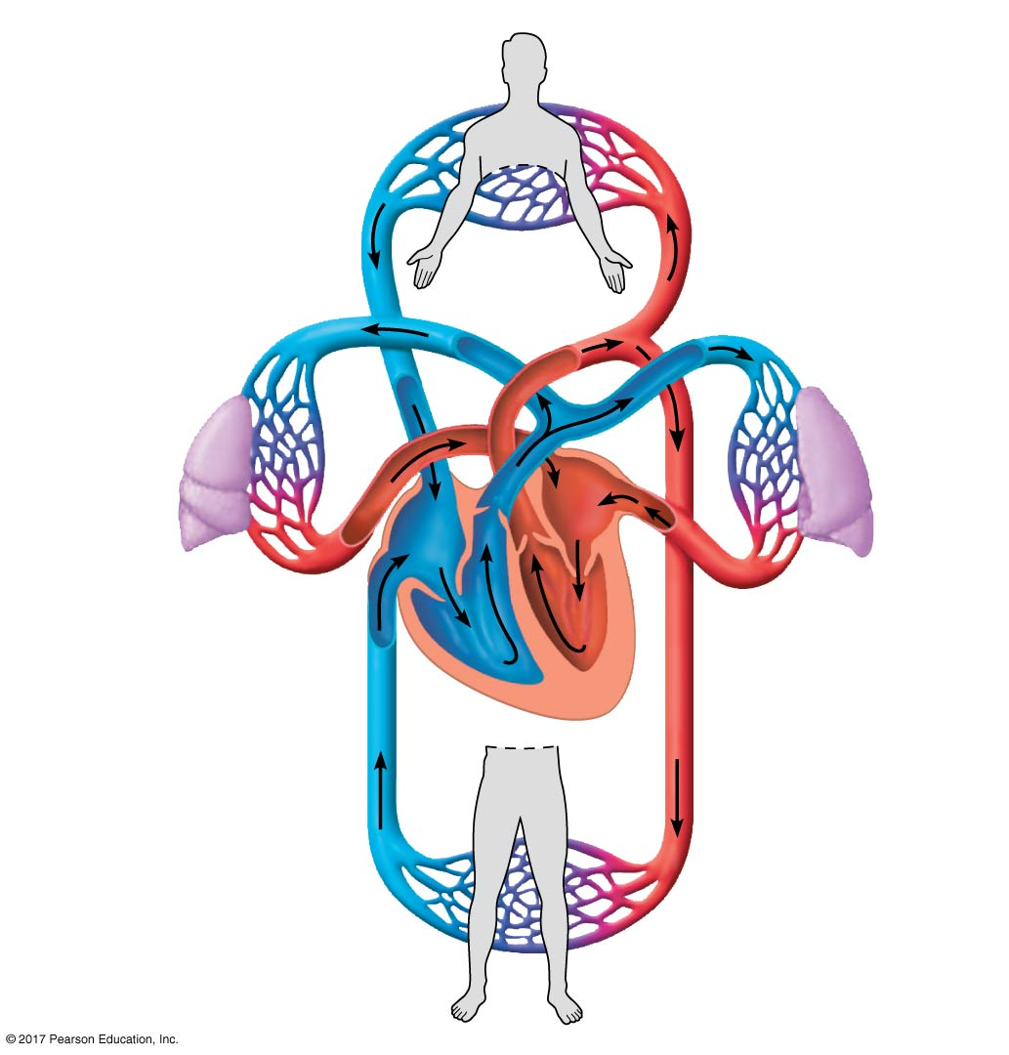
Figure 42.5
Superior
vena cava
Capillaries of
head and
forelimbs
7
Pulmonary
artery
Pulmonary
artery
Capillaries
of right lung
9
Aorta
Capillaries
of left lung
6
3
2
3
4
11
Pulmonary
vein
5
Pulmonary
vein
1
Right atrium
10
Left atrium
Right ventricle
Left ventricle
Inferior
vena cava
Aorta
Capillaries of
abdominal organs
and hind limbs
8
© 2017 Pearson Education, Inc.
Notes:
Figure 42.5 The mammalian cardiovascular system: an overview

Slide 35
Animation: Path of Blood Flow in Mammals

Slide 36
The Mammalian Heart: A Closer Look
The human heart is about the size of a clenched fist and consists mainly of cardiac muscle
The two atria have relatively thin walls and serve as collection chambers for blood returning to the heart
The ventricles have thicker walls and contract much more forcefully

Slide 37
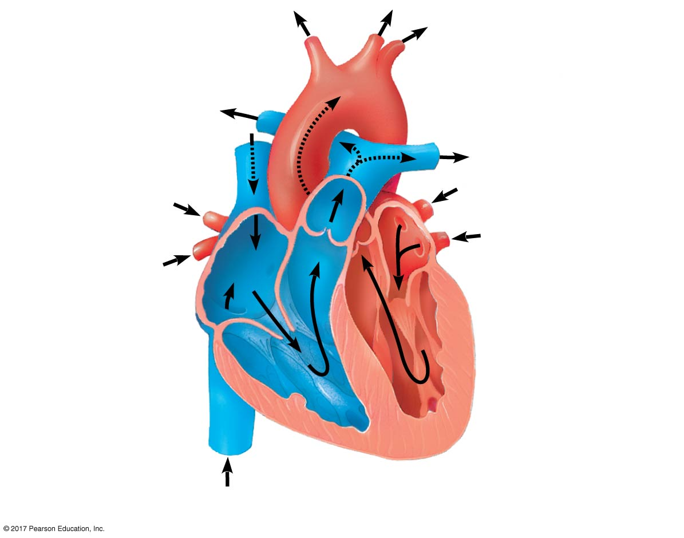
Figure 42.6
Pulmonary artery
Aorta
Pulmonary
artery
Right
atrium
Left
atrium
Semilunar
valve
Semilunar
valve
Atrioventricular
(AV) valve
Atrioventricular
(AV) valve
Right
ventricle
Left
ventricle
© 2017 Pearson Education, Inc.
Notes:
Figure 42.6 The mammalian heart: a closer look

Slide 38
The heart contracts and relaxes in a rhythmic cycle called the cardiac cycle
The contraction, or pumping, phase is called systole
The relaxation, or filling, phase is called diastole

Slide 39
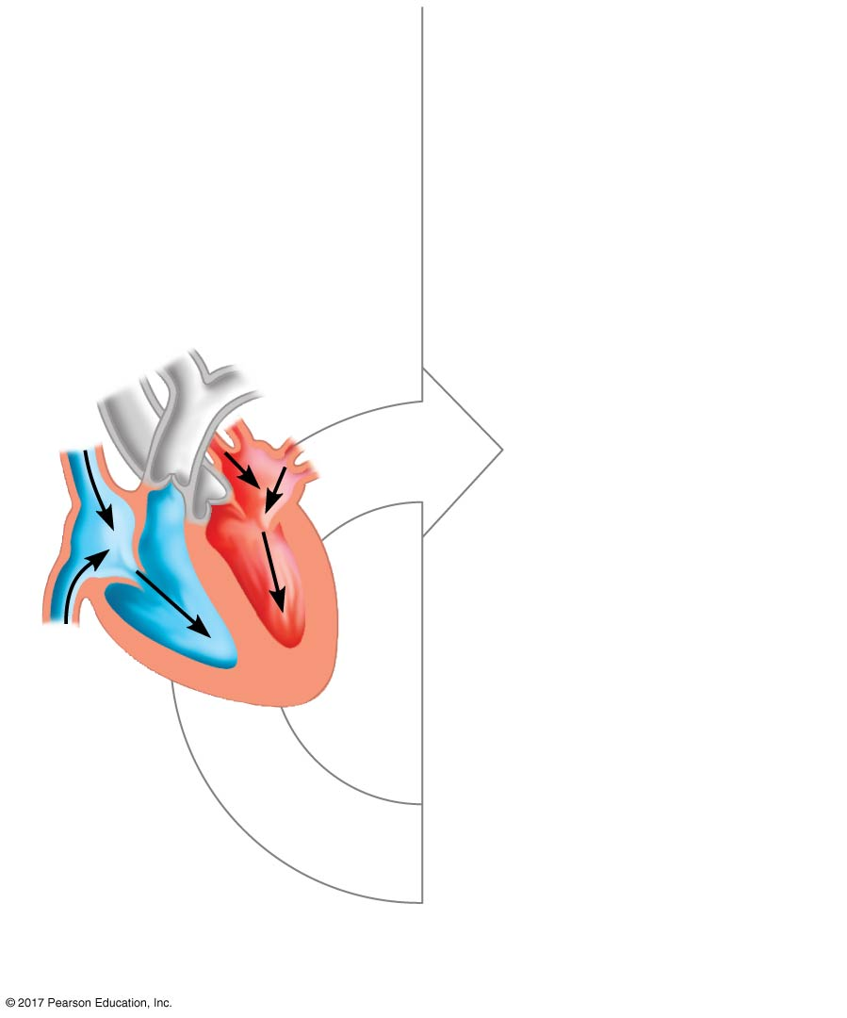
Figure 42.7_1
Atrial and
ventricular diastole
1
0.4
sec
© 2017 Pearson Education, Inc.
Notes:
Figure 42.7_1 The cardiac cycle (step 1)

Slide 40
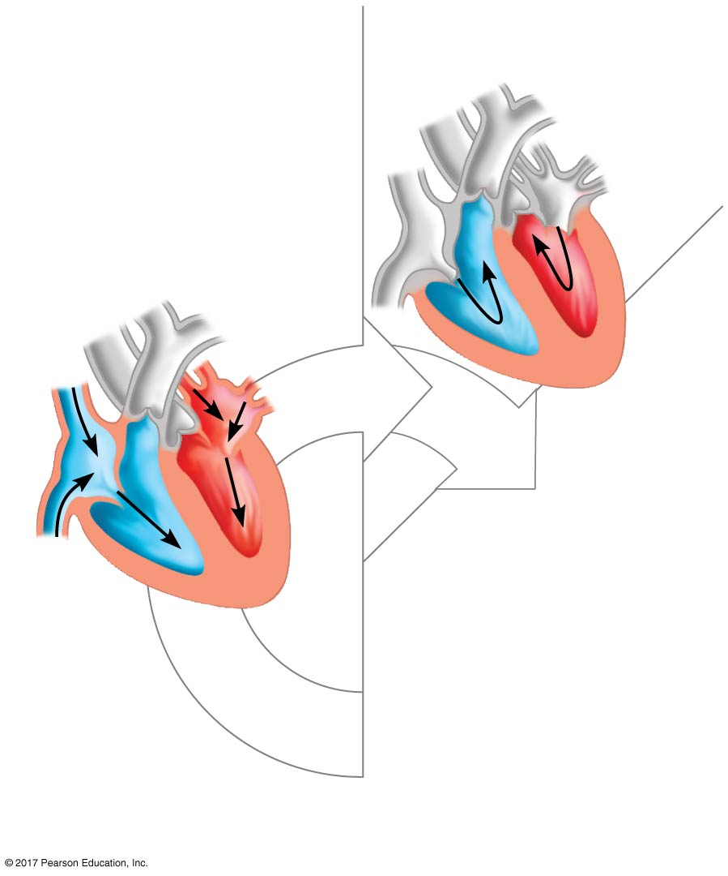
Figure 42.7_2
Atrial systole and
ventricular diastole
2
Atrial and
ventricular diastole
1
0.1
sec
0.4
sec
© 2017 Pearson Education, Inc.
Notes:
Figure 42.7_2 The cardiac cycle (step 2)

Slide 41
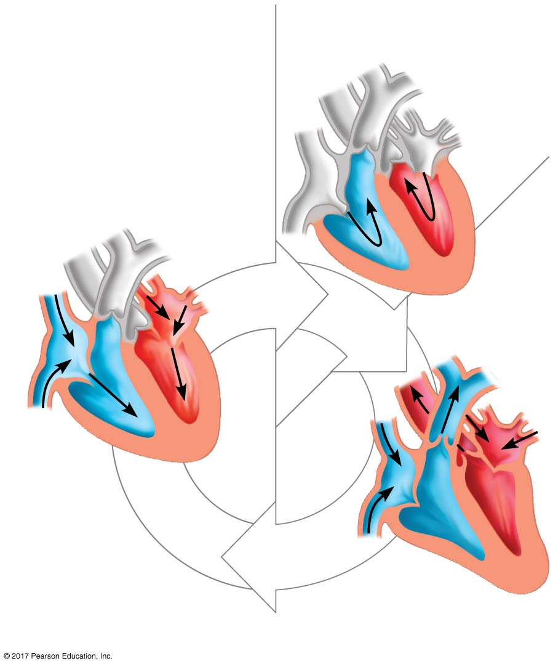
Figure 42.7_3
Atrial systole and
ventricular diastole
2
Atrial and
ventricular diastole
1
0.1
sec
0.3 sec
0.4
sec
3
Ventricular systole
and atrial diastole
© 2017 Pearson Education, Inc.
Notes:
Figure 42.7_3 The cardiac cycle (step 3)

Slide 42
The cardiac output is the volume of blood pumped into the systemic circulation per minute and depends on both the heart rate and stroke volume
The heart rate is the number of beats per minute
The stroke volume is the amount of blood pumped in a single contraction

Slide 43
Four valves prevent backflow of blood in the heart
The atrioventricular (AV) valves separate each atrium and ventricle
The semilunar valves control blood flow to the aorta and the pulmonary artery

Slide 44
The “lub-dup” sound of a heart beat is caused by the recoil of blood against the AV valves (lub) then against the semilunar (dup) valves
Backflow of blood through a defective valve causes a heart murmur

Slide 45
Maintaining the Heart’s Rhythmic Beat
Some cardiac muscle cells are autorhythmic, meaning they contract without any signal from the nervous system
The sinoatrial (SA) node, or pacemaker, sets the rate and timing at which cardiac muscle cells contract
Impulses that travel during the cardiac cycle can be recorded as an electrocardiogram (ECG or EKG)

Slide 46
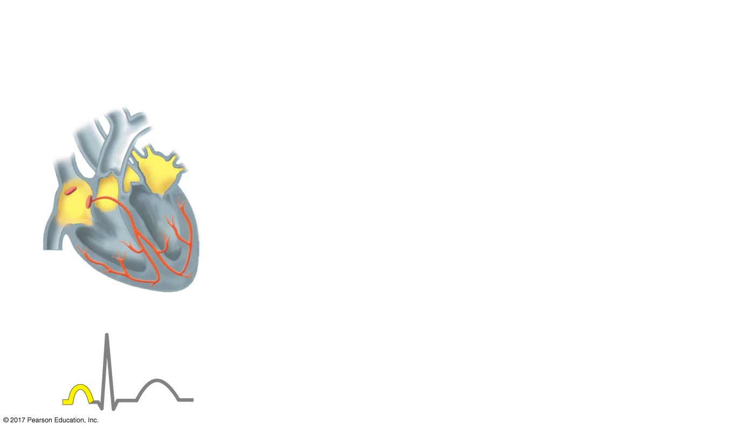
Figure 42.8_1
1
Signals (yellow)
from SA node
spread through
atria.
SA node
(pacemaker)
ECG
© 2017 Pearson Education, Inc.
Notes:
Figure 42.8_1 The control of heart rhythm (step 1)

Slide 47
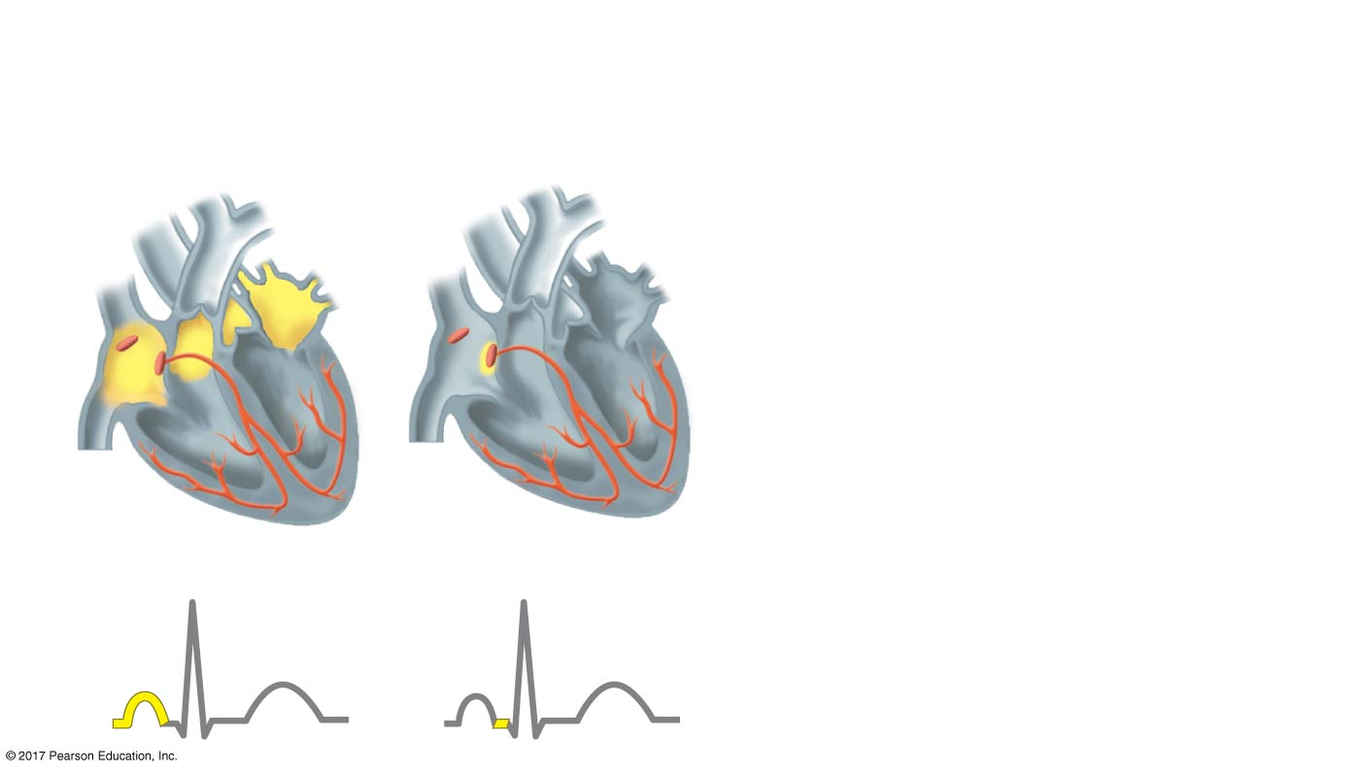
Figure 42.8_2
1
Signals (yellow)
from SA node
spread through
atria.
2
Signals are
delayed at AV
node.
SA node
(pacemaker)
AV
node
ECG
© 2017 Pearson Education, Inc.
Notes:
Figure 42.8_2 The control of heart rhythm (step 2)

Slide 48
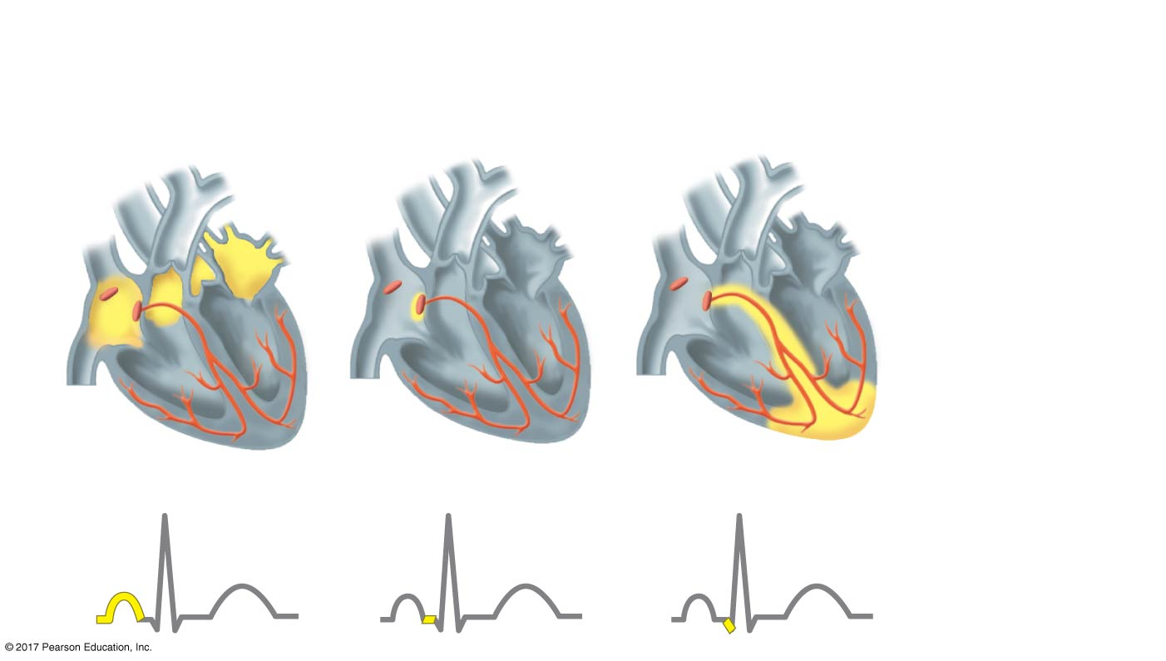
Figure 42.8_3
1
Signals (yellow)
from SA node
spread through
atria.
2
Signals are
delayed at AV
node.
3
Bundle branches
pass signals to
heart apex.
SA node
(pacemaker)
AV
node
Bundle
branches
Heart
apex
ECG
© 2017 Pearson Education, Inc.
Notes:
Figure 42.8_3 The control of heart rhythm (step 3)

Slide 49
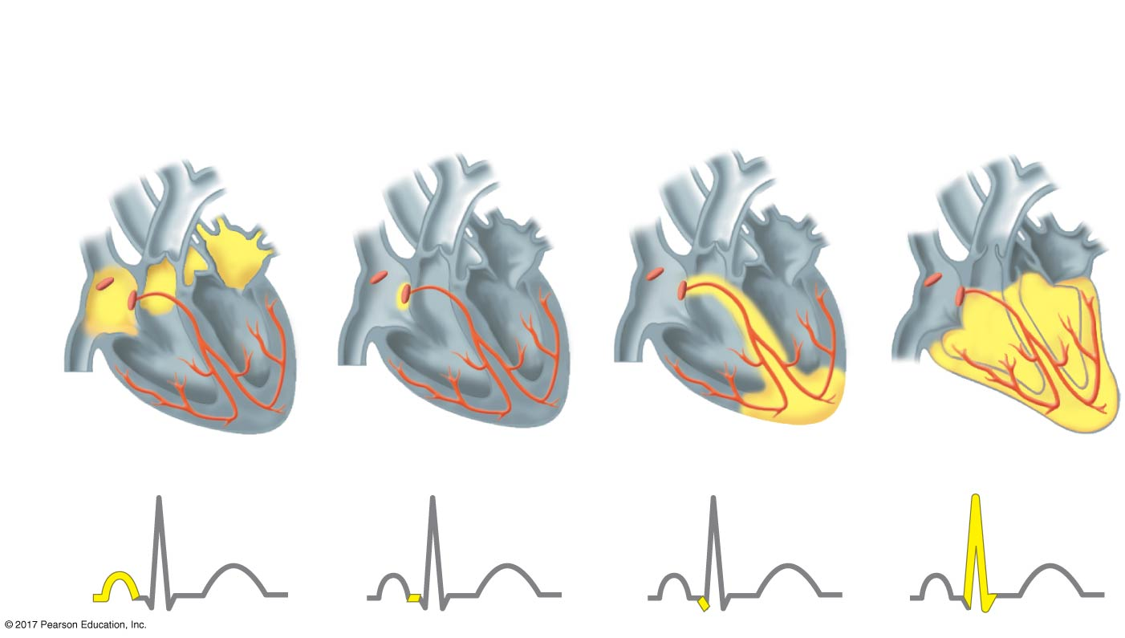
Figure 42.8_4
1
Signals (yellow)
from SA node
spread through
atria.
2
Signals are
delayed at AV
node.
3
Bundle branches
pass signals to
heart apex.
4
Signals
spread
throughout
ventricles.
SA node
(pacemaker)
AV
node
Bundle
branches
Purkinje
fibers
Heart
apex
ECG
© 2017 Pearson Education, Inc.
Notes:
Figure 42.8_4 The control of heart rhythm (step 4)

Slide 50
Impulses from the SA node travel to the atrioventricular (AV) node
Here, the impulses are delayed and then travel to the Purkinje fibers that make the ventricles contract

Slide 51
The pacemaker is regulated by two portions of the nervous system: the sympathetic and parasympathetic divisions
The sympathetic division speeds up the pacemaker
The parasympathetic division slows down the pacemaker
The pacemaker is also regulated by hormones and temperature

Slide 52
Concept 42.3: Patterns of blood pressure and flow reflect the structure and arrangement of blood vessels
The vertebrate circulatory system relies on blood vessels that exhibit a close match of structure and function

Slide 53
Blood Vessel Structure and Function
All blood vessels contain a central lumen lined with an epithelial layer that lines blood vessels
This endothelium is smooth and minimizes resistance
Capillaries are only slightly wider than a red blood cell
Capillaries have thin walls, the endothelium plus its basal lamina, to facilitate the exchange of materials

Slide 54
Arteries and veins have an endothelium, smooth muscle, and connective tissue
Arteries have thick, elastic walls to accommodate the high pressure of blood pumped from the heart
In the thinner-walled veins, blood flows back to the heart mainly as a result of muscle action
Unlike arteries, veins contain valves to maintain unidirectional blood flow

Slide 55
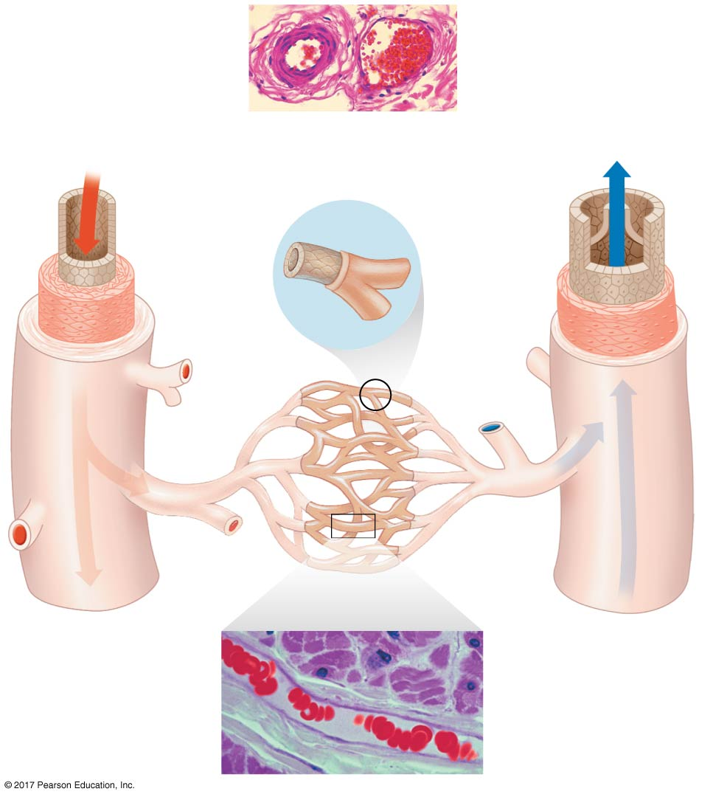
Figure 42.9
Artery
LM
Vein
Red blood cells
100 µm
Basal lamina
Valve
Endothelium
Endothelium
Smooth
muscle
Smooth
muscle
Connective
tissue
Capillary
Connective
tissue
Arteriole
Venule
Capillary bed
15 µm
Red blood cells
in capillary
LM
© 2017 Pearson Education, Inc.
Notes:
Figure 42.9 The structure of blood vessels

Slide 56
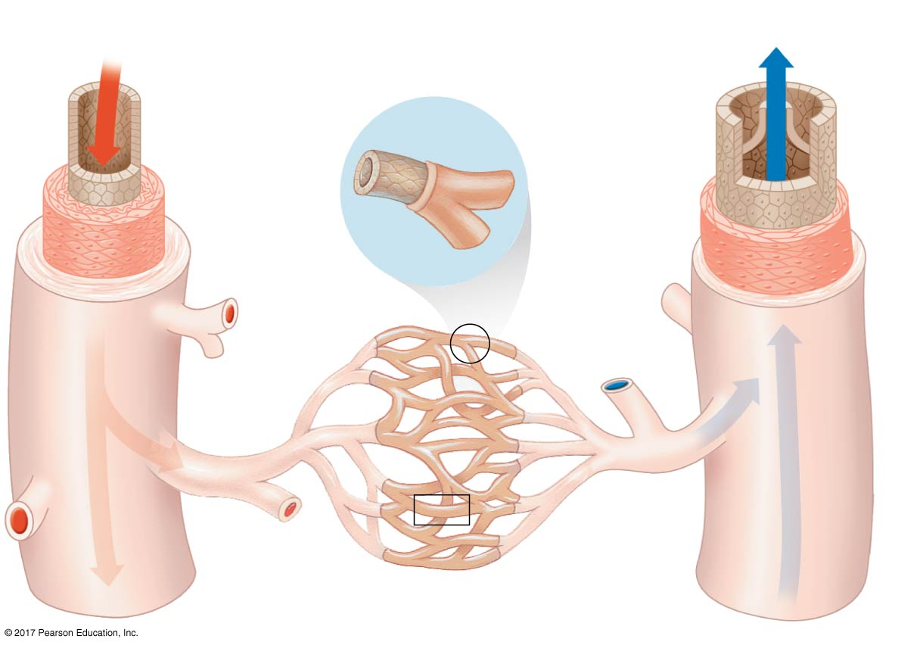
Figure 42.9a
Artery
Vein
Basal lamina
Valve
Endothelium
Endothelium
Smooth
muscle
Smooth
muscle
Connective
tissue
Capillary
Connective
tissue
Arteriole
Venule
Capillary bed
© 2017 Pearson Education, Inc.
Notes:
Figure 42.9a The structure of blood vessels (part 1: detail)

Slide 57
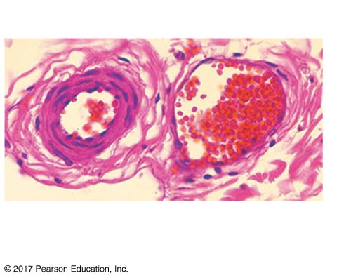
Figure 42.9b
Artery
Vein
LM
Red blood cells
100 µm
© 2017 Pearson Education, Inc.
Notes:
Figure 42.9b The structure of blood vessels (part 2: artery and vein LM)

Slide 58
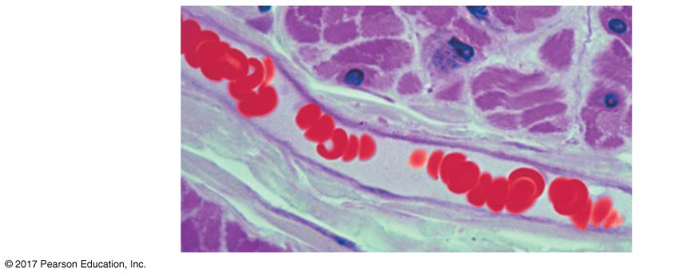
Figure 42.9c
15 μm
Red blood
cells in
capillary
LM
© 2017 Pearson Education, Inc.
Notes:
Figure 42.9c The structure of blood vessels (part 3: capillary LM)

Slide 59
Blood Flow Velocity
Physical laws governing movement of fluids through pipes affect blood flow and blood pressure
Velocity of blood flow is slowest in the capillary beds as a result of the high resistance and large total cross-sectional area
Blood flow in capillaries is necessarily slow for exchange of materials

Slide 60
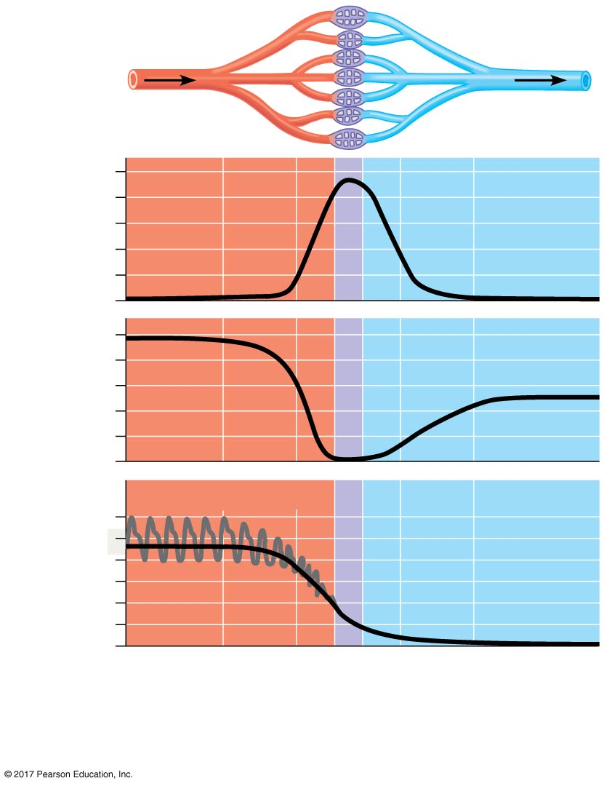
Figure 42.10
Area (cm²)
5,000
4,000
3,000
2,000
1,000
0
50
Velocity
(cm/sec)
40
30
20
10
0
Systolic pressure
120
Pressure
(mm Hg)
100
80
60
Diastolic
pressure
Mean
pressure
40
20
0
Aorta
Arteries
Arterioles
Capillaries
Venules
Veins
Venae
cavae
© 2017 Pearson Education, Inc.
Notes:
Figure 42.10 The interrelationship of cross-sectional area of blood vessels, blood flow velocity, and blood pressure

Slide 61
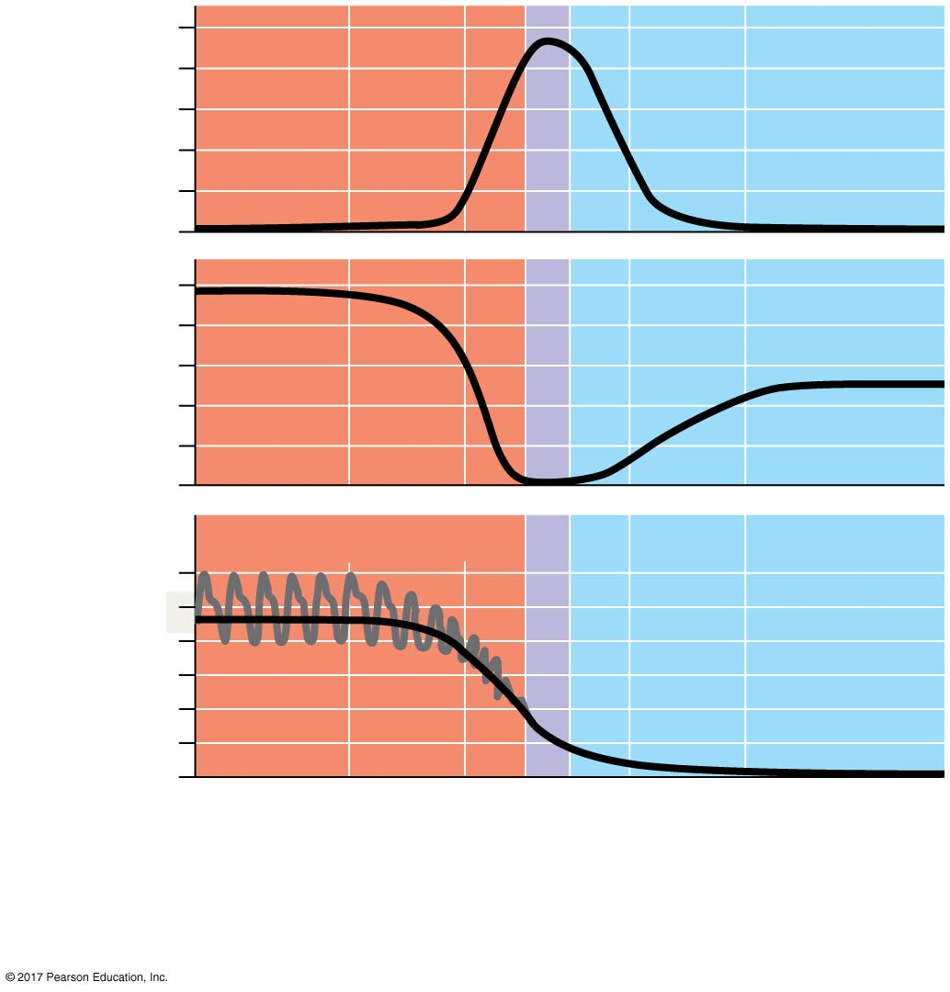
Figure 42.10a
5,000
Area (cm²)
4,000
3,000
2,000
1,000
0
50
Velocity
(cm/sec)
40
30
20
10
0
Systolic pressure
120
Pressure
(mm Hg)
100
80
60
Diastolic
pressure
Mean
pressure
40
20
0
Aorta
Arteries
Arterioles
Capillaries
Venules
Veins
Venae
cavae
© 2017 Pearson Education, Inc.
Notes:
Figure 42.10a The interrelationship of cross-sectional area of blood vessels, blood flow velocity, and blood pressure (part 1: detail)

Slide 62
Blood Pressure
Blood flows from areas of higher pressure to areas of lower pressure
Blood pressure is a force exerted in all directions, including against the walls of blood vessels
The recoil of elastic arterial walls plays a role in maintaining blood pressure
The resistance to blood flow in the narrow diameters of tiny capillaries and arterioles dissipates much of the pressure

Slide 63
Changes in Blood Pressure During the Cardiac Cycle
Systolic pressure is the pressure in the arteries during ventricular systole; it is the highest pressure in the arteries
A pulse is the rhythmic bulging of artery walls with each heartbeat
Diastolic pressure is the pressure in the arteries during diastole; it is lower than systolic pressure

Slide 64
Regulation of Blood Pressure
Homeostatic mechanisms regulate arterial blood pressure by altering the diameter of arterioles
Vasoconstriction is the contraction of smooth muscle in arteriole walls; it increases blood pressure
Vasodilation is the relaxation of smooth muscles in the arterioles; it causes blood pressure to fall

Slide 65
Nitric oxide (NO) is a major inducer of vasodilation
The peptide endothelin is a potent inducer of vasoconstriction
Vasoconstriction and vasodilation are often coupled to changes in cardiac output that affect blood pressure

Slide 66
Blood Pressure and Gravity
Blood pressure is generally measured for an artery in the arm at the same height as the heart
Blood pressure for a healthy 20-year-old human at rest is about 120 mm Hg at systole and 70 mm Hg at diastole
Gravity has a significant effect on blood pressure

Slide 67
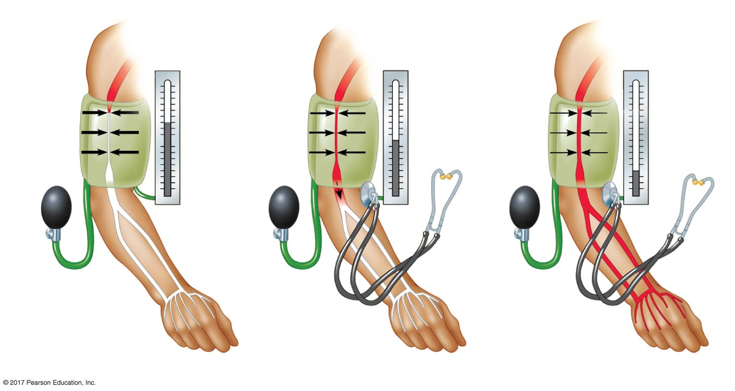
Figure 42.11
Pressure in cuff
greater than
120 mm Hg
Pressure in cuff
drops below
120 mm Hg
Pressure in
cuff below
70 mm Hg
Cuff
inflated
with air
120
120
70
Artery
closed
Sounds
audible in
stethoscope
Sounds
stop
1
2
3
© 2017 Pearson Education, Inc.
Notes:
Figure 42.11 Measurement of blood pressure

Slide 68
Fainting is caused by inadequate blood flow to the head
Animals with long necks require a very high systolic pressure to pump blood a great distance against gravity
Because blood pressure is low in veins, one-way valves in veins prevent backflow of blood
Return of blood is also enhanced by contraction of smooth muscle in venule walls and skeletal muscle contraction

Slide 69
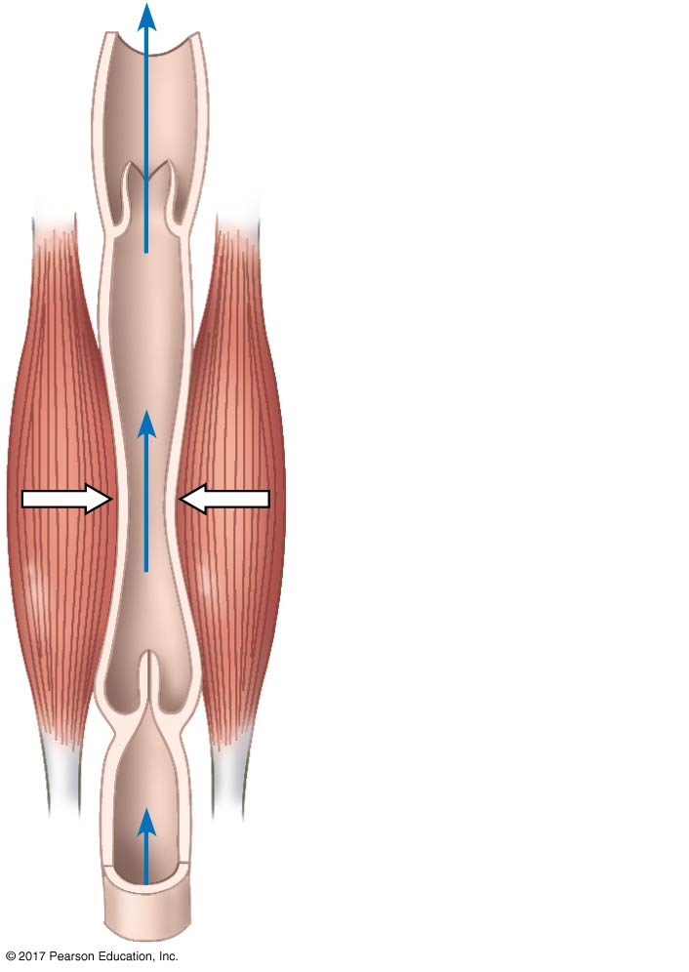
Figure 42.12
Direction of blood
flow in vein
(toward heart)
Valve (open)
Skeletal muscle
Valve (closed)
© 2017 Pearson Education, Inc.
Notes:
Figure 42.12 Blood flow in veins

Slide 70
Capillary Function
Blood flows through only 5–10% of the body’s capillaries at any given time
Capillaries in major organs are usually filled to capacity
Blood supply varies in many other sites

Slide 71
Two mechanisms regulate distribution of blood in capillary beds
Constriction or dilation of arterioles that supply capillary beds
Precapillary sphincters that control flow of blood between arterioles and venules
Blood flow is regulated by nerve impulses, hormones, and other chemicals

Slide 72
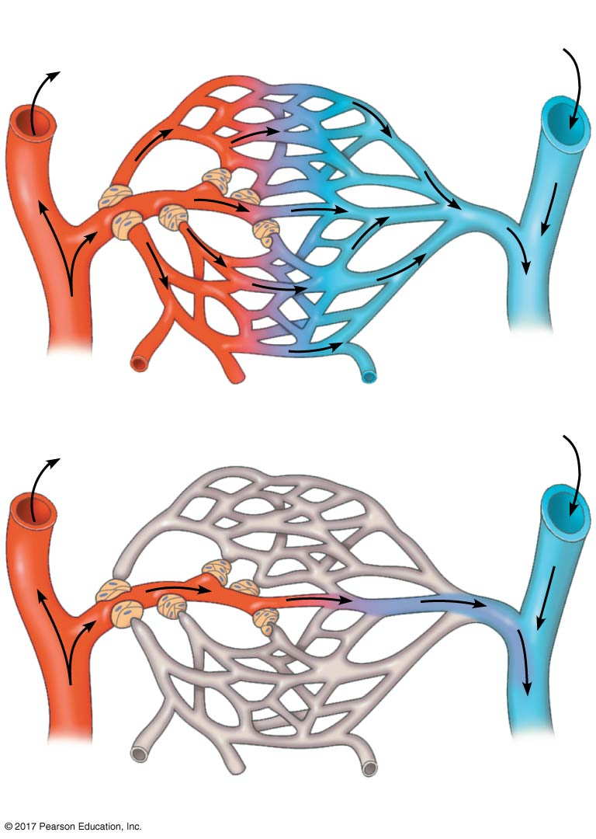
Figure 42.13
Precapillary sphincters
Thoroughfare
channel
Capillaries
Arteriole
Venule
(a) Sphincters relaxed
Arteriole
Venule
(b) Sphincters contracted
© 2017 Pearson Education, Inc.
Notes:
Figure 42.13 Blood flow in capillary beds

Slide 73
The exchange of substances between the blood and interstitial fluid takes place across the thin endothelial walls of the capillaries
Blood pressure tends to drive fluid out of capillaries, and blood proteins tend to pull fluid back
These proteins are responsible for much of the blood’s osmotic pressure
On average, there is a net loss of fluid from capillaries

Slide 74
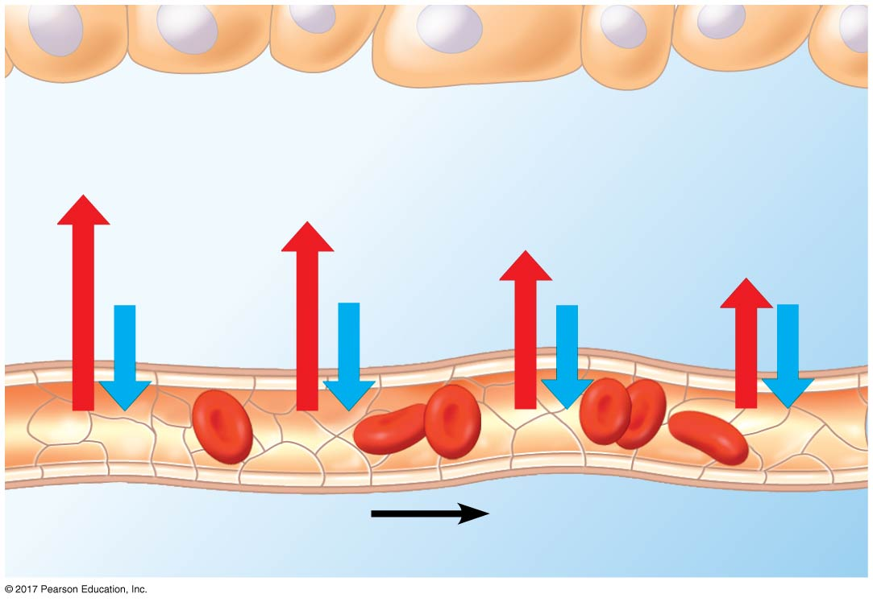
Figure 42.14
INTERSTITIAL
FLUID
Body cell
Net fluid movement out
Blood
pressure
Osmotic
pressure
Arterial end
of capillary
Venous end
of capillary
Direction of blood flow
© 2017 Pearson Education, Inc.
Notes:
Figure 42.14 Fluid exchange between capillaries and the interstitial fluid

Slide 75
Fluid Return by the Lymphatic System
The lymphatic system returns fluid that leaks out from the capillary beds
Fluid lost by capillaries is called lymph
The lymphatic system drains into veins in the neck
Valves in lymph vessels prevent the backflow of fluid

Slide 76
Edema is swelling caused by disruptions in the flow of lymph
Lymph nodes are organs that filter lymph and play an important role in the body’s defense
When the body is fighting an infection, lymph nodes become swollen and tender

Slide 77
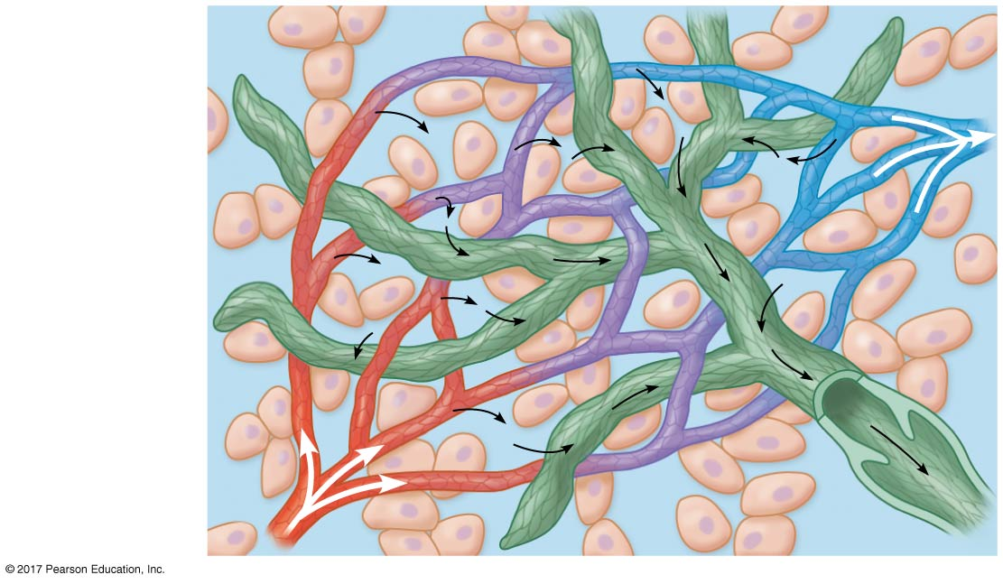
Figure 42.15
Blood
capillary
Interstitial
fluid
Tissue
cells
Lymphatic
vessel
Arteriole
© 2017 Pearson Education, Inc.
Notes:
Figure 42.15 The close association of lymphatic vessels and blood capillaries

Slide 78
Concept 42.4: Blood components function in exchange, transport, and defense
With open circulation, the fluid is continuous with the fluid surrounding all body cells
The closed circulatory systems of vertebrates contain a more highly specialized fluid called blood

Slide 79
Blood Composition and Function
Blood in vertebrates is a connective tissue consisting of several kinds of cells suspended in a liquid matrix called plasma
Cells and cell fragments occupy about 45% of the volume of blood

Slide 80
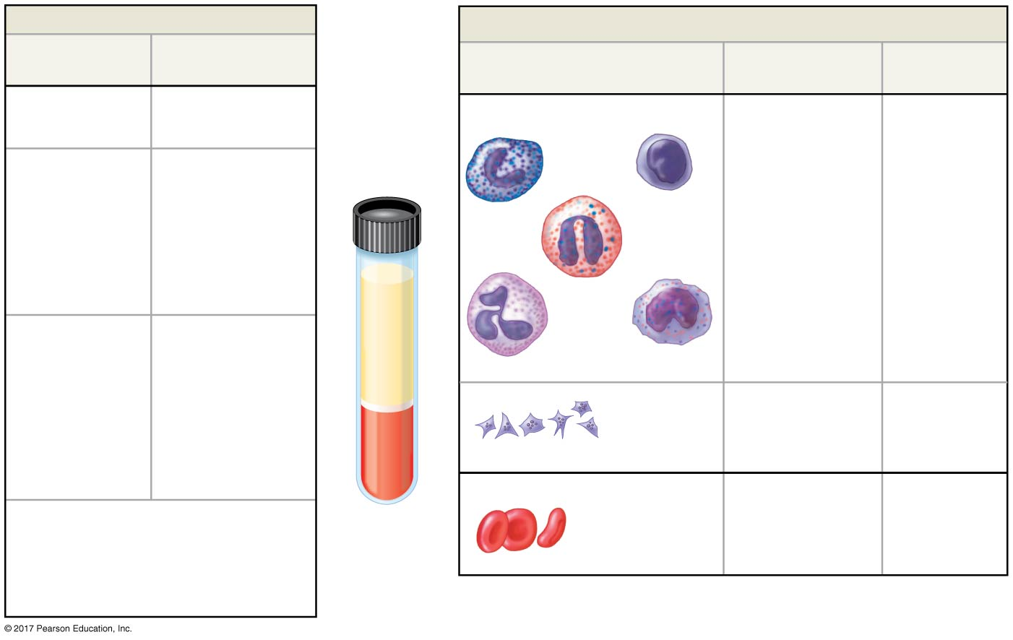
Figure 42.16
Plasma 55%
Cellular elements 45%
Constituent
Major functions
Cell type
Number per
µL (mm³) of blood
Functions
Water
Solvent
Leukocytes
(white blood cells)
5,000–10,000
Defense and
immunity
Separated
blood
elements
Ions (blood
electrolytes)
Osmotic balance,
pH buffering,
and regulation
of membrane
permeability
Sodium
Basophils
Lymphocytes
Potassium
Calcium
Magnesium
Chloride
Eosinophils
Bicarbonate
Plasma proteins
Albumin
Osmotic balance,
pH buffering
Neutrophils
Monocytes
Immunoglobulins
(antibodies)
Defense
Platelets
250,000–400,000
Blood clotting
Apolipoproteins
Lipid transport
Fibrinogen
Clotting
Erythrocytes (red blood cells)
5,000,000–6,000,000
Transport of O₂
and some CO₂
Substances transported by blood
Nutrients (such as glucose, fatty acids,
vitamins), waste products of
metabolism, respiratory gases
(O₂ and CO₂), and hormones
© 2017 Pearson Education, Inc.
Notes:
Figure 42.16 The composition of mammalian blood

Slide 81
Figure 42.16a
Plasma 55%
Constituent
Major functions
Water
Solvent
Ions (blood
electrolytes)
Osmotic balance,
pH buffering,
and regulation
of membrane
permeability
Sodium, Potassium,
Calcium, Magnesium,
Chloride, Bicarbonate
Plasma proteins
Albumin
Osmotic balance, pH buffering
Immunoglobulins
(antibodies)
Defense
Apolipoproteins
Lipid transport
Fibrinogen
Clotting
Substances transported by blood
Nutrients (such as glucose, fatty acids, vitamins),
waste products of metabolism, respiratory gases
(O₂ and CO₂), and hormones
© 2017 Pearson Education, Inc.
Notes:
Figure 42.16a The composition of mammalian blood (part 1: plasma)

Slide 82
Figure 42.16b
Cellular elements 45%
Cell type
Number per
µL (mm³) of blood
Functions
Leukocytes
(white blood cells)
5,000–10,000
Defense and
immunity
Basophils
Lymphocytes
Eosinophils
Neutrophils
Monocytes
Platelets
250,000–400,000
Blood clotting
Erythrocytes
(red blood cells)
5,000,000–6,000,000
Transport of O₂
and some CO₂
© 2017 Pearson Education, Inc.
Notes:
Figure 42.16b The composition of mammalian blood (part 2: cellular)

Slide 83
Plasma
Plasma contains inorganic salts as dissolved ions, sometimes called electrolytes
Plasma proteins influence blood pH and help maintain osmotic balance between blood and interstitial fluid
Certain plasma proteins function in lipid transport, immunity, and blood clotting
Plasma is similar in composition to interstitial fluid, but plasma has a much higher protein concentration

Slide 84
Cellular Elements
Suspended in blood plasma are two types of cells:
Red blood cells (erythrocytes) transport O₂
White blood cells (leukocytes) function in defense
Platelets are fragments of cells that are involved in clotting

Slide 85
Erythrocytes
Red blood cells, or erythrocytes, are the most numerous blood cells
They contain hemoglobin, the iron-containing protein that transports O₂
Each molecule of hemoglobin binds up to four molecules of O₂
In mammals, mature erythrocytes lack nuclei and mitochondria

Slide 86
Sickle-cell disease is caused by abnormal hemoglobin proteins that form aggregates
The aggregates can deform an erythrocyte into a sickle shape
Sickled cells can rupture or can block blood vessels

Slide 87
Leukocytes
There are five major types of white blood cells, or leukocytes
They function in defense either by phagocytizing bacteria and debris or by mounting immune responses against foreign substances
They are found both in and outside of the circulatory system

Slide 88
Platelets
Platelets are fragments of cells and function in blood clotting

Slide 89
Video: Leukocyte Adhesion and Rolling

Slide 90
Stem Cells and the Replacement of Cellular Elements
Erythrocytes, leukocytes, and platelets all develop from a common source of stem cells in the red marrow of bones, especially ribs, vertebrae, sternum, and pelvis
The hormone erythropoietin (EPO) stimulates erythrocyte production when O₂ delivery is low
Physicians can use recombinant EPO to treat people with conditions such as anemia

Slide 91
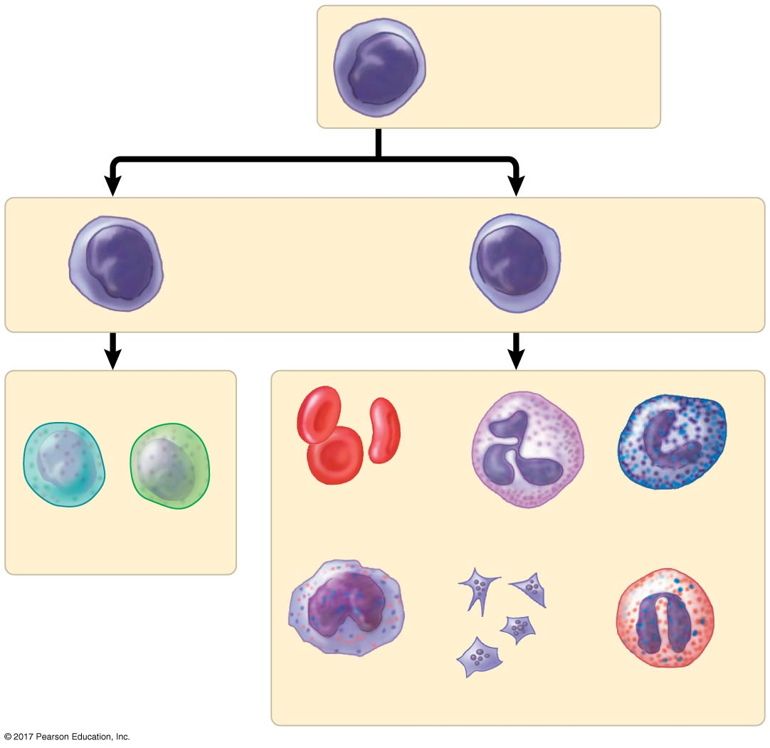
Figure 42.17
Stem cells
(in bone marrow)
Lymphoid
progenitor
cells
Myeloid
progenitor
cells
B cells T cells
Erythrocytes
Basophils
Neutrophils
Lymphocytes
Monocytes
Eosinophils
Platelets
© 2017 Pearson Education, Inc.
Notes:
Figure 42.17 Differentiation of blood cells

Slide 92
Blood Clotting
Coagulation is the formation of a solid clot from liquid blood
A cascade of complex reactions converts inactive fibrinogen to fibrin, forming a clot
A blood clot formed within a blood vessel is called a thrombus and can block blood flow

Slide 93
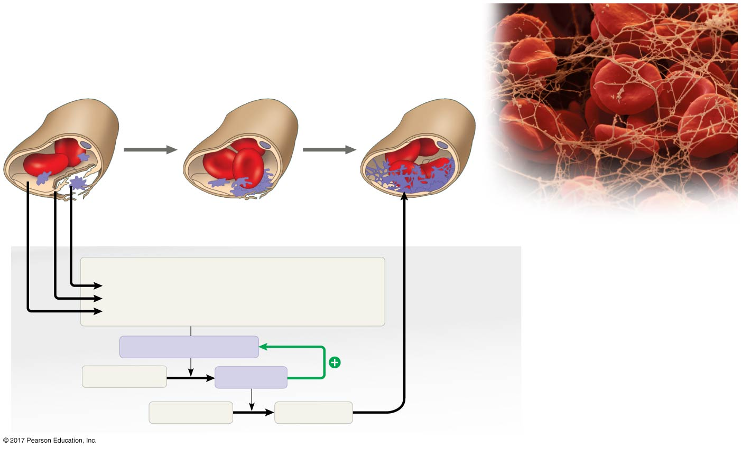
Figure 42.18
2
3
1
3
Collagen fibers
Red blood cells caught
in threads of fibrin
Platelet
Platelet
plug
Fibrin clot
5 µm
Clotting factors from:
Fibrin clot
formation
Platelets
Damaged cells
Plasma (factors include calcium, vitamin K)
Enzymatic cascade
Positive
feedback
Prothrombin
Thrombin
Fibrinogen
Fibrin
© 2017 Pearson Education, Inc.
Notes:
Figure 42.18 Blood clotting

Slide 94
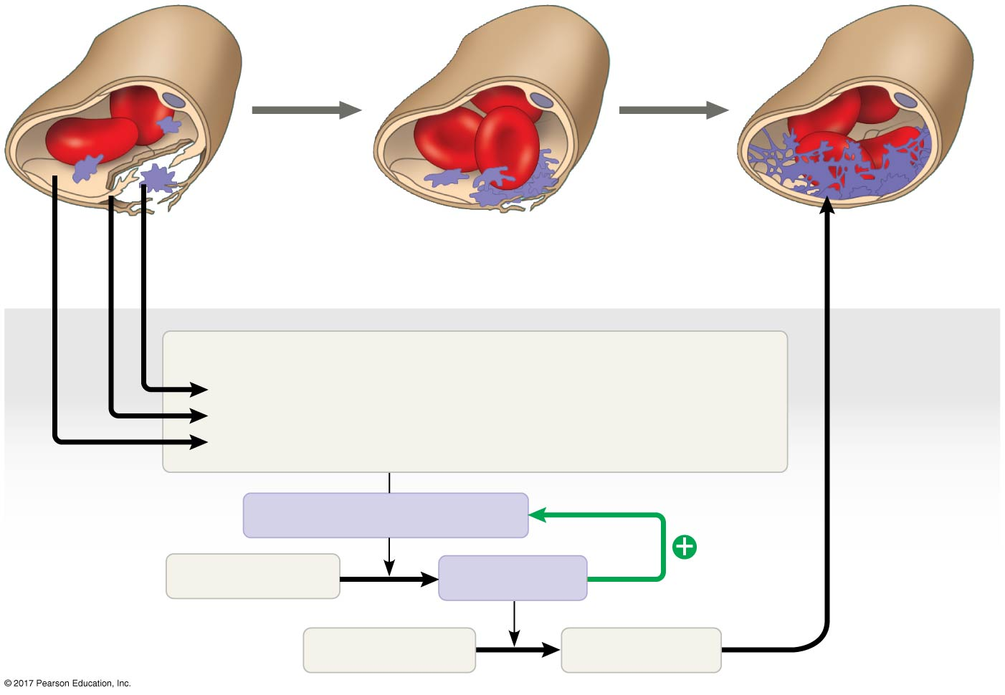
Figure 42.18a
1
2
3
1
Collagen fibers
Platelet
plug
Fibrin clot
Platelet
Clotting factors from:
Fibrin clot
formation
Platelets
Damaged cells
Plasma (factors include calcium, vitamin K)
Enzymatic cascade
Positive
feedback
Prothrombin
Thrombin
Fibrinogen
Fibrin
© 2017 Pearson Education, Inc.
Notes:
Figure 42.18a Blood clotting (part 1: detail)

Slide 95
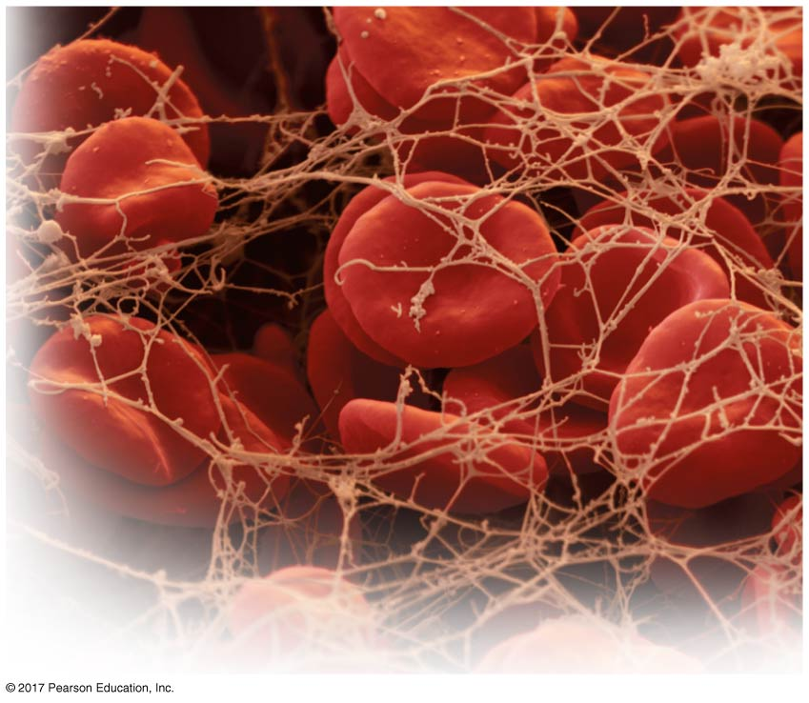
Figure 42.18b
Red blood cells caught
in threads of fibrin
5 µm
© 2017 Pearson Education, Inc.
Notes:
Figure 42.18b Blood clotting (part 2: SEM)

Slide 96
Cardiovascular Disease
Cardiovascular diseases are disorders of the heart and the blood vessels
These diseases range in seriousness from minor disturbances of vein or heart function to life-threatening disruptions of blood flow to the heart or brain

Slide 97
Atherosclerosis, Heart Attacks, and Stroke
One type of cardiovascular disease, atherosclerosis, is caused by the buildup of fatty deposits (plaque) within arteries
Cholesterol is a key player in the development of atherosclerosis

Slide 98
Low-density lipoprotein (LDL) delivers cholesterol to cells for membrane production
High-density lipoprotein (HDL) scavenges excess cholesterol for return to the liver
Risk for heart disease increases with a high LDL to HDL ratio
Inflammation is also a factor in cardiovascular disease

Slide 99
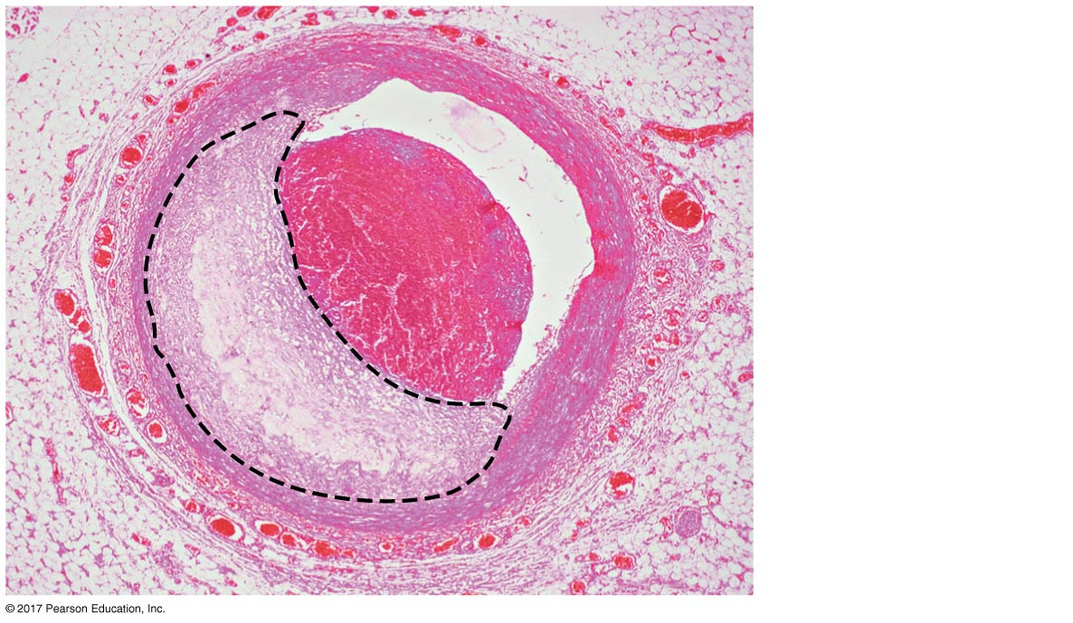
Figure 42.19
Endothelium
Lumen
Thrombus
Plaque
© 2017 Pearson Education, Inc.
Notes:
Figure 42.19 Atherosclerosis

Slide 100
A heart attack, or myocardial infarction, is the damage or death of cardiac muscle tissue resulting from blockage of one or more coronary arteries
A stroke is the death of nervous tissue in the brain, usually resulting from rupture or blockage of arteries in the head
Angina pectoris is chest pain caused by partial blockage of the coronary arteries

Slide 101
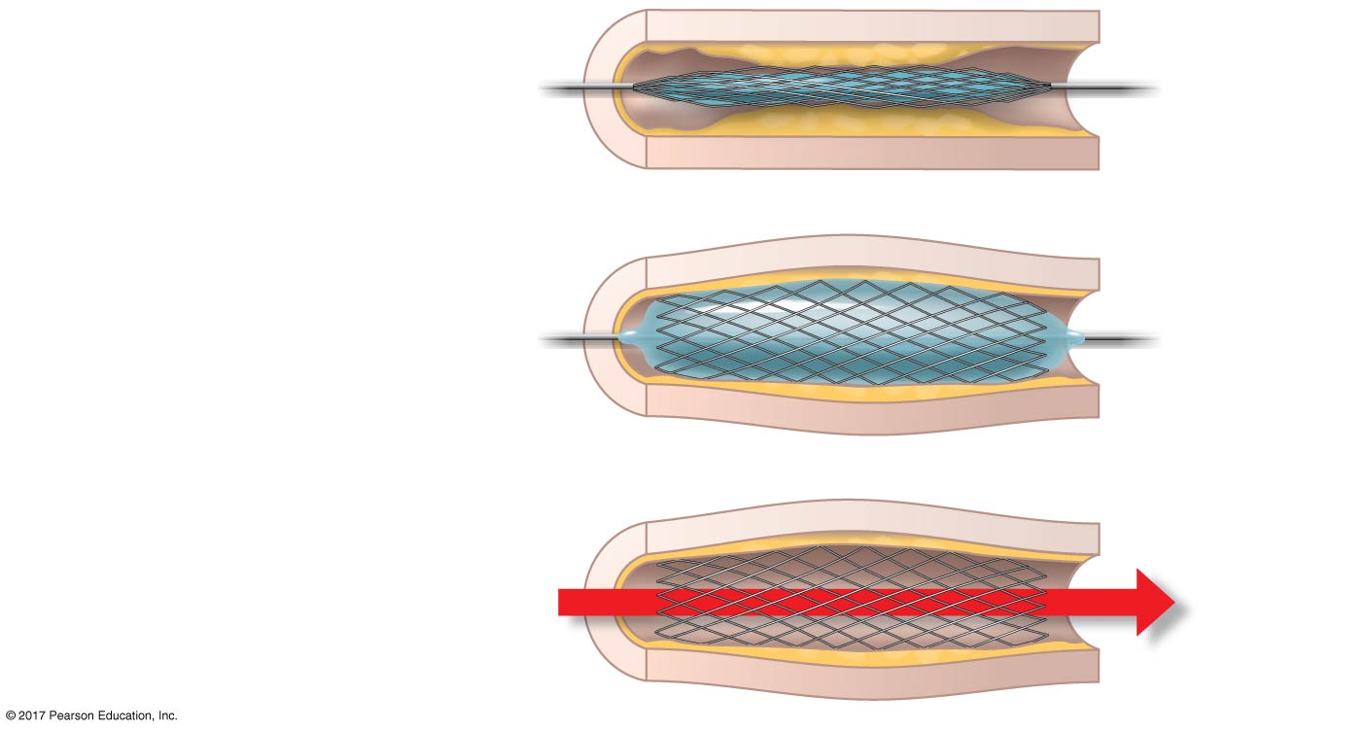
Figure 42.20
1
Artery
Plaque
A stent and a balloon
are inserted into an
obstructed artery.
Stent
around
balloon
2
Inflating the balloon
expands the stent,
widening the artery.
3
The balloon is removed,
leaving the stent in
place.
Increased
blood
flow
© 2017 Pearson Education, Inc.
Notes:
Figure 42.20 Inserting a stent to widen an obstructed artery

Slide 102
Risk Factors and Treatment of Cardiovascular Disease
A high LDL/HDL ratio increases the risk of cardiovascular disease
The proportion of LDL relative to HDL can be decreased by exercise and by avoiding smoking and foods with trans fats
Drugs called statins reduce LDL levels and risk of heart attacks

Slide 103
Inflammation plays a role in atherosclerosis and thrombus formation
Aspirin inhibits inflammation and reduces the risk of heart attacks and stroke
Hypertension, or high blood pressure, also contributes to heart attack and stroke, as well as other health problems
Hypertension can be controlled by dietary changes, exercise, and/or medication

Slide 104
Concept 42.5: Gas exchange occurs across specialized respiratory surfaces
Gas exchange is the uptake of O₂ from the environment and the discharge of CO₂ to the environment

Slide 105
Partial Pressure Gradients in Gas Exchange
Partial pressure is the pressure exerted by a particular gas in a mixture of gases
Partial pressures also apply to gases dissolved in liquids such as water
O₂ is much less soluble in water than in air

Slide 106
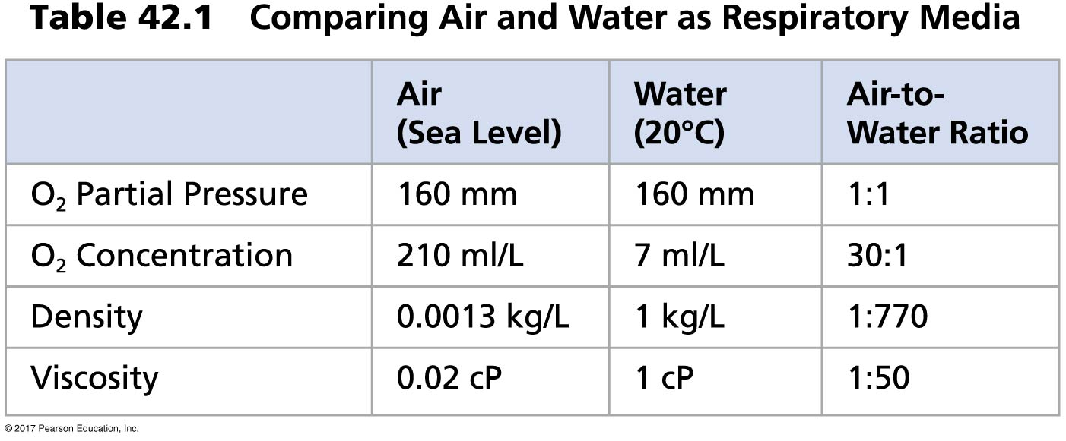
Table 42.1
© 2017 Pearson Education, Inc.
Notes:
Table 42.1 Comparing air and water as respiratory media

Slide 107
Respiratory Media
Breathing air is relatively easy and need not be very efficient
In a given volume, there is less O₂ available in water than in air
Obtaining O₂ from water requires greater efficiency than air breathing

Slide 108
Respiratory Surfaces
Gas exchange across respiratory surfaces takes place by diffusion
Respiratory surfaces vary by animal and can include the skin, gills, tracheae, and lungs

Slide 109
Gills in Aquatic Animals
Gills are outfoldings of the body that create a large surface area for gas exchange
Ventilation moves the respiratory medium over the respiratory surface
Aquatic animals move through water or move water over their gills for ventilation

Slide 110
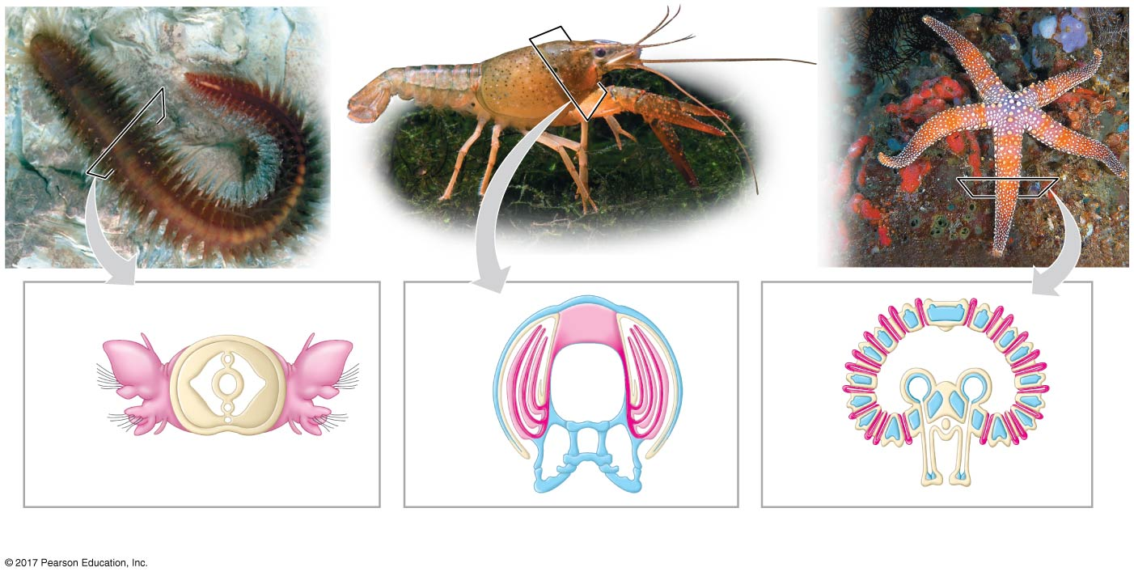
Figure 42.21
Coelom
Gills
Parapodium
(functions as gill)
Gills
Tube foot
(a) Marine worm
(b) Crayfish
(c) Sea star
© 2017 Pearson Education, Inc.
Notes:
Figure 42.21 Diversity in the structure of gills, external body surfaces that function in gas exchange

Slide 111
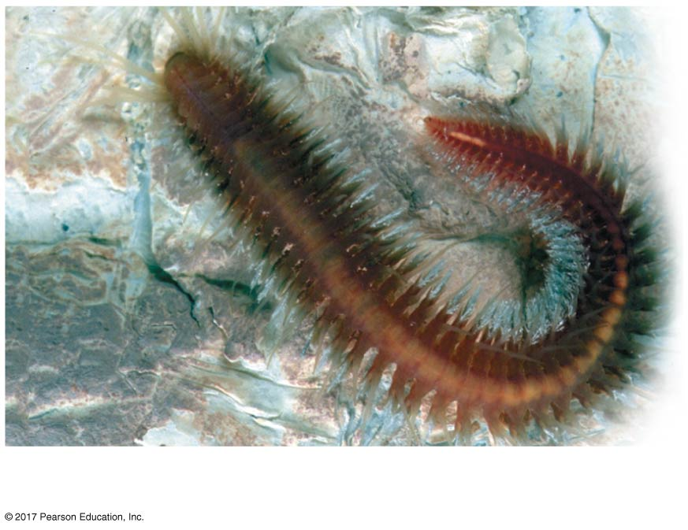
Figure 42.21a
(a) Marine worm
© 2017 Pearson Education, Inc.
Notes:
Figure 42.21a Diversity in the structure of gills, external body surfaces that function in gas exchange (part 1: marine worm)

Slide 112
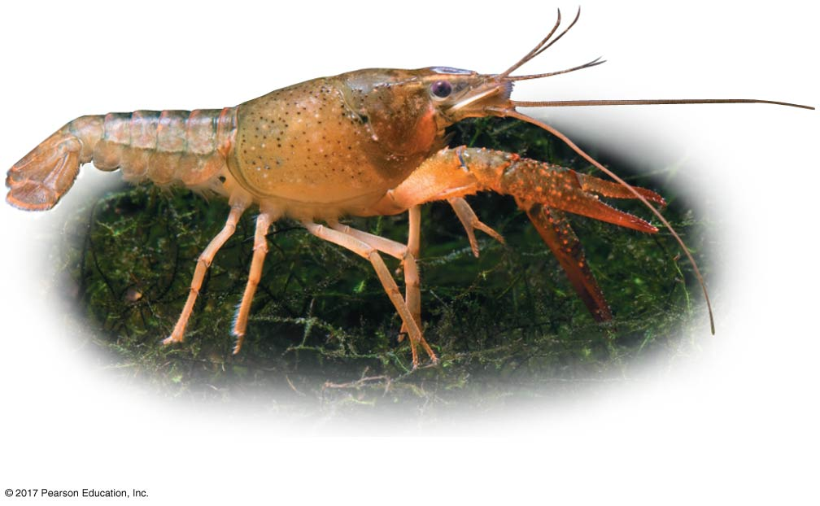
Figure 42.21b
(b) Crayfish
© 2017 Pearson Education, Inc.
Notes:
Figure 42.21b Diversity in the structure of gills, external body surfaces that function in gas exchange (part 2: crayfish)

Slide 113
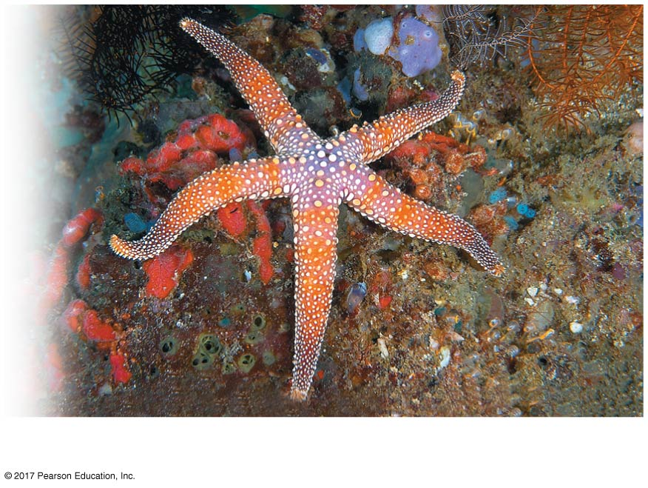
Figure 42.21c
(c) Sea star
© 2017 Pearson Education, Inc.
Notes:
Figure 42.21c Diversity in the structure of gills, external body surfaces that function in gas exchange (part 3: sea star)

Slide 114
Fish gills use a countercurrent exchange system, where blood flows in the opposite direction to water passing over the gills
Blood is always less saturated with O₂ than the water it meets
In fish gills, more than 80% of the O₂ dissolved in the water is removed as water passes over the respiratory surface

Slide 115
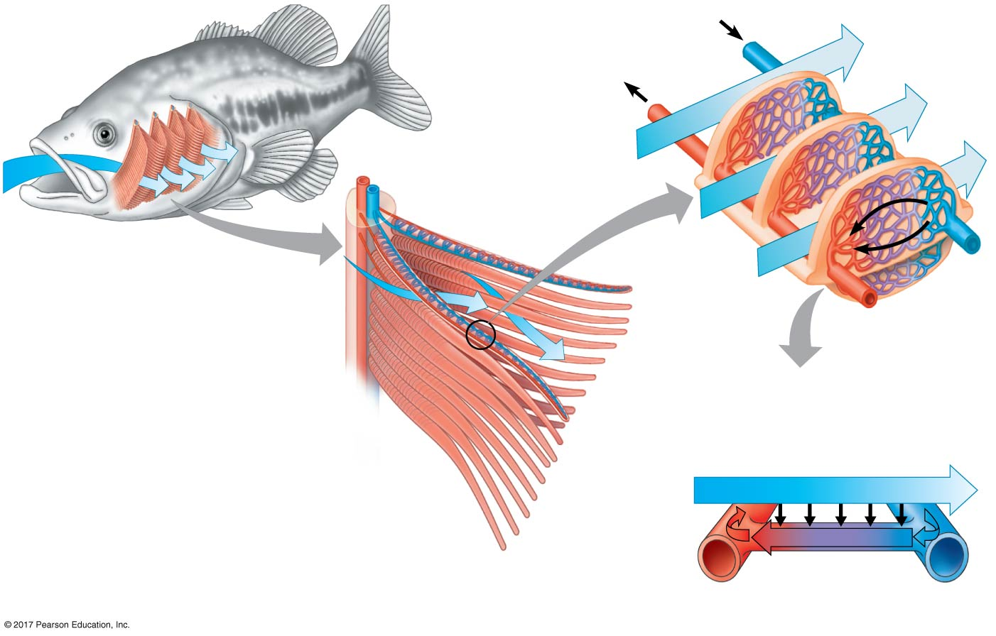
Figure 42.22
O₂-poor blood
Gill
arch
O₂-rich blood
Blood
vessels
Gill arch
Water flow
into mouth
Operculum
Lamella
Water flow
Blood flow
Countercurrent exchange
P_{O2} (mm Hg) in water
Gill filaments
150
120
90
60
30
Net diffu-
sion of O₂
30
140
110
80
50
20
P_{O2} (mm Hg)
in blood
© 2017 Pearson Education, Inc.
Notes:
Figure 42.22 The structure and function of fish gills

Slide 116
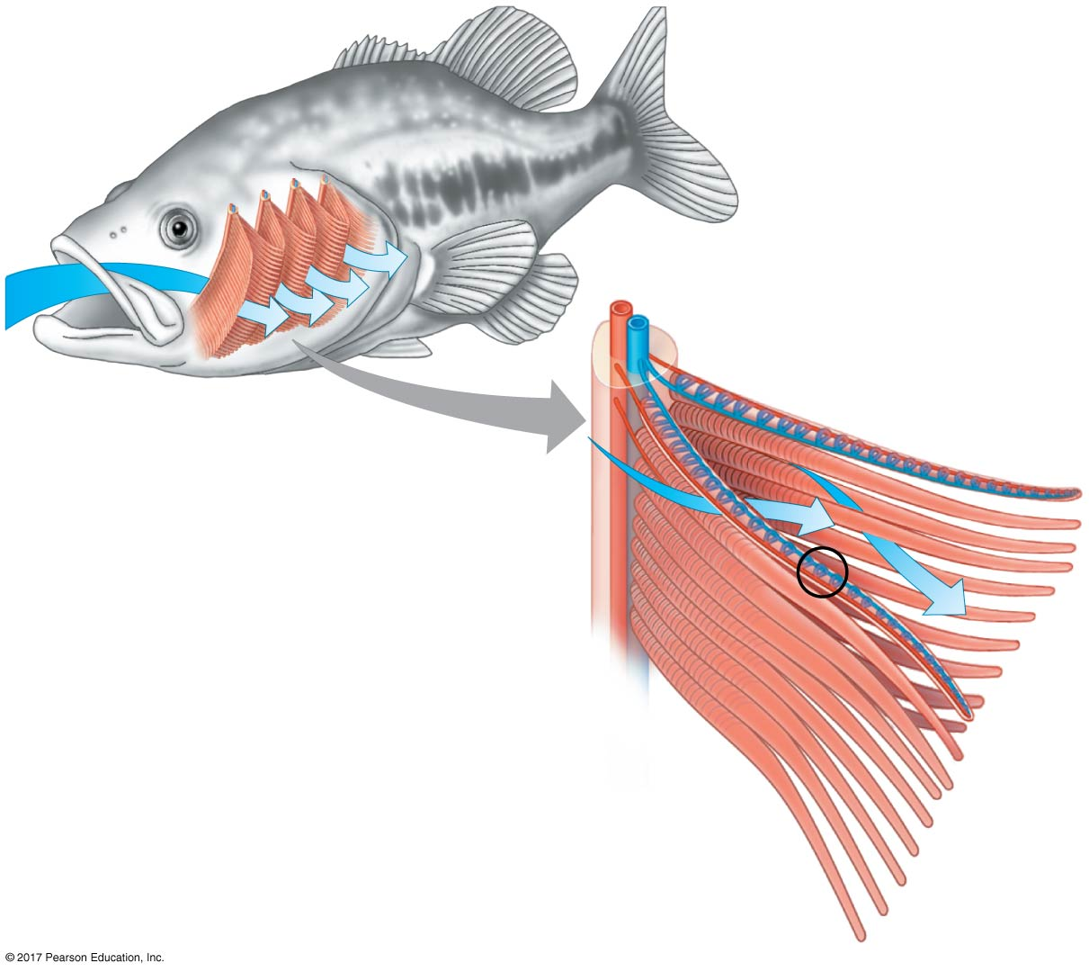
Figure 42.22a
Gill
arch
Blood
vessels
Gill arch
Water flow
into mouth
Operculum
Gill filaments
© 2017 Pearson Education, Inc.
Notes:
Figure 42.22a The structure and function of fish gills (part 1: gill arches)

Slide 117
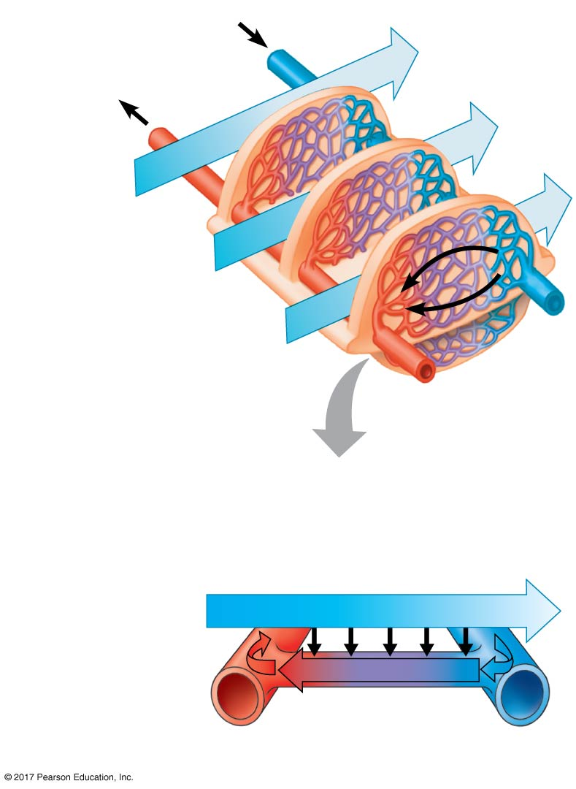
Figure 42.22b
O₂-poor blood
O₂-rich blood
Lamella
Water flow
Blood flow
Countercurrent exchange
P_{O2} (mm Hg) in water
150
120
90
60
30
Net diffu-
sion of O₂
140
110
80
50
20
P_{O2} (mm Hg)
in blood
© 2017 Pearson Education, Inc.
Notes:
Figure 42.22b The structure and function of fish gills (part 2: lamellae)

Slide 118
Tracheal Systems in Insects
The tracheal system of insects consists of a network of branching tubes throughout the body
The tracheal tubes supply O₂ directly to body cells
The respiratory and circulatory systems are separate
Larger insects must ventilate their tracheal system to meet O₂ demands

Slide 119
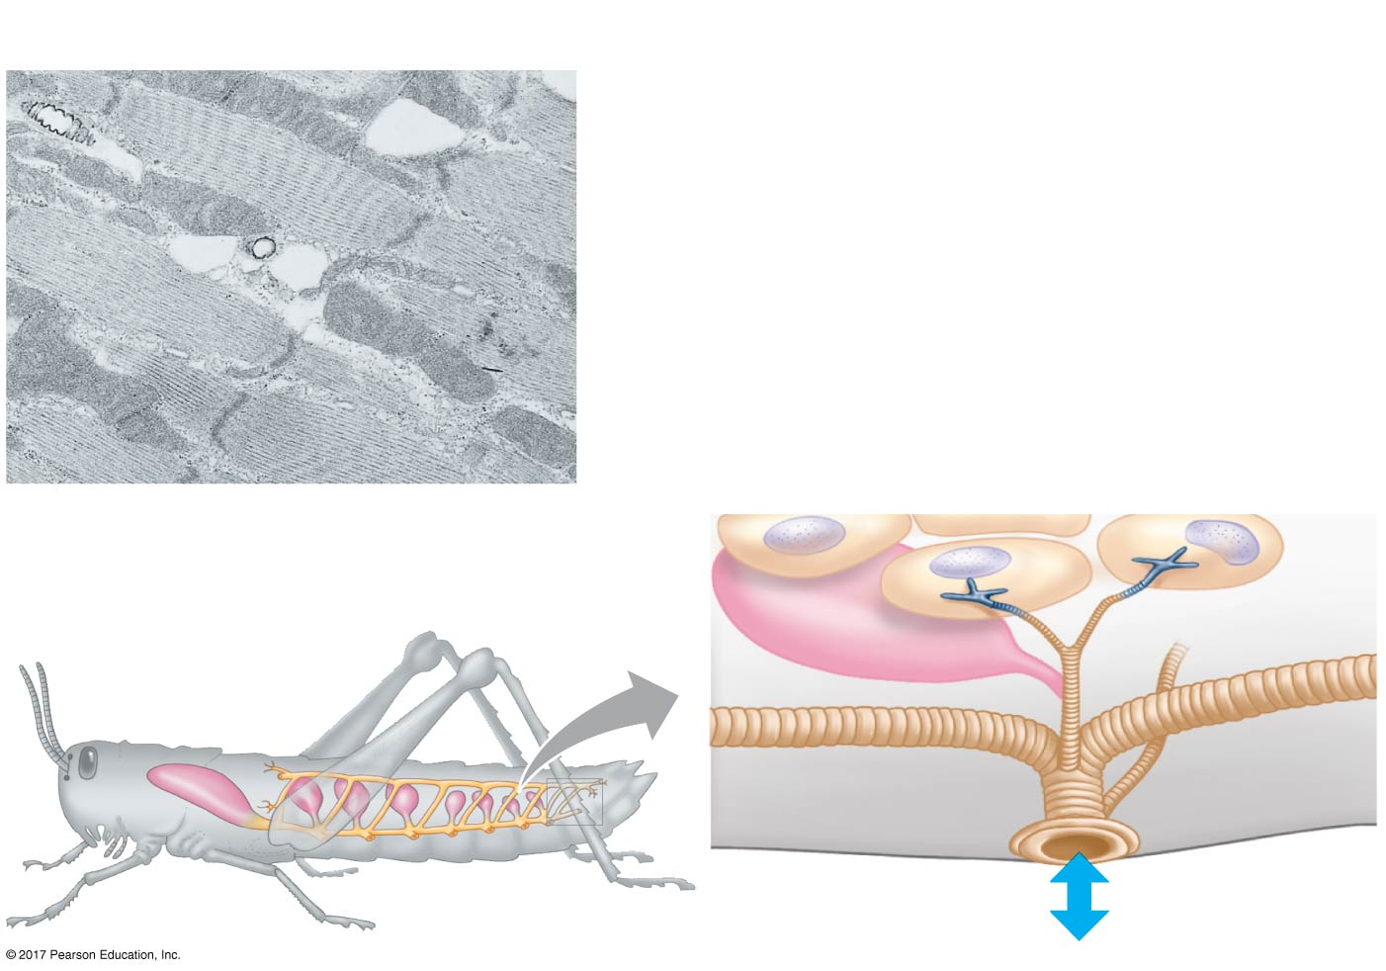
Figure 42.23
Tracheoles
Mitochondria
Muscle fiber
2.5 µm
Body
cell
Tracheae
Air
sac
Air sacs
Tracheole
Trachea
Air
External opening
© 2017 Pearson Education, Inc.
Notes:
Figure 42.23 A tracheal system

Slide 120
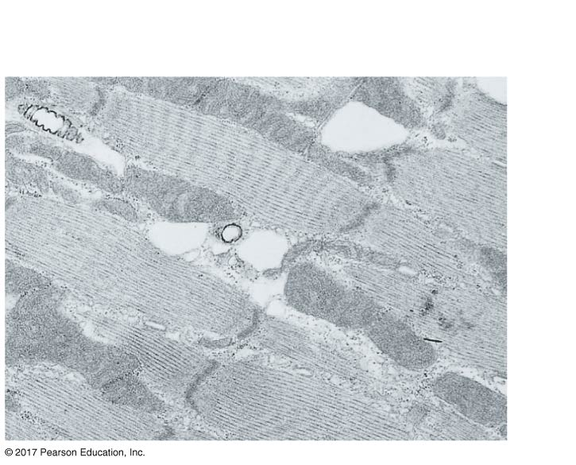
Figure 42.23a
Tracheoles
Mitochondria
Muscle fiber
2.5 µm
© 2017 Pearson Education, Inc.
Notes:
Figure 42.23a A tracheal system (part 1: TEM)

Slide 121
Lungs
Lungs are an infolding of the body surface
The circulatory system (open or closed) transports gases between the lungs and the rest of the body
The size and complexity of lungs correlate with an animal’s metabolic rate

Slide 122
Mammalian Respiratory Systems: A Closer Look
A system of branching ducts conveys air to the lungs
Air inhaled through the nostrils is filtered, warmed, humidified, and sampled for odors
The pharynx directs air to the lungs and food to the stomach
Swallowing moves the larynx upward and tips the epiglottis over the glottis in the pharynx to prevent food from entering the trachea, or windpipe

Slide 123
Air passes through the pharynx, larynx, trachea, bronchi, and bronchioles to the alveoli, where gas exchange occurs
Exhaled air passes over the vocal cords in the larynx to create sounds
Cilia and mucus line the epithelium of the air ducts and move particles up to the pharynx
This “mucus escalator” cleans the respiratory system and allows particles to be swallowed into the esophagus

Slide 124
Gas exchange takes place in alveoli, air sacs at the tips of bronchioles
Oxygen diffuses through the moist film of the epithelium and into capillaries
Carbon dioxide diffuses from the capillaries across the epithelium and into the air space

Slide 125
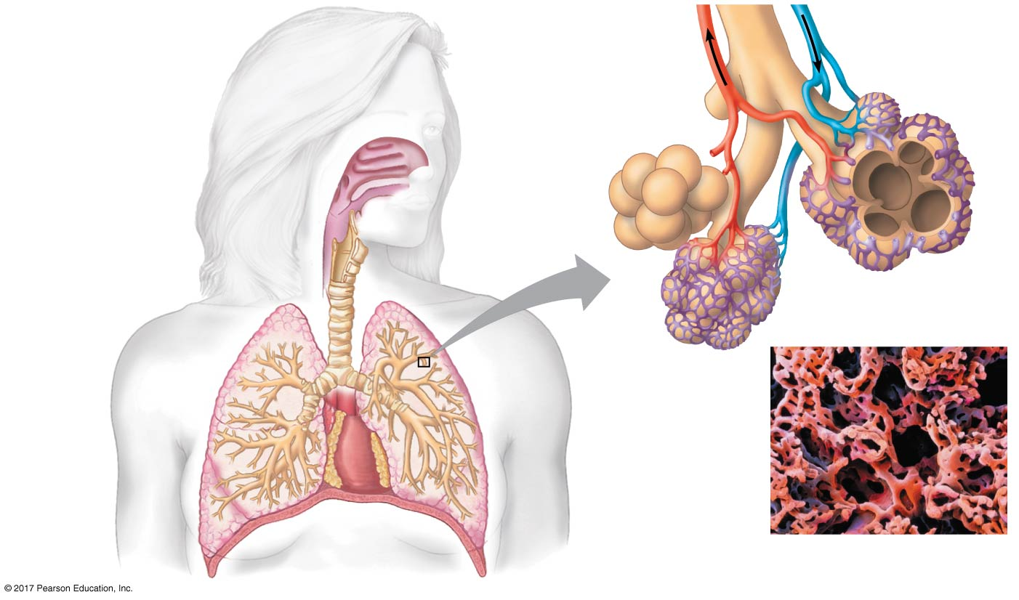
Figure 42.24
Branch of
pulmonary vein
(oxygen-rich
blood)
Branch of
pulmonary artery
(oxygen-poor
blood)
Terminal
bronchiole
Nasal
cavity
Pharynx
Larynx
Left
lung
(Esophagus)
Alveoli
Trachea
50 µm
Right lung
Bronchus
Capillaries
Bronchiole
Diaphragm
Dense capillary bed
enveloping alveoli (SEM)
(Heart)
© 2017 Pearson Education, Inc.
Notes:
Figure 42.24 The mammalian respiratory system

Slide 126
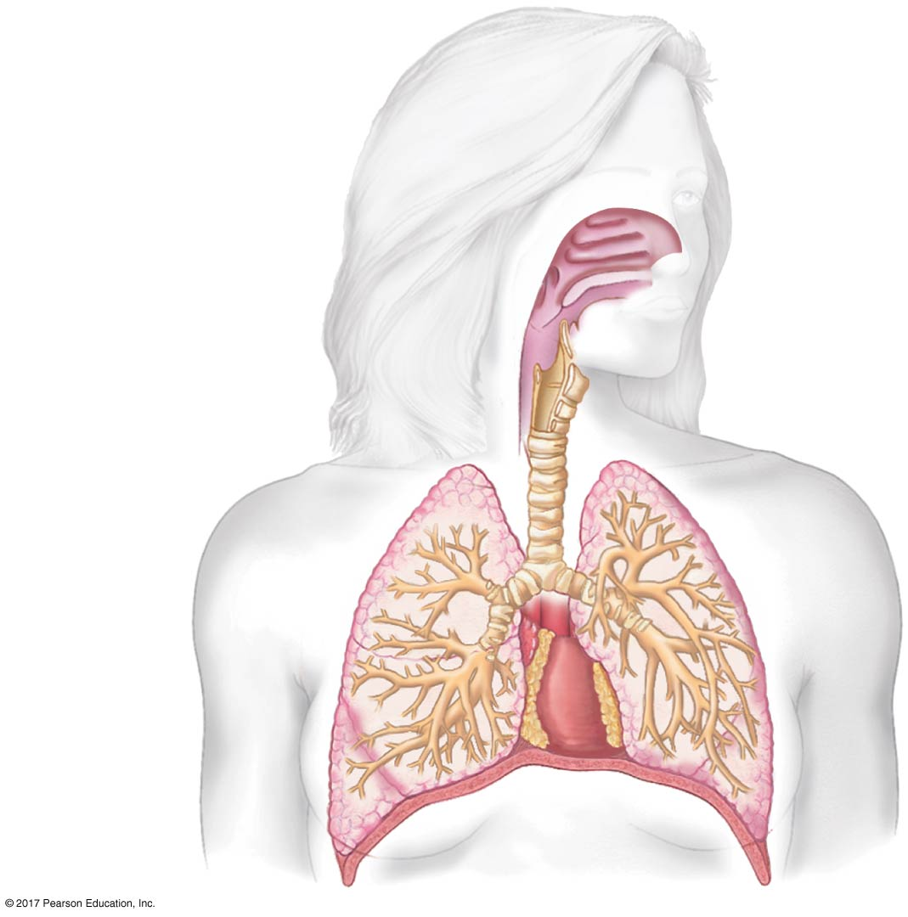
Figure 42.24a
Nasal
cavity
Pharynx
Larynx
Left
lung
(Esophagus)
Trachea
Right lung
Bronchus
Bronchiole
Diaphragm
(Heart)
© 2017 Pearson Education, Inc.
Notes:
Figure 42.24a The mammalian respiratory system (part 1: overview)

Slide 127
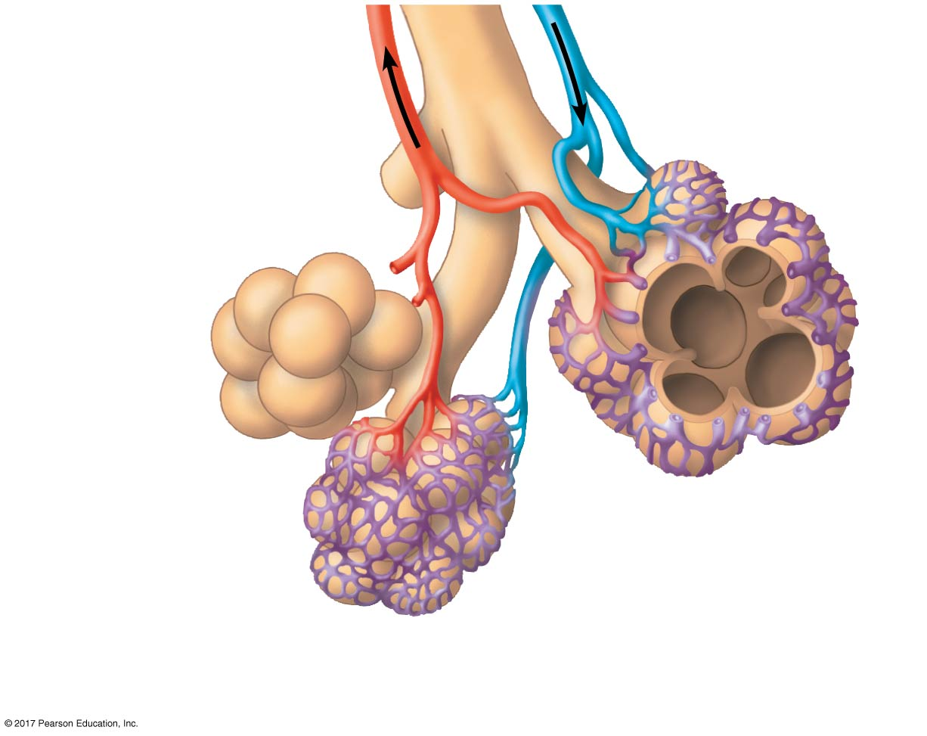
Figure 42.24b
Branch of
pulmonary vein
(oxygen-rich
blood)
Branch of
pulmonary artery
(oxygen-poor
blood)
Terminal
bronchiole
Alveoli
Capillaries
© 2017 Pearson Education, Inc.
Notes:
Figure 42.24b The mammalian respiratory system (part 2: alveoli)

Slide 128
Figure 42.24c
50 µm
Dense capillary bed
enveloping alveoli (SEM)
© 2017 Pearson Education, Inc.
Notes:
Figure 42.24c The mammalian respiratory system (part 3: SEM)

Slide 129
Alveoli lack cilia and are susceptible to contamination
Secretions called surfactants coat the surface of the alveoli
Preterm babies lack surfactant and are vulnerable to respiratory distress syndrome; treatment is provided by artificial surfactants

Slide 130
Figure 42.25
Results
Surface tension (dynes/cm)
40
30
20
10
RDS deaths
Deaths from
other causes
0
(n = 9) (n = 0)
(n = 29) (n = 9)
<1,200 g
≥1,200 g
Body mass of infant
Data from M. E. Avery and J. Mead, Surface properties in relation to atelectasis and
hyaline membrane disease, American Journal of Diseases of Children 97:517–523 (1959).
© 2017 Pearson Education, Inc.
Notes:
Figure 42.25 Inquiry: What causes respiratory distress syndrome?

Slide 131
Concept 42.6: Breathing ventilates the lungs
The process that ventilates the lungs is breathing, the alternate inhalation and exhalation of air

Slide 132
How an Amphibian Breathes
An amphibian such as a frog ventilates its lungs by positive pressure breathing, which forces air down the trachea

Slide 133
How a Bird Breathes
Birds have air sacs that function as bellows that keep air flowing through the lungs
Air passes through the lungs in one direction only
Passage of air through the entire system of lungs and air sacs requires two cycles of inhalation and exhalation
Ventilation in birds is highly efficient

Slide 134
Figure 42.26
Anterior
air sacs
Posterior
air sacs
Lungs
Airflow
Air tubes
(parabronchi)
in lung
1 mm
Posterior
air sacs
Lungs
Anterior
air sacs
3
2
4
1
1
First inhalation
3
Second inhalation
2
First exhalation
4
Second exhalation
© 2017 Pearson Education, Inc.
Notes:
Figure 42.26 The avian respiratory system

Slide 135
Figure 42.26a
Airflow
Air tubes
(parabronchi)
in lung
1 mm
© 2017 Pearson Education, Inc.
Notes:
Figure 42.26a The avian respiratory system (part 1: micrograph)

Slide 136
How a Mammal Breathes
Mammals ventilate their lungs by negative pressure breathing, which pulls air into the lungs
Lung volume increases as the rib muscles and diaphragm contract

Slide 137
The tidal volume is the volume of air inhaled with each breath
The maximum tidal volume is the vital capacity
After exhalation, a residual volume of air remains in the lungs

Slide 138
Figure 42.27
Rib cage
expands as
rib muscles
contract.
Rib cage
gets smaller
as rib muscles
relax.
Lung
Diaphragm
1
INHALATION: Diaphragm
contracts (moves down).
2
EXHALATION: Diaphragm
relaxes (moves up).
© 2017 Pearson Education, Inc.
Notes:
Figure 42.27 Negative pressure breathing

Slide 139
Control of Breathing in Humans
Breathing is regulated by involuntary mechanisms
The breathing control centers are found in the medulla oblongata of the brain
The medulla regulates the rate and depth of breathing in response to pH changes in the cerebrospinal fluid

Slide 140
Figure 42.28
NORMAL BLOOD pH
(about 7.4)
Blood CO₂ level falls
and pH rises.
Blood pH falls
due to rising levels of
CO₂ in tissues (such as
when exercising).
Medulla detects
decrease in pH of
cerebrospinal fluid.
Cerebrospinal
fluid
Carotid
arteries
Aorta
Sensors in major
blood vessels
detect decrease
in blood pH.
Signals from
medulla to rib
muscles and
diaphragm
increase rate
and depth of
ventilation.
Medulla
oblongata
Medulla receives
signals from major
blood vessels.
© 2017 Pearson Education, Inc.
Notes:
Figure 42.28 Homeostatic control of breathing

Slide 141
Sensors in the aorta and carotid arteries monitor O₂ and CO₂ concentrations in the blood
These signal the breathing control centers, which respond as needed
Additional modulation of breathing takes place in the pons, next to the medulla

Slide 142
Concept 42.7: Adaptations for gas exchange include pigments that bind and transport gases
The metabolic demands of many organisms require that the blood transport large quantities of O₂ and CO₂

Slide 143
Coordination of Circulation and Gas Exchange
During inhalation, fresh air mixes with air in the lungs
The resulting mixture has a higher O₂ pressure than the blood flowing through alveolar capillaries
In the alveoli, O₂ diffuses into the blood and CO₂ diffuses into the air
By the time the blood leaves the lungs, the pressures of O₂ and CO₂ match the values for air in the alveoli

Slide 144
In the systemic capillaries, gradients of partial pressure favor net diffusion of O₂ out of the blood and CO₂ into the blood
Having unloaded O₂ and loaded CO₂, the blood is returned to the heart and pumped to the lungs again
There, exchange occurs across the alveolar capillaries, resulting in exhaled air enriched in CO₂ and partly depleted of O₂

Slide 145
Figure 42.29
160
120
27
6
1
0.2
Exhaled air
Inhaled air
P_{O2}
P_{CO2}
P_{O2}
P_{CO2}
Alveolar
spaces
Alveolar
epithelial
cells
2
CO₂
O₂
104
Alveolar
capillaries
40
Blood
entering
alveolar
capillaries
P_{O2}
P_{CO2}
40
45
5
P_{O2}
P_{CO2}
Pulmonary
arteries
and systemic
veins
Pulmonary
veins and
systemic
arteries
3
104
40
Heart
P_{O2}
P_{CO2}
>45
Systemic
capillaries
<40
CO₂
O₂
4
Body
tissue
P_{O2}
P_{CO2}
© 2017 Pearson Education, Inc.
Notes:
Figure 42.29 Loading and unloading of respiratory gases

Slide 146
Figure 42.29a
6
Exhaled air
Inhaled air
1
Alveolar
spaces
Alveolar
epithelial
cells
2
CO₂
O₂
Blood
entering
alveolar
capillaries
Alveolar
capillaries
5
Pulmonary
arteries
and systemic
veins
Pulmonary
veins and
systemic
arteries
3
Heart
Systemic
capillaries
CO₂
O₂
4
Body
tissue
© 2017 Pearson Education, Inc.
Notes:
Figure 42.29a Loading and unloading of respiratory gases (part 1: locations)

Slide 147
Figure 42.29b
160
104
104
40
40
0.2
P_{O2}
P_{CO2}
P_{O2}
P_{CO2}
P_{O2}
P_{CO2}
1
Inhaled air
2
Alveolar spaces
3
Pulmonary
veins
120
>45
40
45
<40
27
P_{O2}
P_{CO2}
P_{O2}
P_{CO2}
P_{O2}
P_{CO2}
4
Body
tissue
5
Pulmonary
arteries
6
Exhaled
air
© 2017 Pearson Education, Inc.
Notes:
Figure 42.29b Loading and unloading of respiratory gases (part 2: partial pressures)

Slide 148
Animation: CO₂ from Blood to Lung

Slide 149
Animation: CO₂ from Tissues to Blood

Slide 150
Animation: O₂ from Blood to Tissues

Slide 151
Animation: O₂ from Lungs to Blood

Slide 152
BioFlix: Gas Exchange

Slide 153
Respiratory Pigments
Respiratory pigments, proteins that transport oxygen, greatly increase the amount of oxygen that blood can carry
Arthropods and many molluscs have hemocyanin, with copper as the oxygen-binding component
Most vertebrates and some invertebrates use hemoglobin
In vertebrates, hemoglobin is contained within erythrocytes

Slide 154
Figure 42.30
Iron
Heme
© 2017 Pearson Education, Inc.
Notes:
Figure 42.30 Hemoglobin

Slide 155
A single hemoglobin molecule can carry four molecules of O₂, one molecule for each iron- containing heme group
The hemoglobin dissociation curve shows that a small change in the partial pressure of oxygen can result in a large change in delivery of O₂

Slide 156
CO₂ produced during cellular respiration lowers blood pH and decreases the affinity of hemoglobin for O₂; this is called the Bohr shift
Hemoglobin plays a minor role in transport of CO₂ and assists in buffering the blood

Slide 157
Figure 42.31
100
O₂ saturation of hemoglobin (%)
100
O₂ saturation of hemoglobin (%)
O₂ unloaded
to tissues
at rest
pH 7.4
80
80
pH 7.2
O₂ unloaded
to tissues
during
exercise
Hemoglobin
retains less
O₂ at lower pH
(higher CO₂
concentration)
60
60
40
40
20
20
0
0
0
20
40
60
80
100
0
20
40
60
80
100
P_{O2} (mm Hg)
Tissues during
exercise
Tissues
at rest
Lungs
P_{O2} (mm Hg)
(a) P_{O2} and hemoglobin dissociation at pH 7.4
(b) pH and hemoglobin dissociation
© 2017 Pearson Education, Inc.
Notes:
Figure 42.31 Dissociation curves for hemoglobin at 37ºC

Slide 158
Figure 42.31a
100
O₂ saturation of hrmoglobin (%)
O₂ unloaded
to tissues
at rest
80
O₂ unloaded
to tissues
during
exercise
60
40
20
0
0
20
40
60
80
100
Tissues during
exercise
Tissues
at rest
Lungs
P_{O2} (mm Hg)
(a) P_{O2} and hemoglobin dissociation at pH 7.4
© 2017 Pearson Education, Inc.
Notes:
Figure 42.31a Dissociation curves for hemoglobin at 37ºC (part 1: constant pH)

Slide 159
Figure 42.31b
O₂ saturation of hemoglobin (%)
100
pH 7.4
80
pH 7.2
Hemoglobin
retains less
O₂ at lower pH
(higher CO₂
concentration)
60
40
20
0
0
20
40
60
80
100
P_{O2} (mm Hg)
(b) pH and hemoglobin dissociation
© 2017 Pearson Education, Inc.
Notes:
Figure 42.31b Dissociation curves for hemoglobin at 37ºC (part 2: variable pH)

Slide 160
Carbon Dioxide Transport
Only about 7% of CO₂ from respiring cells diffuses into the blood and is transported in blood plasma, bound to hemoglobin
The remainder diffuses into erythrocytes and reacts with water to form H₂CO₃, which dissociates into H⁺ and bicarbonate ions (HCO₃–)
In the lungs, the relative partial pressures of CO₂ favor the net diffusion of CO₂ out of the blood

Slide 161
Respiratory Adaptations of Diving Mammals
Diving mammals have evolutionary adaptations that allow them to perform extraordinary feats
Weddell seals in Antarctica can remain underwater for 20 minutes to an hour
The Cuvier’s beaked whale can dive to 2,900 m and stay submerged for more than 2 hours
These animals have a high blood to body volume ratio

Slide 162
Figure 42.UN02
Weddell seal
© 2017 Pearson Education, Inc.
Notes:
Figure 42.UN02 In-text figure, Weddell seal, p. 947

Slide 163
Deep-diving air breathers stockpile O₂ and use it slowly
Diving mammals can store oxygen in their muscles in myoglobin proteins
Diving mammals also conserve oxygen by
Changing their buoyancy to glide passively
Routing blood to vital tissues
Deriving ATP in muscles from fermentation once oxygen is depleted

Slide 164
Figure 42.4
(a) Single circulation: fish
Double circulation: amphibian
Double circulation: mammal
Gill
capillaries
Pulmocutaneous circuit
Pulmonary circuit
Lung
and skin
capillaries
Lung
capillaries
Artery
Atrium
Atrium
Heart:
(A)
(A)
Atrium (A)
A
A
Ventricle (V)
V
V
Right
Left
Right
Left
Vein
Ventricle (V)
Systemic
capillaries
Systemic
capillaries
Oxygen-rich blood
Body
capillaries
Oxygen-poor blood
Systemic circuit
Systemic circuit
© 2017 Pearson Education, Inc.
Notes:
Figure 42.4 Examples of vertebrate circulatory schemes

Slide 165
Figure 42.UN01a
Percent of individuals
30
20
10
0
0
50
100
150
200
250
300
Plasma LDL cholesterol (mg/dL)
Individuals with an inactivating mutation in one copy of
PCSK9 gene (study group)
Data from J. C. Cohen et al., Sequence variations in PCSK9, low LDL, and protection
against coronary heart disease, New England Journal of Medicine 354:1264–1272 (2006).
© 2017 Pearson Education, Inc.
Notes:
Figure 42.UN01a Skills exercise: making and interpreting histograms (part 1)

Slide 166
Figure 42.UN01b
Percent of individuals
30
20
10
0
0
50
100
150
200
250
300
Plasma LDL cholesterol (mg/dL)
Individuals with two functional copies of PCSK9 gene (control group)
Data from J. C. Cohen et al., Sequence variations in PCSK9, low LDL, and protection
against coronary heart disease, New England Journal of Medicine 354:1264–1272 (2006).
© 2017 Pearson Education, Inc.
Notes:
Figure 42.UN01b Skills exercise: making and interpreting histograms (part 2)

Slide 167
Figure 42.UN01c
© 2017 Pearson Education, Inc.
Notes:
Figure 42.UN01c Skills exercise: making and interpreting histograms (part 3)

Slide 168
Figure 42.UN03
Exhaled air
Inhaled air
Alveolar
spaces
Alveolar
epithelial
cells
CO₂
O₂
Alveolar
capillaries
Pulmonary
arteries
Pulmonary
veins
Systemic
veins
Systemic
arteries
Heart
Systemic
capillaries
CO₂
O₂
Body tissue
© 2017 Pearson Education, Inc.
Notes:
Figure 42.UN03 Summary of key concepts: double circulation

Slide 169
Figure 42.UN04
100
O₂ saturation of
hemoglobin (%)
Fetus
80
Mother
60
40
20
0
0
20
40
60
80
100
P_{O2} (mm Hg)
© 2017 Pearson Education, Inc.
Notes:
Figure 42.UN04 Test your understanding, question 10 (dissociation curves)

Slide 170
Figure 42.UN05
© 2017 Pearson Education, Inc.
Notes:
Figure 42.UN05 Test your understanding, question 13 (diving bell spider)

