Slide 1
Notes:
1

Slide 2
A Balancing Act
Physiological systems of animals operate in a fluid environment
Relative concentrations of water and solutes must be maintained within fairly narrow limits
Osmoregulation controls solute concentrations and balances water gain and loss

Slide 3
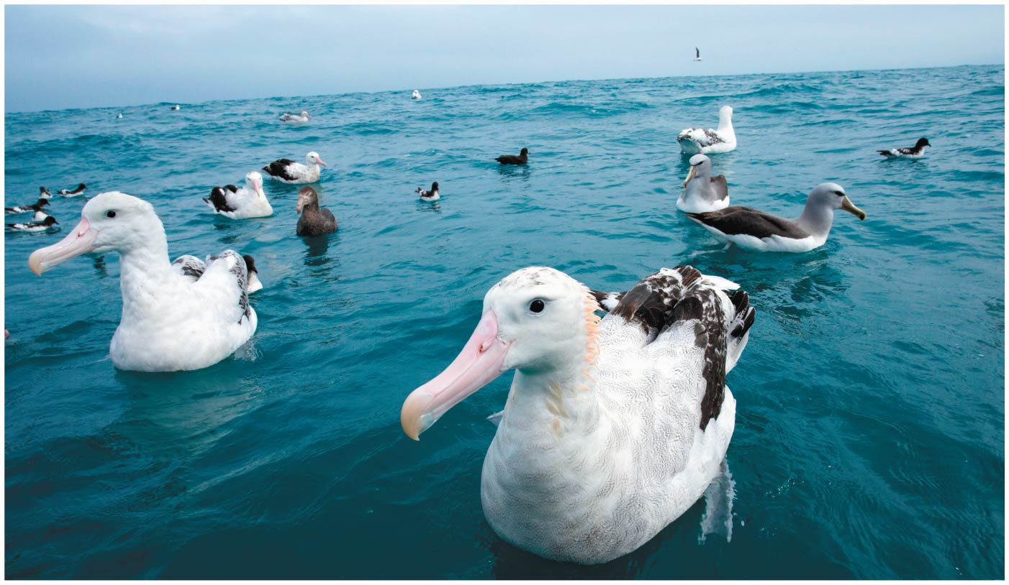
Figure 44.1
Notes:
Figure 44.1 How does an albatross drink salt water without ill effect?

Slide 4
Figure 44.1a
Notes:
Figure 44.1a How does an albatross drink salt water without ill effect? (part 1: wingspan)

Slide 5
Desert and marine animals face desiccating environments that can quickly deplete body water
Freshwater animals survive by conserving solutes and absorbing salts from their surroundings
Excretion rids the body of nitrogenous metabolites and other waste products

Slide 6
Concept 44.1: Osmoregulation balances the uptake and loss of water and solutes
Osmoregulation is based largely on balancing the uptake and loss of water and solutes
The driving force for movement of water and solutes is a concentration gradient of one or more solutes across the plasma membrane

Slide 7
Osmosis and Osmolarity
Water enters and leaves cells by osmosis
Osmolarity, the solute concentration of a solution, determines the movement of water across a selectively permeable membrane
If two solutions are isoosmotic, water molecules will cross the membrane at equal rates in both directions

Slide 8
If two solutions differ in osmolarity, the net flow of water is from the hypoosmotic (less concentrated) to the hyperosmotic (more concentrated) solution

Slide 9
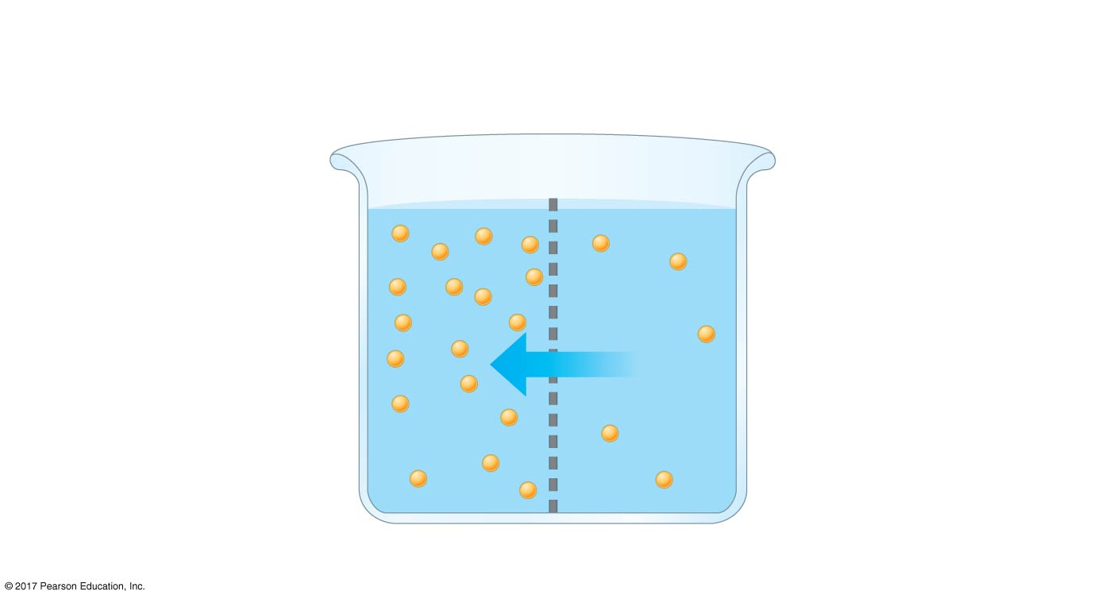
Figure 44.2
Selectively permeable
membrane
Solutes
Water
Hyperosmotic side:
Hypoosmotic side:
Higher solute concentration
Lower free H₂O concentration
Lower solute concentration
Higher free H₂O concentration
Net water flow
Notes:
Figure 44.2 Solute concentration and osmosis

Slide 10
Osmoregulatory Challenges and Mechanisms
Animals can maintain water balance in one of two ways
Osmoconformers are isoosmotic with their surroundings and do not regulate their osmolarity
Osmoregulators expend energy to control water uptake and loss in a hyperosmotic or hypoosmotic environment

Slide 11
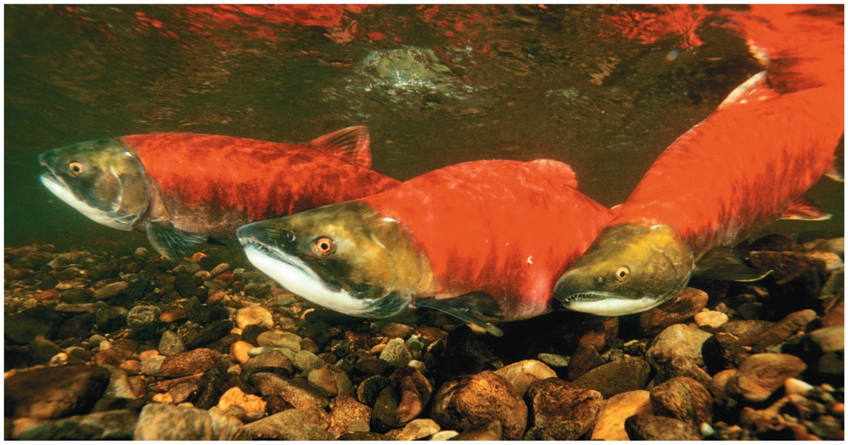
Figure 44.3
Notes:
Figure 44.3 Sockeye salmon (Oncorhynchus nerka), osmoregulators that migrate between rivers and the ocean

Slide 12
Most animals are stenohaline; they cannot tolerate substantial changes in external osmolarity
Euryhaline animals can survive large fluctuations in external osmolarity

Slide 13
Marine Animals
Most marine invertebrates are osmoconformers
Many marine vertebrates and some marine invertebrates are osmoregulators
Marine bony fishes are hypoosmotic to seawater
They balance water loss by drinking large amounts of seawater and eliminating the ingested salts through their gills and kidneys

Slide 14
Osmoregulation is frequently coupled to elimination of nitrogenous waste products, such as urea
Sharks have a high concentration of urea in their bodies, but trimethylamine oxide (TMAO) protects them from its denaturing effect
Sharks take in water by osmosis and in their food; the excess water is disposed of in urine
The urine also removes some of the salt that diffuses into the shark’s body

Slide 15
Freshwater Animals
Freshwater animals constantly take in water by osmosis from their hypoosmotic environment
They lose salts by diffusion and maintain water balance by drinking almost no water and excreting large amounts of dilute urine
Salts lost by diffusion are replaced in foods and by uptake across the gills

Slide 16
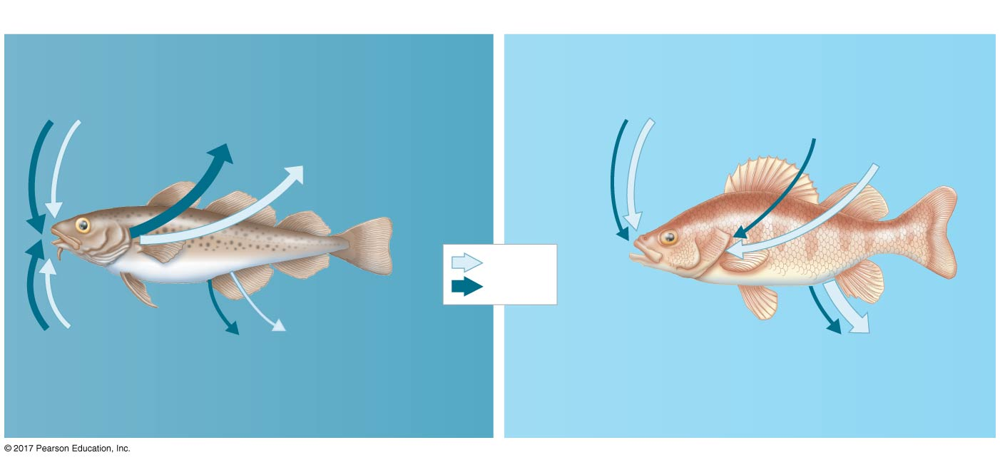
Figure 44.4
(a) Osmoregulation in a marine fish
(b) Osmoregulation in a freshwater fish
Gain of water
and salt ions
from food
Excretion
of salt
ions
from gills
Osmotic water
loss through
gills and other
parts of
body surface
Gain of water
and some ions
in food
Uptake
of salt
ions
by gills
Osmotic water
gain through
gills and other
parts of
body surface
Water
Salt
SALT WATER
FRESH WATER
Gain of water
and salt ions
from drinking
seawater
Excretion of salt ions and
small amounts of water in
scanty urine from kidneys
Excretion of salt ions
and large amounts of
water in dilute urine
from kidneys
Notes:
Figure 44.4 Osmoregulation in marine and freshwater bony fishes: a comparison

Slide 17
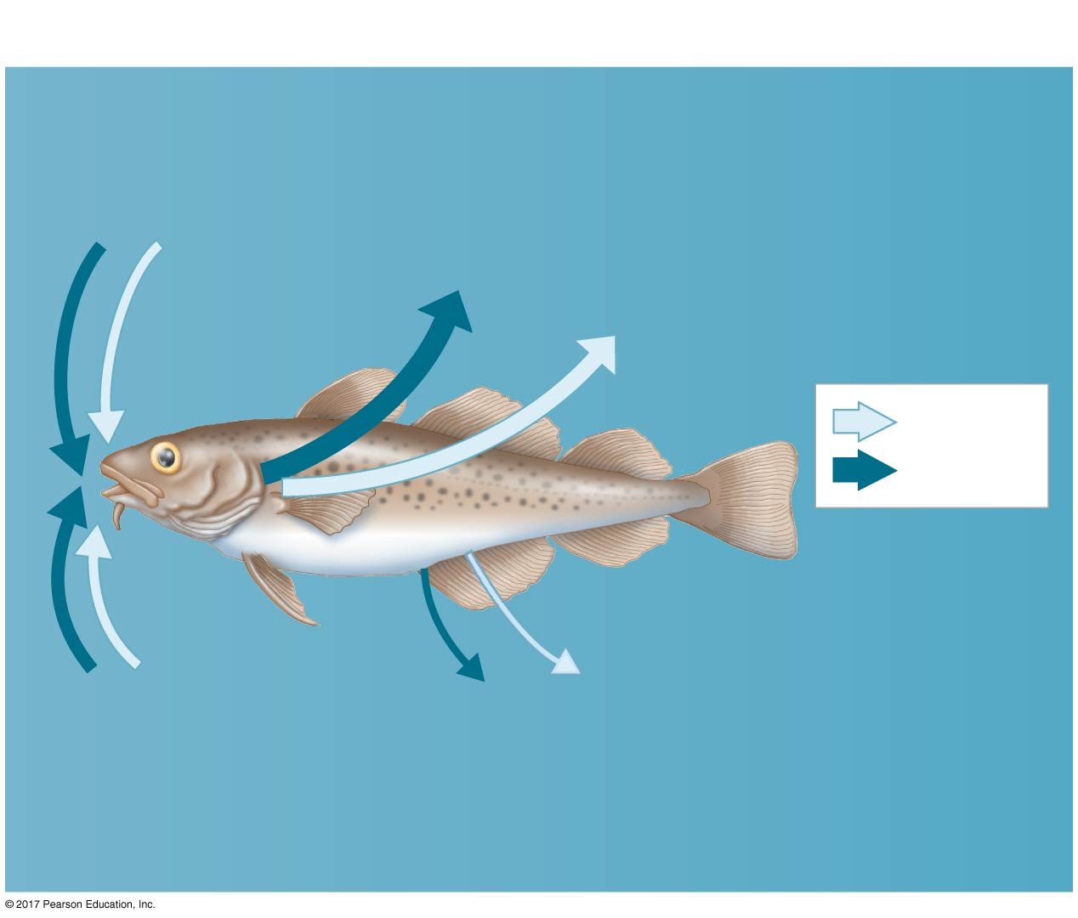
Figure 44.4a
(a) Osmoregulation in a marine fish
Gain of water
and salt ions
from food
Excretion
of salt
ions
from gills
Osmotic water
loss through
gills and other
parts of
body surface
Water
Salt
SALT WATER
Gain of water
and salt ions
from drinking
seawater
Excretion of salt ions and
small amounts of water in
scanty urine from kidneys
Notes:
Figure 44.4a Osmoregulation in marine and freshwater bony fishes: a comparison (part 1: marine)

Slide 18
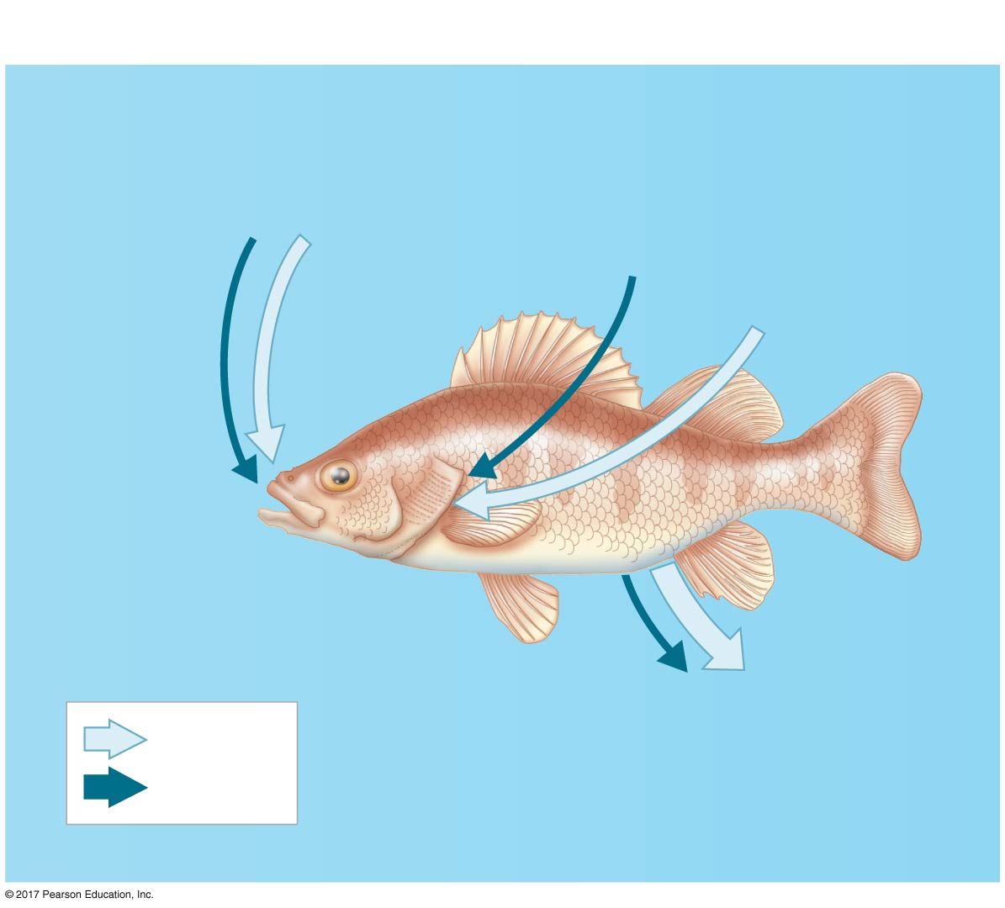
Figure 44.4b
(b) Osmoregulation in a freshwater fish
Gain of water
and some ions
in food
Uptake
of salt
ions
by gills
Osmotic water
gain through
gills and other
parts of
body surface
FRESH WATER
Excretion of salt ions
and large amounts of
water in dilute urine
from kidneys
Water
Salt
Notes:
Figure 44.4b Osmoregulation in marine and freshwater bony fishes: a comparison (part 2: freshwater)

Slide 19
Animals That Live in Temporary Waters
Some aquatic invertebrates in temporary ponds lose almost all their body water and survive in a dormant state
This adaptation is called anhydrobiosis
Tardigrades (water bears) can dehydrate from about 85% water to 2% water in the dehydrated, inactive state

Slide 20
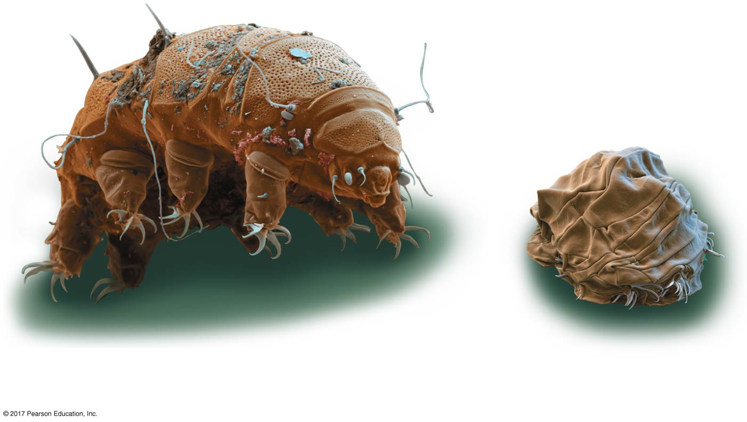
Figure 44.5
50 µm
Hydrated tardigrade
Dehydrated
tardigrade
Notes:
Figure 44.5 Anhydrobiosis

Slide 21
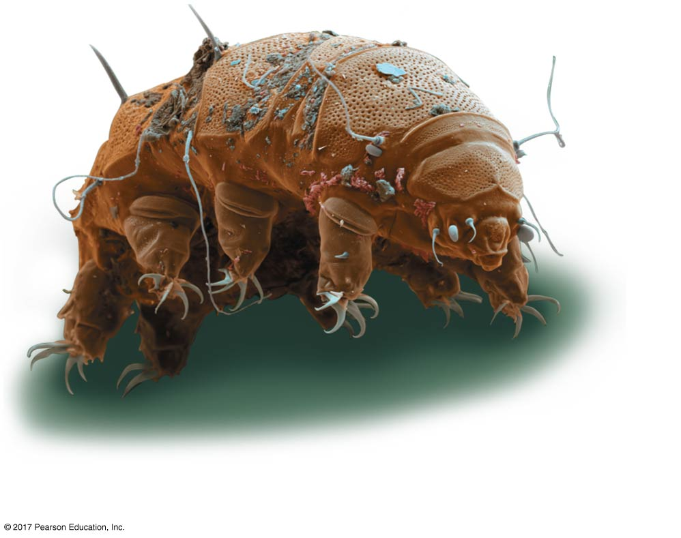
Figure 44.5a
50 µm
Hydrated tardigrade
Notes:
Figure 44.5a Anhydrobiosis (part 1: hydrated)

Slide 22
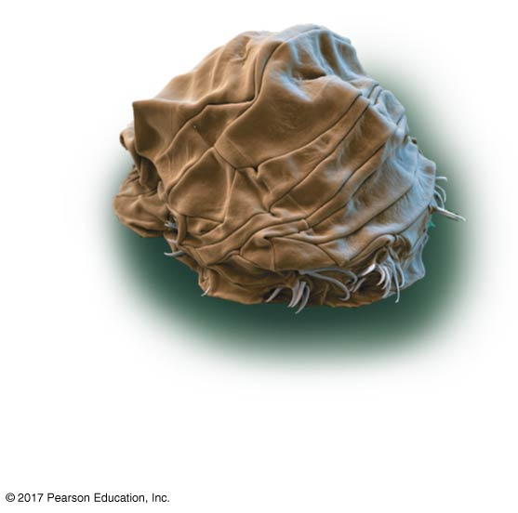
Figure 44.5b
50 µm
Dehydrated
tardigrade
Notes:
Figure 44.5b Anhydrobiosis (part 2: dehydrated)

Slide 23
Land Animals
Adaptations to reduce water loss are key to survival on land
Body coverings of most terrestrial animals help prevent dehydration
Desert animals get major water savings from simple anatomical features and behaviors such as a nocturnal lifestyle
Land animals maintain water balance by eating moist food and producing water metabolically through cellular respiration

Slide 24
Energetics of Osmoregulation
Osmoregulators must expend energy to maintain osmotic gradients
The amount of energy differs based on
How different the animal’s osmolarity is from its surroundings
How easily water and solutes move across the animal’s surface
The work required to pump solutes across the membrane

Slide 25
Transport Epithelia in Osmoregulation
Animals regulate the solute content of body fluid that bathes their cells
Transport epithelia are epithelial cells specialized for controlled movement of solutes in specific directions
They are typically arranged into complex tubular networks
An example is in the nasal glands of marine birds, which remove excess sodium chloride from the blood

Slide 26
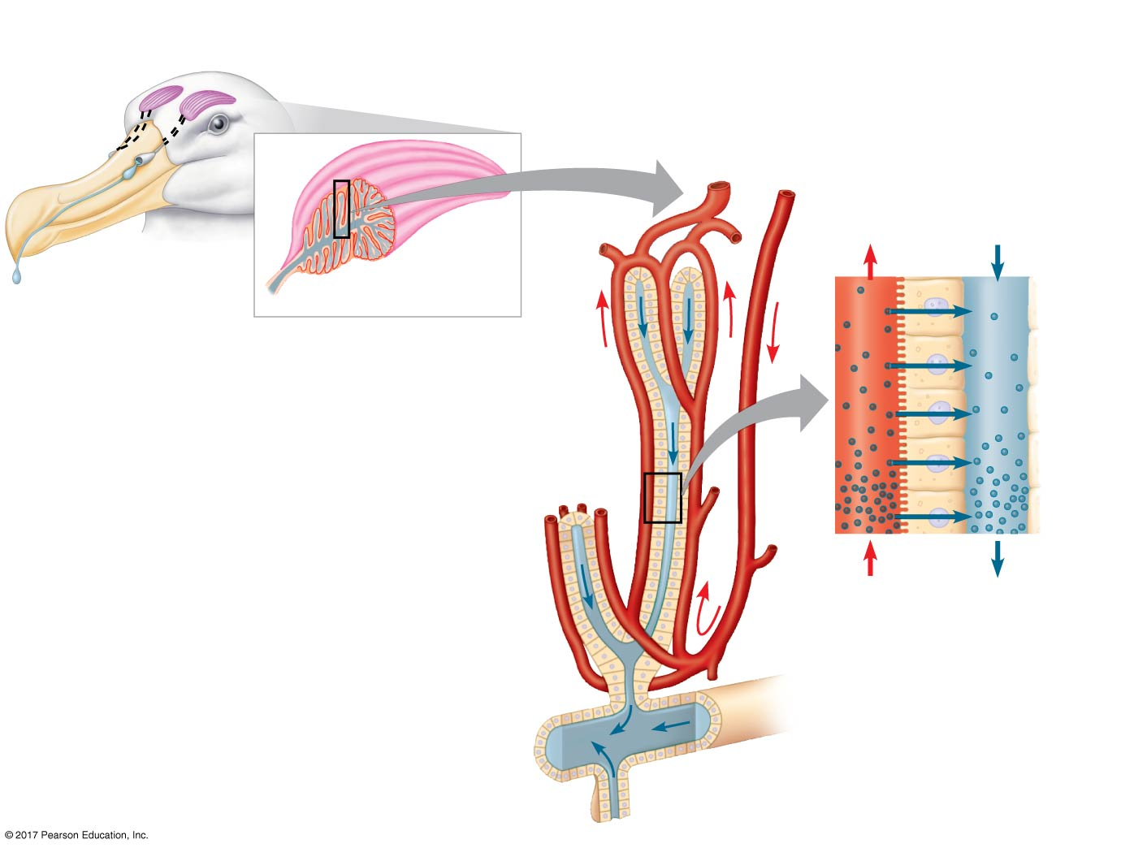
Figure 44.6
Nostril with salt
secretions
Secretory cell of
transport epithelium
Vein
Artery
Lumen of
secretory
tubule
Nasal salt gland
Capillary
Secretory tubule
Transport
epithelium
Salt
ions
Blood
flow
Salt
secretion
Central duct
Notes:
Figure 44.6 Salt secretion in the nasal glands of a marine bird

Slide 27
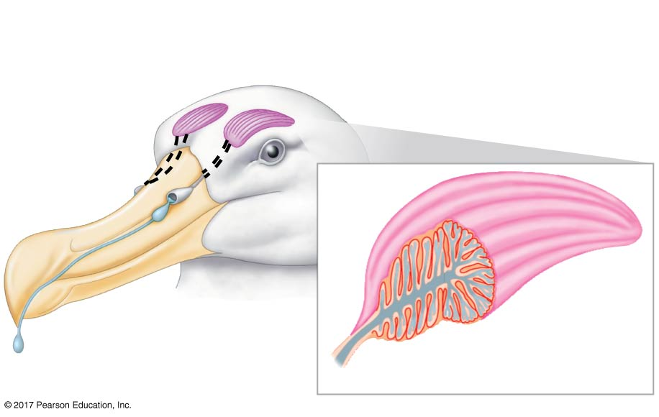
Figure 44.6a
Nostril with salt
secretions
Nasal salt gland
Notes:
Figure 44.6a Salt secretion in the nasal glands of a marine bird (part 1: bird’s head)

Slide 28
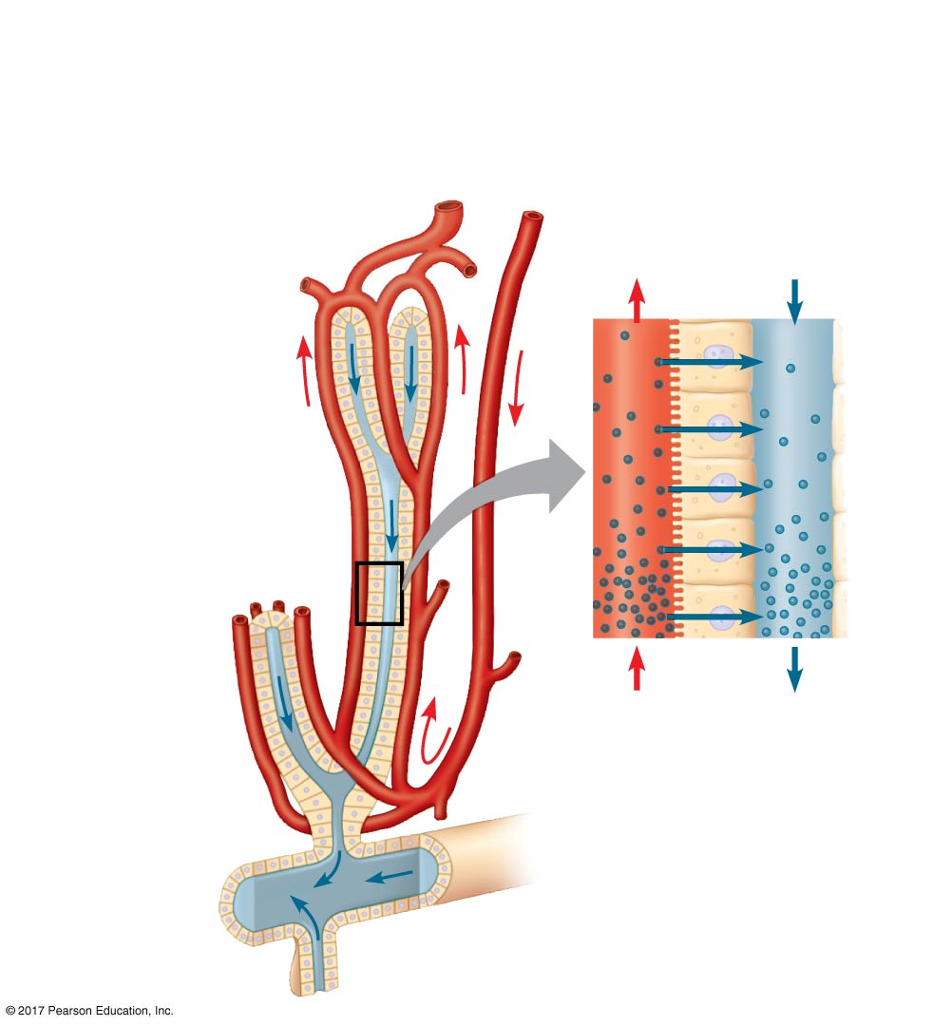
Figure 44.6b
Secretory cell of
transport epithelium
Vein
Artery
Lumen of
secretory
tubule
Capillary
Secretory tubule
Transport
epithelium
Salt
ions
Blood
flow
Salt
secretion
Central duct
Notes:
Figure 44.6b Salt secretion in the nasal glands of a marine bird (part 2: interior of nasal salt gland)

Slide 29
Concept 44.2: An animal’s nitrogenous wastes reflect its phylogeny and habitat
The type and quantity of an animal’s waste products may greatly affect its water balance
Among the most significant wastes are nitrogenous breakdown products of proteins and nucleic acids
Some animals convert toxic ammonia (NH₃) to less toxic compounds prior to excretion

Slide 30
Forms of Nitrogenous Waste
Animals excrete nitrogenous wastes in different forms: ammonia, urea, or uric acid
These differ in toxicity and the energy costs of producing them

Slide 31
Ammonia
Animals that excrete nitrogenous wastes as ammonia need access to lots of water
In many invertebrates, ammonia release occurs across the whole body surface

Slide 32
Urea
Most terrestrial mammals and many marine species excrete urea, which is less toxic than ammonia
In vertebrates, urea is produced in the liver
The circulatory system carries urea to the kidneys, where it is excreted
Conversion of ammonia to urea is energetically expensive; excretion of urea requires less water than ammonia

Slide 33
Uric Acid
Insects, land snails, and many reptiles, including birds, mainly excrete uric acid
Uric acid is relatively nontoxic and does not dissolve readily in water
It can be secreted as a paste with little water loss
Uric acid is more energetically expensive to produce than urea

Slide 34
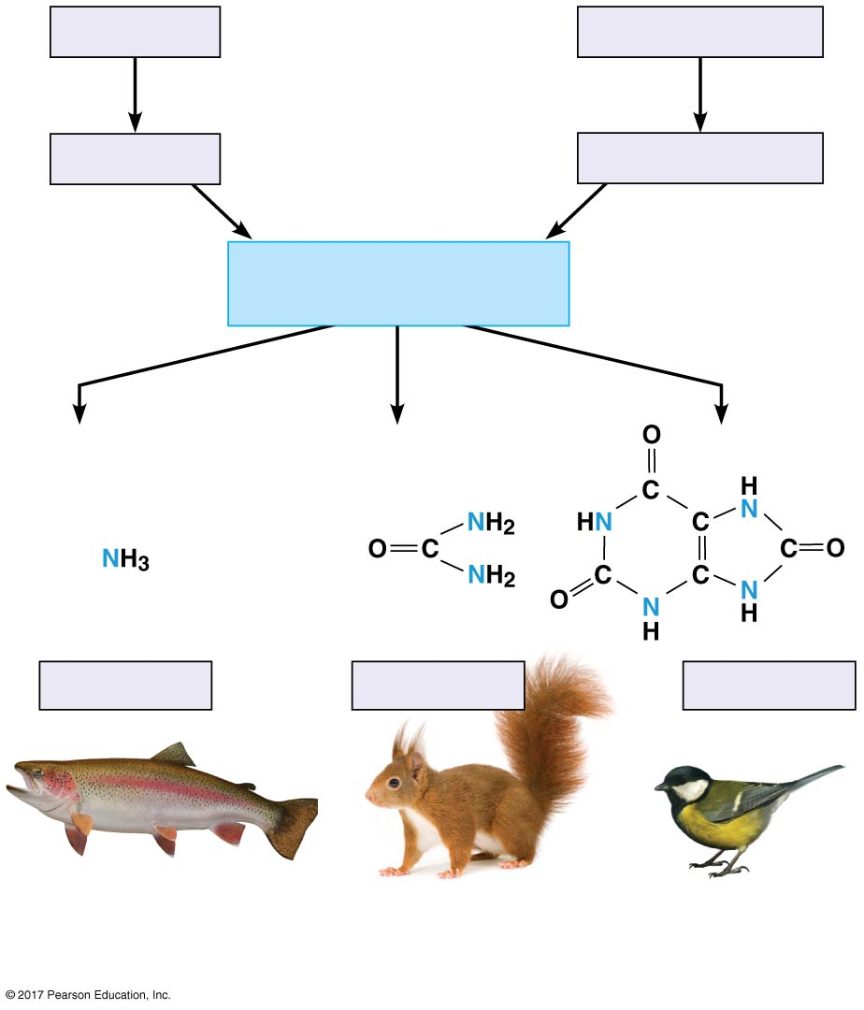
Figure 44.7
Proteins
Nucleic acids
Amino acids
Nitrogenous bases
—NH₂
(amino groups)
Ammonia
Urea
Uric acid
Most aquatic animals,
including most bony
fishes
Mammals, most
amphibians, sharks,
some bony fishes
Birds and many other
reptiles, insects, land
snails
Notes:
Figure 44.7 Forms of nitrogenous waste

Slide 35
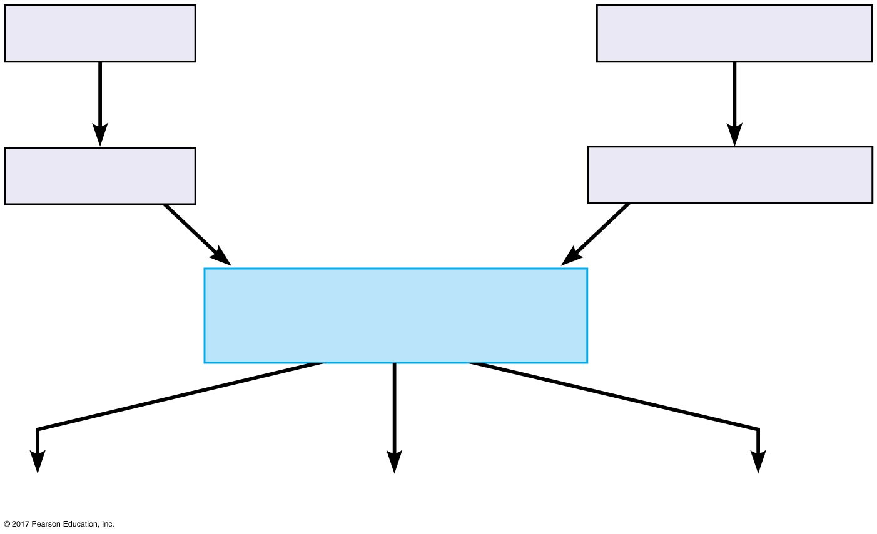
Figure 44.7a
Proteins
Nucleic acids
Breakdown of nitrogen-
containing macromolecules
Amino acids
Nitrogenous bases
Removal of nitrogen-
containing amino group
—NH₂
(amino groups)
Conversion to nitrogenous waste
Notes:
Figure 44.7a Forms of nitrogenous waste (part 1: flowchart)

Slide 36
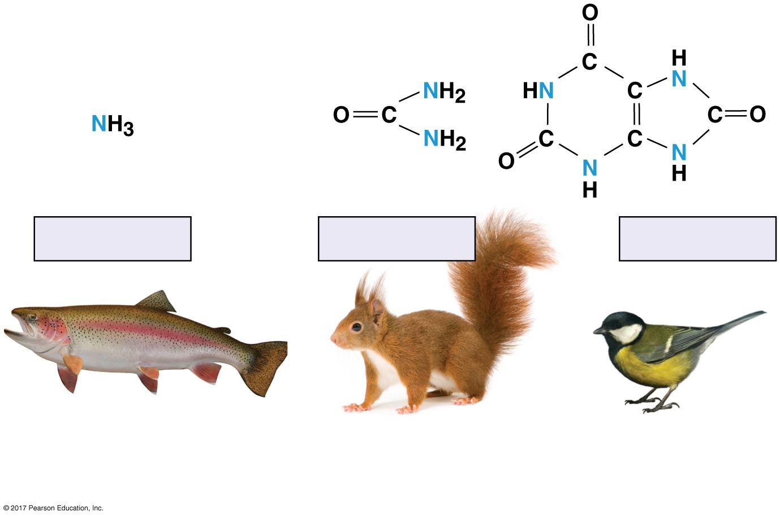
Figure 44.7b
Ammonia
Urea
Uric acid
Most aquatic animals,
including most bony
fishes
Mammals, most
amphibians, sharks,
some bony fishes
Birds and many other
reptiles, insects, land
snails
Notes:
Figure 44.7b Forms of nitrogenous waste (part 2: structures)

Slide 37
The Influence of Evolution and Environment on Nitrogenous Wastes
The kind of nitrogenous wastes excreted depends on an animal’s evolutionary history and habitat, especially water availability
Another factor is the immediate environment of the animal egg
The amount of nitrogenous waste is coupled to the animal’s energy budget

Slide 38
Concept 44.3: Diverse excretory systems are variations on a tubular theme
Excretory systems regulate solute movement between internal fluids and the external environment
These systems are central to homeostasis

Slide 39
Excretory Processes
Most excretory systems produce urine by refining a filtrate derived from body fluids
Key functions of most excretory systems
Filtration: Filtering of body fluids
Reabsorption: Reclaiming valuable solutes
Secretion: Adding nonessential solutes and wastes to the filtrate
Excretion: Processed filtrate containing nitrogenous wastes is released from the body

Slide 40
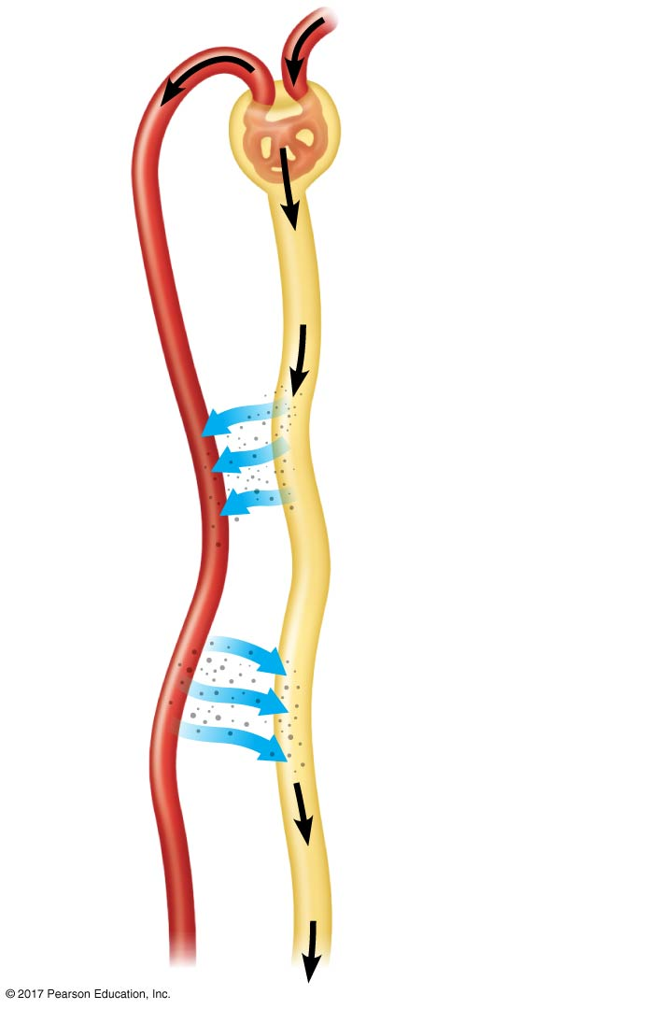
Figure 44.8
Capillary
1
Filtration
Filtrate
Excretory
tubule
2
Reabsorption
3
Secretion
Urine
4
Excretion
Notes:
Figure 44.8 Key steps of excretory system function: an overview

Slide 41
Survey of Excretory Systems
Systems that perform basic excretory functions vary widely among animal groups
They usually involve a complex network of tubules

Slide 42
Protonephridia
A protonephridium is a network of dead-end tubules that branch throughout the body
The smallest branches of the network are capped by a cellular unit called a flame bulb
These tubules excrete a dilute fluid and function in osmoregulation

Slide 43
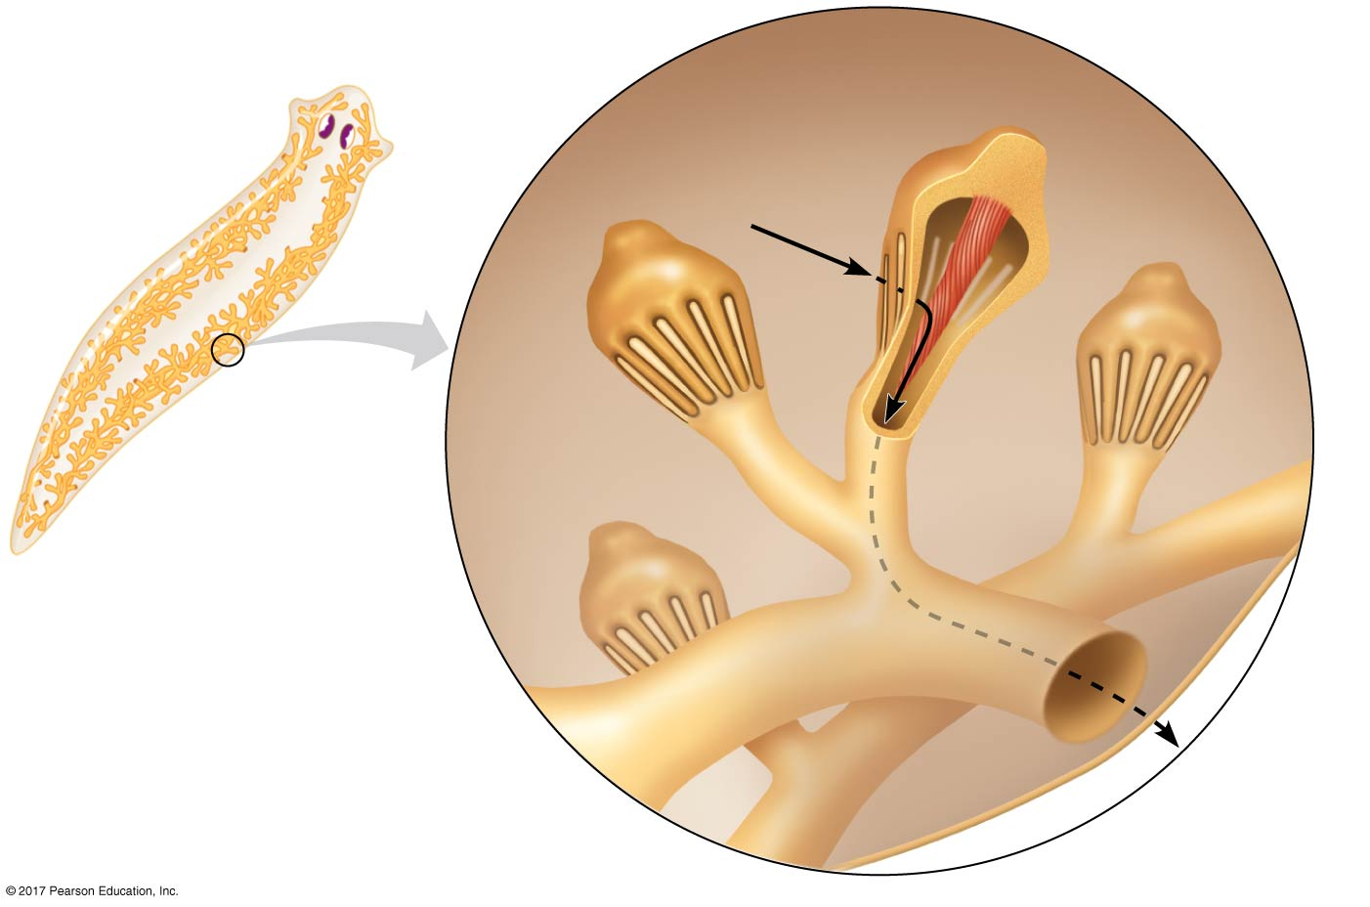
Figure 44.9
Tubules of
protonephridia
INTERSTITIAL
FLUID
Cap
cell
Cilia
Tubule
cell
Flame
bulb
Tubule
Opening in
body wall
Notes:
Figure 44.9 Protonephridia in a planarian

Slide 44
Metanephridia
Each segment of an earthworm has a pair of open-ended metanephridia
Metanephridia consist of tubules that collect coelomic fluid and produce dilute urine for excretion
Metanephridia of earthworms function in excretion and osmoregulation

Slide 45
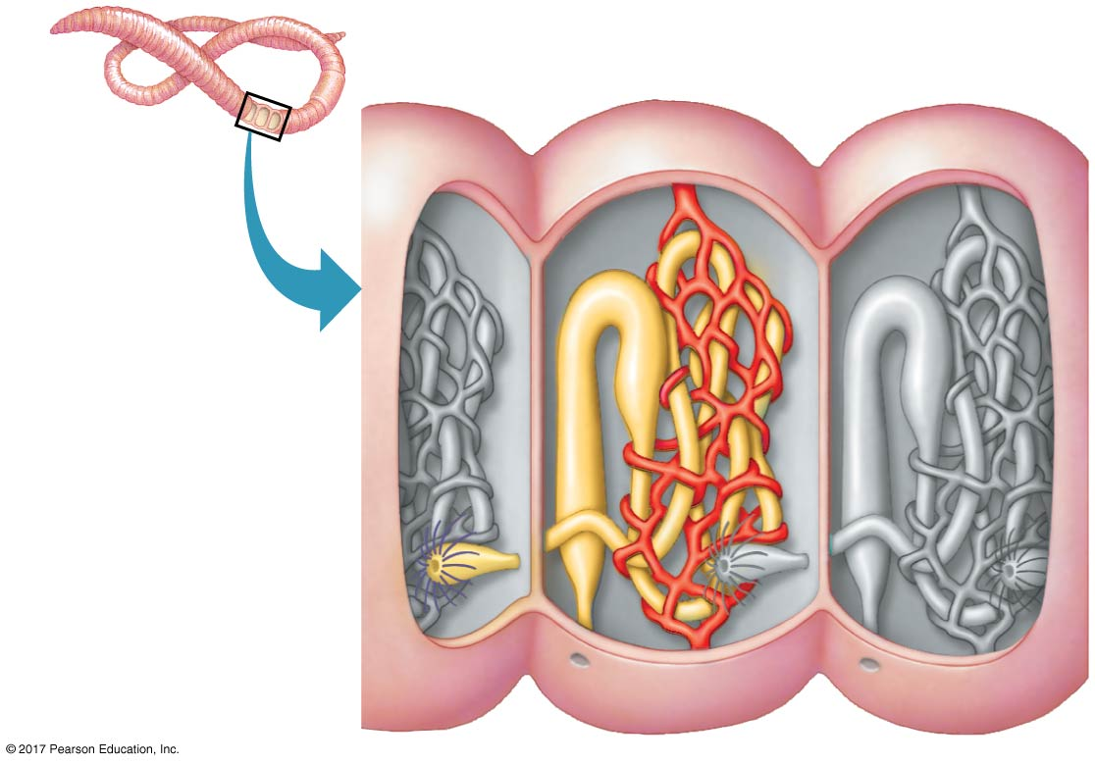
Figure 44.10
Coelom
Capillary
network
Components of a
metanephridium:
Collecting tubule
Internal opening
Bladder
External opening
Notes:
Figure 44.10 Metanephridia of an earthworm

Slide 46
Malpighian Tubules
In insects and other terrestrial arthropods, Malpighian tubules remove nitrogenous wastes from hemolymph and function in osmoregulation
Insects produce a relatively dry waste matter, mainly uric acid, an important adaptation to terrestrial life
This system is capable of conserving water very effectively

Slide 47
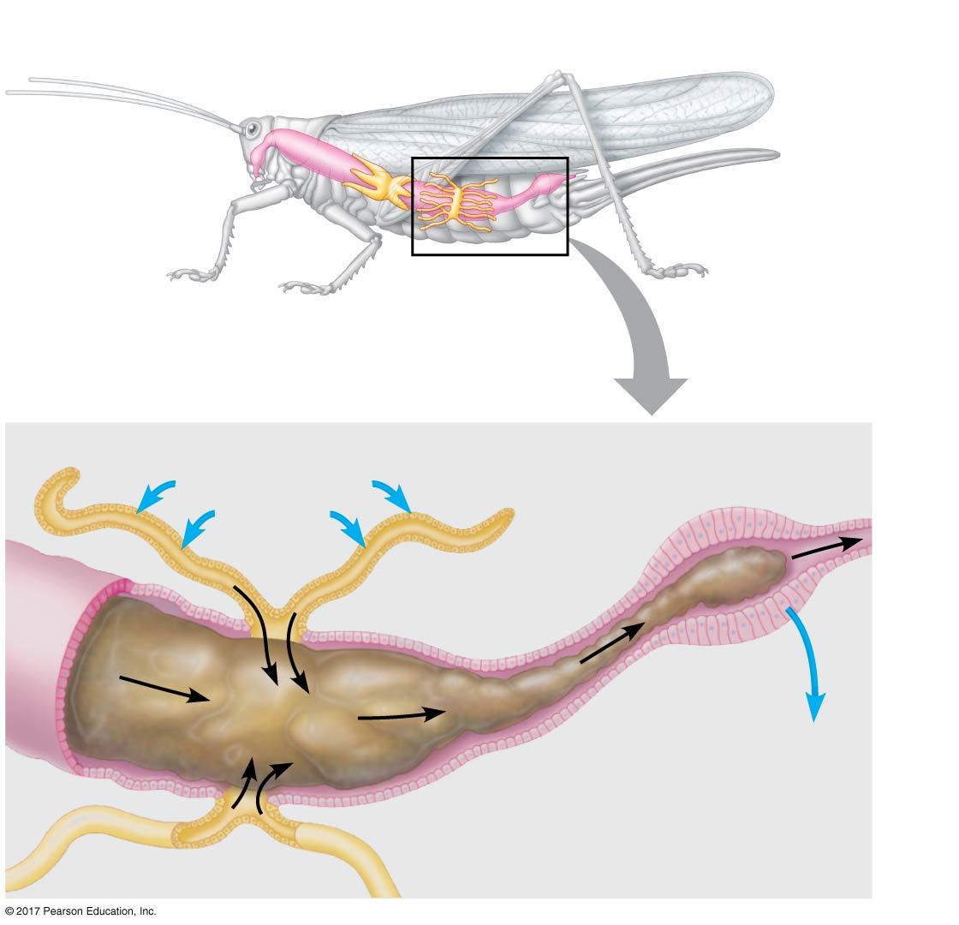
Figure 44.11
Digestive tract
Rectum
Hindgut
Intestine
Midgut
(stomach)
Malpighian
tubules
Salt, water, and
nitrogenous
wastes
Feces and urine
To anus
Malpighian
tubule
Rectum
Reabsorption of
H₂O, ions, and
valuable organic
molecules
HEMO-
LYMPH
Notes:
Figure 44.11 Malpighian tubules of insects

Slide 48
Kidneys
Kidneys, the excretory organs of vertebrates, function in both excretion and osmoregulation
The numerous tubules of kidneys are highly organized
The vertebrate excretory system also includes ducts and other structures that carry urine from the tubules out of the kidney and out of the body

Slide 49
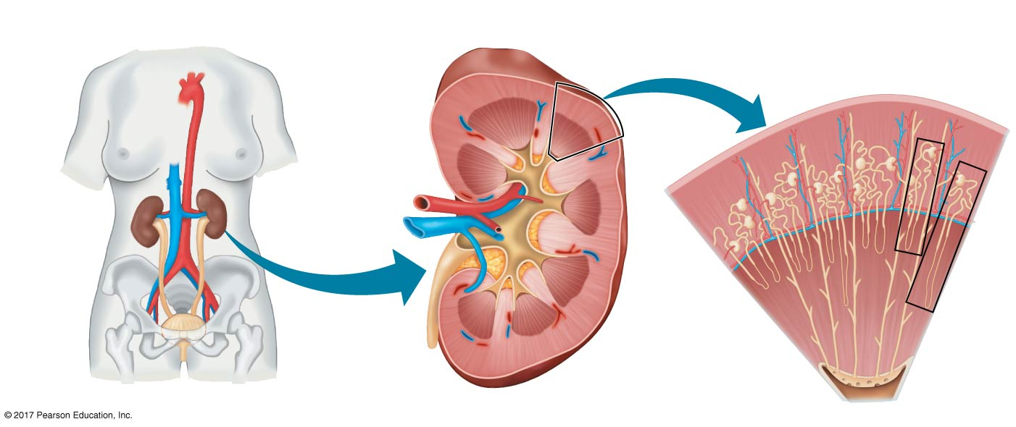
Figure 44.12a
Excretory Organs
Kidney Structure
Nephron Types
Renal
cortex
Cortical
nephron
Juxtamedullary
nephron
Renal
medulla
Posterior
vena cava
Renal
artery
Renal artery
and vein
Kidney
Renal
vein
Aorta
Renal
cortex
Ureter
Urinary
bladder
Ureter
Renal
medulla
Urethra
Renal pelvis
Notes:
Figure 44.12a Exploring the mammalian excretory system (part 1)

Slide 50
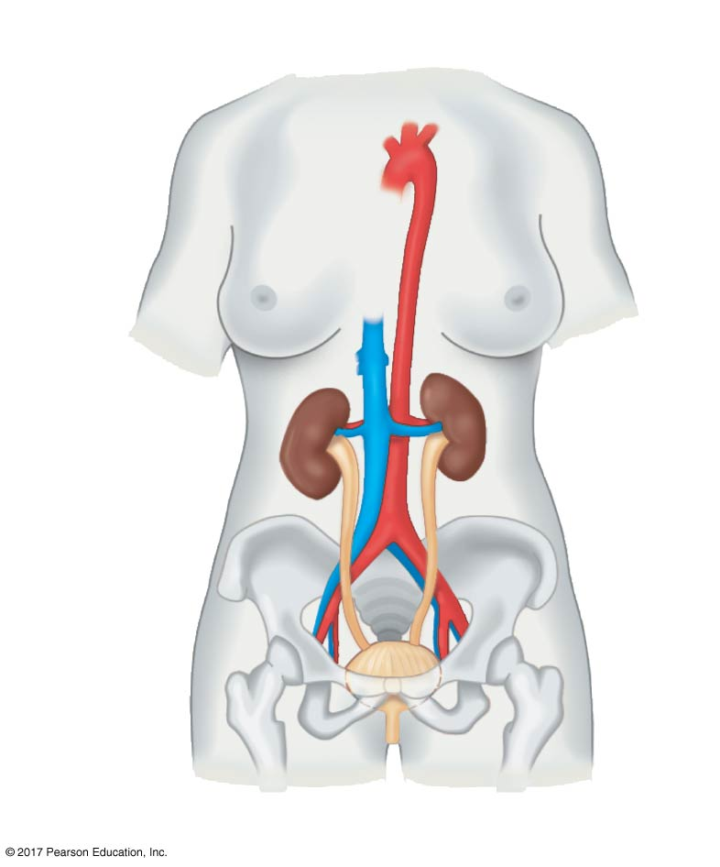
Figure 44.12aa
Excretory Organs
Posterior
vena cava
Renal artery
and vein
Kidney
Aorta
Ureter
Urinary
bladder
Urethra
Notes:
Figure 44.12aa Exploring the mammalian excretory system (part 1a: organs)

Slide 51
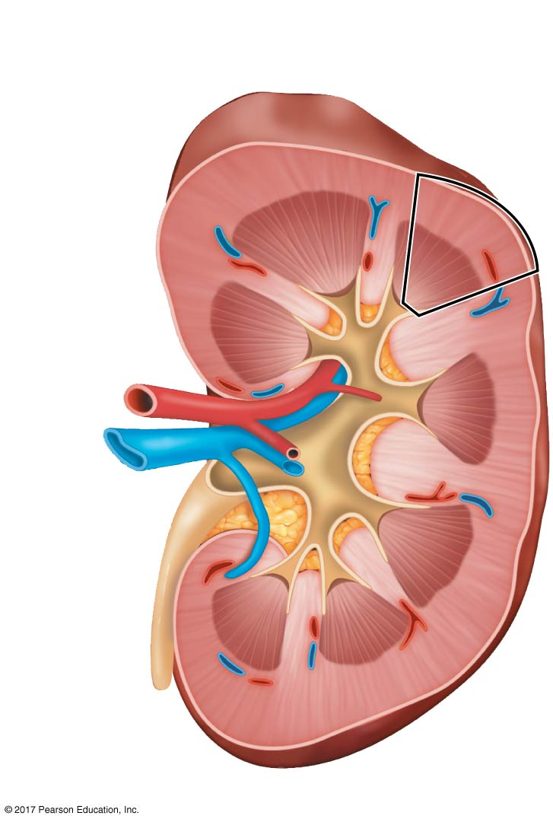
Figure 44.12ab
Kidney Structure
Renal
cortex
Renal
medulla
Renal
artery
Renal
vein
Ureter
Renal pelvis
Notes:
Figure 44.12ab Exploring the mammalian excretory system (part 1b: kidney structure)

Slide 52
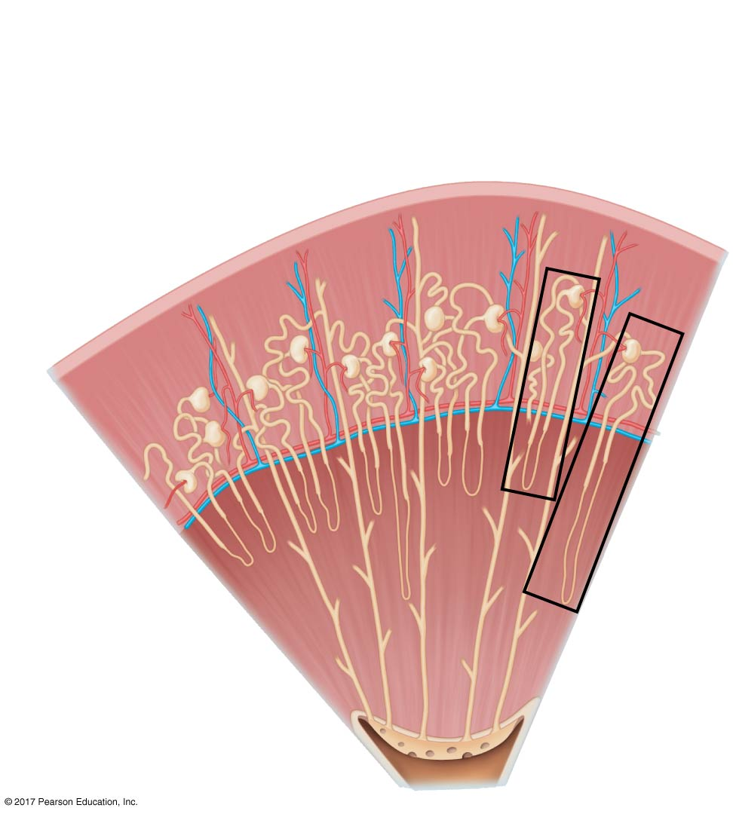
Figure 44.12ac
Nephron Types
Cortical
nephron
Juxtamedullary
nephron
Renal
cortex
Renal
medulla
Notes:
Figure 44.12ac Exploring the mammalian excretory system (part 1c: nephron types)

Slide 53
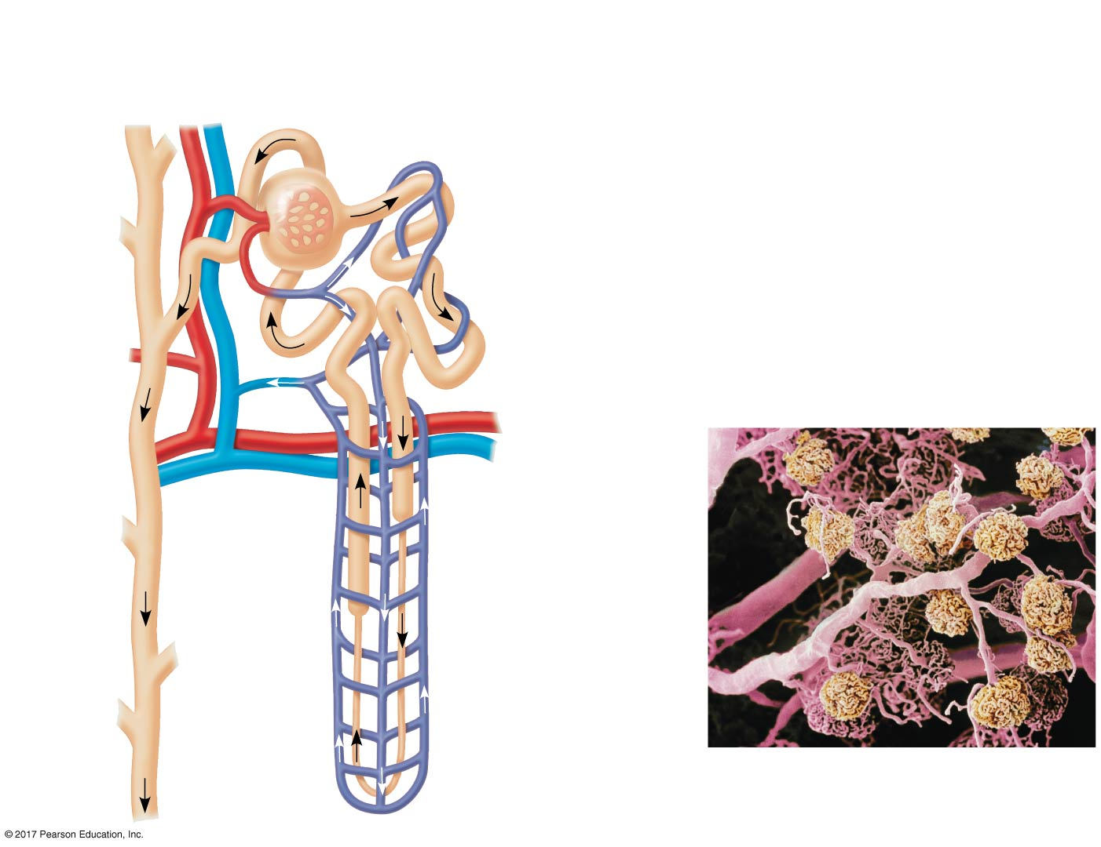
Figure 44.12b
Nephron Organization
Afferent arteriole
from renal artery
Glomerulus
Bowman’s
capsule
Proximal
tubule
Distal
tubule
Peritubular
capillaries
Efferent
arteriole
from
glomerulus
Branch of
renal vein
Descending
limb
Vasa
recta
Loop of
Henle
Collecting
duct
200 µm
Ascending
limb
Blood vessels from a human kidney.
Arterioles and peritubular capillaries
appear pink; glomeruli appear yellow.
Notes:
Figure 44.12b Exploring the mammalian excretory system (part 2)

Slide 54
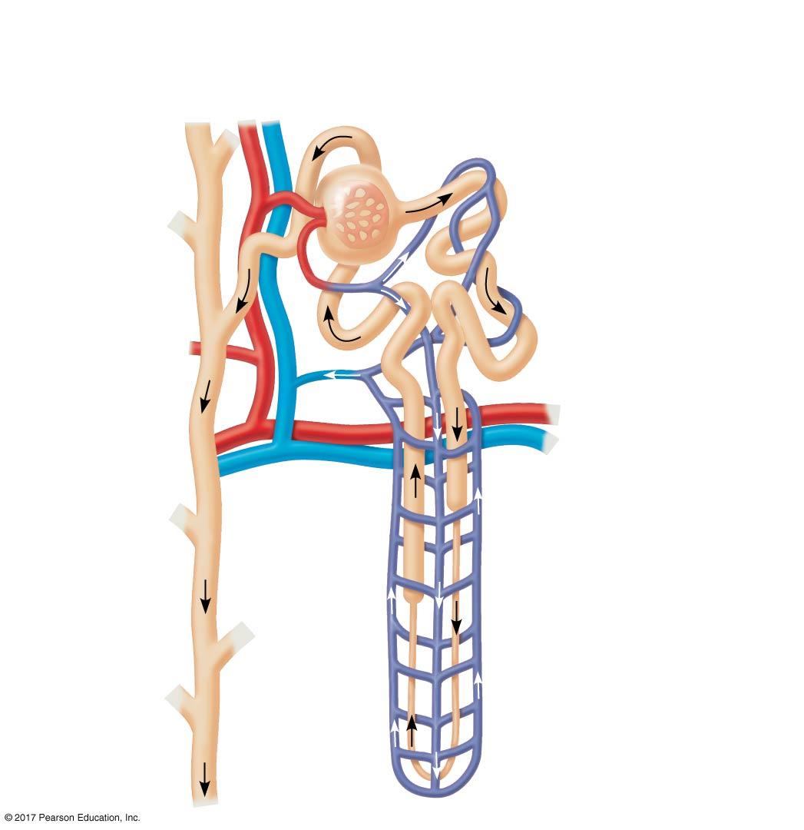
Figure 44.12ba
Nephron Organization
Afferent arteriole
from renal artery
Glomerulus
Bowman’s
capsule
Proximal
tubule
Distal
tubule
Peritubular
capillaries
Efferent
arteriole
from
glomerulus
Branch of
renal vein
Descending
limb
Vasa
recta
Loop of
Henle
Collecting
duct
Ascending
limb
Notes:
Figure 44.12ba Exploring the mammalian excretory system (part 2a: nephron organization)

Slide 55
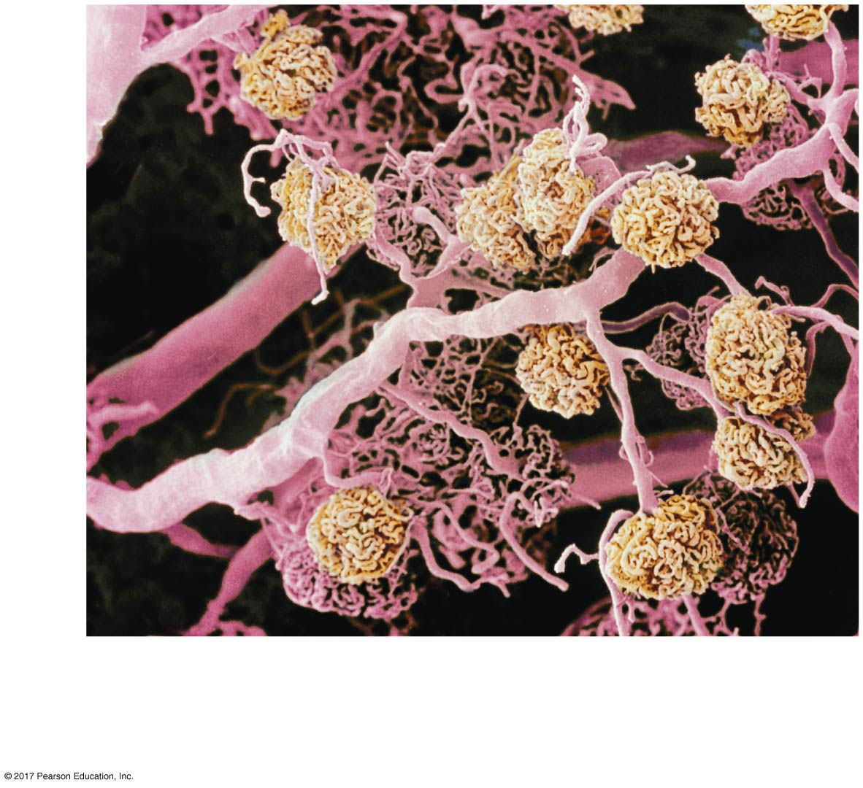
Figure 44.12bb
200 µm
Blood vessels from a human kidney.
Arterioles and peritubular capillaries
appear pink; glomeruli appear yellow.
Notes:
Figure 44.12bb Exploring the mammalian excretory system (part 2b: SEM)

Slide 56
Animation: Nephron Introduction

Slide 57
Concept 44.4: The nephron is organized for stepwise processing of blood filtrate
The filtrate produced in Bowman’s capsule contains salts, glucose, amino acids, vitamins, nitrogenous wastes, and other small molecules

Slide 58
From Blood Filtrate to Urine: A Closer Look
Proximal Tubule
Reabsorption of ions, water, and nutrients takes place in the proximal tubule
Molecules are transported actively and passively from the filtrate into the interstitial fluid and then capillaries
As the filtrate passes through the proximal tubule, materials to be excreted become concentrated
Some toxic materials are actively secreted into the filtrate

Slide 59
Descending Limb of the Loop of Henle
Reabsorption of water continues through channels formed by aquaporin proteins
Movement is driven by the high osmolarity of the interstitial fluid, which is hyperosmotic to the filtrate
The filtrate becomes increasingly concentrated

Slide 60
Ascending Limb of the Loop of Henle
In the ascending limb of the loop of Henle, salt but not water is able to diffuse from the tubule into the interstitial fluid
The filtrate becomes increasingly dilute

Slide 61
Distal Tubule
The distal tubule regulates the K⁺ and NaCl concentrations of body fluids
The controlled movement of ions (H⁺ and HCO₃–) contributes to pH regulation

Slide 62
Collecting Duct
The collecting duct carries filtrate through the medulla to the renal pelvis
One of the most important tasks is reabsorption of solutes and water
Urine is hyperosmotic to body fluids

Slide 63
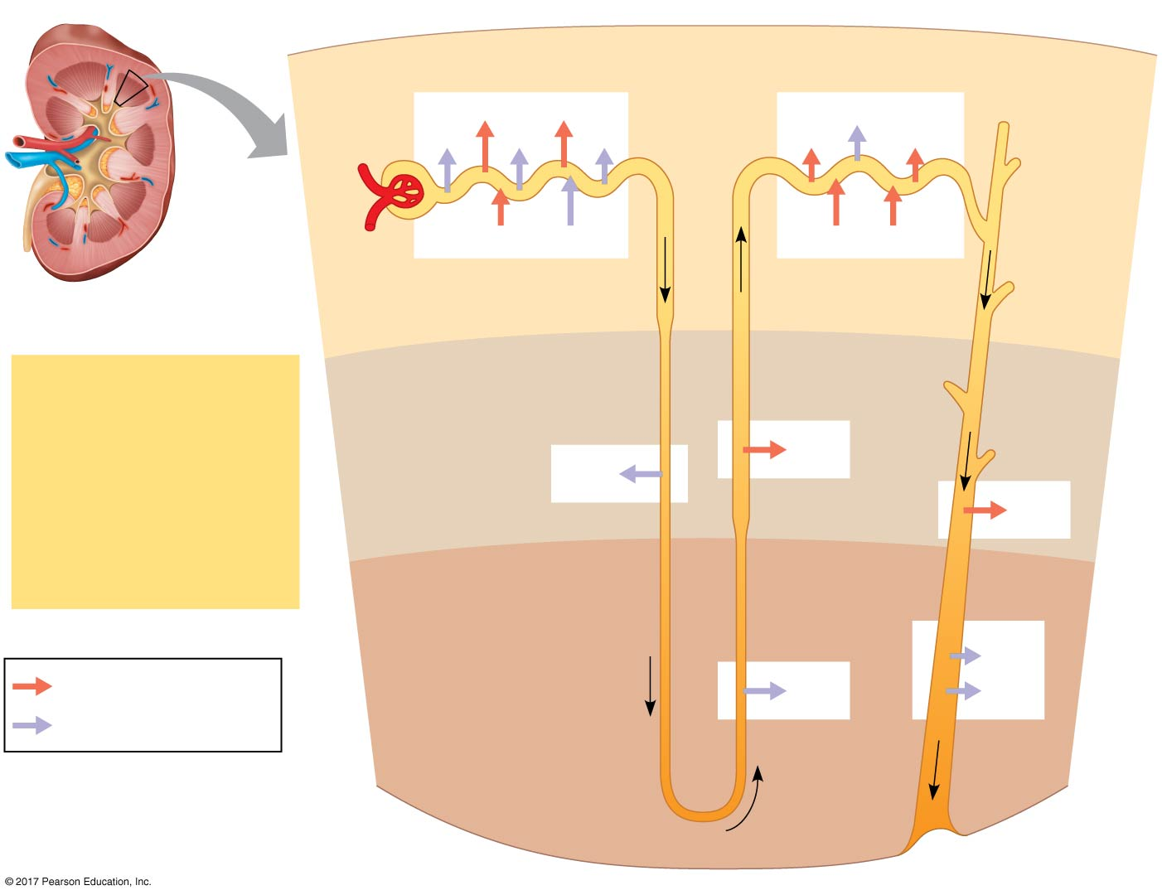
Figure 44.13
1
Proximal tubule
4
Distal tubule
NaCl
Nutrients
H₂O
HCO₃–
H₂O
K⁺
NaCl
HCO₃–
H⁺
NH₃
K⁺
H⁺
Interstitial
fluid
CORTEX
3
Thick segment
of ascending
limb
Filtrate
2
Descending limb
of loop of
Henle
H₂O
Salts (NaCl and others)
NaCl
HCO₃–
H₂O
H⁺
OUTER
MEDULLA
NaCl
Urea
Glucose, amino acids
3
Thin segment
of ascending
limb
5
Collecting
duct
Some drugs
Urea
Active transport
NaCl
H₂O
Passive transport
INNER
MEDULLA
Notes:
Figure 44.13 The nephron and collecting duct: regional functions of the transport epithelium

Slide 64
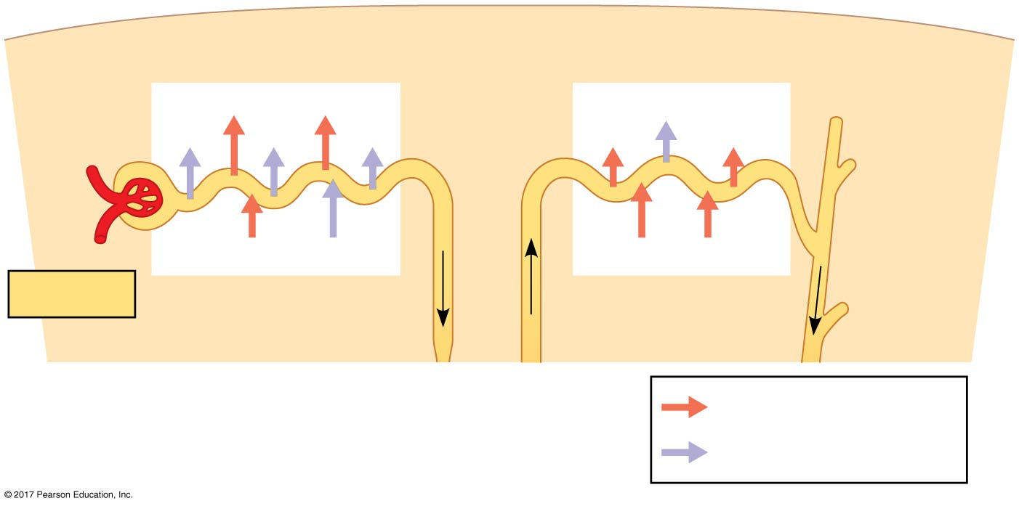
Figure 44.13a
1
Proximal tubule
4
Distal tubule
NaCl
Nutrients
H₂O
HCO₃–
H₂O
K⁺
NaCl
HCO₃–
H⁺
NH₃
K⁺
H⁺
Filtrate
Interstitial
fluid
CORTEX
Active transport
Passive transport
Notes:
Figure 44.13a The nephron and collecting duct: regional functions of the transport epithelium (part 1: cortex)

Slide 65
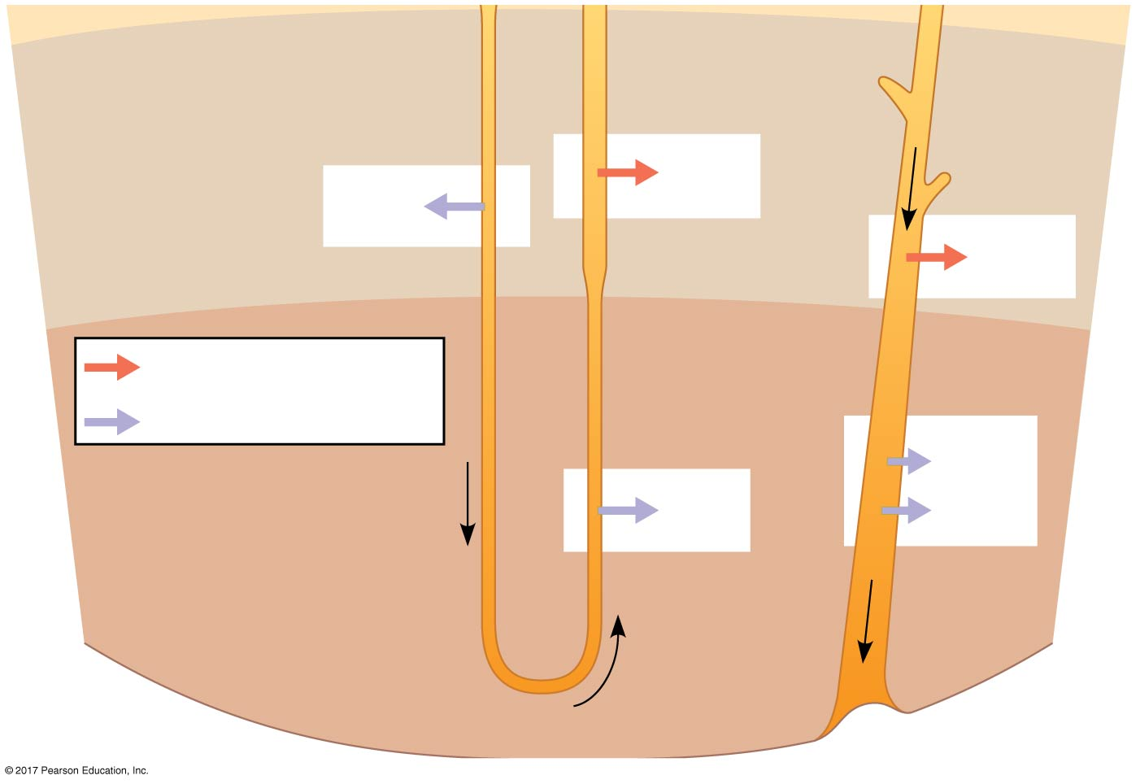
Figure 44.13b
3
Thick segment
of ascending
limb
2
Descending limb
of loop of
Henle
NaCl
H₂O
OUTER
MEDULLA
NaCl
3
Thin segment
of ascending
limb
5
Collecting
duct
Active transport
Passive transport
Urea
NaCl
H₂O
INNER
MEDULLA
Notes:
Figure 44.13b The nephron and collecting duct: regional functions of the transport epithelium (part 2: medulla)

Slide 66
Animation: Bowman’s Capsule and Proximal Tubule

Slide 67
Animation: Collecting Duct

Slide 68
Animation: Loop of Henle and Distal Tubule

Slide 69
Solute Gradients and Water Conservation
The mammalian kidney’s ability to conserve water is a key terrestrial adaptation
Hyperosmotic urine can be produced only because considerable energy is expended to transport solutes against concentration gradients
The two primary solutes affecting osmolarity are NaCl and urea

Slide 70
Concentrating Urine in the Mammalian Kidney
In the proximal tubule, filtrate volume decreases as water and salt are reabsorbed, but osmolarity remains the same
As the filtrate flows to the descending limb of the loop of Henle, solutes become more concentrated due to water leaving the tubule by osmosis
NaCl diffusing from the ascending limb maintains a high osmolarity in the interstitial fluid of the renal medulla

Slide 71
Energy is expended to actively transport NaCl from the filtrate in the upper part of the ascending limb
The countercurrent multiplier system involving the loop of Henle maintains a high salt concentration in the kidney
This system allows the vasa recta to supply the kidney with nutrients without interfering with the osmolarity gradient

Slide 72
In the collecting duct, osmosis extracts water from the filtrate as it passes from cortex to medulla and encounters interstitial fluid of increasing osmolarity
Urine produced is isoosmotic to the interstitial fluid of the inner medulla, but hyperosmotic to blood and interstitial fluids elsewhere in the body

Slide 73
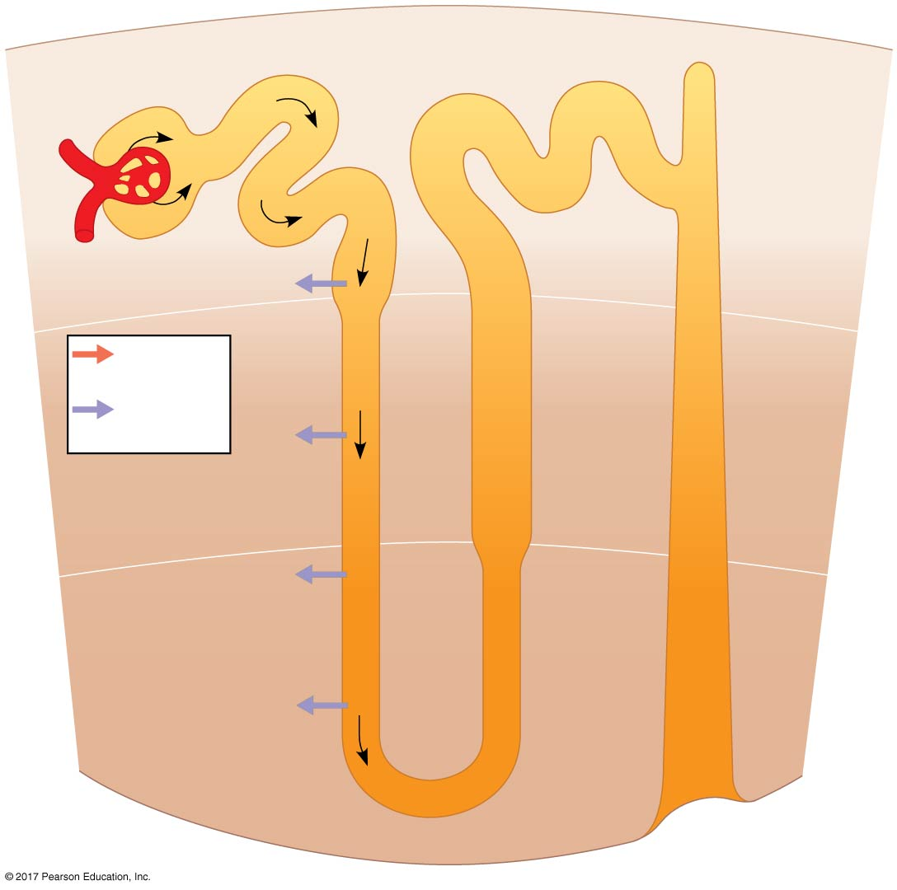
Figure 44.14_1
Osmolarity of
interstitial
fluid
(mOsm/L)
300
300
300
300
CORTEX
H₂O
Active
transport
400
400
Passive
transport
H₂O
OUTER
MEDULLA
600
600
H₂O
900
900
H₂O
INNER
MEDULLA
1,200
1,200
Notes:
Figure 44.14_1 How the human kidney concentrates urine (step 1)

Slide 74
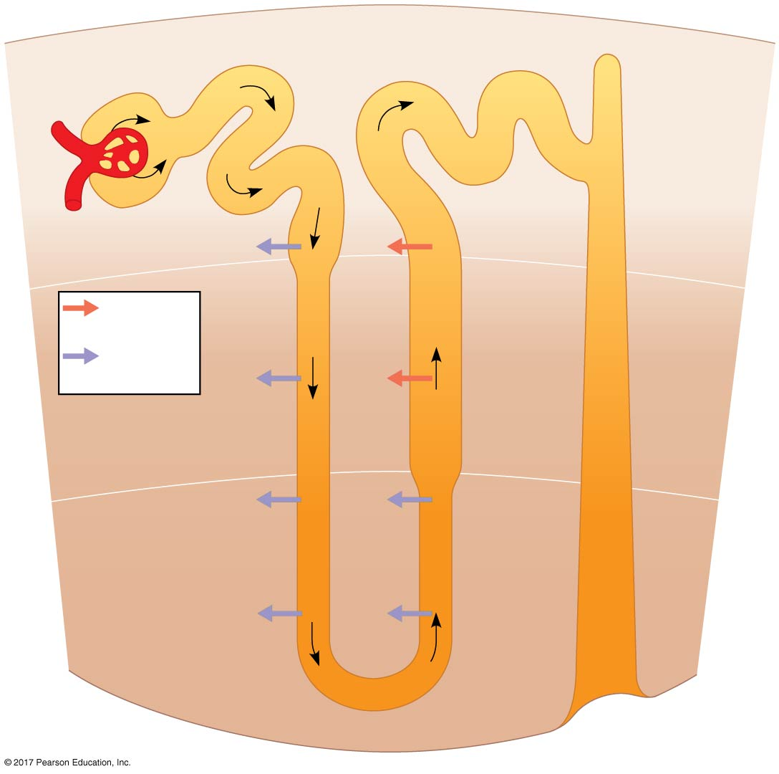
Figure 44.14_2
Osmolarity of
interstitial
fluid
(mOsm/L)
300
300
300
100
100
300
CORTEX
H₂O
NaCl
Active
transport
400
200
400
Passive
transport
H₂O
NaCl
OUTER
MEDULLA
600
400
600
H₂O
NaCl
900
700
900
H₂O
NaCl
INNER
MEDULLA
1,200
1,200
Notes:
Figure 44.14_2 How the human kidney concentrates urine (step 2)

Slide 75
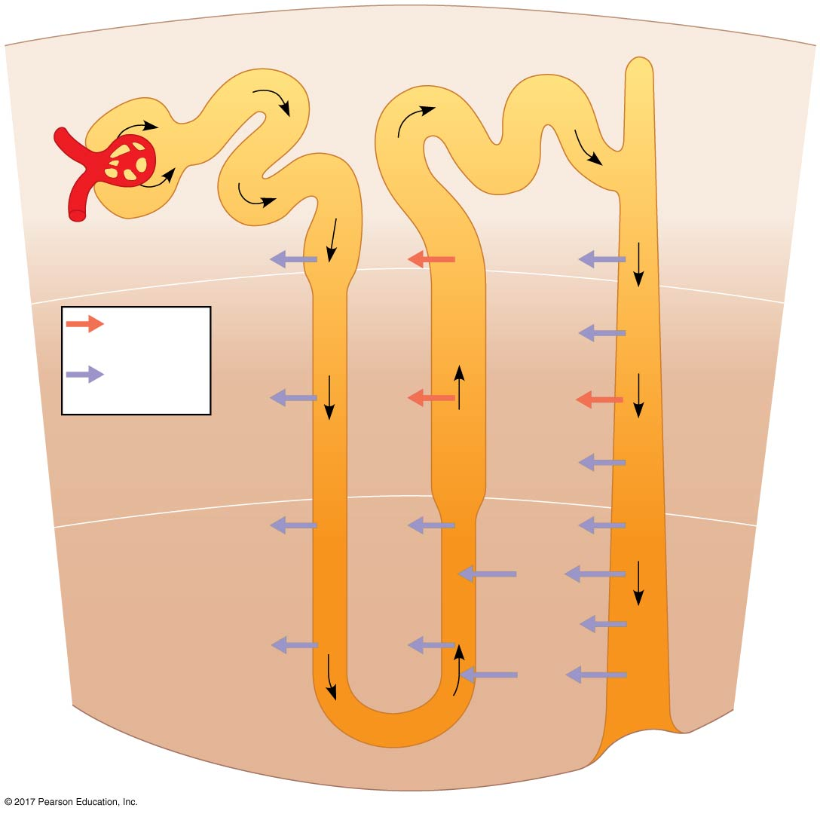
Figure 44.14_3
Osmolarity of
interstitial
fluid
(mOsm/L)
300
300
300
100
100
300
300
CORTEX
H₂O
NaCl
H₂O
Active
transport
400
200
H₂O
400
400
Passive
transport
H₂O
NaCl
NaCl
OUTER
MEDULLA
H₂O
600
400
600
600
H₂O
NaCl
H₂O
Urea
900
700
900
H₂O
H₂O
NaCl
INNER
MEDULLA
Urea
1,200
1,200
1,200
Notes:
Figure 44.14_3 How the human kidney concentrates urine (step 3)

Slide 76
Adaptations of the Vertebrate Kidney to Diverse Environments
Variations in nephron structure and function equip the kidneys of different vertebrates for osmoregulation in various habitats

Slide 77
Mammals
The juxtamedullary nephron is key to water conservation in terrestrial animals
Mammals that inhabit dry environments have long loops of Henle, while those in fresh water have relatively short loops

Slide 78
Case Study: Kidney Function in the Vampire Bat
The South American vampire bat, which feeds at night on the blood of large birds and mammals, illustrates the versatility of the mammalian kidney
The vampire bat can alternate rapidly between producing large amounts of dilute urine and small amounts of very hyperosmotic urine

Slide 79
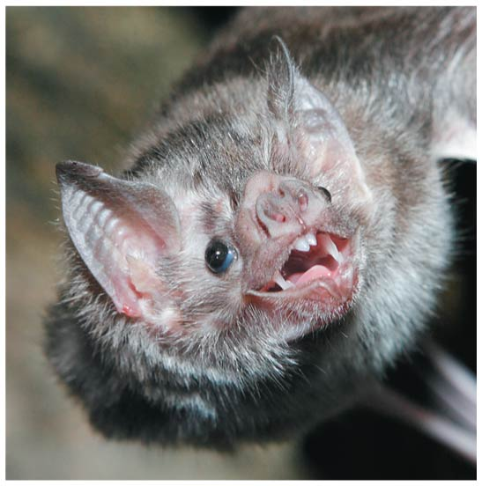
Figure 44.15
Notes:
Figure 44.15 A vampire bat (Desmodus rotundas), a mammal with unique excretory challenges

Slide 80
Birds and Other Reptiles
Birds have shorter loops of Henle than mammals do, but conserve water by excreting uric acid instead of urea
Other reptiles have only cortical nephrons but reabsorb water from wastes in the cloaca
Reptiles also excrete nitrogenous waste as uric acid

Slide 81
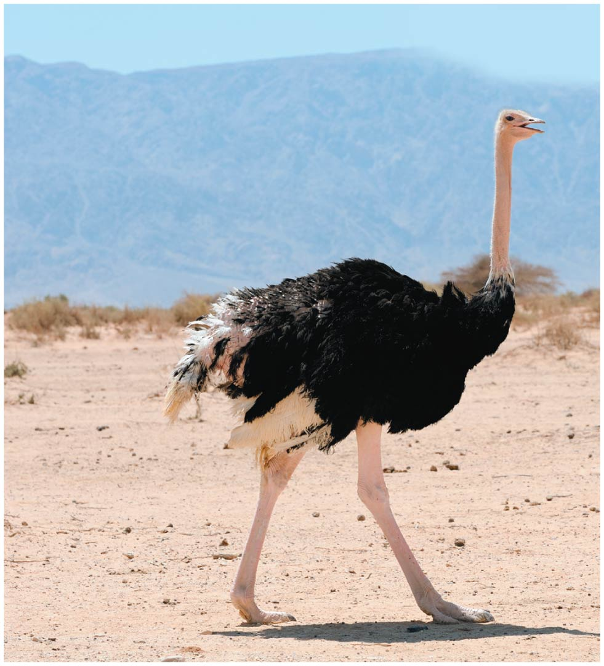
Figure 44.16
Notes:
Figure 44.16 An ostrich (Struthio camelus), an animal well adapted to its dry environment

Slide 82
Freshwater Fishes and Amphibians
Freshwater fishes conserve salt in their distal tubules and excrete large volumes of very dilute urine
Kidney function in amphibians is similar to freshwater fishes
Amphibians conserve water on land by reabsorbing water from the urinary bladder

Slide 83
Marine Bony Fishes
Marine bony fishes have fewer and smaller nephrons than freshwater fishes, and their nephrons lack a distal tubule
Their kidneys have small glomeruli; some lack glomeruli entirely
Filtration rates are low, and very little urine is excreted
Osmoregulation relies on specialized chloride cells in the gills

Slide 84
Figure 44.17
MAKE CONNECTIONS: Ion Movement and Gradients
Osmoregulation
Information Processing
SALT WATER
Na⁺
Cl–
CHLORIDE
CELL
K⁺
Channel
open
Channel
closed
Na⁺
Na⁺
BLOOD
K⁺
NEURON
Na⁺
Gas Exchange
Locomotion
H₂O
H₂O
H⁺
H₂O
K⁺
K⁺
H⁺
Filament of
flagellum
H₂O
H₂O
Guard cells
Flagellar
motor
Hook
H⁺
Notes:
Figure 44.17 Make connections: ion movement and gradients

Slide 85
Figure 44.17a
Osmoregulation
SALT WATER
Na⁺
Cl⁻
CHLORIDE
CELL
K⁺
In marine bony fishes,
ion gradients drive
secretion of salt (NaCl),
a process essential to
avoid dehydration.
Na⁺
K⁺
BLOOD
Notes:
Figure 44.17a Make connections: ion movement and gradients (part 1: osmoregulation)

Slide 86
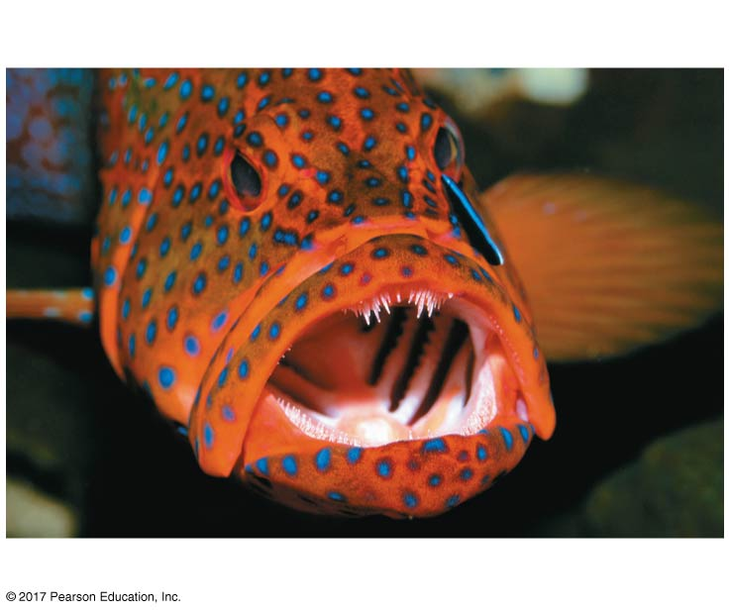
Figure 44.17aa
Osmoregulation
A marine bony fish
Notes:
Figure 44.17aa Make connections: ion movement and gradients (part 1a: osmoregulation, photo)

Slide 87
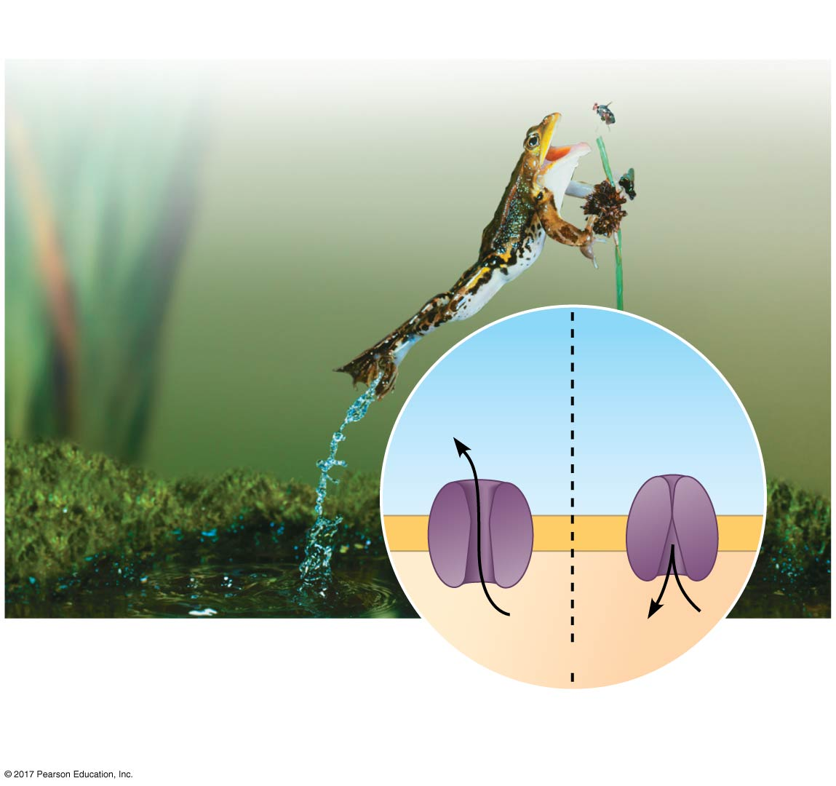
Figure 44.17b
Information Processing
Channel
open
Channel
closed
Na⁺
Na⁺
In neurons, the opening
and closing of channels
selective for sodium or other ions underlies the
transmission of information as nerve impulses.
NEURON
Notes:
Figure 44.17b Make connections: ion movement and gradients (part 2: information processing)

Slide 88
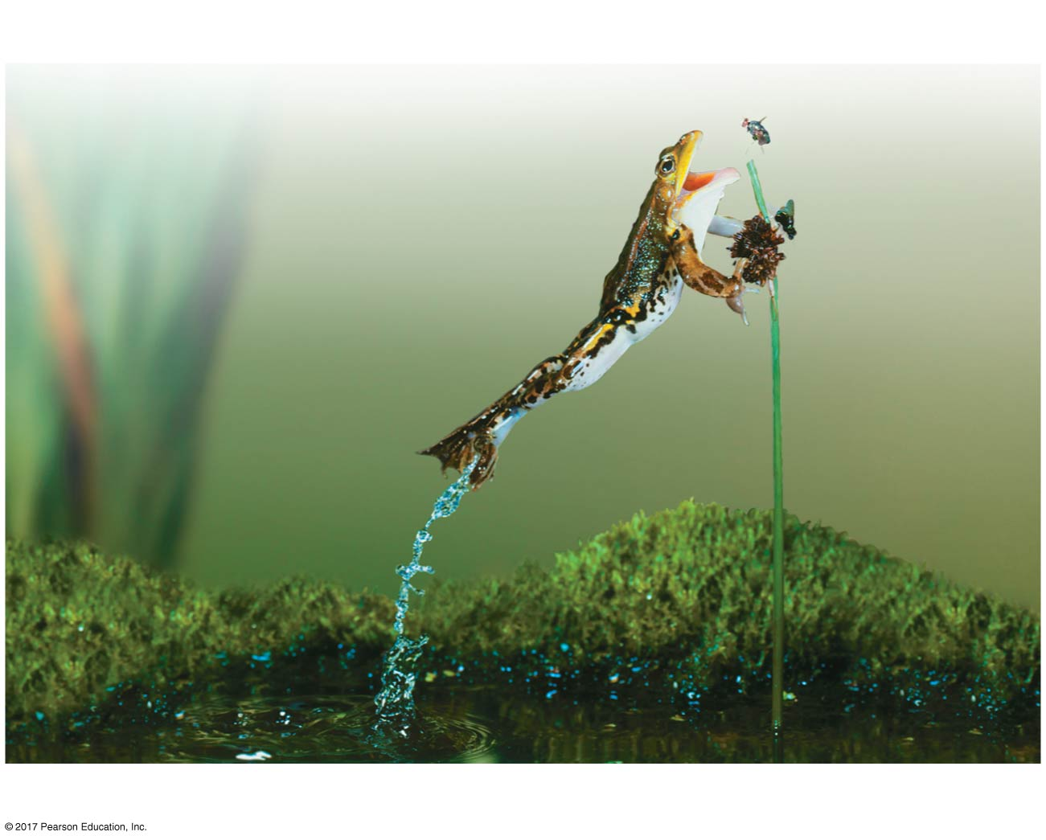
Figure 44.17ba
Information Processing
Leap of a frog capturing prey
Notes:
Figure 44.17ba Make connections: ion movement and gradients (part 2a: information processing, photo)

Slide 89
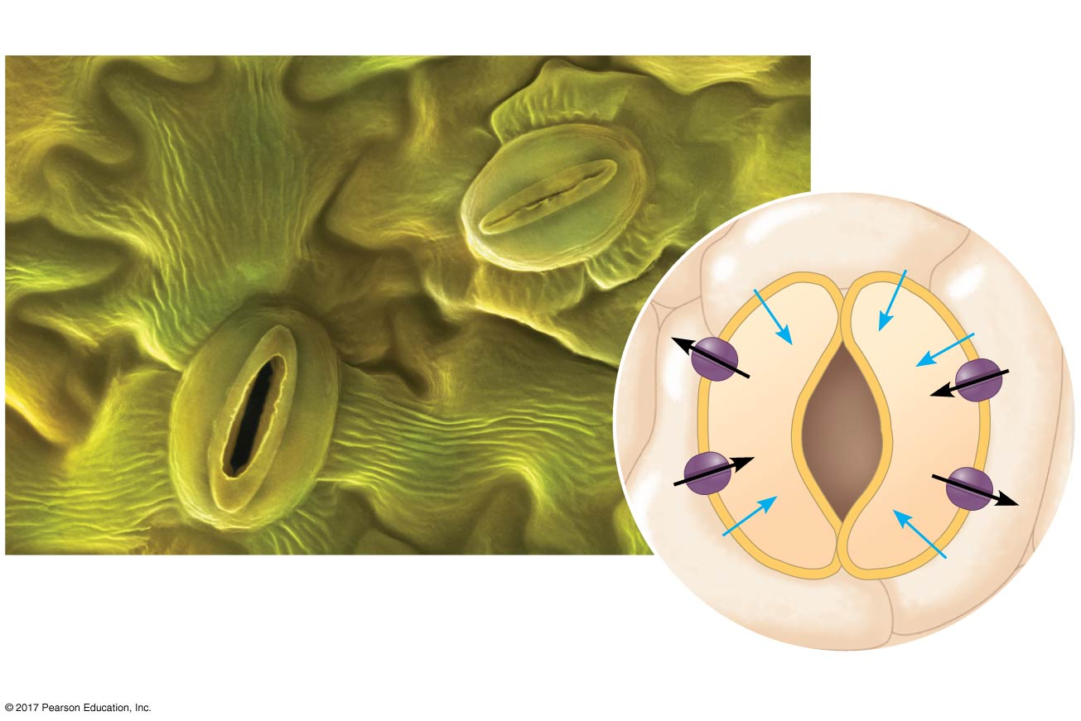
Figure 44.17c
Gas Exchange
H₂O
H₂O
H⁺
H₂O
K⁺
K⁺
H⁺
H₂O
H₂O
Ion gradients provide the basis for
the opening of plant stomata by
surrounding guard cells.
Guard cells
Notes:
Figure 44.17c Make connections: ion movement and gradients (part 3: gas exchange)

Slide 90
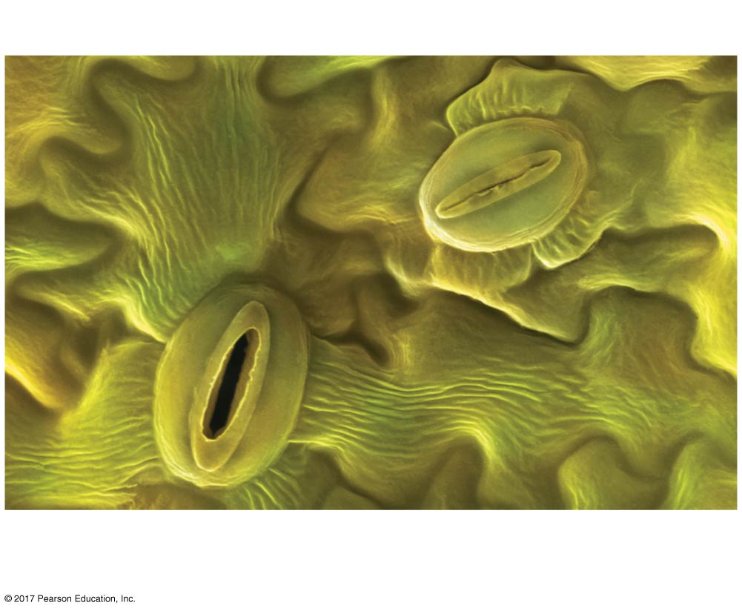
Figure 44.17ca
Gas Exchange
Opening of plant stomata by surrounding
guard cells
Notes:
Figure 44.17ca Make connections: ion movement and gradients (part 3a: gas exchange, micrograph)

Slide 91
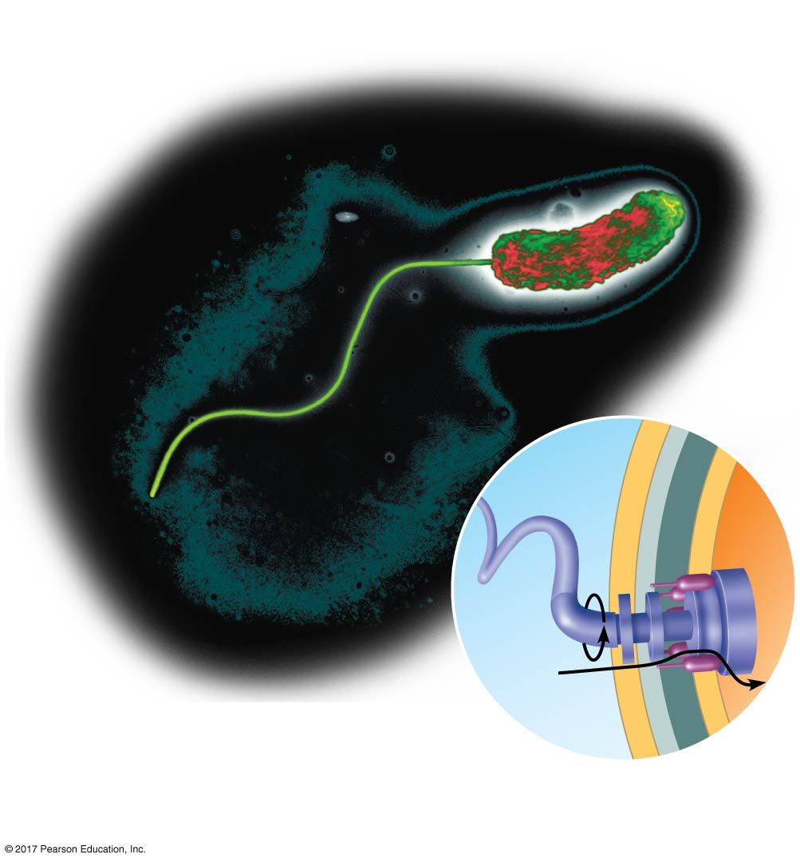
Figure 44.17d
Locomotion
Filament of
flagellum
Flagellar
motor
Hook
H⁺
A gradient of H⁺ ions powers the bacterial flagellum.
Notes:
Figure 44.17d Make connections: ion movement and gradients (part 4: locomotion)

Slide 92
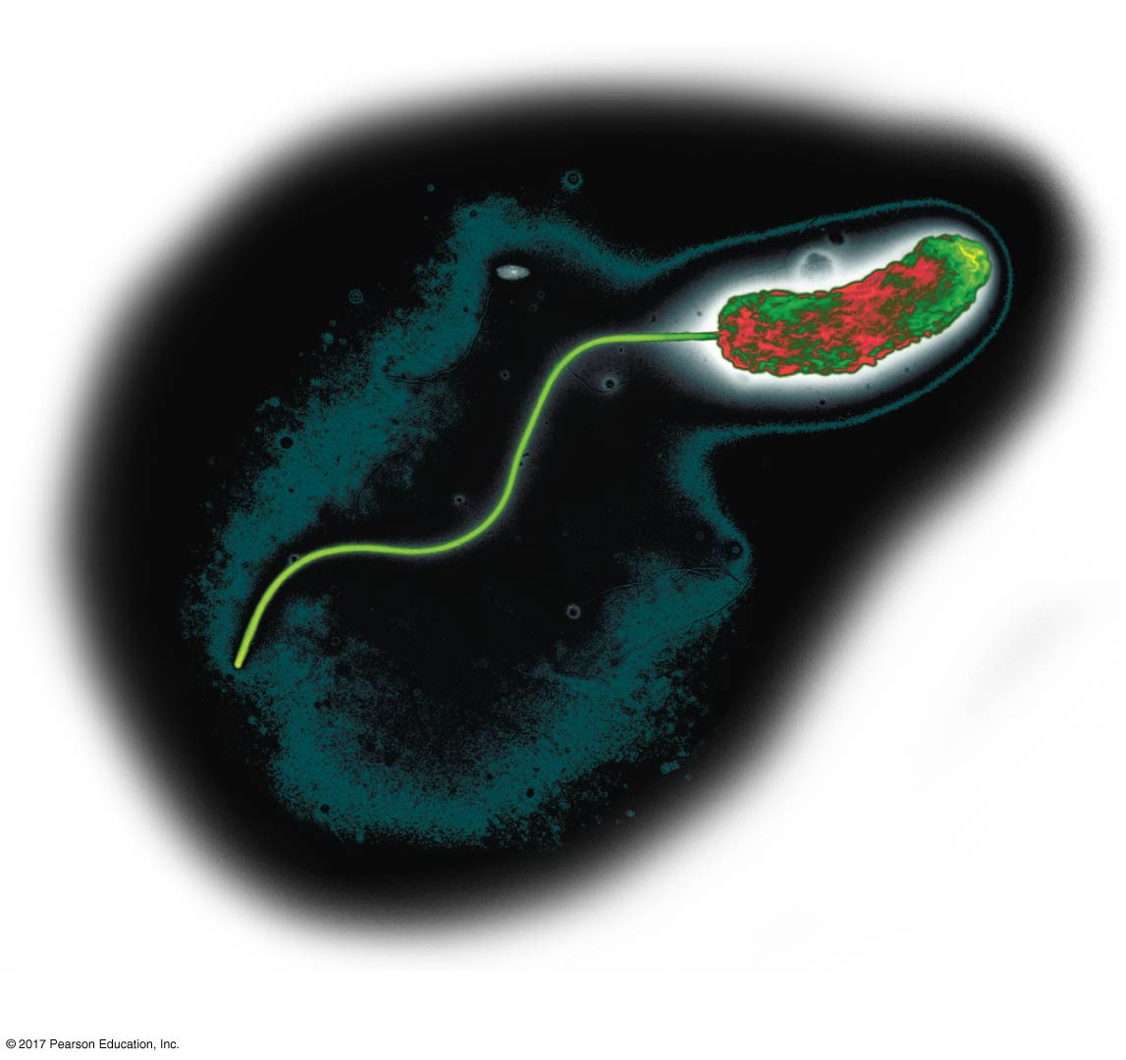
Figure 44.17da
Locomotion
A bacterial flagellum
Notes:
Figure 44.17da Make connections: ion movement and gradients (part 4a: locomotion, micrograph)

Slide 93
Concept 44.5: Hormonal circuits link kidney function, water balance, and blood pressure
Mammals can control the volume and osmolarity of urine in response to changes in salt intake and water availability

Slide 94
Homeostatic Regulation of the Kidney
A combination of nervous and hormonal controls manages the osmoregulatory functions of the mammalian kidney
These controls contribute to homeostasis for blood pressure and blood volume

Slide 95
Antidiuretic Hormone
Antidiuretic hormone, ADH, is also called vasopressin
ADH molecules released from the posterior pituitary bind to and activate membrane receptors on collecting duct cells
This initiates a signal cascade leading to insertion of aquaporin proteins into the membrane lining the collection duct
The increase in water recapture reduces urine volume

Slide 96
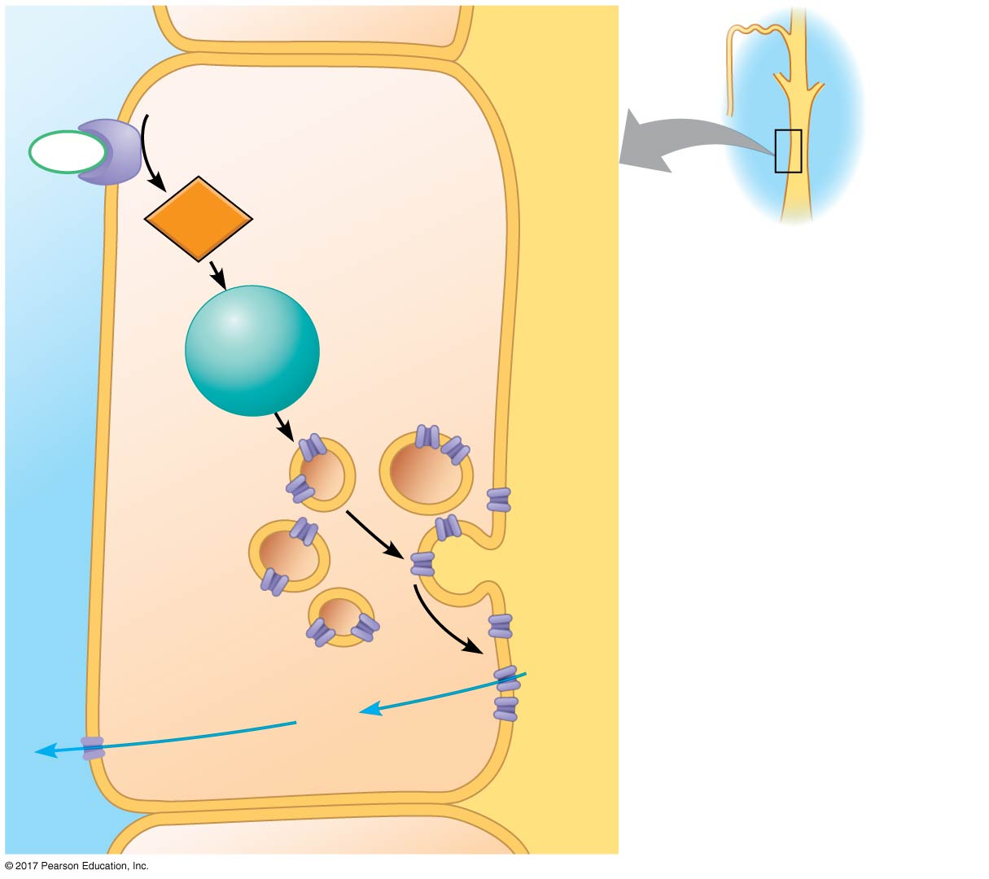
Figure 44.18
ADH
receptor
LUMEN
Collecting
duct
COLLECTING
DUCT CELL
ADH
Second
messenger
cAMP
Protein
kinase A
Storage
vesicle
Exocytosis
Aquaporin
water
channel
H₂O
H₂O
Notes:
Figure 44.18 Control of collecting duct permeability by antidiuretic hormone (ADH)

Slide 97
Osmoreceptor cells in the hypothalamus monitor blood osmolarity and regulate release of ADH from the posterior pituitary
When osmolarity rises above its set point, ADH release into the bloodstream increases
When osmolarity drops below a set point, it causes a reduction in ADH secretion

Slide 98
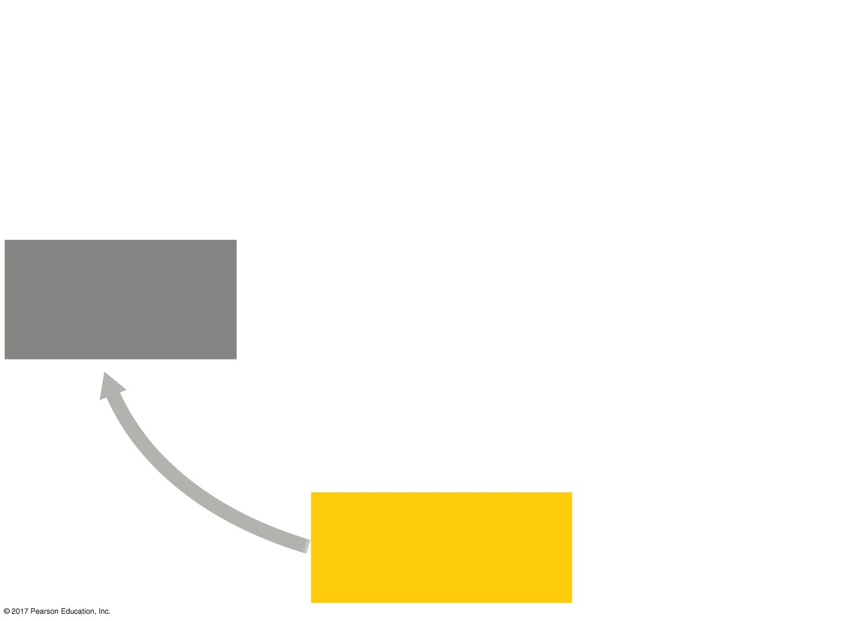
Figure 44.19_1
Blood osmolarity
increases
(such as after
sweating profusely).
NORMAL
BLOOD OSMOLARITY
(285–295 mOsm/L)
Notes:
Figure 44.19_1 Regulation of fluid retention in the kidney (step 1)

Slide 99
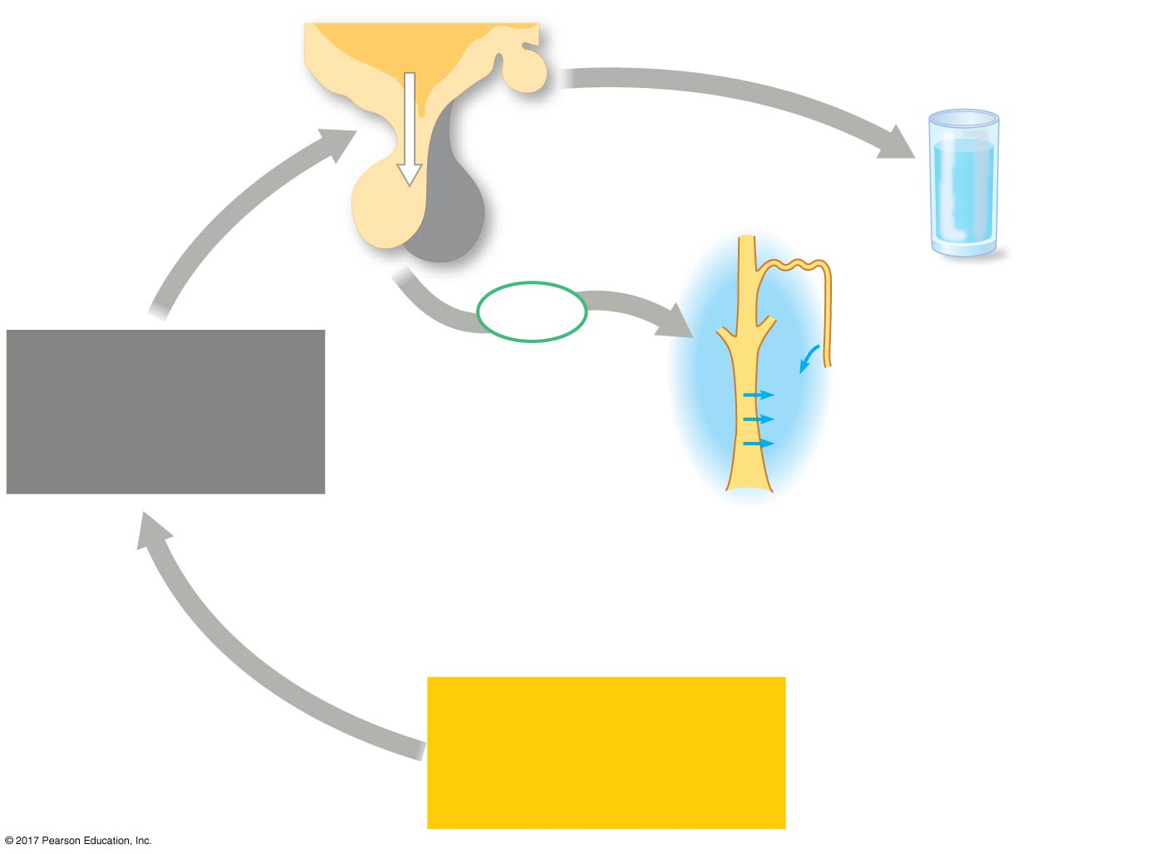
Figure 44.19_2
Specific neurons
of hypothalamus
generate thirst.
Osmoreceptors
in hypothalamus
trigger release of
ADH.
Hypothalamus
Posterior
pituitary
Distal
tubule
ADH
Blood osmolarity
increases
(such as after
sweating profusely).
Collecting
duct
H₂O reabsorption
NORMAL
BLOOD OSMOLARITY
(285–295 mOsm/L)
Notes:
Figure 44.19_2 Regulation of fluid retention in the kidney (step 2)

Slide 100
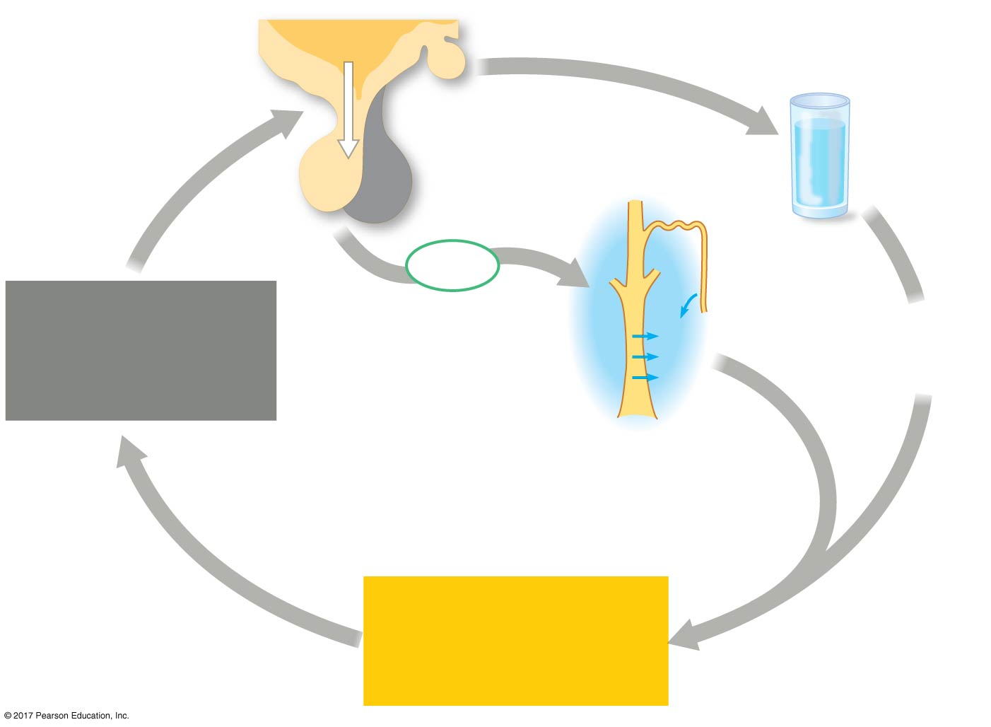
Figure 44.19_3
Specific neurons
of hypothalamus
generate thirst.
Osmoreceptors
in hypothalamus
trigger release of
ADH.
Hypothalamus
Posterior
pituitary
Distal
tubule
ADH
Blood osmolarity
increases
(such as after
sweating profusely).
Collecting
duct
Drinking of
water
H₂O reabsorption
NORMAL
BLOOD OSMOLARITY
(285–295 mOsm/L)
Notes:
Figure 44.19_3 Regulation of fluid retention in the kidney (step 3)

Slide 101
Animation: Effect of ADH

Slide 102
Alcohol is a diuretic, as it inhibits the release of ADH
Mutation in ADH production causes severe dehydration and results in diabetes insipidus

Slide 103
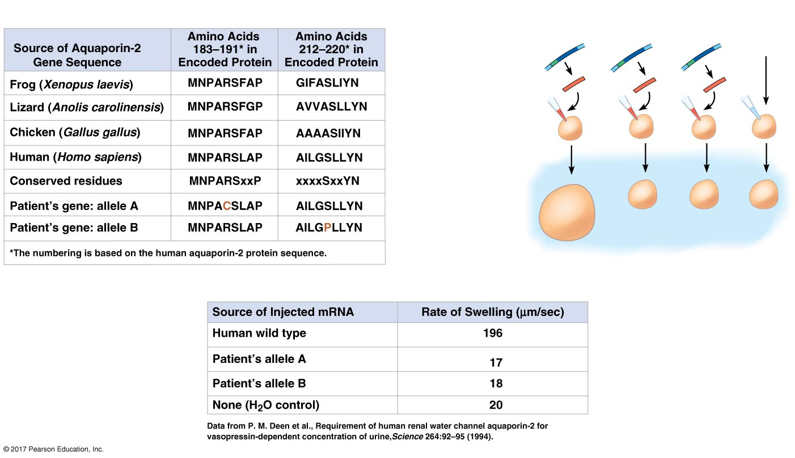
Figure 44.20
Experiment
1
Inject wild-
type and
mutant
aquaporin
mRNA
into frog
oocytes.
Wild-type
Allele A
Allele B
H₂O
(control)
2
Transfer
to 10-mOsm
solution and
measure rate
of oocyte
swelling.
Oocyte
10-mOsm
solution
Results
Notes:
Figure 44.20 Inquiry: Can aquaporin mutations cause diabetes?

Slide 104
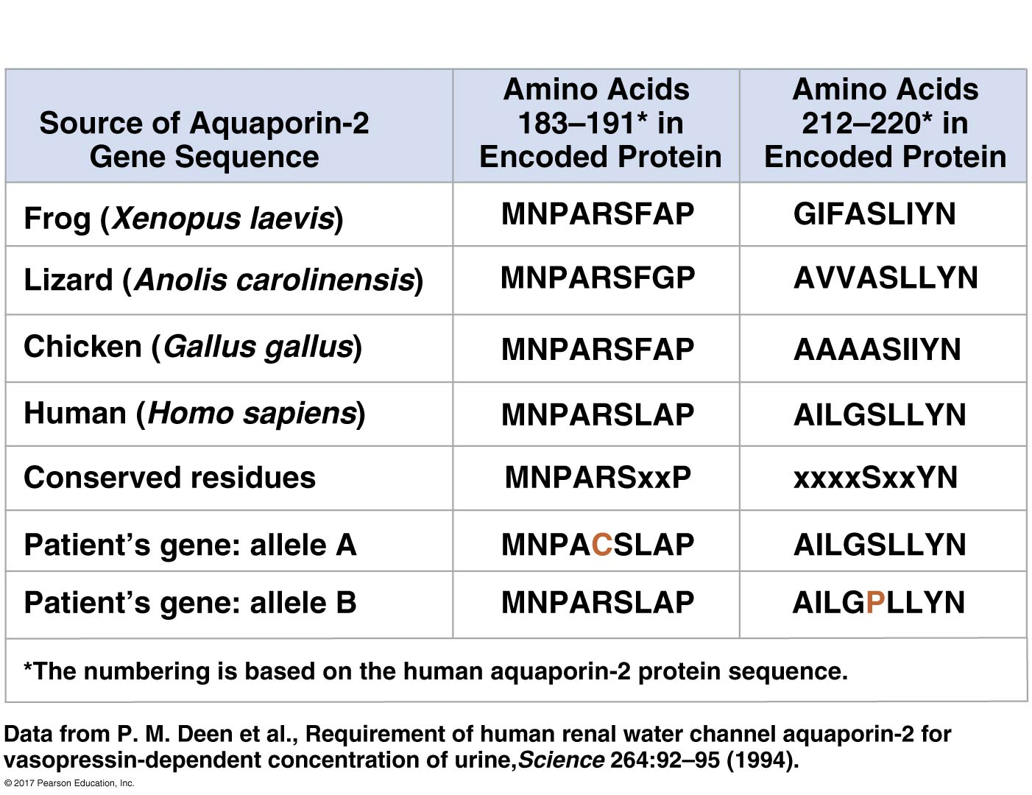
Figure 44.20a
Experiment
Notes:
Figure 44.20a Inquiry: Can aquaporin mutations cause diabetes? (part 1: experiment, protein sequences)

Slide 105
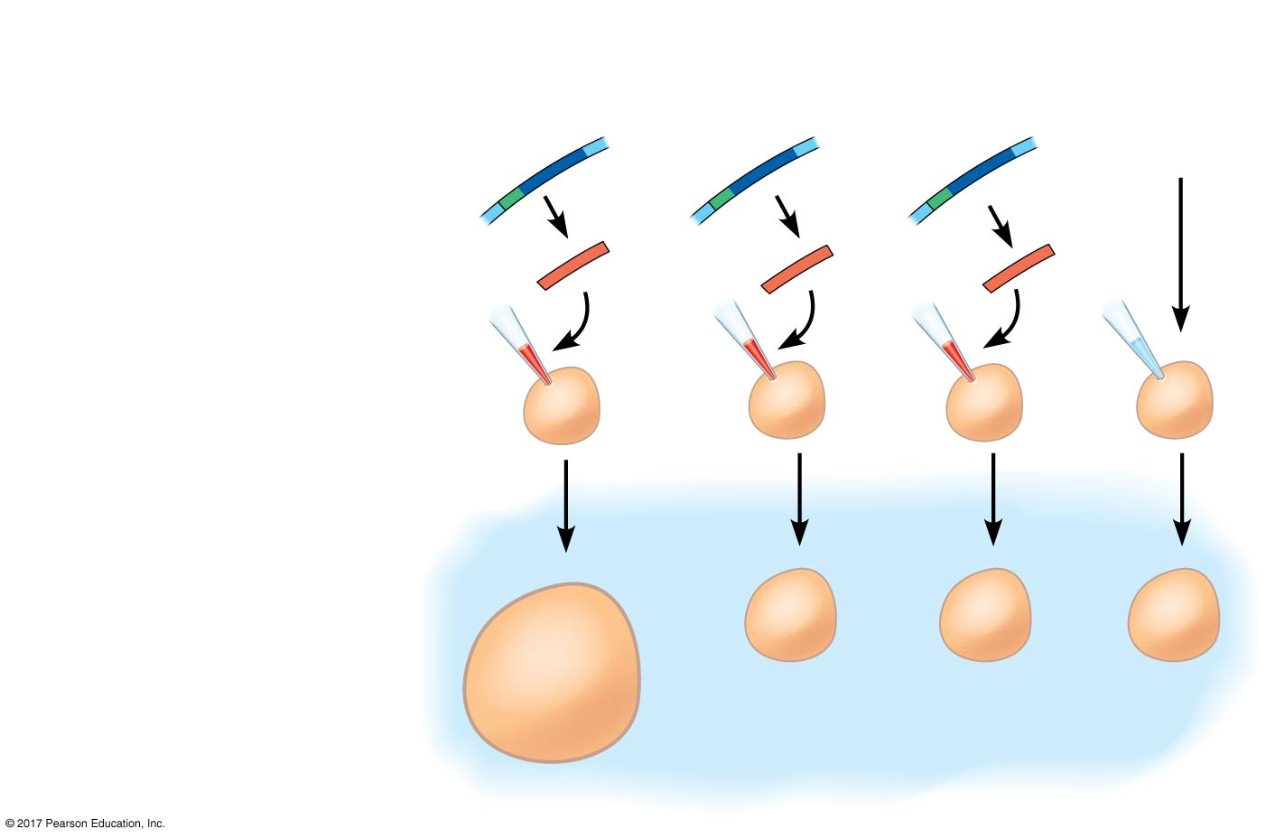
Figure 44.20b
Experiment
1
Inject wild-
type and
mutant
aquaporin
mRNA
into frog
oocytes.
Wild-type
Allele A
Allele B
H₂O
(control)
2
Transfer
to 10-mOsm
solution and
measure rate
of oocyte
swelling.
Oocyte
10-mOsm
solution
Notes:
Figure 44.20b Inquiry: Can aquaporin mutations cause diabetes? (part 2: experiment, procedure)

Slide 106
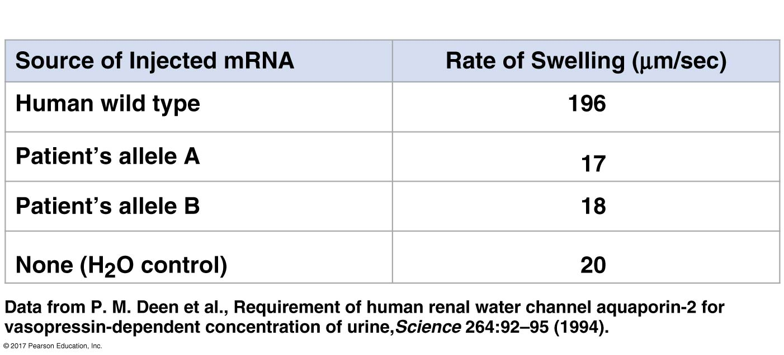
Figure 44.20c
Results
Notes:
Figure 44.20c Inquiry: Can aquaporin mutations cause diabetes? (part 3: results)

Slide 107
The Renin-Angiotensin-Aldosterone System
The renin-angiotensin-aldosterone system (RAAS) is part of a complex feedback circuit that functions in homeostasis
A drop in blood pressure near the glomerulus causes the juxtaglomerular apparatus (JGA) to release the enzyme renin
Renin triggers the formation of the peptide angiotensin II

Slide 108
Angiotensin II raises blood pressure and decreases blood flow to the kidneys
It also stimulates the release of the hormone aldosterone, which increases blood volume and pressure

Slide 109
Figure 44.21_1
NORMAL
BLOOD PRESSURE
AND VOLUME
Blood pressure or
blood volume drops
(for example, due to
dehydration or blood loss).
Notes:
Figure 44.21_1 Regulation of blood volume and blood pressure by the renin-angiotensin-aldosterone system (RAAS) (step 1)

Slide 110
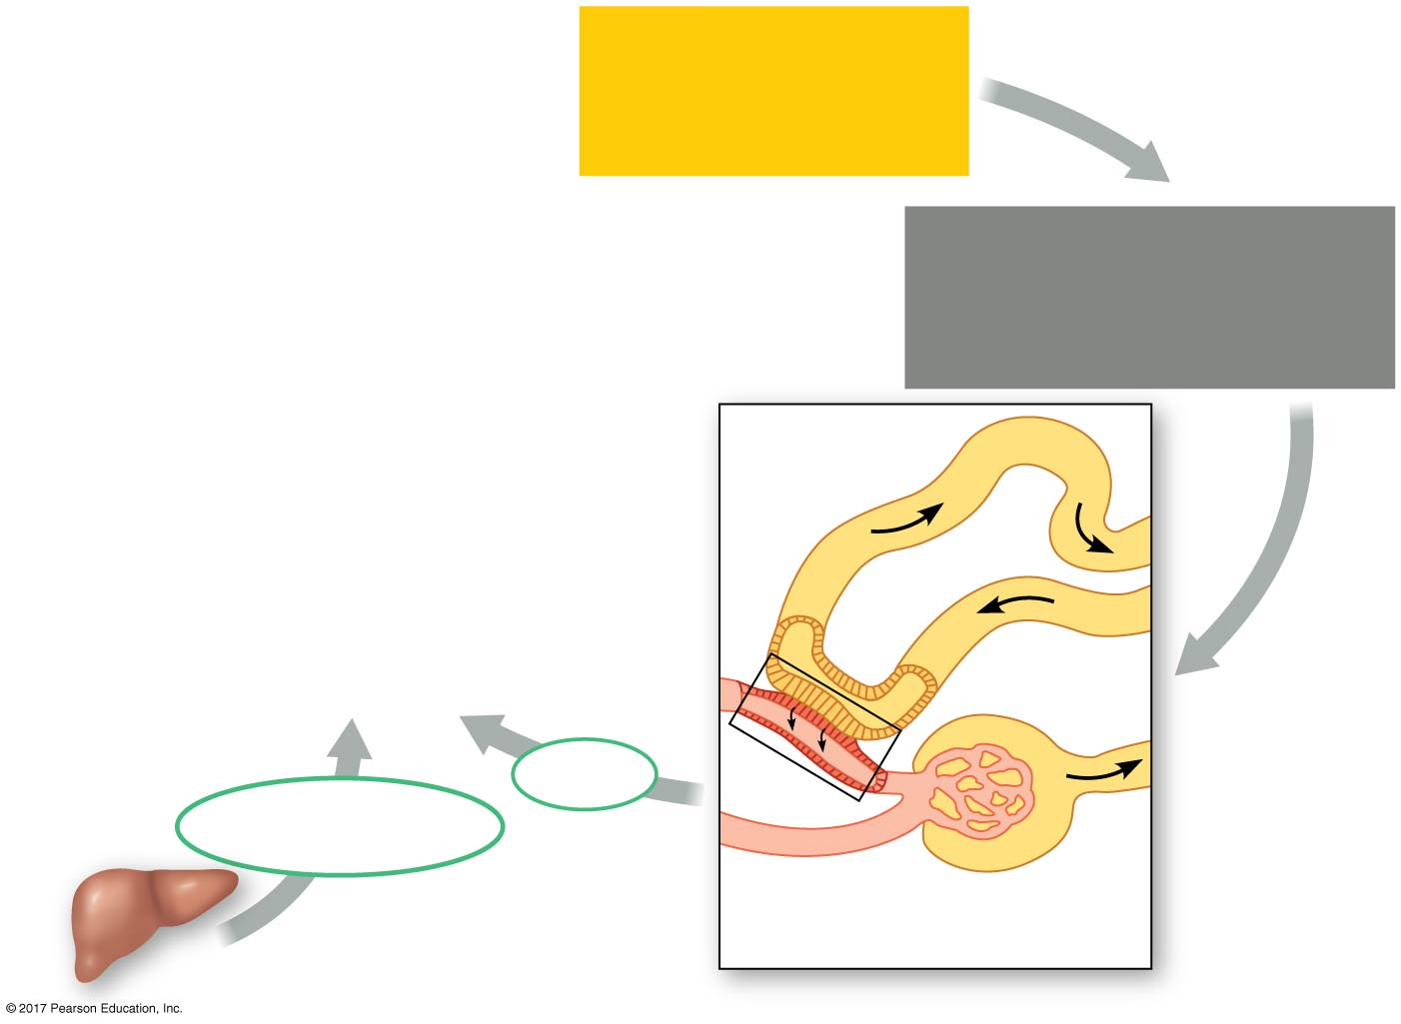
Figure 44.21_2
NORMAL
BLOOD PRESSURE
AND VOLUME
Blood pressure or
blood volume drops
(for example, due to
dehydration or blood loss).
Distal
tubule
JGA
releases
renin.
Sensors in
JGA detect
decrease.
Renin
Angiotensinogen
Juxtaglomerular
apparatus (JGA)
Liver
Notes:
Figure 44.21_2 Regulation of blood volume and blood pressure by the renin-angiotensin-aldosterone system (RAAS) (step 2)

Slide 111
Figure 44.21_3
NORMAL
BLOOD PRESSURE
AND VOLUME
Blood pressure or
blood volume drops
(for example, due to
dehydration or blood loss).
Distal
tubule
Angiotensin II
ACE
JGA
releases
renin.
Angiotensin I
Sensors in
JGA detect
decrease.
Renin
Angiotensinogen
Juxtaglomerular
apparatus (JGA)
Liver
Notes:
Figure 44.21_3 Regulation of blood volume and blood pressure by the renin-angiotensin-aldosterone system (RAAS) (step 3)

Slide 112
Figure 44.21_4
Na⁺ and H₂O are
reabsorbed.
NORMAL
BLOOD PRESSURE
AND VOLUME
Aldosterone
Blood pressure or
blood volume drops
(for example, due to
dehydration or blood loss).
Arterioles constrict.
Adrenal gland
Distal
tubule
Angiotensin II
ACE
JGA
releases
renin.
Angiotensin I
Sensors in
JGA detect
decrease.
Renin
Angiotensinogen
Juxtaglomerular
apparatus (JGA)
Liver
Notes:
Figure 44.21_4 Regulation of blood volume and blood pressure by the renin-angiotensin-aldosterone system (RAAS) (step 4)

Slide 113
Coordinated Regulation of Salt and Water Balance
ADH and RAAS both increase water reabsorption, but only RAAS will respond to a decrease in blood volume
Another hormone, atrial natriuretic peptide (ANP), opposes the RAAS
ANP is released in response to an increase in blood volume and pressure and inhibits the release of renin

Slide 114
Figure 44.UN01a
Notes:
Figure 44.UN01a Skills exercise: describing and interpreting quantitative data (part 1)

Slide 115
Figure 44.UN01b
Notes:
Figure 44.UN01b Skills exercise: describing and interpreting quantitative data (part 2)

Slide 116
Figure 44.UN02
Animal
Inflow/Outflow
Urine
Freshwater
fish. Lives in
water less
concentrated
than body
fluids; fish
tends to gain
water, lose salt
Does not drink water
Large volume
of urine
Salt in
(active trans-
port by gills)
H₂O in
Urine is less
concentrated
than body
fluids
Salt out
H₂O out
Marine bony
fish. Lives in
water more
concentrated
than body
fluids; fish
tends to lose
water, gain salt
Drinks water
Small volume
of urine
Salt in
H₂O out
Urine is
slightly less
concentrated
than body
fluids
Salt out (active
transport by gills)
Terrestrial
vertebrate.
Terrestrial
environment;
tends to lose
body water
to air
Drinks water
Moderate
volume of urine
Salt in
(by mouth)
Urine is more
concentrated
than body
fluids
H₂O and salt out
Notes:
Figure 44.UN02 Summary of key concepts: osmoregulation

Slide 117
Figure 44.UN02a
Animal
Inflow/Outflow
Urine
Freshwater
fish. Lives in
water less
concentrated
than body
fluids; fish
tends to gain
water, lose salt
Does not drink water
Large volume
of urine
Salt in
(active trans-
port by gills)
H₂O in
Urine is less
concentrated
than body
fluids
Salt out
H₂O out
Notes:
Figure 44.UN02a Summary of key concepts: osmoregulation (part 1)

Slide 118
Figure 44.UN02b
Animal
Inflow/Outflow
Urine
Marine bony
fish. Lives in
water more
concentrated
than body
fluids; fish
tends to lose
water, gain salt
Drinks water
Small volume
of urine
Salt in H₂O out
Urine is
slightly less
concentrated
than body
fluids
Salt out (active
transport by gills)
Notes:
Figure 44.UN02b Summary of key concepts: osmoregulation (part 2)

Slide 119
Figure 44.UN02c
Animal
Inflow/Outflow
Urine
Terrestrial
vertebrate.
Terrestrial
environment;
tends to lose
body water
to air
Drinks water
Moderate
volume of urine
Salt in
(by mouth)
Urine is more
concentrated
than body
fluids
H₂O and salt out
Notes:
Figure 44.UN02c Summary of key concepts: osmoregulation (part 3)

Slide 120
Figure 44.UN03
Notes:
Figure 44.UN03 Test your understanding, question 7 (water gain and loss)

Slide 121
Figure 44.UN04
Notes:
Figure 44.UN04 Test your understanding, question 11 (marine iguana)

