Slide 1
Notes:
1

Slide 2
A Kingdom of Consumers
In general, animals are efficient consumers of other organisms
Most have adaptations that help them to detect, capture, eat, and digest other organisms
For example, the chameleon captures insect prey with its long, sticky, quick-moving tongue

Slide 3
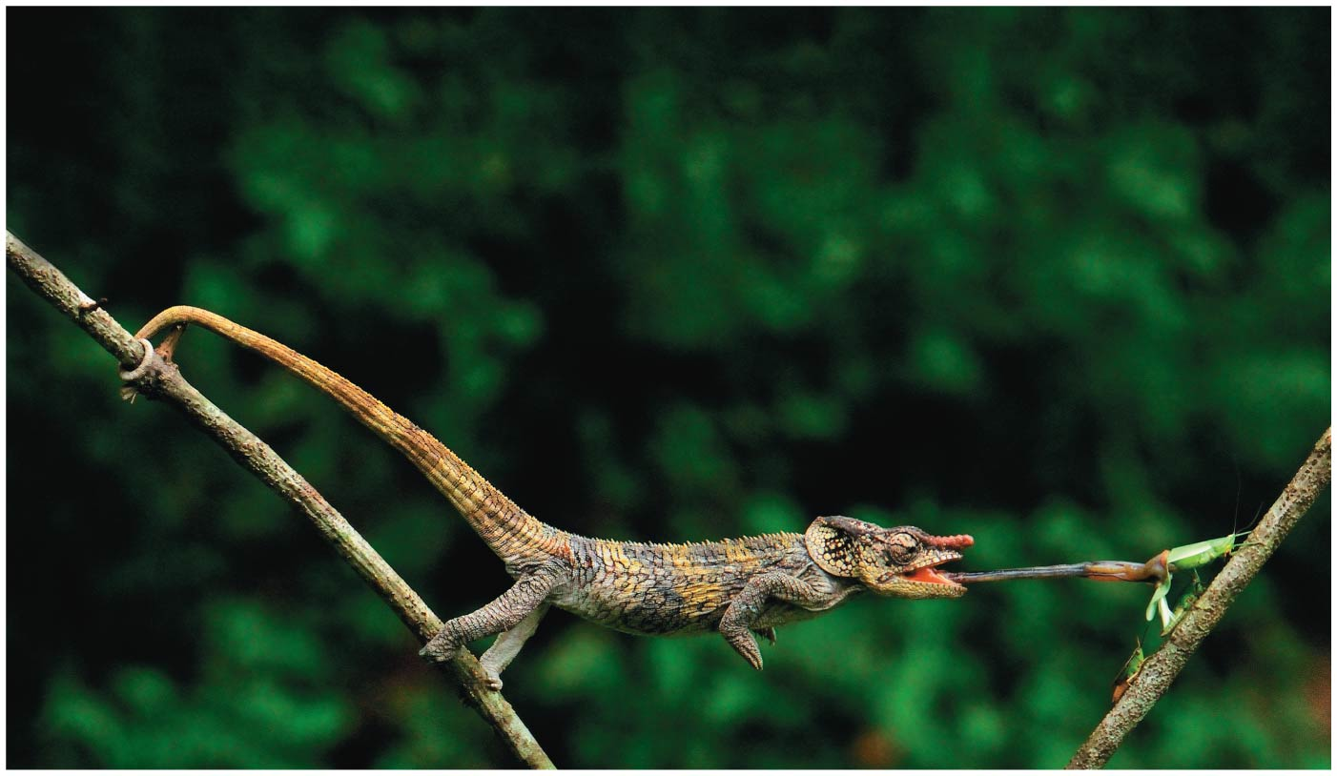
Figure 32.1
Notes:
Figure 32.1 What adaptations make a chameleon a fearsome predator?

Slide 4
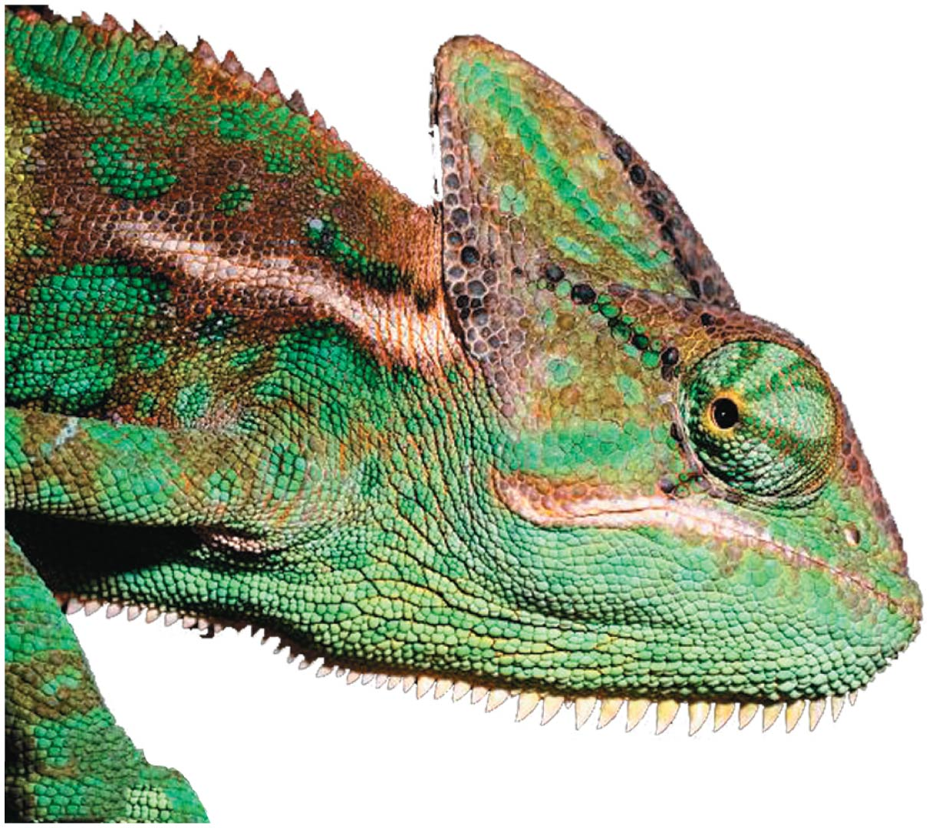
Figure 32.1a
Notes:
Figure 32.1a What adaptations make a chameleon a fearsome predator? (part 1: close-up)

Slide 5
Concept 32.1: Animals are multicellular, heterotrophic eukaryotes with tissues that develop from embryonic layers
There are exceptions to nearly every criterion for distinguishing animals from other life-forms
Several characteristics, taken together, sufficiently define the animal kingdom

Slide 6
Nutritional Mode
Animals are heterotrophs that ingest their food

Slide 7
Cell Structure and Specialization
Animals are multicellular eukaryotes
Cells are supported by structural proteins such as collagen, rather than cell walls
Nervous tissue and muscle tissue are unique, defining characteristics of animals
Tissues are groups of similar cells that act as a functional unit

Slide 8
Reproduction and Development
Most animals reproduce sexually, with the diploid stage usually dominating the life cycle
After a sperm fertilizes an egg, the zygote undergoes rapid cell division called cleavage
Cleavage leads to formation of a multicellular, hollow blastula
The blastula undergoes gastrulation, forming a gastrula with different layers of embryonic tissues

Slide 9
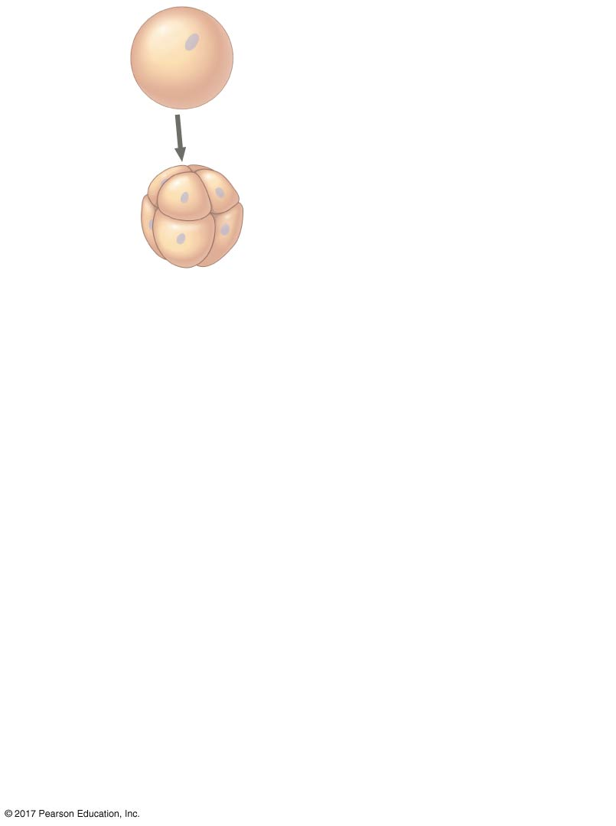
Figure 32.2_1
Zygote
Cleavage
Eight-cell
stage
Notes:
Figure 32.2_1 Early embryonic development in animals (step 1)

Slide 10
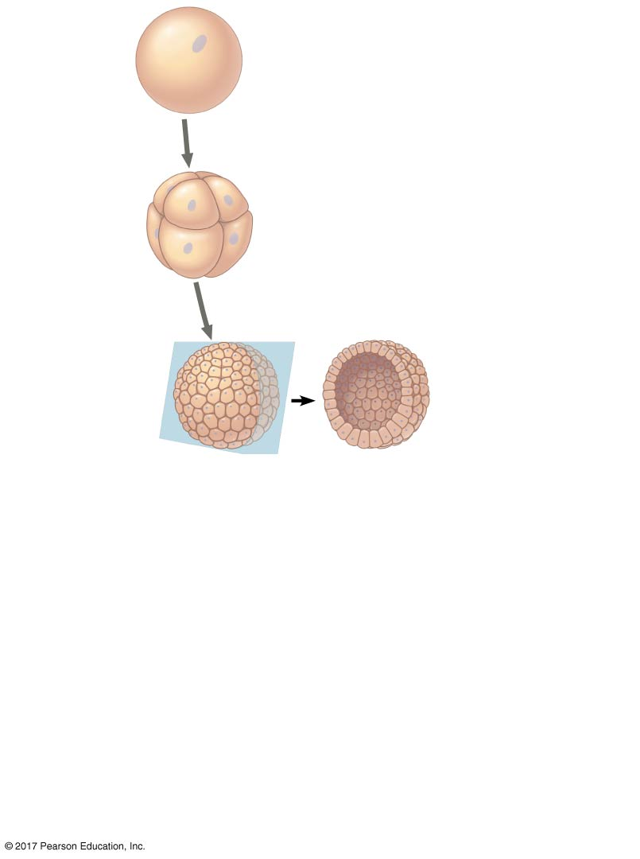
Figure 32.2_2
Zygote
Cleavage
Eight-cell
stage
Cleavage
Blastocoel
Blastula
Cross section
of blastula
Notes:
Figure 32.2_2 Early embryonic development in animals (step 2)

Slide 11
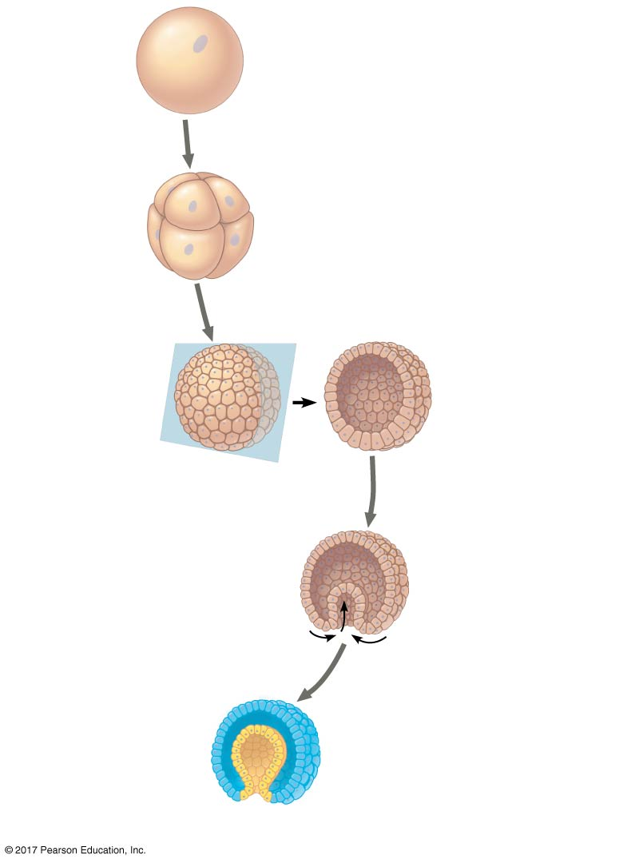
Figure 32.2_3
Zygote
Cleavage
Eight-cell
stage
Cleavage
Blastocoel
Blastula
Cross section
of blastula
Gastrulation
Cross section
of gastrula
Blastocoel
Endoderm
Blastopore
Ectoderm
Archenteron
Notes:
Figure 32.2_3 Early embryonic development in animals (step 3)

Slide 12
Video: Sea Urchin Embryonic Development (Time Lapse)

Slide 13
Most animals have at least one larval stage
A larva is sexually immature and morphologically distinct from the adult; it eventually undergoes metamorphosis to become a juvenile
A juvenile resembles an adult, but is not yet sexually mature

Slide 14
All animals have developmental genes that regulate the expression of other genes
Most animals share a unique family of developmental genes called Hox genes
Hox genes regulate the development of body form
Although the Hox family of genes has been highly conserved, it can produce a wide diversity of animal morphology

Slide 15
Concept 32.2: The history of animals spans more than half a billion years
Biologists have identified 1.3 million living animal species to date; far more are estimated to exist
The common ancestor of all living animals likely lived about 770 million years ago

Slide 16
Steps in the Origin of Multicellular Animals
Morphological and molecular evidence points to a group of protists called choanoflagellates as the closest living relatives to animals
The common ancestor may have resembled modern choanoflagellates

Slide 17
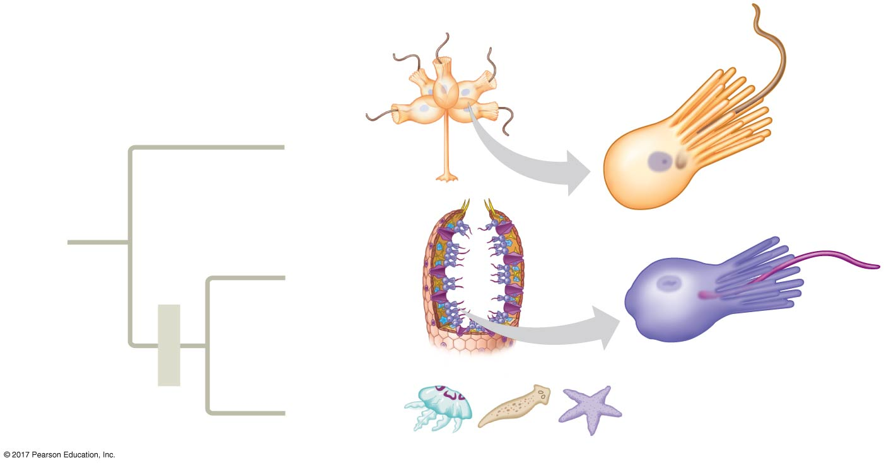
Figure 32.3
Individual
choanoﬂagellate
Choano-
ﬂagellates
OTHER
EUKARYOTES
Sponges
Animals
Collar cell
(choanocyte)
Other
animals
Notes:
Figure 32.3 Three lines of evidence that choanoflagellates are closely related to animals

Slide 18
The origin of multicellularity requires the evolution of new ways for cells to adhere (attach) and signal (communicate) to each other
Choanoflagellates and animals have sequence similarities in the genes involved in adherence and attachment

Slide 19
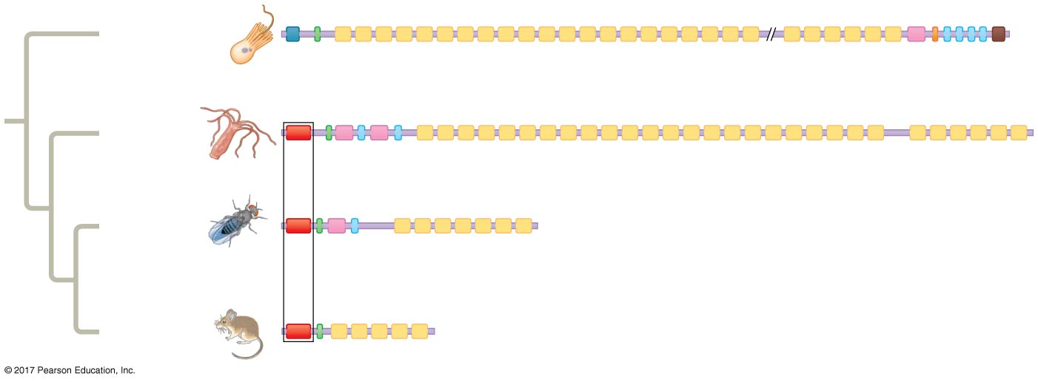
Figure 32.4
Choano-
flagellate
Hydra
“CCD” domain (only
found in animals)
Fruit fly
Mouse
Notes:
Figure 32.4 Cadherin proteins in choanoflagellates and animals

Slide 20
Neoproterozoic Era (1 Billion–541 Million Years Ago)
Early members of the animal fossil record include the Ediacaran biota, which dates back to about 560 million years ago
Microscopic fossils of animal embryos have been found in Neoproterozoic rocks

Slide 21
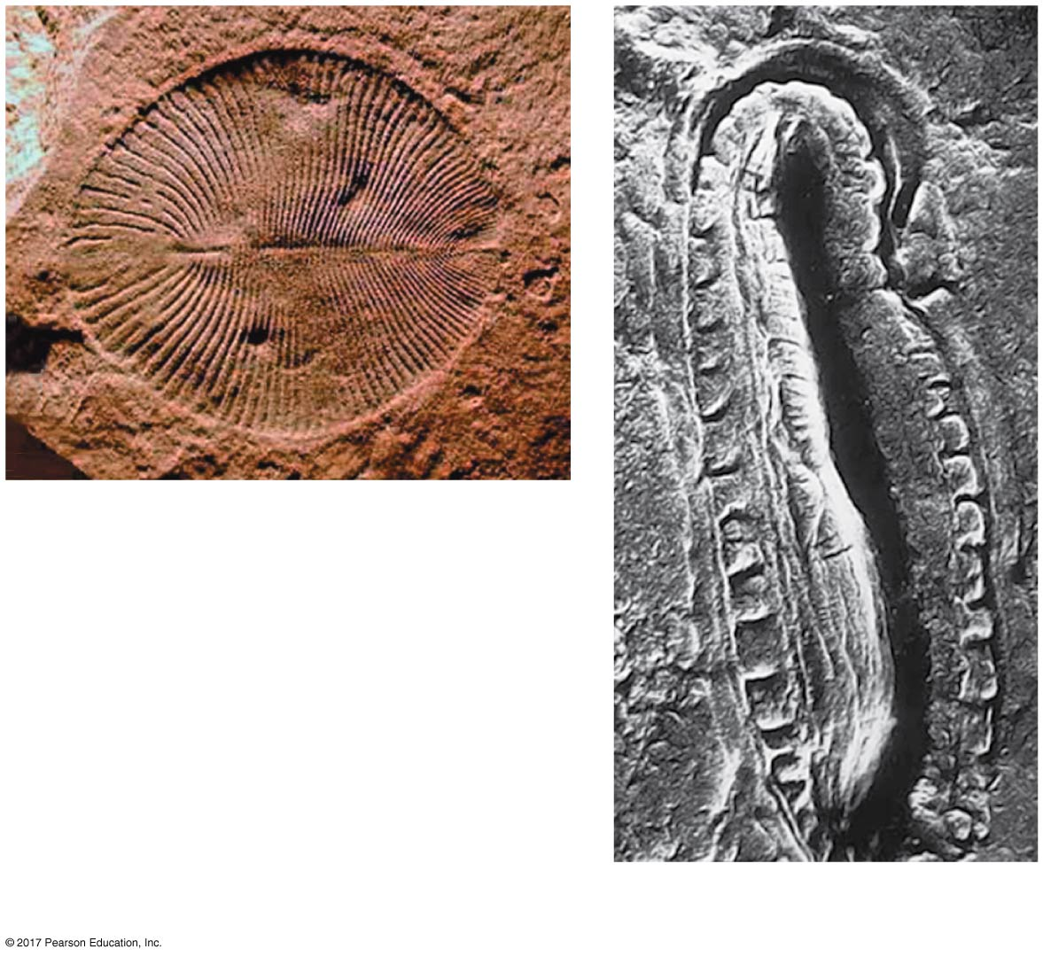
Figure 32.5
1 cm
(a) Dickinsonia costata
2.5 cm
(b) Kimberella
Notes:
Figure 32.5 Ediacaran fossil animals

Slide 22
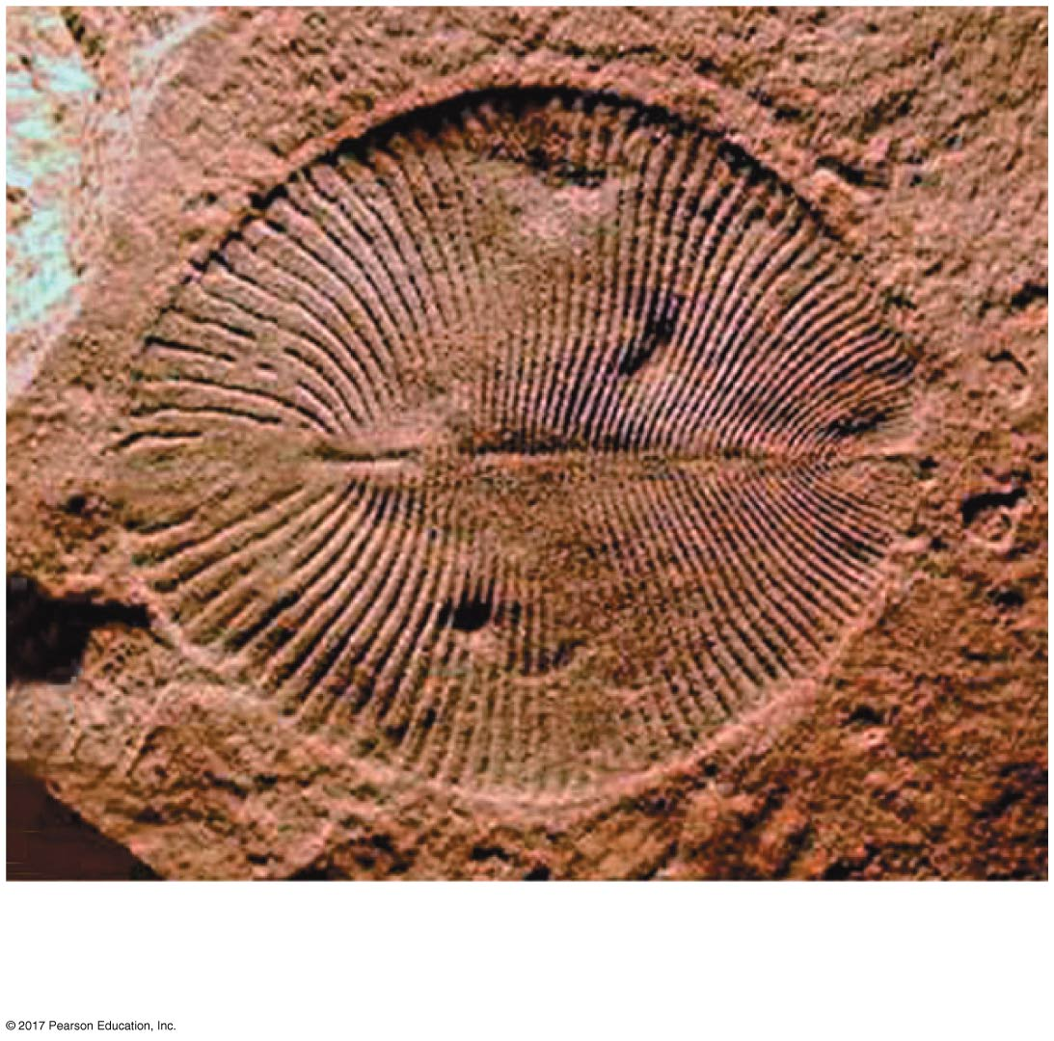
Figure 32.5a
(a) Dickinsonia costata
2.5 cm
Notes:
Figure 32.5a Ediacaran fossil animals (part 1: Dickinsonia costata)

Slide 23
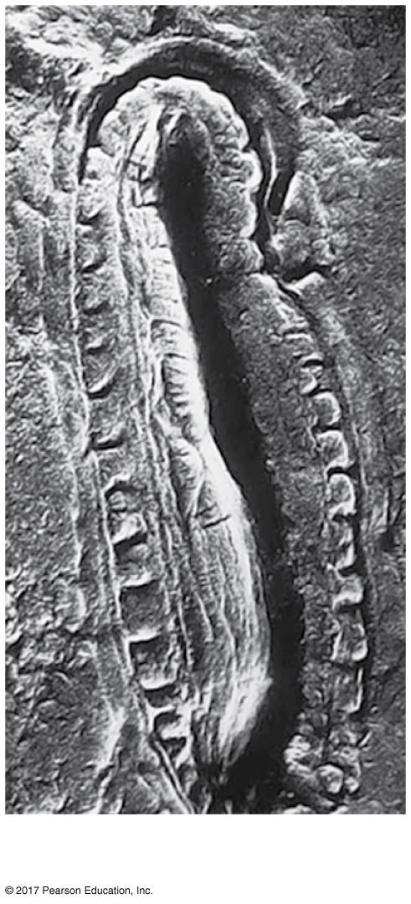
Figure 32.5b
1 cm
(b) Kimberella
Notes:
Figure 32.5b Ediacaran fossil animals (part 2: Kimberella)

Slide 24
Evidence of predation has also been found in fossils of the Ediacaran period (635–541 million years ago)

Slide 25
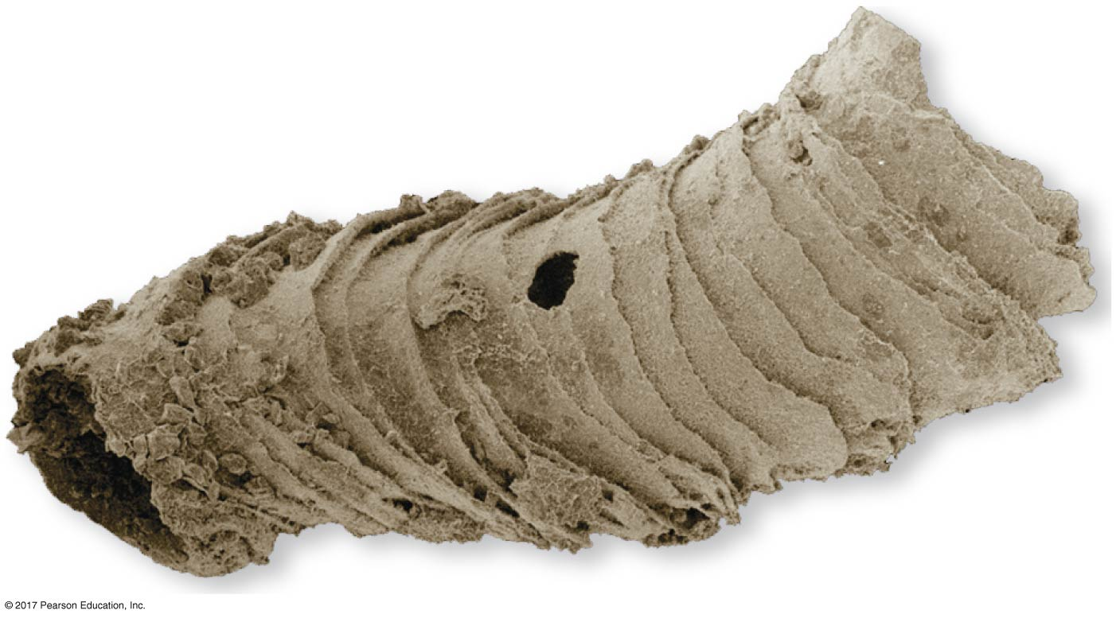
Figure 32.6
Bore hole
0.1 mm
Notes:
Figure 32.6 Early evidence of predation

Slide 26
Paleozoic Era (541–252 Million Years Ago)
The Cambrian explosion (535–525 million years ago) marks the earliest fossil appearance of many major groups of living animals
Most of the fossils from the Cambrian explosion are of bilaterians, organisms that have the following traits:
Bilaterally symmetric form
Complete digestive tract
One-way digestive system

Slide 27
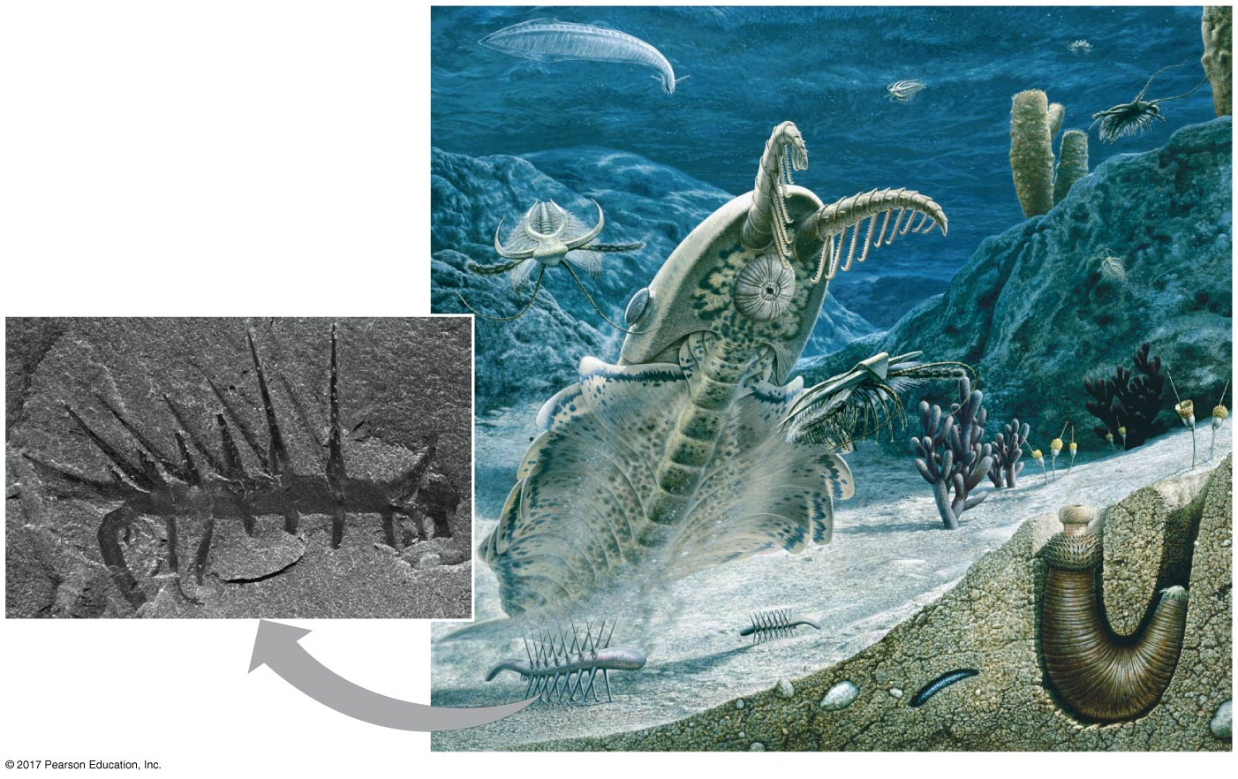
Figure 32.7
1 cm
Fossil of
Hallucigenia
(530 mya)
Notes:
Figure 32.7 A Cambrian seascape

Slide 28
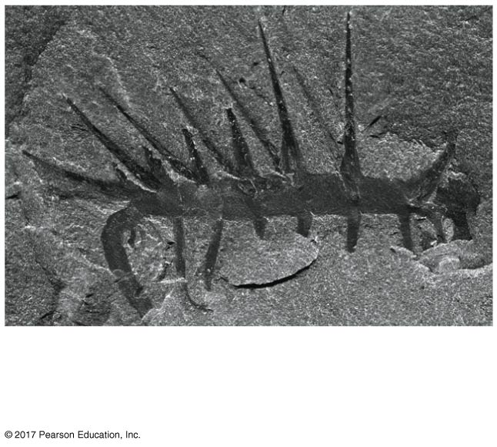
Figure 32.7a
1 cm
Fossil of Hallucigenia
(530 mya)
Notes:
Figure 32.7a A Cambrian seascape (part 1: painting)

Slide 29
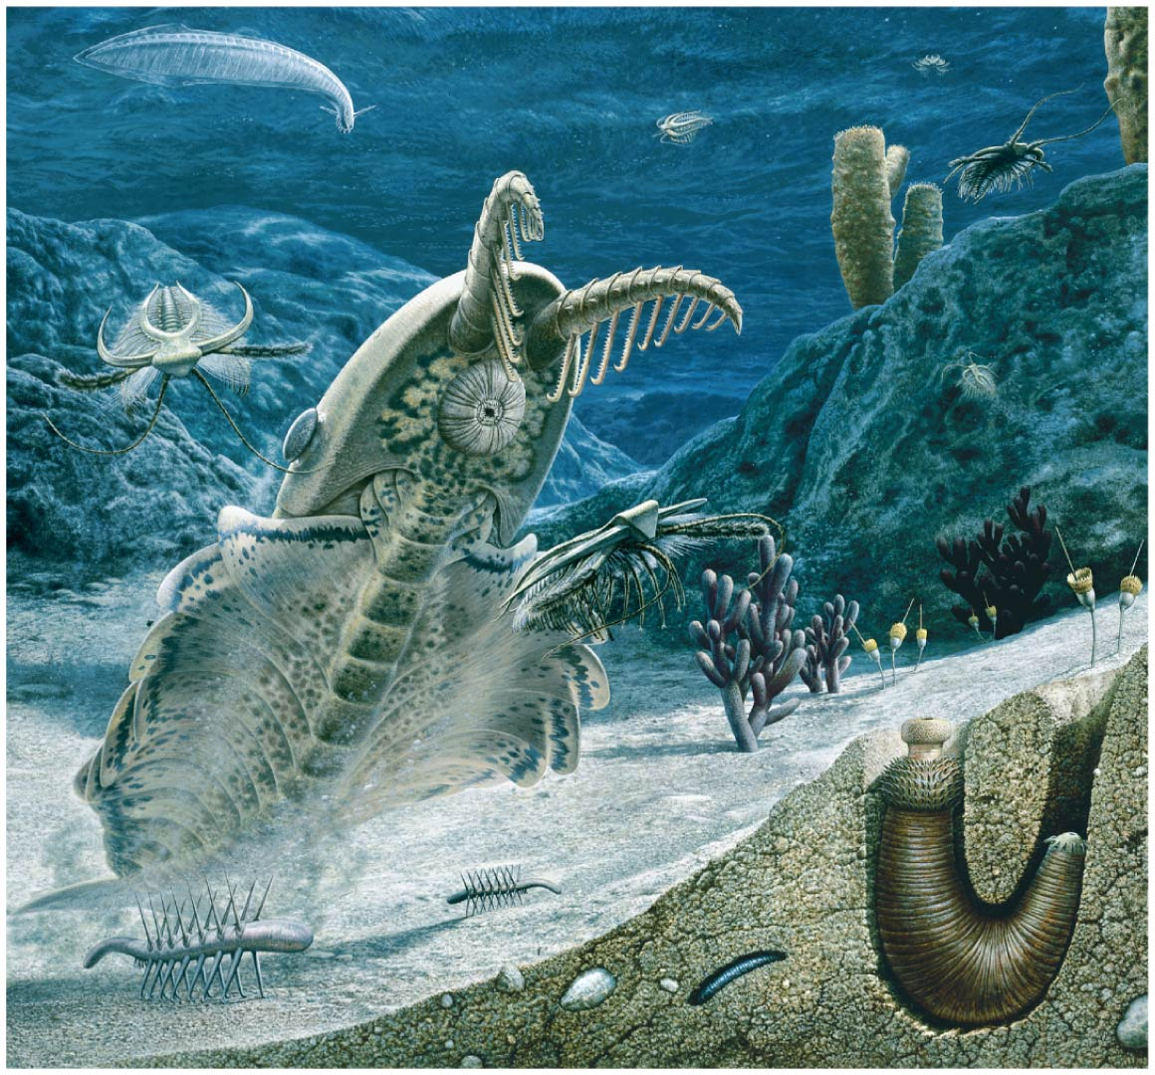
Figure 32.7b
Notes:
Figure 32.7b A Cambrian seascape (part 2: Hallucigenia)

Slide 30
There are several hypotheses regarding the cause of the Cambrian explosion and decline of Ediacaran biota
New predator-prey relationships
A rise in atmospheric oxygen
The evolution of the Hox gene complex and addition of new microRNAs (small RNAs involved in gene regulation)

Slide 31
Animal diversity continued to increase through the Paleozoic era, but was punctuated by mass extinctions
Animals began to make an impact on land by 450 million years ago
Vertebrates made the transition to land around 365 million years ago

Slide 32
Mesozoic Era (252–66 Million Years Ago)
Coral reefs emerged, becoming important marine ecological niches for other organisms
The ancestors of plesiosaurs were reptiles that returned to the water
During the Mesozoic era, dinosaurs were the dominant terrestrial vertebrates
The first mammals emerged
Flowering plants and insects diversified

Slide 33
Cenozoic Era (66 Million Years Ago to the Present)
The beginning of the Cenozoic era followed mass extinctions of both terrestrial and marine animals
These extinctions included the large, nonflying dinosaurs and the marine reptiles
Mammals increased in size and exploited vacated ecological niches
The global climate cooled

Slide 34
Concept 32.3: Animals can be characterized by “body plans”
Zoologists sometimes categorize animals according to a body plan, a set of morphological and developmental traits
Some body plans have been conserved, while others have changed multiple times over the course of evolution

Slide 35
Symmetry
Animals can be categorized according to the symmetry of their bodies, or lack of it
Some animals have radial symmetry, the type of symmetry found in a flowerpot
Radially symmetrical animals have a top and a bottom, but no front and back, or left and right

Slide 36
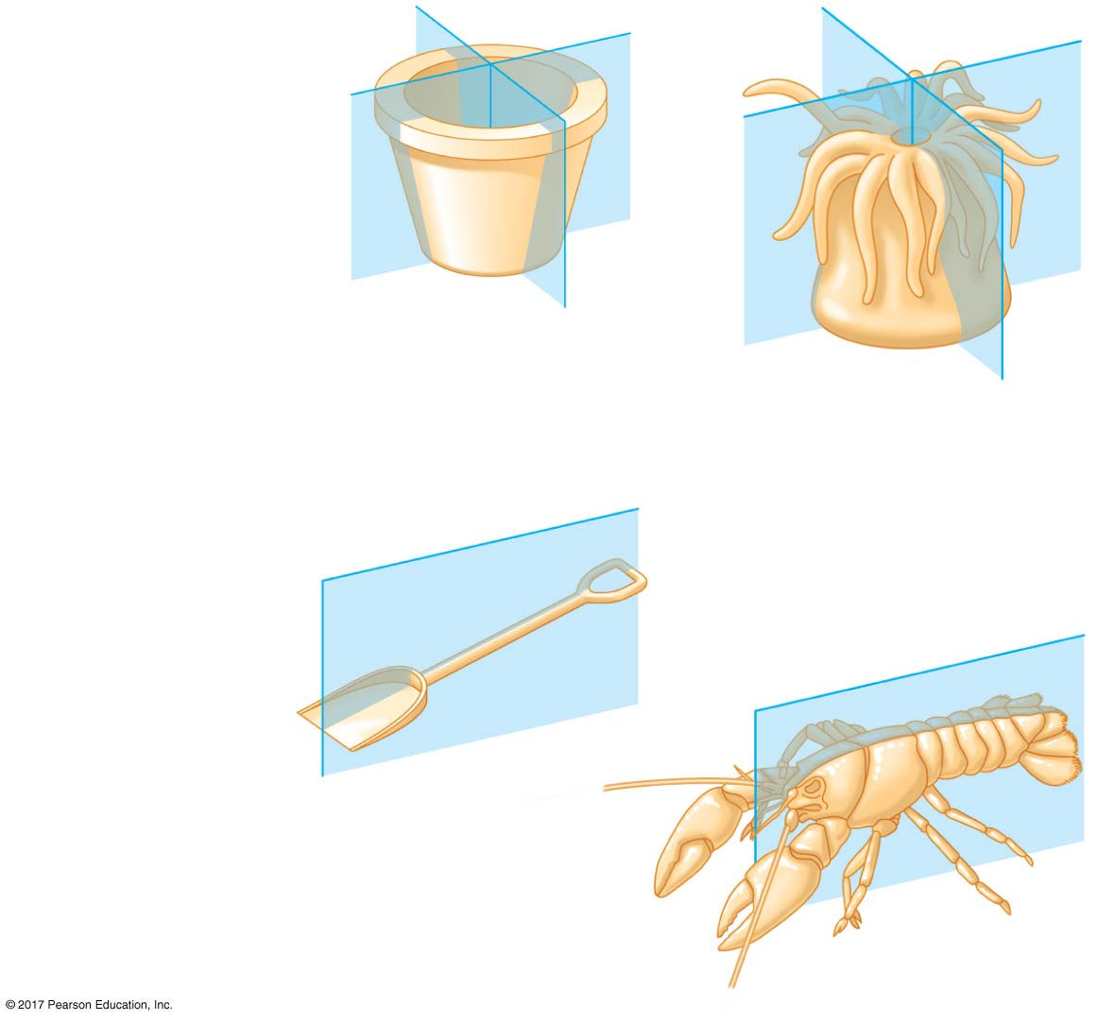
Figure 32.8
(a) Radial symmetry
(b) Bilateral symmetry
Notes:
Figure 32.8 Body symmetry

Slide 37
Figure 32.8a
(a) Radial symmetry
Notes:
Figure 32.8a Body symmetry

Slide 38
Figure 32.8b
(b) Bilateral symmetry
Notes:
Figure 32.8b Body symmetry

Slide 39
The two-sided symmetry of a shovel is an example of bilateral symmetry
Bilaterally symmetrical animals have
A dorsal (top) side and a ventral (bottom) side
A right and left side
Anterior (front) and posterior (back) ends
Many also have sensory equipment, such as a brain, concentrated in their anterior end

Slide 40
Radial animals are often sessile or planktonic (drifting or weakly swimming)
Bilateral animals typically move actively and have a central nervous system

Slide 41
Tissues
Animal body plans also vary according to the organization of the animal’s tissues
Tissues are collections of specialized cells isolated from other tissues by membranous layers
During development, three germ layers give rise to the tissues and organs of the animal embryo

Slide 42
Ectoderm is the germ layer covering the embryo’s surface
Endoderm is the innermost germ layer and lines the developing digestive tube, called the archenteron

Slide 43
Sponges and a few other groups lack true tissues
Diploblastic animals have only ectoderm and endoderm
These include cnidarians and a few other groups
Triploblastic animals also have an intermediate tissue layer called mesoderm
All bilaterally symmetrical animals are triploblastic

Slide 44
Body Cavities
Most triploblastic animals possess a body cavity
A true body cavity is called a coelom and is derived from mesoderm
Coelomates are animals that possess a true coelom

Slide 45
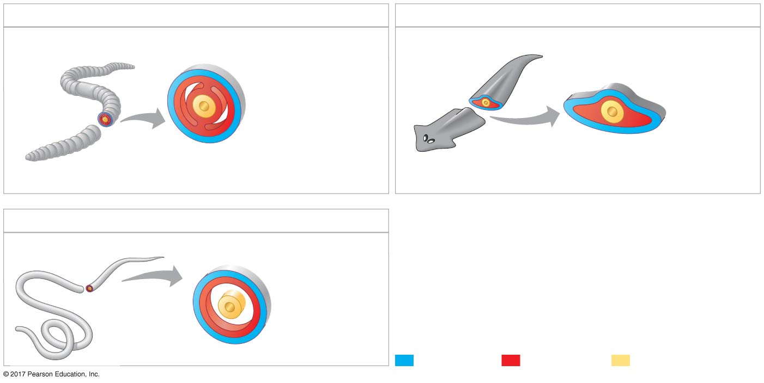
Figure 32.9
(a) Coelomate
(c) Acoelomate
Coelom
Body covering
(from ectoderm)
Body covering
(from ectoderm)
Tissue-
filled region
(from
mesoderm)
Tissue layer
lining coelom
and suspending
internal organs
(from mesoderm)
Digestive tract
(from endoderm)
Wall of digestive cavity
(from endoderm)
(b) Pseudocoelomate
Body covering
(from ectoderm)
Pseudo-
coelom
Muscle layer
(from
mesoderm)
Digestive
tract (from endoderm)
Ectoderm
Mesoderm
Endoderm
Notes:
Figure 32.9 Body cavities of triploblastic animals

Slide 46
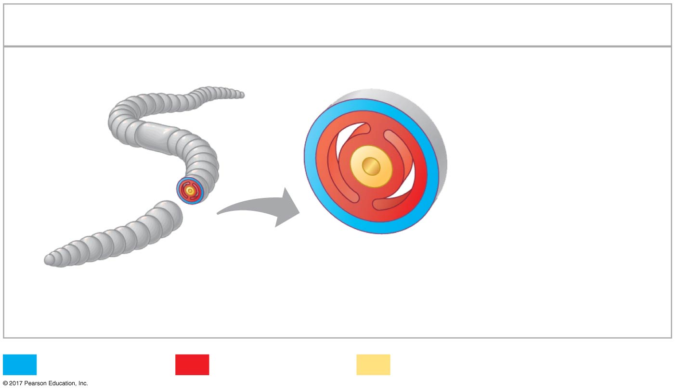
Figure 32.9a
(a) Coelomate
Coelom
Body covering
(from ectoderm)
Tissue layer
lining coelom
and suspending
internal organs
(from mesoderm)
Digestive tract
(from endoderm)
Ectoderm
Mesoderm
Endoderm
Notes:
Figure 32.9a Body cavities of triploblastic animals (part 1: coelomate)

Slide 47
A pseudocoelom is a body cavity derived from the mesoderm and endoderm
Triploblastic animals that possess a pseudocoelom are called pseudocoelomates

Slide 48
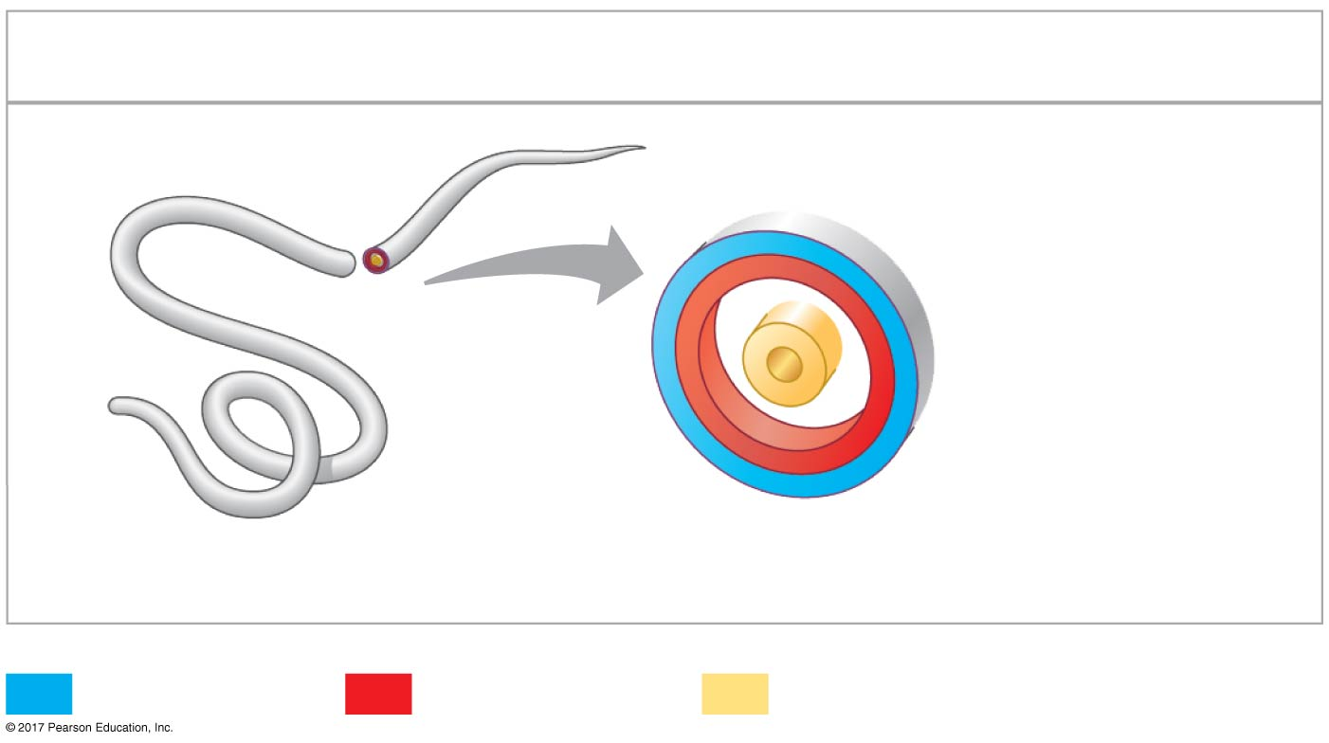
Figure 32.9b
(b) Pseudocoelomate
Body covering
(from ectoderm)
Pseudocoelom
Muscle layer
(from
mesoderm)
Digestive tract
(from endoderm)
Ectoderm
Mesoderm
Endoderm
Notes:
Figure 32.9b Body cavities of triploblastic animals (part 2: pseudocoelomate)

Slide 49
Triploblastic animals that lack a body cavity are called acoelomates

Slide 50
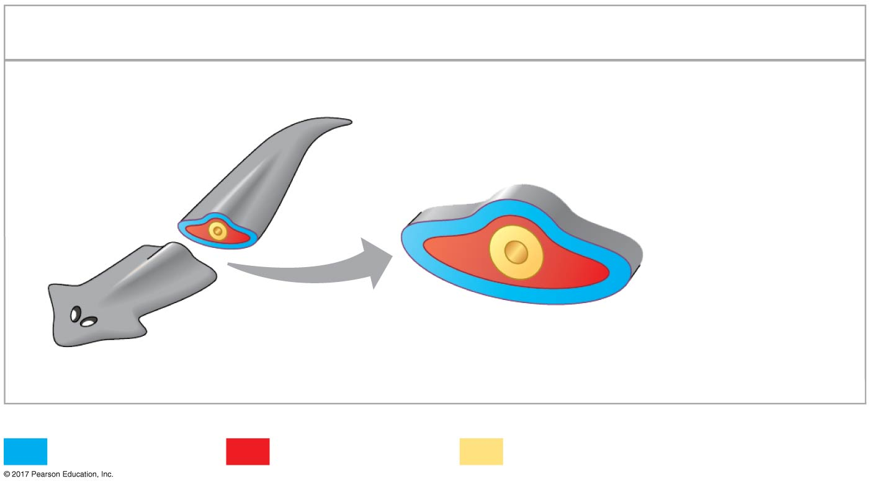
Figure 32.9c
(c) Acoelomate
Body covering
(from ectoderm)
Tissue-
filled region
(from
mesoderm)
Wall of digestive cavity
(from endoderm)
Ectoderm
Mesoderm
Endoderm
Notes:
Figure 32.9c Body cavities of triploblastic animals (part 3: acoelomate)

Slide 51
A body cavity has many functions
Fluid cushions the suspended organs
Fluid acts like a skeleton against which muscles can work
The cavity enables internal organs to grow and move independently of the outer body wall

Slide 52
Terms such as coelomates and pseudocoelomates refer to organisms that have a similar body plan and belong to the same grade
A grade is a group whose members share key biological features
A grade is not necessarily a clade, an ancestor and all of its descendants

Slide 53
Protostome and Deuterostome Development
Based on early development, many animals can be categorized as having protostome development or deuterostome development
These developmental modes differ in cleavage, coelom formation, and fate of the blastopore

Slide 54
Cleavage
In protostome development, cleavage is spiral and determinate
In animals with determinate cleavage, the developmental fate of embryonic cells is determined early in development

Slide 55
In deuterostome development, cleavage is radial and indeterminate
In animals with indeterminate cleavage, each cell in the early stages of cleavage retains the capacity to develop into a complete embryo
Indeterminate cleavage makes possible identical twins and embryonic stem cells

Slide 56
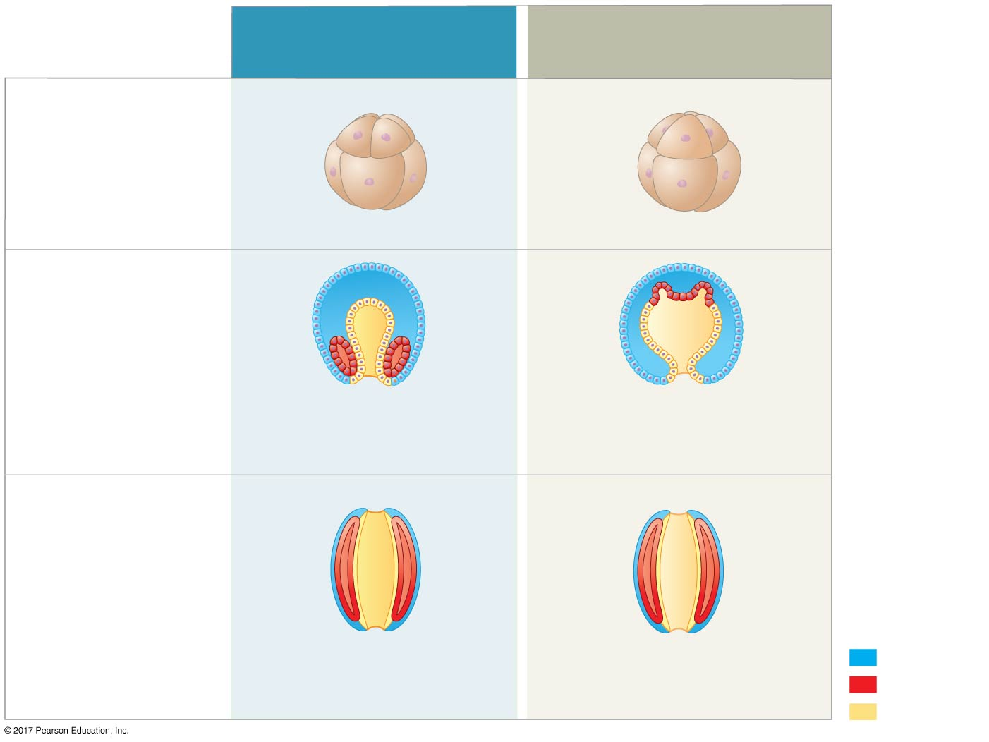
Figure 32.10
Protostome development
(examples: molluscs,
annelids)
Deuterostome development
(examples: echinoderms,
chordates)
(a) Cleavage
Eight-cell stage
Eight-cell stage
Spiral and determinate
Radial and indeterminate
(b) Coelom formation
Coelom
Archenteron
Coelom
Mesoderm
Blastopore
Blastopore
Mesoderm
Solid masses of mesoderm
split and form coelom.
Folds of archenteron
form coelom.
(c) Fate of the blastopore
Anus
Mouth
Digestive tube
Mouth
Anus
Ectoderm
Mouth develops from
blastopore.
Anus develops from
blastopore.
Mesoderm
Endoderm
Notes:
Figure 32.10 A comparison of protostome and deuterostome development

Slide 57
Figure 32.10a
Protostome development
(examples: molluscs,
annelids)
Deuterostome development
(examples: echinoderms,
chordates)
(a) Cleavage
Eight-cell stage
Eight-cell stage
Ectoderm
Mesoderm
Endoderm
Spiral and determinate
Radial and indeterminate
Notes:
Figure 32.10a A comparison of protostome and deuterostome development (part 1: cleavage)

Slide 58
Coelom Formation
In protostome development, the splitting of solid masses of mesoderm forms the coelom
In deuterostome development, the mesoderm buds from the wall of the archenteron to form the coelom

Slide 59
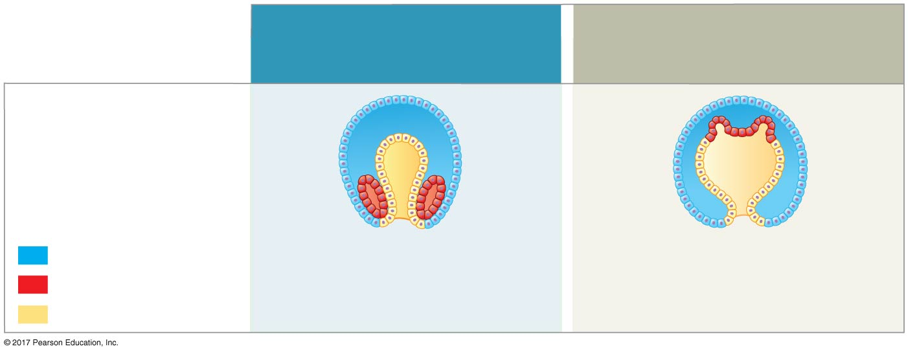
Figure 32.10b
Protostome development
(examples: molluscs,
annelids)
Deuterostome development
(examples: echinoderms,
chordates)
(b) Coelom formation
Coelom
Archenteron
Coelom
Ectoderm
Mesoderm
Blastopore
Blastopore
Mesoderm
Mesoderm
Solid masses of mesoderm
split and form coelom.
Folds of archenteron
form coelom.
Endoderm
Notes:
Figure 32.10b A comparison of protostome and deuterostome development (part 2: coelom formation)

Slide 60
Fate of the Blastopore
The blastopore forms during gastrulation and connects the archenteron to the exterior of the gastrula
In protostome development, the blastopore becomes the mouth
In deuterostome development, the blastopore becomes the anus

Slide 61
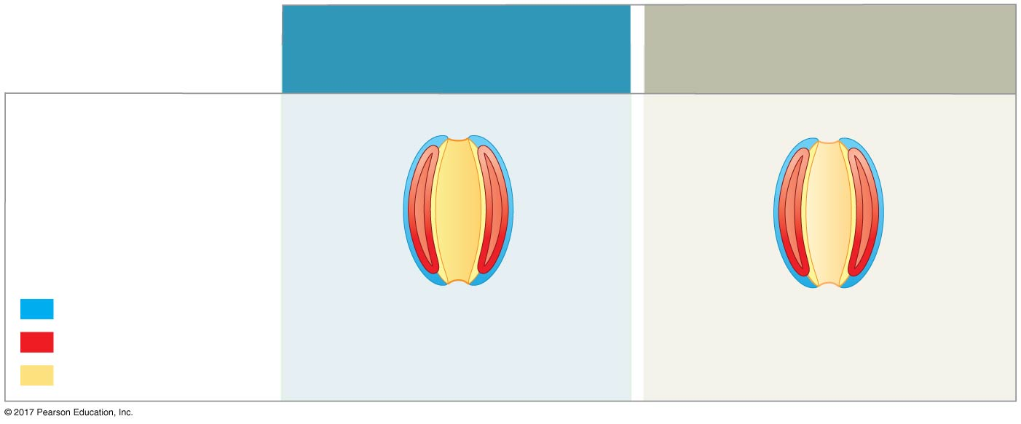
Figure 32.10c
Protostome development
(examples: molluscs,
annelids)
Deuterostome development
(examples: echinoderms,
chordates)
(c) Fate of the blastopore
Anus
Mouth
Digestive tube
Ectoderm
Mouth
Anus
Mesoderm
Mouth develops from
blastopore.
Anus develops from
blastopore.
Endoderm
Notes:
Figure 32.10c A comparison of protostome and deuterostome development (part 3: fate of the blastopore)

Slide 62
Concept 32.4: Views of animal phylogeny continue to be shaped by new molecular and morphological data
By 500 million years ago, most animal phyla with members alive today were established

Slide 63
The Diversification of Animals
Zoologists recognize about three dozen animal phyla
Phylogenies are now based on a combination of whole-genome analysis, morphological traits, ribosomal RNA (rRNA) genes, Hox genes, protein-coding nuclear genes, and mitochondrial genes

Slide 64
Five important points about the relationships among living animals are reflected in their phylogeny
All animals share a common ancestor
Sponges are the sister group to all other animals
Eumetazoa (“true animals”) is a clade of animals with tissues

Slide 65
Most animal phyla belong to the clade Bilateria
There are three major clades of bilaterian animals, all of which are invertebrates, animals that lack a backbone, except Chordata, which includes vertebrates, animals with a backbone

Slide 66
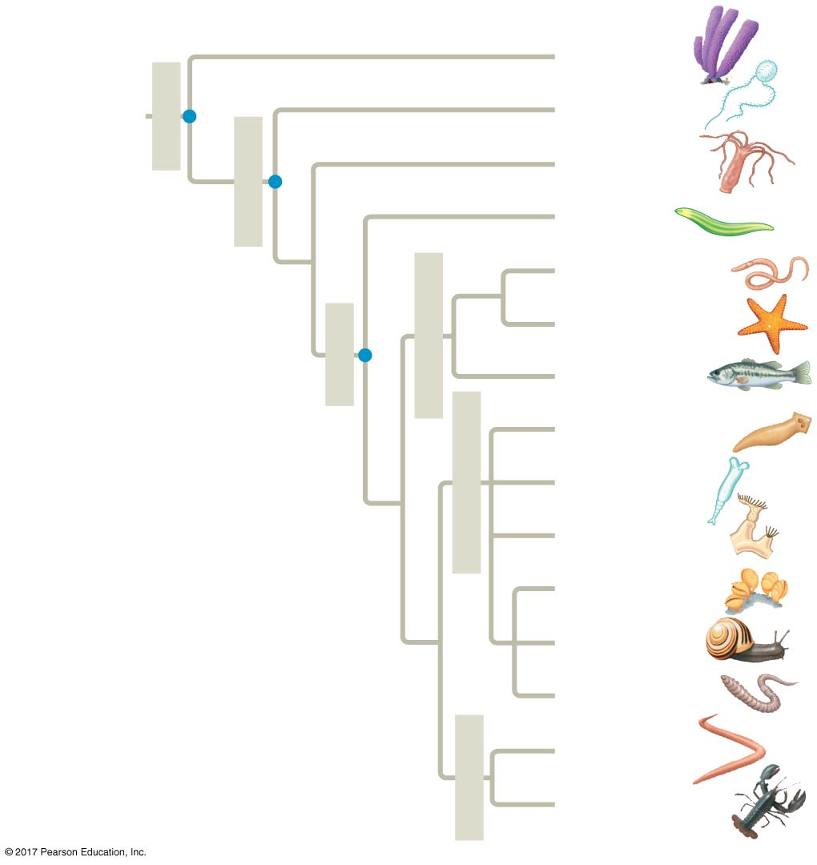
Figure 32.11
Porifera
Metazoa
ANCESTRAL
PROTIST
Ctenophora
Eumetazoa
Cnidaria
770 million
years ago
Acoela
Deuterostomia
Hemichordata
680 million
years ago
Bilateria
Echinodermata
Chordata
Lophotrochozoa
Platyhelminthes
670 million
years ago
Syndermata
Ectoprocta
Brachiopoda
Mollusca
Annelida
Ecdysozoa
Nematoda
Arthropoda
Notes:
Figure 32.11 A phylogeny of living animals

Slide 67
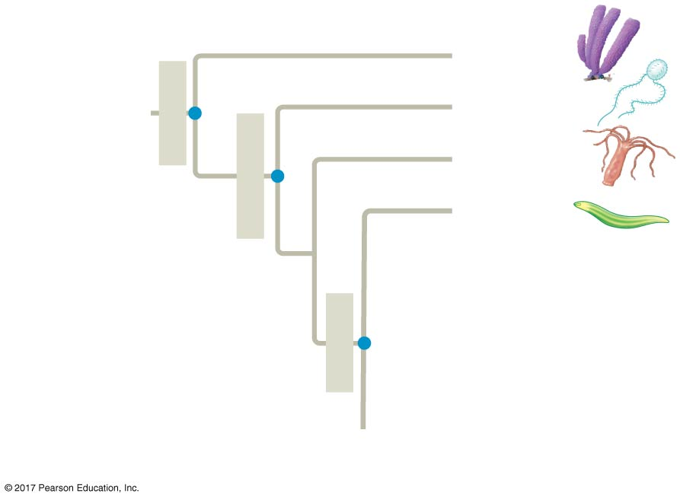
Figure 32.11a
Porifera
Metazoa
ANCESTRAL
PROTIST
Ctenophora
Eumetazoa
Cnidaria
770 million
years ago
Acoela
680 million
years ago
Bilateria
670 million
years ago
Notes:
Figure 32.11a A phylogeny of living animals (part 1)

Slide 68
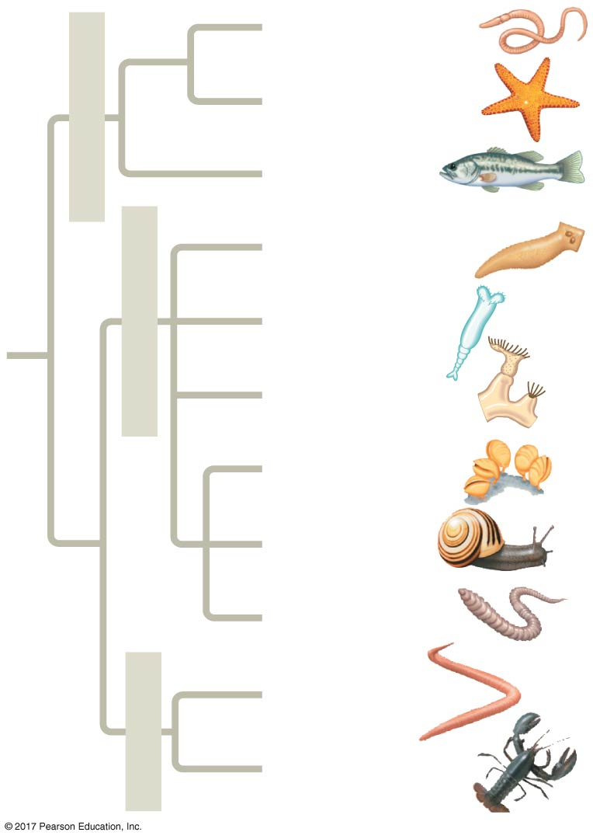
Figure 32.11b
Deuterostomia
Hemichordata
Echinodermata
Chordata
Lophotrochozoa
Platyhelminthes
Syndermata
Ectoprocta
Brachiopoda
Mollusca
Annelida
Ecdysozoa
Nematoda
Arthropoda
Notes:
Figure 32.11b A phylogeny of living animals (part 2)

Slide 69
The bilaterians are divided into three clades: Deuterostomia, Ecdysozoa, and Lophotrochozoa
Deuterostomia includes hemichordates (acorn worms), echinoderms (sea stars and relatives), and chordates
This clade includes both vertebrates and invertebrates

Slide 70
The ecdysozoans and the lophotochozoans are composed entirely of invertebrates
Members of Ecdysozoa secrete external skeletons
As they grow, they shed their exoskeletons through a process called ecdysis

Slide 71
Lophotrochozoa is another clade of bilaterian invertebrates
Some lophotrochozoans have a feeding structure called a lophophore
Others go through a distinct developmental stage called the trochophore larva

Slide 72
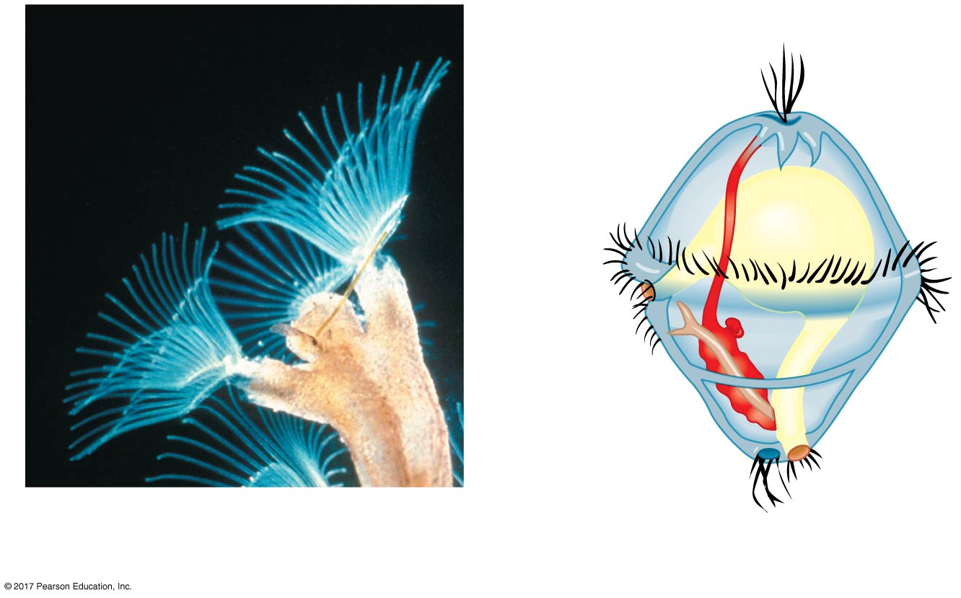
Figure 32.12
Lophophore
Apical tuft
of cilia
Mouth
Anus
(a) Lophophore feeding structures of an ectoproct
(b) Structure of a trochophore larva
Notes:
Figure 32.12 Morphological characteristics of lophotrochozoans

Slide 73
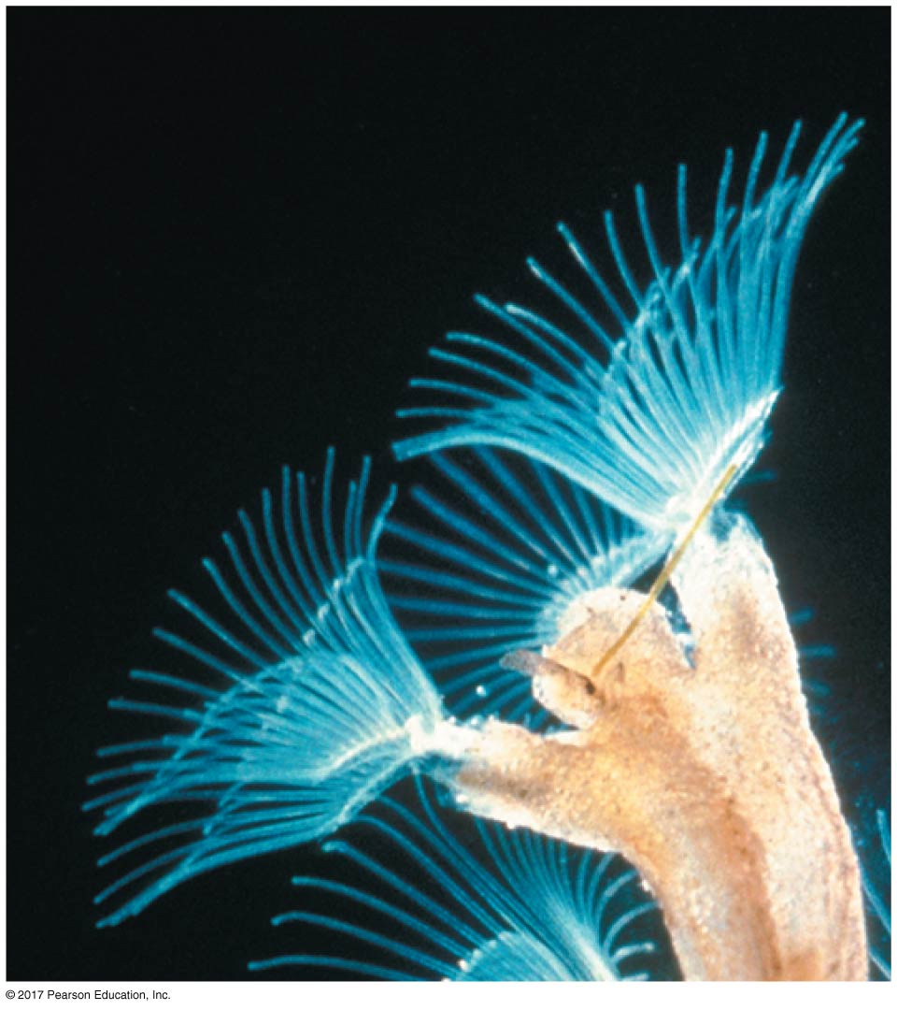
Figure 32.12a
Lophophore
Notes:
Figure 32.12a Morphological characteristics of lophotrochozoans (part 1: photo)

Slide 74
Future Directions in Animal Systematics
Systematics, like all fields of scientific research, is an ongoing, dynamic process of inquiry
Three outstanding questions are the focus of current research
Are sponges monophyletic?
Are ctenophores basal metazoans?
Are acoelomate flatworms basal bilaterians?

Slide 75
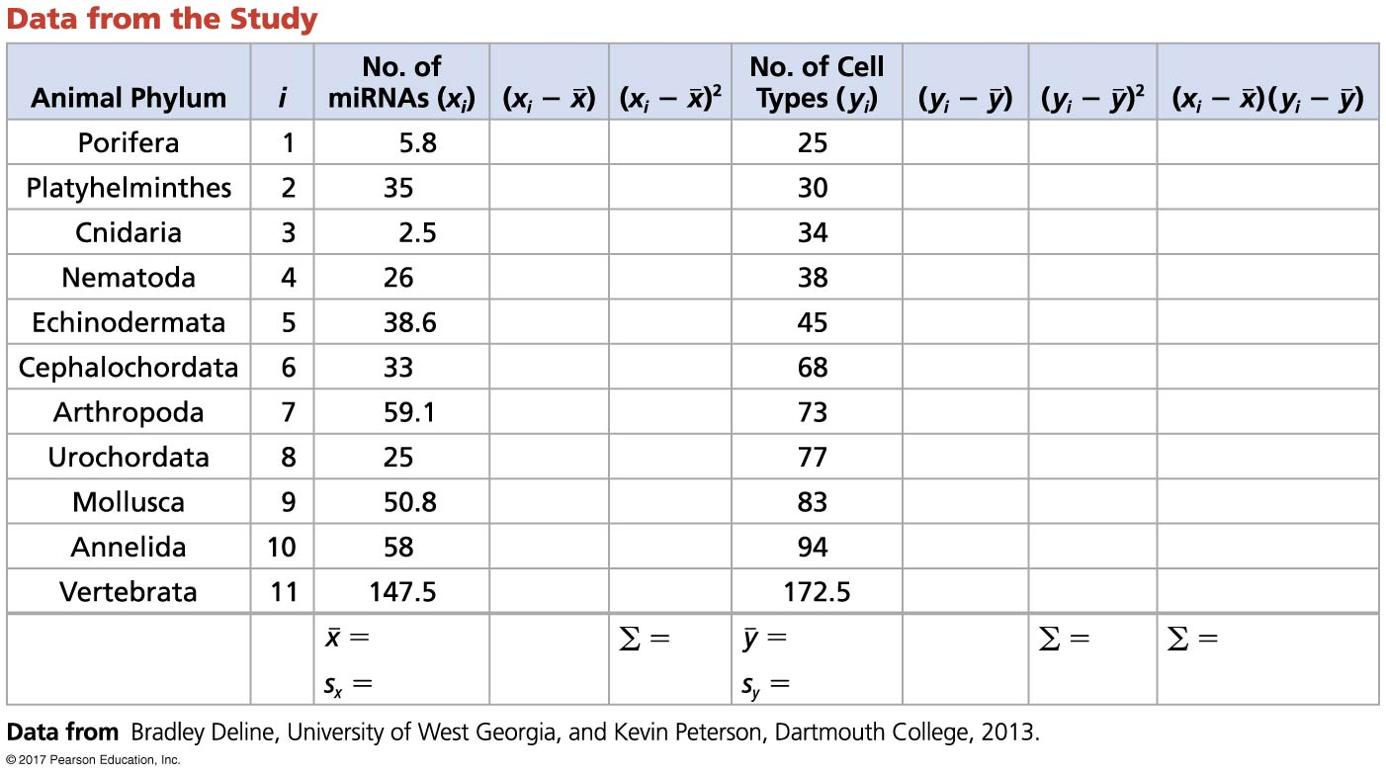
Figure 32.UN01
Notes:
Figure 32.UN01 Skills Exercise: Calculating and Interpreting Correlation Coefficients

Slide 76
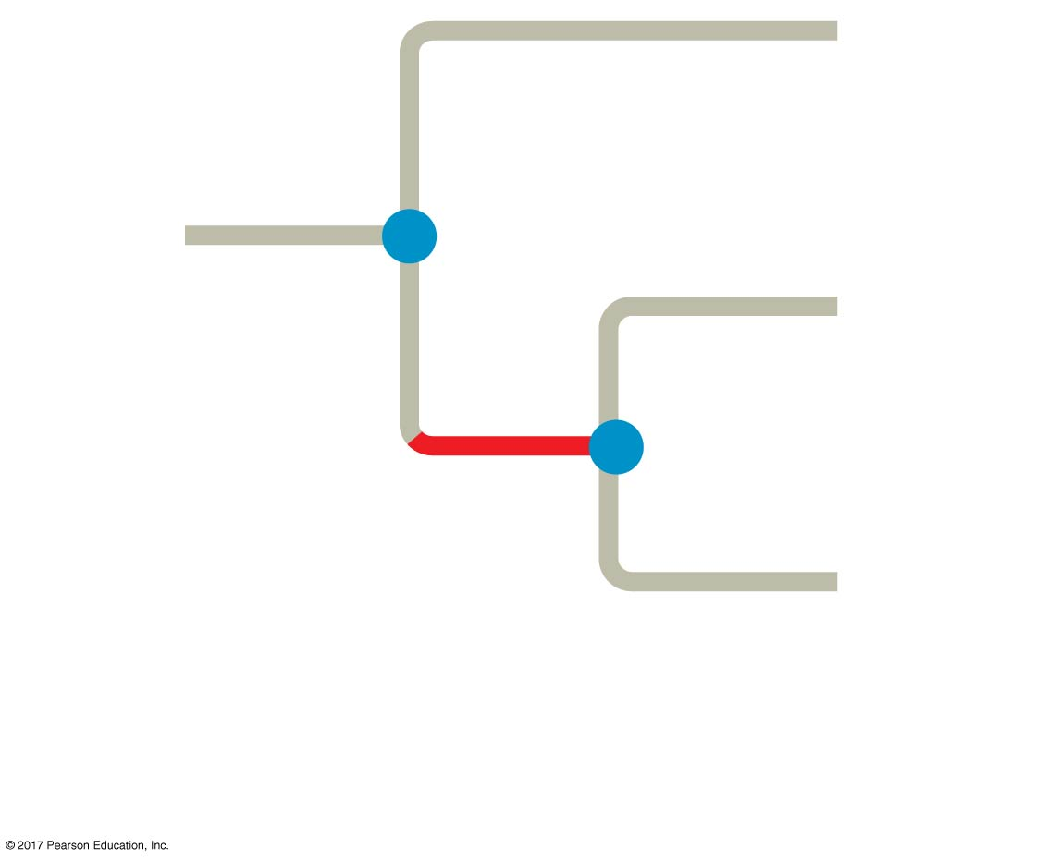
Figure 32.UN02
Fungi
Sponges
Common
ancestor of
fungi and
animals
(1 bya)
All other
animals
Most recent
common ancestor of
animals (770 mya)
Notes:
Figure 32.UN02 Concept Check 32.2: Visual Skills

Slide 77
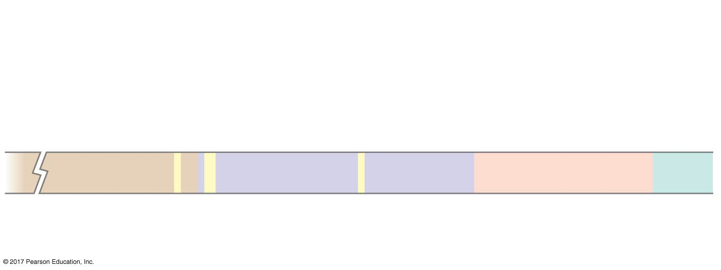
Figure 32.UN03
535–525 mya:
Cambrian explosion
Origin and
diversification
of dinosaurs
365 mya:
Early land
vertebrates
Increased
diversity of
mammals
560 mya:
Ediacaran animals
Era
Neoproterozoic
Paleozoic
Mesozoic
Ceno-
zoic
1,000
541
252
66
0
Millions of years ago (mya)
Notes:
Figure 32.UN03 Summary of key concepts: history of animals

Slide 78
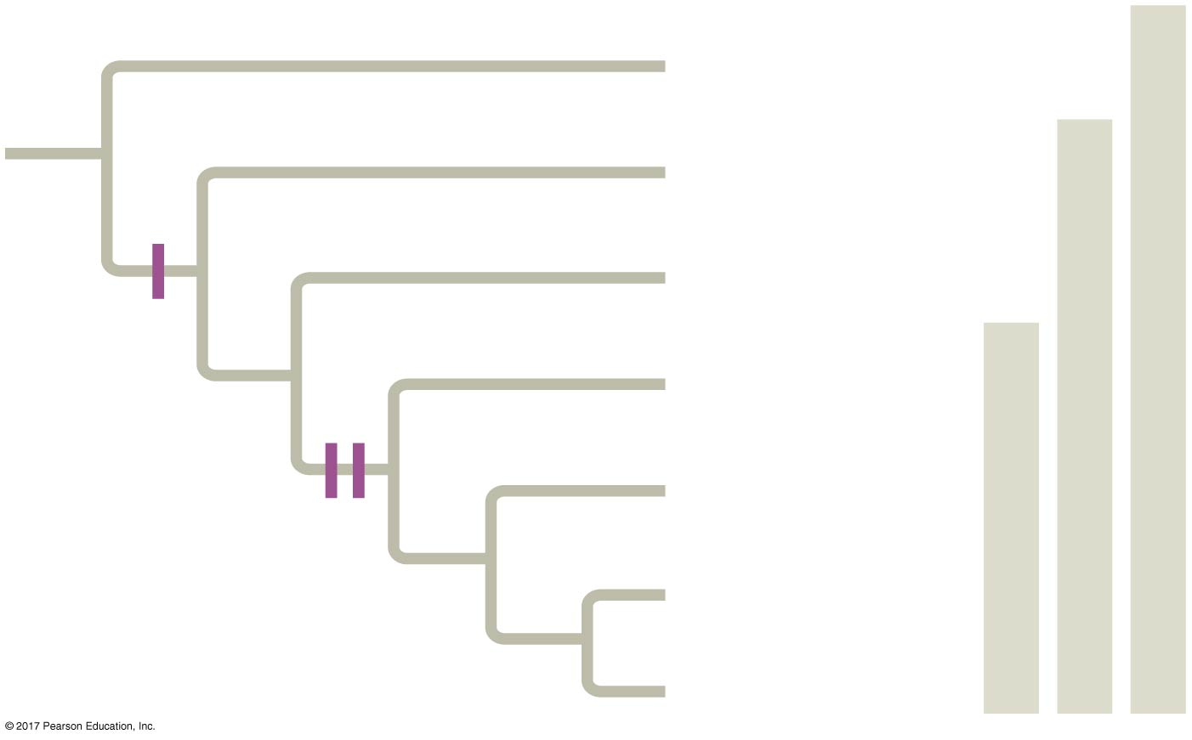
Figure 32.UN04
Porifera
(basal animals)
Metazoa
Ctenophora
Eumetazoa
Cnidaria
Tissues
Bilateria (most animals)
Acoela (basal
bilaterians)
Deuterostomia
Bilateral
symmetry
Lophotrochozoa
Three germ
layers
Ecdysozoa
Notes:
Figure 32.UN04 Summary of key concepts: key steps in animal evolution

Slide 79
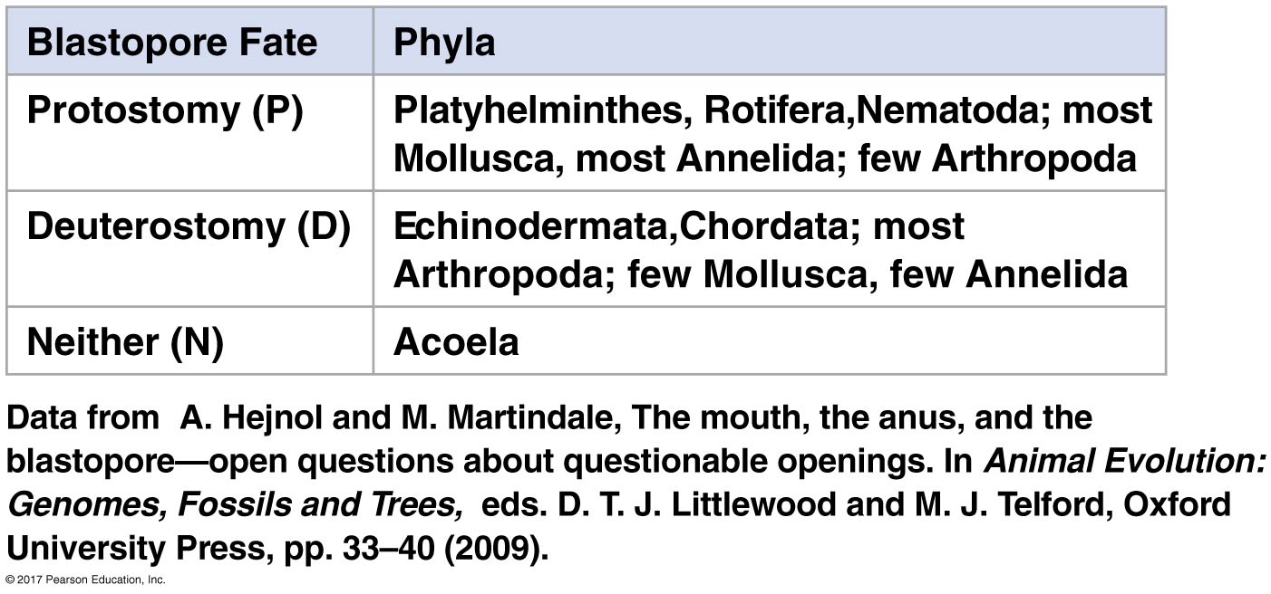
Figure 32.UN05
Notes:
Figure 32.UN05 Test your understanding, question 6 (blastopore fates)

Slide 80
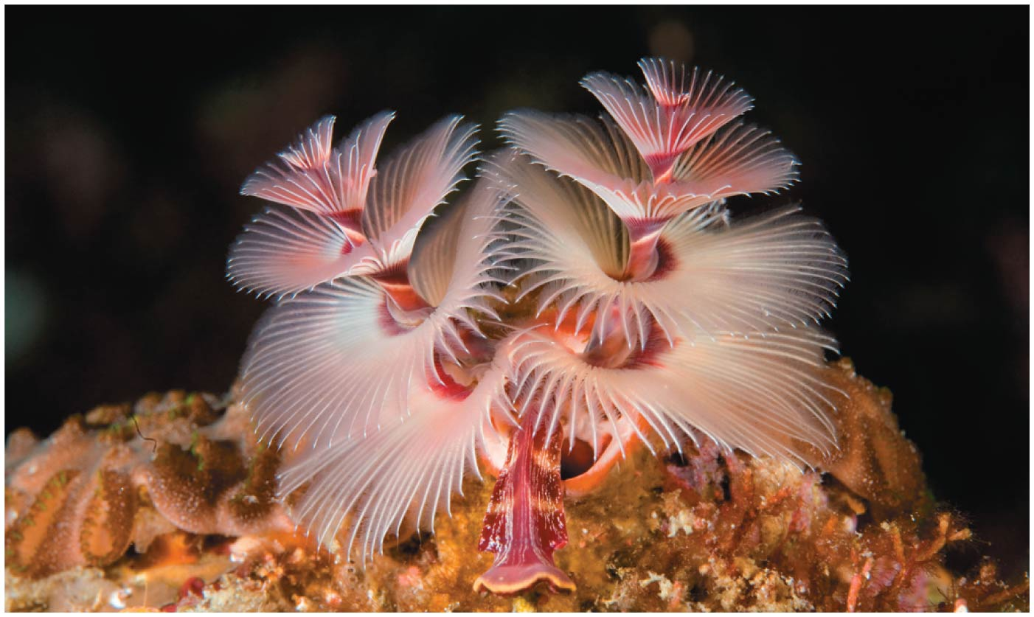
Figure 32.UN06
Notes:
Figure 32.UN06 Test your understanding, question 8 (animal body structure, lifestyle and clades)

