Slide 1
Notes:
1

Slide 2
Half a Billion Years of Backbones
Early in the Cambrian period, about 530 million years ago, an astonishing variety of invertebrate animals inhabited Earth’s oceans
One type of animal gave rise to vertebrates, one of the most successful groups of animals
The animals called vertebrates get their name from vertebrae, the series of bones that make up the backbone

Slide 3
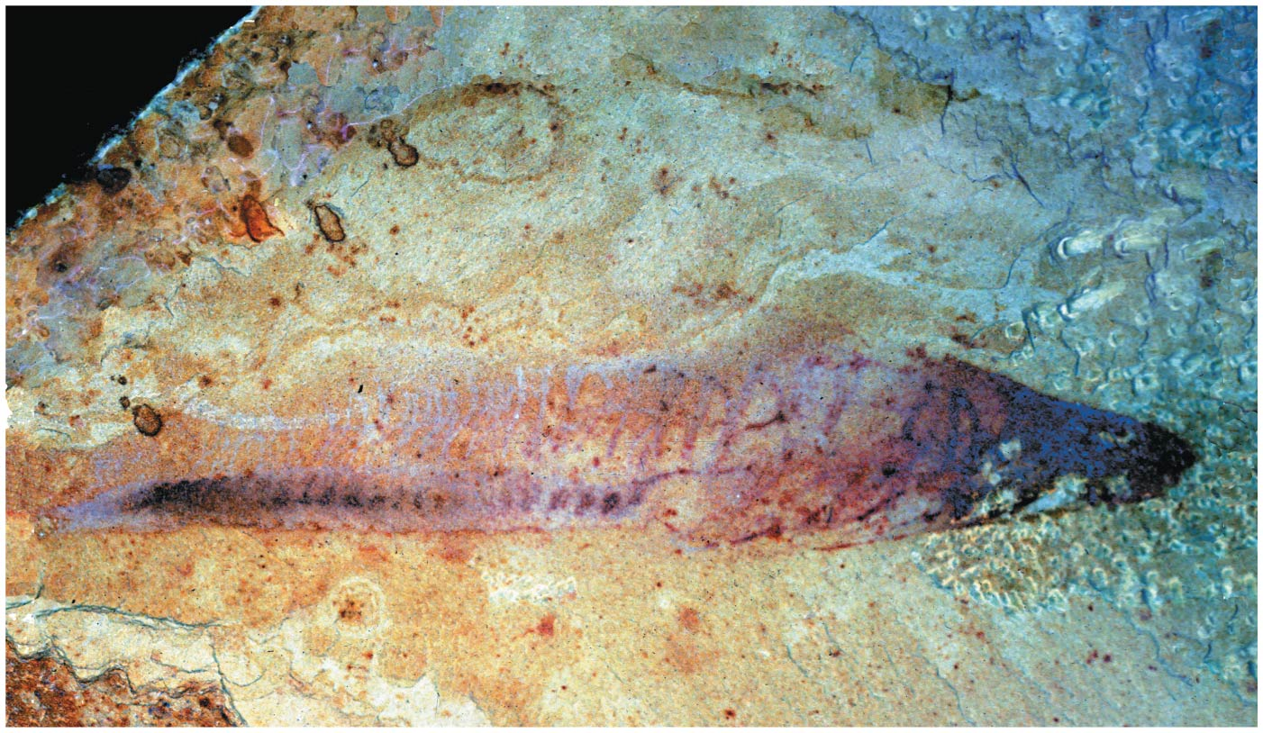
Figure 34.1
Notes:
Figure 34.1 What is the relationship between this ancient organism and humans?

Slide 4
One lineage of vertebrates colonized land 365 million years ago
They gave rise to modern amphibians, reptiles (including birds), and mammals
There are more than 57,000 species of vertebrates, including the largest organisms ever to live on Earth
Vertebrates have great disparity, a wide range of differences within the group

Slide 5
Concept 34.1: Chordates have a notochord and a dorsal, hollow nerve cord
Chordates (phylum Chordata) are bilaterian animals that belong to the clade of animals known as Deuterostomia
Chordates comprise all vertebrates and two groups of invertebrates, the urochordates and cephalochordates

Slide 6
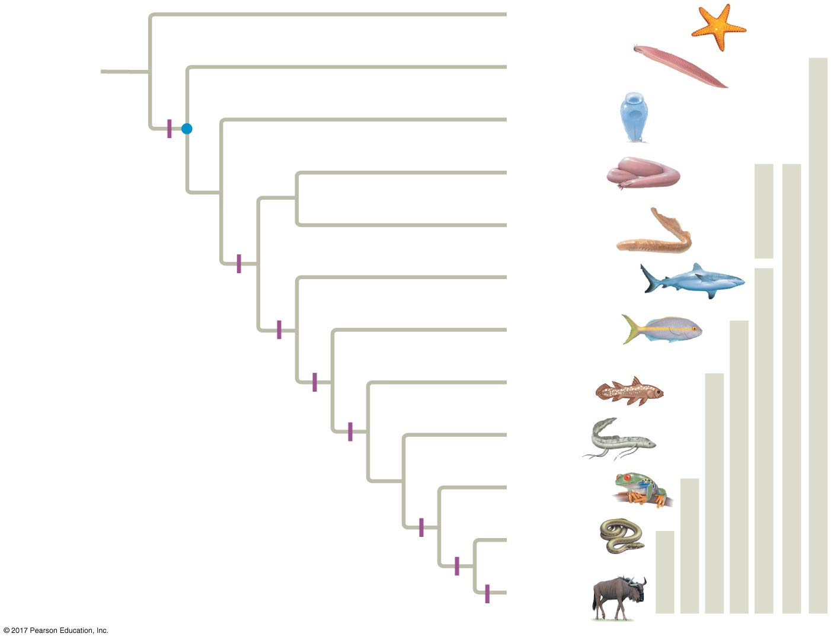
Figure 34.2
Echinodermata
ANCESTRAL
DEUTEROSTOME
Cephalochordata
Chordates
Urochordata
Notochord
Myxini
Cyclostomes
Vertebrates
Common
ancestor of
chordates
Petromyzontida
Vertebrae
Chondrichthyes
Gnathostomes
Actinopterygii
Osteichthyans
Jaws, mineralized skeleton
Actinistia
Lobe-fins
Lungs or lung derivatives
Dipnoi
Lobed fins
Amphibia
Tetrapods
Limbs with digits
Reptilia
Amniotes
Amniotic egg
Mammalia
Milk
Notes:
Figure 34.2 Phylogeny of living chordates

Slide 7
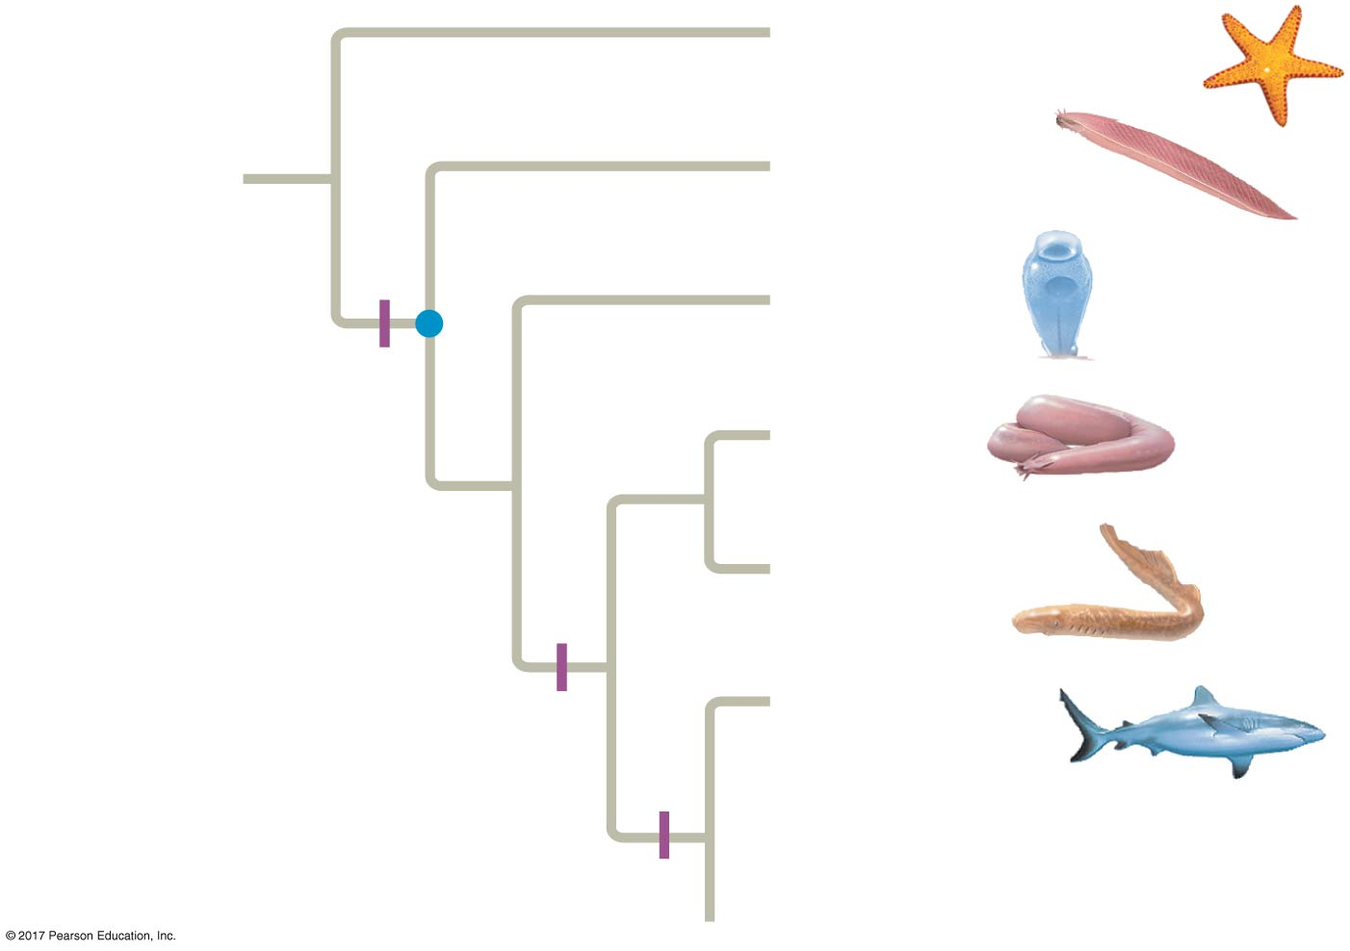
Figure 34.2a
Echinodermata
ANCESTRAL
DEUTEROSTOME
Cephalochordata
Urochordata
Notochord
Myxini
Common
ancestor of
chordates
Petromyzontida
Vertebrae
Chondrichthyes
Jaws, mineralized skeleton
Notes:
Figure 34.2a Phylogeny of living chordates (part 1)

Slide 8
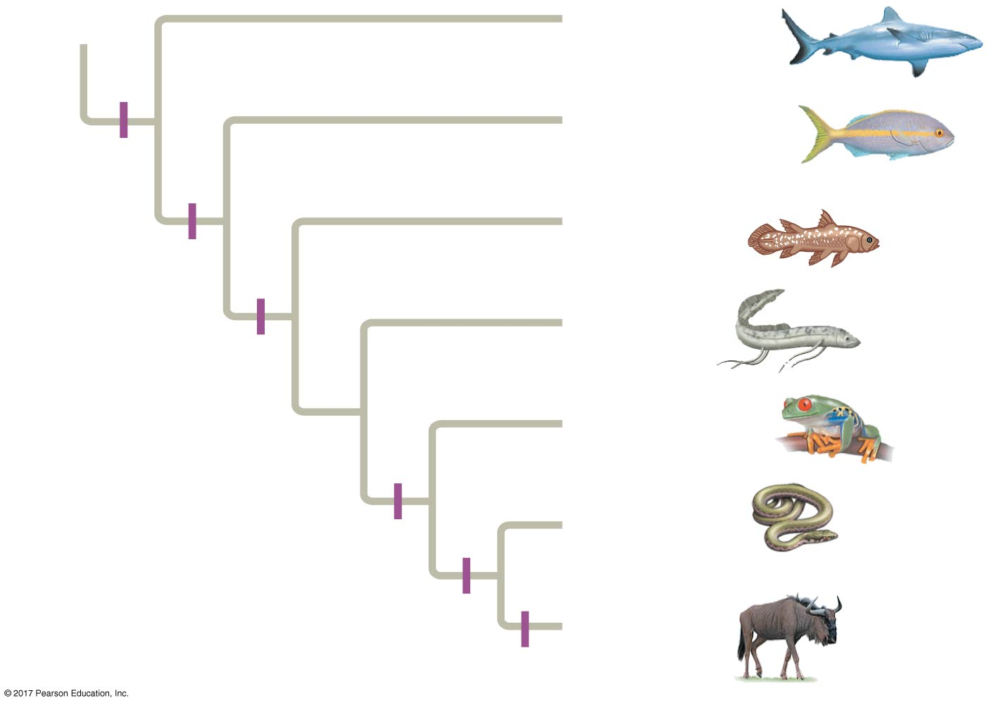
Figure 34.2b
Chondrichthyes
Actinopterygii
Jaws,
mineralized
skeleton
Actinistia
Lungs or
lung derivatives
Dipnoi
Lobed fins
Amphibia
Limbs with digits
Reptilia
Amniotic egg
Mammalia
Milk
Notes:
Figure 34.2b Phylogeny of living chordates (part 2)

Slide 9
Derived Characters of Chordates
All chordates share a set of derived characters
Some species have some of these traits only during embryonic development
Four key characters of chordates
Notochord
Dorsal, hollow nerve cord
Pharyngeal slits or clefts
Muscular, post-anal tail

Slide 10
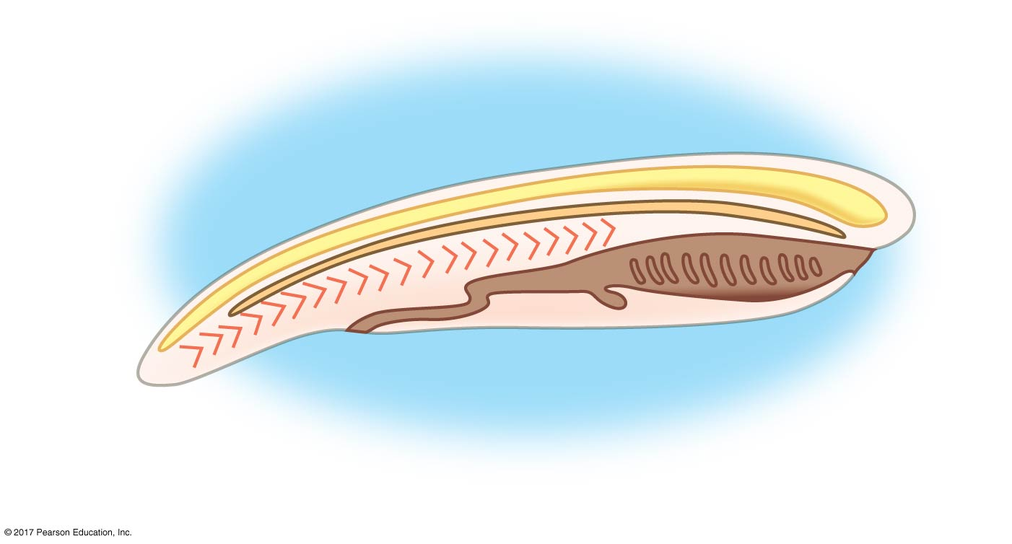
Figure 34.3
Notochord
Dorsal, hollow nerve cord
Muscle
segments
Mouth
Anus
Post-anal tail
Pharyngeal slits or clefts
Notes:
Figure 34.3 Chordate characteristics

Slide 11
Notochord
The notochord is a longitudinal, flexible rod between the digestive tube and nerve cord
It provides skeletal support throughout most of the length of a chordate
In most vertebrates, a more complex, jointed skeleton develops, and the adult retains only remnants of the embryonic notochord

Slide 12
Dorsal, Hollow Nerve Cord
The nerve cord of a chordate embryo develops from a plate of ectoderm that rolls into a tube dorsal to the notochord
The nerve cord develops into the central nervous system: the brain and the spinal cord

Slide 13
Pharyngeal Slits or Clefts
In all chordate embryos, grooves form along the outer surface of the pharynx called pharyngeal clefts
In most chordates, these grooves develop into pharyngeal slits that open to the outside of the body

Slide 14
Functions of pharyngeal slits
Suspension-feeding structures in many invertebrate chordates
Gas exchange in vertebrates (except vertebrates with limbs, the tetrapods)
Develop into parts of the ear, head, and neck in tetrapods

Slide 15
Muscular, Post-Anal Tail
Chordates have a tail posterior to the anus
In many species, the tail is greatly reduced during embryonic development
The tail contains skeletal elements and muscles
It provides propelling force in many aquatic species

Slide 16
Lancelets
Lancelets (Cephalochordata) are named for their bladelike shape
They are marine suspension feeders that retain characteristics of the chordate body plan as adults

Slide 17
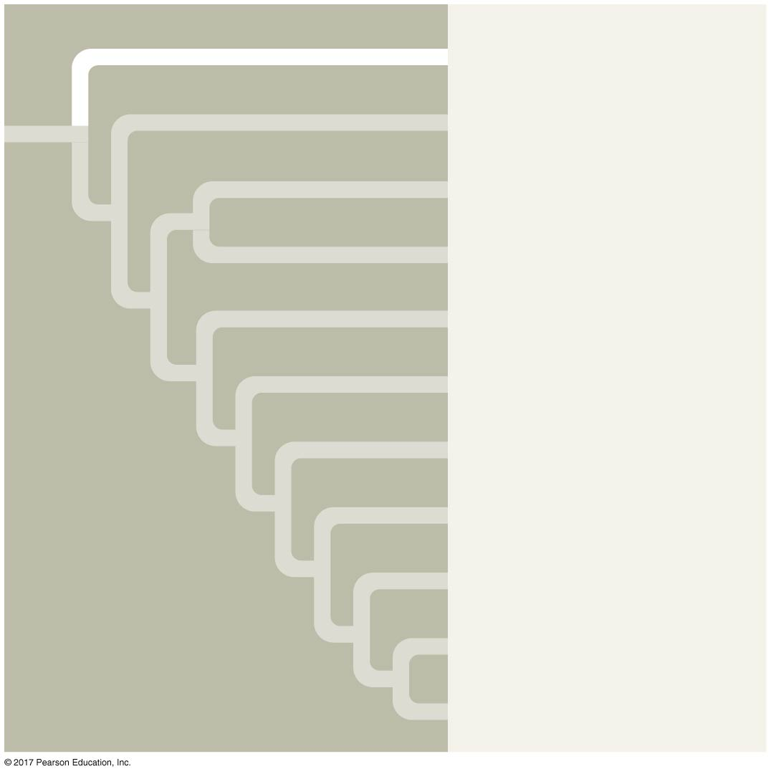
Figure 34.UN01
Cephalochordata
Urochordata
Myxini
Petromyzontida
Chondrichthyes
Actinopterygii
Actinistia
Dipnoi
Amphibia
Reptilia
Mammalia
Notes:
Figure 34.UN01 In-text figure, Cephalochordata mini-tree, p. 718

Slide 18
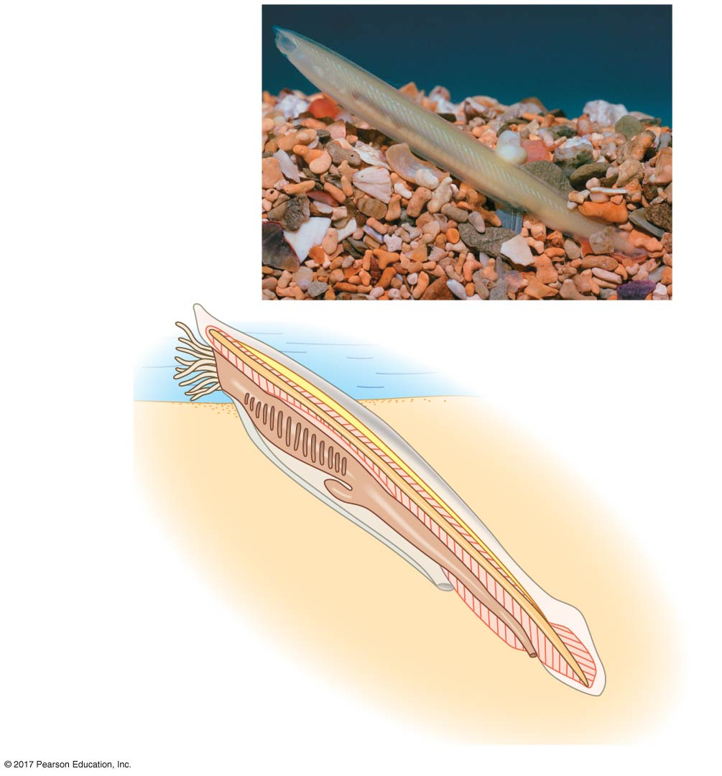
Figure 34.4
1 cm
Cirri
Mouth
Notochord
Pharyngeal slits
Dorsal, hollow
nerve cord
Atrium
Digestive tract
Atriopore
Segmental
muscles
Anus
Tail
Notes:
Figure 34.4 The lancelet Branchiostoma, a cephalochordate

Slide 19
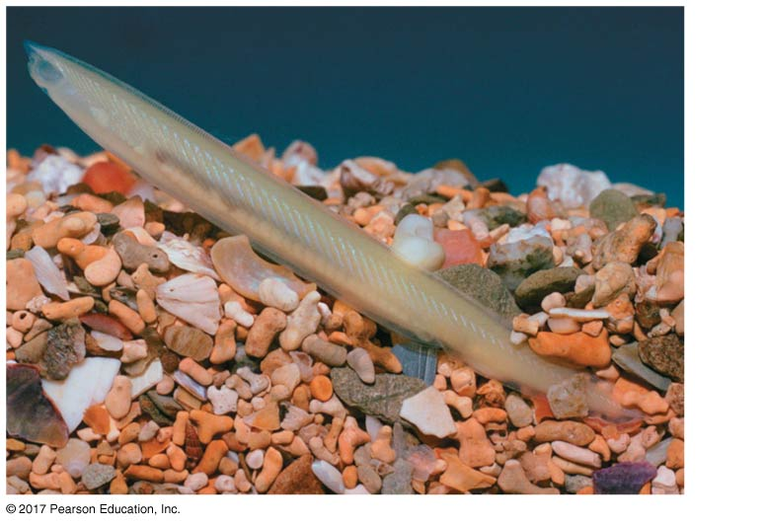
Figure 34.4a
1 cm
Notes:
Figure 34.4a The lancelet Branchiostoma, a cephalochordate (part 1: photo)

Slide 20
Tunicates
Tunicates (Urochordata) are more closely related to other chordates than are lancelets
Tunicates most resemble chordates during their larval stage, which may last only a few minutes

Slide 21
Metamorphosis from the larva to adult form involves the resorption of the tail and notochord and 90° rotation of the remaining organs
Adult tunicates draw in water through an incurrent siphon, filtering food particles
When attacked, tunicates, or “sea squirts,” shoot water through their excurrent siphon
Tunicates are highly derived and have fewer Hox genes than other vertebrates

Slide 22
Figure 34.UN02
Cephalochordata
Urochordata
Myxini
Petromyzontida
Chondrichthyes
Actinopterygii
Actinistia
Dipnoi
Amphibia
Reptilia
Mammalia
Notes:
Figure 34.UN02 In-text figure, Urochordata mini-tree, p. 719

Slide 23
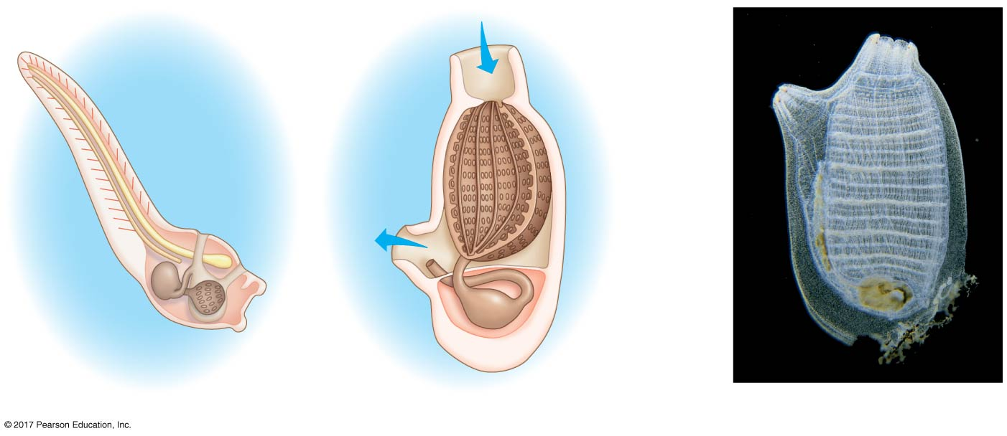
Figure 34.5
Water flow
Incurrent
siphon
to mouth
Notochord
Dorsal, hollow
nerve cord
Excurrent
siphon
Tail
Excurrent
siphon
Excurrent
siphon
Atrium
Muscle
segments
Incurrent
siphon
Pharynx
with
numerous
slits
Intestine
Stomach
Anus
Atrium
Intestine
Esophagus
Tunic
Pharynx with slits
Stomach
(a) A tunicate larva
(b) An adult tunicate
(c) An adult tunicate
Notes:
Figure 34.5 A tunicate, a urochordate

Slide 24
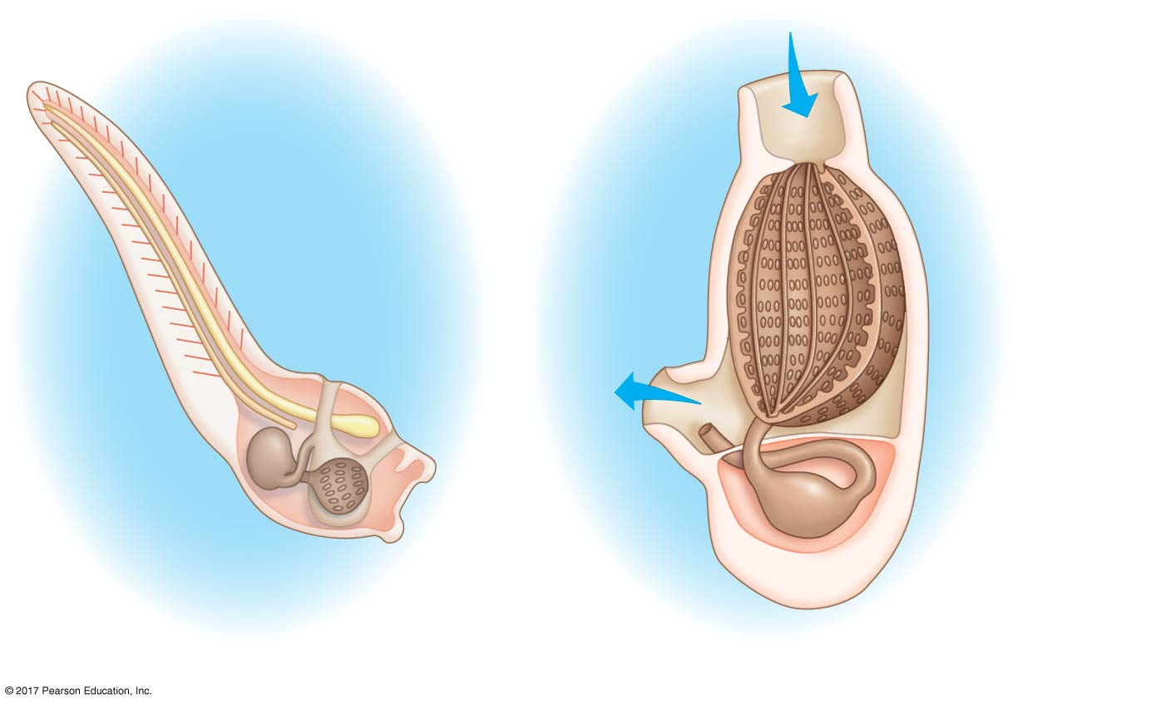
Figure 34.5a
Incurrent
siphon
to mouth
Notochord
Water flow
Dorsal, hollow
nerve cord
Tail
Excurrent
siphon
Excurrent
siphon
Atrium
Muscle
segments
Incurrent
siphon
Pharynx
with
numerous
slits
Intestine
Anus
Stomach
Intestine
Atrium
Tunic
Esophagus
Pharynx with slits
Stomach
(a) A tunicate larva
(b) An adult tunicate
Notes:
Figure 34.5a A tunicate, a urochordate (part 1: art)

Slide 25
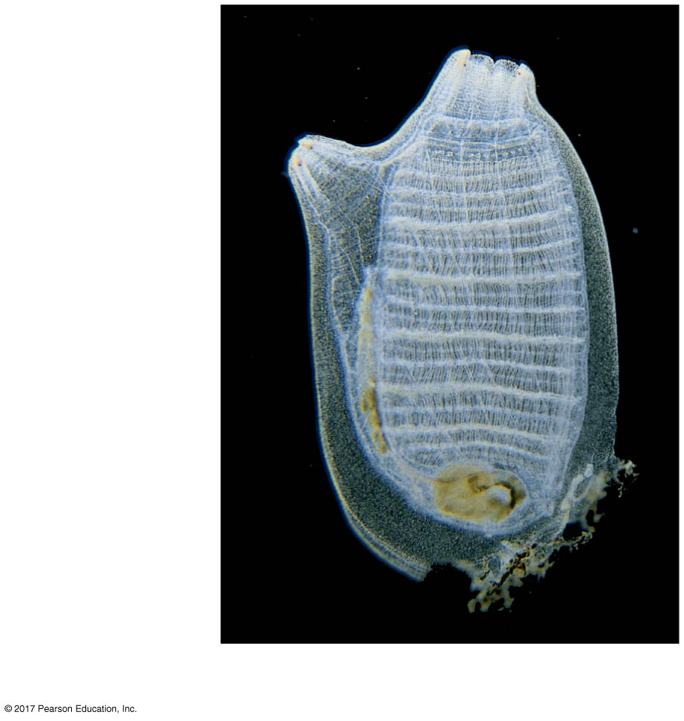
Figure 34.5b
Incurrent
siphon
to mouth
Excurrent
siphon
Atrium
Pharynx
with
numerous
slits
Tunic
(c) An adult tunicate
Notes:
Figure 34.5b A tunicate, a urochordate (part 2: photo)

Slide 26
Early Chordate Evolution
Ancestral chordates may have resembled lancelets
The same Hox genes that organize the vertebrate brain are expressed in the lancelet’s simple nerve cord tip

Slide 27
Genes associated with the heart and thyroid are present in tunicates and vertebrates but are absent from nonchordate invertebrates
Tunicates have embryonic cells that share characteristics with cells found in the vertebrate neural crest

Slide 28
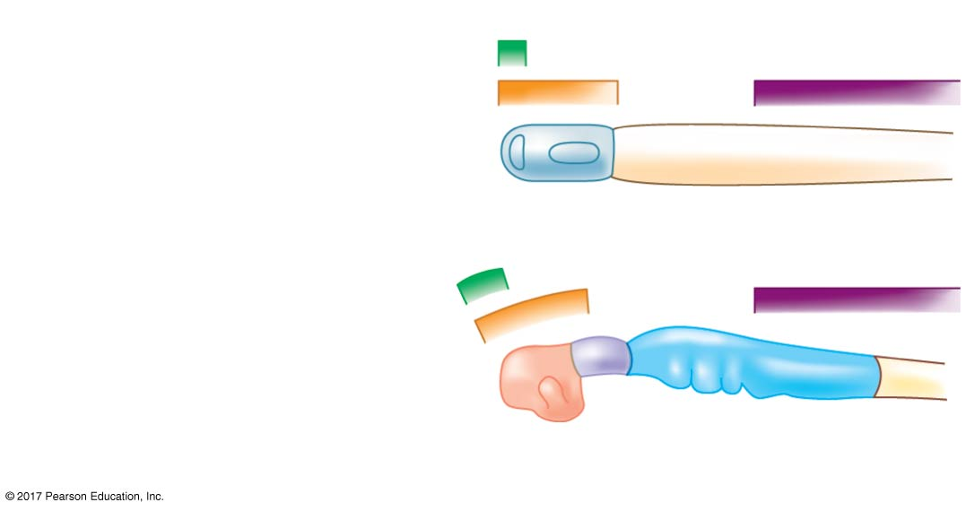
Figure 34.6
BF1
Otx
Hox3
Nerve cord of lancelet embryo
BF1
Otx
Hox3
Brain of vertebrate embryo
(shown straightened)
Forebrain
Midbrain
Hindbrain
Notes:
Figure 34.6 Expression of developmental genes in lancelets and vertebrates

Slide 29
Concept 34.2: Vertebrates are chordates that have a backbone
A skeletal system and complex nervous system have allowed vertebrates efficiency at two essential tasks
Capturing food
Evading predators

Slide 30
Derived Characters of Vertebrates
Vertebrates have two or more sets of Hox genes; lancelets and tunicates have only one
In the majority of vertebrates, the vertebrae that enclose the spinal cord have taken over the mechanical roles of the notochord
The neural crest, cells that appear along the edges of the closing neural tube of an embryo, is another unique feature of vertebrates

Slide 31
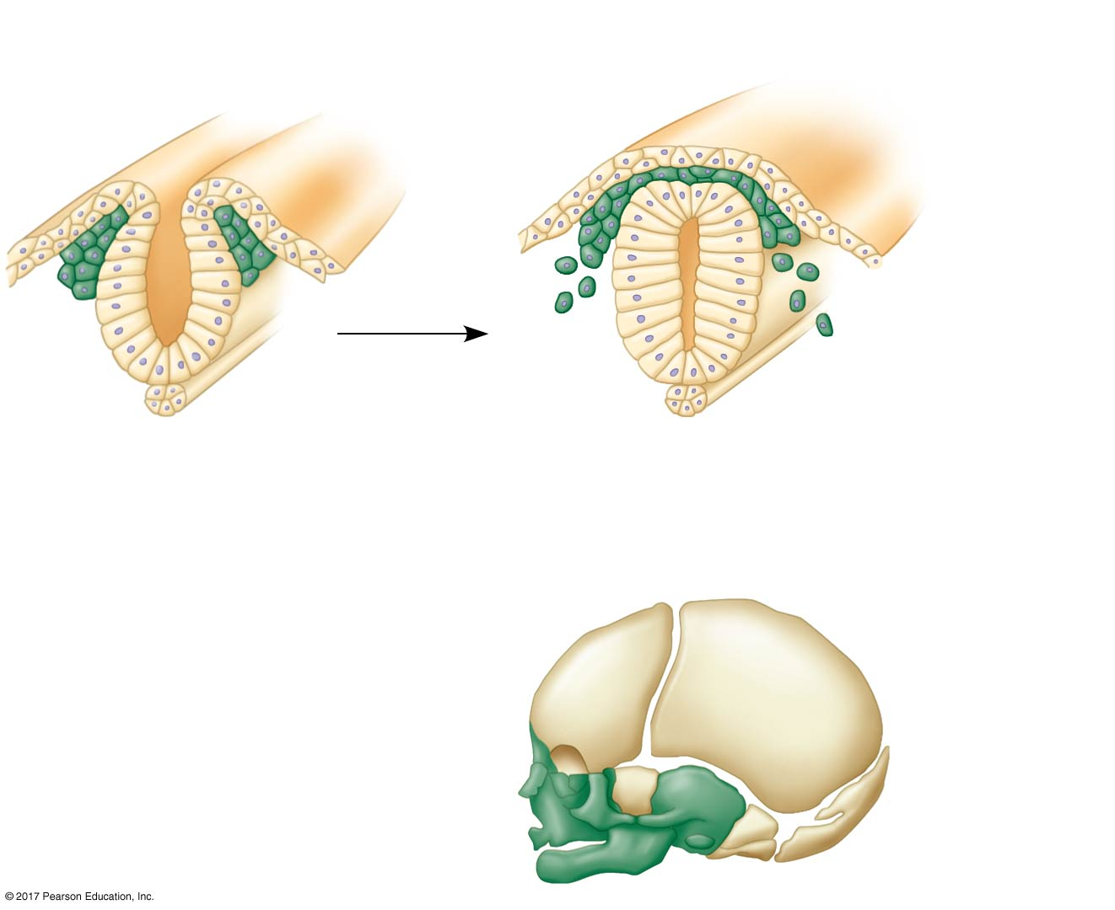
Figure 34.7
Closing
neural tube
Neural
crest
Neural
tube
Migrating neural
crest cells
Notochord
(a) The neural crest consists of bilateral bands of cells that form the neural tube.
(b) Neural crest cells migrate to distant sites in the embryo.
(c) Neural crest cells give rise to anatomical structures unique to vertebrates.
Notes:
Figure 34.7 The neural crest, embryonic source of many unique vertebrate traits

Slide 32
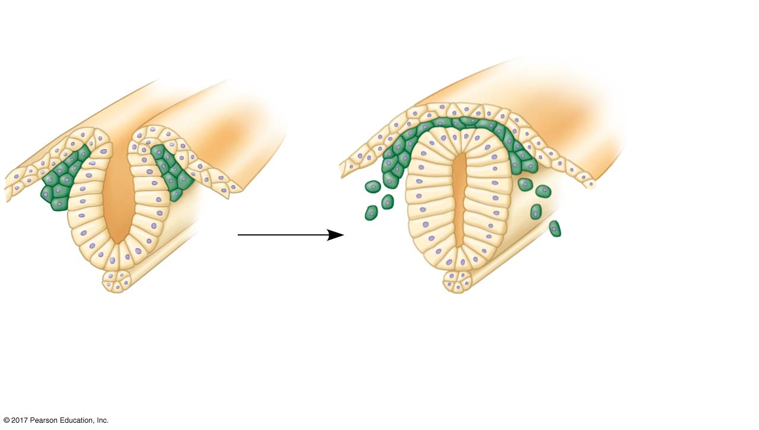
Figure 34.7a
Closing
neural tube
Neural
crest
Neural
tube
Migrating neural
crest cells
Notochord
(a) The neural crest consists of bilateral bands of cells that form the neural tube.
(b) Neural crest cells migrate to distant sites in the embryo.
Notes:
Figure 34.7a The neural crest, embryonic source of many unique vertebrate traits (part 1)

Slide 33
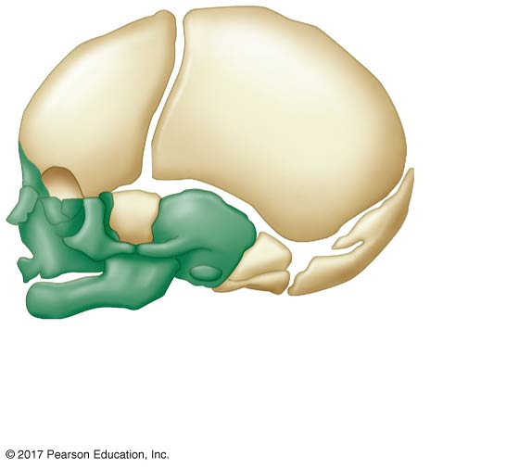
Figure 34.7b
(c) Neural crest cells give rise to anatomical structures unique to vertebrates.
Notes:
Figure 34.7b The neural crest, embryonic source of many unique vertebrate traits (part 2)

Slide 34
Hagfishes and Lampreys
Fossil evidence shows that the earliest vertebrates lacked jaws
Only two lineages of jawless vertebrates remain today: the hagfishes and the lampreys
Members of these groups lack a backbone
The presence of rudimentary vertebrae and the results of phylogenetic analysis indicate that both hagfishes and lampreys are vertebrates

Slide 35
Together, the hagfishes and lampreys form a clade of living jawless vertebrates, the cyclostomes
Vertebrates with jaws make up a much larger clade, the gnathostomes

Slide 36
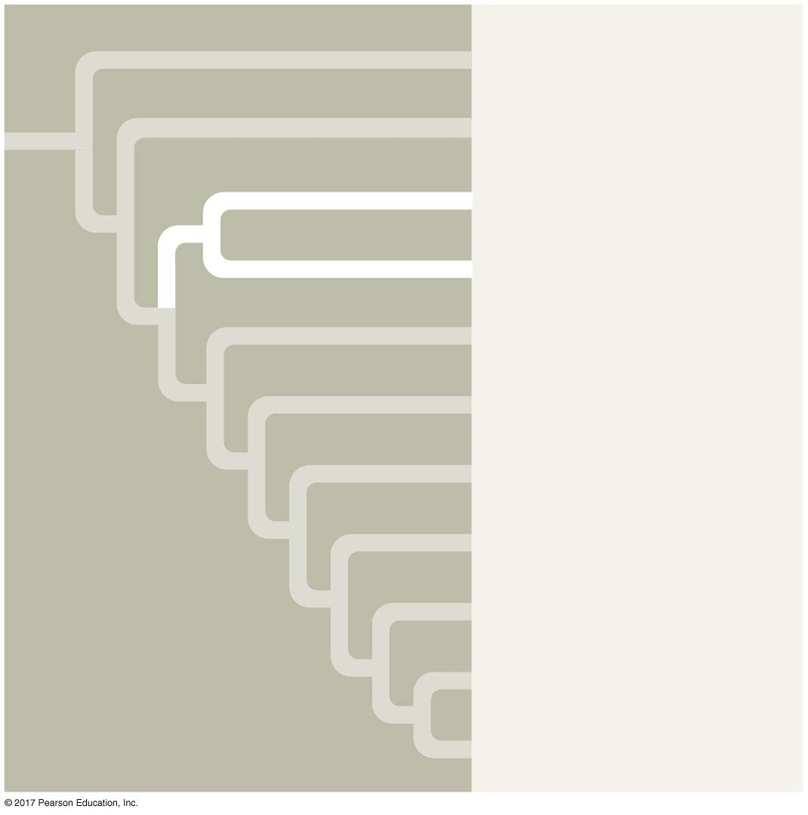
Figure 34.UN03
Cephalochordata
Urochordata
Myxini
Petromyzontida
Chondrichthyes
Actinopterygii
Actinistia
Dipnoi
Amphibia
Reptilia
Mammalia
Notes:
Figure 34.UN03 In-text figure, Myxini and Petromyzontida mini-tree, p. 721

Slide 37
Hagfishes
Hagfishes are jawless vertebrates that have a cartilaginous skull, reduced vertebrae, and a flexible rod of cartilage derived from the notochord
They have a small brain, eyes, ears, a nasal opening, and tooth-like formations in their mouths
All hagfishes are marine; most are bottom-dwelling scavengers
Hagfishes produce slime to repel competitors and predators

Slide 38
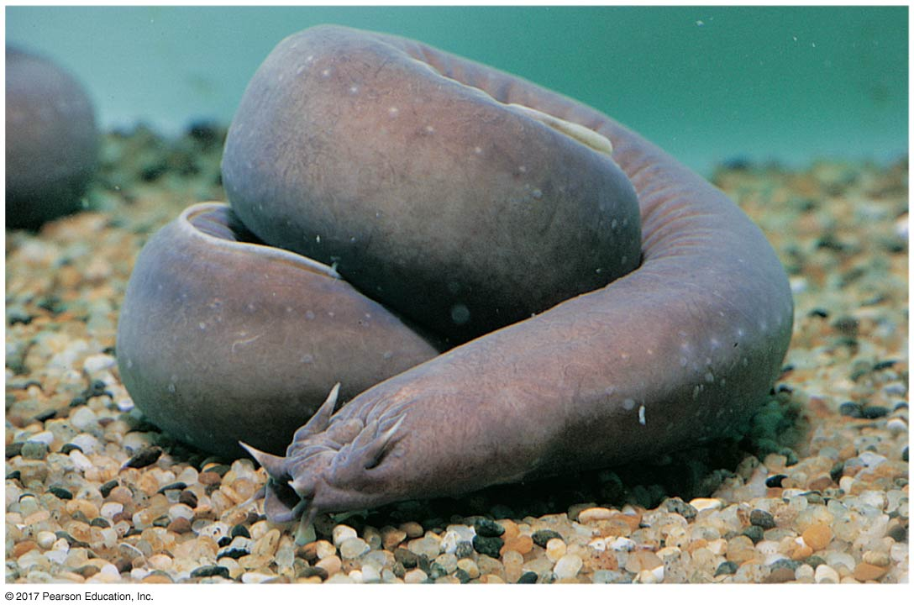
Figure 34.8
Slime
glands
Notes:
Figure 34.8 A hagfish

Slide 39
Lampreys
Lampreys are jawless vertebrates that inhabit various marine and freshwater habitats
Some are parasites that feed by clamping their mouths onto a live fish
Free-living species feed as larvae for several years and then mature, reproduce, and die within a few days
Lampreys have a notochord and cartilaginous skeleton

Slide 40
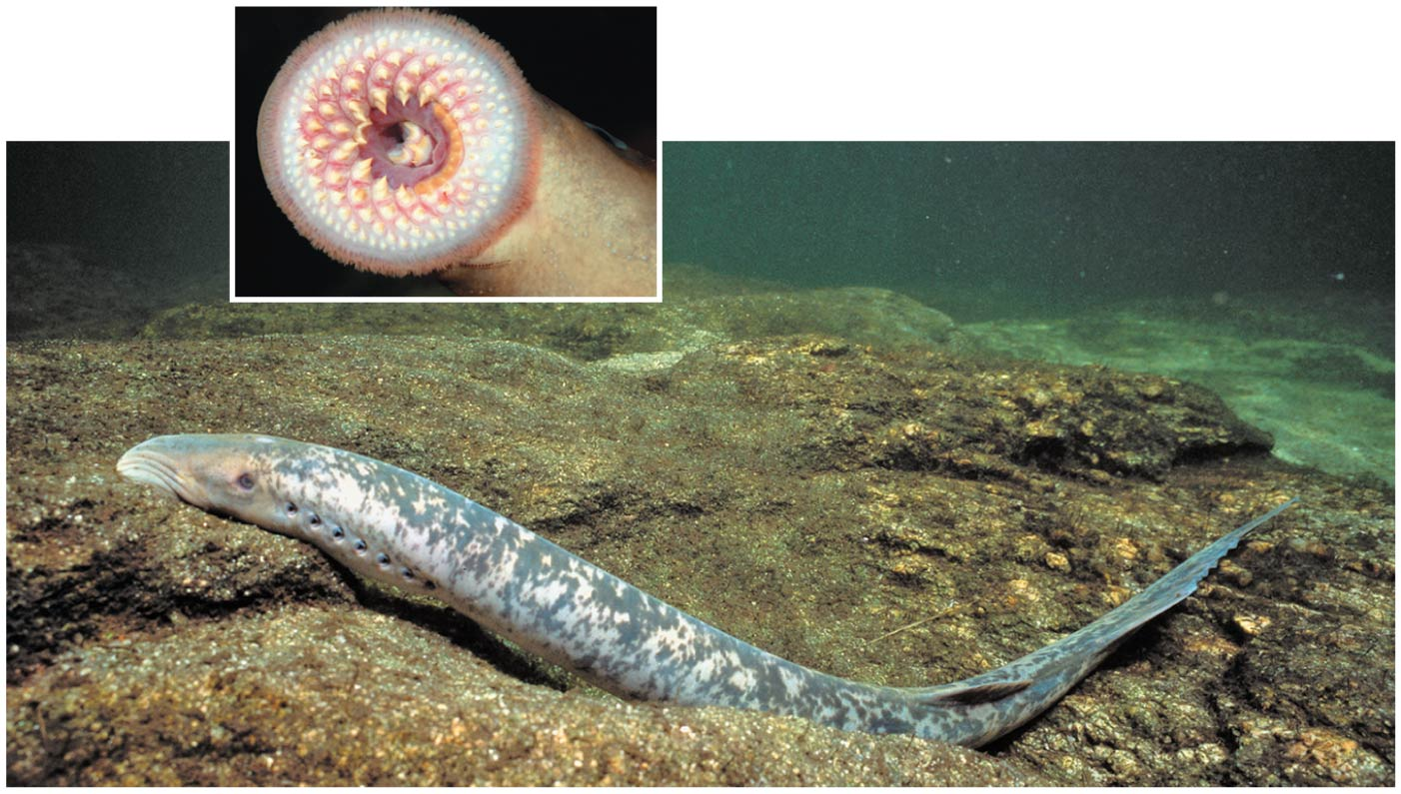
Figure 34.9
Notes:
Figure 34.9 A sea lamprey

Slide 41
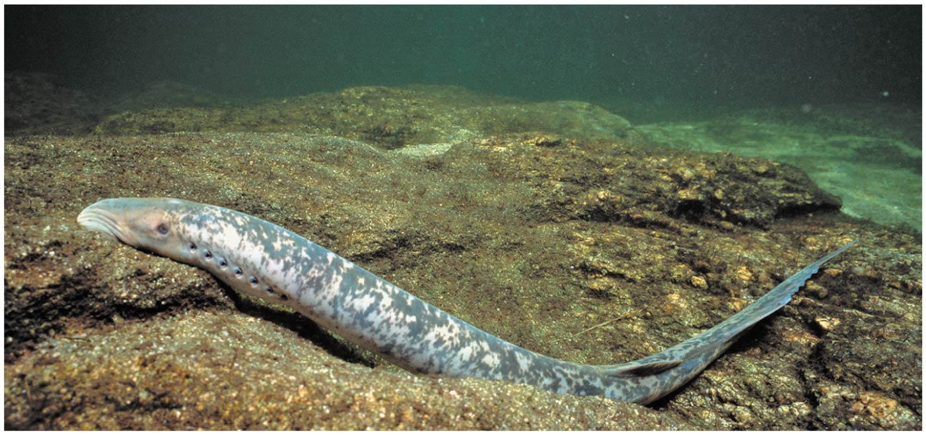
Figure 34.9a
Notes:
Figure 34.9a A sea lamprey (part 1: lamprey)

Slide 42
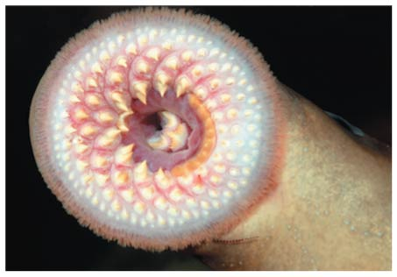
Figure 34.9b
Notes:
Figure 34.9b A sea lamprey (part 2: lamprey mouth)

Slide 43
Early Vertebrate Evolution
Fossils from the Cambrian explosion document the transition to craniates
The most primitive of the fossils are those of the 3-cm-long Haikouella
Haikouella resembled lancelets but had a well-formed brain, eyes, and muscular segments
Unlike vertebrates, Haikouella lacked a skull and ear organs

Slide 44
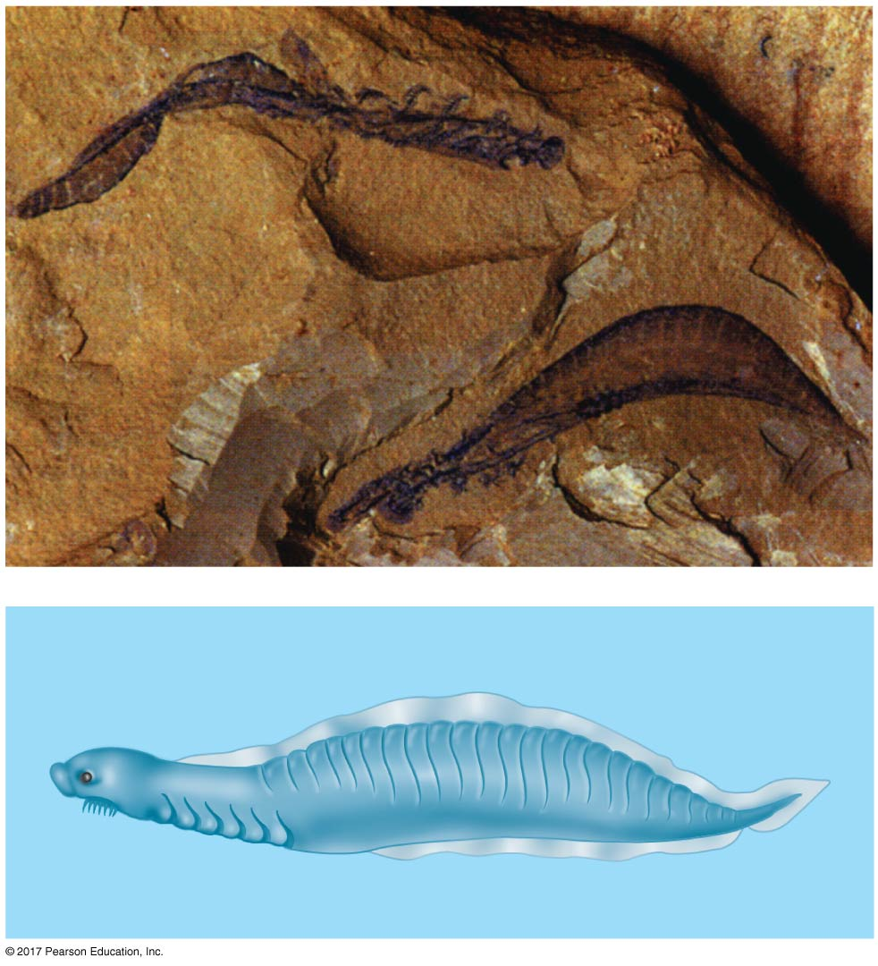
Figure 34.10
5 mm
Segmented muscles
Pharyngeal slits
Notes:
Figure 34.10 Fossil of an early chordate

Slide 45
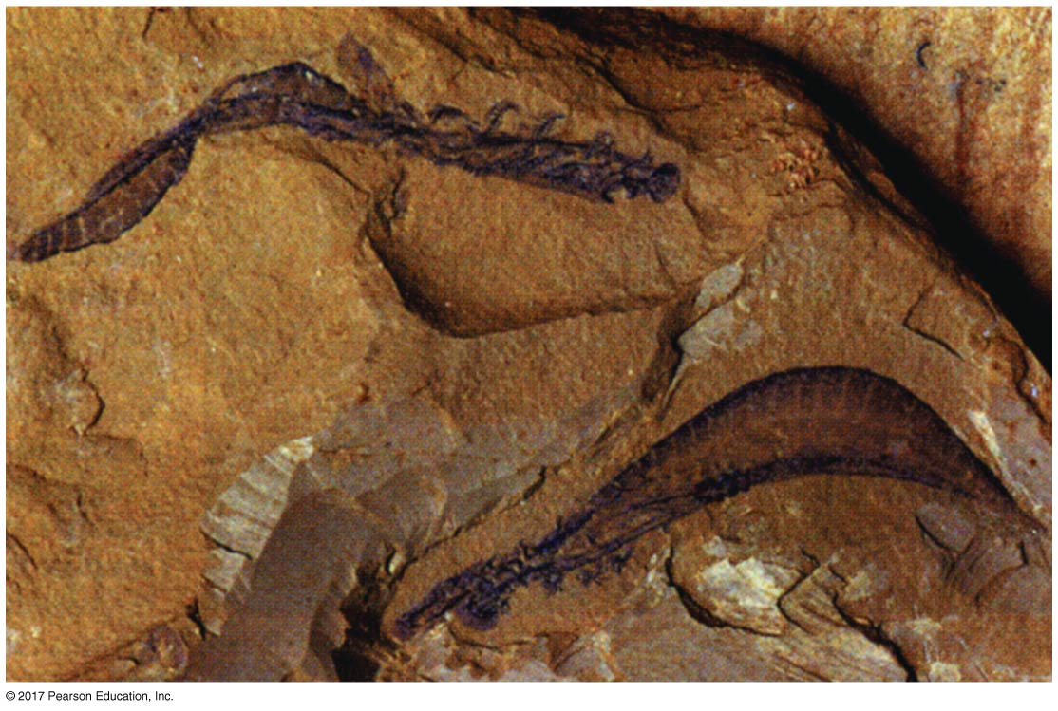
Figure 34.10a
5 mm
Notes:
Figure 34.10a Fossil of an early chordate (part 1: fossil)

Slide 46
Conodonts were among the earliest vertebrates in the fossil record, dating to 500 million years ago
They had a set of barbed hooks at the anterior end of the mouth used for capturing prey
These hooks, and another set of dental elements in the pharynx, were mineralized

Slide 47
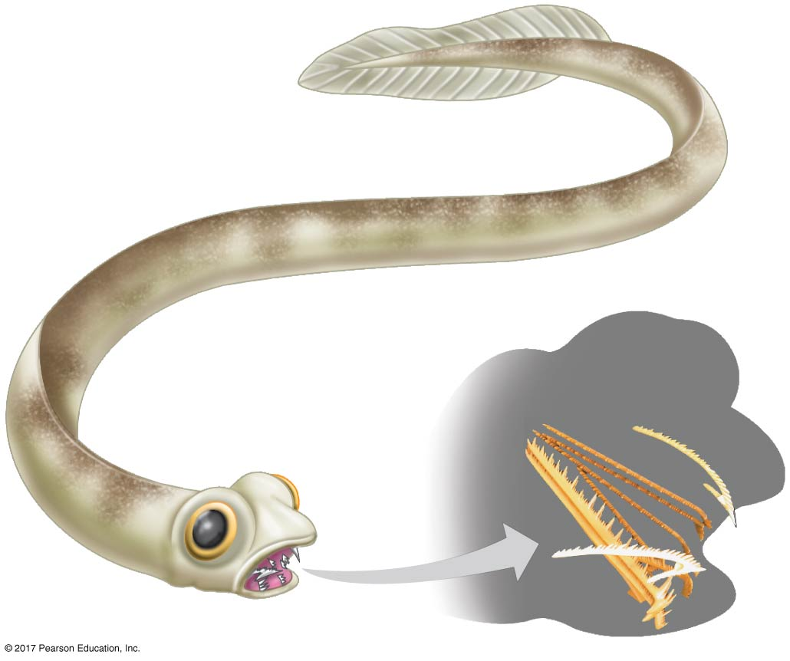
Figure 34.11
Dental elements
(within
head)
0.5 cm
Notes:
Figure 34.11 A conodont

Slide 48
Other jawless vertebrates had a muscular pharynx for sucking in food items
They were also armored with defensive plates of mineralized bone to protect them from predators
All of the jawless, armored vertebrates became extinct by the end of the Devonian

Slide 49
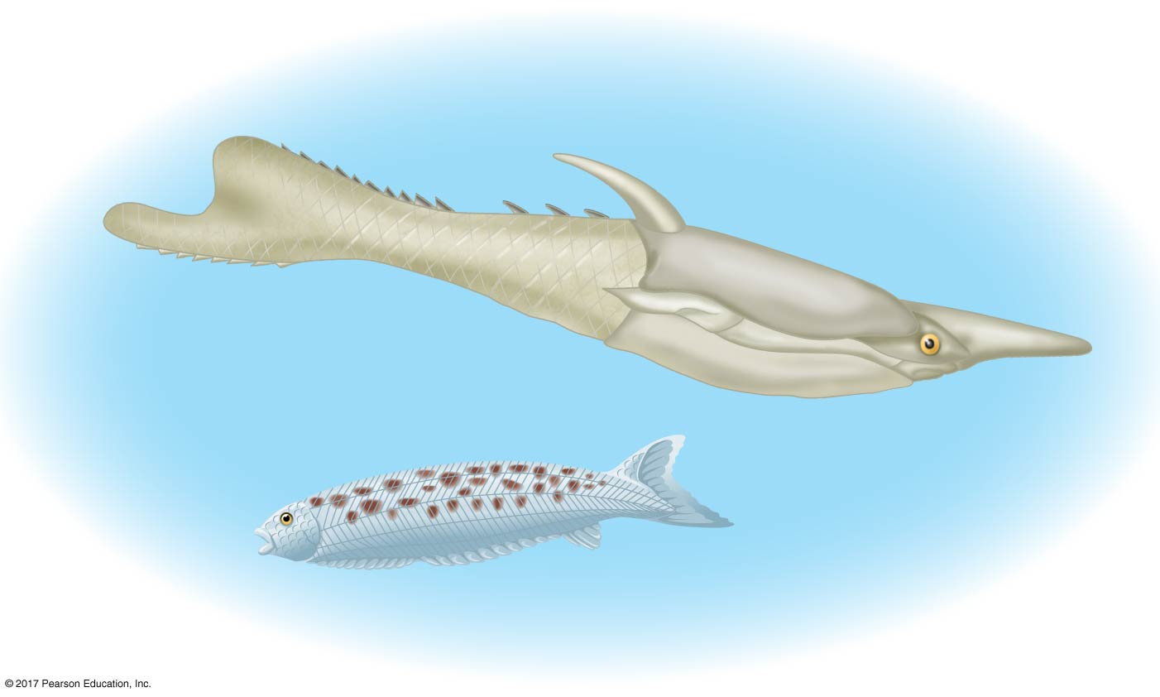
Figure 34.12
Pteraspis
Pharyngolepis
Notes:
Figure 34.12 Jawless armored vertebrates

Slide 50
The vertebrate skeleton evolved as a structure made of unmineralized cartilage
Mineralized bone first appeared on the outer surface of the skull in some jawless vertebrates 470 million years ago
Skeletons with a thin layer of bone lining the cartilage appeared by 430 million years ago

Slide 51
Concept 34.3: Gnathostomes are vertebrates that have jaws
Today, jawed vertebrates, or gnathostomes, outnumber jawless vertebrates
Gnathostomes include sharks and their relatives, ray-finned fishes, lobe-finned fishes, amphibians, reptiles (including birds), and mammals

Slide 52
Derived Characters of Gnathostomes
Gnathostomes (“jaw mouth”) have jaws (hinged structures) with teeth that are used to grip and slice food items
One hypothesis suggests that jaws evolved by modification of the skeletal rods that supported the pharyngeal (gill) slits

Slide 53
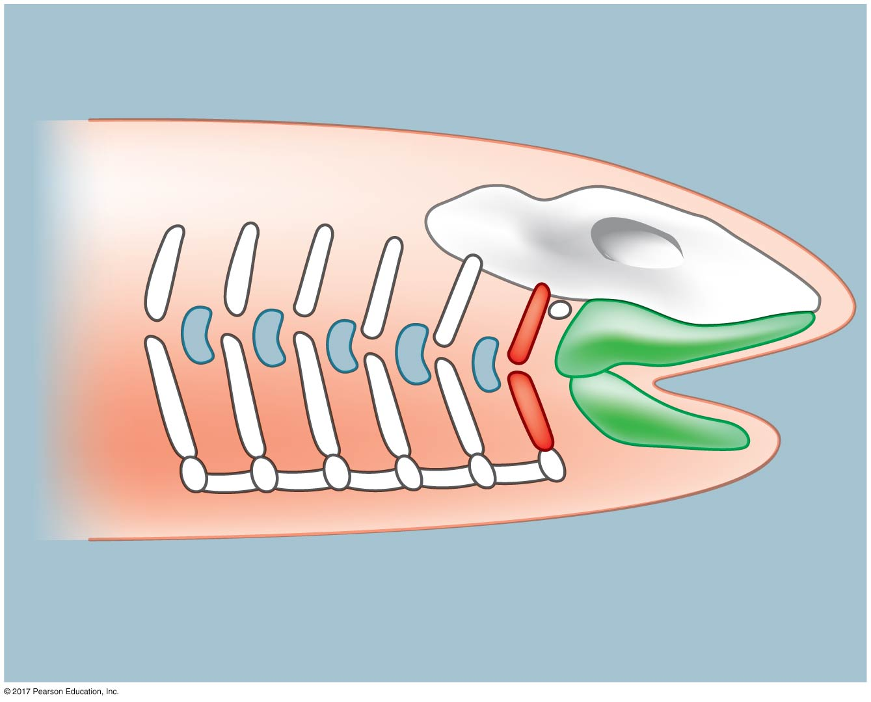
Figure 34.13
Gill slits
Cranium
Skeletal
rods
Modified
skeletal rods
Notes:
Figure 34.13 Possible step in the evolution of jawbones

Slide 54
Other characters common to gnathostomes
Genome duplication, including duplication of Hox genes
An enlarged forebrain associated with enhanced senses of smell and vision
The lateral line system, rows of organs sensitive to vibrations that are located along each side of the body of aquatic gnathostomes

Slide 55
Fossil Gnathostomes
The earliest gnathostomes appeared in the fossil record 440 million years ago
Over time, dorsal, ventral, and anal fins stiffened by bony structures called fin rays evolved
Fin rays provided thrust and steering control for pursuit of prey and avoidance of predators
The early gnathostomes included armored vertebrates called placoderms

Slide 56
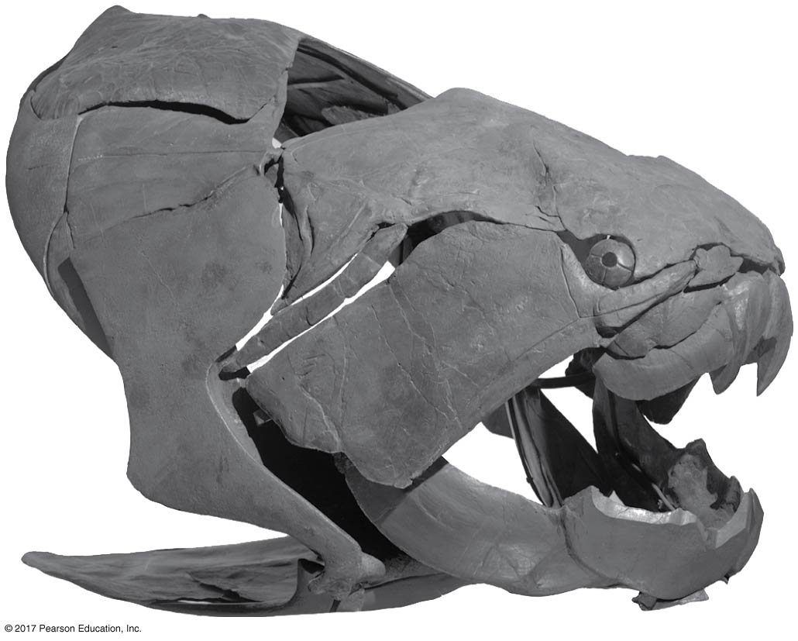
Figure 34.14
0.5 m
Notes:
Figure 34.14 Fossil of an early gnathostome

Slide 57
Another group of jawed vertebrates called acanthodians radiated during the Silurian and Devonian periods (444–359 million years ago)
Placoderms were extinct by 359 million years ago, followed by acanthodians about 70 million years later
The three surviving lineages of jawed vertebrates—chondrichthyans, ray-finned fishes, and lobe-fins—evolved by 420 million years ago.

Slide 58
Chondrichthyans (Sharks, Rays, and Their Relatives)
Chondrichthyans have a skeleton composed primarily of cartilage
The largest and most diverse group of chondrichthyans includes the sharks, rays, and skates
A second group is composed of a few dozen species of ratfishes, or chimaeras

Slide 59
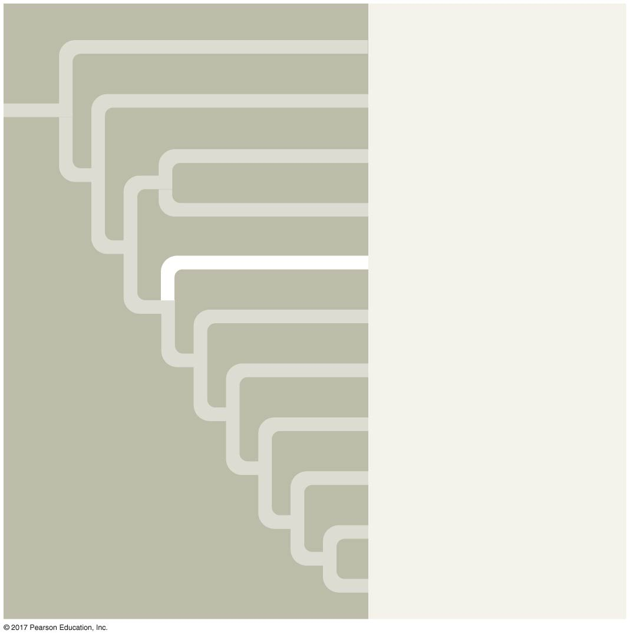
Figure 34.UN04
Cephalochordata
Urochordata
Myxini
Petromyzontida
Chondrichthyes
Actinopterygii
Actinistia
Dipnoi
Amphibia
Reptilia
Mammalia
Notes:
Figure 34.UN04 In-text figure, Chondrichthyes mini-tree, p. 724

Slide 60
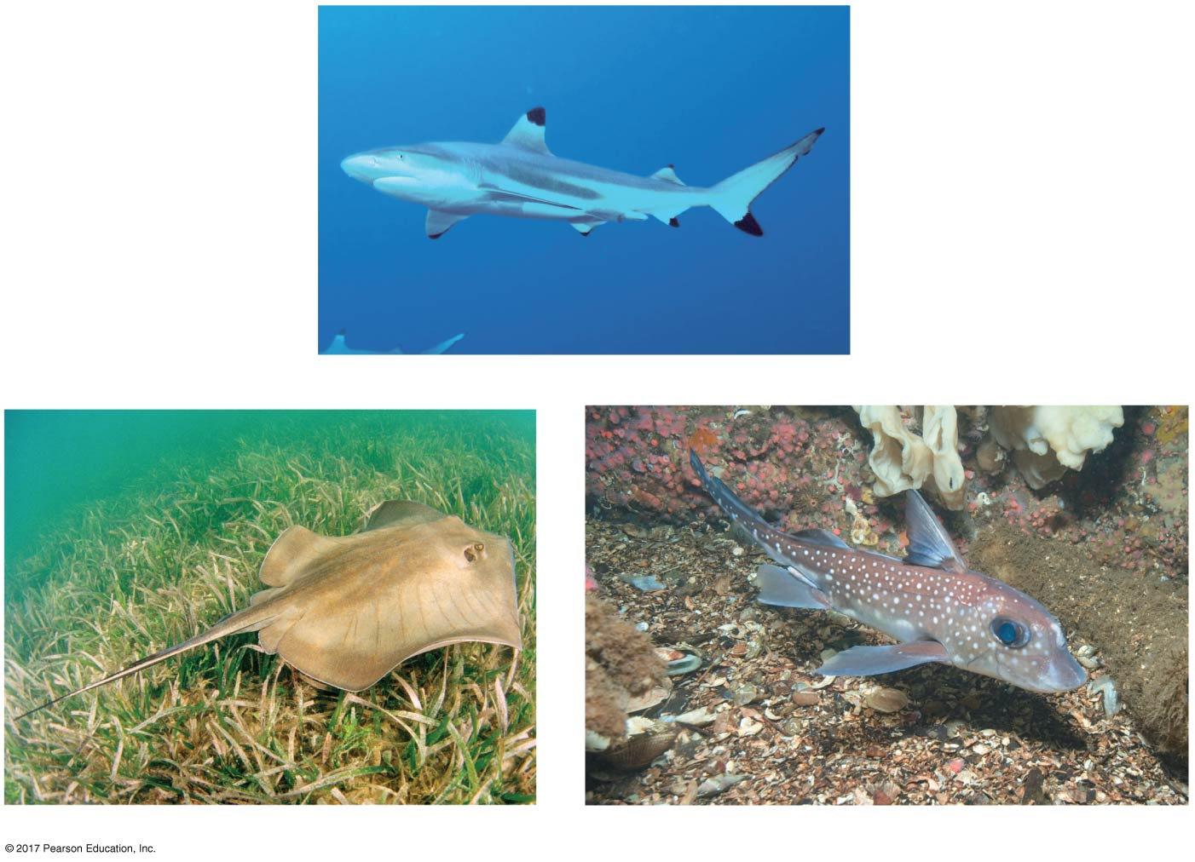
Figure 34.15
Dorsal fins
Pectoral fins
Pelvic fins
(a) Blacktip reef shark (Carcharhinus melanopterus)
(b) Southern stingray (Dasyatis americana)
(c) Spotted ratfish (Hydrolagus colliei)
Notes:
Figure 34.15 Chondrichthyans

Slide 61
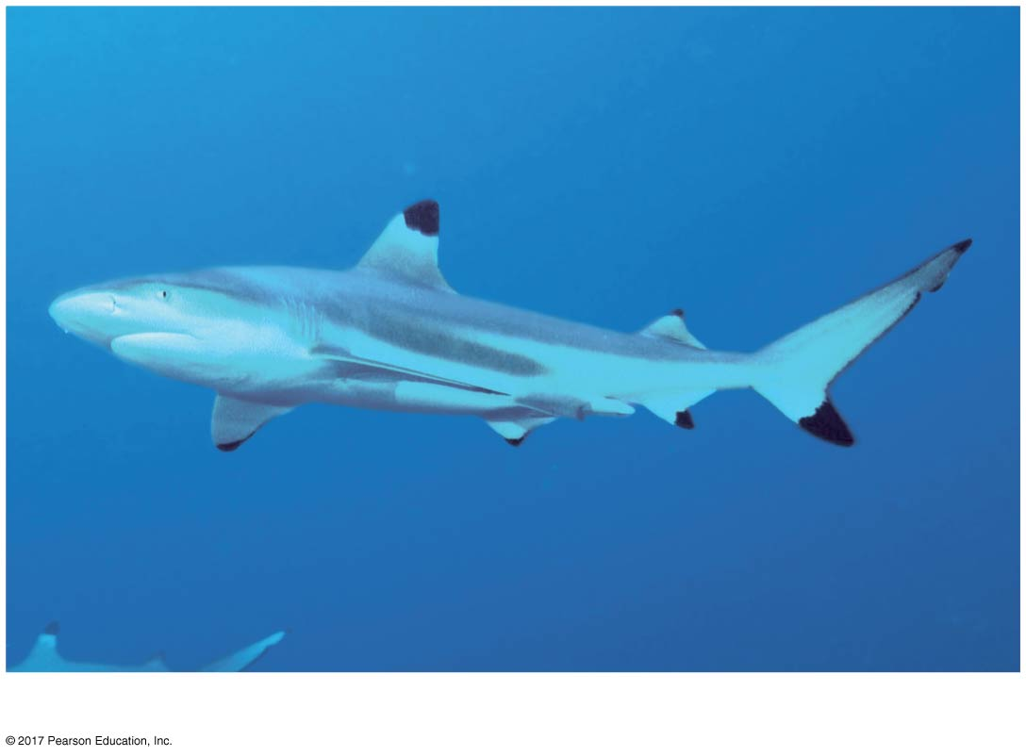
Figure 34.15a
Dorsal fins
Pectoral fins
Pelvic fins
(a) Blacktip reef shark (Carcharhinus melanopterus)
Notes:
Figure 34.15a Chondrichthyans (part 1: blacktip reef shark)

Slide 62
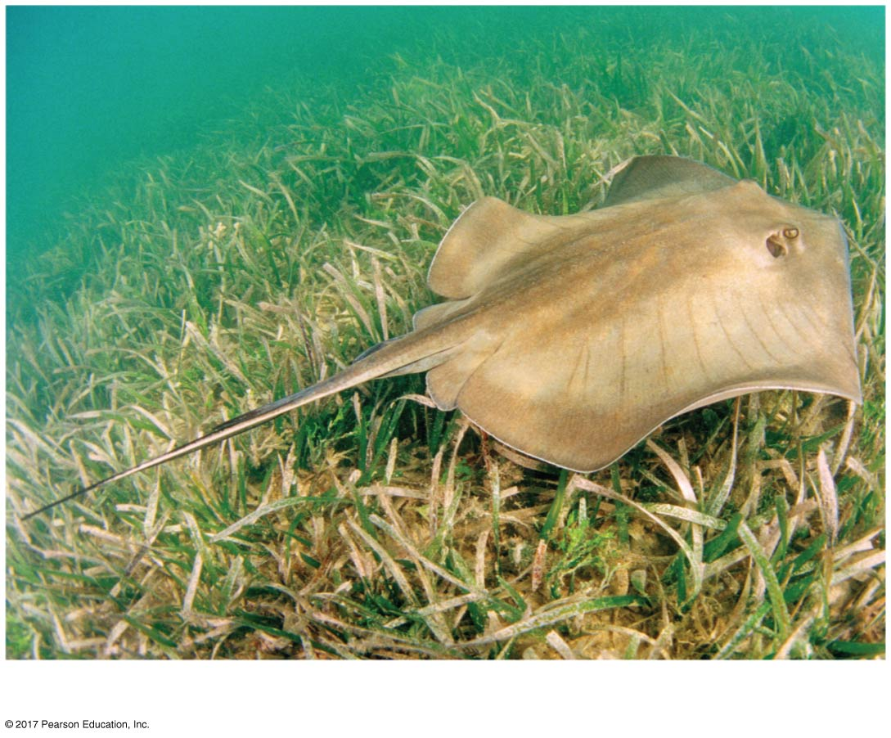
Figure 34.15b
(b) Southern stingray (Dasyatis americana)
Notes:
Figure 34.15b Chondrichthyans (part 2: Southern stingray)

Slide 63
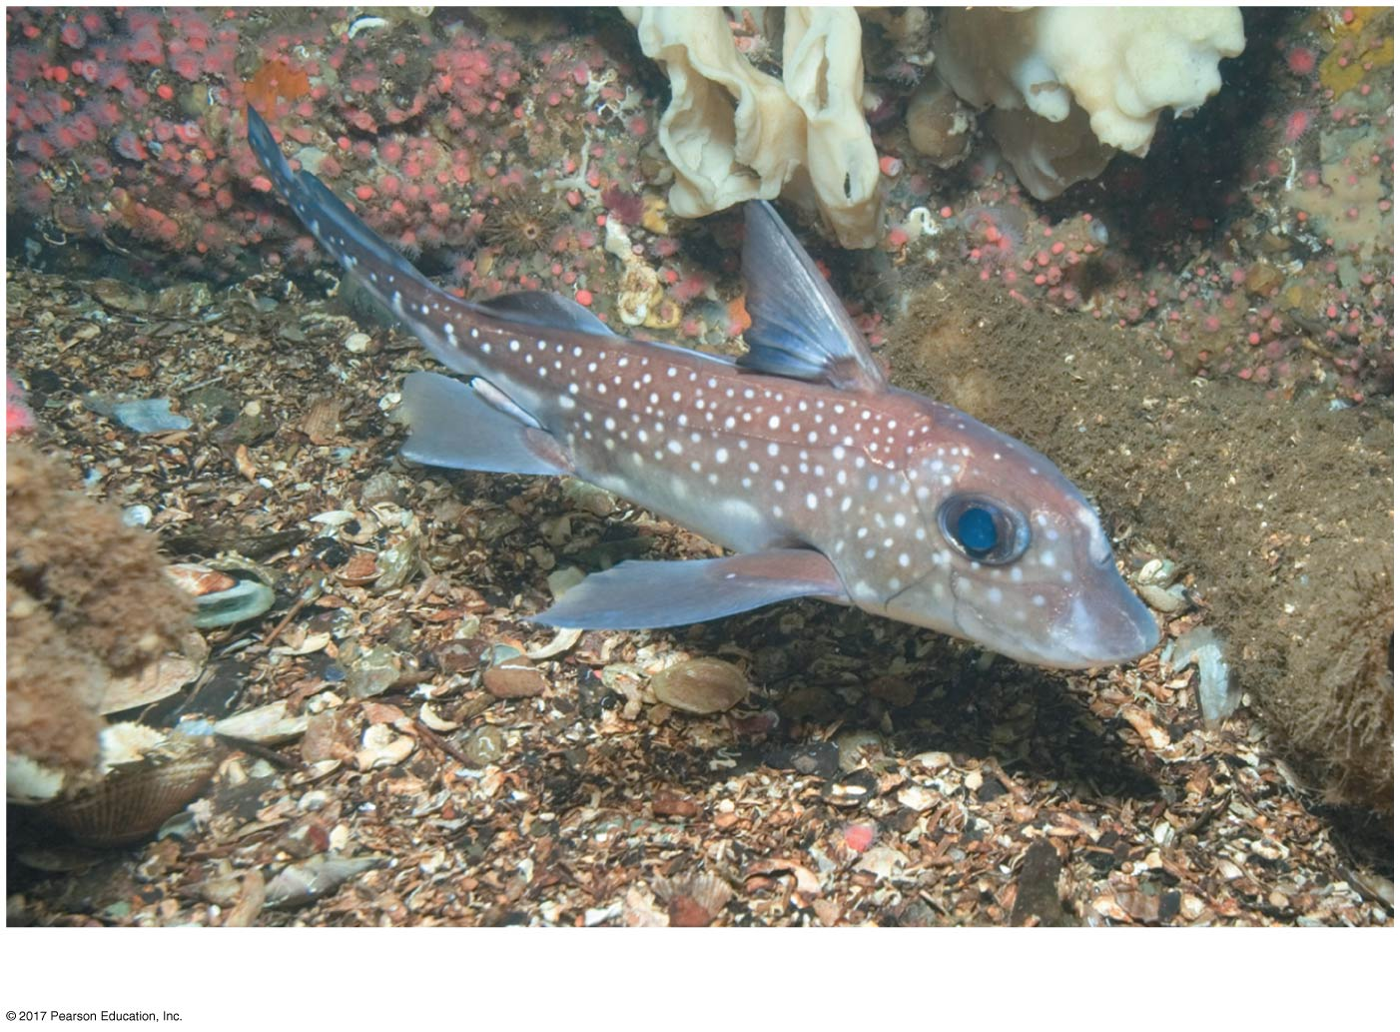
Figure 34.15c
(c) Spotted ratfish (Hydrolagus colliei)
Notes:
Figure 34.15c Chondrichthyans (part 3: spotted ratfish)

Slide 64
Video: Manta Ray

Slide 65
Sharks have a streamlined body and are swift swimmers
Dorsal fins function as stabilizers, and paired pectoral and pelvic fins are used for maneuvering
Continual swimming keeps sharks from sinking and maintains continuous flow of water over gills

Slide 66
The largest sharks are suspension feeders, but most are carnivores
Sharks have a short digestive tract with a spiral valve that increases surface area and slows the passage of food
Acute senses including sight, smell, and the ability to detect electrical fields from nearby animals are adaptations for their active carnivorous lifestyle

Slide 67
Shark eggs are fertilized internally, but embryos can develop in different ways
Oviparous: Eggs hatch outside the mother’s body
Ovoviviparous: Eggs are retained within the oviduct; young are born after hatching within the uterus
Viviparous: The embryo develops within the uterus and is nourished from the mother’s blood through a yolk sac placenta

Slide 68
The reproductive tract, excretory system, and digestive tract empty into the cloaca, a common chamber with an opening to the outside

Slide 69
Most rays are bottom-dwellers that feed on molluscs and crustaceans
They are flattened and have enlarged pectoral fins that function like water wings
Many have whiplike tails; in some species, the tail bears venomous barbs for defense

Slide 70
Chondrichthyans are severely threatened by overfishing
Shark populations in the Pacific have plummeted by up to 95%

Slide 71
Ray-Finned Fishes and Lobe-Fins
The vast majority of vertebrates are osteichthyans, nearly all of which have a bony endoskeleton
Osteichthyans include the bony fishes and tetrapods
Aquatic osteichthyans are the vertebrates we informally call fishes

Slide 72
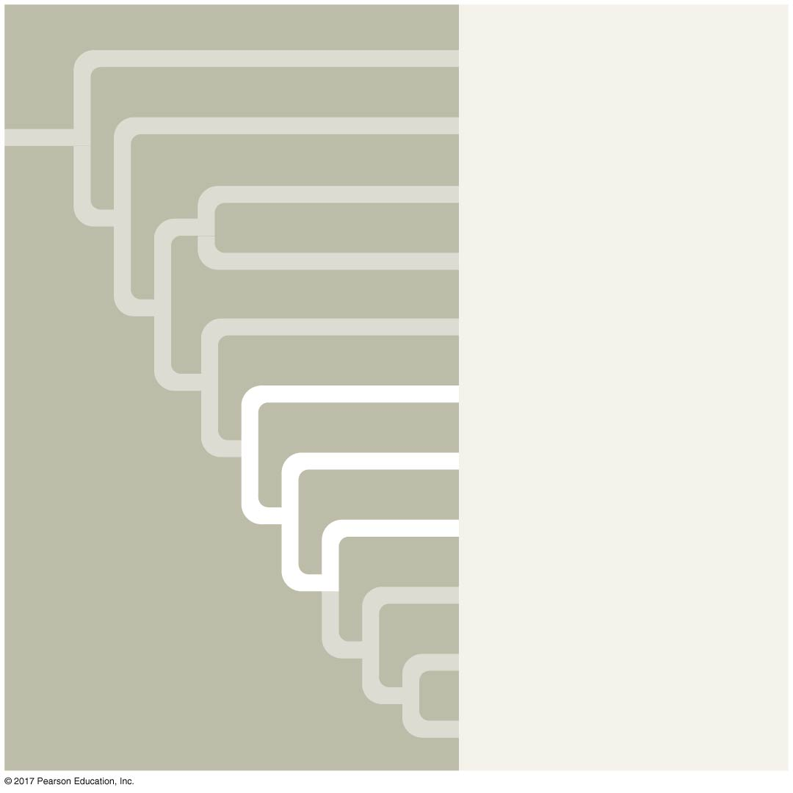
Figure 34.UN05
Cephalochordata
Urochordata
Myxini
Petromyzontida
Chondrichthyes
Actinopterygii
Actinistia
Dipnoi
Amphibia
Reptilia
Mammalia
Notes:
Figure 34.UN05 In-text figure, Actinopterygii, Actinistia, and Dipnoi mini-tree, p. 726

Slide 73
Most fishes breathe by drawing water over gills protected by an operculum
Fishes control their buoyancy with an air sac known as a swim bladder
The skin secretes mucus and is covered by flattened, bony scales in most fishes
Fishes have a lateral line system
Most species are oviparous, but some have internal fertilization and birthing

Slide 74
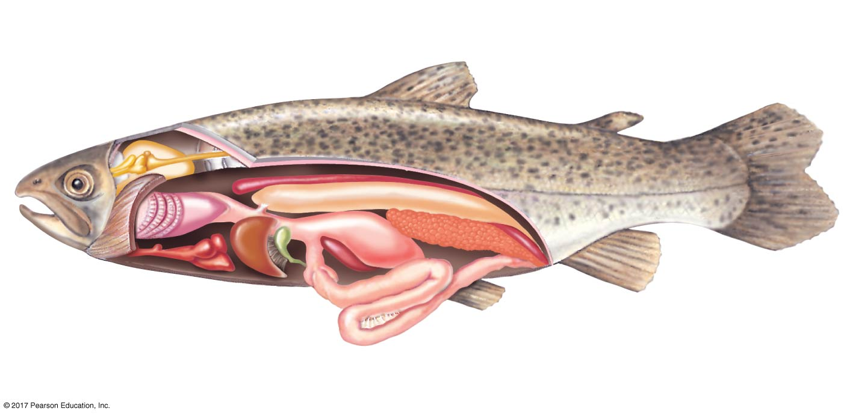
Figure 34.16
Swim
bladder
Dorsal fin
Adipose fin
(characteristic
of trout)
Kidney
Caudal
fin
Spinal cord
Brain
Nostril
Cut edge
of operculum
Anal fin
Heart
Liver
Lateral
line
Anus
Stomach
Gonad
Gills
Pelvic
fin
Urinary
bladder
Intestine
Notes:
Figure 34.16 Anatomy of a trout, a ray-finned fish

Slide 75
Ray-Finned Fishes
The ray-finned fishes (Actinopterygii) include nearly all the familiar aquatic osteichthyans
Ray-finned fishes originated during the Silurian period (444–419 million years ago)
The fins, supported mainly by long, flexible rays, are modified for maneuvering, defense, and other functions

Slide 76
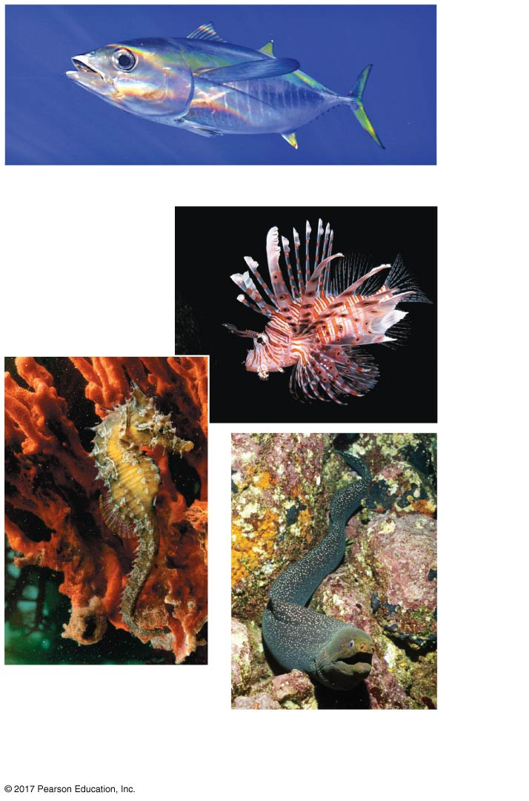
Figure 34.17
Yellowfin tuna (Thunnus albacares)
Red lionfish
(Pterois
volitans)
Common sea
horse
(Hippocampus
ramulosus)
Fine-spotted moray eel
(Gymnothorax dovii)
Notes:
Figure 34.17 Ray-finned fishes (Actinopterygii)

Slide 77
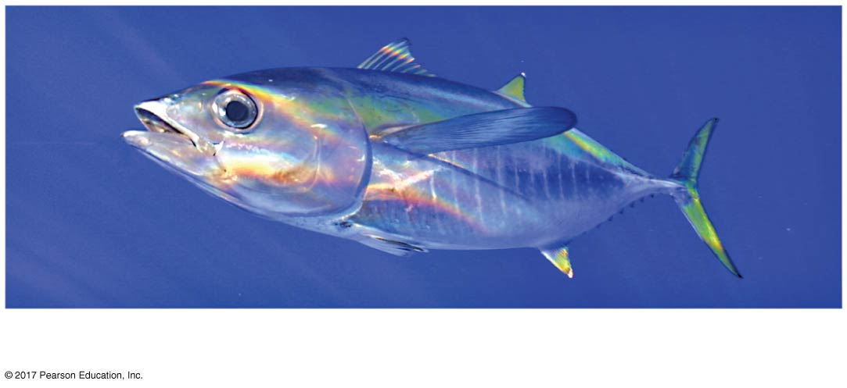
Figure 34.17a
Yellowfin tuna (Thunnus albacares)
Notes:
Figure 34.17a Ray-finned fishes (Actinopterygii) (part 1: yellowfin tuna)

Slide 78
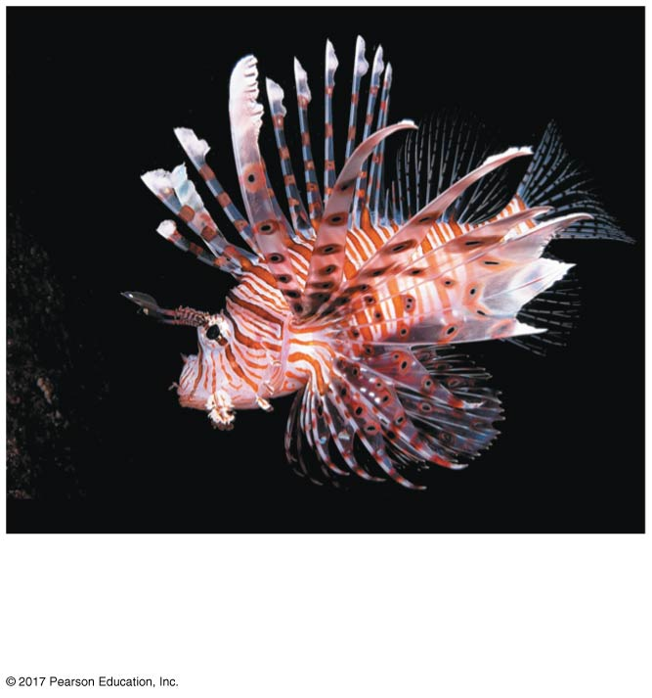
Figure 34.17b
Red lionfish
(Pterois volitans)
Notes:
Figure 34.17b Ray-finned fishes (Actinopterygii) (part 2: red lionfish)

Slide 79
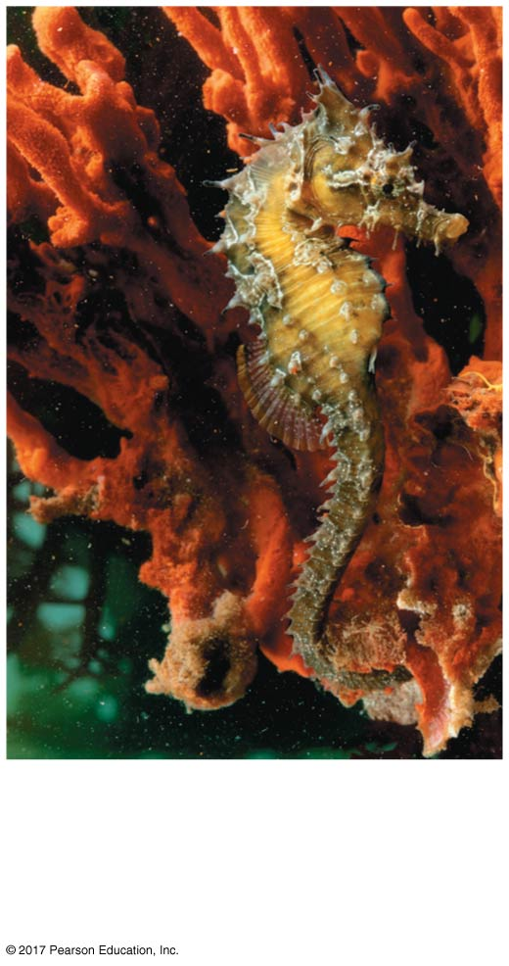
Figure 34.17c
Common sea horse
(Hippocampus
ramulosus)
Notes:
Figure 34.17c Ray-finned fishes (Actinopterygii) (part 3: common sea horse)

Slide 80
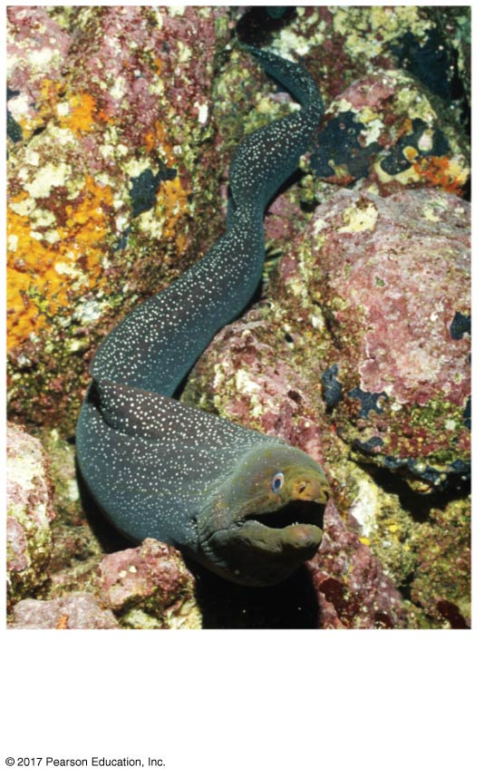
Figure 34.17d
Fine-spotted moray eel
(Gymnothorax dovii)
Notes:
Figure 34.17d Ray-finned fishes (Actinopterygii) (part 4: fine-spotted moray eel)

Slide 81
Video: Clownfish and Anemone

Slide 82
Video: Coral Reef

Slide 83
Video: Seahorse Camouflage

Slide 84
Humans have harvested ray-finned fishes for thousands of years, but industrial-scale fishing has driven many fisheries to collapse
Ray-finned fishes are also negatively impacted by dams that change water flow patterns, affecting prey capture, migration, and spawning

Slide 85
Lobe-Fins
The lobe-fins (Sarcopterygii) also originated in the Silurian period
They have rod-shaped bones surrounded by a thick layer of muscle in their pelvic and pectoral fins
The lobed fins may have been used by ancient species to maneuver across the substrate of aquatic habitats (as seen in some living species)

Slide 86
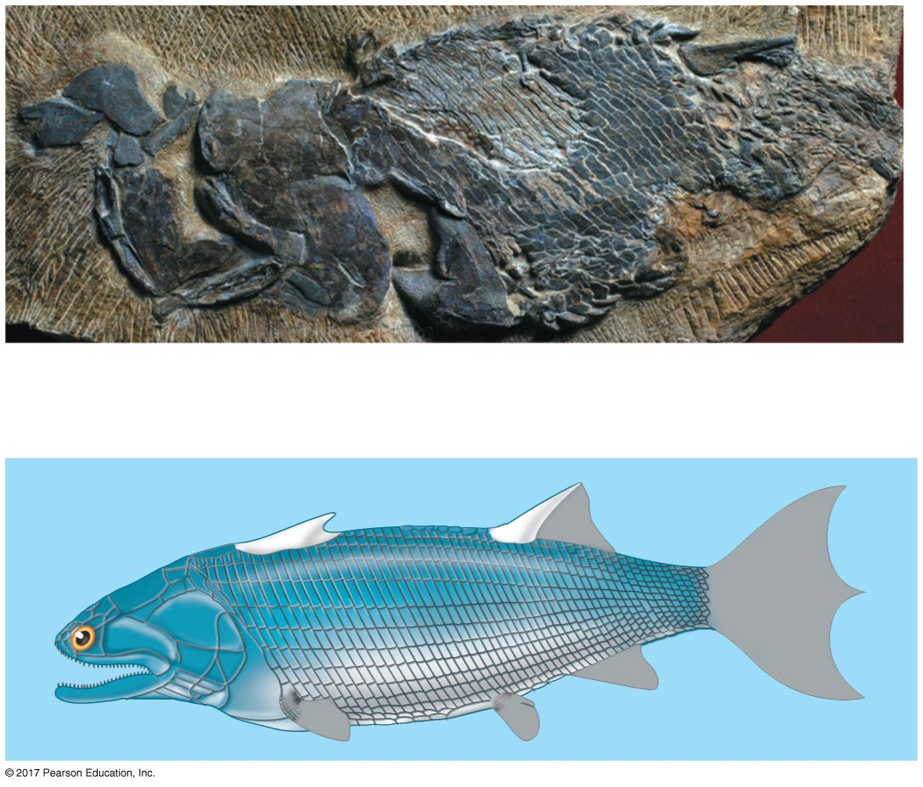
Figure 34.18
5 cm
Lower
jaw
Scaly
covering
Dorsal
spine
Notes:
Figure 34.18 A reconstruction of an ancient lobe-fin

Slide 87
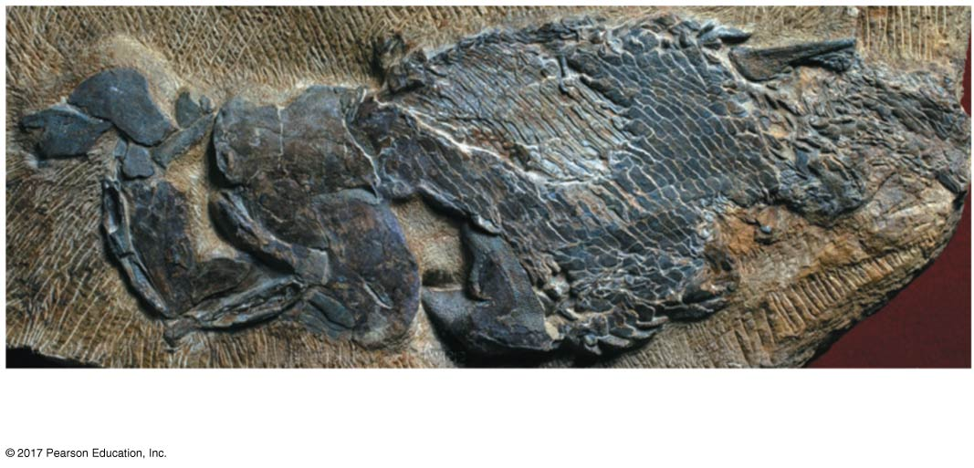
Figure 34.18a
5 cm
Lower jaw
Scaly covering
Dorsal spine
Notes:
Figure 34.18a A reconstruction of an ancient lobe-fin (part 1: fossil)

Slide 88
Three lineages survive and include coelacanths (Actinistia), lungfishes (Dipnoi), and tetrapods
Coelacanths were thought to have become extinct 75 million years ago, but a living coelacanth was caught off the coast of South Africa in 1938

Slide 89
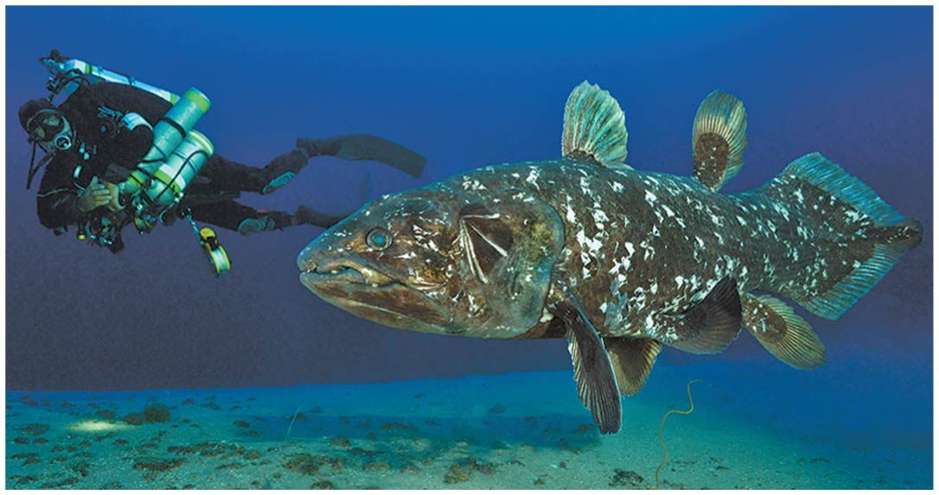
Figure 34.19
Notes:
Figure 34.19 A coelacanth (Latimeria)

Slide 90
The living lungfishes are all found in the Southern Hemisphere
Though gills are the main organs for gas exchange, they can also surface to gulp air into their lungs
The third surviving lineage of lobe-fins is tetrapods, a group that adapted to life on land

Slide 91
Concept 34.4: Tetrapods are gnathostomes that have limbs
One of the most significant events in vertebrate history was when the fins of some lobe-fins evolved into the limbs and feet of tetrapods
Tetrapods diversified greatly following the colonization of land

Slide 92
Derived Characters of Tetrapods
Tetrapods have some specific adaptations
Four limbs and feet with digits
A neck, which allows separate movement of the head
Fusion of the pelvic girdle to the backbone
The absence of gills (except some aquatic species)
Ears for detecting airborne sounds

Slide 93
The Origin of Tetrapods
Tiktaalik, nicknamed a “fishapod,” shows both fish and tetrapod characteristics
Traits it shares with fish include fins, gills, lungs, and scales

Slide 94
Traits shared with tetrapods but not fish include
Ribs to breathe air and support its body
A neck and shoulders, allowing movement of the head
Front fins with the bone pattern of a tetrapod limb
Pelvis and rear fin that are larger and more robust than those found in fish

Slide 95
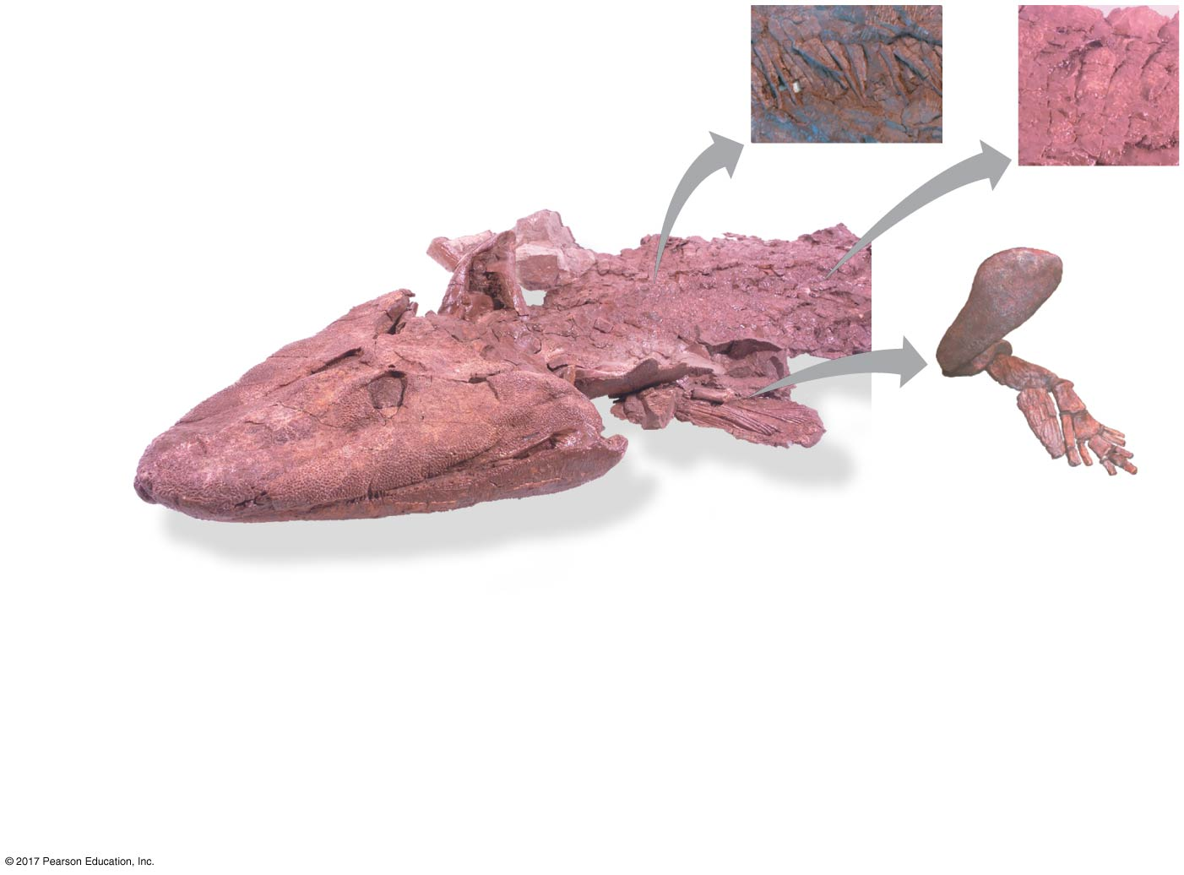
Figure 34.20
Shoulder bones
Ribs
Neck
Scales
Head
Eyes on top of skull
Humerus
Flat skull
“Wrist”
Elbow
Ulna
Radius
Fin
Fin skeleton
Fish
Characters
Tetrapod
Characters
Scales
Neck
Fins
Ribs
Gills and lungs
Fin skeleton
Flat skull
Eyes on top of skull
Notes:
Figure 34.20 Discovery of a “fishapod”: Tiktaalik

Slide 96
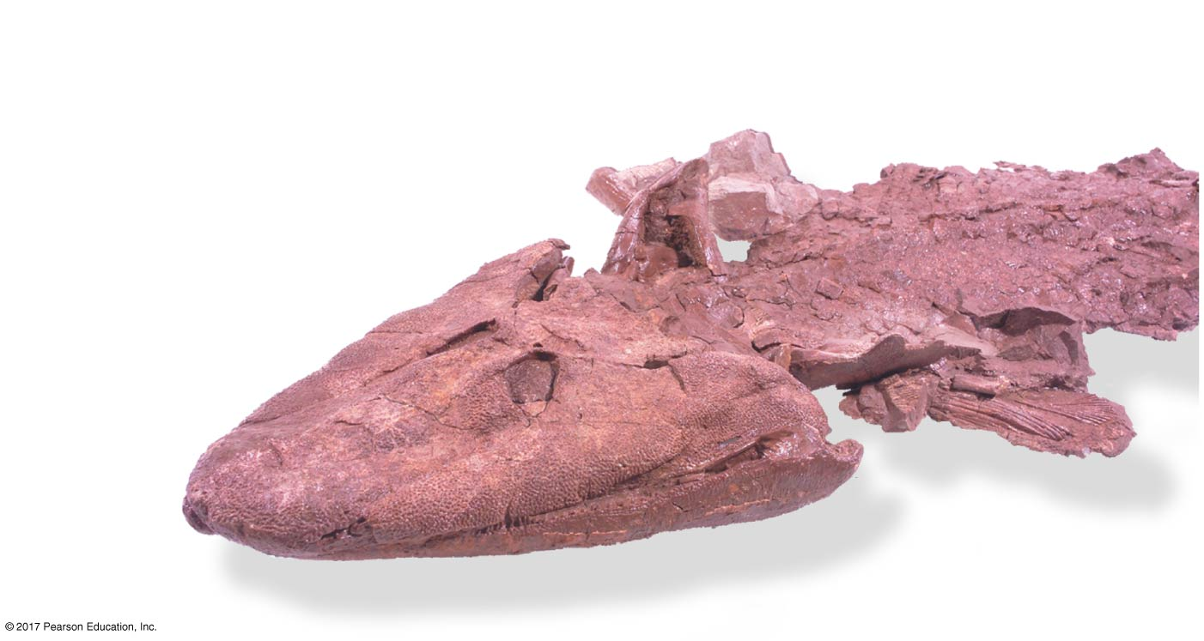
Figure 34.20a
Shoulder bones
Neck
Head
Eyes on top of skull
Flat skull
Fin
Notes:
Figure 34.20a Discovery of a “fishapod”: Tiktaalik (part 1: detail)

Slide 97
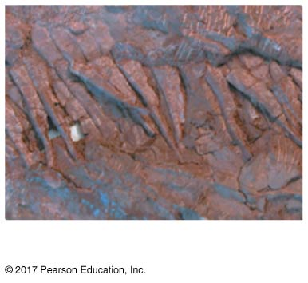
Figure 34.20b
Ribs
Notes:
Figure 34.20b Discovery of a “fishapod”: Tiktaalik (part 2: ribs)

Slide 98
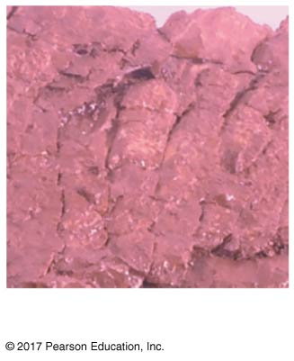
Figure 34.20c
Scales
Notes:
Figure 34.20c Discovery of a “fishapod”: Tiktaalik (part 3: scales)

Slide 99
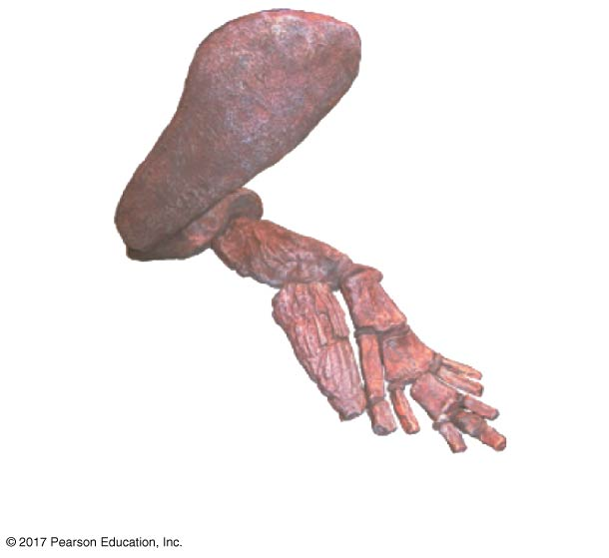
Figure 34.20d
Humerus
Ulna
“Wrist”
Elbow
Radius
Fin skeleton
Notes:
Figure 34.20d Discovery of a “fishapod”: Tiktaalik (part 4: fin skeleton)

Slide 100
Tiktaalik could most likely prop itself on its fins and walk in water, but it is unlikely that it walked on land
Fossils like Tiktaalik have allowed paleontologists to reconstruct the evolution of the tetrapod limb
The first tetrapods appeared 365 million years ago and diversified rapidly over the following 60 million years

Slide 101
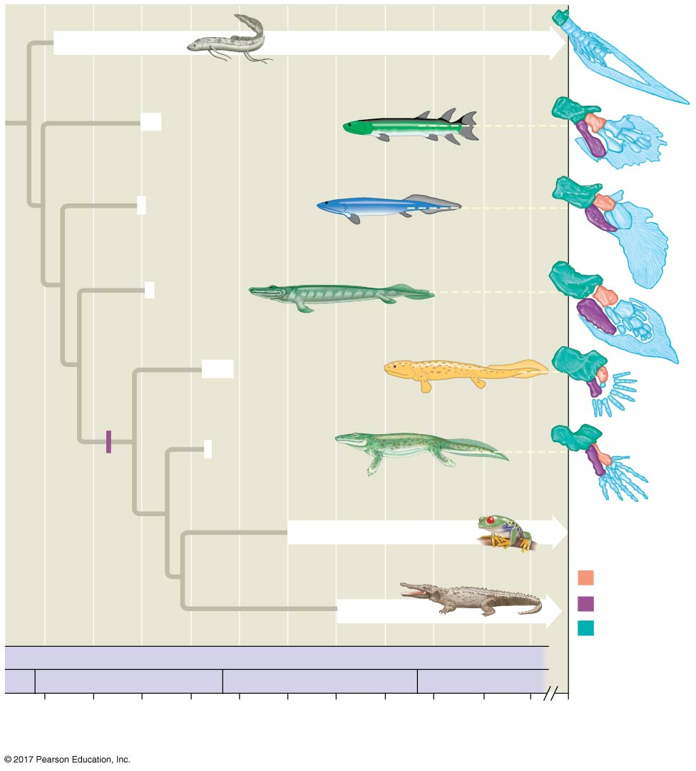
Figure 34.21
Lungfishes
Eusthenopteron
Panderichthys
Tiktaalik
Acanthostega
Limbs
with digits
Tulerpeton
Amphibians
Ulna
Amniotes
Radius
Humerus
Silurian
PALEOZOIC
Devonian
Carboniferous
Permian
415
400
385
370
355
340
325
310
295
280
265
0
Time (millions of years ago)
Notes:
Figure 34.21 Steps in the origin of limbs with digits

Slide 102
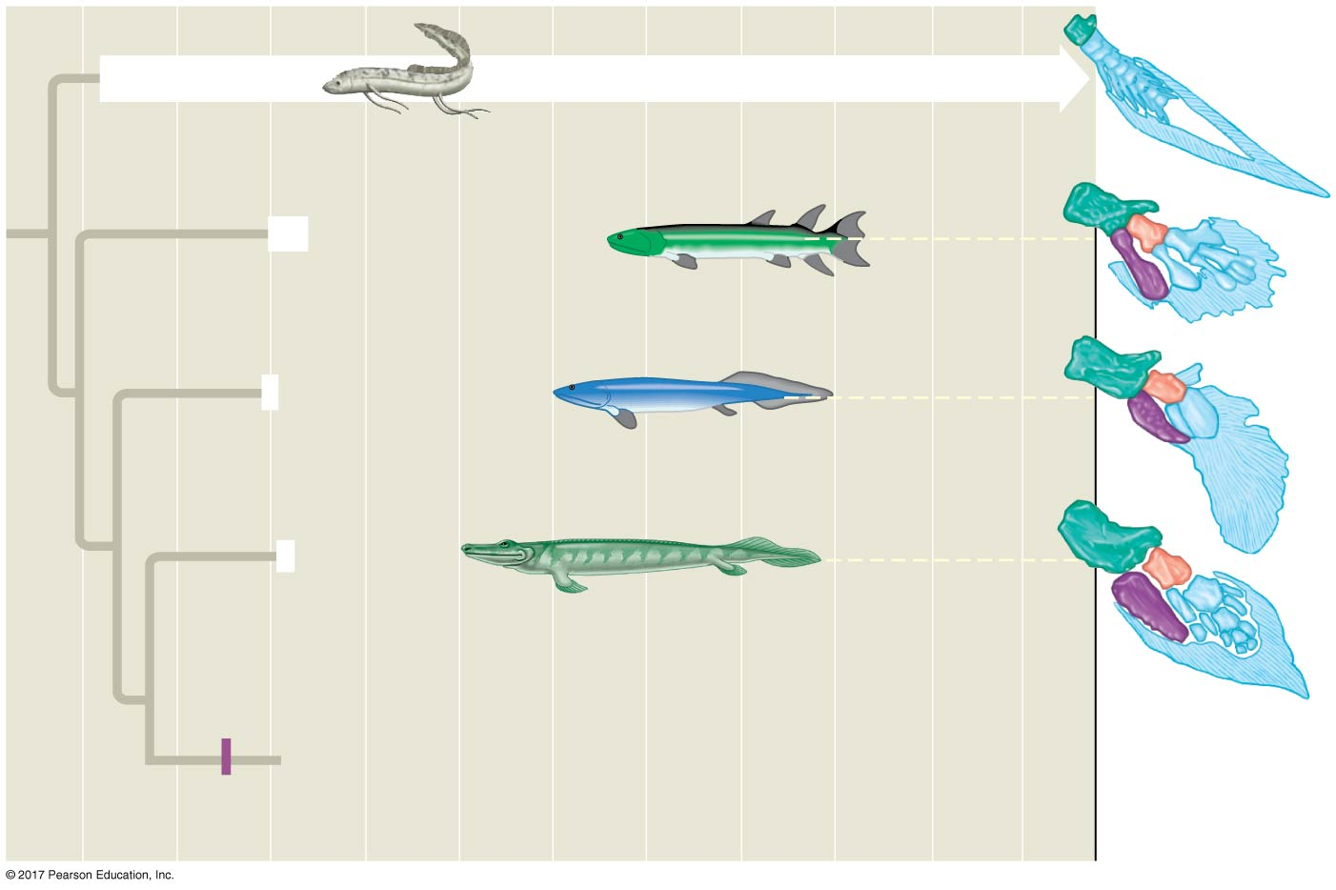
Figure 34.21a
Lungfishes
Eusthenopteron
Panderichthys
Tiktaalik
Ulna
Limbs
with digits
Radius
Humerus
Notes:
Figure 34.21a Steps in the origin of limbs with digits (part 1: limbs without digits)

Slide 103
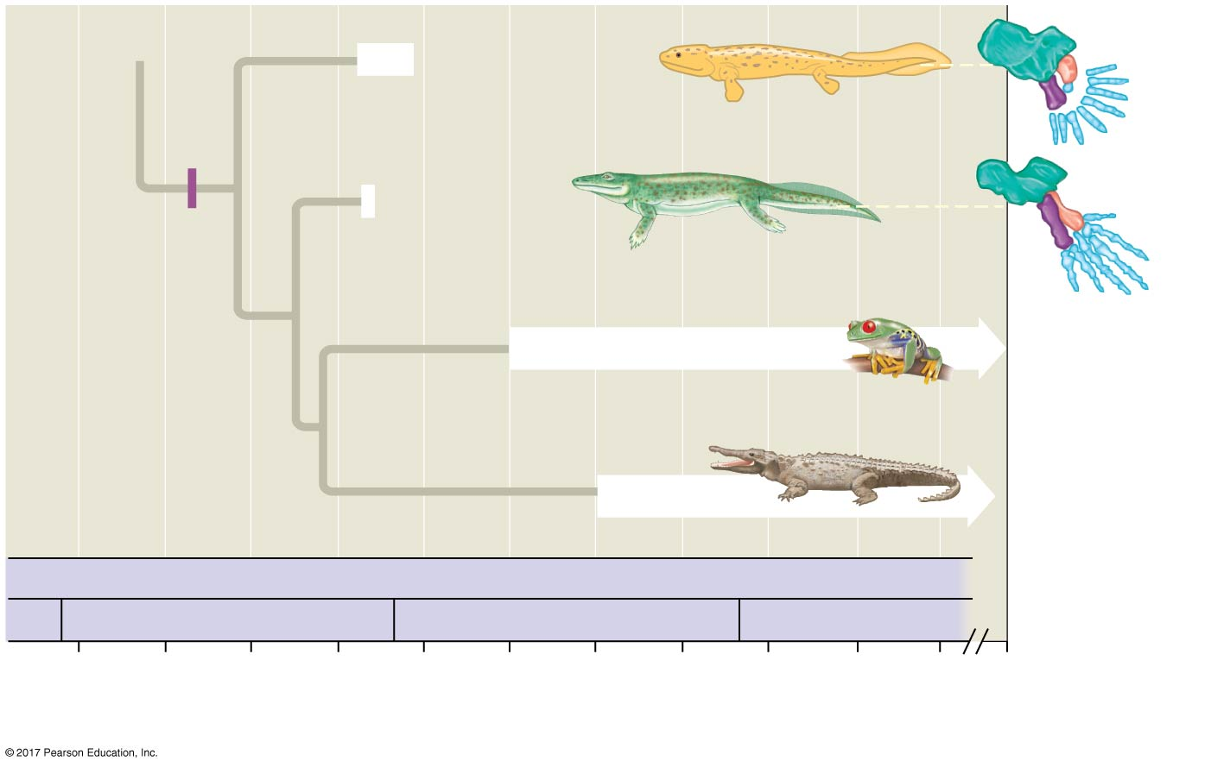
Figure 34.21b
Acanthostega
Tulerpeton
Limbs
with digits
Amphibians
Ulna
Amniotes
Radius
Humerus
Silurian
PALEOZOIC
Devonian
Carboniferous
Permian
415
400
385
370
355
340
325
310
295
280
265
0
Time (millions of years ago)
Notes:
Figure 34.21b Steps in the origin of limbs with digits (part 2: limbs with digits)

Slide 104
Amphibians
Amphibians (class Amphibia) are represented by about 6,150 species in three clades
Salamanders (Urodela, “tailed ones”)
Frogs (Anura, “tail-less ones”)
Caecilians (Apoda, “legless ones”)

Slide 105
Figure 34.UN06
Cephalochordata
Urochordata
Myxini
Petromyzontida
Chondrichthyes
Actinopterygii
Actinistia
Dipnoi
Amphibia
Reptilia
Mammalia
Notes:
Figure 34.UN06 In-text figure, Amphibia mini-tree, p. 729

Slide 106
Salamanders
Salamanders (Urodela) are amphibians with tails
Some are aquatic, but others live on land as adults or throughout life
Paedomorphosis, the retention of juvenile features in sexually mature organisms, is common in aquatic salamanders

Slide 107
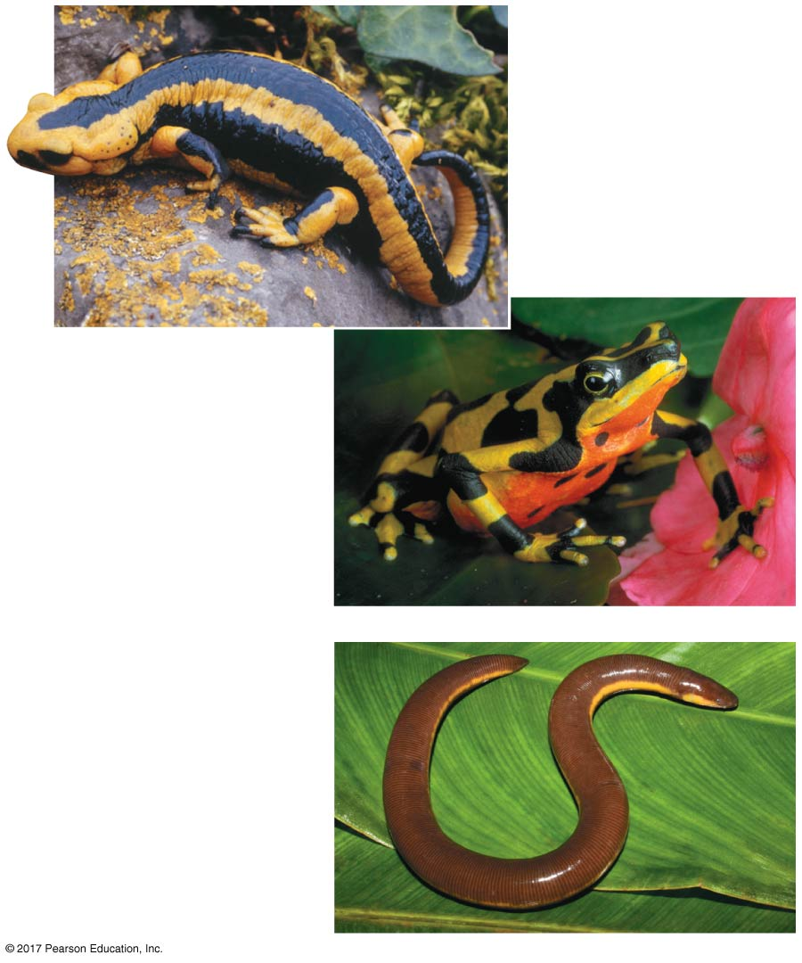
Figure 34.22
(a) Order Urodela
(b) Order Anura
(c) Order Apoda
Notes:
Figure 34.22 Amphibians

Slide 108
Figure 34.22a
(a) Order Urodela
Notes:
Figure 34.22a Amphibians (part 1: salamanders)

Slide 109
Frogs
Frogs (Anura) lack tails and have powerful hind legs for locomotion on land
Frogs with leathery skin are called “toads”

Slide 110
Figure 34.22b
(b) Order Anura
Notes:
Figure 34.22b Amphibians (part 2: toads and frogs)

Slide 111
Caecilians
Caecilians (Apoda) are legless, are nearly blind, and resemble earthworms
The absence of legs is a secondary adaptation

Slide 112
Figure 34.22c
(c) Order Apoda
Notes:
Figure 34.22c Amphibians (caecilians)

Slide 113
Lifestyle and Ecology of Amphibians
Amphibian means “both ways of life,” referring to the metamorphosis of an aquatic larva into a terrestrial adult
For example, the larval stage of a frog (tadpole) is an aquatic herbivore with gills, a lateral line system, and a long, finned tail
During metamorphosis, the tadpole develops legs, lungs, a pair of external eardrums, and a carnivorous digestive system

Slide 114
Figure 34.23
(a) The tadpole
(b) During metamorphosis
(c) The adults return to water to mate
Notes:
Figure 34.23 The “dual life” of a frog (Rana temporaria)

Slide 115
Figure 34.23a
(a) The tadpole
Notes:
Figure 34.23a The “dual life” of a frog (Rana temporaria) (part 1: tadpole)

Slide 116
Figure 34.23b
(b) During metamorphosis
Notes:
Figure 34.23b The “dual life” of a frog (Rana temporaria) (part 2: metamorphosis)

Slide 117
Figure 34.23c
(c) The adults return to water to mate
Notes:
Figure 34.23c The “dual life” of a frog (Rana temporaria) (part 3: mating adults)

Slide 118
Some amphibians are strictly aquatic or strictly terrestrial, but most are found in damp habitats
Most amphibians have moist skin that complements the lungs in gas exchange

Slide 119
Fertilization is external in most species, and the eggs require a moist environment
In some species, males or females care for the eggs on their back, in their mouth, or in their stomach

Slide 120
Figure 34.24
Notes:
Figure 34.24 A mobile nursery

Slide 121
Amphibian populations have been declining in recent decades
The causes include a disease-causing chytrid fungus, habitat loss, climate change, and pollution
At least 9 amphibian species have become extinct in the past 40 years; more than 100 others have not been observed and may be extinct

Slide 122
Concept 34.5: Amniotes are tetrapods that have a terrestrially adapted egg
Amniotes are a group of tetrapods whose living members are the reptiles, including birds, and mammals

Slide 123
Figure 34.25
Turtles
Archosaurs
Crocodilians
†Pterosaurs
† Ornithischian dinosaurs
Dinosaurs
Saurischians
† Saurischian dinosaurs other than birds
Diapsids
Common
ancestor
of reptiles
Birds
†Plesiosaurs
ANCESTRAL
AMNIOTE
†Ichthyosaurs
Lepidosaurs
Tuataras
Squamates
(lizards and
snakes)
Synapsids
Mammals
Notes:
Figure 34.25 A phylogeny of amniotes

Slide 124
Figure 34.25a
Turtles
Archosaurs
Crocodilians
†Pterosaurs
† Ornithischian dinosaurs
Dinosaurs
Saurischians
† Saurischian dinosaurs other than birds
Diapsids
Common
ancestor
of reptiles
Birds
ANCESTRAL
AMNIOTE
Notes:
Figure 34.25a A phylogeny of amniotes (part 1: diapsids)

Slide 125
Figure 34.25b
Diapsids
Common
ancestor
of reptiles
†Plesiosaurs
ANCESTRAL
AMNIOTE
†Ichthyosaurs
Lepidosaurs
Tuataras
Squamates
(lizards and
snakes)
Synapsids
Mammals
Notes:
Figure 34.25b A phylogeny of amniotes (part 2: synapsids)

Slide 126
Derived Characters of Amniotes
Amniotes are named for the major derived character of the clade, the amniotic egg, which contains membranes that protect the embryo
The extraembryonic membranes are the amnion, chorion, yolk sac, and allantois
The amnion encloses the embryo in a fluid-filled sac that reduces the dependence of tetrapods on an aqueous environment for reproduction

Slide 127
Figure 34.26
Extraembryonic membranes
Allantois
Chorion
Embryo
Amniotic cavity
with amniotic
fluid
Yolk
(nutrients)
Albumen
Shell
Amnion
Yolk sac
Extraembryonic membranes
Notes:
Figure 34.26 The amniotic egg

Slide 128
The amniotic egg was a key adaptation to life on land
The amniotic eggs of most reptiles and some mammals have a shell
Amniotes have other terrestrial adaptations, such as relatively impermeable skin and the ability to use the rib cage to ventilate the lungs

Slide 129
Early Amniotes
Living amphibians and amniotes split from a common ancestor about 350 million years ago
Early amniotes lived in warm, moist areas, but expanded into more diverse environments over time
The earliest amniotes resembled small, predacious lizards with sharp teeth
Later groups included herbivores

Slide 130
Figure 34.27
Notes:
Figure 34.27 Artist’s reconstruction of Hylonomus, an early amniote

Slide 131
Reptiles
The reptile clade includes the tuataras, lizards, snakes, turtles, crocodilians, birds, and some extinct groups
Reptiles have scales that create a waterproof barrier
Most reptiles lay shelled eggs on land
Fertilization occurs internally, before the eggshell is secreted

Slide 132
Figure 34.UN08
Cephalochordata
Urochordata
Myxini
Petromyzontida
Chondrichthyes
Actinopterygii
Actinistia
Dipnoi
Amphibia
Reptilia
Mammalia
Notes:
Figure 34.UN08 In-text figure, Reptilia mini-tree, p. 733

Slide 133
Figure 34.28
Notes:
Figure 34.28 Hatching reptiles

Slide 134
Most reptiles are ectothermic, absorbing external heat as the main source of body heat
Ectotherms regulate their body temperature through behavioral adaptations
Birds are endothermic, capable of maintaining body temperature through metabolism

Slide 135
The Origin and Evolutionary Radiation of Reptiles
Fossil evidence indicates that the earliest reptiles lived about 310 million years ago and resembled lizards
Like all living reptiles, early reptiles were diapsids
A key derived character of diapsids is a pair of holes on each side of the skull behind the eye sockets through which muscles pass to attach to the jaw

Slide 136
The diapsids are composed of two main lineages: the lepidosaurs and the archosaurs
The lepidosaurs include tuataras, lizards, snakes, and extinct mososaurs
The archosaur lineage produced the turtles, crocodilians, pterosaurs, and dinosaurs

Slide 137
Pterosaurs were the first tetrapods to exhibit flapping flight
Pterosaurs went extinct by 66 million years ago
The dinosaurs diversified into a vast range of shapes and sizes
They included herbivores with diverse adaptations for defense and bipedal carnivores called theropods, which included the ancestors to birds

Slide 138
Fossil discoveries and research have led to the conclusion that many dinosaurs were agile and fast moving
Paleontologists have also discovered signs of parental care among dinosaurs
Some anatomical evidence supports the hypothesis that at least some dinosaurs were endotherms

Slide 139
Dinosaurs, with the exception of birds, became extinct by the end of the Cretaceous (66 million years ago)
Their extinction may have been partly caused by an asteroid

Slide 140
Lepidosaurs
One surviving lineage of lepidosaurs is represented by two species of lizard-like reptiles called tuataras
Living tuataras are restricted to small islands off the coast of New Zealand
They are threatened by introduced rats, which consume their eggs

Slide 141
Figure 34.29
(a) Tuatara (Sphenodon punctatus)
(c) Wagler’s pit viper (Tropidolaemus wagleri)
(b) Australian thorny devil lizard (Moloch horridus)
(d) Black-breasted hill turtle (Geomyda spengleri)
(e) American alligator (Alligator mississippiensis)
Notes:
Figure 34.29 Extant reptiles (other than birds)

Slide 142
Figure 34.29a
(a) Tuatara (Sphenodon punctatus)
Notes:
Figure 34.29a Extant reptiles (other than birds) (part 1: tuatara)

Slide 143
The other major living lineage of lepidosaurs consists of the squamates, the lizards and snakes
Squamates range in size from the tiny Jaragua lizard at 16 mm long to the Komodo dragon at 3 m long

Slide 144
Figure 34.29b
(b) Australian thorny devil lizard (Moloch horridus)
Notes:
Figure 34.29b Extant reptiles (other than birds) (part 2: Australian thorny devil lizard)

Slide 145
Video: Galápagos Marine Iguana

Slide 146
Snakes are legless lepidosaurs that evolved from lizards with legs
Snakes are carnivorous and have adaptations to aid in capture and consumption of prey, including
Chemical sensors
Heat-detecting organs
Venom
Loosely articulated jawbones and elastic skin

Slide 147
Figure 34.29c
(c) Wagler’s pit viper (Tropidolaemus wagleri)
Notes:
Figure 34.29c Extant reptiles (other than birds) (part 3: Wagler’s pit viper)

Slide 148
Video: Snake Ritual Wrestling

Slide 149
Turtles
Turtles have several distinctive traits including the lack of holes in the skull behind the eye socket
New fossil evidence indicates that turtles once had, but lost, the skull holes over the course of evolution
All turtles have a boxlike shell made of upper and lower shields that are fused to the vertebrae, clavicles, and ribs

Slide 150
Figure 34.29d
(d) Black-breasted hill turtle (Geomyda spengleri)
Notes:
Figure 34.29d Extant reptiles (other than birds) (part 4: black-breasted hill turtle)

Slide 151
Video: Galápagos Tortoise

Slide 152
Some turtles have adapted to deserts and others live entirely in ponds and rivers
The largest turtles live in the sea
Many species of sea turtles are endangered by accidental capture in fishing nets or development of beaches where they lay eggs

Slide 153
Crocodilians
Crocodilians (alligators and crocodiles) belong to an archosaur lineage that dates back to the late Triassic
Living crocodilians are restricted to warm regions

Slide 154
Figure 34.29e
(e) American alligator (Alligator mississippiensis)
Notes:
Figure 34.29e Extant reptiles (other than birds) (part 5: American alligator)

Slide 155
Birds
Birds are archosaurs, but almost every feature of their reptilian anatomy has undergone modification in their adaptation to flight

Slide 156
Derived Characters of Birds
Many characters of birds are adaptations that facilitate flight
The major adaptation is wings with keratin feathers
Weight-saving adaptations that improve the efficiency of flight include lack of a urinary bladder, females with only one ovary, small gonads, and loss of teeth

Slide 157
Figure 34.30
Finger 1
(b) Bone structure
Palm
(a) Wing
Finger 2
Forearm
Finger 3
Wrist
Shaft
Shaft
Vane
Barb
Barbule
Hook
(c) Feather structure
Notes:
Figure 34.30 Form fits function: the avian wing and feather

Slide 158
Figure 34.30a
Finger 1
Palm
(a) Wing
Finger 2
Forearm
Finger 3
Wrist
Shaft
Shaft
Vane
Barb
Barbule
Hook
(c) Feather structure
Notes:
Figure 34.30a Form fits function: the avian wing and feather (part 1: art)

Slide 159
Figure 34.30b
Notes:
Figure 34.30b Form fits function: the avian wing and feather (part 2: eagle)

Slide 160
Figure 34.30c
(c) Bone structure
Notes:
Figure 34.30c Form fits function: the avian wing and feather (part 3: bone)

Slide 161
Video: Flapping Geese

Slide 162
Video: Soaring Hawk

Slide 163
Video: Swans Taking Flight

Slide 164
Flight enhances hunting and scavenging, escape from terrestrial predators, and migration
Flight requires a great expenditure of energy, acute vision, and fine muscle control

Slide 165
Birds generally display complex behaviors including elaborate courtship rituals
Fertilization is internal
Eggs and the developing embryos inside must be kept warm through brooding by one or both parents

Slide 166
The Origin of Birds
Birds probably descended from small theropods, a group of carnivorous dinosaurs
Feathers evolved long before powered flight
Early feathers might have evolved for insulation, camouflage, or courtship display

Slide 167
By 160 million years ago, feathered theropods had evolved into birds
Archaeopteryx remains the oldest bird known
It had feathered wings, but retained ancestral characters such as teeth, claws, and a long tail

Slide 168
Figure 34.31
Wing claw
Toothed beak
Airfoil wing
with contour
feathers
Long tail with
many vertebrae
Notes:
Figure 34.31 Was Archaeopteryx the first bird?

Slide 169
Living Birds
Living birds belong to the clade Neornithes
Several groups of birds include one or more flightless species
The ratites are all flightless birds
Penguins use powerful pectoral muscles to “fly” in water
Certain species of rails, ducks, and pigeons are also flightless

Slide 170
Figure 34.32
Notes:
Figure 34.32 An emu (Dromaius novaehollandiae), a flightless bird native to Australia

Slide 171
Figure 34.33
Notes:
Figure 34.33 A king penguin (Aptenodytes patagonicus) “flying” underwater

Slide 172
The demands of flight have rendered the general body form of many flying birds similar to one another
Bird species can be distinguished by characters including profile, color, flying style, behavior, beak shape, and foot structure

Slide 173
Figure 34.34
Notes:
Figure 34.34 Hummingbird feeding while hovering

Slide 174
Figure 34.35
Notes:
Figure 34.35 A specialized beak

Slide 175
Figure 34.35a
Notes:
Figure 34.35a A specialized beak (part 1: greater flamingo)

Slide 176
Figure 34.35b
Notes:
Figure 34.35b A specialized beak (part 2: greater flamingo beak)

Slide 177
Figure 34.36
Notes:
Figure 34.36 Feet adapted to perching

Slide 178
Concept 34.6: Mammals are amniotes that have hair and produce milk
Mammals, class Mammalia, are represented by more than 5,300 species

Slide 179
Figure 34.UN09
Cephalochordata
Urochordata
Myxini
Petromyzontida
Chondrichthyes
Actinopterygii
Actinistia
Dipnoi
Amphibia
Reptilia
Mammalia
Notes:
Figure 34.UN09 In-text figure, Mammalia mini-tree, p. 738

Slide 180
Derived Characters of Mammals
Mammals have many derived characters
Mammary glands, which produce milk
Hair and a fat layer under the skin for insulation
Kidneys, which conserve water from wastes
Endothermy and a high metabolic rate
Efficient respiratory and circulatory systems
A large brain-to-body-size ratio
Extensive parental care
Differentiated teeth

Slide 181
Figure 34.37
Notes:
Figure 34.37 Adaptations of the kangaroo rat to its extremely dry habitat

Slide 182
Early Evolution of Mammals
Mammals belong to a group of amniotes called synapsids
Synapsids have a single hole behind the eye socket on each side of the skull for attachment of the jaw muscle
Two bones that made up the jaw joint in early synapsids were incorporated into the mammalian middle ear

Slide 183
Figure 34.38
Biarmosuchus,
an extinct
synapsid
Articular
Temporal
fenestra
Quadrate
Dentary
Jaw joint
Squamosal
(a) Articular and quadrate bones in the jaw
Middle ear
Eardrum
Stapes
Inner ear
Eardrum
Middle ear
Inner ear
Stapes
Incus (quadrate)
Sound
Sound
Malleus (articular)
Present-day reptile
Present-day mammal
(b) Articular and quadrate bones in the middle ear
Notes:
Figure 34.38 The evolution of the mammalian ear bones

Slide 184
Synapsids evolved into large herbivores and carnivores during the Permian period (299–252 million years ago)
Mammal-like synapsids emerged by the end of the Triassic (252–201 million years ago)
The first true mammals arose during the Jurassic (201–145 million years ago)

Slide 185
By the early Cretaceous (140 million years ago), the three living lineages of mammals emerged: monotremes, marsupials, and eutherians
Mammals underwent adaptive radiation after the extinction of the large dinosaurs, pterosaurs, and marine reptiles during the late Cretaceous

Slide 186
Monotremes
Monotremes are a small group of egg-laying mammals consisting of echidnas and the platypus
Females lack nipples and secrete milk from glands on their bellies; the baby sucks milk from the mother’s fur

Slide 187
Figure 34.39
Notes:
Figure 34.39 Short-beaked echidna (Tachyglossus aculeatus), an Australian monotreme

Slide 188
Figure 34.39a
Notes:
Figure 34.39a Short-beaked echidna (Tachyglossus aculeatus), an Australian monotreme (part 1: monotreme)

Slide 189
Figure 34.39b
Notes:
Figure 34.39b Short-beaked echidna (Tachyglossus aculeatus), an Australian monotreme (part 2: egg)

Slide 190
Marsupials
Marsupials include opossums, kangaroos, and koalas
The embryo develops within the mother’s uterus and is nourished by the placenta
A marsupial is born very early in its development
It completes its embryonic development while nursing in a maternal pouch called a marsupium

Slide 191
Figure 34.40
(a) A young brushtail possum
(b) A greater bilby
Notes:
Figure 34.40 Australian marsupials

Slide 192
Figure 34.40a
(a) A young brushtail possum
Notes:
Figure 34.40a Australian marsupials (part 1: young brushtail possum)

Slide 193
Figure 34.40b
(b) A greater bilby
Notes:
Figure 34.40b Australian marsupials (part 2: greater bilby)

Slide 194
In some species, the marsupium opens to the front of the mother’s body; in other species it opens to the rear of the mother’s body
In Australia, convergent evolution has resulted in a diversity of marsupials that resemble the eutherians in other parts of the world

Slide 195
Figure 34.41
Marsupial mammals
Eutherian mammals
Plantigale
Deer mouse
Marsupial mole
Mole
Sugar glider
Flying squirrel
Wombat
Woodchuck
Tasmanian devil
Wolverine
Kangaroo
Patagonian cavy
Notes:
Figure 34.41 Convergent evolution of marsupials and eutherians (placental mammals)

Slide 196
Figure 34.41a
Marsupial
mammals
Eutherian
mammals
Plantigale
Deer mouse
Mole
Marsupial mole
Flying squirrel
Sugar glider
Notes:
Figure 34.41a Convergent evolution of marsupials and eutherians (placental mammals) (part 1)

Slide 197
Figure 34.41b
Marsupial
mammals
Eutherian
mammals
Wombat
Woodchuck
Tasmanian devil
Wolverine
Kangaroo
Patagonian cavy
Notes:
Figure 34.41b Convergent evolution of marsupials and eutherians (placental mammals) (part 2)

Slide 198
Eutherians (Placental Mammals)
Compared with marsupials, eutherians have a more complex placenta
Young eutherians complete their embryonic development within a uterus, joined to the mother by the placenta

Slide 199
Molecular and morphological data give conflicting dates on the diversification of eutherians
Molecular data suggest it occurred about 100 million years ago
Morphological data indicate 60 million years ago

Slide 200
Figure 34.42a
(5 species)
Monotremes
Monotremata
(324 species)
Marsupials
ANCESTRAL
Marsupialia
MAMMAL
Proboscidea
Sirenia
Tubulidentata
Hyracoidea
Afrosoricida
(5,010 species)
Eutherians
Macroscelidea
Xenarthra
Rodentia
Lagomorpha
Primates
Dermoptera
Scandentia
Carnivora
Cetartiodactyla
Perissodactyla
Chiroptera
Eulipotyphla
Pholidota
Notes:
Figure 34.42a Exploring mammalian diversity (part 1: phylogenetic relationships of mammals)

Slide 201
Figure 34.42aa
(5 species)
Monotremes
Monotremata
(324 species)
Marsupials
ANCESTRAL
Marsupialia
MAMMAL
Proboscidea
Sirenia
Tubulidentata
Hyracoidea
(5,010 species)
Eutherians
Afrosoricida
Macroscelidea
Notes:
Figure 34.42aa Exploring mammalian diversity (part 1a: phylogenetic tree)

Slide 202
Figure 34.42ab
Proboscidea
Sirenia
Tubulidentata
Hyracoidea
(5,010 species)
Eutherians
Afrosoricida
Macroscelidea
Xenarthra
Rodentia
Lagomorpha
Primates
Dermoptera
Scandentia
Carnivora
Cetartiodactyla
Perissodactyla
Chiroptera
Eulipotyphla
Pholidota
Notes:
Figure 34.42ab Exploring mammalian diversity (part 1b: phylogenetic tree)

Slide 203
Figure 34.42b
Orders
Main
Orders
Main
and Examples
Characteristics
and Examples
Characteristics
Monotremata
Lay eggs; no nipples;
young suck milk from
fur of mother
Marsupialia
Completes embryonic
development in pouch
on mother’s body
Platypuses,
echidnas
Kangaroos,
opossums,
koalas
Echidna
Koala
Proboscidea
Long, muscular trunk;
thick, loose skin; upper
incisors elongated
as tusks
Tubulidentata
Teeth consisting of
many thin tubes
cemented together;
eats ants and termites
Elephants
Aardvarks
African elephant
Aardvark
Sirenia
Aquatic; finlike fore-
limbs and no hind
limbs; herbivorous
Hyracoidea
Short legs; stumpy
tail; herbivorous;
complex, multi-
chambered stomach
Manatees,
dugongs
Hyraxes
Manatee
Rock hyrax
Xenarthra
Reduced teeth or no
teeth; herbivorous
(sloths) or carnivorous
(anteaters, armadillos)
Rodentia
Chisel-like, continuously
growing incisors worn
down by gnawing;
herbivorous
Sloths,
anteaters,
armadillos
Squirrels,
beavers,
rats,
porcupines,
mice
Tamandua
Red squirrel
Lagomorpha
Chisel-like incisors;
hind legs longer than
forelegs and adapted
for running and
jumping; herbivorous
Primates
Opposable thumbs;
forward-facing eyes;
well-developed cerebral
cortex; omnivorous
Rabbits, hares,
picas
Lemurs, monkeys,
chimpanzees,
gorillas, humans
Golden lion
Jackrabbit
tamarin
Carnivora
Sharp, pointed canine
teeth and molars for
shearing; carnivorous
Perissodactyla
Hooves with an odd
number of toes on
each foot; herbivorous
Dogs, wolves,
bears, cats,
weasels,
otters, seals,
walruses
Horses,
zebras,
tapirs,
rhinoceroses
Coyote
Indian rhinoceros
Cetartiodactyla
Hooves with an even
number of toes on
each foot; herbivorous
Chiroptera
Adapted for flight; broad
skinfold that extends
from elongated fingers
to body and legs;
carnivorous or
herbivorous
Artiodactyls:
sheep, pigs,
cattle, deer,
giraffes
Bats
Bighorn sheep
Frog-eating bat
Cetaceans:
whales,
dolphins,
porpoises
Aquatic; streamlined
body; paddle-like
forelimbs and no hind
limbs; thick layer of
insulating blubber;
carnivorous
Eulipotyphla
Eat mainly insects
and other small
invertebrates
“Core
insectivores”:
some moles,
some shrews
Pacific white-
sided porpoise
Star-nosed
mole
Notes:
Figure 34.42b Exploring mammalian diversity (part 2: orders and examples)

Slide 204
Figure 34.42ba
Orders
Main
and Examples
Characteristics
Monotremata
Lay eggs; no nipples;
young suck milk from
fur of mother
Platypuses,
echidnas
Echidna
Marsupialia
Completes embryonic
development in pouch
on mother’s body
Kangaroos,
opossums,
koalas
Koala
Notes:
Figure 34.42ba Exploring mammalian diversity (part 2a: orders and examples)

Slide 205
Figure 34.42bb
Orders
Main
and Examples
Characteristics
Proboscidea
Long, muscular trunk;
thick, loose skin;
upper incisors
elongated as tusks
Elephants
African elephant
Sirenia
Aquatic; finlike forelimbs
and no hind limbs;
herbivorous
Manatees,
dugongs
Manatee
Tubulidentata
Teeth consisting of many
thin tubes cemented
together; eats ants and
termites
Aardvarks
Aardvark
Hyracoidea
Short legs; stumpy tail;
herbivorous; complex,
multichambered stomach
Hyraxes
Rock hyrax
Notes:
Figure 34.42bb Exploring mammalian diversity (part 2b: orders and examples)

Slide 206
Figure 34.42bc
Orders
Main
and Examples
Characteristics
Xenarthra
Reduced teeth or no
teeth; herbivorous
(sloths) or carnivorous
(anteaters, armadillos)
Sloths,
anteaters,
armadillos
Tamandua
Lagomorpha
Chisel-like incisors;
hind legs longer than
forelegs and adapted
for running and jump-
ing; herbivorous
Rabbits, hares,
picas
Jackrabbit
Rodentia
Chisel-like, continuously
growing incisors worn
down by gnawing;
herbivorous
Squirrels, beavers,
rats, porcupines,
mice
Red squirrel
Primates
Lemurs, monkeys,
chimpanzees,
gorillas,
humans
Opposable thumbs;
forward-facing eyes;
well-developed cerebral
cortex; omnivorous
Golden lion
tamarin
Notes:
Figure 34.42bc Exploring mammalian diversity (part 2c: orders and examples)

Slide 207
Figure 34.42bd
Orders
Main
and Examples
Characteristics
Carnivora
Sharp, pointed canine
teeth and molars for
shearing; carnivorous
Dogs, wolves,
bears, cats,
weasels,
otters, seals,
walruses
Coyote
Cetartiodactyla
Hooves with an even
number of toes on
each foot; herbivorous
Artiodactyls:
sheep, pigs,
cattle, deer,
giraffes
Bighorn sheep
Cetaceans:
whales,
dolphins,
porpoises
Aquatic; streamlined
body; paddle-like
forelimbs and no hind
limbs; thick layer of
insulating blubber;
carnivorous
Pacific white-
sided porpoise
Notes:
Figure 34.42bd Exploring mammalian diversity (part 2d: orders and examples)

Slide 208
Figure 34.42be
Orders
Main
and Examples
Characteristics
Perissodactyla
Hooves with an odd
number of toes on
each foot; herbivorous
Horses,
zebras,
tapirs,
rhinoceroses
Indian rhinoceros
Chiroptera
Adapted for flight; broad
skinfold that extends
from elongated fingers to
body and legs;
carnivorous or
herbivorous
Bats
Frog-eating bat
Eulipotyphla
Eat mainly insects
and other small
invertebrates
“Core
insectivores”:
some moles,
some shrews
Star-nosed
mole
Notes:
Figure 34.42be Exploring mammalian diversity (part 2e: orders and examples)

Slide 209
Video: Bat Licking Nectar

Slide 210
Video: Bat Pollinating Agave Plant

Slide 211
Video: Galápagos Sea Lion

Slide 212
Video: Wolves Agonistic Behavior

Slide 213
Video: Shark Eating a Seal

Slide 214
Primates
The mammalian order Primates includes lemurs, tarsiers, monkeys, and apes
Humans are members of the ape group

Slide 215
Derived Characters of Primates
Most primates have hands and feet adapted for grasping, and flat nails instead of claws

Slide 216
Other derived characters of primates
A large brain and short jaws
Forward-looking eyes close together on the face, providing depth perception
A fully opposable thumb (in monkeys and apes)

Slide 217
Living Primates
There are three main groups of living primates
Lemurs, lorises, and bush babies
Tarsiers
Anthropoids (monkeys and apes)

Slide 218
Figure 34.43
Notes:
Figure 34.43 Verreaux’s sifakas (Propithecus verreauxi), a type of lemur

Slide 219
The oldest known tarsier fossils date to about 55 million years old and indicate that tarsiers are more closely related to anthropoids than to lemurs

Slide 220
Figure 34.44
Lemurs, lorises,
and bush babies
ANCESTRAL
PRIMATE
Tarsiers
New World monkeys
Anthropoids
Old World monkeys
Gibbons
Orangutans
Gorillas
Chimpanzees
and bonobos
†Australopithecus
Humans and
extinct Homo
species
70
60
50
40
30
20
10
0
Time (millions of years ago)
Notes:
Figure 34.44 A phylogenetic tree of primates

Slide 221
The first monkeys evolved in the Old World (Africa and Asia)
In the New World (South America), monkeys first appeared roughly 25 million years ago
New World and Old World monkeys underwent separate adaptive radiations during their many millions of years of separation

Slide 222
Figure 34.45
(a) New World monkey: spider monkey
(b) Old world monkey: macaque
Notes:
Figure 34.45 New World monkeys and Old World monkeys

Slide 223
Figure 34.45a
(a) New World monkey: spider monkey
Notes:
Figure 34.45a New World monkeys and Old World monkeys (part 1: spider monkey)

Slide 224
Figure 34.45b
(b) Old world monkey: macaque
Notes:
Figure 34.45b New World monkeys and Old World monkeys (part 2: macaque)

Slide 225
The other group of anthropoids consists of primates informally called apes
This group includes gibbons, orangutans, gorillas, chimpanzees, bonobos, and humans
Apes diverged from Old World monkeys about 25–30 million years ago

Slide 226
Figure 34.46
(a) Gibbon
(b) Orangutan
(c) Gorilla
(d) Chimpanzee
(e) Bonobo
Notes:
Figure 34.46 Nonhuman apes

Slide 227
Figure 34.46a
(a) Gibbon
Notes:
Figure 34.46a Nonhuman apes (part 1: gibbon)

Slide 228
Figure 34.46b
(b) Orangutan
Notes:
Figure 34.46b Nonhuman apes (part 2: oranguntan)

Slide 229
Figure 34.46c
(c) Gorilla
Notes:
Figure 34.46c Nonhuman apes (part 3: gorilla)

Slide 230
Figure 34.46d
(d) Chimpanzee
Notes:
Figure 34.46d Nonhuman apes (part 4: chimpanzee)

Slide 231
Figure 34.46e
(e) Bonobo
Notes:
Figure 34.46e Nonhuman apes (part 5: bonobo)

Slide 232
Video: Gibbons Brachiating

Slide 233
Video: Chimp Agonistic Behavior

Slide 234
Video: Chimp Cracking Nut

Slide 235
Concept 34.7: Humans are mammals that have a large brain and bipedal locomotion
The species Homo sapiens is about 200,000 years old, which is very young, considering that life has existed on Earth for at least 3.5 billion years

Slide 236
Derived Characters of Humans
A number of characters distinguish humans from other apes
Upright posture and bipedal locomotion
Larger brains capable of language, symbolic thought, artistic expression, and the manufacture and use of complex tools
Reduced jawbones and jaw muscles
Shorter digestive tract

Slide 237
The human and chimpanzee genomes are 99% identical
Humans and chimpanzees differ in the expression of 19 regulatory genes
Changes in regulatory genes can have large effects

Slide 238
The Earliest Hominins
The study of human origins is known as paleoanthropology
Hominins are extinct species that are more closely related to humans than to chimpanzees
Paleoanthropologists have discovered fossils of about 20 species of extinct hominins

Slide 239
Figure 34.47
Paranthropus
robustus
Homo
ergaster
Homo
neanderthalensis
Homo
sapiens
0
?
Paranthropus
boisei
0.5
1.0
1.5
Australopithecus
africanus
2.0
Millions of years ago
Kenyanthropus
platyops
2.5
Australopithecus
garhi
3.0
Homo erectus
Australopithecus
anamensis
3.5
Homo
rudolfensis
4.0
Homo
habilis
4.5
Australopithecus
afarensis
5.0
5.5
Ardipithecus ramidus
6.0
Orrorin tugenensis
6.5
Sahelanthropus
tchadensis
7.0
Notes:
Figure 34.47 A timeline for selected hominin species

Slide 240
Figure 34.47a
Paranthropus
robustus
Homo
ergaster
Homo
neanderthalensis
Homo
sapiens
0
?
Paranthropus
boisei
0.5
Millions of years ago
1.0
1.5
Australopithecus
africanus
2.0
2.5
Australopithecus
garhi
3.0
Homo erectus
3.5
Homo
rudolfensis
Homo
habilis
4.0
Notes:
Figure 34.47a A timeline for selected hominin species (part 1: 3.5 mya to present)

Slide 241
Figure 34.47b
Kenyanthropus
platyops
2.5
3.0
Australopithecus
anamensis
3.5
Millions of years ago
4.0
4.5
Australopithecus
afarensis
5.0
5.5
Ardipithecus ramidus
6.0
Orrorin tugenensis
6.5
Sahelanthropus
tchadensis
7.0
Notes:
Figure 34.47b A timeline for selected hominin species (part 2: 7.0 mya to 3.5 mya)

Slide 242
The oldest fossil evidence of hominins dates back to 6.5 million years ago
Early hominins show evidence of small brains and increasing bipedalism
They were also small in stature; Ardipithecus ramidus (4.4 million years old) was only about 1.2 m tall

Slide 243
Figure 34.48
Notes:
Figure 34.48 The skeleton of “Ardi,” a 4.4-million-year-old hominin, Ardipithecus ramidus

Slide 244
Misconception: Early hominins were chimpanzees or evolved from chimpanzees
Correction: Hominins and chimpanzees shared a common ancestor
Misconception: Human evolution is like a ladder leading directly to Homo sapiens
Correction: Hominin evolution included many branches or coexisting species, though only humans survive today

Slide 245
Australopiths
Australopiths are a paraphyletic assemblage of hominins living between 4 and 2 million years ago
Some species, such as Australopithecus afarensis, walked fully erect

Slide 246
Figure 34.49
(a) The Laetoli footprints
(b) An artist’s reconstruction of A. afarensis
Notes:
Figure 34.49 Evidence that hominins walked upright 3.5 million years ago

Slide 247
Figure 34.49a
(a) The Laetoli footprints
Notes:
Figure 34.49a Evidence that hominins walked upright 3.5 million years ago (part 1: photo)

Slide 248
Figure 34.49b
(b) An artist’s reconstruction of A. afarensis
Notes:
Figure 34.49b Evidence that hominins walked upright 3.5 million years ago (part 2: artist’s reconstruction)

Slide 249
“Robust” australopiths had sturdy skulls and powerful jaws
“Gracile” australopiths were more slender and had lighter jaws

Slide 250
Bipedalism
Hominins began to walk long distances on two legs about 1.9 million years ago
Bipedal walking was energy efficient in the arid environments inhabited by hominins at the time

Slide 251
Tool Use
The oldest evidence of tool use, cut marks on animal bones, is 2.5 million years old
Fossil evidence indicates tool use may have originated prior to the evolution of large brains

Slide 252
Early Homo
The earliest fossils placed in our genus Homo are those of Homo habilis, ranging in age from about 2.4 to 1.6 million years
Stone tools have been found with H. habilis, giving this species its name, which means “handy man”

Slide 253
Homo ergaster was the first fully bipedal, large-brained hominid
The species existed between 1.9 and 1.5 million years ago
Homo ergaster shows a significant decrease in sexual dimorphism (a size difference between sexes) compared with its ancestors

Slide 254
Homo ergaster fossils were previously assigned to Homo erectus; most paleoanthropologists now recognize these as separate species

Slide 255
Figure 34.50
Notes:
Figure 34.50 Fossil of Homo ergaster

Slide 256
Homo erectus originated in Africa and was the first hominin to migrate out of Africa
The oldest fossils of hominins outside Africa date back to 1.8 million years ago

Slide 257
Neanderthals
Neanderthals, Homo neanderthalensis, lived in Europe and the Near East from 350,000 to between 40,000 and 28,000 years ago
Neanderthals were thick-boned with a larger brain than modern humans
They buried their dead, and they made hunting tools

Slide 258
The lineages leading to H. sapiens and H. neanderthalensis diverged about 400,000 years ago
Genetic analysis indicates that subsequent gene flow occurred between Neanderthals and Homo sapiens
For example, DNA extracted from a fossil of a human jawbone was recently found to contain long stretches of Neanderthal DNA

Slide 259
Figure 34.51
Results
7
These relatively high bars indicate that the
Neanderthal genome was more similar to
genomes of non-Africans than of Africans.
6
Genetic similarity index (D)
5
4
3
2
1
0
Africans to
Non-Africans to Africans
Non-Africans to
Africans
Non-Africans
Populations being compared in relation to Neanderthals
Notes:
Figure 34.51 Inquiry: did gene flow occur between Neanderthals and humans?

Slide 260
Figure 34.52
Notes:
Figure 34.52 Fossil evidence of human-Neanderthal interbreeding

Slide 261
Homo sapiens
The oldest fossils of Homo sapiens are found at two different sites in Ethiopia and include specimens that are 195,000 and 160,000 years old
All living humans are descended from African ancestors

Slide 262
Figure 34.UN11
Notes:
Figure 34.UN11 In-text figure, Homo sapiens skull fossil, p. 751

Slide 263
The oldest fossils of Homo sapiens outside Africa date back about 115,000 years and are from the Middle East
Humans first arrived in the New World sometime before 15,000 years ago

Slide 264
In 2015, a new member of the human family was discovered, Homo naledi
Scientists cannot determine the age of these fossils using radioactive isotopes
The presence of both derived and early hominin traits in the fossils leaves the position of H. naledi on the hominin tree uncertain

Slide 265
Figure 34.53
Notes:
Figure 34.53 Fossils of hand and foot bones of Homo naledi

Slide 266
In 2004, 18,000-year-old fossils were found in Indonesia, and a new small hominin was named: Homo floresiensis
Although the issue is controversial, most studies support the designation of H. floresiensis as a new hominin species

Slide 267
Homo sapiens were the first group to show evidence of symbolic and sophisticated thought
A 77,000-year-old artistic carving was recently discovered in a cave in South Africa
By 30,000 year ago, humans were producing spectacular cave paintings

Slide 268
Figure 34.54
Notes:
Figure 34.54 Art, a human hallmark

Slide 269
Figure 34.UN07a
Notes:
Figure 34.UN07a Problem-solving exercise: can declining amphibian populations be saved by a vaccine? (part 1: yellow-legged frogs)

Slide 270
Figure 34.UN07b
Bd abundance on frog’s
skin (organisms/g of frog)
24,000
0.8
Percentage survival
22,000
0.7
20,000
0.6
0.5
18,000
0.4
16,000
0.3
14,000
0.2
12,000
0.1
0
0
0
1
2
3
4
0
1
2
3
4
Number of prior
Number of prior
Bd exposures
Bd exposures
Notes:
Figure 34.UN07b Problem-solving exercise: can declining amphibian populations be saved by a vaccine? (part 2: graph)

Slide 271
Figure 34.UN07c
Notes:
Figure 34.UN07c Problem-solving exercise: can declining amphibian populations be saved by a vaccine? (part 3: table)

Slide 272
Figure 34.UN10a
Notes:
Figure 34.UN10a Skills exercise: determining the equation of a regression line (part 1)

Slide 273
Figure 34.UN10b
Notes:
Figure 34.UN10b Skills exercise: determining the equation of a regression line (part 2)

Slide 274
Figure 34.UN12
Chordates: notochord; dorsal, hollow nerve cord; pharyngeal slits; post-anal tail
Clade
Description
Cephalochordata
(lancelets)
Basal chordates; marine suspension
feeders that exhibit four key derived
characters of chordates
Vertebrates: Hox genes duplication, backbone of vertebrae
Cyclostomes: jawless vertebrates
Urochordata
(tunicates)
Marine suspension feeders;
larvae display the derived traits of
chordates
. . . . . . . . . . . . . .
Myxini (hagfishes)
and Petromyzontida
(lampreys)
Jawless aquatic vertebrates with
reduced vertebrae; hagfishes have
head with a skull and brain, eyes, and
other sensory organs; some lampreys
feed by attaching to a live fish and
ingesting its blood
Chondrichthyes
(sharks, rays, skates,
ratfishes)
Aquatic gnathostomes; have
cartilaginous skeleton, a derived trait
formed by the reduction of an ancestral
mineralized skeleton
Gnathostomes: hinged jaws, four sets of Hox genes
. . . . . . . .
Aquatic gnathostomes; have bony
skeleton and maneuverable fins
supported by rays
Actinopterygii
(ray-finned fishes)
Osteichthyans: bony skeleton
. . . . . .
Lobe-fins: muscular fins or limbs
Actinistia
(coelacanths)
Ancient lineage of aquatic lobefins still
surviving in Indian Ocean
Tetrapods: four limbs, neck, fused pelvic girdle
Dipnoi
(lungfishes)
Freshwater lobe-fins with both lungs
and gills; sister group of tetrapods
Amniotes: amniotic egg, rib cage ventilation
Amphibia (salamanders,
frogs, caecilians)
Have four limbs descended from
modified fins; most have moist skin that
functions in gas exchange; many live
both in water (as larvae) and on land
(as adults)
Reptilia (tuataras,
lizards and snakes,
turtles, crocodilians,
birds)
One of two groups of living amniotes;
have amniotic eggs and rib cage
ventilation, key adaptations for life on
land
Evolved from synapsid ancestors;
include egg-laying monotremes
(echidnas, platypus); pouched
marsupials (such as kangaroos,
opossums); and eutherians
(placental mammals, such as rodents,
primates)
Mammalia
(monotremes,
marsupials,
eutherians)
Notes:
Figure 34.UN12 Summary of key concepts: clade descriptions

Slide 275
Figure 34.UN12a
Clade
Description
Cephalochordata
(lancelets)
Basal chordates; marine suspen-
sion feeders that exhibit four key
derived characters of chordates
Urochordata
(tunicates)
Marine suspension feeders;
larvae display the derived traits
of chordates
Myxini (hagfishes)
and Petromyzontida
(lampreys)
Jawless aquatic vertebrates with
reduced vertebrae; hagfishes have
head with a skull and brain,
eyes, and other sensory organs;
some lampreys feed by attaching
to a live fish and ingesting
its blood
Chondrichthyes
(sharks, rays, skates,
ratfishes)
Aquatic gnathostomes; have
cartilaginous skeleton, a derived
trait formed by the reduction of
an ancestral mineralized skeleton
Actinopterygii
(ray-finned fishes)
Aquatic gnathostomes; have
bony skeleton and maneuverable
fins supported by rays
Actinistia
(coelacanths)
Ancient lineage of aquatic lobe-
fins still surviving in Indian Ocean
Freshwater lobe-fins with both
lungs and gills; sister group
of tetrapods
Dipnoi
(lungfishes)
Notes:
Figure 34.UN12a Summary of key concepts: clade descriptions

Slide 276
Figure 34.UN12b
Clade
Description
Amphibia (salamanders,
frogs, caecilians)
Have four limbs descended
from modified fins; most have
moist skin that functions in gas
exchange; many live both in
water (as larvae) and on land
(as adults)
Reptilia (tuataras,
lizards and snakes,
turtles, crocodilians,
birds)
One of two groups of living
amniotes; have amniotic eggs
and rib cage ventilation, key
adaptations for life on land
Mammalia
(monotremes,
marsupials,
eutherians)
Evolved from synapsid ancestors;
include egg-laying monotremes
(echidnas, platypus); pouched
marsupials (such as kangaroos,
opossums); and eutherians
(placental mammals, such as
rodents, primates)
Notes:
Figure 34.UN12b Summary of key concepts: clade descriptions

Slide 277
Figure 34.UN13
Notes:
Figure 34.UN13 Test your understanding, question 8 (brain size)

Slide 278
Figure 34.UN14
Notes:
Figure 34.UN14 Test your understanding, question 10 (vertebrate with hair)

