Slide 1
Notes:
1

Slide 2
Discovering Ecology
The discovery of two new frog species in Papua New Guinea raises many ecological questions
What environmental factors limit their geographic distribution?
What factors (food, pathogens) affect population size?

Slide 3
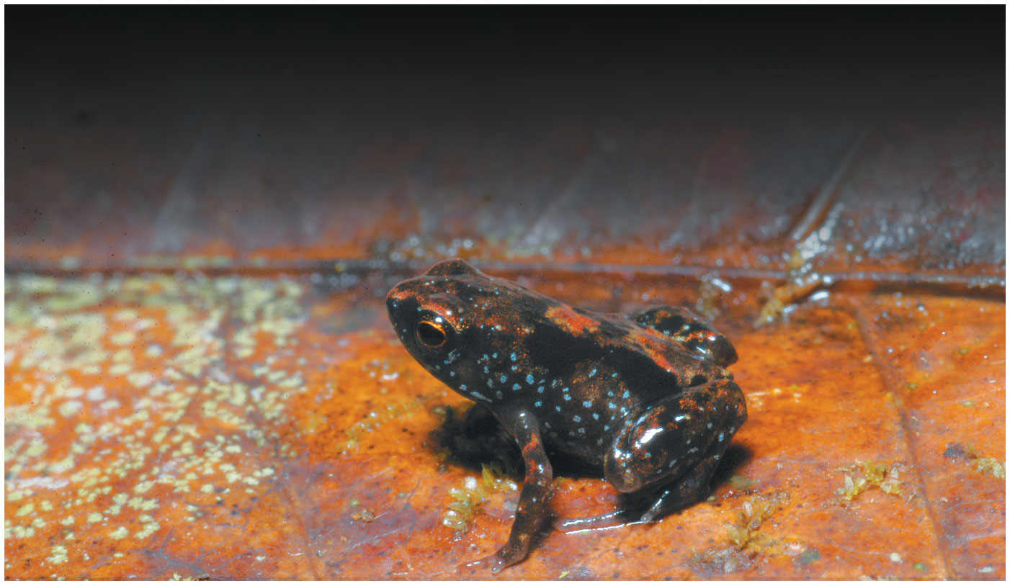
Figure 52.1
Notes:
Figure 52.1 What limits the distribution of this tiny frog?

Slide 4
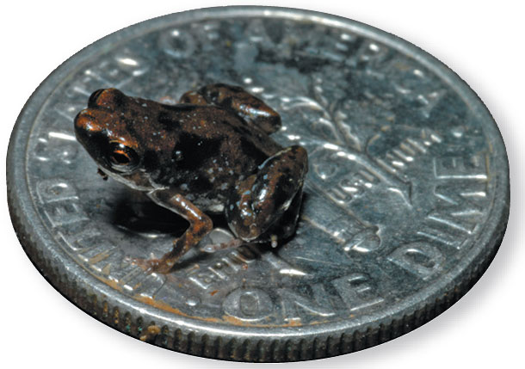
Figure 52.1a
Notes:
Figure 52.1a What limits the distribution of this tiny frog? (part 1: frog on a dime)

Slide 5
Ecology is the scientific study of the interactions between organisms and the living and nonliving components of their environment
These interactions determine the distribution of organisms and their abundance
Interactions studied by ecologists can be organized in a hierarchy that ranges from individual organisms to the planet

Slide 6
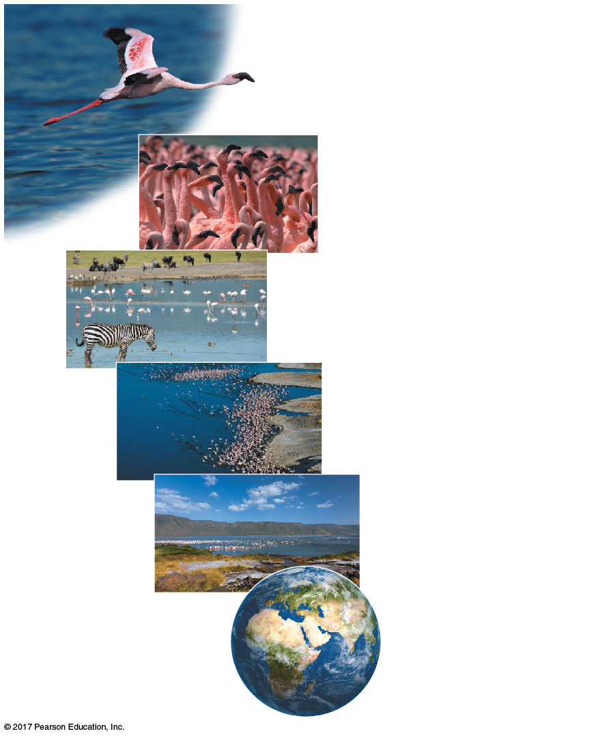
Figure 52.2
Organismal ecology
Population ecology
Community ecology
Ecosystem ecology
Landscape ecology
Global ecology
Notes:
Figure 52.2 Exploring the scope of ecological research

Slide 7
Organismal Ecology
Organismal ecology studies how an organism’s structure, physiology, and (for animals) behavior meet environmental challenges
Organismal ecology includes physiological, evolutionary, and behavioral ecology

Slide 8
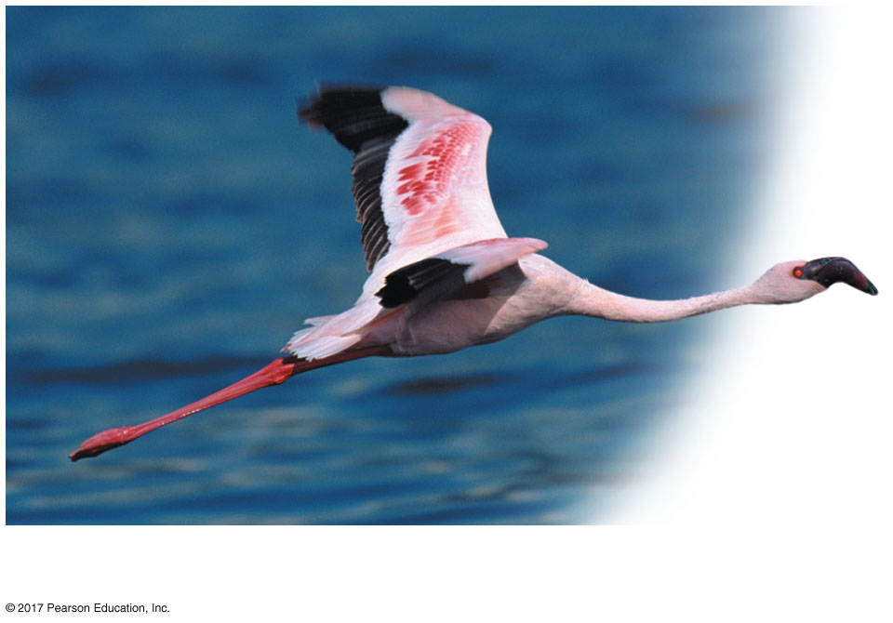
Figure 52.2f
Organismal ecology
Notes:
Figure 52.2f Exploring the scope of ecological research (part 6: organismal ecology)

Slide 9
Population Ecology
A population is a group of individuals of the same species living in an area
Population ecology focuses on factors affecting population size over time

Slide 10
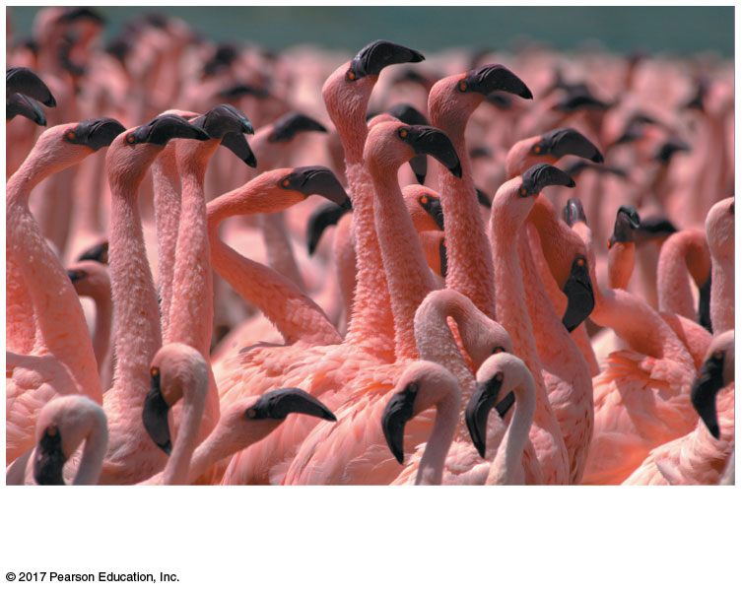
Figure 52.2e
Population ecology
Notes:
Figure 52.2e Exploring the scope of ecological research (part 5: population ecology)

Slide 11
Community Ecology
A community is a group of populations of different species in an area
Community ecology examines the effect of interspecific interactions on community structure and organization

Slide 12
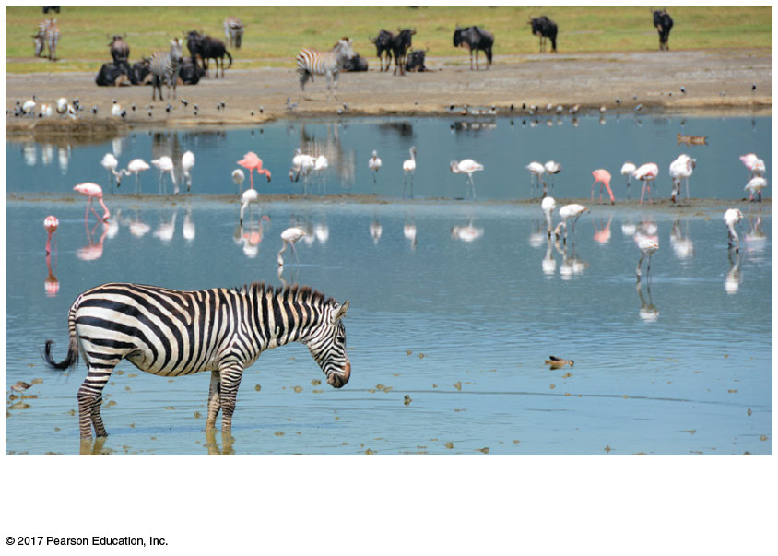
Figure 52.2d
Community ecology
Notes:
Figure 52.2d Exploring the scope of ecological research (part 4: community ecology)

Slide 13
Ecosystem Ecology
An ecosystem is the community of organisms in an area and the physical factors with which they interact
Ecosystem ecology emphasizes energy flow and chemical cycling between organisms and the environment

Slide 14
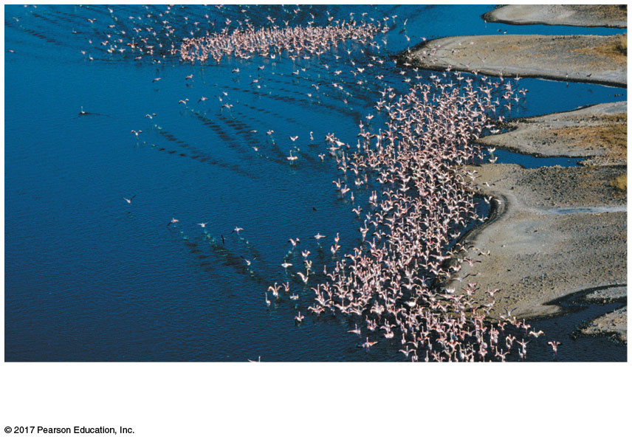
Figure 52.2c
Ecosystem ecology
Notes:
Figure 52.2c Exploring the scope of ecological research (part 3: ecosystem ecology)

Slide 15
Landscape Ecology
A landscape (or seascape) is a mosaic of connected ecosystems
Landscape ecology focuses on the exchanges of energy, materials, and organisms across multiple ecosystems

Slide 16
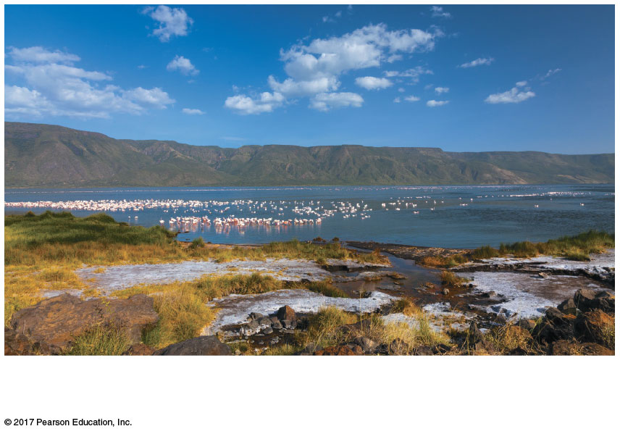
Figure 52.2b
Landscape ecology
Notes:
Figure 52.2b Exploring the scope of ecological research (part 2: landscape ecology)

Slide 17
Global Ecology
The biosphere is the global ecosystem, the sum of all the planet’s ecosystems and landscapes
Global ecology examines the influence of energy and materials on organisms across the biosphere

Slide 18
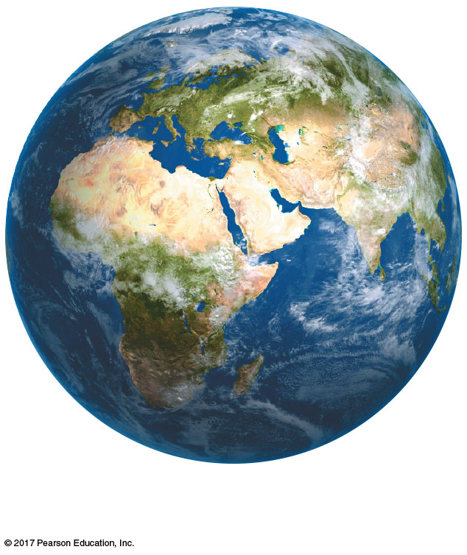
Figure 52.2a
Global ecology
Notes:
Figure 52.2a Exploring the scope of ecological research (part 1: global ecology)

Slide 19
Concept 52.1: Earth’s climate varies by latitude and season and is changing rapidly
The long-term prevailing weather conditions in an area constitute its climate
Four major physical components of climate are temperature, precipitation, sunlight, and wind

Slide 20
Global Climate Patterns
Global climate patterns are determined largely by solar energy and Earth’s movement in space
The warming effect of the sun establishes temperature variations, circulation of air and water, and evaporation of water
This causes latitudinal variations in climate

Slide 21
Latitudinal Variation in Sunlight Intensity
The angle at which sunlight hits Earth affects its intensity, the amount of heat and light per unit of surface area
The intensity of sunlight is strongest in the tropics (between 23.5º north latitude and 23.5º south latitude) where sunlight strikes Earth most directly

Slide 22
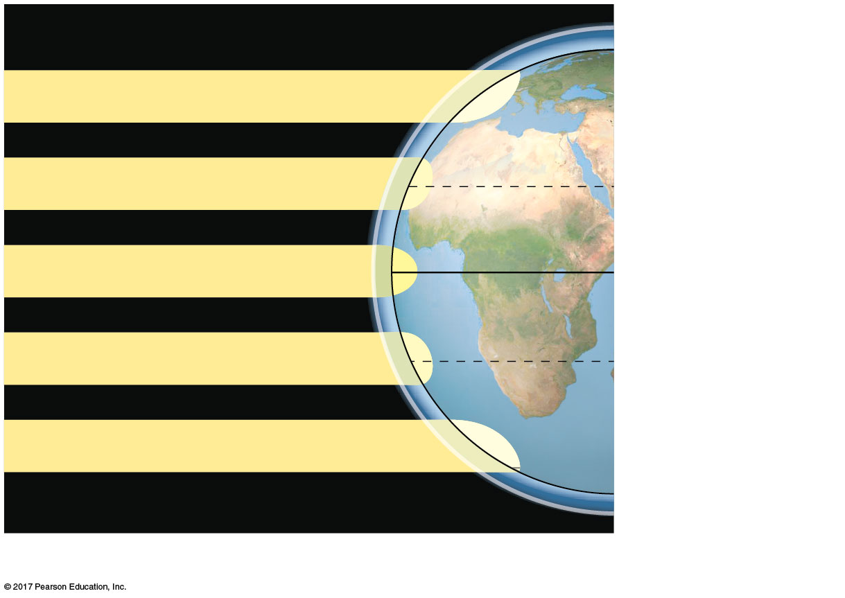
Figure 52.3a
Atmosphere
90ºN (North Pole)
Low angle of incoming sunlight
23.5ºN (Tropic of
Cancer)
Sun overhead at equinoxes
0º (Equator)
23.5ºS (Tropic of
Capricorn)
Low angle of incoming sunlight
90ºS (South Pole)
Latitudinal variation in sunlight intensity
Notes:
Figure 52.3a Exploring global climate patterns (part 1: sunlight intensity)

Slide 23
Global Air Circulation and Precipitation Patterns
Global air circulation and precipitation patterns play major roles in determining climate patterns
Water evaporates in the tropics, and warm, wet air masses flow from the tropics toward the poles
Rising air masses release water and cause high precipitation, especially in the tropics

Slide 24
Dry, descending air masses create arid climates, especially near 30º north and south
Air flowing close to Earth’s surface creates predictable global wind patterns
Cooling trade winds blow from east to west in the tropics; prevailing westerlies blow from west to east in the temperate zones

Slide 25
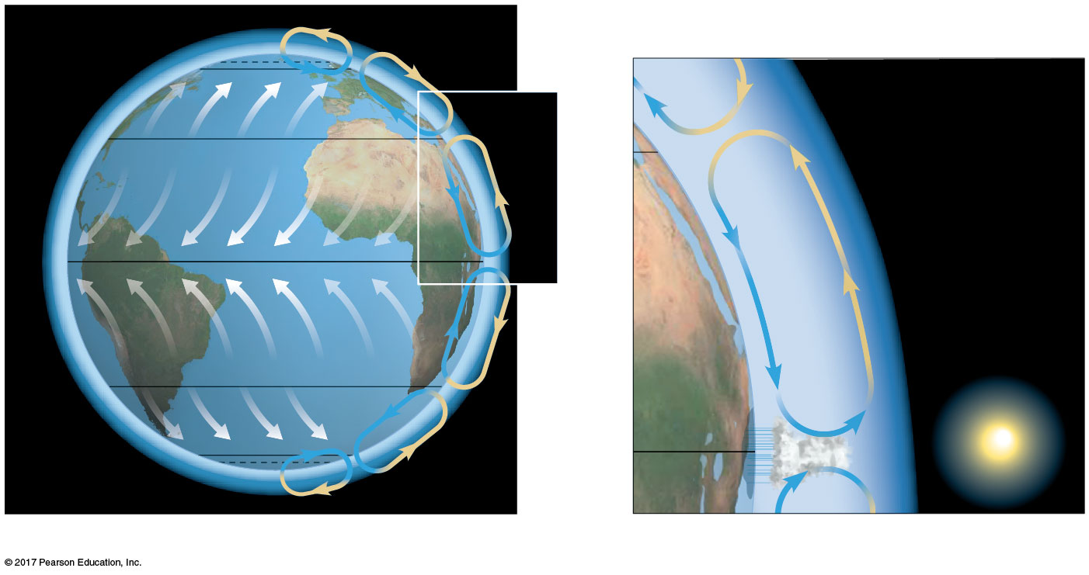
Figure 52.3b
66.5ºN (Arctic Circle)
60ºN
30ºN
Westerlies
Descending
dry air
absorbs
moisture.
30ºN
Northeast trades
0º
Ascending
moist air
releases
moisture.
Southeast trades
30ºS
Westerlies
60ºS
0º
66.5ºS (Antarctic Circle)
Global air circulation and precipitation patterns
Notes:
Figure 52.3b Exploring global climate patterns (part 2: air circulation and precipitation)

Slide 26
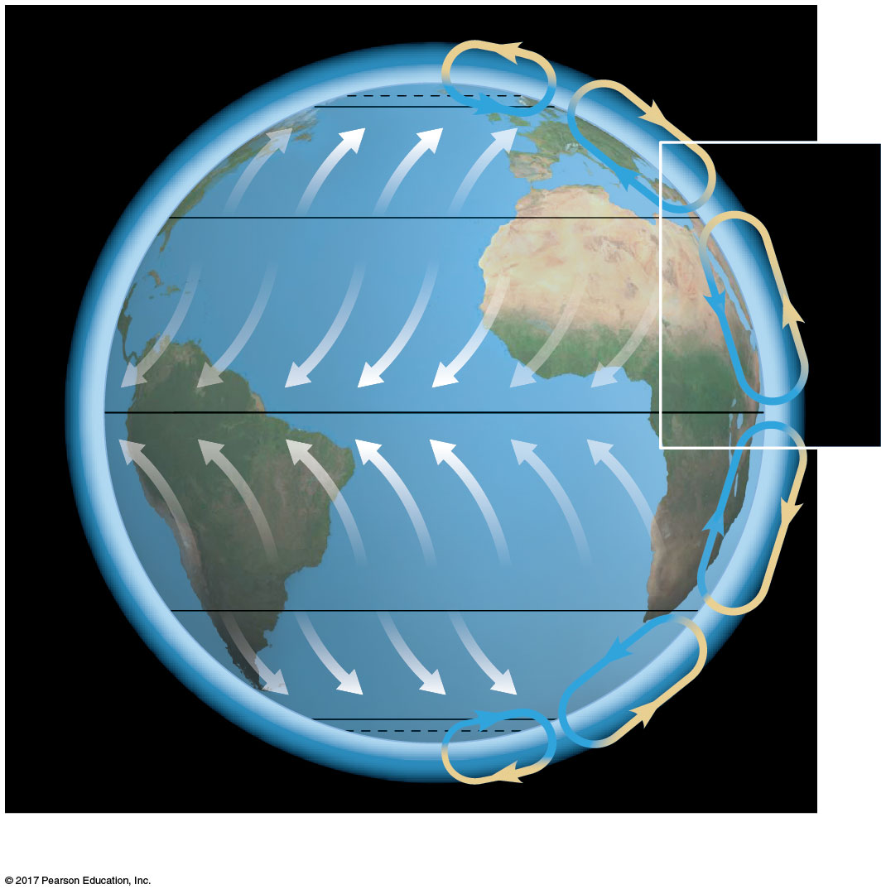
Figure 52.3ba
66.5ºN (Arctic Circle)
60ºN
30ºN
Westerlies
Northeast trades
0º
Southeast trades
30ºS
Westerlies
60ºS
66.5ºS (Antarctic Circle)
Global air circulation and precipitation patterns
Notes:
Figure 52.3ba Exploring global climate patterns (part 2a: air circulation and precipitation)

Slide 27
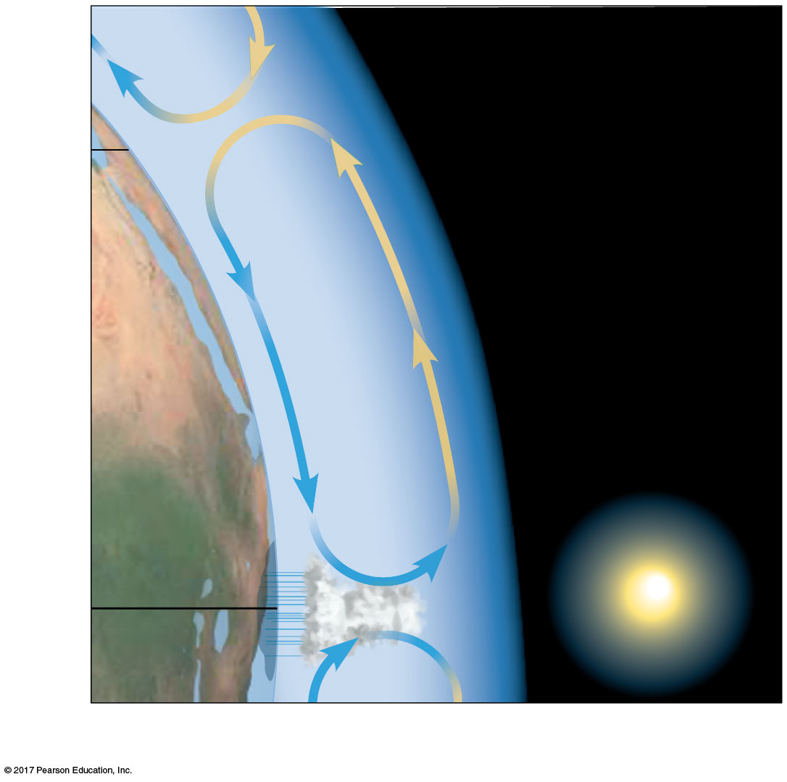
Figure 52.3bb
Descending
dry air
absorbs
moisture.
30ºN
Ascending
moist air
releases
moisture.
0º
Global air circulation and precipitation patterns
Notes:
Figure 52.3bb Exploring global climate patterns (part 2b: air circulation and precipitation, detail)

Slide 28
Regional and Local Effects on Climate
Climate varies seasonally and is modified by other factors including large bodies of water and mountain ranges

Slide 29
Seasonality
Seasonal variations in day length, solar radiation, and temperature increase steadily toward the poles
Seasonality at high latitudes is caused by the tilt of Earth’s axis of rotation and its annual passage around the sun

Slide 30
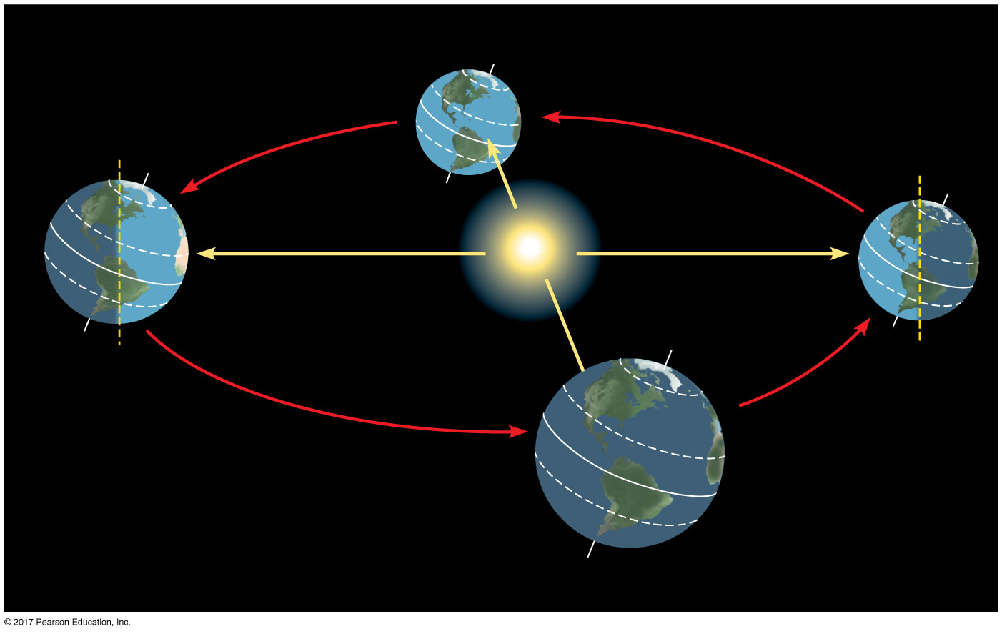
Figure 52.4
March equinox
December
solstice
June solstice
Sun
60ºN
Constant tilt
of 23.5º
23.5ºN
0º (Equator)
23.5ºS
September equinox
Notes:
Figure 52.4 Seasonal variation in sunlight intensity

Slide 31
The changing angle of the sun affects local environments
Regions at 20ºN and 20ºS latitudes have wet and dry seasons due to the changing angle of the sun

Slide 32
Seasonal changes in wind patterns alter ocean currents
These changes can cause upwelling of cold, nutrient-rich water from deep ocean layers
This influx of nutrients to surface waters stimulates population growth of phytoplankton and the organisms that feed on them

Slide 33
Bodies of Water
Ocean currents influence the climate of nearby terrestrial environments
Currents flowing toward the equator carry cold water from the poles; currents flowing away from the equator carry warm water toward the poles
Air is cooled or warmed by these currents before passing over the land

Slide 34
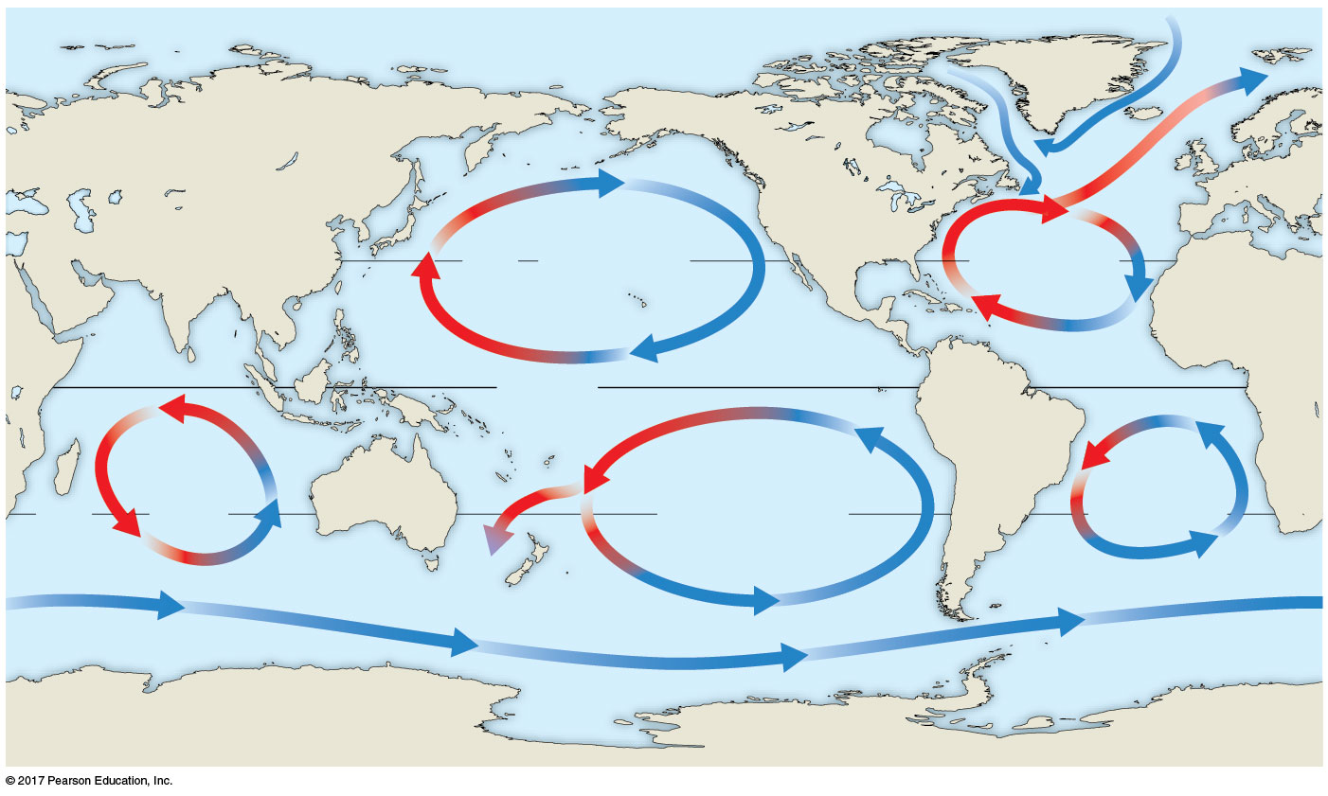
Figure 52.5
Labrador
Current
California Current
Gulf
Stream
30ºN
North Pacific
Subtropical Gyre
North Atlantic
Subtropical
Gyre
Equator
Indian
Ocean
Subtropical
Gyre
South
Atlantic
Subtropical
Gyre
Humboldt Current
30ºS
South Pacific
Subtropical Gyre
E. Australian
Current
Antarctic
Circumpolar
Current
Notes:
Figure 52.5 Global circulation of surface water in the oceans

Slide 35
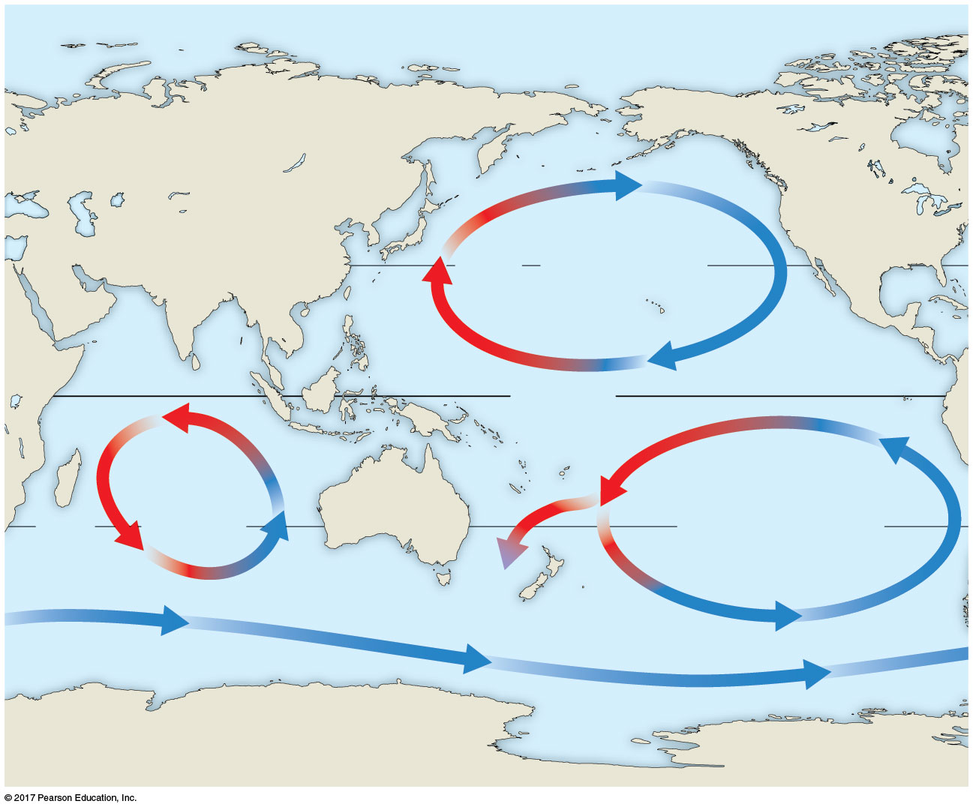
Figure 52.5a
California Current
30ºN
North Pacific
Subtropical Gyre
Equator
Indian
Ocean
Subtropical
Gyre
Humboldt Current
30ºS
South Pacific
Subtropical Gyre
E. Australian
Current
Antarctic
Circumpolar
Current
Notes:
Figure 52.5a Global circulation of surface water in the oceans (part 1: Indian and Pacific Oceans)

Slide 36
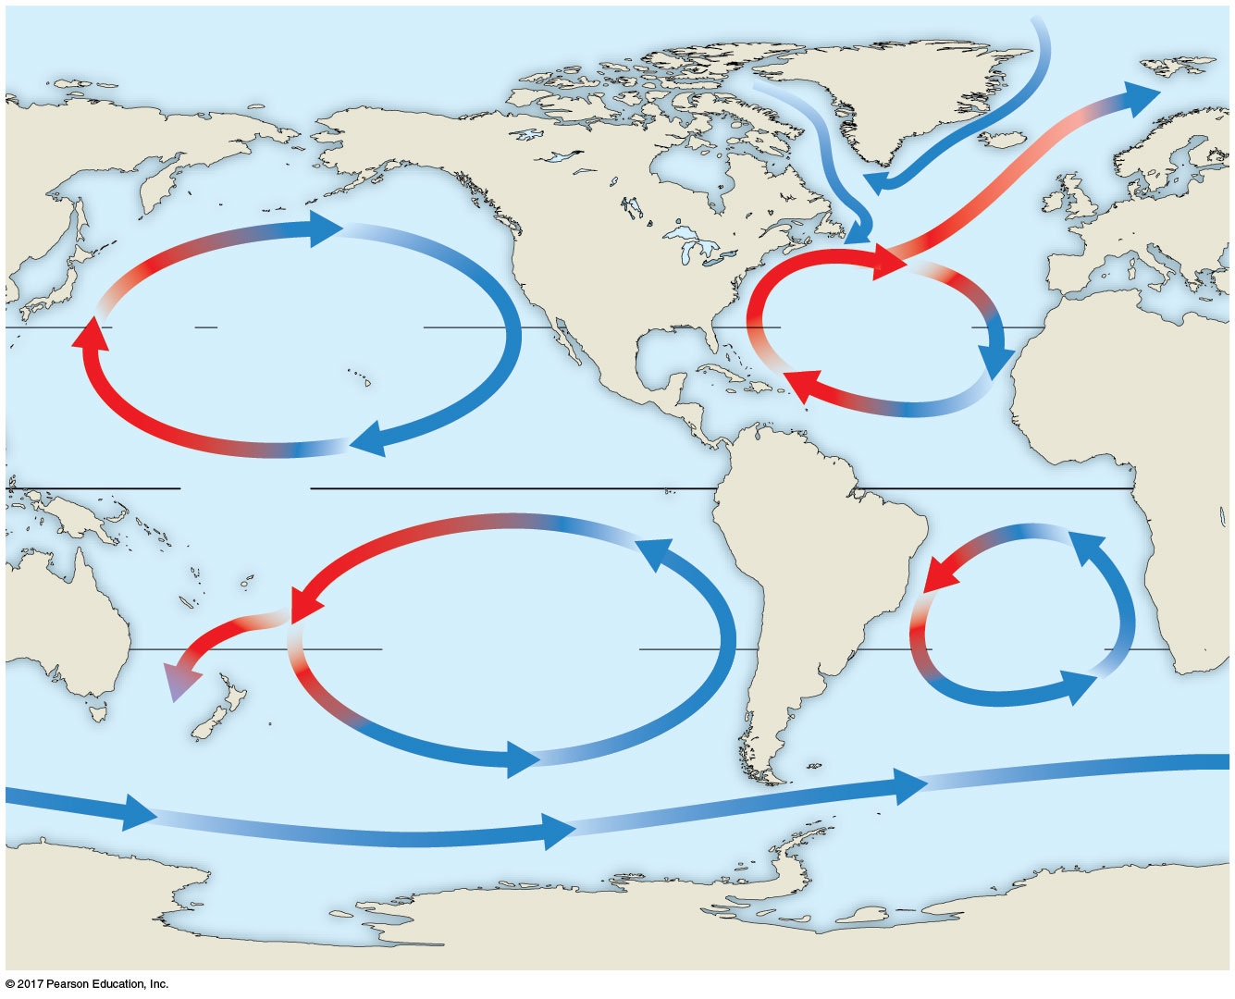
Figure 52.5b
Labrador
Current
California Current
Gulf
Stream
30ºN
North Pacific
Subtropical Gyre
North Atlantic
Subtropical
Gyre
Equator
Humboldt Current
South
Atlantic
Subtropical
Gyre
South Pacific
Subtropical Gyre
E. Australian
Current
Notes:
Figure 52.5b Global circulation of surface water in the oceans (part 2: Pacific and Atlantic Oceans)

Slide 37
Large bodies of water moderate the climate of nearby land
During the day, air rises over warm land and draws a breeze from the cooler water
As the land cools at night, air rises over the warmer water and draws cooler air from land back over the water, which is replaced by warm air from offshore

Slide 38
Mountains
Mountains influence air flow over land and affect climate in surrounding areas
Warm air cools as it rises up a mountain and releases moisture on the windward side
Cool, dry air absorbs moisture from the land as it descends, creating a “rain shadow” on the leeward side

Slide 39
Mountains also affect the amount of sunlight reaching an area
In the Northern Hemisphere, south-facing slopes receive more sunlight than north-facing slopes
Every 1,000-m increase in elevation produces a temperature drop of approximately 6ºC

Slide 40
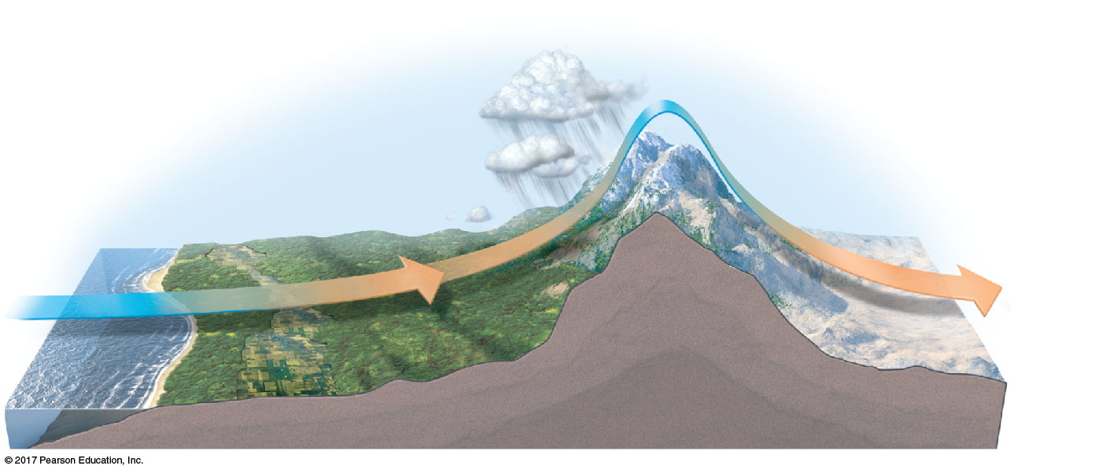
Figure 52.6
2
Precipitation
Leeward side
of mountains
1
Cool air flow
3
Rain
shadow
Mountain
range
Ocean
Notes:
Figure 52.6 How large bodies of water and mountains affect climate

Slide 41
Microclimate
Microclimate refers to very fine, localized patterns in climate
Features of the environment, for example, forest trees, influence surrounding areas by casting shade, altering evaporation from soil, or changing wind patterns

Slide 42
Every environment is characterized by differences in
Abiotic factors, including nonliving attributes such as temperature, light, water, and nutrients
Biotic factors, including other organisms that are part of an individual’s environment

Slide 43
Global Climate Change
Climate change is a directional change to the global climate lasting three decades or more
Burning of fossil fuels and deforestation have increased the concentration of greenhouse gases in the atmosphere
As a result, wind and precipitation patterns are shifting, and global temperature and the frequency of extreme weather events have increased

Slide 44
One way to predict the effects of future global climate change is to study how species responded to changes in the past
The geographic ranges of many species have shifted in response to climate change
Determining the location of suitable habitat under different climate scenarios can help predict future range shifts

Slide 45
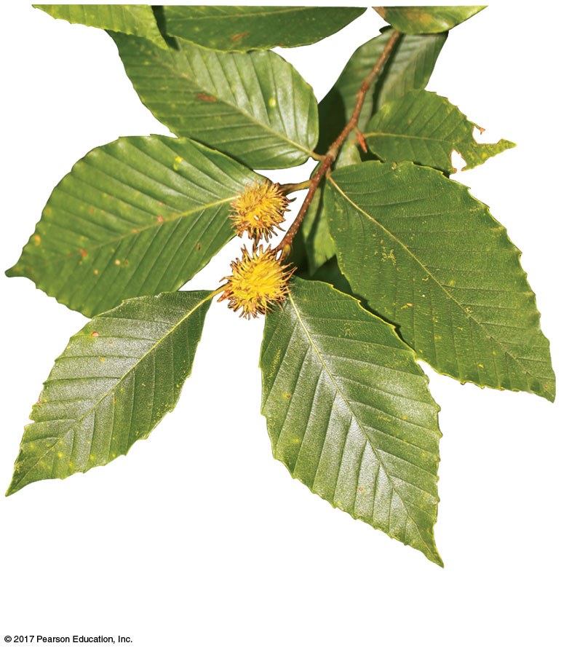
Figure 52.7b
American beech
(Fagus grandifolia)
Notes:
Figure 52.7b Current range and predicted ranges for the American beech under two climate-change scenarios (part 2: photo)

Slide 46
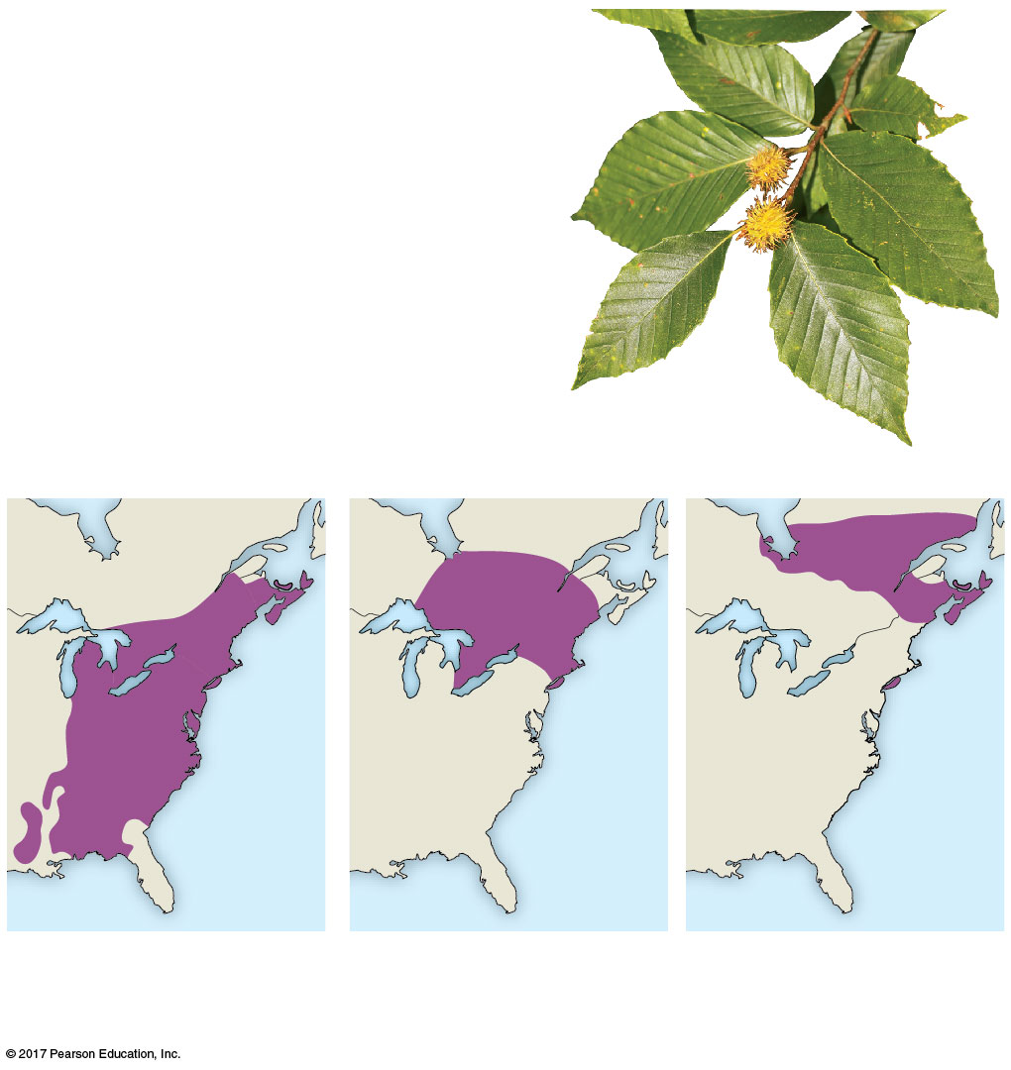
Figure 52.7
American beech
(Fagus grandifolia)
(a) Current range
(b) 4.5ºC warming
over next century
(c) 6.5ºC warming
over next century
Notes:
Figure 52.7 Current range and predicted ranges for the American beech under two climate-change scenarios

Slide 47
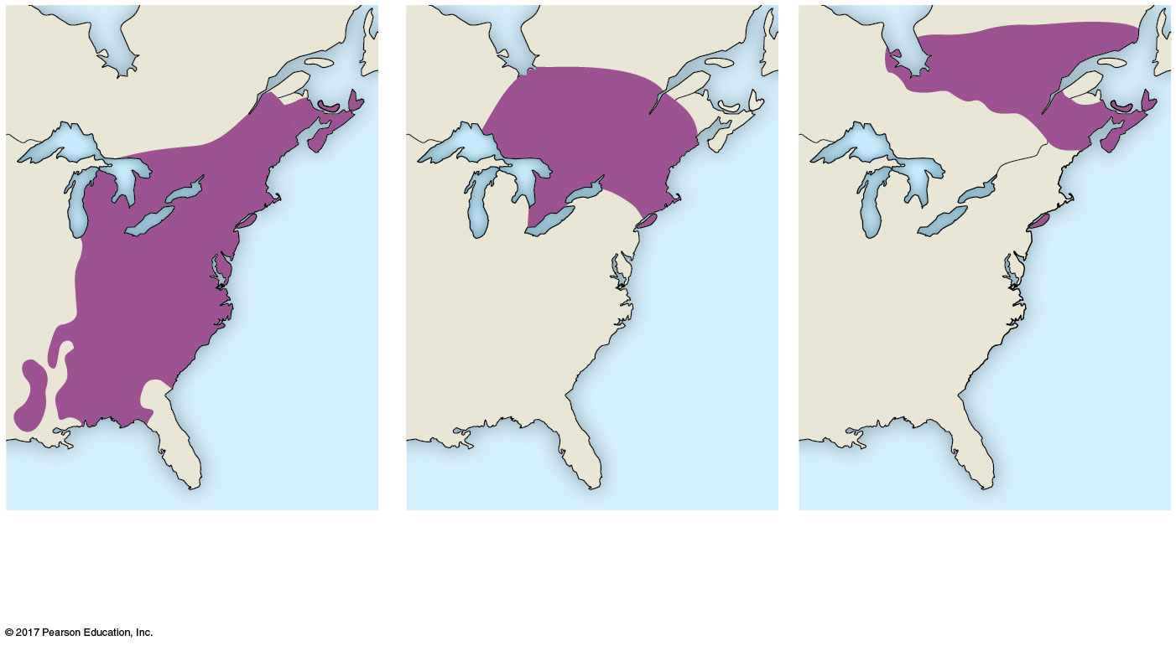
Figure 52.7a
(a) Current range
(b) 4.5ºC warming
over next century
(c) 6.5ºC warming
over next century
Notes:
Figure 52.7a Current range and predicted ranges for the American beech under two climate-change scenarios (part 1: maps)

Slide 48
Species that have difficulty dispersing or face a shortage of suitable habitat may have smaller ranges or could become extinct
For example, the geographic ranges of 67 bumblebee species in the Northern Hemisphere have decreased

Slide 49
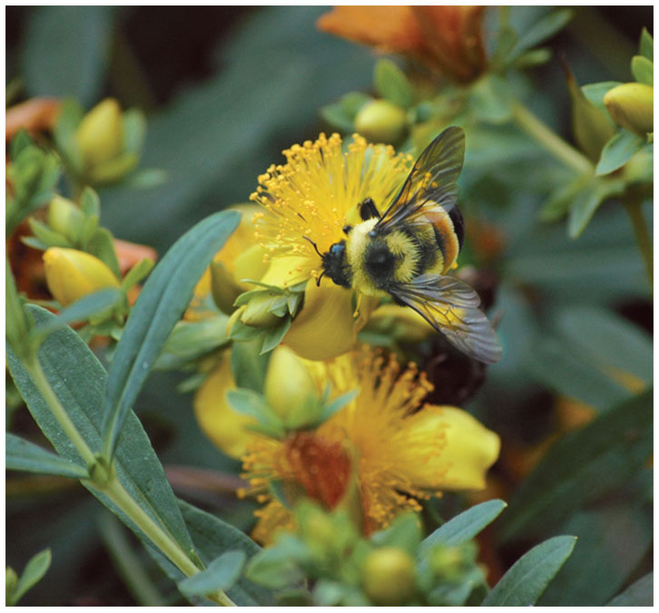
Figure 52.8
Notes:
Figure 52.8 The rusty-patched bumblebee (Bombus affinis)

Slide 50
Concept 52.2: The distribution of terrestrial biomes is controlled by climate and disturbance
Biomes are major life zones characterized by vegetation type (terrestrial biomes) or physical environment (aquatic biomes)

Slide 51
Climate and Terrestrial Biomes
Climate is a major factor determining the locations of terrestrial biomes because it strongly influences the distribution of plants

Slide 52
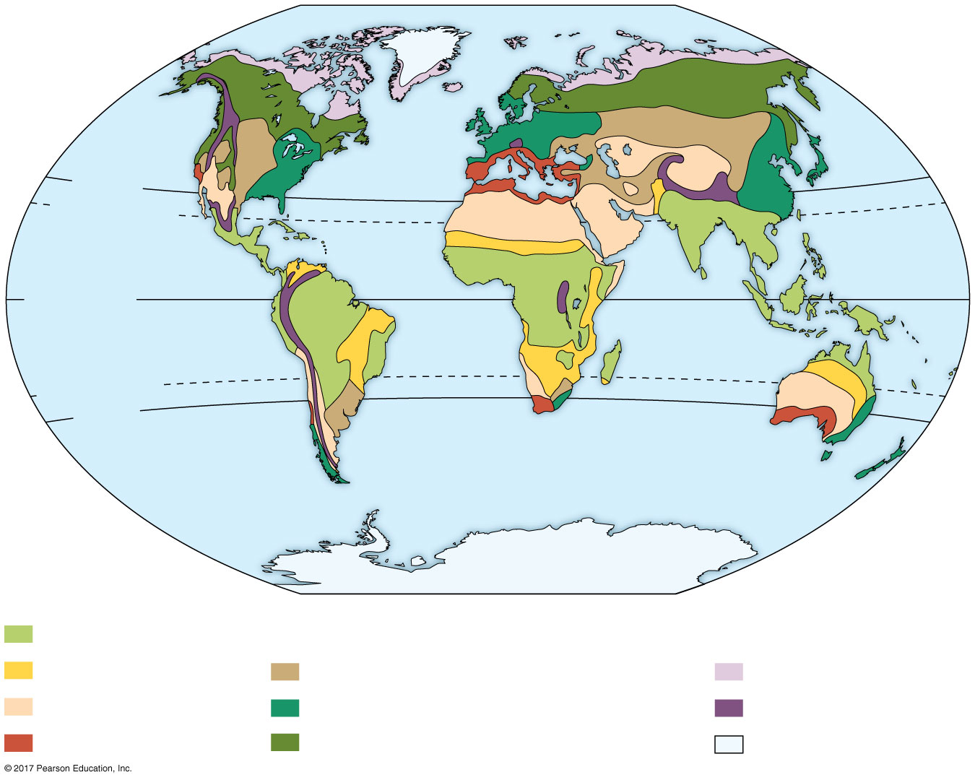
Figure 52.9
30ºN
Tropic of
Cancer
Equator
Tropic of
Capricorn
30ºS
Tropical forest
Savanna
Temperate grassland
Tundra
Desert
Temperate broadleaf forest
High mountains
Chaparral
Northern coniferous forest
Polar ice
Notes:
Figure 52.9 The distribution of major terrestrial biomes

Slide 53
A climograph plots the annual mean temperature and precipitation in a region
Biomes are affected not just by mean temperature and precipitation, but also by the pattern of temperature and precipitation through the year

Slide 54
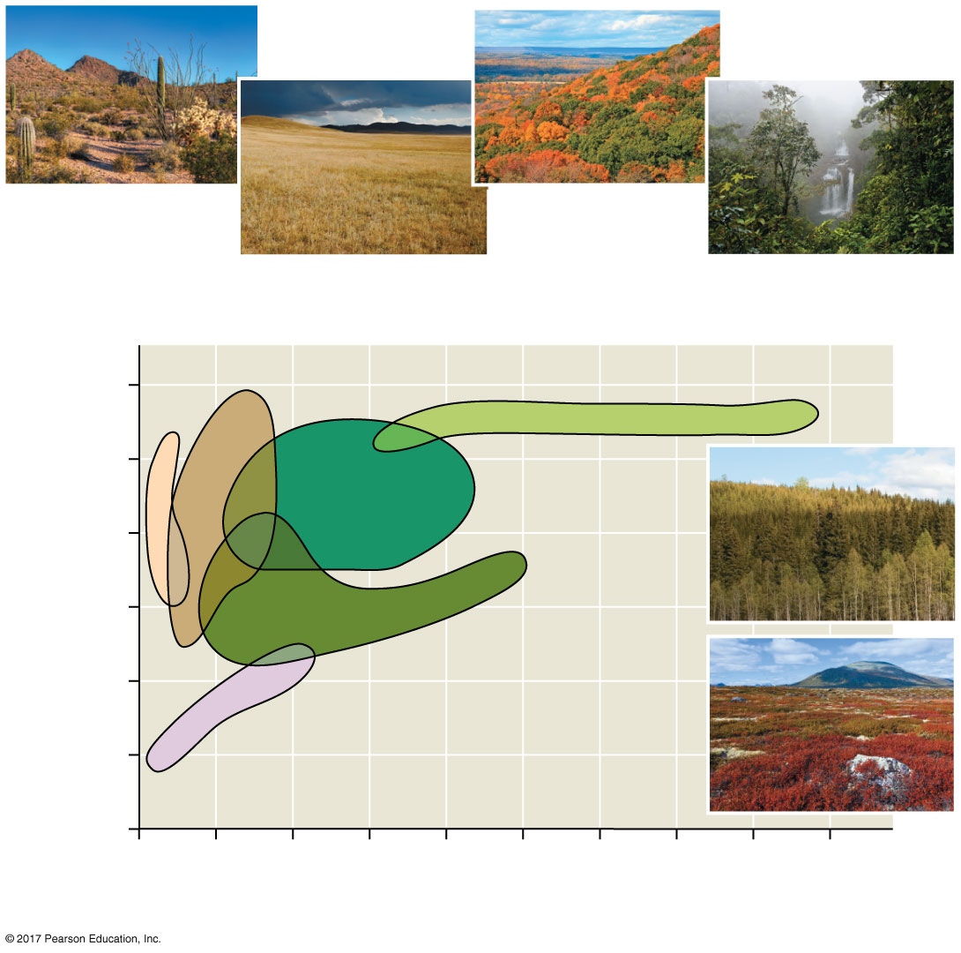
Figure 52.10
Desert
Temperate
broadleaf
forest
Temperate
grassland
Tropical forest
Annual mean temperature (ºC)
30
15
Northern
coniferous
forest
0
Arctic and
alpine
tundra
–15
0
100
200
300
400
Annual mean precipitation (cm)
Notes:
Figure 52.10 A climograph for some major types of biomes in North America

Slide 55
General Features of Terrestrial Biomes
Terrestrial biomes are often named for major physical or climatic factors and vegetation
Terrestrial biomes usually grade into each other, without sharp boundaries
The area of intergradation, called an ecotone, may be wide or narrow

Slide 56
Vertical layering is an important feature of terrestrial biomes, and in a forest it might consist of an upper canopy, low-tree layer, shrub understory, ground layer of herbaceous plants, forest floor, and root layer
Layering of vegetation in all biomes provides diverse habitats for animals
The species composition of each kind of biome varies from one location to another

Slide 57
Similar characteristics can arise in distant biomes through convergent evolution
For example, cacti in North America and euphorbs in African deserts appear similar but are from different evolutionary lineages

Slide 58
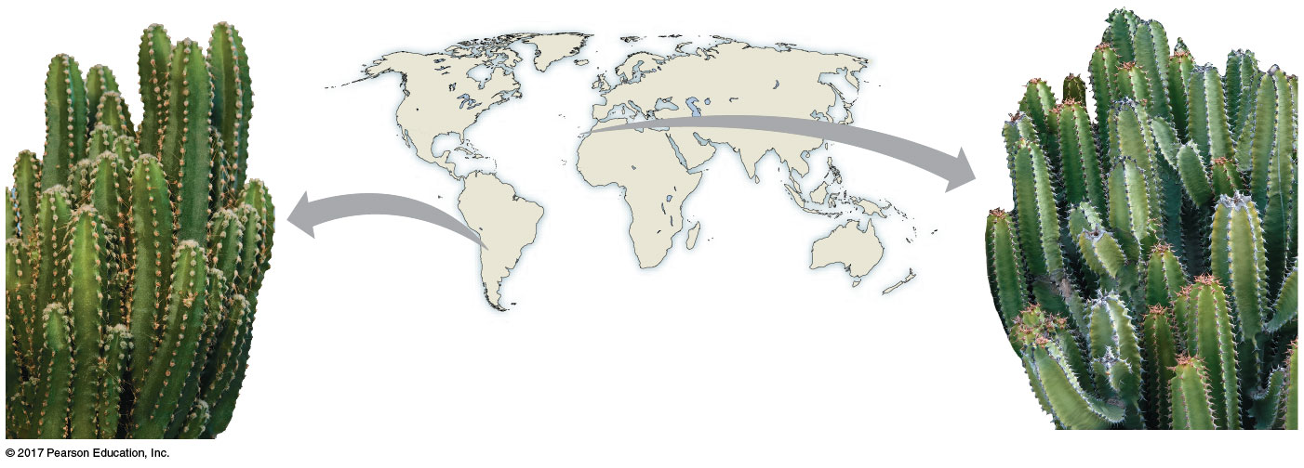
Figure 52.11
Euphorbia
canariensis
Cereus sp.
Notes:
Figure 52.11 Convergent evolution in a cactus and a euphorb

Slide 59
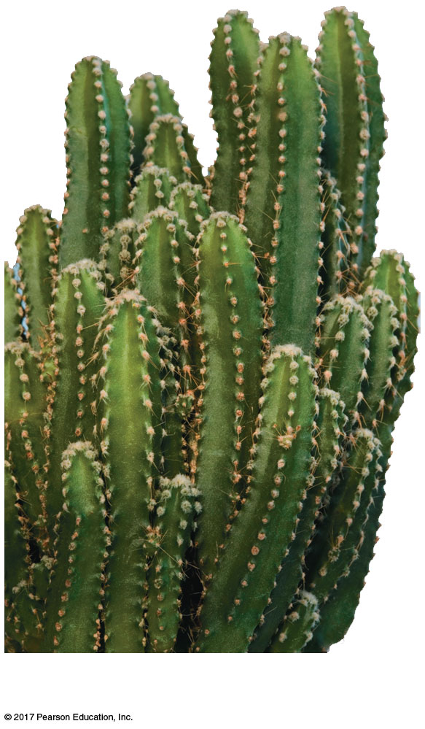
Figure 52.11a
Cereus sp.
Notes:
Figure 52.11a Convergent evolution in a cactus and a euphorb (part 1: Cereus sp.)

Slide 60
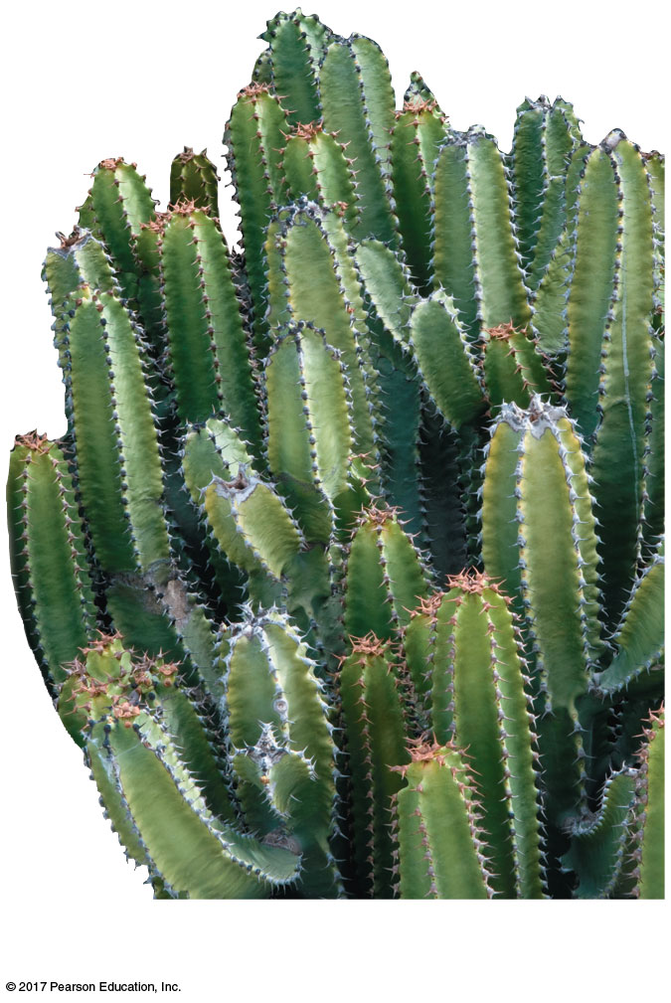
Figure 52.11b
Euphorbia canariensis
Notes:
Figure 52.11b Convergent evolution in a cactus and a euphorb (part 2: Euphorbia canariensis)

Slide 61
Disturbance and Terrestrial Biomes
Disturbance is an event such as a storm, fire, or human activity that changes a community
For example, frequent fires can kill woody plants and maintain the characteristic vegetation of a savanna
For example, hurricanes create openings in forests that allow different species to grow
In many biomes, even dominant plants depend on periodic disturbance

Slide 62
Terrestrial Biomes
Terrestrial biomes can be characterized by distribution, precipitation, temperature, plants, and animals

Slide 63
Tropical Forest
Distribution is in equatorial and subequatorial regions
In tropical rain forests, rainfall is relatively constant, while in tropical dry forests precipitation is highly seasonal
Temperature is high year-round (25–29ºC) with little seasonal variation

Slide 64
Tropical forests are vertically layered, and competition for light is intense
Animal diversity is higher in tropical forests than any other terrestrial biome
Humans impact tropical forests through deforestation for conversion to farmland, urban areas, and other uses

Slide 65
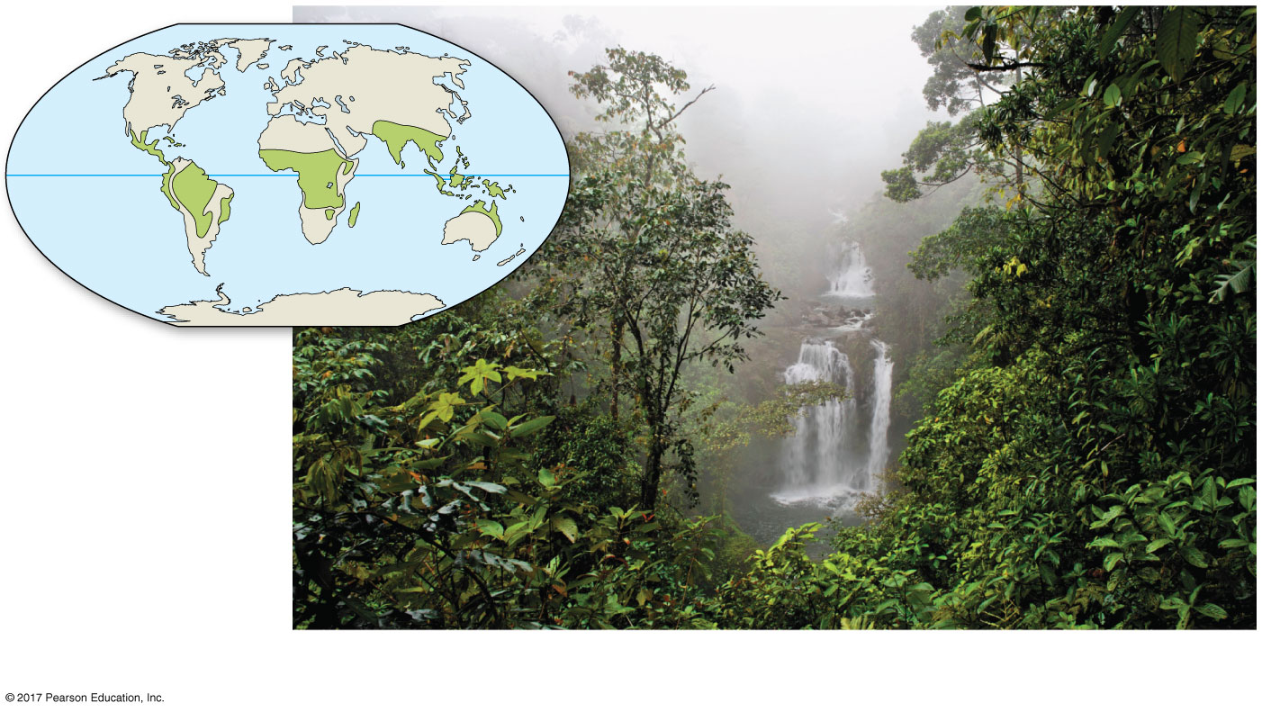
Figure 52.12a
A tropical rain forest in Costa Rica
Notes:
Figure 52.12a Exploring terrestrial biomes (part 1: tropical forest)

Slide 66
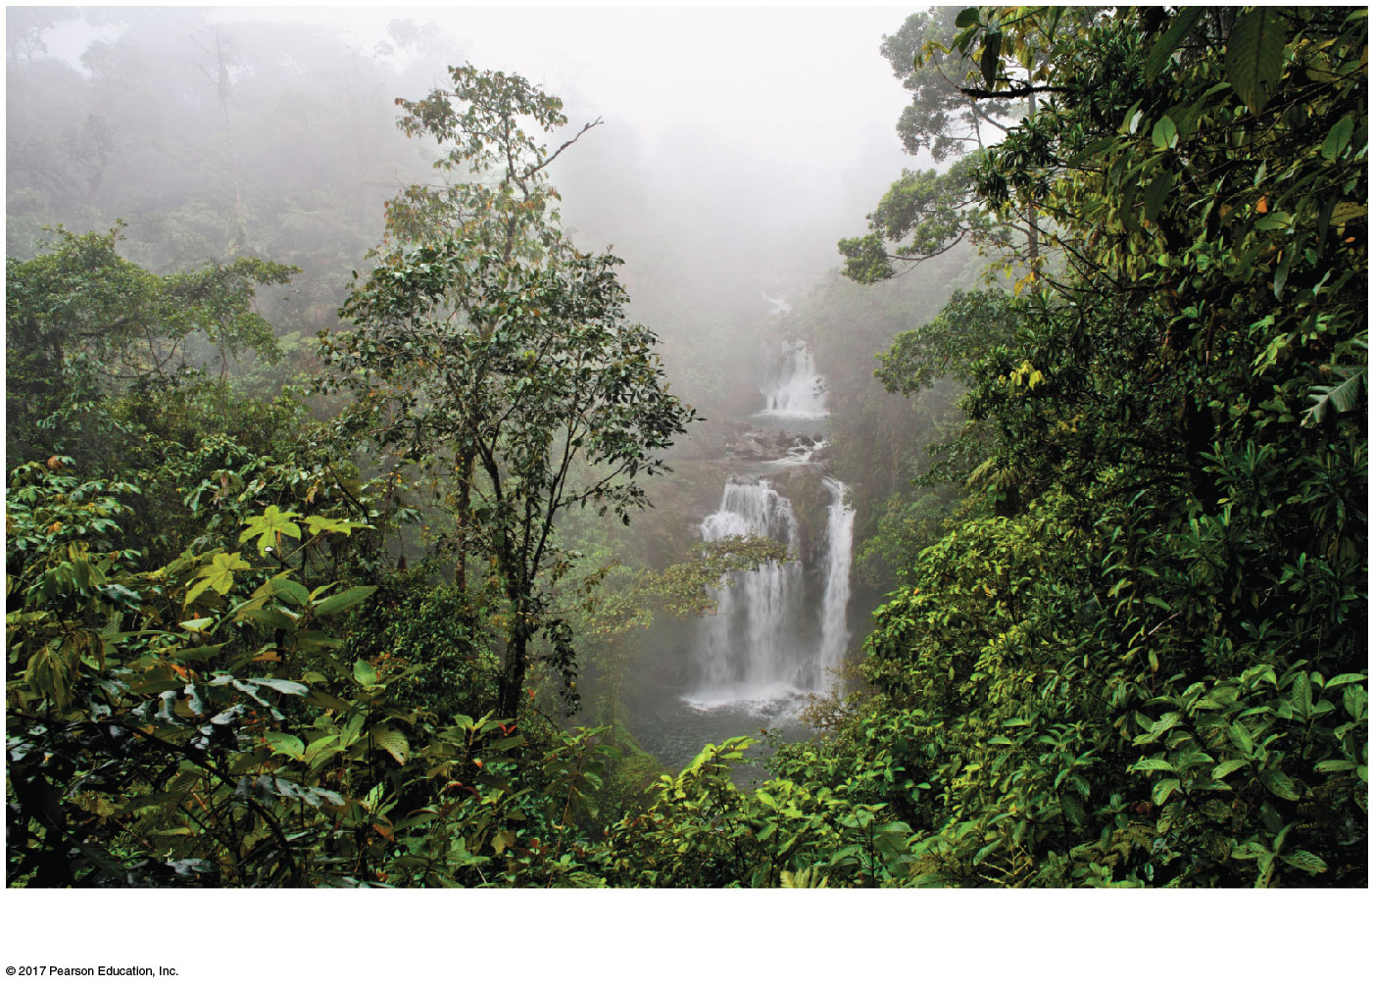
Figure 52.12aa
A tropical rain forest in Costa Rica
Notes:
Figure 52.12aa Exploring terrestrial biomes (part 1a: tropical forest, photo)

Slide 67
Desert
Deserts occur in bands near 30º north and south of the equator and in the interior of continents
Precipitation is low and highly variable, generally less than 30 cm per year
Temperature is variable seasonally and daily
Deserts may be hot or cold

Slide 68
Desert plant adaptations include heat and desiccation tolerance, water storage, and reduced leaf surface area
Many desert animals are nocturnal, and many have adaptations for water conservation
Humans have reduced biodiversity in deserts through urbanization and irrigated agriculture

Slide 69
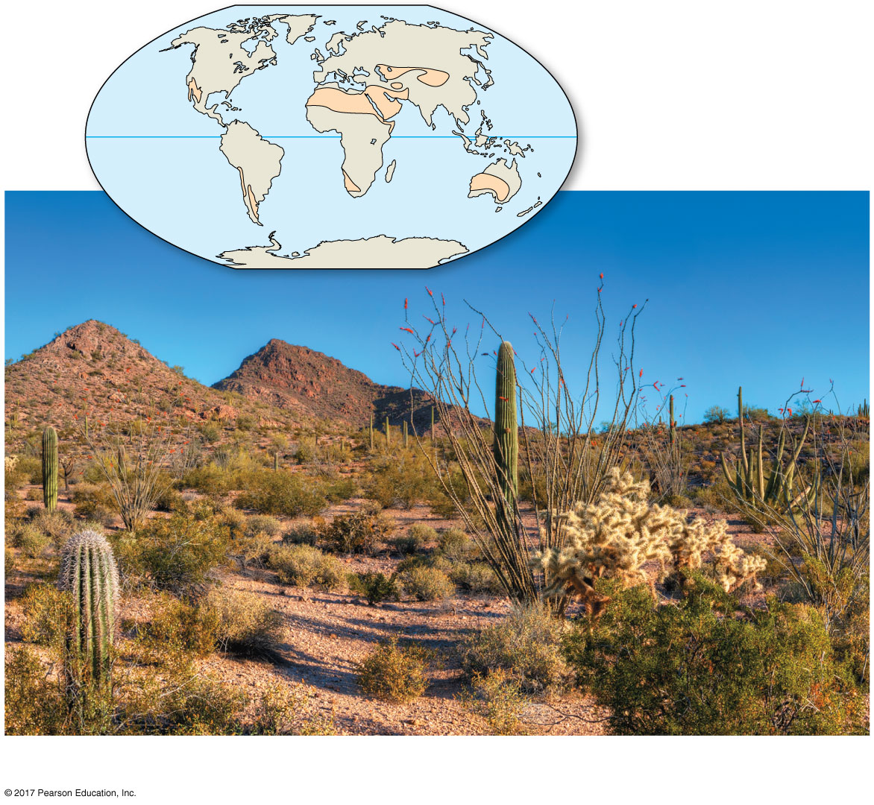
Figure 52.12b
Organ Pipe Cactus National Monument, Arizona
Notes:
Figure 52.12b Exploring terrestrial biomes (part 2: desert)

Slide 70
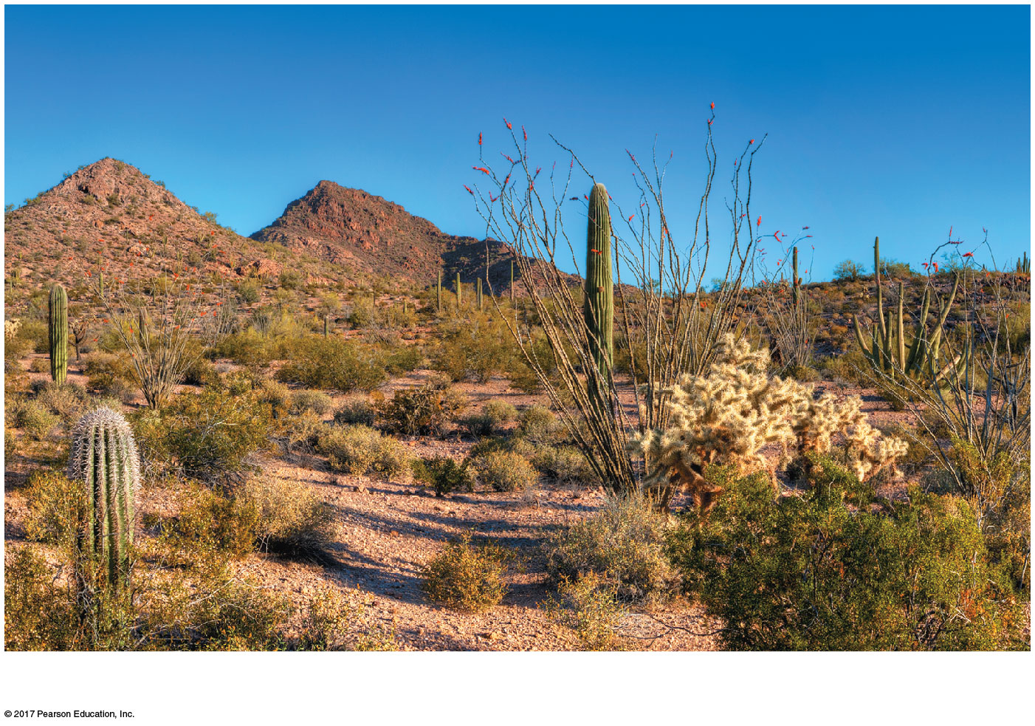
Figure 52.12ba
Organ Pipe Cactus National Monument, Arizona
Notes:
Figure 52.12ba Exploring terrestrial biomes (part 2a: desert, photo)

Slide 71
Savanna
Distribution includes equatorial and subequatorial regions
Precipitation is seasonal with dry seasons lasting eight to nine months
Savanna temperature averages 24–29ºC but is more seasonally variable than in the tropics

Slide 72
The dominant plant species are fire-adapted and tolerant of seasonal drought
Grasses and forbs make up most of the ground cover
Large herbivores are common, but insects are the dominant herbivores
Human-induced fires help maintain the savanna, but cattle ranching and overhunting threaten large-mammal populations

Slide 73
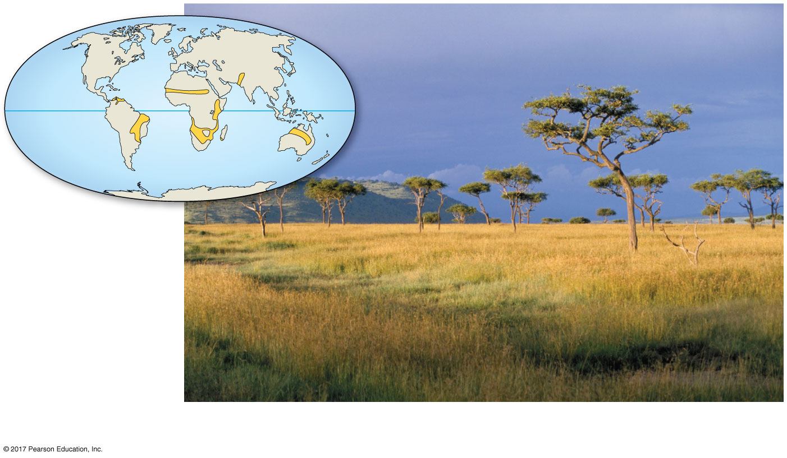
Figure 52.12c
A savanna in Kenya
Notes:
Figure 52.12c Exploring terrestrial biomes (part 3: savanna)

Slide 74
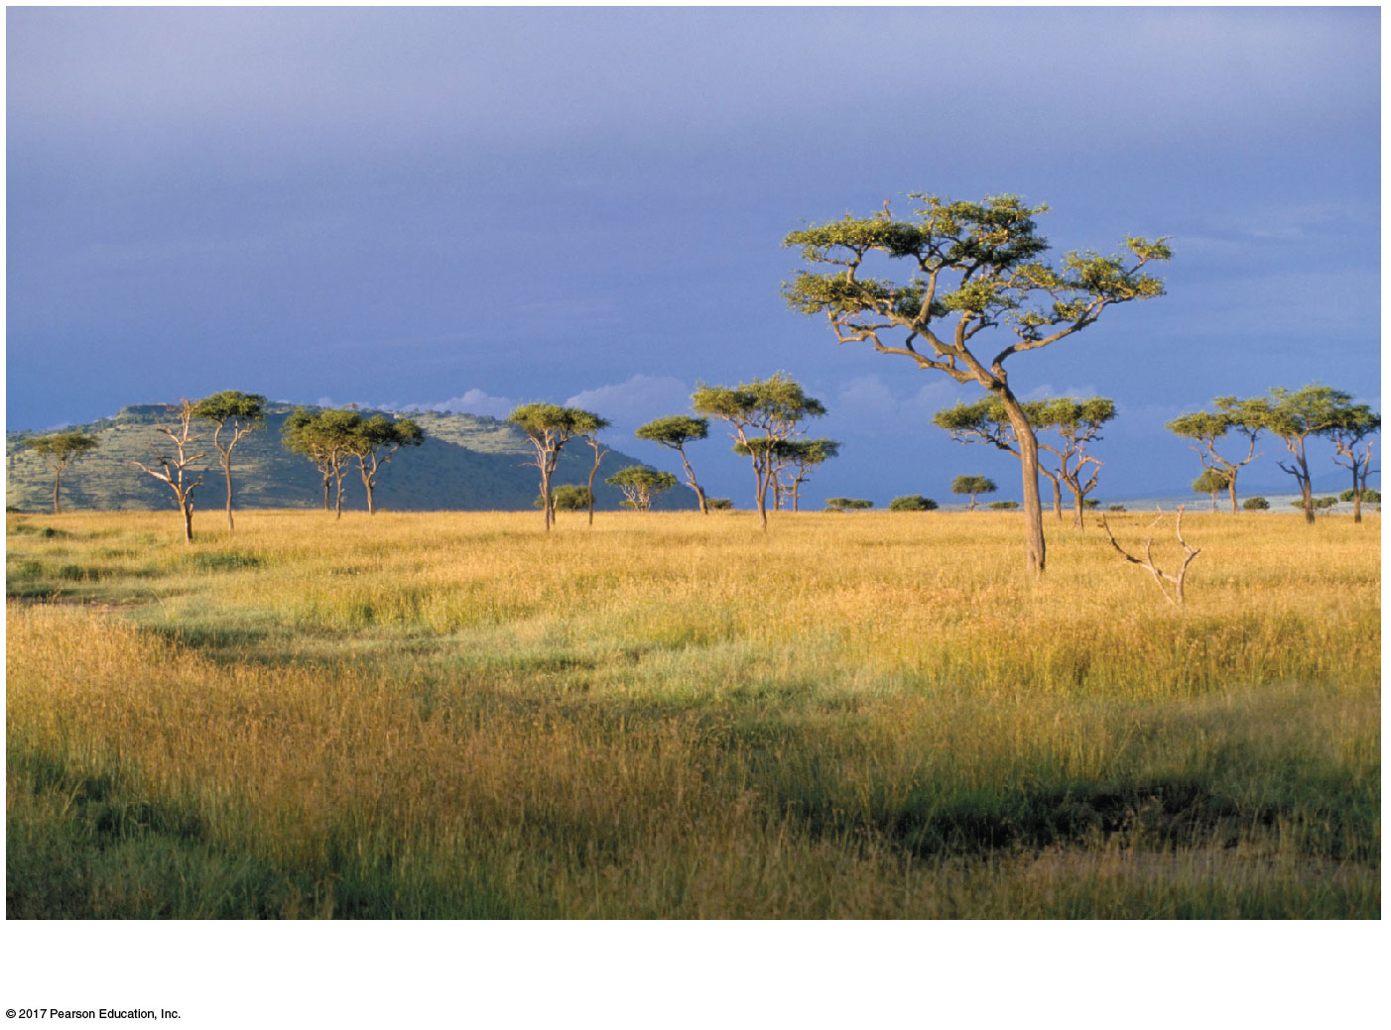
Figure 52.12ca
A savanna in Kenya
Notes:
Figure 52.12ca Exploring terrestrial biomes (part 3a: savanna, photo)

Slide 75
Chaparral
Chaparral occurs in midlatitude coastal regions on several continents
Precipitation is highly seasonal with rainy winters and dry summers
Summer is hot (30ºC to as hot as 40ºC); fall, winter, and spring are cool (10–12ºC)

Slide 76
Chaparral is dominated by shrubs, small trees, grasses, and herbs; many plants are adapted to fire and drought
Animals include amphibians, birds and other reptiles, insects, browsing mammals, and a diversity of small mammals
Humans have reduced chaparral areas through agriculture and urbanization

Slide 77
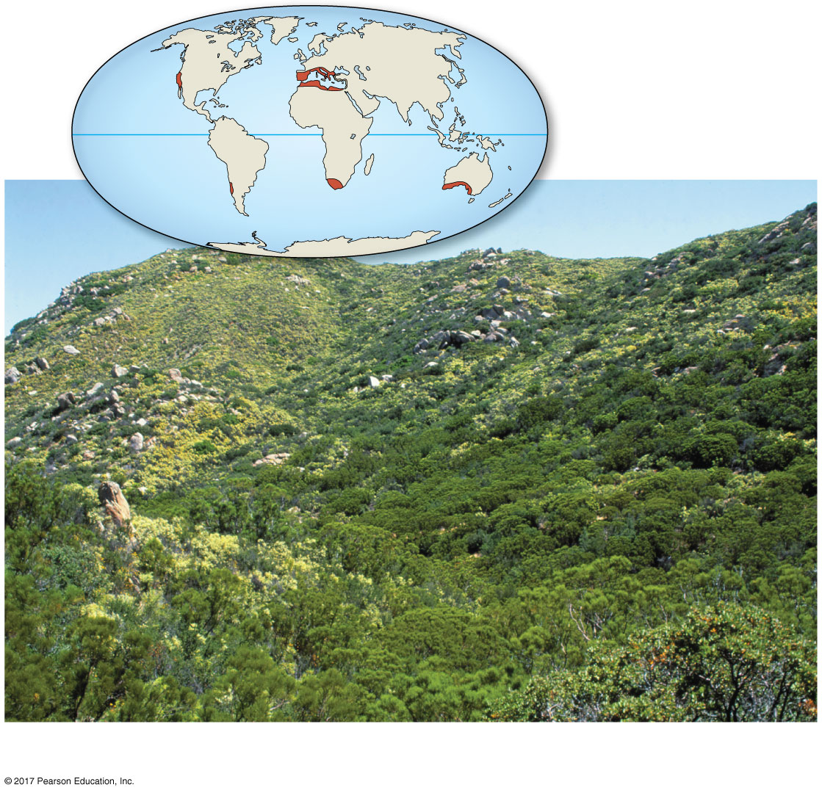
Figure 52.12d
An area of chaparral in California
Notes:
Figure 52.12d Exploring terrestrial biomes (part 4: chaparral)

Slide 78
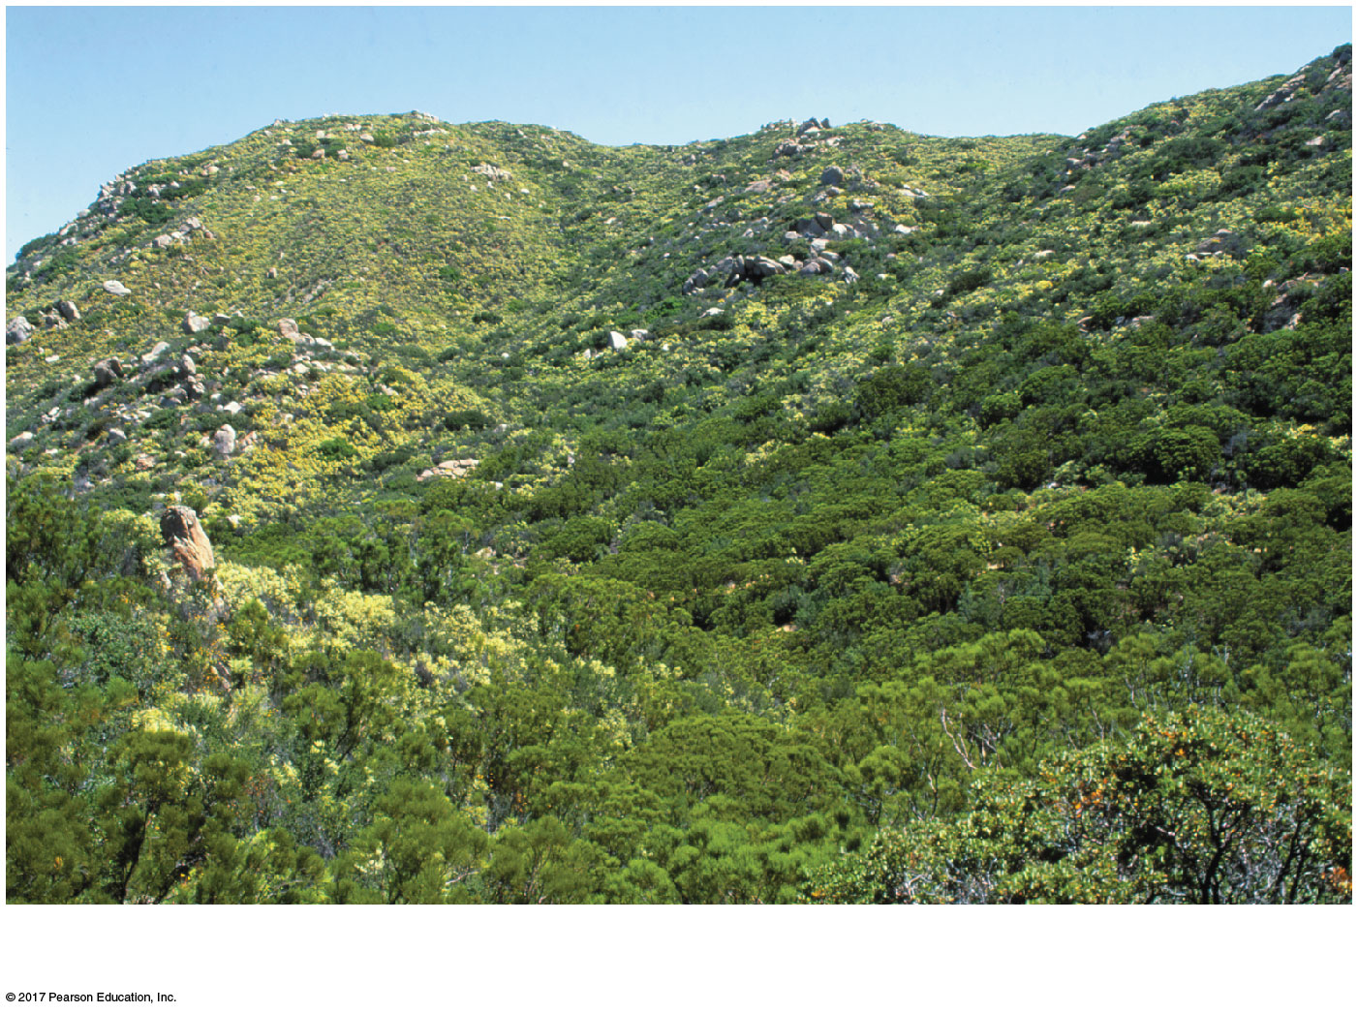
Figure 52.12da
An area of chaparral in California
Notes:
Figure 52.12da Exploring terrestrial biomes (part 4a: chaparral, photo)

Slide 79
Temperate Grassland
Temperate grasslands are found on many continents
Precipitation is highly seasonal
Winters are cold (often below –10ºC) and dry; summers are hot (often near 30ºC) and wet

Slide 80
The dominant plants, grasses and forbs, are adapted to droughts and fire
Native mammals include large grazers such as bison and wild horses and small burrowers such as prairie dogs
Most grasslands have been converted to farmland

Slide 81
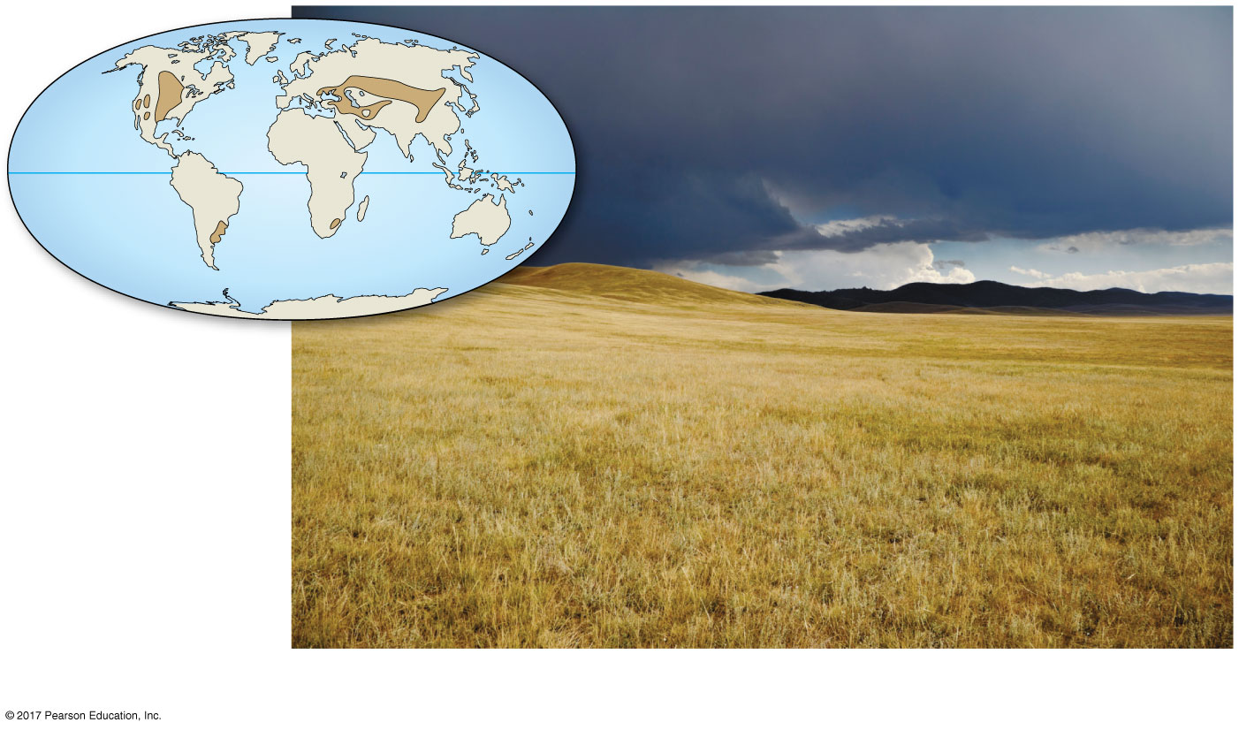
Figure 52.12e
A grassland in Mongolia
Notes:
Figure 52.12e Exploring terrestrial biomes (part 5: temperate grassland)

Slide 82
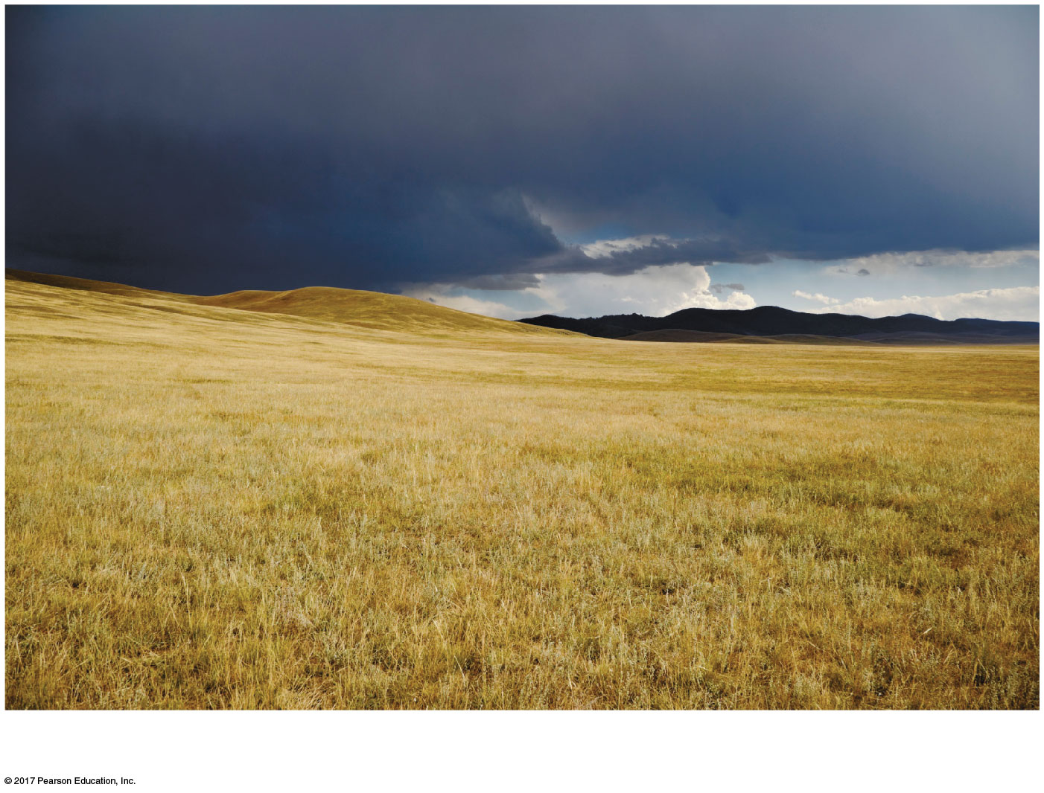
Figure 52.12ea
A grassland in Mongolia
Notes:
Figure 52.12ea Exploring terrestrial biomes (part 5a: temperate grassland, photo)

Slide 83
Northern Coniferous Forest
The northern coniferous forest, or taiga, spans northern North America and Eurasia and is the largest terrestrial biome on Earth
Precipitation varies; some forests have periodic droughts and others, especially near coasts, are wet
Winters are cold; summers may be hot (e.g., Siberia ranges from –50ºC to 20ºC)

Slide 84
Conifers such as pine, spruce, fir, and hemlock dominate
Animals include migratory and resident birds and large mammals such as moose, brown bears, and Siberian tigers
Periodic insect outbreaks kill vast areas of forest
Humans are logging old-growth stands at such a rapid rate that they may soon disappear

Slide 85
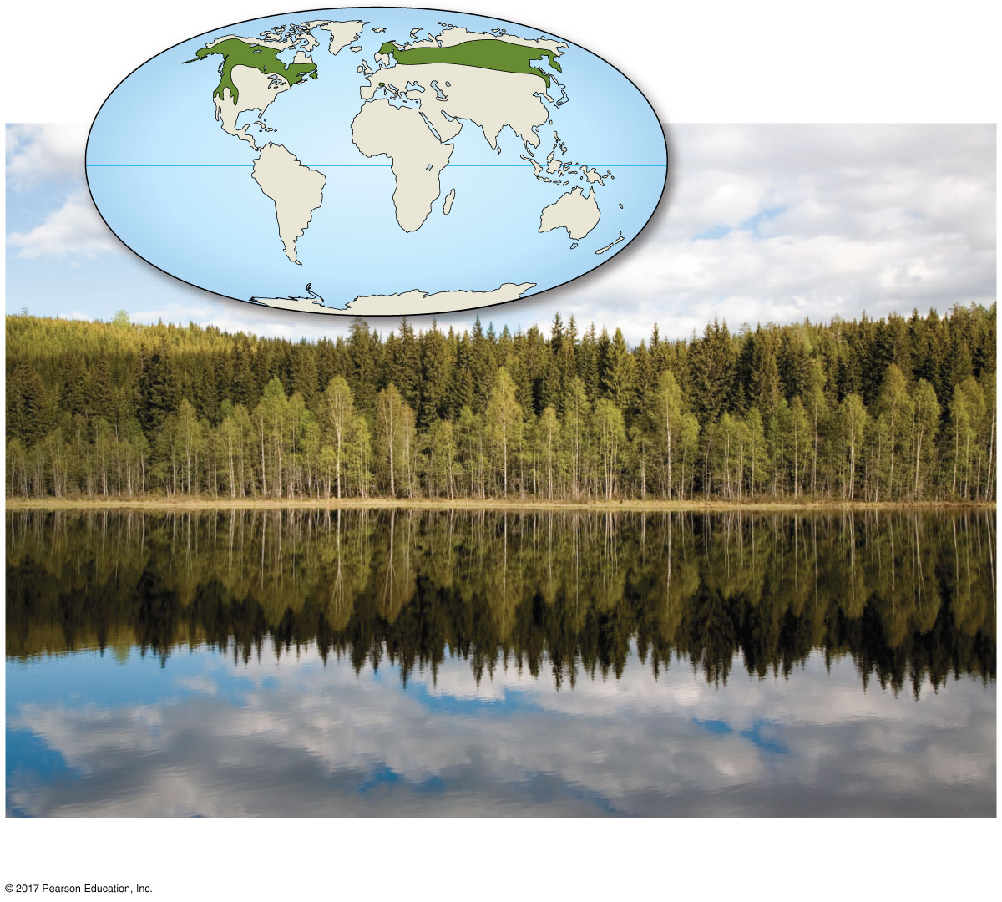
Figure 52.12f
A coniferous forest in Norway
Notes:
Figure 52.12f Exploring terrestrial biomes (part 6: coniferous forest)

Slide 86
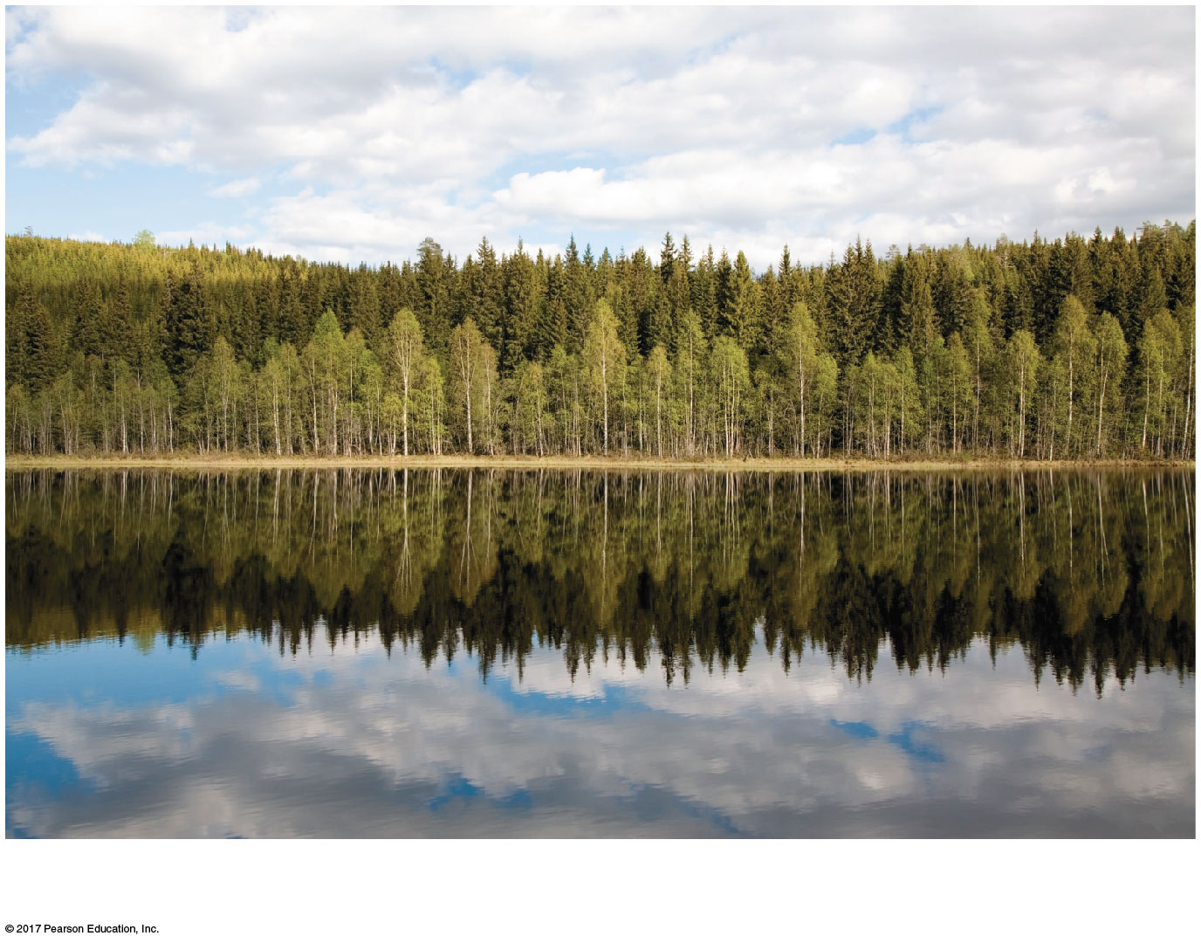
Figure 52.12fa
A coniferous forest in Norway
Notes:
Figure 52.12fa Exploring terrestrial biomes (part 6a: coniferous forest, photo)

Slide 87
Temperate Broadleaf Forest
Distribution is primarily at midlatitudes in the Northern Hemisphere, with smaller areas in Chile, South Africa, Australia, and New Zealand
Significant amounts of precipitation fall during all seasons as rain or snow
Winters average 0ºC; summers are hot and humid (near 35ºC)

Slide 88
A mature temperate broadleaf forest has vertical layers, including a closed canopy, understory trees, a shrub layer, and an herb layer
The dominant plants are deciduous trees in the Northern Hemisphere and evergreen eucalyptus in Australia

Slide 89
Mammals, birds, and insects make use of all vertical layers in the forest
In the Northern Hemisphere, many mammals hibernate and many birds migrate in the winter
These forests have been heavily settled by human populations on all continents but are recovering in places

Slide 90
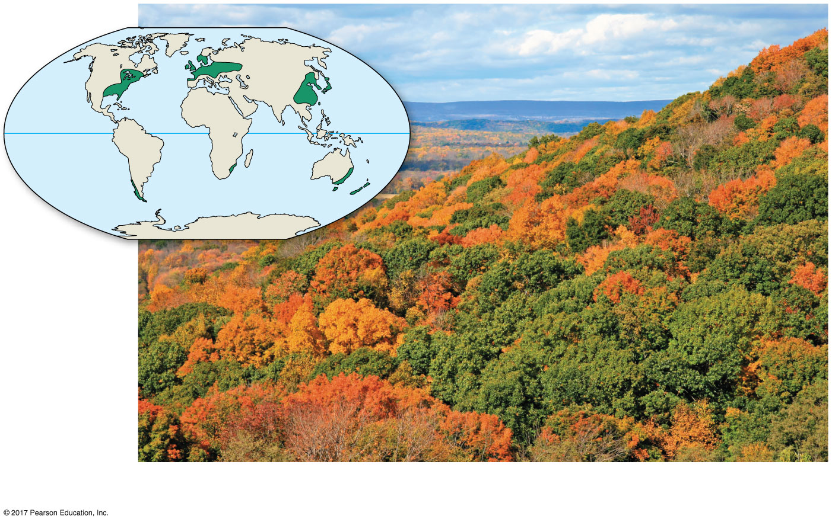
Figure 52.12g
A temperate broadleaf forest in New Jersey
Notes:
Figure 52.12g Exploring terrestrial biomes (part 7: broadleaf forest)

Slide 91
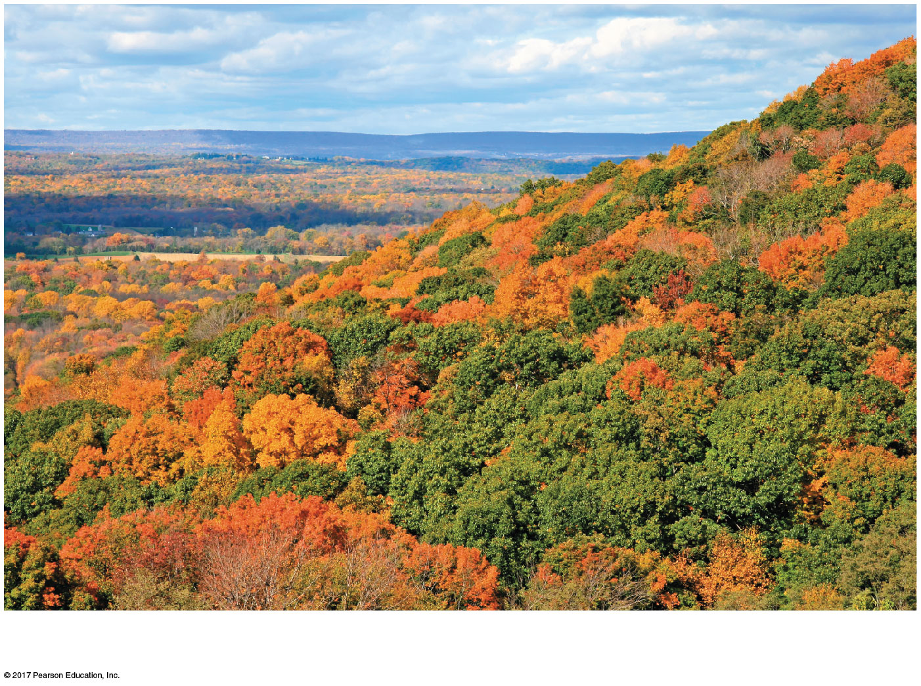
Figure 52.12ga
A temperate broadleaf forest in New Jersey
Notes:
Figure 52.12ga Exploring terrestrial biomes (part 7a: broadleaf forest, photo)

Slide 92
Tundra
Tundra covers expansive areas of the Arctic; alpine tundra exists on high mountaintops at all latitudes
Annual precipitation is lower in arctic tundra (20–60 cm) than alpine tundra (>100 cm)
Winters are cold (below –30ºC); summers are relatively cool (less than 10ºC)

Slide 93
Vegetation is herbaceous (mosses, grasses, forbs, dwarf shrubs and trees, and lichen)
Permafrost, a permanently frozen layer of soil, restricts the growth of plant roots
Mammals include musk oxen, caribou, reindeer, bears, wolves, and foxes; many migratory bird species nest in the summer
Human settlement is sparse, but tundra has become the focus of oil and mineral extraction

Slide 94
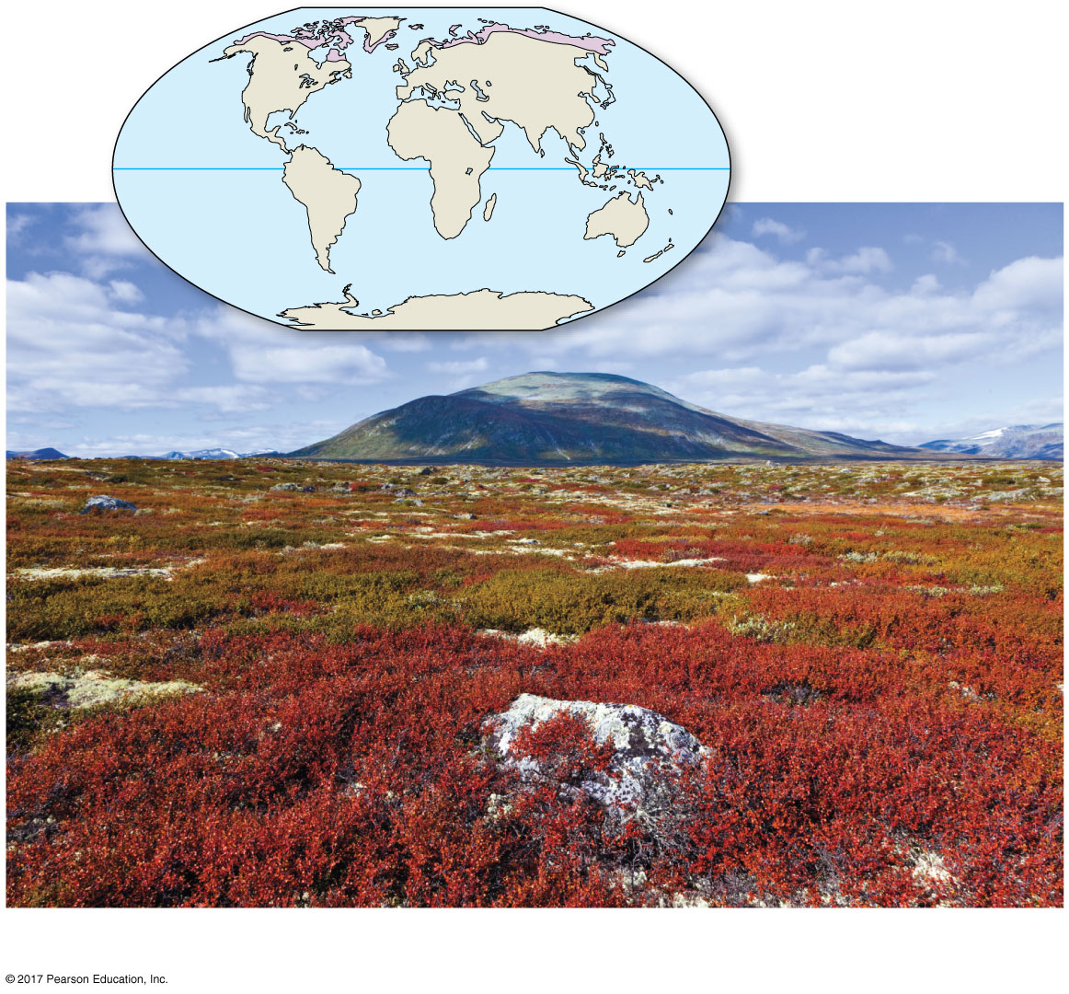
Figure 52.12h
Dovrefjell-Sunndalsfjella National Park, Norway, in autumn
Notes:
Figure 52.12h Exploring terrestrial biomes (part 8: tundra)

Slide 95
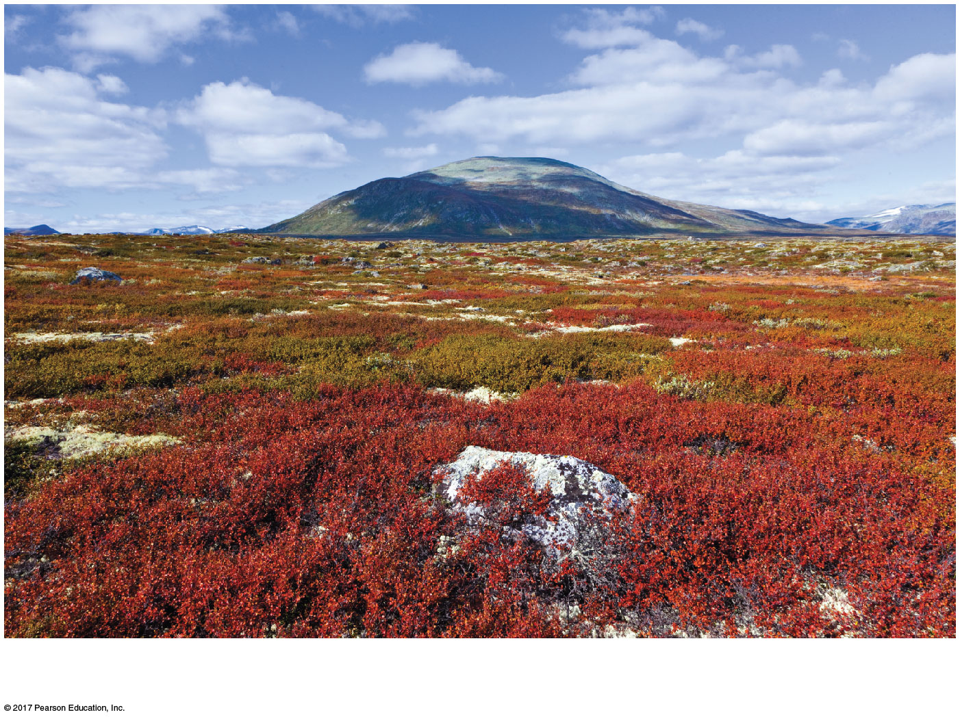
Figure 52.12ha
Dovrefjell-Sunndalsfjella National Park, Norway, in autumn
Notes:
Figure 52.12ha Exploring terrestrial biomes (part 8a: tundra, photo)

Slide 96
Concept 52.3: Aquatic biomes are diverse and dynamic systems that cover most of Earth
Aquatic biomes are characterized by their physical and chemical environment
They show less latitudinal variation than terrestrial biomes

Slide 97
Marine biomes have an average salt concentration of 3%; freshwater biomes have salt concentrations of less than 0.1%
Oceans make up the largest marine biome, covering about 75% of Earth’s surface
The surrounding terrestrial biome, patterns and speed of water flow, and climate all influence the characteristics of freshwater biomes

Slide 98
Zonation in Aquatic Biomes
Many aquatic biomes are stratified into zones defined by light penetration, temperature, and depth
The upper photic zone has sufficient light for photosynthesis; the lower aphotic zone receives little light
The photic and aphotic zones make up the pelagic zone
The abyssal zone is located in the aphotic zone with a depth of 2,000 to 6,000 m

Slide 99
The organic and inorganic sediment at the bottom of all aquatic zones is called the benthic zone
The communities of organisms in the benthic zone are collectively called the benthos
Detritus, dead organic matter, falls from the productive surface water and is an important source of food

Slide 100
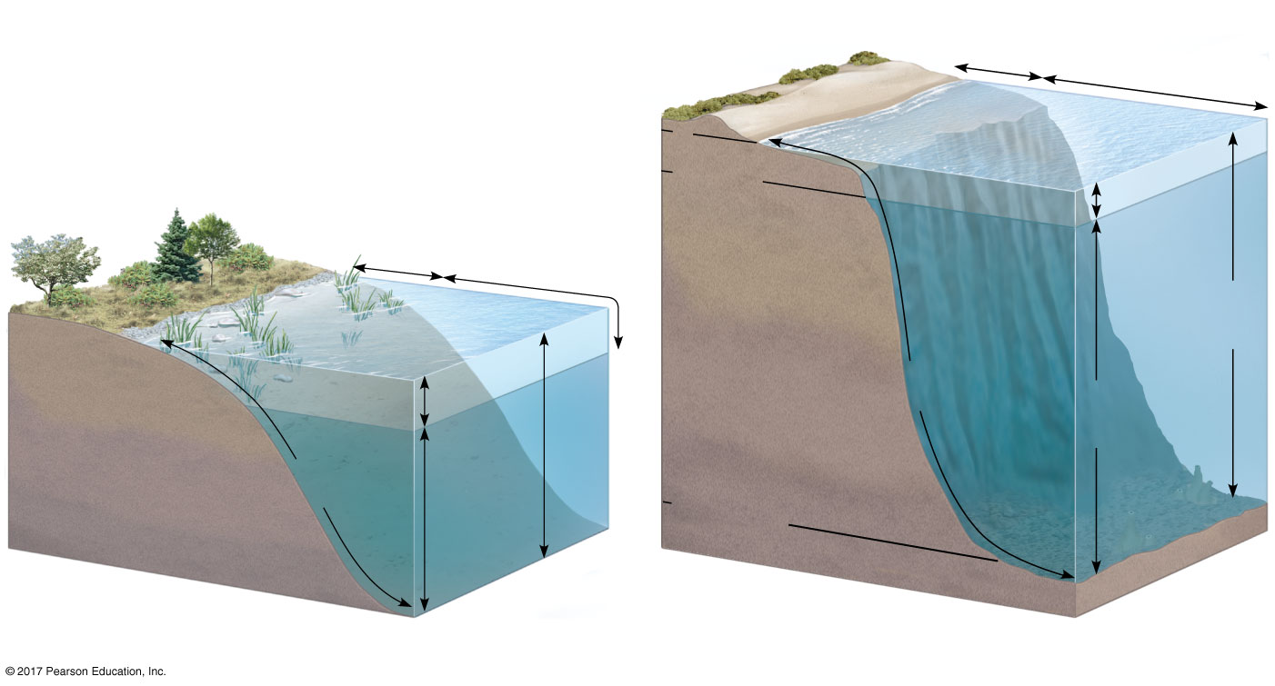
Figure 52.13
Intertidal zone
Neritic
zone
Oceanic
zone
0
200 m
Photic
zone
Littoral
zone
Limnetic
zone
Continental
shelf
Pelagic
zone
Photic
zone
Benthic
zone
Pelagic
zone
Aphotic
zone
Benthic
zone
Aphotic
zone
2,000–
6,000 m
Abyssal
zone
(a) Zonation in a lake
(b) Marine zonation
Notes:
Figure 52.13 Zonation in aquatic environments

Slide 101
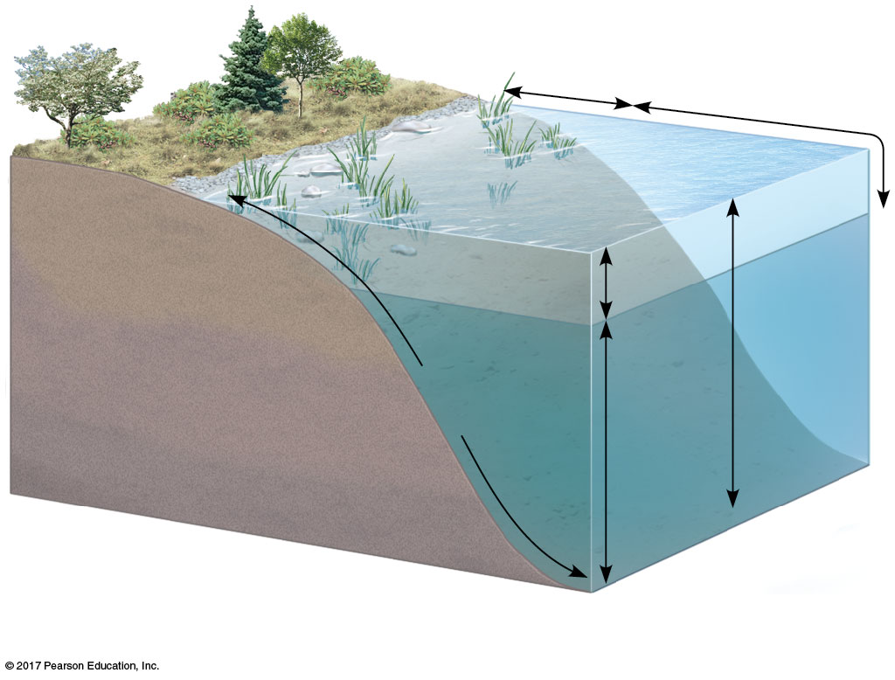
Figure 52.13a
Littoral
zone
Limnetic
zone
Photic
zone
Pelagic
zone
Benthic
zone
Aphotic
zone
(a) Zonation in a lake
Notes:
Figure 52.13a Zonation in aquatic environments (part 1: lake)

Slide 102
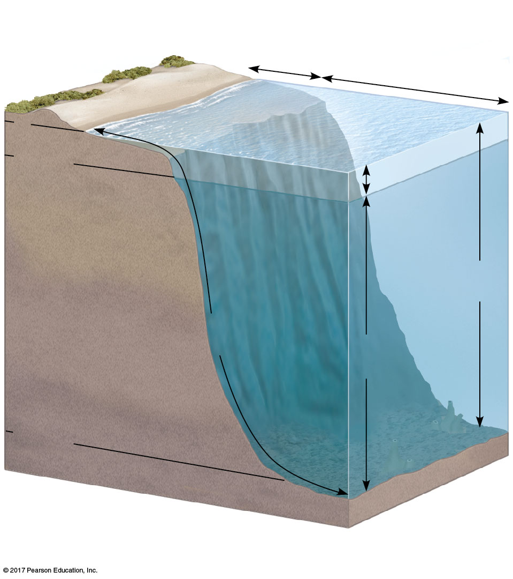
Figure 52.13b
Intertidal zone
Neritic
zone
Oceanic zone
0
200 m
Photic
Continental
shelf
zone
Pelagic
zone
Benthic
zone
Aphotic
zone
2,000–
6,000 m
Abyssal
zone
(b) Marine zonation
Notes:
Figure 52.13b Zonation in aquatic environments (part 2: marine)

Slide 103
In oceans and most lakes, a temperature boundary called the thermocline separates the warm upper layer from the cold deeper water
Many lakes undergo a semiannual mixing of their waters called turnover
Turnover mixes oxygenated water from the surface with nutrient-rich water from the bottom

Slide 104
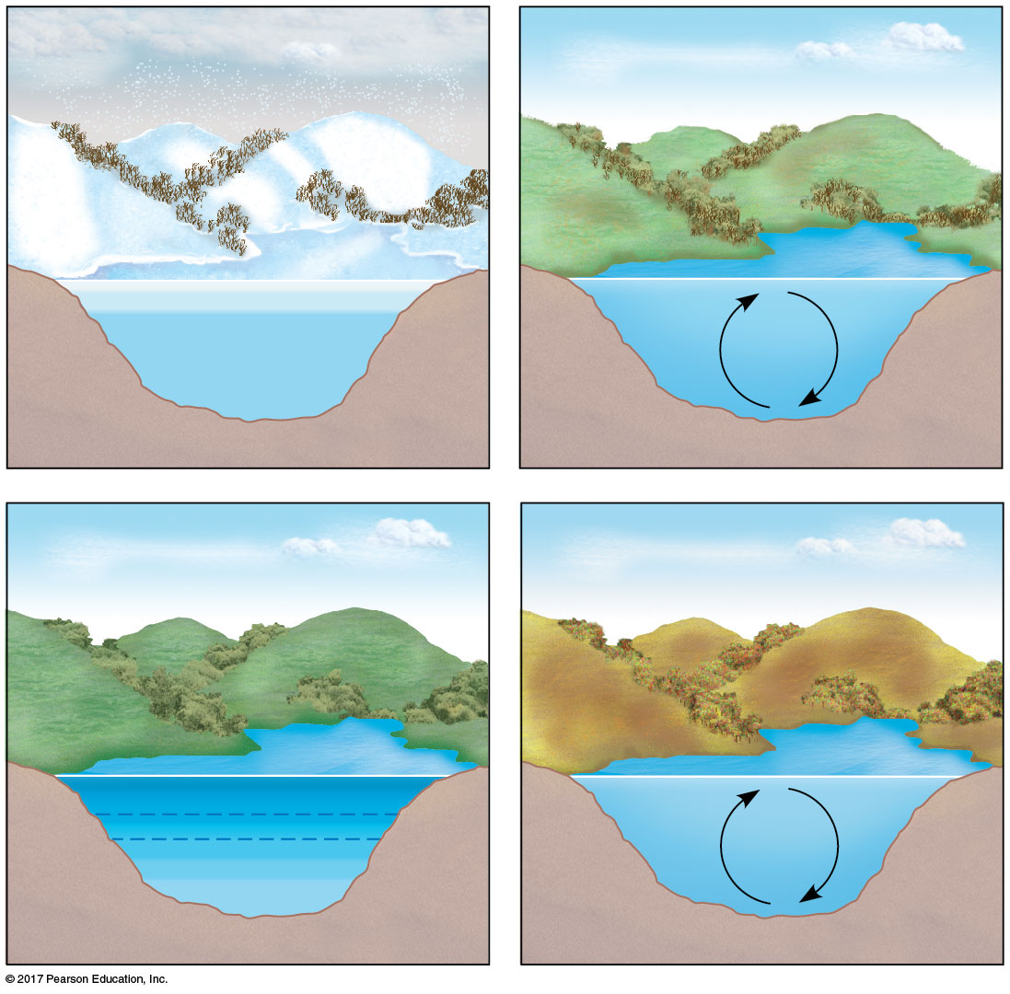
Figure 52.14
Winter
Spring
2º
0º
4º
4ºC
4ºC
Summer
Autumn
22º
4º
18º
8º
4ºC
4ºC
Thermocline
Notes:
Figure 52.14 Seasonal turnover in lakes with winter ice cover

Slide 105
Communities in aquatic biomes vary with depth, light penetration, distance from shore, and position in the pelagic or benthic zone
In marine communities, most organisms occur in the relatively shallow photic zone
The aphotic zone in oceans is extensive but harbors little life

Slide 106
Aquatic Biomes
Major aquatic biomes can be characterized by their physical environment, chemical environment, geologic features, photosynthetic organisms, and heterotrophs

Slide 107
Lakes
Size varies from small ponds to very large lakes
Temperate lakes may have a seasonal thermocline; tropical lowland lakes have a year-round thermocline
Oligotrophic lakes are nutrient-poor and generally oxygen-rich
Eutrophic lakes are nutrient-rich and often depleted of oxygen in deep zones or throughout if ice covered in winter

Slide 108
Oligotrophic lakes have less surface area relative to depth than eutrophic lakes
Rooted and floating aquatic plants live in the shallow, well-lit littoral zone close to shore
Phytoplankton inhabit the limnetic zone, where the water is too deep to support rooted plants

Slide 109
Zooplankton are drifting heterotrophs that graze on the phytoplankton
Invertebrates live in the benthic zone
Fishes live in all zones with sufficient oxygen
Human-induced nutrient enrichment can lead to algal blooms, oxygen depletion, and fish kills

Slide 110
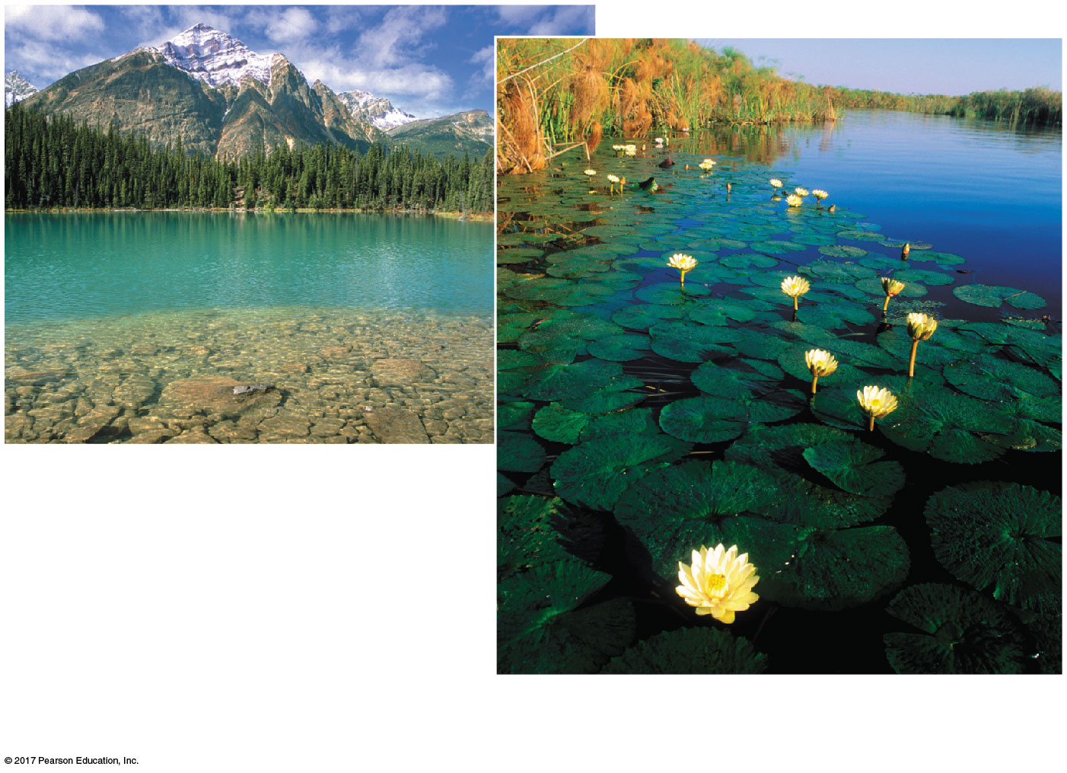
Figure 52.15a
An oligotrophic lake in Jasper
National Park, Alberta
A eutrophic lake in the Okavango Delta,
Botswana
Notes:
Figure 52.15a Exploring aquatic biomes (part 1: lakes)

Slide 111
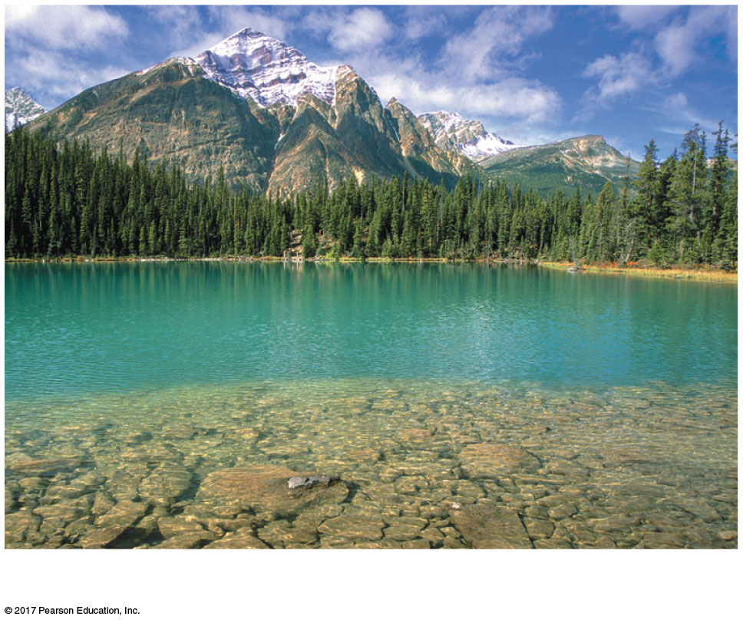
Figure 52.15aa
An oligotrophic lake in Jasper National Park, Alberta
Notes:
Figure 52.15aa Exploring aquatic biomes (part 1a: oligotrophic lake)

Slide 112
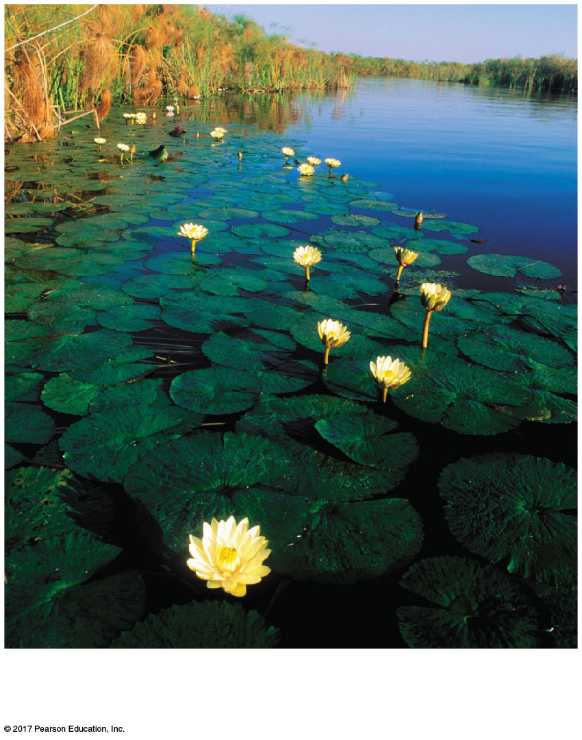
Figure 52.15ab
A eutrophic lake in the Okavango Delta,
Botswana
Notes:
Figure 52.15ab Exploring aquatic biomes (part 1b: eutrophic lake)

Slide 113
Wetlands
Wetlands are inundated by water at least some of the time and support plants adapted to water-saturated soil
Rapid organic production and decomposition periodically deplete dissolved oxygen
Wetlands develop in shallow basins, along flooded river banks, or on the coasts of large lakes and seas

Slide 114
Wetlands are among the most productive biomes on Earth
Plants include lilies, cattails, sedges, bald cypress, and black spruce
Wetlands are home to diverse invertebrates and birds, as well as otters, frogs, and alligators
Humans have destroyed up to 90% of wetlands in Europe; wetlands purify water and reduce flooding

Slide 115
Figure 52.15b
A basin wetland in the United Kingdom
Notes:
Figure 52.15b Exploring aquatic biomes (part 2: wetlands)

Slide 116
Streams and Rivers
The most prominent physical characteristic of streams and rivers is current
Headwaters are generally cold, clear, turbulent, swift, and oxygen-rich; they are often narrow and rocky
Downstream waters form rivers and are generally warmer, more turbid, and well oxygenated; they are often wide and meandering and have silty bottoms

Slide 117
Headwater streams may be rich in phytoplankton or rooted aquatic plants
A diversity of fishes and invertebrates inhabit unpolluted rivers and streams
Pollution degrades water quality and kills aquatic organisms
Damming and flood control impair natural functioning of stream and river ecosystems

Slide 118
Figure 52.15c
A headwater stream in Washington
The Loire river in France, far from
its headwaters
Notes:
Figure 52.15c Exploring aquatic biomes (part 3: streams and rivers)

Slide 119
Figure 52.15ca
A headwater stream in Washington
Notes:
Figure 52.15ca Exploring aquatic biomes (part 3a: headwater stream)

Slide 120
Figure 52.15cb
The Loire river in France, far from
its headwaters
Notes:
Figure 52.15cb Exploring aquatic biomes (part 3b: river)

Slide 121
Estuaries
An estuary is a transition area between river and sea
Salinity varies spatially and with the rise and fall of the tides
Estuaries are nutrient-rich and highly productive
Estuaries include a complex network of tidal channels, islands, natural levees, and mudflats

Slide 122
Saltmarsh grasses and algae are the major producers
An abundant supply of food attracts marine invertebrates, fish, waterfowl, and marine mammals
Filling, dredging, and pollution upstream have disrupted estuaries worldwide

Slide 123
Figure 52.15d
An estuary in southern Spain
Notes:
Figure 52.15d Exploring aquatic biomes (part 4: estuaries)

Slide 124
Intertidal Zones
An intertidal zone is periodically submerged and exposed by the tides
Intertidal organisms are challenged by variations in temperature and salinity and by the mechanical forces of wave action
Oxygen and nutrient levels are high
Substrates are generally either rocky or sandy

Slide 125
Sandy zones protected from vigorous waves support sea grass and algae; rocky zones support attached marine algae
In rocky zones, many animals have structural adaptations for attaching to the hard substrate
In sandy zones, worms, clams, and crustaceans bury themselves in sand
Other animals include sponges, sea anemones, echinoderms, and small fishes
Oil pollution has disrupted many intertidal areas

Slide 126
Figure 52.15e
A rocky intertidal zone on the Oregon
coast
Notes:
Figure 52.15e Exploring aquatic biomes (part 5: intertidal zones)

Slide 127
Oceanic Pelagic Zone
The oceanic pelagic zone is constantly mixed by wind-driven oceanic currents
Oxygen levels are generally high
Seasonal turnover in temperate oceans renews nutrients in the photic zones; nutrient concentrations are lower in tropical oceans due to year-round thermal stratification
This biome covers approximately 70% of Earth’s surface

Slide 128
Phytoplankton and zooplankton are the dominant organisms
Phytoplankton in this zone account for about half of the photosynthesis on Earth
Fish, squid, turtles, and marine mammals also occupy the pelagic zone
Overfishing, pollution, ocean acidification, and global warming have all harmed this biome

Slide 129
Figure 52.15f
Open ocean near Iceland
Notes:
Figure 52.15f Exploring aquatic biomes (part 6: ocean pelagic zone)

Slide 130
Video: Shark Eating a Seal

Slide 131
Coral Reefs
Coral reefs are formed from the calcium carbonate skeletons of corals (cnidarians)
Shallow reef-building corals live in the photic zone in warm (about 20–30ºC), clear water; deep-sea corals live at depths of 200–1,500 m
Corals require high oxygen concentrations and a solid substrate for attachment
A coral reef progresses from a fringing reef to a barrier reef to a coral atoll

Slide 132
Corals form a mutualistic relationship with unicellular algae, which provide them with organic molecules
In addition to corals, other invertebrates and fish are also exceptionally diverse
Collection of coral skeletons, overfishing, global warming, pollution, and aquaculture are threats to coral reef ecosystems

Slide 133
Figure 52.15g
A coral reef in the Red Sea
Notes:
Figure 52.15g Exploring aquatic biomes (part 7: coral reefs)

Slide 134
Video: Clownfish and Anemone

Slide 135
Video: Coral Reef

Slide 136
Marine Benthic Zone
The marine benthic zone consists of the seafloor below the surface waters of the coastal, or neritic, zone and the offshore pelagic zone
Organisms in the very deep benthic (abyssal) zone are adapted to continuous cold and extremely high water pressure
Substrate is mainly soft sediments; some areas are rocky

Slide 137
Shallow areas contain seaweeds and filamentous algae
Deep-sea hydrothermal vents of volcanic origin on mid-oceanic ridges are surrounded by unique chemoautotrophic prokaryotes, as well as echinoderms and arthropods
Neritic benthic communities include invertebrates and fishes
Overfishing and dumping of waste have depleted fish populations

Slide 138
Figure 52.15h
A deep-sea hydrothermal vent community
Notes:
Figure 52.15h Exploring aquatic biomes (part 8: marine benthic zone)

Slide 139
Video: Tubeworms

Slide 140
Concept 52.4: Interactions between organisms and the environment limit the distribution of species
Species distributions are the result of ecological factors and evolutionary history
For example, kangaroos occur only in Australia, in part because the lineage originated there when the continent was geographically isolated
Ecological factors also affect the kangaroo distribution; particular species occur in some habitats, but not others

Slide 141
Both biotic and abiotic factors influence species distribution
For example, temperature, water availability, and interspecific interactions affect the distribution of the saguaro cactus

Slide 142
Figure 52.16
CALIFORNIA
ARIZONA
BAJA
CALIFORNIA
SONORA
100 km
BAJA
CALIFORNIA
SUR
GULF
OF
CALIFORNIA
Sonoran desert
Saguaro cacti observed
Notes:
Figure 52.16 Distribution of the saguaro cactus in North America

Slide 143
Figure 52.16a
Notes:
Figure 52.16a Distribution of the saguaro cactus in North America (part 1: photo)

Slide 144
Ecologists ask questions about where species occur and why species occur where they do

Slide 145
Figure 52.17
Yes
Area inaccessible
or insufficient time
Why is species
X absent from
an area?
Does dispersal
limit its
distribution?
Do biotic factors
(other species)
limit its
distribution?
No
Yes
Predation, parasitism,
competition, disease
Chemical
factors
Water, oxygen, salinity, pH,
soil nutrients, etc.
Do abiotic factors
limit its
distribution?
No
Temperature, light, soil
structure, fire, moisture, etc.
Physical
factors
Notes:
Figure 52.17 Flowchart of factors limiting geographic distribution

Slide 146
Dispersal and Distribution
Dispersal is the movement of individuals or gametes away from centers of high population density or from their area of origin
Dispersal contributes to the global distribution of organisms

Slide 147
Natural Range Expansions and Adaptive Radiation
Natural range expansions show the influence of dispersal on distribution
For example, cattle egrets arrived in the Americas in the late 1800s and have since expanded their distribution

Slide 148
Figure 52.18
Current
1970
1966
1965
1960
1961
1943
1958
1951
1937
1956
1970
Notes:
Figure 52.18 Dispersal of the cattle egret in the Americas

Slide 149
Figure 52.18a
Notes:
Figure 52.18a Dispersal of the cattle egret in the Americas (part 1: photo)

Slide 150
In rare cases, long-distance dispersal can lead to adaptive radiation, the rapid evolution of an ancestral species into many ecologically diverse species
For example, Hawaiian silverswords are a diverse group descended from an ancestral North American tarweed

Slide 151
Species Transplants
Species transplants include organisms that are intentionally or accidentally relocated from their original distribution
If a transplant is successful, it indicates that the potential range of a species is larger than its actual range
Species transplants can disrupt the communities or ecosystems to which they have been introduced

Slide 152
Biotic Factors
Biotic factors that affect the distribution of organisms may include
Predation
Herbivory
Competition
Mutualism
Parasitism

Slide 153
For example, grazing by the long-spined sea urchin (Centrostephanus rodgersii) prevents the establishment of seaweed

Slide 154
Figure 52.19
100
80
Seaweed cover (%)
Urchins removed
60
40
20
Control (urchins present)
0
August
1982
February
1983
August
1983
February
1984
Notes:
Figure 52.19 Effects of feeding by sea urchins on seaweed distribution

Slide 155
Figure 52.19a
Notes:
Figure 52.19a Effects of feeding by sea urchins on seaweed distribution (part 1: photo)

Slide 156
Abiotic Factors
Abiotic factors affecting the distribution of organisms include
Temperature
Water
Oxygen
Salinity
Sunlight
Soil
Most abiotic factors vary in space and time

Slide 157
Temperature
Environmental temperature is an important factor in the distribution of organisms because of its effects on biological processes
Cells may freeze and rupture below 0ºC, while most proteins denature above 45ºC
Mammals and birds expend energy to regulate their internal temperature

Slide 158
Range shifts in response to climate change can dramatically affect the distribution of other species
For example, the long-spined sea urchin (C. rodgersii) expanded its range in response to increasing water temperature
C. rodgersii consumed the seaweed in its new range and destroyed the diverse communities that formerly inhabited the seaweed stands

Slide 159
Figure 52.20
AUSTRALIA
1
Southern
portion of
C. rodgersii
native range
TASMANIA
AUSTRALIA
East Australian
Current
1960s
2
Expanded range
of C. rodgersii;
kelp communities
decimated
1978
TASMANIA
1980s
1980s
1980s
2005
3
Continuation of
expanded range;
kelp communities
threatened
100 km
Notes:
Figure 52.20 A sea urchin’s expanding range

Slide 160
Water and Oxygen
Water availability in habitats is another important factor in species distribution
Desert organisms exhibit adaptations for water conservation
Water affects oxygen availability, as oxygen diffuses slowly in water
Oxygen concentrations can be low in deep oceans and deep lakes

Slide 161
Salinity
Salt concentration affects the water balance of organisms through osmosis
Most aquatic organisms are restricted to either freshwater or saltwater habitats
Salmon are able to migrate between fresh water and ocean
Few terrestrial organisms are adapted to high-salinity habitats

Slide 162
Sunlight
Light intensity and quality (wavelength) affect photosynthesis
Shading by leaves makes competition for light intense on the forest floor
Water absorbs light; as a result, in aquatic environments most photosynthesis occurs near the surface
In deserts, high light levels increase temperature and can stress plants and animals

Slide 163
Figure 52.21
Notes:
Figure 52.21 Alpine tree line in Banff National Park

Slide 164
Rocks and Soil
Many characteristics of soil limit the distribution of plants and thus the animals that feed on them
Physical structure
pH
Mineral composition

Slide 165
Concept 52.5: Ecological change and evolution affect one another over long and short periods of time
Ecological interactions can cause evolutionary change, and vice versa
For example, increase in offspring size evolves rapidly in Trinidadian guppies when predators are removed
Evolution of larger body sizes affects nutrient cycling in guppy habitats

Slide 166
Figure 52.22
Ecological
change
Alters outcome
of ecological
interactions
Alters selective
pressures in
population
Evolutionary
change
Notes:
Figure 52.22 Reciprocal effects of ecological and evolutionary change

Slide 167
Figure 52.0
UNIT 8: ECOLOGY
Dr. Tracy Langkilde
A fire ant prying up a scale on a
fence lizard’s head in order to inject
venom into the underlying skin
“Reducing the abundance of an invasive species can buy
native populations enough time to respond naturally.”
Notes:
Figure 52.0 Unit 8: Ecology

Slide 168
Figure 52.0a
Dr. Tracy Langkilde
Notes:
Figure 52.0a Unit 8: Ecology (part 1: Dr. Tracy Langkilde)

Slide 169
Figure 52.0b
A fire ant prying up a scale on a
fence lizard’s head in order to inject
venom into the underlying skin
Notes:
Figure 52.0b Unit 8: Ecology (part 2: fire ant and fence lizard)

Slide 170
Figure 52.23
Estimated total nitrogen
excretion rate for population
[µg N/(m² · hr)]
60
40
20
0
Guppies
from high-
predation
ponds
Guppies
from low-
predation
ponds
Notes:
Figure 52.23 An example of reciprocal eco-evolutionary effects

Slide 171
Figure 52.UN01a
Notes:
Figure 52.UN01a Skills exercise: making a bar graph and a line graph to interpret data (part 1)

Slide 172
Figure 52.UN01b
Notes:
Figure 52.UN01b Skills exercise: making a bar graph and a line graph to interpret data (part 2)

Slide 173
Figure 52.UN01c
Spartina patens
Notes:
Figure 52.UN01c Skills exercise: making a bar graph and a line graph to interpret data (part 3)

Slide 174
Figure 52.UN01d
Typha angustifolia
Notes:
Figure 52.UN01d Skills exercise: making a bar graph and a line graph to interpret data (part 4)

Slide 175
Figure 52.UN02_1
Yes
Area inaccessible or
insufficient time
Does dispersal limit its distribution?
Notes:
Figure 52.UN02_1 Summary of key concepts: limiting factors of distribution (step 1)

Slide 176
Figure 52.UN02_2
Yes
Area inaccessible or
insufficient time
Does dispersal limit its distribution?
No
Do biotic factors (other species)
limit its distribution?
Yes
Predation, parasitism,
competition, disease
Notes:
Figure 52.UN02_2 Summary of key concepts: limiting factors of distribution (step 2)

Slide 177
Figure 52.UN02_3
Yes
Area inaccessible or
insufficient time
Does dispersal limit its distribution?
No
Do biotic factors (other species)
limit its distribution?
Yes
Predation, parasitism,
competition, disease
No
Chemical factors:
Water, oxygen, salinity, pH,
soil nutrients, etc.
Do abiotic factors limit its distribution?
Physical factors:
Temperature, light, soil
structure, fire, moisture, etc.
Notes:
Figure 52.UN02_3 Summary of key concepts: limiting factors of distribution (step 3)

Slide 178
Figure 52.UN03
Notes:
Figure 52.UN03 Test your understanding, question 9 (otters and kelp)

Slide 179
Figure 52.UN04
Mean height (cm)
75
50
25
0
Altitude (m)
3,000
2,000
Sierra Nevada
1,000
Great Basin
Plateau
0
Seed collection sites
Data from J. Clausen et al., Experimental studies on the nature of species.
III. Environmental responses of climatic races of Achillea, Carnegie Institution
of Washington Publication No. 581 (1948).
Notes:
Figure 52.UN04 Test your understanding, question 11 (plant height and elevation)

Slide 180
Figure 52.UN05
Notes:
Figure 52.UN05 Test your understanding, question 13 (diverse habitats)

